Slide 1
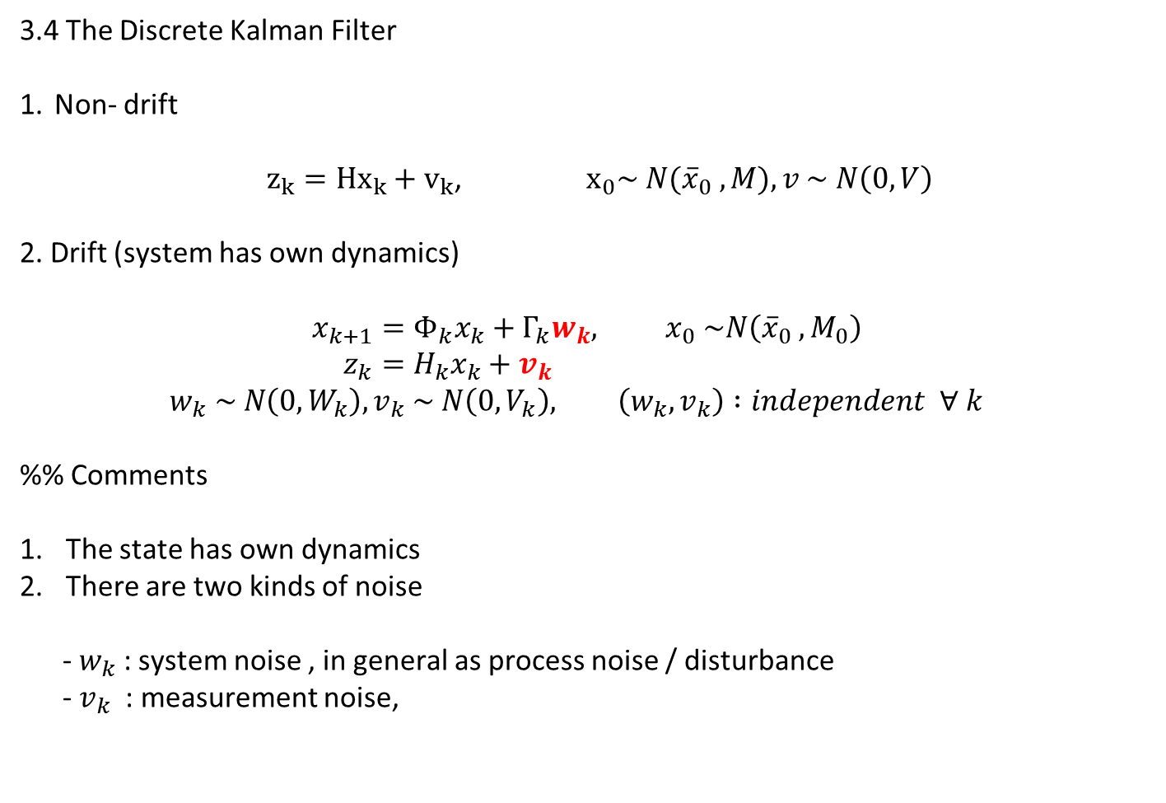
3.4 The Discrete Kalman Filter
Non- drift
$z_{k}={Hx}_{k}+v_{k}$, ${ x}_{0}\sim N({\overline{x}}_{0} , M), v \sim N\left(0, V\right)$
2. Drift (system has own dynamics)
$$x_{k+1}=Φ_{k}x_{k}+Γ_{k}w_{k}, x_{0} \sim N\left({\overline{x}}_{0} , M_{0}\right) \\ z_{k}=H_{k}x_{k}+v_{k}$$
$$w_{k} \sim N\left(0, W_{k}\right), v_{k} \sim N\left(0, V_{k}\right), \left(w_{k}, v_{k}\right) :independent ∀ k$$
%% Comments
The state has own dynamics
There are two kinds of noise
- $w_{k}$ : system noise , in general as process noise / disturbance
- $v_{k}$ : measurement noise,

Slide 2
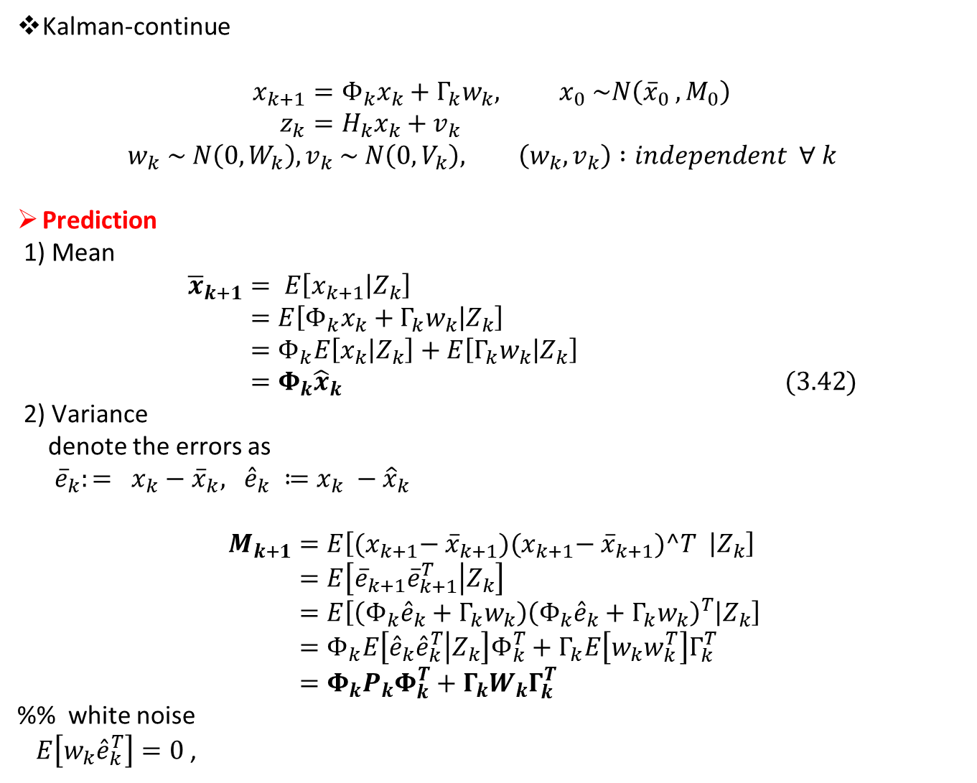
Kalman-continue
$$x_{k+1}=Φ_{k}x_{k}+Γ_{k}w_{k}, x_{0} \sim N\left({\overline{x}}_{0} , M_{0}\right) \\ z_{k}=H_{k}x_{k}+v_{k}$$
$$w_{k} \sim N\left(0, W_{k}\right), v_{k} \sim N\left(0, V_{k}\right), \left(w_{k}, v_{k}\right) :independent ∀ k$$
Prediction
1) Mean
$${\overline{x}}_{k+1}= E\left[x_{k+1} | Z_{k}\right] \\ =E\left[Φ_{k}x_{k}+Γ_{k}w_{k} | Z_{k}\right] \\ =Φ_{k}E\left[x_{k} | Z_{k}\right]+E\left[Γ_{k}w_{k} | Z_{k}\right] \\ =Φ_{k}{\hat{x}}_{k} (3.42)$$
2) Variance
denote the errors as
${\overline{e}}_{k}:= x_{k}−{\overline{x}}_{k}, {\hat{e}}_{k} ≔x_{k} −{\hat{x}}_{k}$
$$M_{k+1}=E\left[{(x}_{k+1}− {\overline{x}}_{k+1}){(x}_{k+1}− {\overline{x}}_{k+1})^T | Z_{k}\right] \\ =E\left[{\overline{e}}_{k+1}{\overline{e}}_{k+1}^{T} | Z_{k}\right] \\ =E\left[\left(Φ_{k}{\hat{e}}_{k}+Γ_{k}w_{k}\right){\left(Φ_{k}{\hat{e}}_{k}+Γ_{k}w_{k}\right)}^{T} | Z_{k}\right] \\ =Φ_{k}E\left[{\hat{e}}_{k}{\hat{e}}_{k}^{T} | Z_{k}\right]Φ_{k}^{T}+Γ_{k}E\left[w_{k}w_{k}^{T}\right]Γ_{k}^{T} \\ =Φ_{k}P_{k}Φ_{k}^{T}+Γ_{k}W_{k}Γ_{k}^{T}$$
%% white noise
$E\left[w_{k}{\hat{e}}_{k}^{T}\right]=0$,

Slide 3
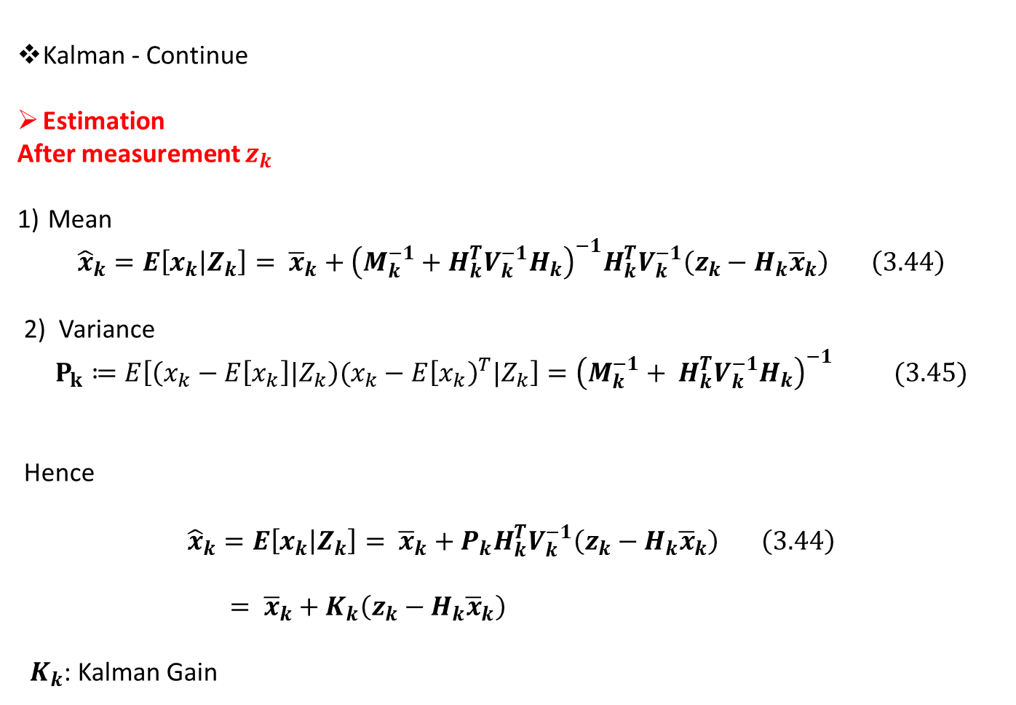
Kalman - Continue
Estimation
After measurement $z_{k}$
Mean
$${\hat{x}}_{k}=E\left[x_{k} | Z_{k}\right]= {\overline{x}}_{k}+{\left(M_{k}^{−1}+H_{k}^{T}V_{k}^{−1}H_{k}\right)}^{−1}H_{k}^{T}V_{k}^{−1}\left(z_{k}−H_{k}{\overline{x}}_{k}\right) \left(3.44\right)$$
2) Variance
$$P_{k}≔E\left[\left(x_{k}−E\left[x_{k}\right]|Z_{k}\right)(x_{k}−E{\left[x_{k}\right)}^{T}|Z_{k}\right]={\left(M_{k}^{−1}+ H_{k}^{T}V_{k}^{−1}H_{k}\right)}^{−1} (3.45)$$
Hence
$${\hat{x}}_{k}=E\left[x_{k} | Z_{k}\right]= {\overline{x}}_{k}+P_{k}H_{k}^{T}V_{k}^{−1}\left(z_{k}−H_{k}{\overline{x}}_{k}\right) \left(3.44\right)$$
$= {\overline{x}}_{k}+K_{k}\left(z_{k}−H_{k}{\overline{x}}_{k}\right)$
$K_{k}$: Kalman Gain

Slide 4
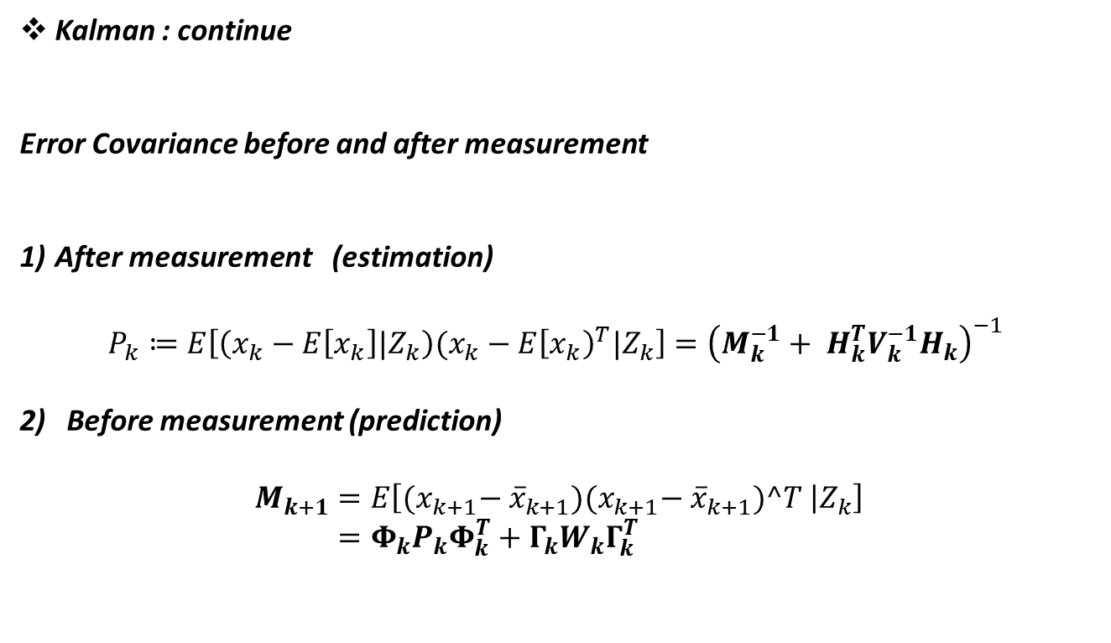
Kalman : continue
Error Covariance before and after measurement
After measurement (estimation)
$$P_{k}≔E\left[\left(x_{k}−E\left[x_{k}\right]|Z_{k}\right)(x_{k}−E{\left[x_{k}\right)}^{T}|Z_{k}\right]={\left(M_{k}^{−1}+ H_{k}^{T}V_{k}^{−1}H_{k}\right)}^{−1}$$
Before measurement (prediction)
$$M_{k+1}=E\left[{(x}_{k+1}− {\overline{x}}_{k+1}){(x}_{k+1}− {\overline{x}}_{k+1})^T | Z_{k}\right] \\ =Φ_{k}P_{k}Φ_{k}^{T}+Γ_{k}W_{k}Γ_{k}^{T}$$

Slide 5
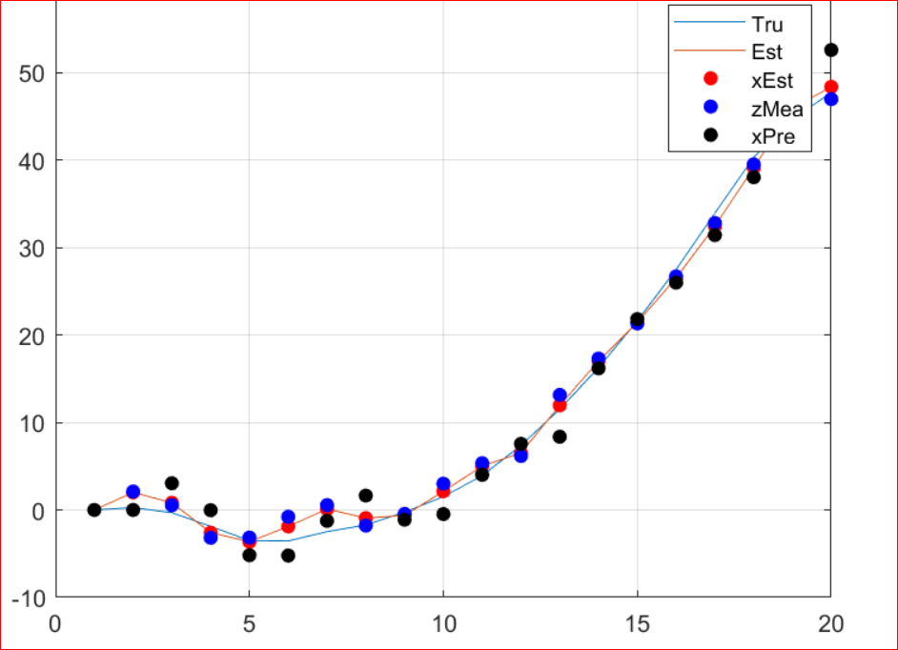
Github ; 2023_stochastic / Tut_week_5.mlx

Slide 6

Kalman- Innovation – orthogonality
1.Iterated Expectation (previous lecture)
$E\left[X\right]=E[E\left[X | Y\right]]$
2. $E\left[XY\right]=E\left[E\left[X | Z\right]Y\right]$ if Z is measurable with respect to $Y$, i.e., $Z=f(Y)$
Proof: $E\left[XY\right]=E\left[E\left[XY | Z\right]\right]$,
Consider $E\left[XY | Z\right] =E\left[X | Z\right]Y ∵Z=f(Y)$
Hence
$E\left[XY\right]=E\left[E\left[XY | Z\right]\right]=E\left[E\left[X | Z\right]Y\right]$

Slide 7
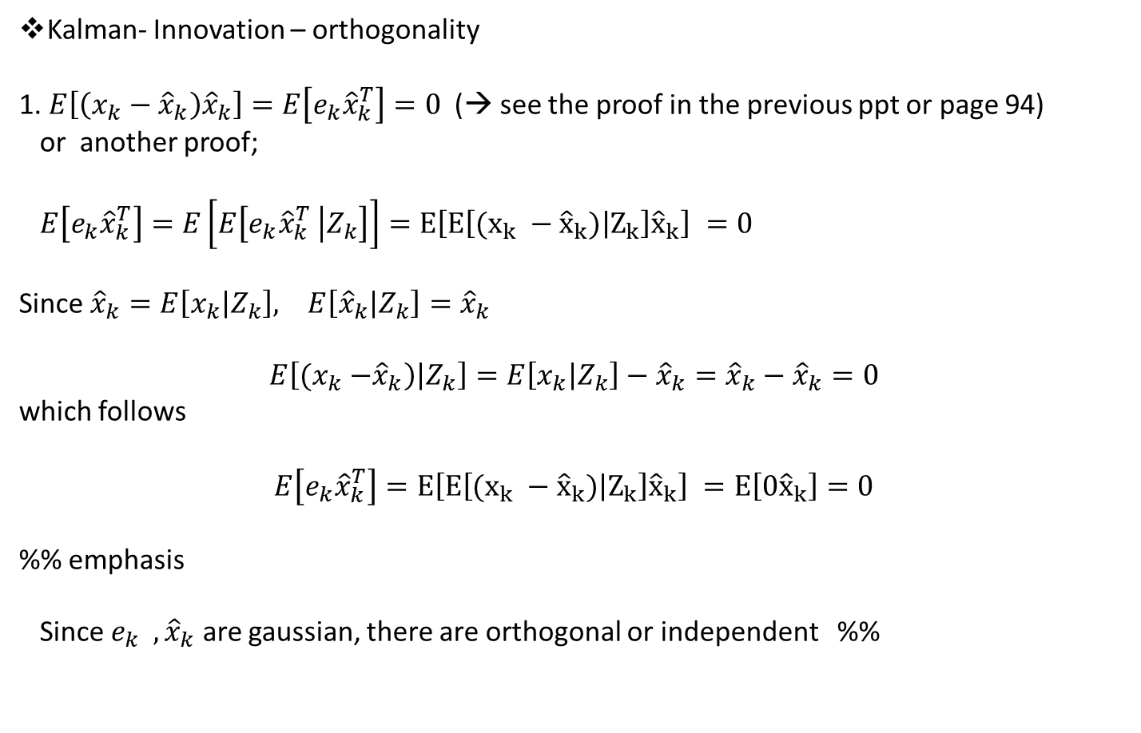
Kalman- Innovation – orthogonality
1. $E\left[\left(x_{k}−{\hat{x}}_{k}\right){\hat{x}}_{k}\right]=E\left[e_{k}{\hat{x}}_{k}^{T}\right]=0$(→ see the proof in the previous ppt or page 94)
or another proof;
$E\left[e_{k}{\hat{x}}_{k}^{T}\right]=E\left[E\left[e_{k}{\hat{x}}_{k}^{T} | Z_{k}\right]\right]=E\left[E\left[(x_{k} −{\hat{x}}_{k}) | Z_{k}\right]{\hat{x}}_{k}\right] =0$
Since ${\hat{x}}_{k}=E\left[x_{k} | Z_{k}\right], E\left[{\hat{x}}_{k} | Z_{k}\right]={\hat{x}}_{k}$
$$E\left[{(x}_{k} −{\hat{x}}_{k}\right)\left|Z_{k}\right]=E\left[x_{k} | Z_{k}\right]−{\hat{x}}_{k}={\hat{x}}_{k}−{\hat{x}}_{k}=0$$
which follows
$$E\left[e_{k}{\hat{x}}_{k}^{T}\right]=E\left[E\left[(x_{k} −{\hat{x}}_{k}) | Z_{k}\right]{\hat{x}}_{k}\right] =E\left[0{\hat{x}}_{k}\right]=0$$
%% emphasis
Since $e_{k} , {\hat{x}}_{k}$ are gaussian, there are orthogonal or independent %%

Slide 8
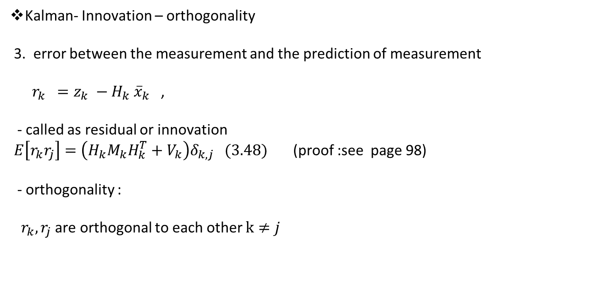
Kalman- Innovation – orthogonality
3. error between the measurement and the prediction of measurement
$r_{k} =z_{k} −H_{k} {\overline{x}}_{k}$ ,
- called as residual or innovation
$E\left[r_{k}r_{j}\right]=\left(H_{k}M_{k}H_{k}^{T}+V_{k}\right)δ_{k,j} (3.48)$ (proof :see page 98)
- orthogonality :
$r_{k}, r_{j}$ are orthogonal to each other $k≠j$

Slide 9
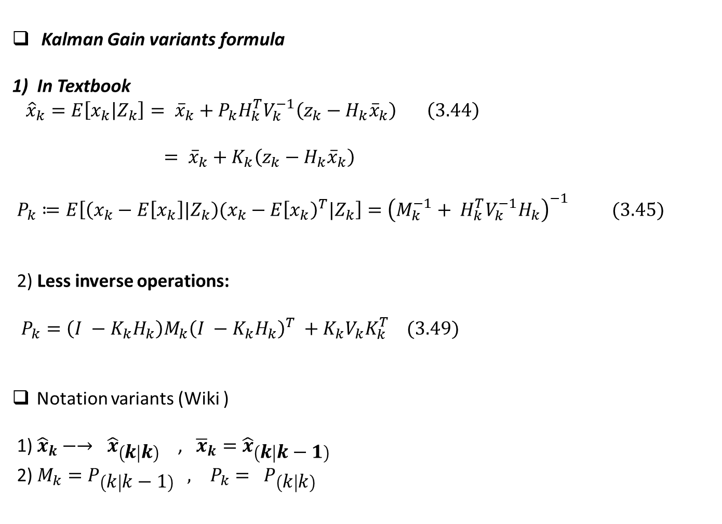
Kalman Gain variants formula
1) In Textbook
${\hat{x}}_{k}=E\left[x_{k} | Z_{k}\right]= {\overline{x}}_{k}+P_{k}H_{k}^{T}V_{k}^{−1}\left(z_{k}−H_{k}{\overline{x}}_{k}\right) \left(3.44\right)$
$= {\overline{x}}_{k}+K_{k}\left(z_{k}−H_{k}{\overline{x}}_{k}\right)$
$P_{k}≔E\left[\left(x_{k}−E\left[x_{k}\right]|Z_{k}\right)(x_{k}−E{\left[x_{k}\right)}^{T}|Z_{k}\right]={\left(M_{k}^{−1}+ H_{k}^{T}V_{k}^{−1}H_{k}\right)}^{−1} (3.45)$
2) Less inverse operations:
$P_{k}=\left(I −K_{k}H_{k}\right)M_{k}{\left(I −K_{k}H_{k}\right)}^{T} +K_{k}V_{k}K_{k}^{T} (3.49)$
Notation variants (Wiki )
1) ${\hat{x}}_{k}−→ {\hat{x}}_{\left(k | k\right)}$ , ${\overline{x}}_{k}={\hat{x}}_{\left(k | k−1\right)}$
2) $M_{k}=P_{\left(k | k−1\right)} , P_{k}= P_{\left(k | k\right)}$

Slide 10
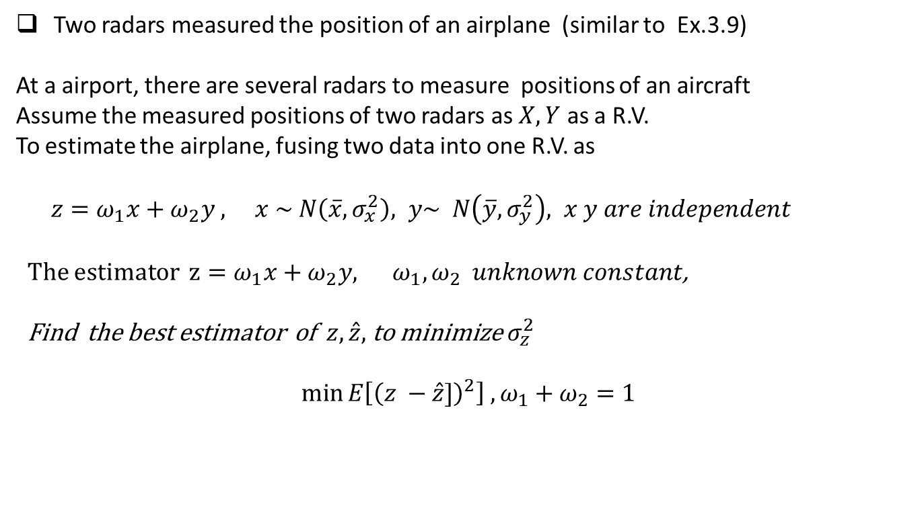
Two radars measured the position of an airplane (similar to Ex.3.9)
At a airport, there are several radars to measure positions of an aircraft
Assume the measured positions of two radars as $X,Y$ as a R.V.
To estimate the airplane, fusing two data into one R.V. as
$z=ω_{1}x+ω_{2}y , x \sim N\left(\overline{x}, σ_{x}^{2}\right), y\sim N\left(\overline{y}, σ_{y}^{2}\right), x y are independent$
The estimator $z=ω_{1}x+ω_{2}y, ω_{1},ω_{2} unknown constant$,
Find the best estimator of $z, \hat{z},$ to minimize $σ_{z}^{2}$
$$\min{E\left[{\left(z −\hat{z}]\right)}^{2}\right] , ω_{1}+ω_{2}=1}$$

Slide 11
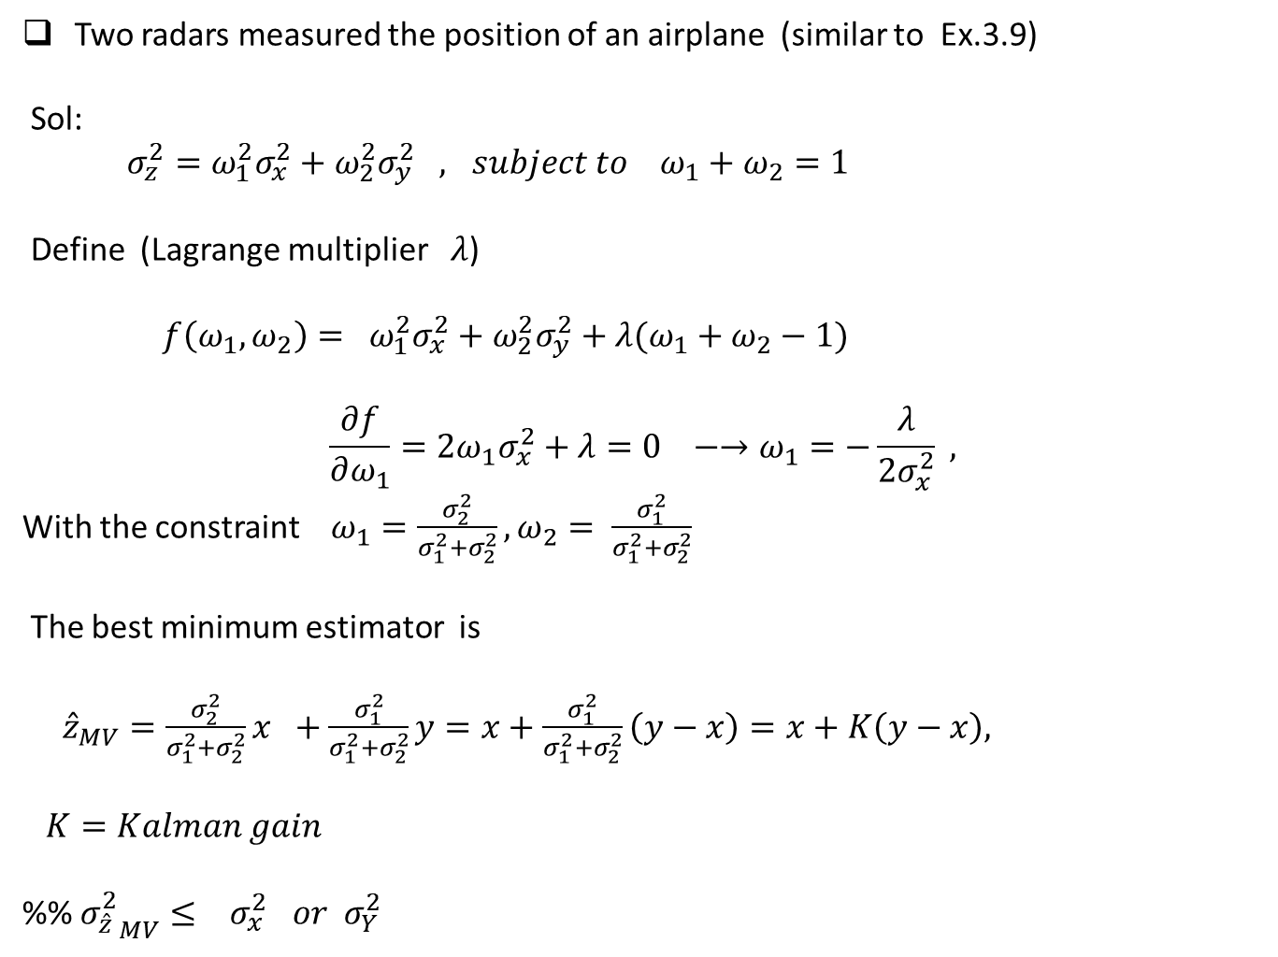
Two radars measured the position of an airplane (similar to Ex.3.9)
Sol:
$σ_{z}^{2}=ω_{1}^{2}σ_{x}^{2}+ω_{2}^{2}σ_{y}^{2} , subject to ω_{1}+ω_{2}=1$
Define (Lagrange multiplier $λ$)
${ f\left(ω_{1}, ω_{2}\right)= ω}_{1}^{2}σ_{x}^{2}+ω_{2}^{2}σ_{y}^{2}+λ(ω_{1}+ω_{2}−1)$
$$\frac{∂f}{∂ω_{1}}=2ω_{1}σ_{x}^{2}+λ=0 −→ω_{1}=−\frac{λ}{2σ_{x}^{2}} ,$$
With the constraint $ω_{1}=\frac{σ_{2}^{2}}{σ_{1}^{2}+σ_{2}^{2}}, ω_{2}= \frac{σ_{1}^{2}}{σ_{1}^{2}+σ_{2}^{2}}$
The best minimum estimator is
${\hat{z}}_{MV}=\frac{σ_{2}^{2}}{σ_{1}^{2}+σ_{2}^{2}}x +\frac{σ_{1}^{2}}{σ_{1}^{2}+σ_{2}^{2}}y=x+\frac{σ_{1}^{2}}{σ_{1}^{2}+σ_{2}^{2}}\left(y−x\right)=x+K\left(y−x\right),$
$K=Kalman gain$
%% ${σ_{\hat{z}}^{2}}_{MV}≤ σ_{x}^{2} or σ_{Y}^{2}$

Slide 12
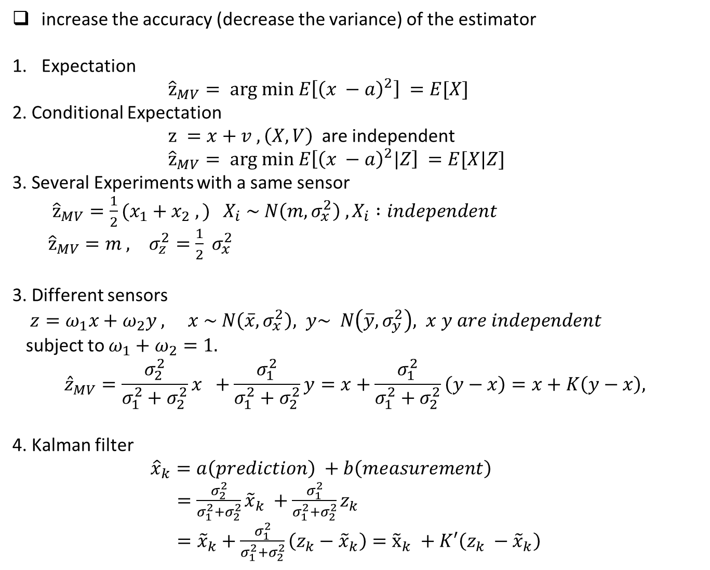
increase the accuracy (decrease the variance) of the estimator
Expectation
${\hat{z}}_{MV}= arg min E\left[{\left(x −a\right)}^{2}\right] =E[X]$
2. Conditional Expectation
$z =x+v , \left(X,V\right)$ are independent
${\hat{z}}_{MV}= arg min E\left[{\left(x −a\right)}^{2}|Z\right] =E[X|Z]$
3. Several Experiments with a same sensor
${\hat{z}}_{MV}={\frac{1}{2}(x}_{1}+x_{2} ,) X_{i} \sim N\left(m, σ_{x}^{2}\right) , X_{i} :independent$
${\hat{z}}_{MV}=m , σ_{z}^{2}=\frac{1}{2} σ_{x}^{2}$
3. Different sensors
$z=ω_{1}x+ω_{2}y , x \sim N\left(\overline{x}, σ_{x}^{2}\right), y\sim N\left(\overline{y}, σ_{y}^{2}\right), x y are independent$
subject to $ω_{1}+ω_{2}=1.$
$${\hat{z}}_{MV}=\frac{σ_{2}^{2}}{σ_{1}^{2}+σ_{2}^{2}}x +\frac{σ_{1}^{2}}{σ_{1}^{2}+σ_{2}^{2}}y=x+\frac{σ_{1}^{2}}{σ_{1}^{2}+σ_{2}^{2}}\left(y−x\right)=x+K\left(y−x\right),$$
4. Kalman filter
${\hat{x}}_{k}=a\left(prediction\right) +b\left(measurement\right)$
$=\frac{σ_{2}^{2}}{σ_{1}^{2}+σ_{2}^{2}}{\tilde{x}}_{k} +\frac{σ_{1}^{2}}{σ_{1}^{2}+σ_{2}^{2}}z_{k}$
$={\tilde{x}}_{k}+\frac{σ_{1}^{2}}{σ_{1}^{2}+σ_{2}^{2}}\left(z_{k}−{\tilde{x}}_{k}\right)={\tilde{x}}_{k} +K′\left(z_{k} −{\tilde{x}}_{k}\right)$

Slide 13

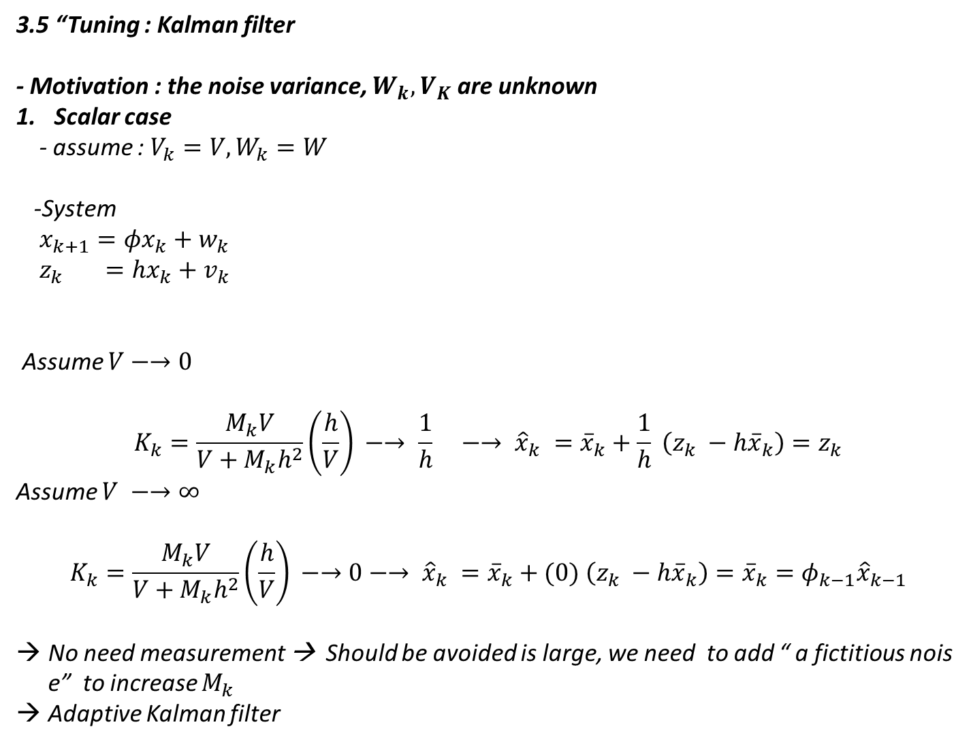

3.5 “Tuning : Kalman filter
- Motivation : the noise variance, $W_{k}, V_{K}$ are unknown
Scalar case
- assume : $V_{k}=V, W_{k}=W$
-System
$x_{k+1}=φx_{k}+w_{k}$
$z_{k} =hx_{k}+v_{k}$
Assume $V−→0$
$$K_{k}=\frac{M_{k}V}{V+M_{k}h^{2}}\left(\frac{h}{V}\right) −→ \frac{1}{h} −→ {\hat{x}}_{k} ={\overline{x}}_{k}+\frac{1}{h} \left(z_{k} −h{\overline{x}}_{k}\right)=z_{k}$$
Assume $V −→∞$
$$K_{k}=\frac{M_{k}V}{V+M_{k}h^{2}}\left(\frac{h}{V}\right) −→0−→ {\hat{x}}_{k} ={\overline{x}}_{k}+(0) \left(z_{k} −h{\overline{x}}_{k}\right)={\overline{x}}_{k}=φ_{k−1}{\hat{x}}_{k−1}$$
No need measurement → Should be avoided is large, we need to add “ a fictitious noise” to increase $M_{k}$
Adaptive Kalman filter
-Prediction
${\overline{x}}_{k+1}=φ{\hat{x}}_{k}$
$M_{k+1}=φ^{2}P_{k}+W$
-Estimation
${\hat{x}}_{k} ={\overline{x}}_{k}+K_{k}(z_{k} −h{\overline{x}}_{k})$
$P_{k}=\frac{1}{\frac{1}{M_{k}}+\frac{h^{2}}{V}} =\frac{M_{k}V}{V+M_{k}h^{2}} , K_{k}=\frac{P_{k}h}{V}$

