Slide 1
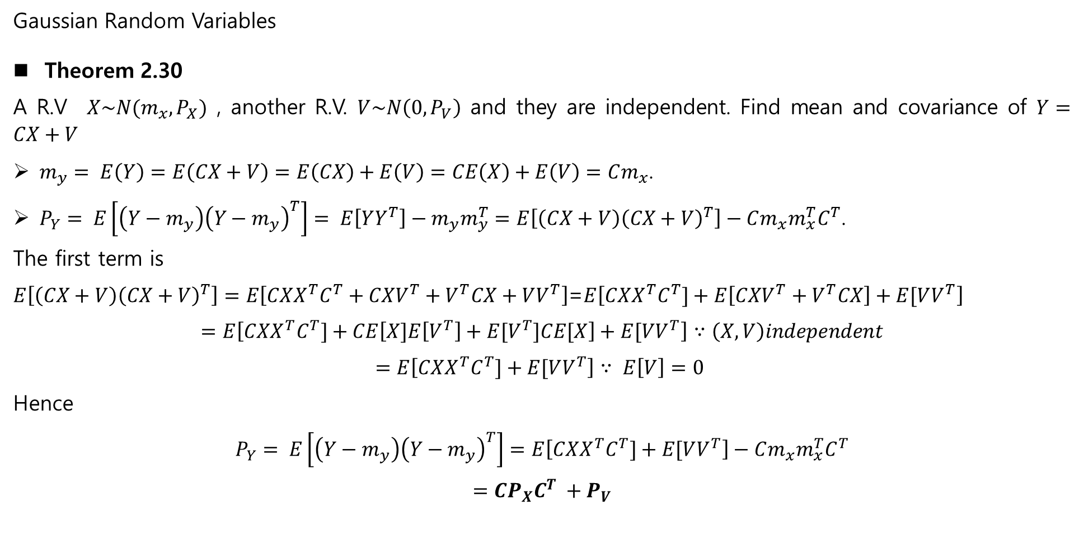
Gaussian Random Variables
Theorem 2.30
A R.V $X\sim N(m_{x},P_{X})$ , another R.V. $V\sim N\left(0, P_{V}\right)$ and they are independent. Find mean and covariance of $Y=CX+V$
$m_{y}= E\left(Y\right)=E\left(CX+V\right)=E\left(CX\right)+E\left(V\right)=CE\left(X\right)+E\left(V\right)=Cm_{x}$.
$P_{Y}= E\left[\left(Y−m_{y}\right){\left(Y−m_{y}\right)}^{T}\right]= E\left[YY^{T}\right]−m_{y}m_{y}^{T}=E\left[\left(CX+V\right){\left(CX+V\right)}^{T}\right]−Cm_{x}m_{x}^{T}C^{T}$.
The first term is
$E\left[\left(CX+V\right){\left(CX+V\right)}^{T}\right]=E\left[CXX^{T}C^{T}+CXV^{T}+V^{T}CX+VV^{T}\right]$=$E\left[CXX^{T}C^{T}]+E\left[CXV^{T}+V^{T}CX\right]+E[VV^{T}\right]$
$$=E\left[CXX^{T}C^{T}]+CE\left[X]E\left[V^{T}\right]+{E[V}^{T}]CE[X\right]+E[VV^{T}\right]∵\left(X,V\right)independent$$
$$=E\left[CXX^{T}C^{T}]+E[VV^{T}\right]∵ E\left[V\right]=0$$
Hence
$$P_{Y}= E\left[\left(Y−m_{y}\right){\left(Y−m_{y}\right)}^{T}\right]=E\left[CXX^{T}C^{T}]+E[VV^{T}\right]−Cm_{x}m_{x}^{T}C^{T}$$
$$=CP_{X}C^{T} +P_{V}$$

Slide 2
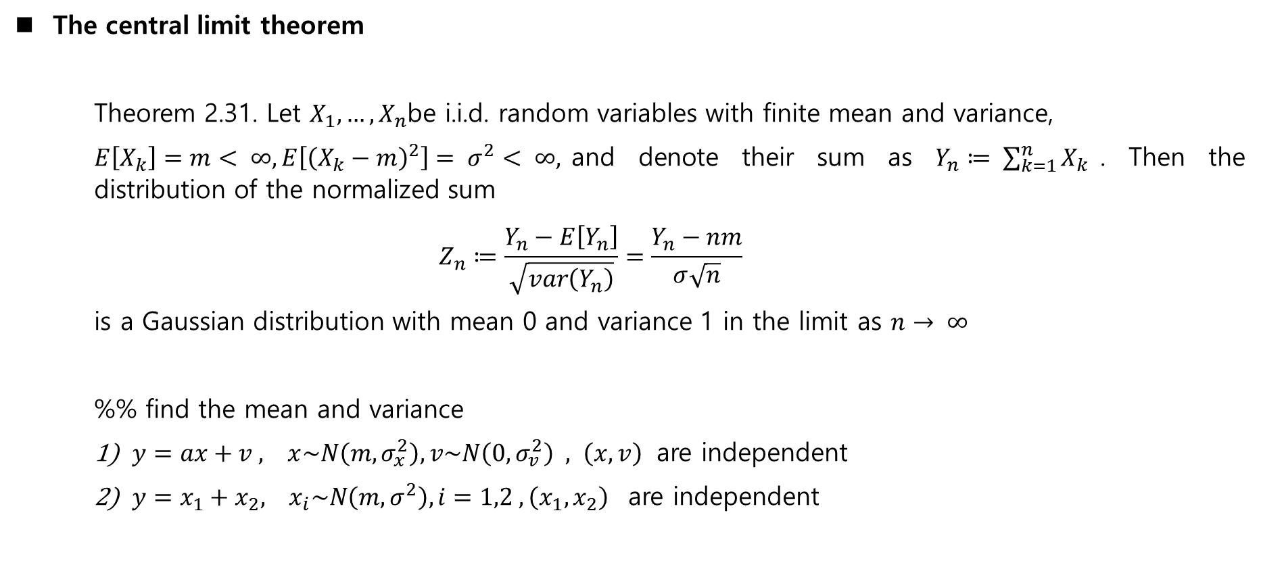
The central limit theorem
Theorem 2.31. Let $X_{1},…, X_{n}$be i.i.d. random variables with finite mean and variance,
$E\left[X_{k}\right]=m< ∞, E\left[{\left(X_{k}−m\right)}^{2}\right]= σ^{2}< ∞,$and denote their sum as $Y_{n}≔ \sum_{k=1}^{n}{X_{k}}$. Then the distribution of the normalized sum
$$Z_{n}≔\frac{Y_{n}−E\left[Y_{n}\right]}{\sqrt{var\left(Y_{n}\right)}}=\frac{Y_{n}−nm}{σ\sqrt{n}}$$
is a Gaussian distribution with mean 0 and variance 1 in the limit as $n→ ∞$
%% find the mean and variance
$y=ax+v , x\sim N\left(m, σ_{x}^{2}\right), v\sim N\left(0, σ_{v}^{2}\right) , \left(x,v\right)$ are independent
$y=x_{1}+x_{2}, x_{i}\sim N\left(m, σ^{2}\right), i=1,2 , \left(x_{1}, x_{2}\right)$ are independent

Slide 3
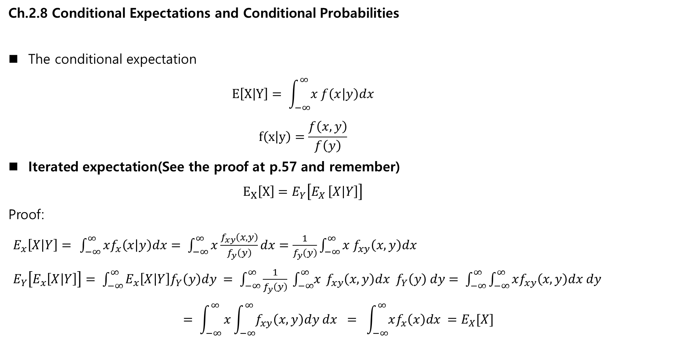
Ch.2.8 Conditional Expectations and Conditional Probabilities
The conditional expectation
$$E\left[X | Y\right]= \int_{−∞}^{∞}{x f\left(x | y\right)dx}$$
$$f\left(x | y\right)=\frac{f\left(x,y\right)}{f\left(y\right)}$$
Iterated expectation(See the proof at p.57 and remember)
$$E_{X}\left[X\right]=E_{Y}\left[E_{X }\left[X | Y\right]\right]$$
Proof:
$E_{x}\left[X | Y\right]=$ $\int_{−∞}^{∞}{xf_{x}\left(x | y\right)dx= \int_{−∞}^{∞}{x\frac{f_{xy}\left(x,y\right)}{f_{y}\left(y\right)}dx=\frac{1}{f_{y}\left(y\right)}}}\int_{−∞}^{∞}{x f_{xy}\left(x,y\right)dx }$
$E_{Y}\left[E_{x}\left[X | Y\right]\right]= \int_{−∞}^{∞}{E_{x}\left[X | Y\right]f_{Y}\left(y\right)dy = \int_{−∞}^{∞}{\frac{1}{f_{y}\left(y\right)} \int_{−∞}^{∞}{x} f_{xy}\left(x,y\right)dx f_{Y}\left(y\right) dy= \int_{−∞}^{∞}{\int_{−∞}^{∞}{xf_{xy}\left(x,y\right)dx dy }}}}$
$$= \int_{−∞}^{∞}{x\int_{−∞}^{∞}{f_{xy}\left(x,y\right)dy dx }}= \int_{−∞}^{∞}{xf_{x}\left(x\right)dx }=E_{X}[X]$$

Slide 4
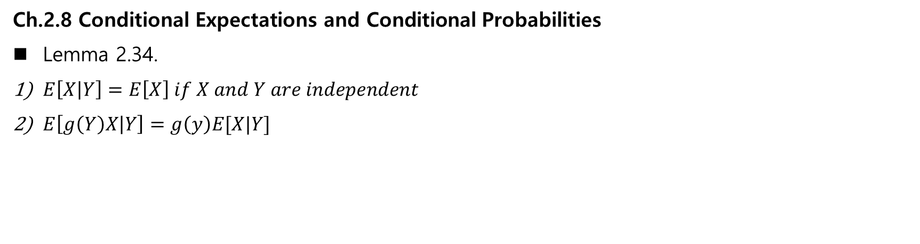
Ch.2.8 Conditional Expectations and Conditional Probabilities
Lemma 2.34.
$E\left[X | Y\right]=E\left[X\right] if X and Y are independent$
$E\left[g\left(Y\right)X | Y\right]=g\left(y\right)E[X|Y]$

Slide 5
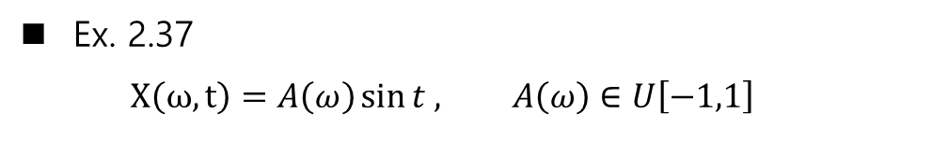
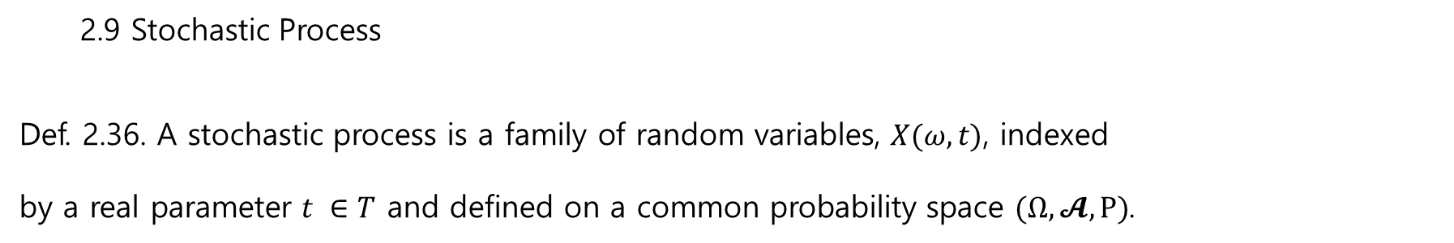

2.9 Stochastic Process
Def. 2.36. A stochastic process is a family of random variables, $X(ω,t)$, indexed
by a real parameter $t ∈T$ and defined on a common probability space $(Ω, 𝓐, P)$.
Ex. 2.37
$$X\left(ω,t\right)=A\left(ω\right)\sin{t , A\left(ω\right)∈U\left[−1,1\right]}$$
Def. 2.38. A stochastic process $X(ω,t)$is said to be continuous in probability at t if
$\lim_{s→t}{P(\{}ω:\left|X\left(ω,t\right)−X\left(ω,s\right)\right|≥ ε)=0$ for all $ε>0$

Slide 6
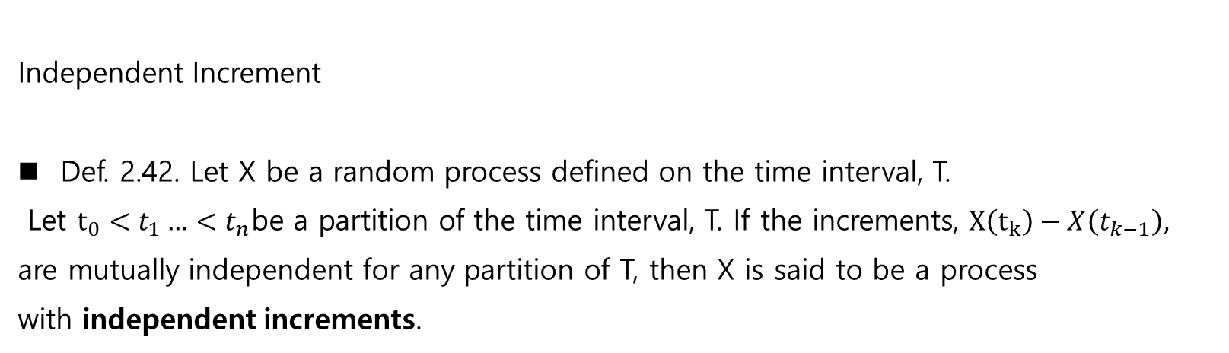
Independent Increment
Def. 2.42. Let X be a random process defined on the time interval, T.
Let $t_{0}<t_{1}…<t_{n}$be a partition of the time interval, T. If the increments, $X\left(t_{k}\right)−X\left(t_{k−1}\right),$
are mutually independent for any partition of T, then X is said to be a process
with independent increments.

Slide 7
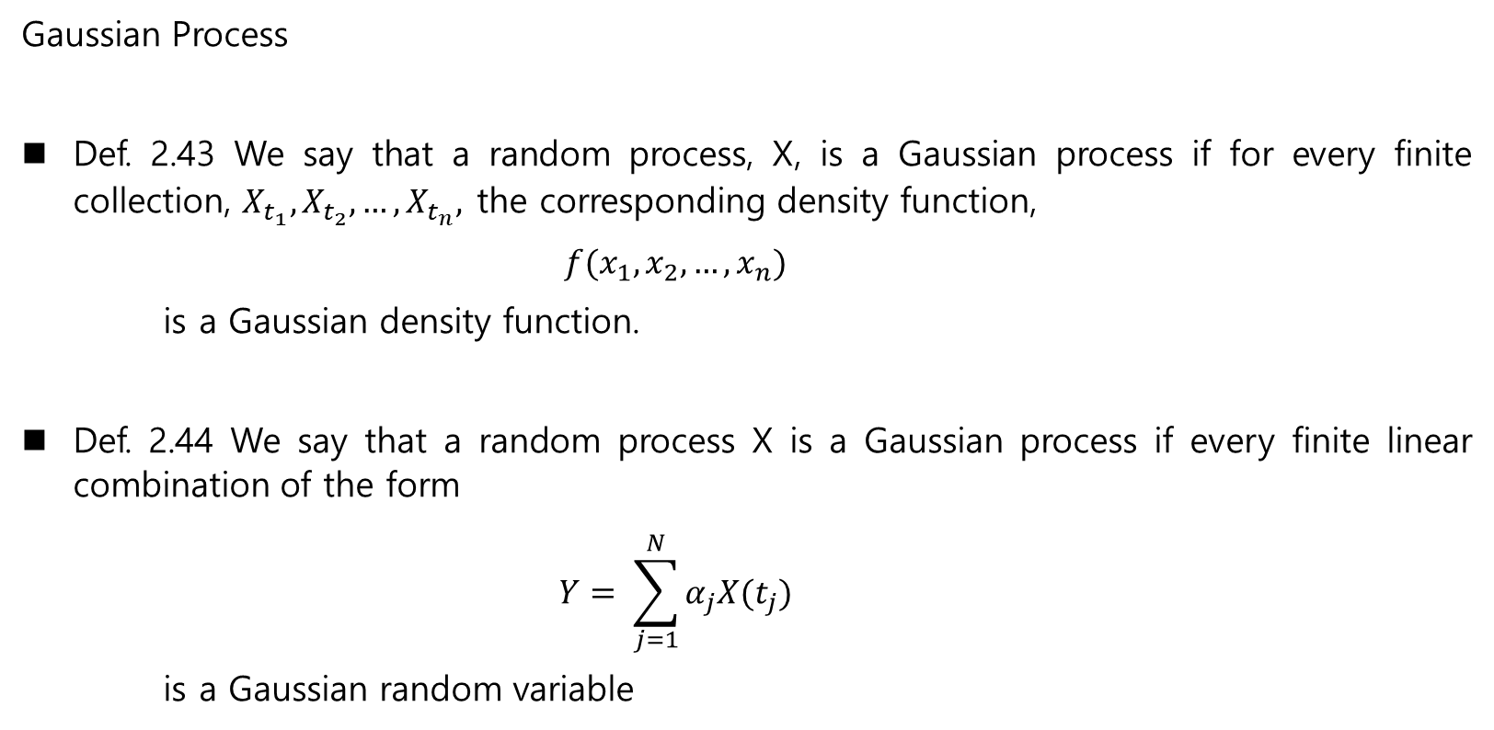
Gaussian Process
Def. 2.43 We say that a random process, X, is a Gaussian process if for every finite collection, $X_{t_{1}}, X_{t_{2}},…, X_{t_{n}},$the corresponding density function,
$$f(x_{1}, x_{2},…, x_{n})$$
is a Gaussian density function.
Def. 2.44 We say that a random process X is a Gaussian process if every finite linear combination of the form
$$Y= \sum_{j=1}^{N}{α_{j}X(t_{j})}$$
is a Gaussian random variable

Slide 8
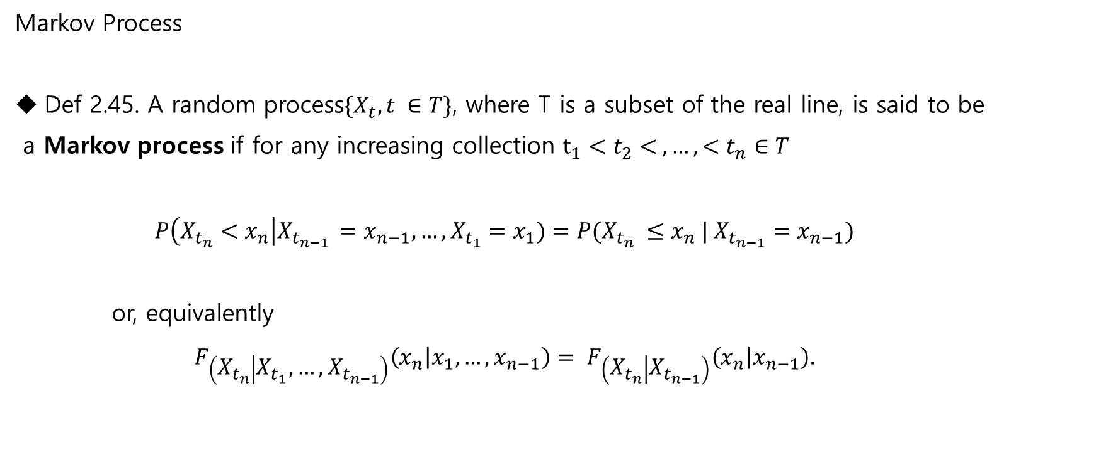
Markov Process
Def 2.45. A random process$\{X_{t}, t ∈T\}$, where T is a subset of the real line, is said to be
a Markov process if for any increasing collection $t_{1}<t_{2}< ,…,<t_{n}∈T$
$$P\left(X_{t_{n}}<x_{n}\right|X_{t_{n−1 }}=x_{n−1},…,X_{t_{1}}=x_{1})=P(X_{t_{n}} ≤x_{n} | X_{t_{n−1}}=x_{n−1})$$
or, equivalently
$$F_{\left(X_{t_{n}} | X_{t_{1}},…, X_{t_{n−1}}\right)}\left(x_{n} | x_{1},…,x_{n−1}\right)= F_{\left(X_{t_{n}} | X_{t_{n−1}}\right)}\left(x_{n} | x_{n−1}\right).$$

Slide 9
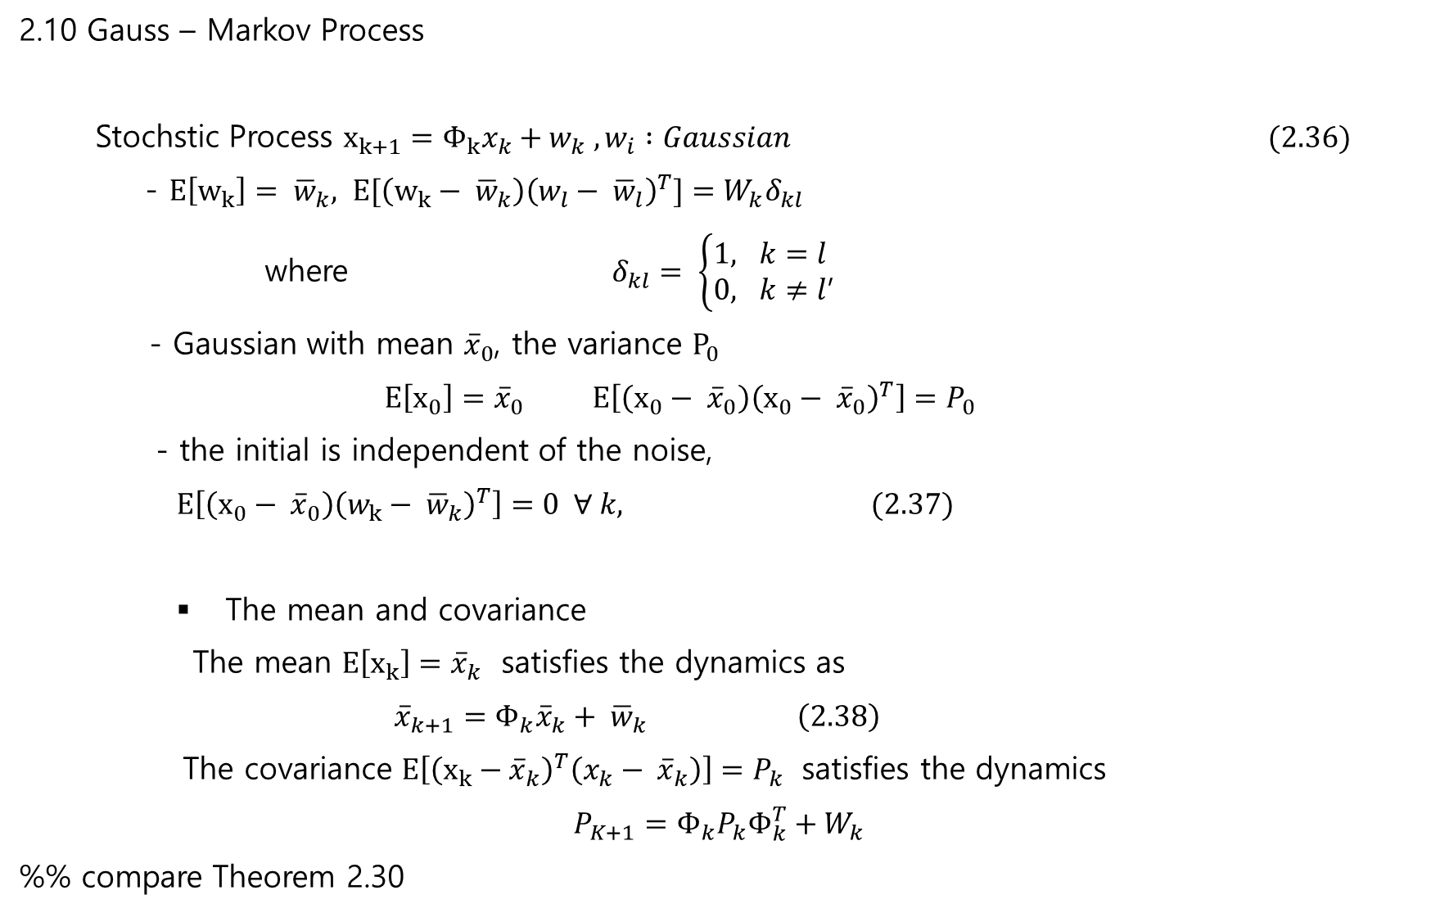
2.10 Gauss – Markov Process
Stochstic Process $x_{k+1}=Φ_{k}x_{k}+w_{k} , w_{i} :Gaussian (2.36)$
- $E\left[w_{k}\right]= {\overline{w}}_{k}, E[\left(w_{k}− {\overline{w}}_{k}\right){\left(w_{l}− {\overline{w}}_{l}\right)}^{T}]=W_{k}δ_{kl}$
where $δ_{kl}= \left\{\begin{matrix}1, k=l \\ 0, k≠l\end{matrix}\right.$,
- Gaussian with mean ${\overline{x}}_{0}$, the variance $P_{0}$
$E\left[x_{0}\right]={\overline{x}}_{0} E\left[\left(x_{0}− {\overline{x}}_{0}\right){\left(x_{0}− {\overline{x}}_{0}\right)}^{T}\right]=P_{0}$
- the initial is independent of the noise,
$E\left[\left(x_{0}− {\overline{x}}_{0}\right){\left(w_{k}− {\overline{w}}_{k}\right)}^{T}\right]=0 ∀ k, (2.37)$
The mean and covariance
The mean $E\left[x_{k}\right]={\overline{x}}_{k}$ satisfies the dynamics as
$${\overline{x}}_{k+1}=Φ_{k}{\overline{x}}_{k}+ {\overline{w}}_{k} \left(2.38\right)$$
The covariance $E\left[{\left(x_{k}−{\overline{x}}_{k}\right)}^{T}\left(x_{k}− {\overline{x}}_{k}\right)\right]=P_{k}$ satisfies the dynamics
$$P_{K+1}=Φ_{k}P_{k}Φ_{k}^{T}+W_{k}$$
%% compare Theorem 2.30

Slide 10

3. Conditional Expectations and Discrete-Time Kalman Filtering - 2.11 Nonlinear Stochastic Process –
3.1 Minimum Variance Estimation
Problem statement – static parameter estimation
$$z=h(x) +ν (3.1)$$
Given measurement $z$ , find a estimator $\hat{x}$ of $x$ to minimize $error =x−\hat{x}$ in some sense
Minimum Variance Estimator
$${\hat{x}}_{MV}=\underset{\hat{x}}{argmin}{E[{\left(x− \hat{x}\right)}^{2}}|z]$$
%% Linear Regression
$$y=ax+b$$
Measurement $\left(x_{i}, y_{i}\right) , i=1,2,3 ,$ unknown $\left(a,b\right).$ Find $\hat{a}, \hat{b}$ subject to
$$\arg_{a,b}{min\sum_{i=1}^{3}{{\left(\hat{a}x_{i}+\hat{b}−y_{i}\right)}^{2}}}$$
Sol:
$$\left[\begin{matrix}y_{1} \\ y_{2} \\ y_{3}\end{matrix}\right]=\left[\begin{matrix}x_{1} & 1 \\ x_{2} & 1 \\ x_{3} & 1\end{matrix}\right]\left[\begin{matrix}\hat{a} \\ \hat{b}\end{matrix}\right] =A\left[\begin{matrix}\hat{a} \\ \hat{b}\end{matrix}\right] −→ \left[\begin{matrix}\hat{a} \\ \hat{b}\end{matrix}\right]={\left(A^{T}A\right)}^{−1}A^{T}\left[\begin{matrix}y_{1} \\ y_{2} \\ y_{3}\end{matrix}\right]$$

Slide 11
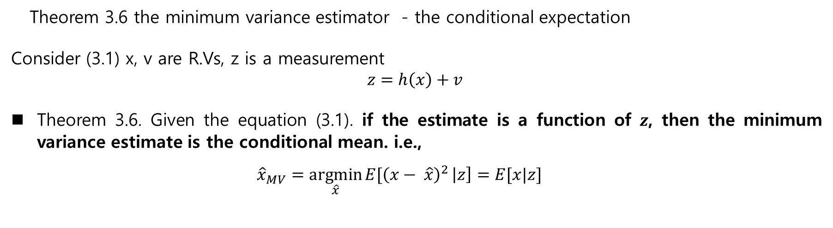
Theorem 3.6 the minimum variance estimator - the conditional expectation
Consider (3.1) x, v are R.Vs, z is a measurement
$$z=h\left(x\right)+v$$
Theorem 3.6. Given the equation (3.1). if the estimate is a function of $z$, then the minimum variance estimate is the conditional mean. i.e.,
$${\hat{x}}_{MV}=\underset{\hat{x}}{argmin}{E[{\left(x− \hat{x}\right)}^{2}}\left|z\right]=E[x|z]$$

Slide 12

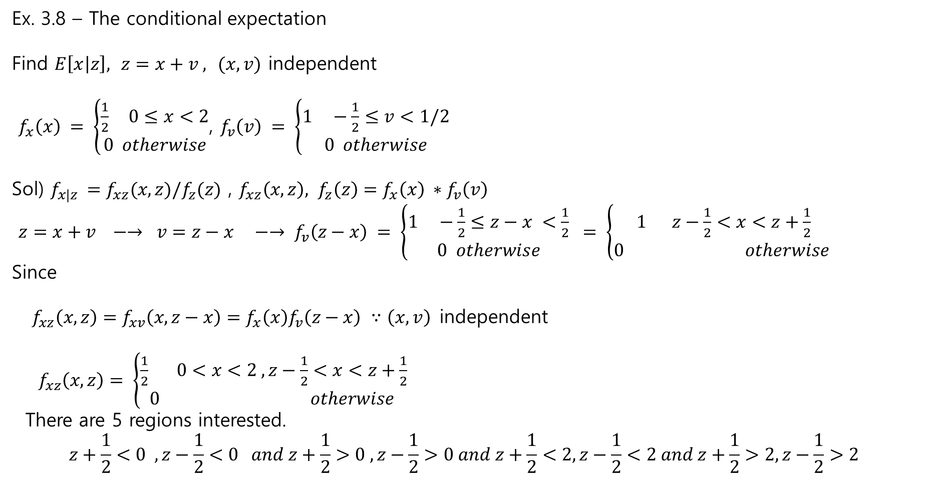

Ex. 3.8 – The conditional expectation
Find $E\left[x | z\right],$ $z=x+v ,$ $(x,v)$ independent
$f_{x}\left(x\right) = \left\{\begin{aligned}\frac{1}{2} 0≤x<2 \\ 0 otherwise\end{aligned}\right.$, $f_{v}\left(v\right) = \left\{\begin{aligned}1 −\frac{1}{2}≤v<1/2 \\ 0 otherwise\end{aligned}\right.$
Sol) $f_{x|z }=f_{xz}(x,z)/f_{z}(z)$ , $f_{xz}\left(x,z\right), f_{z}\left(z\right)=f_{x}\left(x\right) ∗f_{v}\left(v\right)$
$z=x+v −→ v=z−x −→ f_{v}\left(z−x\right) = \left\{\begin{aligned}1 −\frac{1}{2}≤z−x <\frac{1}{2} \\ 0 otherwise\end{aligned}\right. = \left\{\begin{aligned}1 z−\frac{1}{2}<x<z+\frac{1}{2} \\ 0 otherwise \end{aligned}\right.$
Since
$f_{xz}\left(x,z\right)=f_{xv}\left(x,z−x\right)=f_{x}\left(x\right)f_{v}\left(z−x\right) ∵\left(x,v\right)$independent
$f_{xz}\left(x,z\right)= \left\{\begin{aligned}\frac{1}{2} 0<x<2 , z−\frac{1}{2}<x<z+\frac{1}{2} \\ 0 otherwise \end{aligned}\right.$
There are 5 regions interested.
$$z+\frac{1}{2}<0 , z−\frac{1}{2}<0 and z+\frac{1}{2}>0 , z−\frac{1}{2}>0 and z+\frac{1}{2}<2, z−\frac{1}{2}<2 and z+\frac{1}{2}>2, z−\frac{1}{2}>2$$
$$f_{x}(x)$$
$$x$$

Slide 13
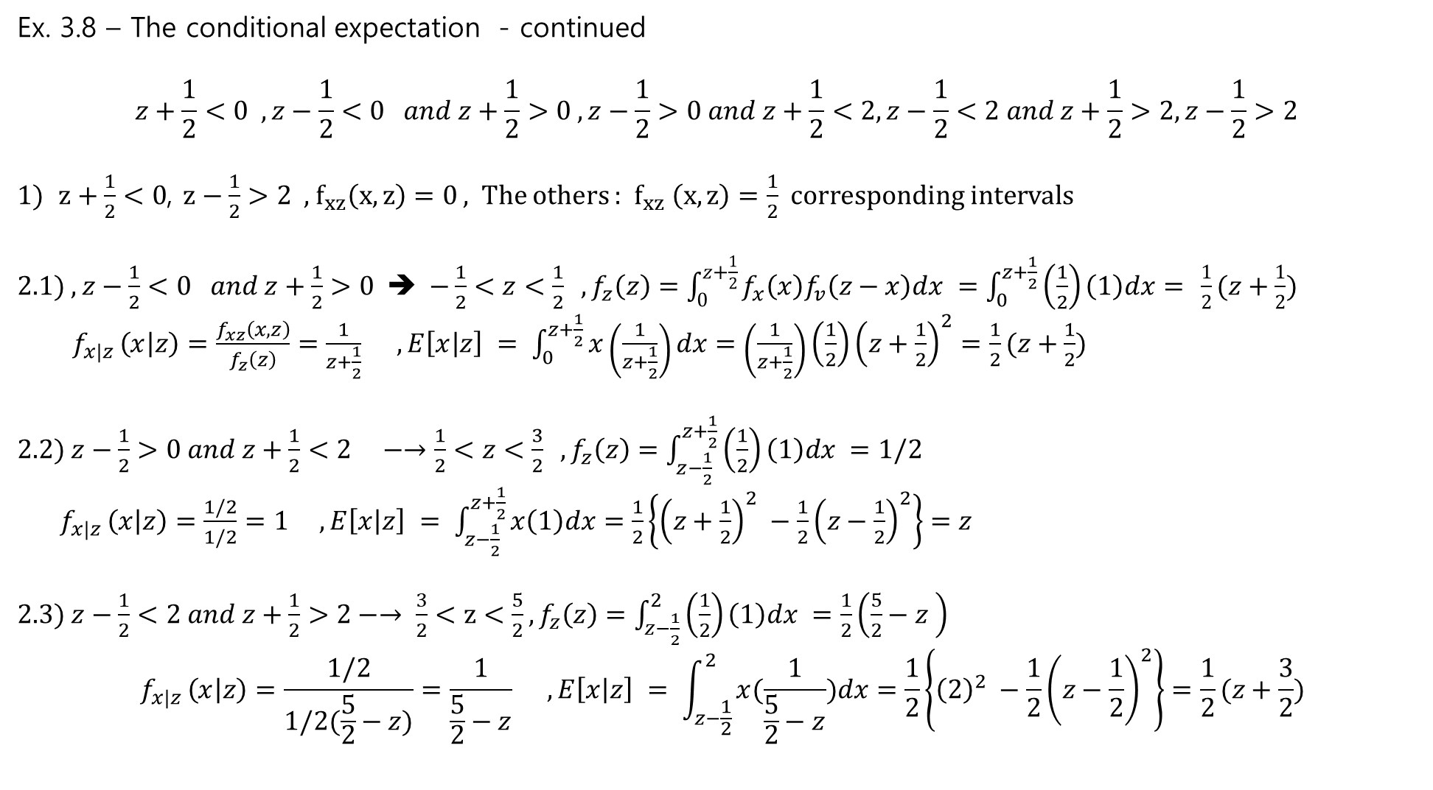
Ex. 3.8 – The conditional expectation - continued
$$z+\frac{1}{2}<0 , z−\frac{1}{2}<0 and z+\frac{1}{2}>0 , z−\frac{1}{2}>0 and z+\frac{1}{2}<2, z−\frac{1}{2}<2 and z+\frac{1}{2}>2, z−\frac{1}{2}>2$$
$z+\frac{1}{2}<0$, $z−\frac{1}{2}>2$, $f_{xz}\left(x,z\right)=0$ , The others : $f_{xz} \left(x,z\right)=\frac{1}{2}$ corresponding intervals
2.1) $, z−\frac{1}{2}<0 and z+\frac{1}{2}>0$ ➔ $−\frac{1}{2}<z<\frac{1}{2} , f_{z}\left(z\right)=\int_{0}^{z+\frac{1}{2}}{f_{x}\left(x\right)f_{v}\left(z−x\right)dx }=\int_{0}^{z+\frac{1}{2}}{\left(\frac{1}{2}\right)\left(1\right)dx= }\frac{1}{2}(z+\frac{1}{2})$
$f_{x|z }\left(x | z\right)=\frac{f_{xz}\left(x,z\right)}{f_{z}\left(z\right)}=\frac{1}{z+\frac{1}{2}} , E\left[x | z\right] = \int_{0}^{z+\frac{1}{2}}{x\left(\frac{1}{z+\frac{1}{2}}\right)dx=\left(\frac{1}{z+\frac{1}{2}}\right)\left(\frac{1}{2}\right){\left(z+\frac{1}{2}\right)}^{2}=\frac{1}{2}(z+\frac{1}{2})}$
2.2) $z−\frac{1}{2}>0 and z+\frac{1}{2}<2 −→\frac{1}{2}<z<\frac{3}{2} ,f_{z}\left(z\right)=\int_{z−\frac{1}{2}}^{z+\frac{1}{2}}{\left(\frac{1}{2}\right)\left(1\right)dx =1/2}$
$f_{x|z }\left(x | z\right)=\frac{1/2}{1/2}=1 , E\left[x | z\right] = \int_{z−\frac{1}{2}}^{z+\frac{1}{2}}{x\left(1\right)dx=\frac{1}{2}\left\{{\left(z+\frac{1}{2}\right)}^{2} −\frac{1}{2}{\left(z−\frac{1}{2}\right)}^{2}\right\}=z}$
2.3) $z−\frac{1}{2}<2 and z+\frac{1}{2}>2−→ \frac{3}{2}<z<\frac{5}{2},f_{z}\left(z\right)=\int_{z−\frac{1}{2}}^{2}{\left(\frac{1}{2}\right)\left(1\right)dx =\frac{1}{2}\left(\frac{5}{2}−z \right)}$
$$f_{x|z }\left(x | z\right)=\frac{1/2}{1/2(\frac{5}{2}−z)}=\frac{1}{\frac{5}{2}−z} , E\left[x | z\right] = \int_{z−\frac{1}{2}}^{2}{x(\frac{1}{\frac{5}{2}−z})dx=\frac{1}{2}\left\{{\left(2\right)}^{2} −\frac{1}{2}{\left(z−\frac{1}{2}\right)}^{2}\right\}=\frac{1}{2}(z+\frac{3}{2})}$$

Slide 14
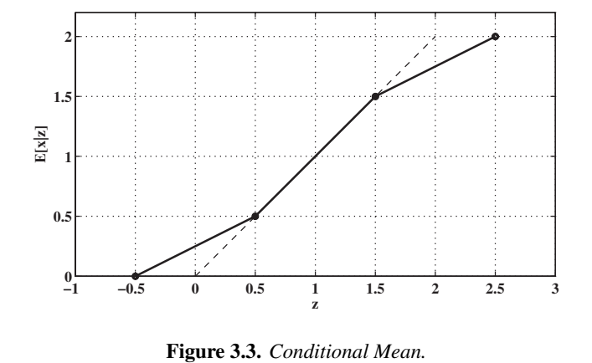
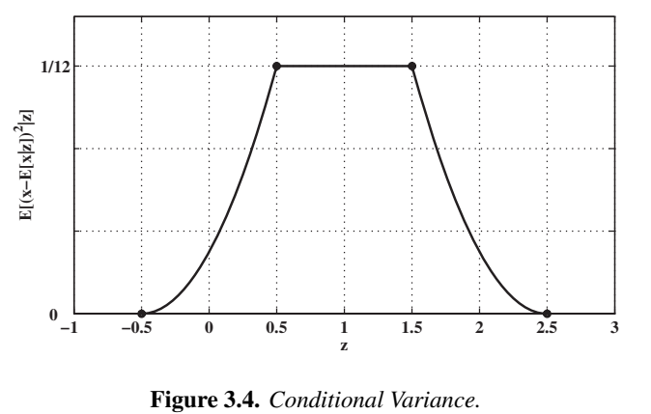
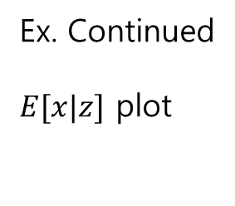

Ex. Continued
$E[x|z]$ plot
$0<x<2, −\frac{1}{2}<v<\frac{1}{2}$
$z=x+v$
Unconditional
-$E\left[z\right] =E\left[x+v\right]=E\left[x\right]$
- $σ_{z}^{2}=?$

