Slide 1
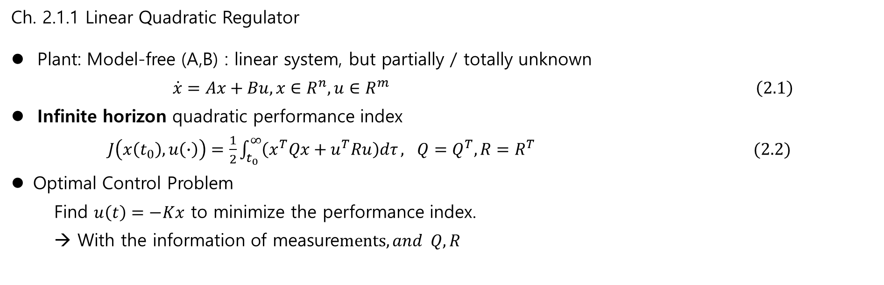
Review integral RL
Ch. 2.1.1 Linear Quadratic Regulator
Plant: Model-free (A,B) : linear system, but partially / totally unknown
$\dot{x}=Ax+Bu,x∈R^{n}, u∈R^{m} \left(2.1\right)$
Infinite horizon quadratic performance index
$J\left(x\left(t_{0}\right), u\left(∙\right)\right)=\frac{1}{2}\int_{t_{0}}^{∞}{\left(x^{T}Qx+u^{T}Ru\right)dτ}, Q=Q^{T}, R=R^{T} (2.2)$
Optimal Control Problem
Find $u\left(t\right)=−Kx$ to minimize the performance index.
→ With the information of measure$ments, and Q, R$

Slide 2
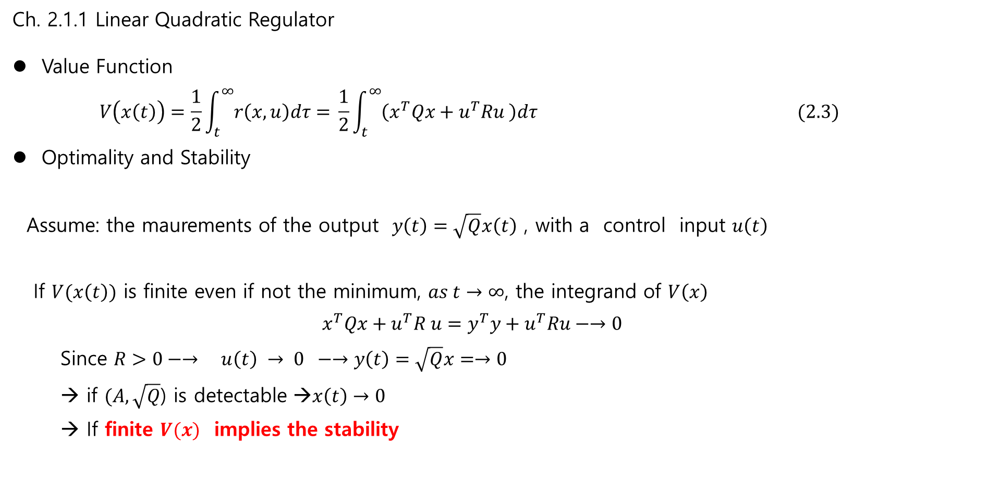
Review integral RL
Ch. 2.1.1 Linear Quadratic Regulator
Value Function
$$V\left(x\left(t\right)\right)=\frac{1}{2}\int_{t}^{∞}{r\left(x,u\right)dτ= }\frac{1}{2}\int_{t}^{∞}{\left(x^{T}Qx+u^{T}Ru \right)dτ} (2.3)$$
Optimality and Stability
Assume: the maurements of the output $y\left(t\right)=\sqrt{Q}x\left(t\right)$ , with a control input $u\left(t\right)$
If $V(x\left(t\right))$ is finite even if not the minimum, $as t→∞$, the integrand of $V\left(x\right)$
$$x^{T}Qx+u^{T}R u=y^{T}y+u^{T}Ru−→0$$
Since $R>0−→ u\left(t\right) → 0 −→y\left(t\right)=\sqrt{Q}x=→0$
→ if $(A, \sqrt{Q}$) is detectable →$x\left(t\right)→0$
→ If finite $V(x)$ implies the stability

Slide 3
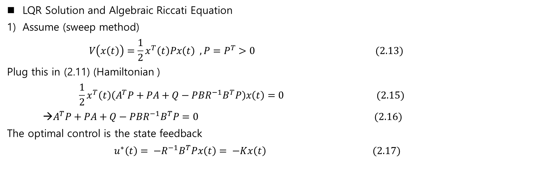
Review
LQR Solution and Algebraic Riccati Equation
Assume (sweep method)
$$V\left(x\left(t\right)\right)=\frac{1}{2}x^{T}\left(t\right)Px\left(t\right) , P=P^{T}>0 (2.13)$$
Plug this in (2.11) (Hamiltonian )
$$\frac{1}{2}x^{T}\left(t\right)\left(A^{T}P+PA+Q−PBR^{−1}B^{T}P\right)x\left(t\right)=0 (2.15)$$
→$A^{T}P+PA+Q−PBR^{−1}B^{T}P=0 (2.16)$
The optimal control is the state feedback
$u^{∗}\left(t\right)= −R^{−1}B^{T}Px\left(t\right)= −Kx\left(t\right) (2.17)$

Slide 4
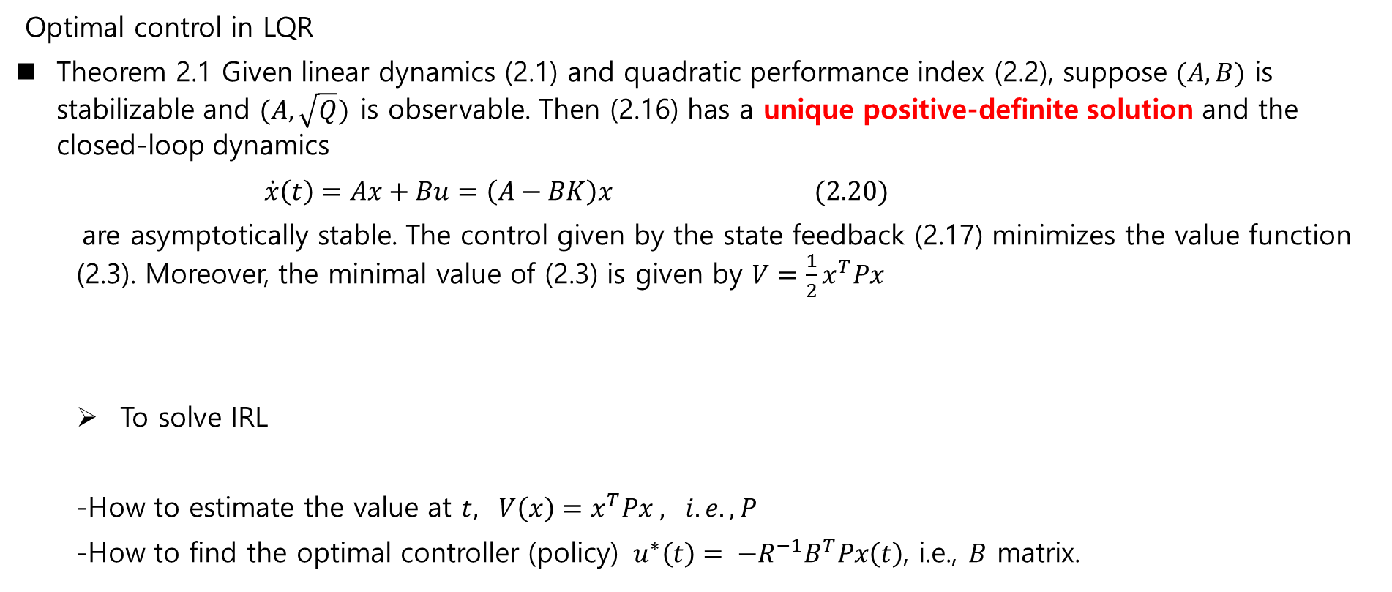
Review
Optimal control in LQR
Theorem 2.1 Given linear dynamics (2.1) and quadratic performance index (2.2), suppose $(A,B)$ is stabilizable and $(A, \sqrt{Q})$ is observable. Then (2.16) has a unique positive-definite solution and the closed-loop dynamics
$$\dot{x}\left(t\right)=Ax+Bu=\left(A−BK\right)x (2.20)$$
are asymptotically stable. The control given by the state feedback (2.17) minimizes the value function (2.3). Moreover, the minimal value of (2.3) is given by $V=\frac{1}{2}x^{T}Px$
To solve IRL
-How to estimate the value at $t, V\left(x\right)=x^{T}Px , i.e., P$
-How to find the optimal controller (policy) ${ u}^{∗}\left(t\right)= −R^{−1}B^{T}Px\left(t\right)$, i.e., $B$ matrix.

Slide 5
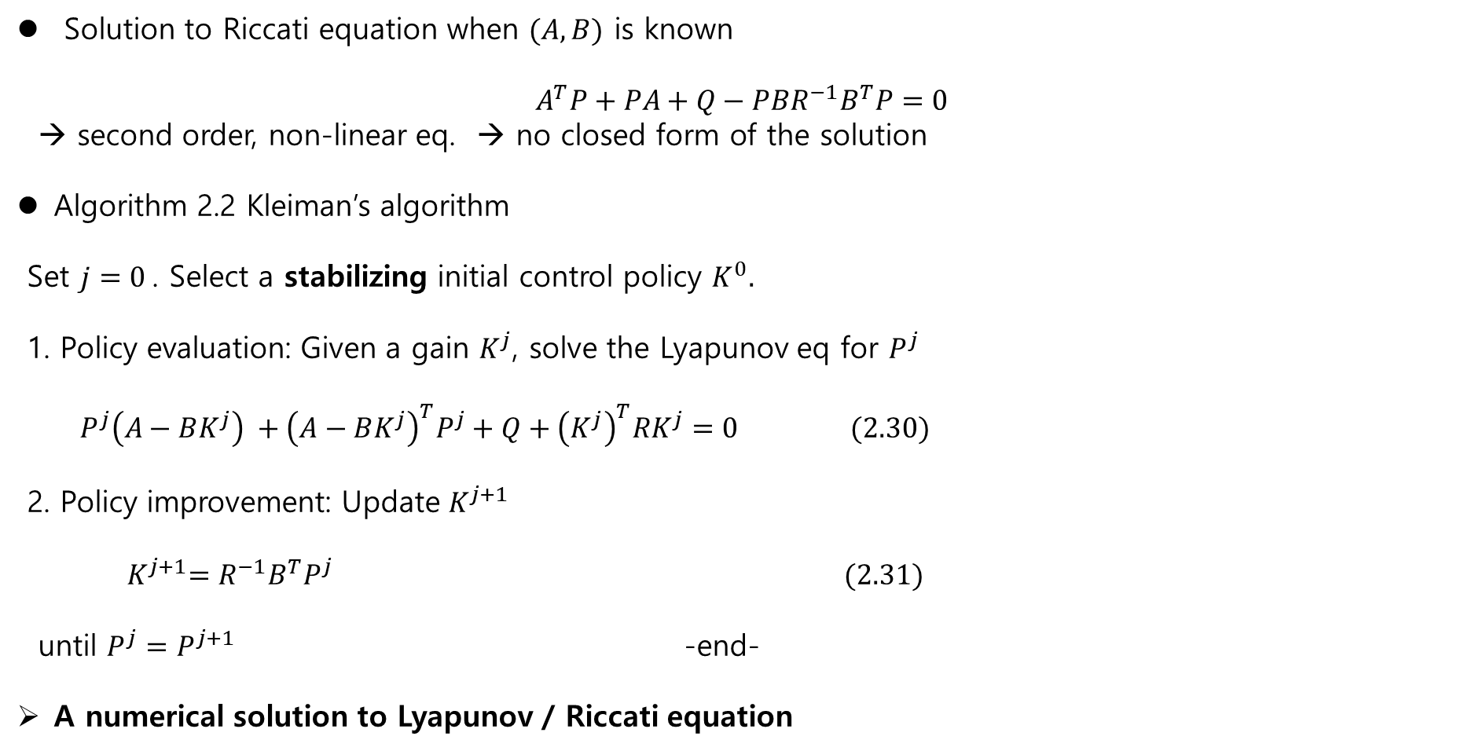
Review - Idea for Model-free ( Solution to Riccati Equation)
Solution to Riccati equation when $(A,B)$ is known
$$A^{T}P+PA+Q−PBR^{−1}B^{T}P=0$$
→ second order, non-linear eq. → no closed form of the solution
Algorithm 2.2 Kleiman’s algorithm
Set $j=0$. Select a stabilizing initial control policy $K^{0}.$
1. Policy evaluation: Given a gain $K^{j}$, solve the Lyapunov eq for $P^{j}$
$P^{j}\left(A−BK^{j}\right) +{\left(A−BK^{j}\right)}^{T}P^{j}+Q+{\left(K^{j}\right)}^{T}RK^{j}=0 (2.30)$
2. Policy improvement: Update $K^{j+1}$
${ K}^{j+1}=R^{−1}B^{T}P^{j} (2.31)$
until $P^{j}=P^{j+1}$ -end-
A numerical solution to Lyapunov / Riccati equation

Slide 6
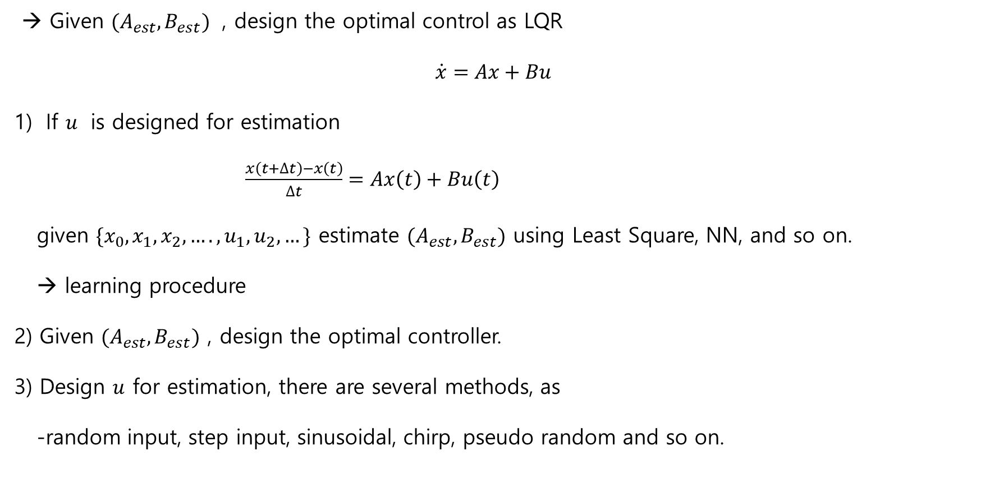
Review: Identification (Estimation) of (A,B)
→ Given ${(A}_{est}, B_{est})$ , design the optimal control as LQR
$$\dot{x}=Ax+Bu$$
If $u$ is designed for estimation
$\frac{x\left(t+∆t\right)−x\left(t\right)}{∆t}=Ax\left(t\right)+Bu\left(t\right)$
given $\{x_{0}, x_{1}, x_{2},…., u_{1}, u_{2},…\}$ estimate $(A_{est},B_{est})$ using Least Square, NN, and so on.
→ learning procedure
2) Given $(A_{est}, B_{est})$ , design the optimal controller.
3) Design $u$ for estimation, there are several methods, as
-random input, step input, sinusoidal, chirp, pseudo random and so on.

Slide 7

Review – Identification)
ModelFree_Identification_LS_0320.mlx (DeepSeek)
2nd order linear system
Sampling time $dt$ : 0.0.1
Identification duration : (1000)($dt$)
Least Square:
A_true = [0 1; -1 -0.5]; B_true = [0; 1];
A_est =
-0.0045 0.9983
-0.8988 -0.3336
B_est =
0.0002
0.0355

Slide 8
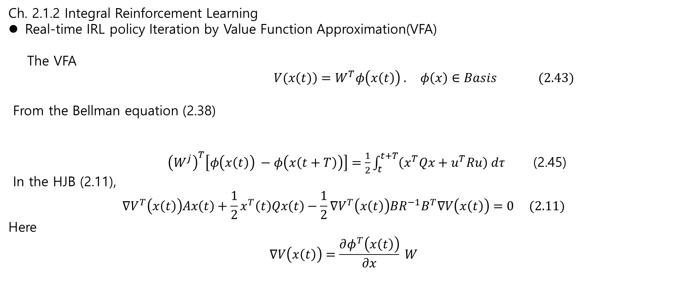
Review – value function approximation
Ch. 2.1.2 Integral Reinforcement Learning
Real-time IRL policy Iteration by Value Function Approximation(VFA)
The VFA
$V(x\left(t)\right)=W^{T}φ\left(x\left(t\right)\right) . φ\left(x\right)∈Basis (2.43)$
From the Bellman equation (2.38)
${\left(W^{j}\right)}^{T}\left[φ\left(x\left(t\right)\right) −φ\left(x\left(t+T\right)\right)\right]=\frac{1}{2}\int_{t}^{t+T}{\left(x^{T}Qx+u^{T}Ru\right) dτ}$ (2.45)
In the HJB (2.11),
$$∇V^{T}\left(x\left(t\right)\right)Ax\left(t\right)+\frac{1}{2}x^{T}\left(t\right)Qx\left(t\right)−\frac{1}{2}∇V^{T}\left(x\left(t\right)\right)BR^{−1}B^{T}∇V\left(x\left(t\right)\right)=0 (2.11)$$
Here
$$∇V\left(x\left(t\right)\right)=\frac{∂φ^{T}\left(x\left(t\right)\right)}{∂x} W$$

Slide 9
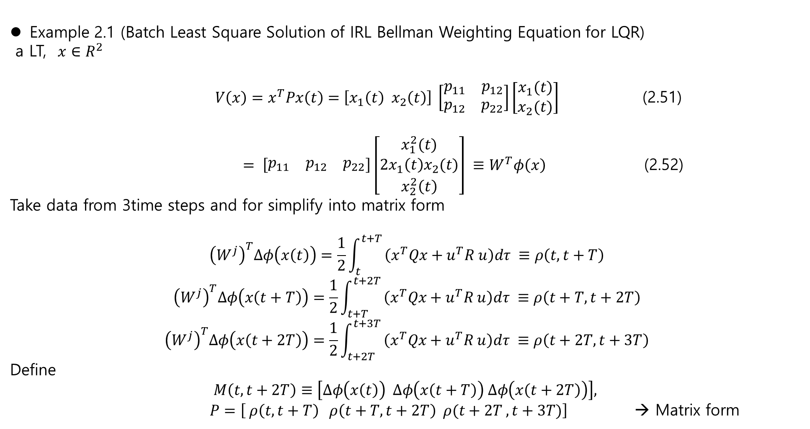
Review
Example 2.1 (Batch Least Square Solution of IRL Bellman Weighting Equation for LQR)
a LT, $x∈R^{2}$
$V\left(x\right)=x^{T}Px\left(t\right)=\left[x_{1}\left(t\right) x_{2}\left(t\right)\right] \left[\begin{matrix}p_{11} & p_{12} \\ p_{12} & p_{22}\end{matrix}\right]\left[\begin{matrix}x_{1}(t) \\ x_{2}(t)\end{matrix}\right]$ (2.51)
$= \left[\begin{matrix}p_{11} & p_{12} & p_{22}\end{matrix}\right]\left[\begin{matrix}x_{1}^{2}(t) \\ 2x_{1}\left(t\right)x_{2}(t) \\ x_{2}^{2}\left(t\right)\end{matrix}\right] ≡W^{T}φ\left(x\right)$ (2.52)
Take data from 3time steps and for simplify into matrix form
$${\left(W^{j}\right)}^{T}∆φ\left(x\left(t\right)\right)=\frac{1}{2}\int_{t}^{t+T }{\left(x^{T}Qx+u^{T}R u\right)dτ ≡ρ\left(t, t+T\right)}$$
$${\left(W^{j}\right)}^{T}∆φ\left(x\left(t+T\right)\right)=\frac{1}{2}\int_{t+T}^{t+2T }{\left(x^{T}Qx+u^{T}R u\right)dτ ≡ρ\left(t+T, t+2T\right)}$$
$${\left(W^{j}\right)}^{T}∆φ\left(x\left(t+2T\right)\right)=\frac{1}{2}\int_{t+2T}^{t+3T }{\left(x^{T}Qx+u^{T}R u\right)dτ ≡ρ\left(t+2T, t+3T\right)}$$
Define
$$M\left(t,t+2T\right)≡\left[∆φ\left(x\left(t\right)\right) ∆φ\left(x\left(t+T\right)\right) ∆φ\left(x\left(t+2T\right)\right)\right],$$
$P=\left[ ρ\left(t, t+T\right) ρ\left(t+T, t+2T\right) ρ(t+2T , t+3T)\right]$ → Matrix form

Slide 10
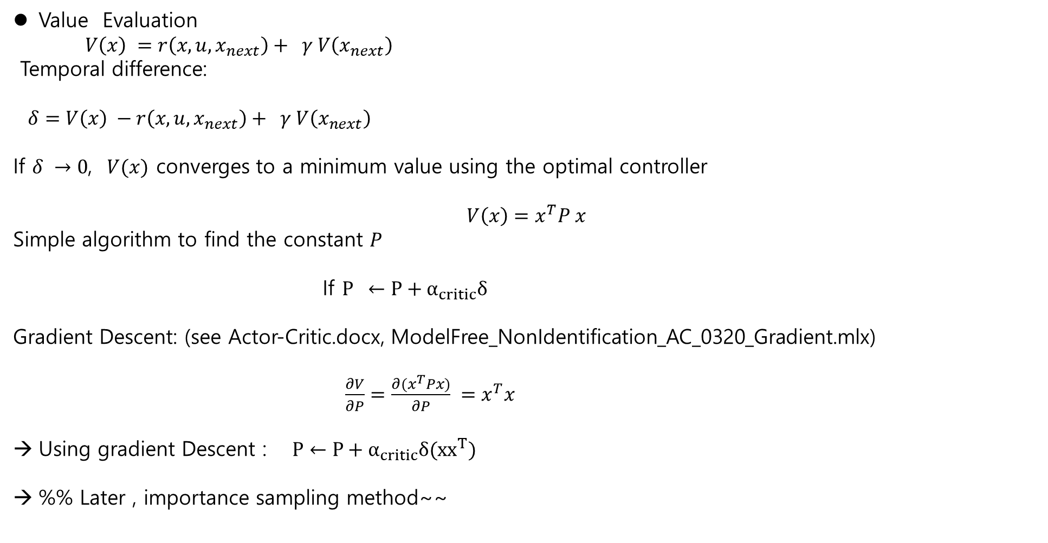
Review – DeepSeek
Value Evaluation
$V\left(x\right) =r\left(x,u,x_{next}\right)+ γ V\left(x_{next}\right)$
Temporal difference:
$δ=V\left(x\right) −r\left(x,u,x_{next}\right)+ γ V\left(x_{next}\right)$
If $δ →0$, $V(x)$ converges to a minimum value using the optimal controller
$$V\left(x\right)=x^{T}P x$$
Simple algorithm to find the constant $P$
If $P ←P+α_{critic}δ$
Gradient Descent: (see Actor-Critic.docx, ModelFree_NonIdentification_AC_0320_Gradient.mlx)
$\frac{∂V}{∂P}=\frac{∂{(x}^{T}Px)}{∂P} =x^{T}x$
Using gradient Descent : $P←P+α_{critic}δ(xx^{T})$
%% Later , importance sampling method~~

Slide 11
2.2 Inverse Optimal Control for Continuous-Time Systems
Given a trajectory / behavior ( by an experts), the learner imitates the behavior
- by reconstructing the experts unknown underlying performance index
- subsequently computing an optimal policy
→ Imitation RL

Slide 12
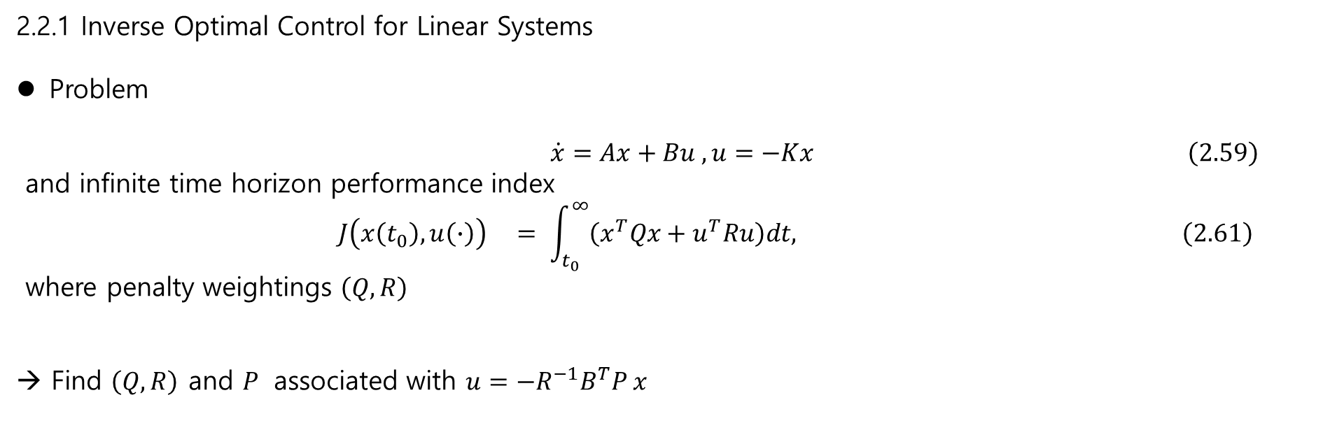
2.2.1 Inverse Optimal Control for Linear Systems
Problem
$\dot{x}=Ax+Bu , u=−Kx \left(2.59\right)$
and infinite time horizon performance index
$$J\left(x\left(t_{0}\right), u\left(∙\right)\right) = \int_{t_{0}}^{∞}{\left(x^{T}Qx+u^{T}Ru\right)dt, \left(2.61\right) }$$
where penalty weightings $\left(Q,R\right)$
→ Find $\left(Q,R\right)$ and $P$ associated with $u=−R^{−1}B^{T}P x$

Slide 13
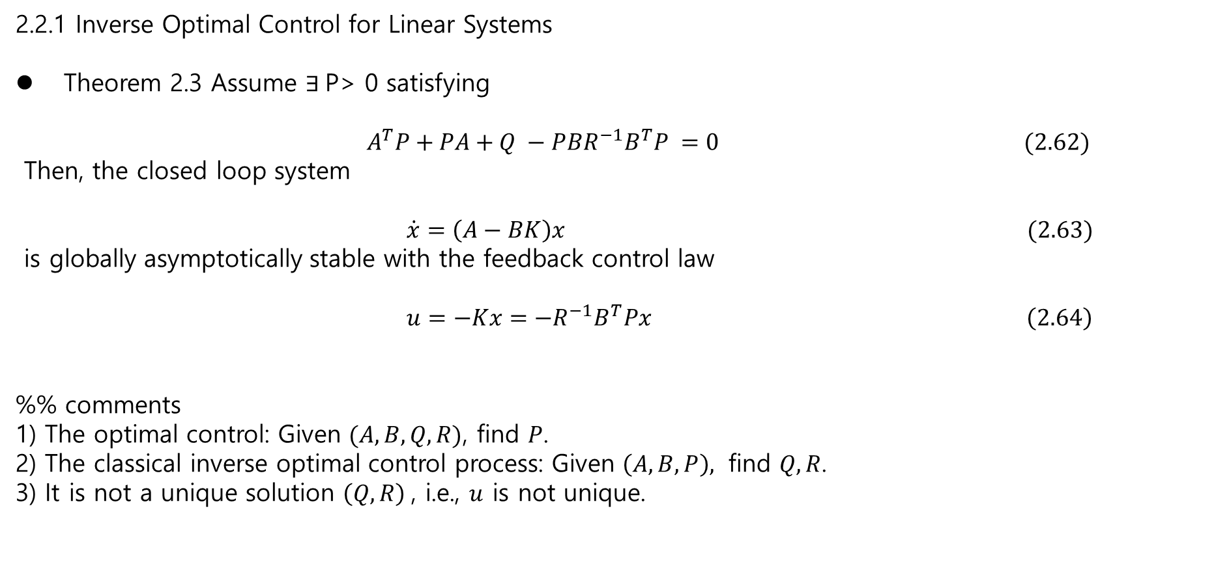
2.2.1 Inverse Optimal Control for Linear Systems
Theorem 2.3 Assume $∃$P> 0 satisfying
${ A}^{T}P+PA+Q −PBR^{−1}B^{T}P =0 (2.62)$
Then, the closed loop system
$\dot{x}=\left(A−BK\right)x (2.63)$
is globally asymptotically stable with the feedback control law
$u=−Kx=−R^{−1}B^{T}Px \left(2.64\right)$
%% comments
1) The optimal control: Given $(A,B,Q,R)$, find $P$.
2) The classical inverse optimal control process: Given $\left(A,B,P\right),$ find $Q, R$.
3) It is not a unique solution $\left(Q,R\right)$, i.e., $u$ is not unique.

