Slide 1
Reinforcement Learning for Feedback control
RL: related to Optimal control problem
Optimal Control :
-offline designed by HJB under complete known system dynamics
-in case: finite horizon: backward-in-time to Bellman equation
→infinite time horizon: Optimal gain is constant (LQR)
Integral RL for control :
-online optimal control in continuous time system for feedback control
-unknown system dynamics completely or partially(hybrid)
→ need learning procedure(policy) with observing states and control data
-(generally) infinite time horizon: forward-in-time to Bellman equation

Slide 2
Reinforcement Learning for Feedback control
Inverse optimal control:
- offline with complete knowledge of the system dynamics
- given a control input, determine the performance functions
Inverse RL:
- online learning
- reconstruct the performance(reward) function based on optimal behaviors( expert?)

Slide 3
Reinforcement Learning for Feedback control
Advantages of IntRL
If system parameters are unknown
- Relax modelling / adaptation to Uncertainty
- intractable analytic solution may be handled by RL
- even if partially measurements (output feedback), IntRL controller design is associated to
optimize full states performance index
(* optimal controller with output feedback is not simple as the state feedback
→ Kalman’s observer is possible to design state feedback even if partially measurement)
Limitation of IntRL
- learning procedure are needed, which are complex.
- should be real time calculated over time evolution
- uncontrollable states which are unstable can not be stabilized any controller.

Slide 4
Ch.2 Background on integral RL and inverse RL for Feedback Control
2.1 Integral Reinforcement Learning for continuous-time system
LQR
design control is a backward-in-time problem (Riccati Equation), full knowledge of the system dynamic
stability, optimality, robustness (infinite gain margin, 60 degree of phase margin)
Matrix quadratic design procedure
system dynamics description fully known
e.g. aircraft control: wind tunnel tests for system identification
→ state feedback
→ if all states are not available, states estimators are designed(Kalman’s observer)

Slide 5

Ch. 2.1.1 Linear Quadratic Regulator
Plant:
$$\dot{x}=Ax+Bu,x∈R^{n}, u∈R^{m} \left(2.1\right)$$
Infinite horizon quadratic performance index
$$J\left(x\left(t_{0}\right), u\left(∙\right)\right)=\frac{1}{2}\int_{t_{0}}^{∞}{\left(x^{T}Qx+u^{T}Ru\right)dτ}, Q=Q^{T}, R=R^{T} (2.2)$$
Optimal Control Problem
Find $u\left(t\right)=−Kx$ to minimize the performance index $J$

Slide 6
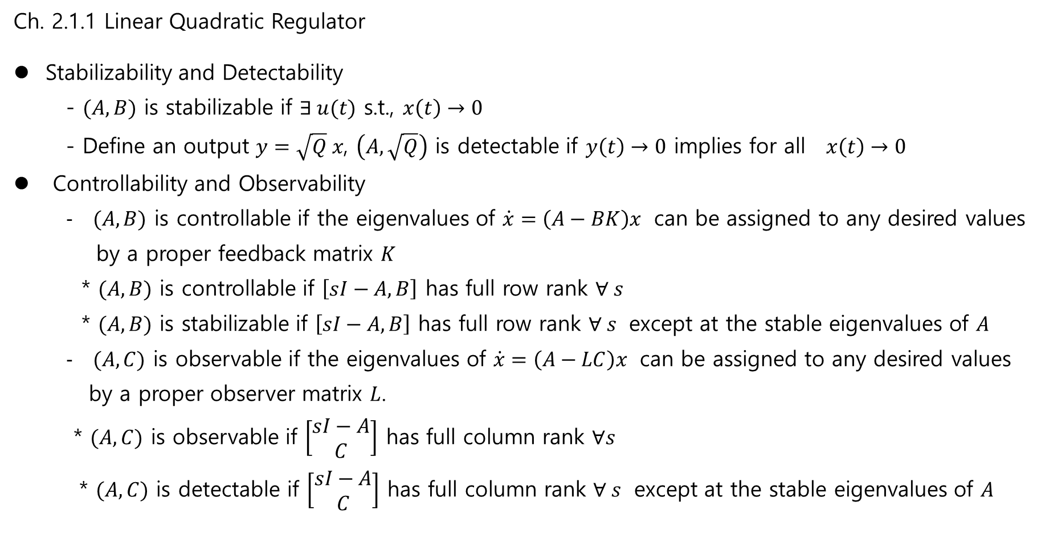
Ch. 2.1.1 Linear Quadratic Regulator
Stabilizability and Detectability
- $(A,B)$ is stabilizable if $∃ u(t)$ s.t., $x\left(t\right)→0$
- Define an output $y=\sqrt{Q} x$, $\left(A, \sqrt{Q}\right)$ is detectable if $y\left(t\right)→0$ implies for all $x\left(t\right)→0$
Controllability and Observability
$(A,B)$ is controllable if the eigenvalues of $\dot{x}=\left(A−BK\right)x$ can be assigned to any desired values
by a proper feedback matrix $K$
* $(A,B)$ is controllable if $\left[sI−A,B\right]$ has full row rank $∀ s$
* $(A,B)$ is stabilizable if $\left[sI−A,B\right]$ has full row rank $∀ s$ except at the stable eigenvalues of $A$
$(A,C)$ is observable if the eigenvalues of $\dot{x}=\left(A−LC\right)x$ can be assigned to any desired values
by a proper observer matrix $L$.
* $(A,C)$ is observable if $\left[\begin{matrix}sI−A \\ C\end{matrix}\right]$ has full column rank $∀s$
* $(A,C)$ is detectable if $\left[\begin{matrix}sI−A \\ C\end{matrix}\right]$ has full column rank $∀ s$ except at the stable eigenvalues of $A$

Slide 7
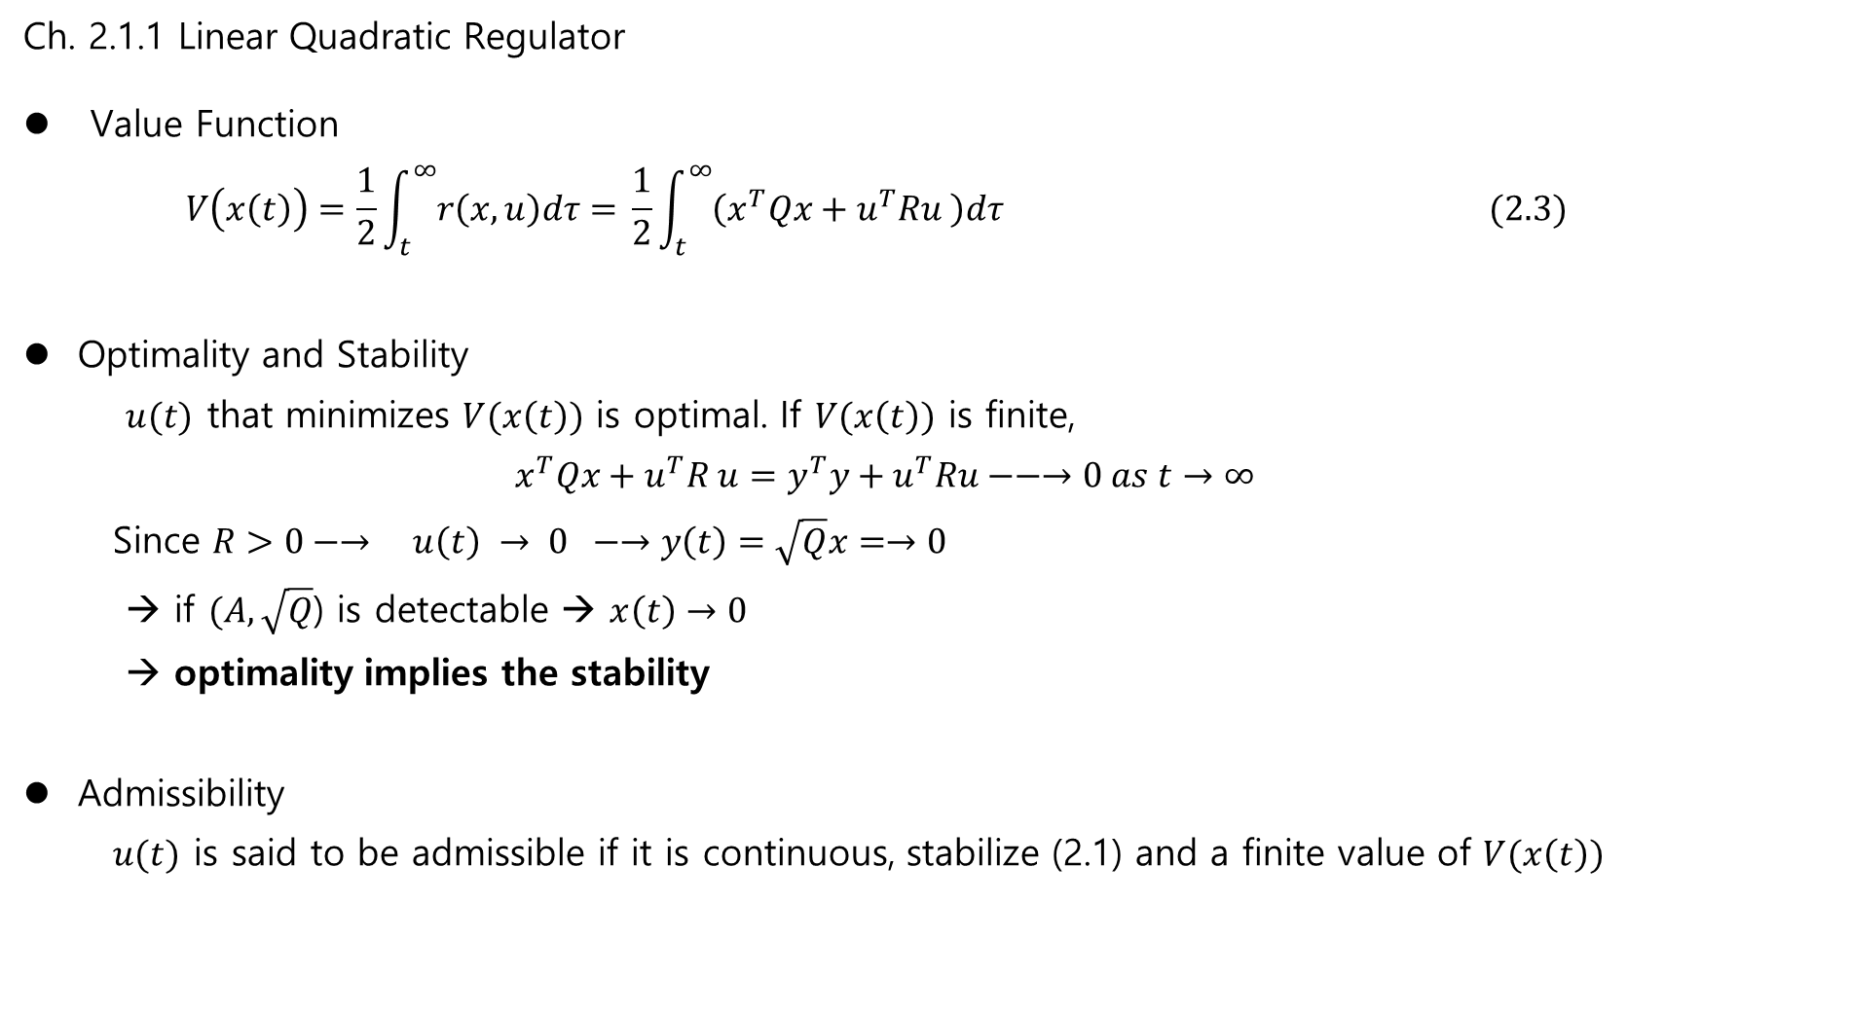
Ch. 2.1.1 Linear Quadratic Regulator
Value Function
$$V\left(x\left(t\right)\right)=\frac{1}{2}\int_{t}^{∞}{r\left(x,u\right)dτ= }\frac{1}{2}\int_{t}^{∞}{\left(x^{T}Qx+u^{T}Ru \right)dτ} (2.3)$$
Optimality and Stability
$u(t)$ that minimizes $V(x\left(t\right))$ is optimal. If $V(x\left(t\right))$ is finite,
$$x^{T}Qx+u^{T}R u=y^{T}y+u^{T}Ru−−→0 as t→∞$$
Since $R>0−→ u\left(t\right) → 0 −→y\left(t\right)=\sqrt{Q}x=→0$
→ if $(A, \sqrt{Q}$) is detectable → $x\left(t\right)→0$
→ optimality implies the stability
Admissibility
$u(t)$ is said to be admissible if it is continuous, stabilize (2.1) and a finite value of $V(x\left(t\right))$

Slide 8
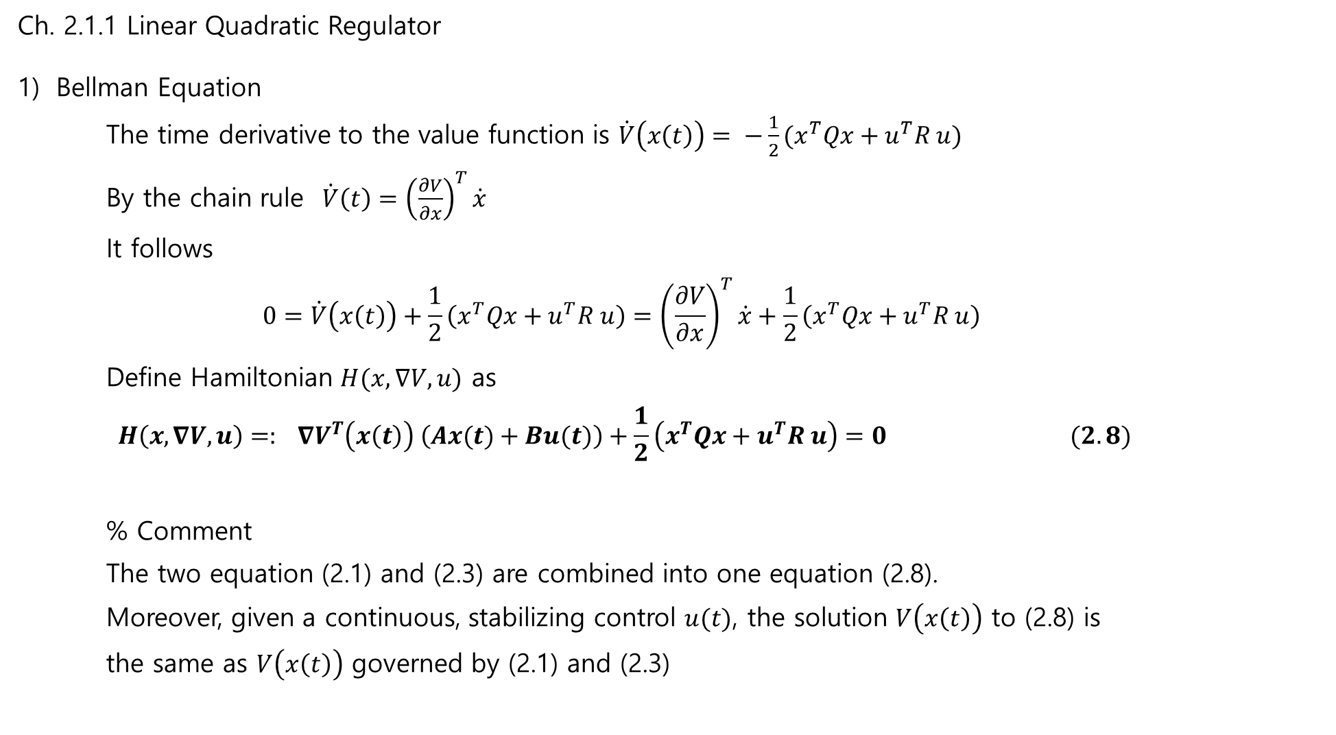
Ch. 2.1.1 Linear Quadratic Regulator
Bellman Equation
The time derivative to the value function is $\dot{V}\left(x\left(t\right)\right)= −\frac{1}{2}(x^{T}Qx+u^{T}R u)$
By the chain rule $\dot{V}\left(t\right)={\left(\frac{∂V}{∂x}\right)}^{T}\dot{x}$
It follows
$$0=\dot{V}\left(x\left(t\right)\right)+\frac{1}{2}\left(x^{T}Qx+u^{T}R u\right)={\left(\frac{∂V}{∂x}\right)}^{T}\dot{x}+\frac{1}{2}\left(x^{T}Qx+u^{T}R u\right)$$
Define Hamiltonian $H(x, ∇V,u)$ as
$$H\left(x, ∇V,u\right)=: ∇V^{T}\left(x\left(t\right)\right) \left(Ax(t)+Bu(t)\right)+\frac{1}{2}\left(x^{T}Qx+u^{T}R u\right)=0 (2.8)$$
% Comment
The two equation (2.1) and (2.3) are combined into one equation (2.8).
Moreover, given a continuous, stabilizing control $u(t)$, the solution $V\left(x\left(t\right)\right)$ to (2.8) is
the same as $V\left(x\left(t\right)\right)$ governed by (2.1) and (2.3)

Slide 9
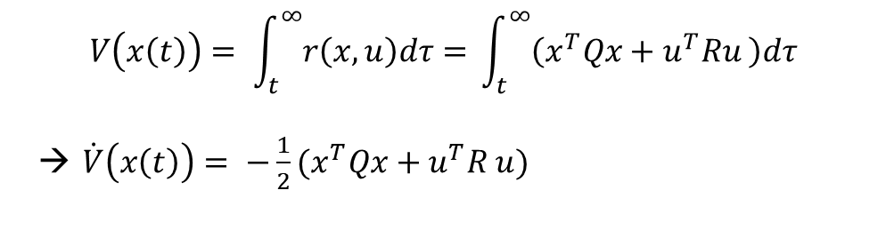
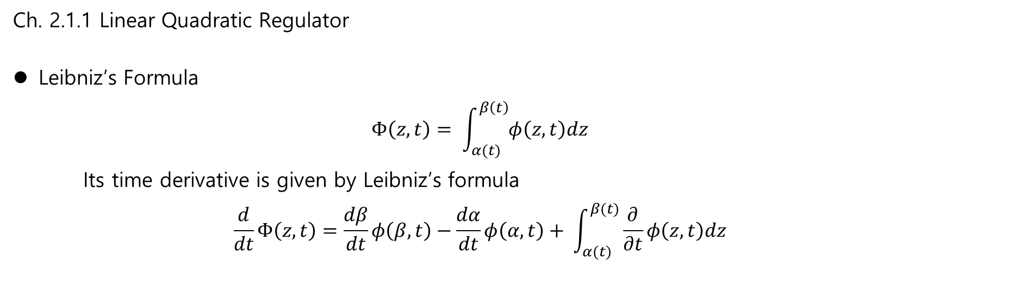
Ch. 2.1.1 Linear Quadratic Regulator
Leibniz’s Formula
$$Φ\left(z,t\right)= \int_{α(t)}^{β\left(t\right)}{φ\left(z,t\right)dz}$$
Its time derivative is given by Leibniz’s formula
$$\frac{d}{dt}Φ\left(z,t\right)=\frac{dβ}{dt}φ\left(β,t\right)−\frac{dα}{dt}φ\left(α,t\right)+ \int_{α(t)}^{β(t)}{\frac{∂}{∂t}φ\left(z,t\right)dz}$$
$$V\left(x\left(t\right)\right)= \int_{t}^{∞}{r\left(x,u\right)dτ= }\int_{t}^{∞}{\left(x^{T}Qx+u^{T}Ru \right)dτ}$$
→ $\dot{V}\left(x\left(t\right)\right)= −\frac{1}{2}(x^{T}Qx+u^{T}R u)$

Slide 10
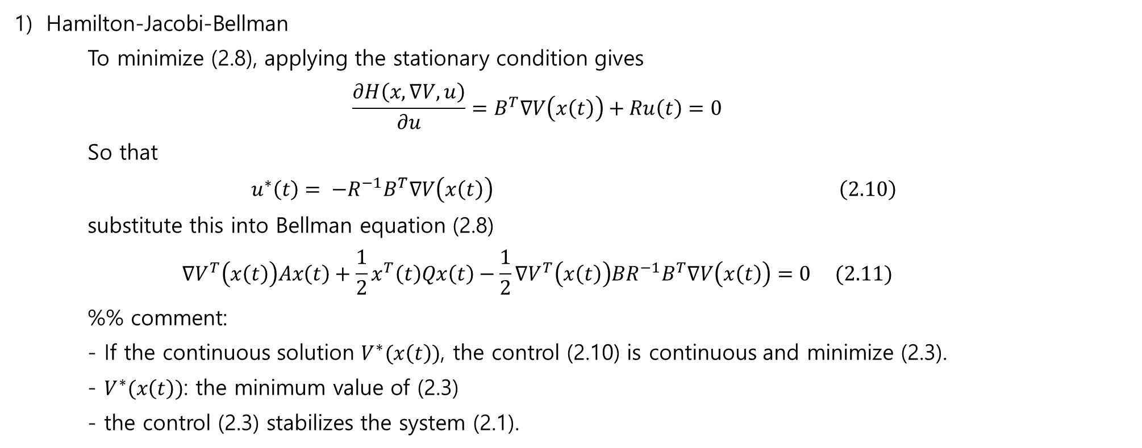
Ch. 2.1.1 Linear Quadratic Regulator
Hamilton-Jacobi-Bellman
To minimize (2.8), applying the stationary condition gives
$$\frac{∂H\left(x, ∇V,u\right)}{∂u}=B^{T}∇V\left(x\left(t\right)\right)+Ru\left(t\right)=0$$
So that
$u^{∗}\left(t\right)= −R^{−1}B^{T}∇V\left(x\left(t\right)\right) \left(2.10\right)$
substitute this into Bellman equation (2.8)
$$∇V^{T}\left(x\left(t\right)\right)Ax\left(t\right)+\frac{1}{2}x^{T}\left(t\right)Qx\left(t\right)−\frac{1}{2}∇V^{T}\left(x\left(t\right)\right)BR^{−1}B^{T}∇V\left(x\left(t\right)\right)=0 (2.11)$$
%% comment:
- If the continuous solution $V^{∗}(x\left(t\right))$, the control (2.10) is continuous and minimize (2.3).
- $V^{∗}(x\left(t\right))$: the minimum value of (2.3)
- the control (2.3) stabilizes the system (2.1).

Slide 11
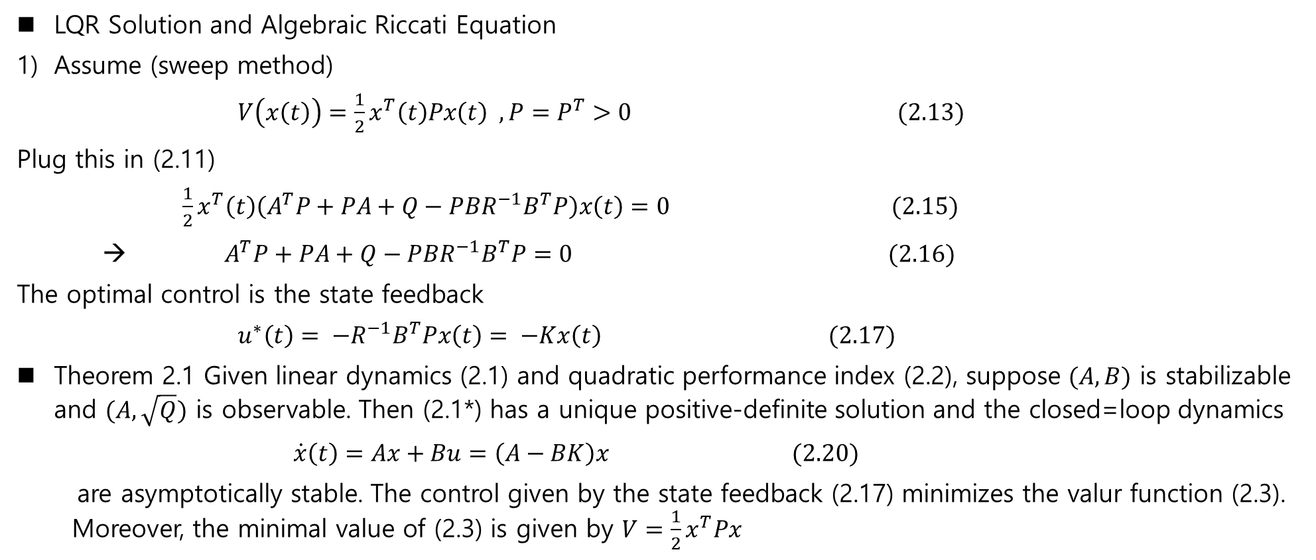
Ch. 2.1.1 Linear Quadratic Regulator
LQR Solution and Algebraic Riccati Equation
Assume (sweep method)
$V\left(x\left(t\right)\right)=\frac{1}{2}x^{T}\left(t\right)Px\left(t\right) , P=P^{T}>0 (2.13)$
Plug this in (2.11)
$\frac{1}{2}x^{T}\left(t\right)\left(A^{T}P+PA+Q−PBR^{−1}B^{T}P\right)x\left(t\right)=0 (2.15)$
→ $A^{T}P+PA+Q−PBR^{−1}B^{T}P=0 (2.16)$
The optimal control is the state feedback
$u^{∗}\left(t\right)= −R^{−1}B^{T}Px\left(t\right)= −Kx\left(t\right) (2.17)$
Theorem 2.1 Given linear dynamics (2.1) and quadratic performance index (2.2), suppose $(A,B)$ is stabilizable and $(A, \sqrt{Q})$ is observable. Then (2.1*) has a unique positive-definite solution and the closed=loop dynamics
$\dot{x}\left(t\right)=Ax+Bu=\left(A−BK\right)x (2.20)$
are asymptotically stable. The control given by the state feedback (2.17) minimizes the valur function (2.3). Moreover, the minimal value of (2.3) is given by $V=\frac{1}{2}x^{T}Px$

Slide 12
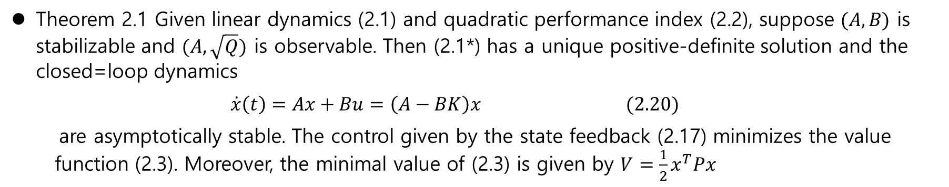
Ch. 2.1.1 Linear Quadratic Regulator
Theorem 2.1 Given linear dynamics (2.1) and quadratic performance index (2.2), suppose $(A,B)$ is stabilizable and $(A, \sqrt{Q})$ is observable. Then (2.1*) has a unique positive-definite solution and the closed=loop dynamics
$\dot{x}\left(t\right)=Ax+Bu=\left(A−BK\right)x (2.20)$
are asymptotically stable. The control given by the state feedback (2.17) minimizes the value function (2.3). Moreover, the minimal value of (2.3) is given by $V=\frac{1}{2}x^{T}Px$

Slide 13
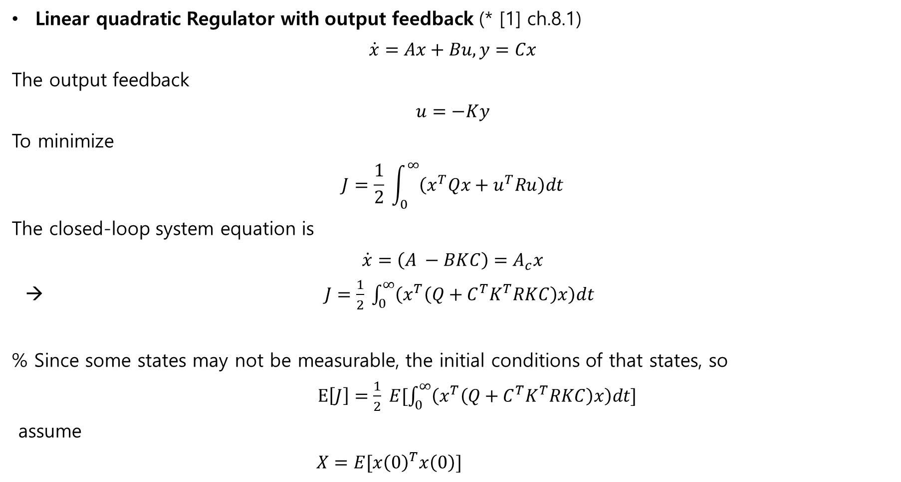
% LQR with output feedback
Linear quadratic Regulator with output feedback (* [1] ch.8.1)
$$\dot{x}=Ax+Bu, y=Cx$$
The output feedback
$$u=−Ky$$
To minimize
$$J=\frac{1}{2} \int_{0}^{∞}{\left(x^{T}Qx+u^{T}Ru\right)dt}$$
The closed-loop system equation is
$$\dot{x}=\left(A −BKC\right)=A_{c}x$$
→ $J=\frac{1}{2} \int_{0}^{∞}{\left(x^{T}\left(Q+C^{T}K^{T}RKC\right)x\right)dt}$
% Since some states may not be measurable, the initial conditions of that states, so
$E\left[J\right]=\frac{1}{2} E[\int_{0}^{∞}{\left(x^{T}\left(Q+C^{T}K^{T}RKC\right)x\right)dt]}$
assume
$X=E[x{\left(0\right)}^{T}x\left(0\right)]$

Slide 14
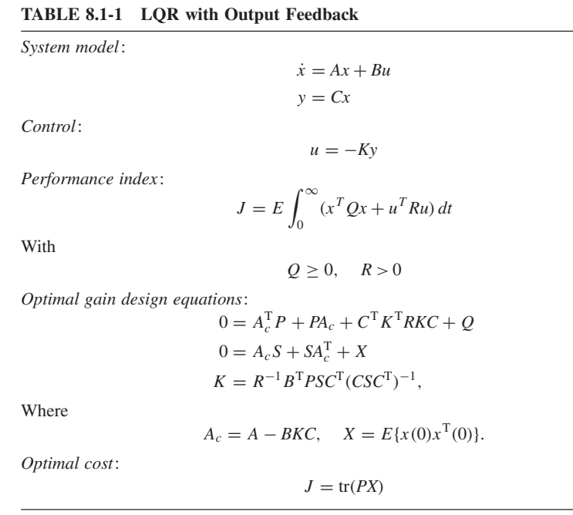
Ch.2 Background on integral RL and inverse RL for Feedback Control
This is the necessary and sufficient condition for the output feedback optimal controller
What conditions are guarantee to have the optimal controller?
Others..

