Slide 1
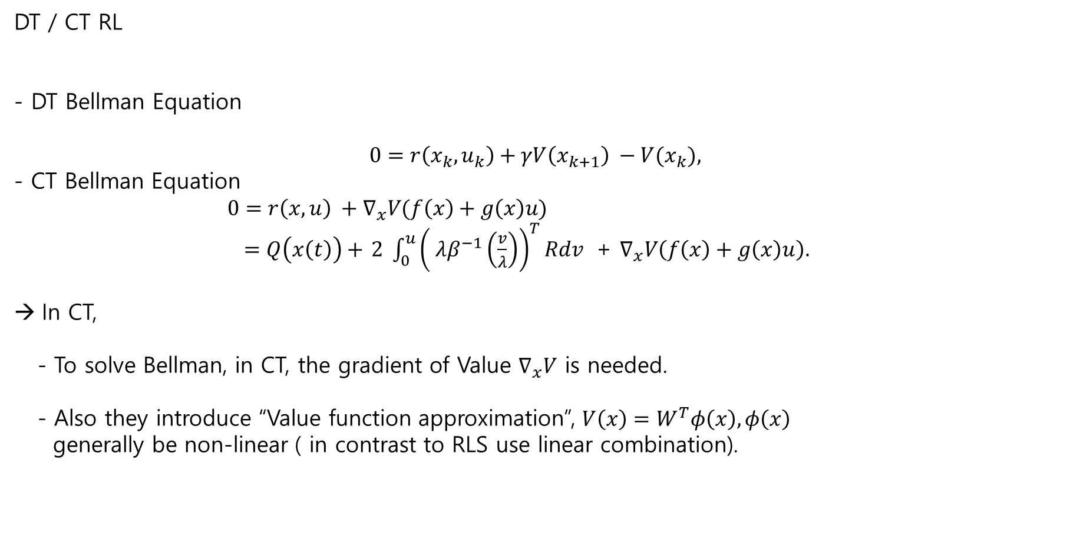
DT / CT RL
- DT Bellman Equation
$$0=r\left(x_{k}, u_{k}\right)+γV\left(x_{k+1}\right) −V(x_{k}),$$
- CT Bellman Equation
$0=r\left(x, u\right) +∇_{x}V(f\left(x\right)+g\left(x\right)u)$
$=Q\left(x\left(t\right)\right)+$ $2 \int_{0}^{u}{{\left( λβ^{−1}\left(\frac{v}{λ}\right)\right)}^{T}Rdv }$ + $∇_{x}V\left(f\left(x\right)+g\left(x\right)u\right).$
In CT,
- To solve Bellman, in CT, the gradient of Value $∇_{x}V$ is needed.
- Also they introduce “Value function approximation”, $V\left(x\right)=W^{T}φ\left(x\right), φ\left(x\right)$
generally be non-linear ( in contrast to RLS use linear combination).

Slide 2
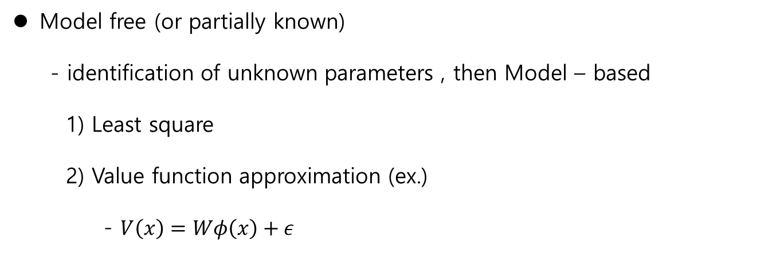
Model free (or partially known)
- identification of unknown parameters , then Model – based
1) Least square
2) Value function approximation (ex.)
- $V\left(x\right)=Wφ\left(x\right)+ε$

Slide 3
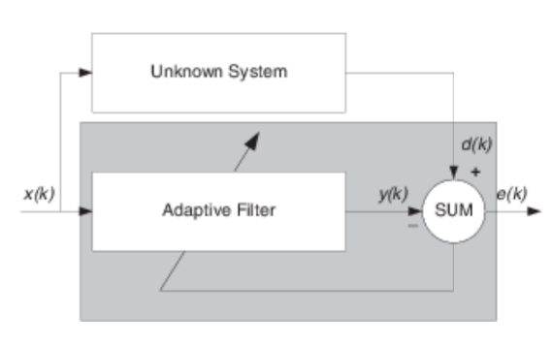
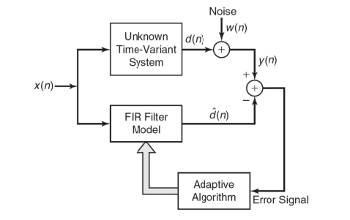
Adaptive Filter
Concerning about a Model Free system
Unknown system: a linear system with time-varying coefficient,
$$d\left(n\right)=x\left(n\right)w_{0}+x\left(n−1\right)w_{1}+…+x\left(n−l\right)w_{l}+noise \left(n\right) =x^{T}\left(n\right)w+noise \left(n\right),$$

Slide 4

Modelling – Recursive Least Square
$$d\left(n\right)=x\left(n\right)w_{0}+x\left(n−1\right)w_{1}+…+x\left(n−l\right)w_{l}+noise (n) \\ =x^{T}\left(n\right)w+noise \left(n\right),$$
$d:$ a desired signal,
$x\left(n\right)=[x\left(n\right), x\left(n−1\right),…,x\left(n−l\right)]$: input vector at time n,
$w={\left[w_{0}, w_{1},…, w_{l}\right]}^{T}$: filter coefficients to estimate.
As
$$e\left[n\right]=d\left[n\right]−\hat{d}\left[n\right]=d\left[n\right]−w^{T}x\left[n\right].$$
- Objective: find $w$, which is time-varying
$$J\left(n\right)= \sum_{i=1}^{n}{λ^{n−i}}{\left(d\left(i\right)−w^{T}x[i]\right)}^{2},$$
$λ:$ the forgetting factor ($0<λ≤1 ).$

Slide 5
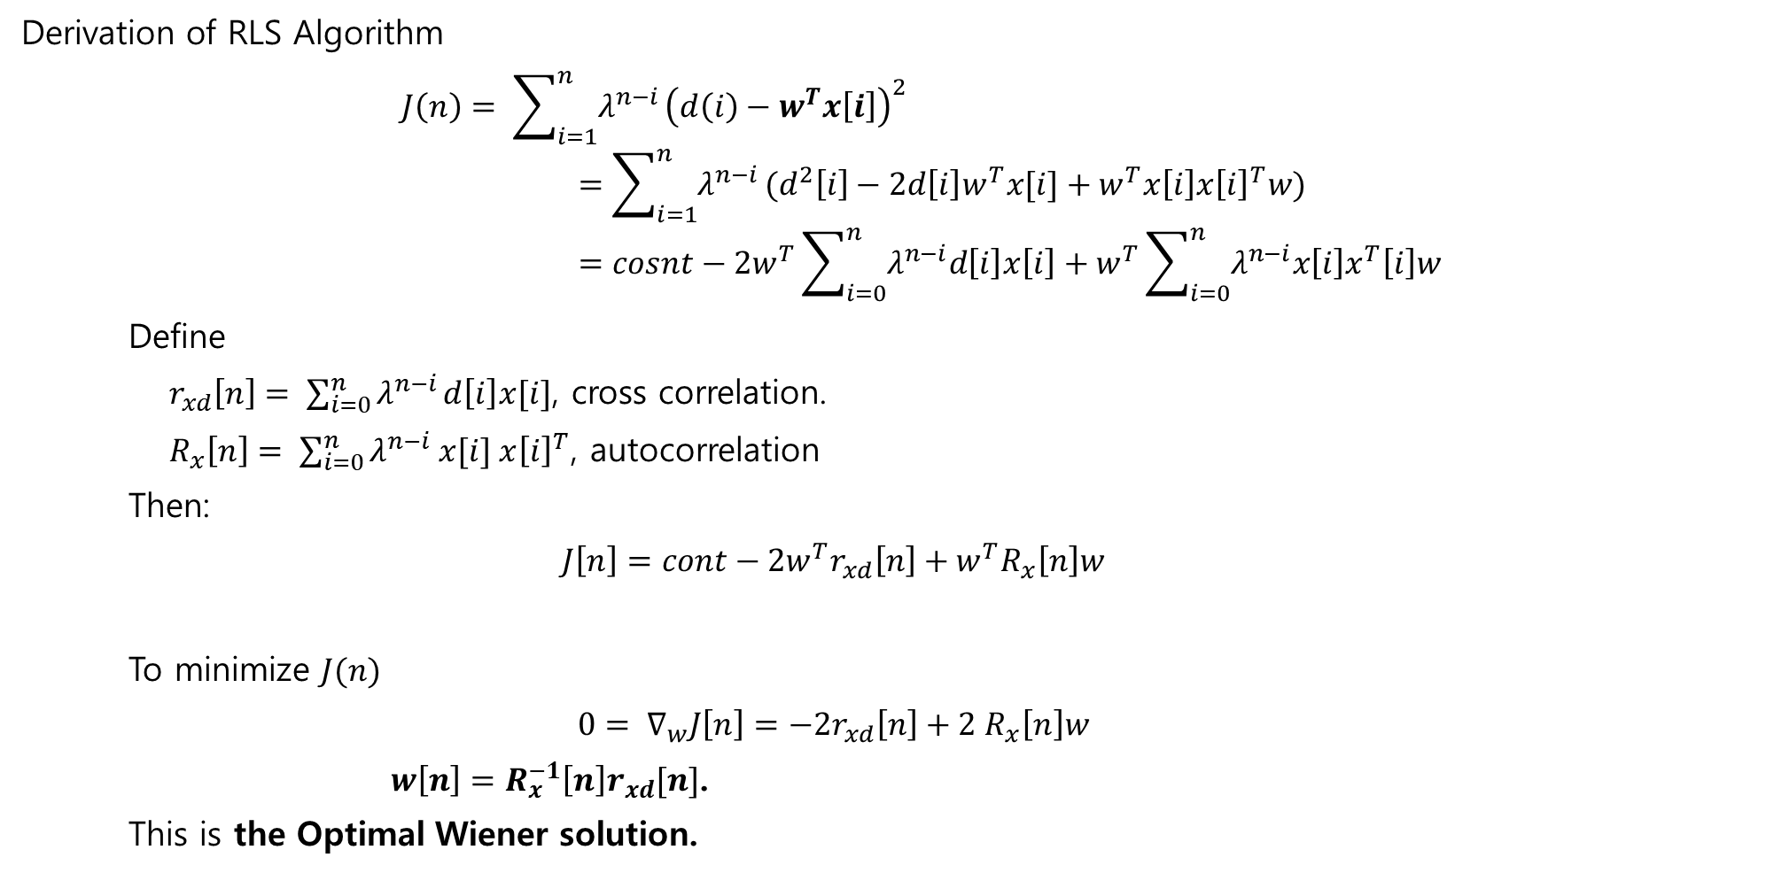
Derivation of RLS Algorithm
$$J\left(n\right)= \sum_{i=1}^{n}{λ^{n−i}}{\left(d\left(i\right)−w^{T}x\left[i\right]\right)}^{2} \\ =\sum_{i=1}^{n}{λ^{n−i}}(d^{2}\left[i\right]−2d\left[i\right]w^{T}x[i]+w^{T}x\left[i\right]x{\left[i\right]}^{T}w) \\ =cosnt−2w^{T}\sum_{i=0}^{n}{λ^{n−i}d\left[i\right]x\left[i\right]}+w^{T}\sum_{i=0}^{n}{λ^{n−i}x\left[i\right]x^{T}\left[i\right]w}$$
Define
$r_{xd}\left[n\right]= \sum_{i=0}^{n}{λ^{n−i}}d\left[i\right]x[i]$, cross correlation.
$R_{x}\left[n\right]= \sum_{i=0}^{n}{λ^{n−i} x[i] x{\left[i\right]}^{T}}$, autocorrelation
Then:
$$J\left[n\right]=cont−2w^{T}r_{xd}\left[n\right]+w^{T}R_{x}\left[n\right]w$$
To minimize $J(n)$
$$0= ∇_{w}J\left[n\right]=−2r_{xd}\left[n\right]+2 R_{x}\left[n\right]w$$
$w\left[n\right]=R_{x}^{−1}\left[n\right]r_{xd}[n]$.
This is the Optimal Wiener solution.

Slide 6

RLS- Recursive
Recursive method
Define
$P\left[n\right]=R_{x}^{−1}[n]$.
By Definition
$$R_{x}\left[n\right]=λR_{x}\left[n−1\right]+x\left[n\right]x^{T}\left[n\right].$$
The inverse is
$P\left[n\right]=R_{x}^{−1}\left[n\right]={\left(λR_{x}\left[n−1\right]+x\left[n\right]x^{T}\left[n\right]\right)}^{−1}$.
Using the matrix Inversion formula
$$P\left[n\right]=λ^{−1}\left(P\left[n−1\right]−k\left[n\right]x^{T}P\left[n−1\right]\right).$$
Where
$$k\left[n\right]=\frac{P\left[n−1\right]x\left[n\right]}{λ+x^{T}\left[n\right]P\left[n−1\right]x\left[n\right]},$$
Which is called Kalman Gain.

Slide 7

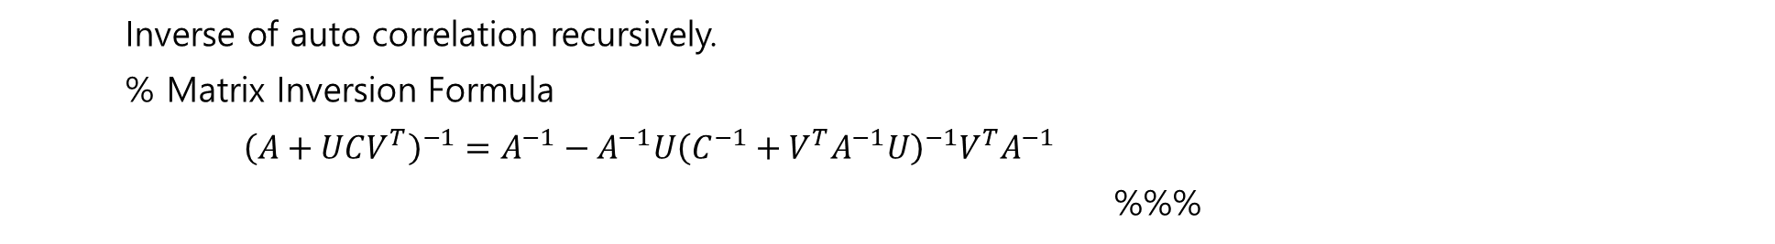
Inverse of auto correlation recursively.
% Matrix Inversion Formula
${\left(A+UCV^{T}\right)}^{−1}=A^{−1}−A^{−1}U{\left(C^{−1}+V^{T}A^{−1}U\right)}^{−1}V^{T}A^{−1}$
%%%
To get the inverse of
$P\left[n\right]=R_{x}^{−1}\left[n\right]={\left(λR_{x}\left[n−1\right]+x\left[n\right]x^{T}\left[n\right]\right)}^{−1}$.
Let:
$A=λR_{x}\left[n−1\right]=λP^{−1}\left[n−1\right],$
$U=x\left[n\right],$
$C=I$,
$V=x\left[n\right].$
Then
$$P\left[n\right]=λ^{−1}\left(P\left[n−1\right]− \frac{P\left[n−1\right]x\left[n\right]x^{T}\left[n\right]P\left[n−1\right]}{λ+x^{T}P\left[n−1\right]x\left[n\right]} \right)$$

Slide 8
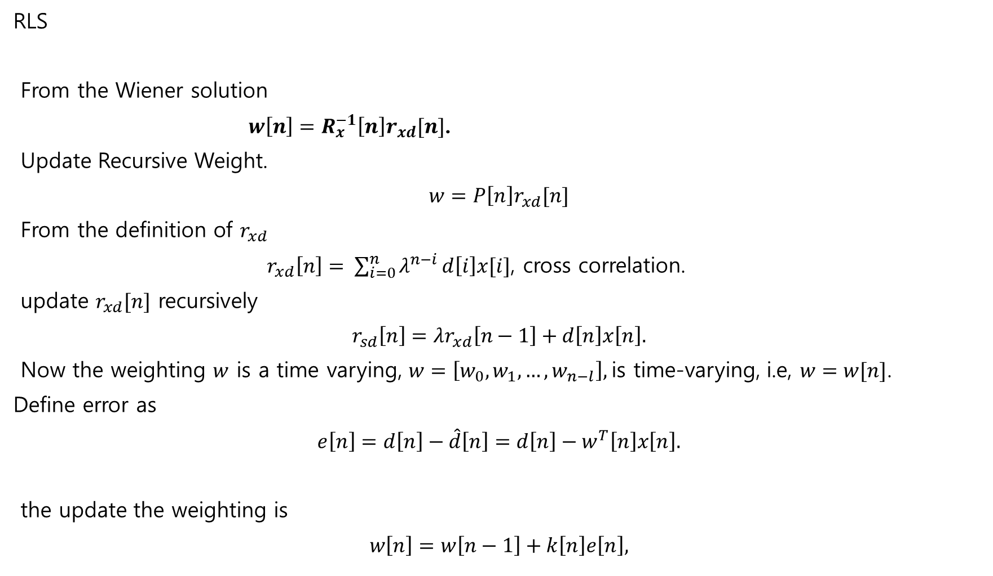
RLS
From the Wiener solution
$w\left[n\right]=R_{x}^{−1}\left[n\right]r_{xd}[n]$.
Update Recursive Weight.
$$w=P\left[n\right]r_{xd}[n]$$
From the definition of $r_{xd}$
$r_{xd}\left[n\right]= \sum_{i=0}^{n}{λ^{n−i}}d\left[i\right]x[i]$, cross correlation.
update $r_{xd}[n]$ recursively
$$r_{sd}\left[n\right]=λr_{xd}\left[n−1\right]+d\left[n\right]x\left[n\right].$$
Now the weighting $w$ is a time varying, $w=\left[w_{0}, w_{1}, …, w_{n−l}\right],$is time-varying, i.e, $w=w[n]$.
Define error as
$$e\left[n\right]=d\left[n\right]−\hat{d}\left[n\right]=d\left[n\right]−w^{T}\left[n\right]x\left[n\right].$$
the update the weighting is
$$w\left[n\right]=w\left[n−1\right]+k\left[n\right]e\left[n\right],$$

Slide 9

Summary of RLS
1. Filter Output:
$\hat{d}\left[n\right]=w^{T}\left[n−1\right]x[n]$.
2. Error:
$e\left[n\right]=d\left[n\right] − \hat{d}[n]$.
3. Kalman Gain:
$$k\left[n\right]=\frac{P\left[n−1\right]x\left[n\right]}{λ+x^{T}\left[n\right]P\left[n−1\right]x\left[n\right]}.$$
4.Weighting Update:
$$w\left[n\right]=w\left[n−1\right]+k\left[n\right]e\left[n\right].$$
5. Correlation inverse update
$$P\left[n\right]=\frac{1}{λ}\left(P\left[n−1\right]−k\left[n\right]P\left[n−1\right]\right) .$$

Slide 10
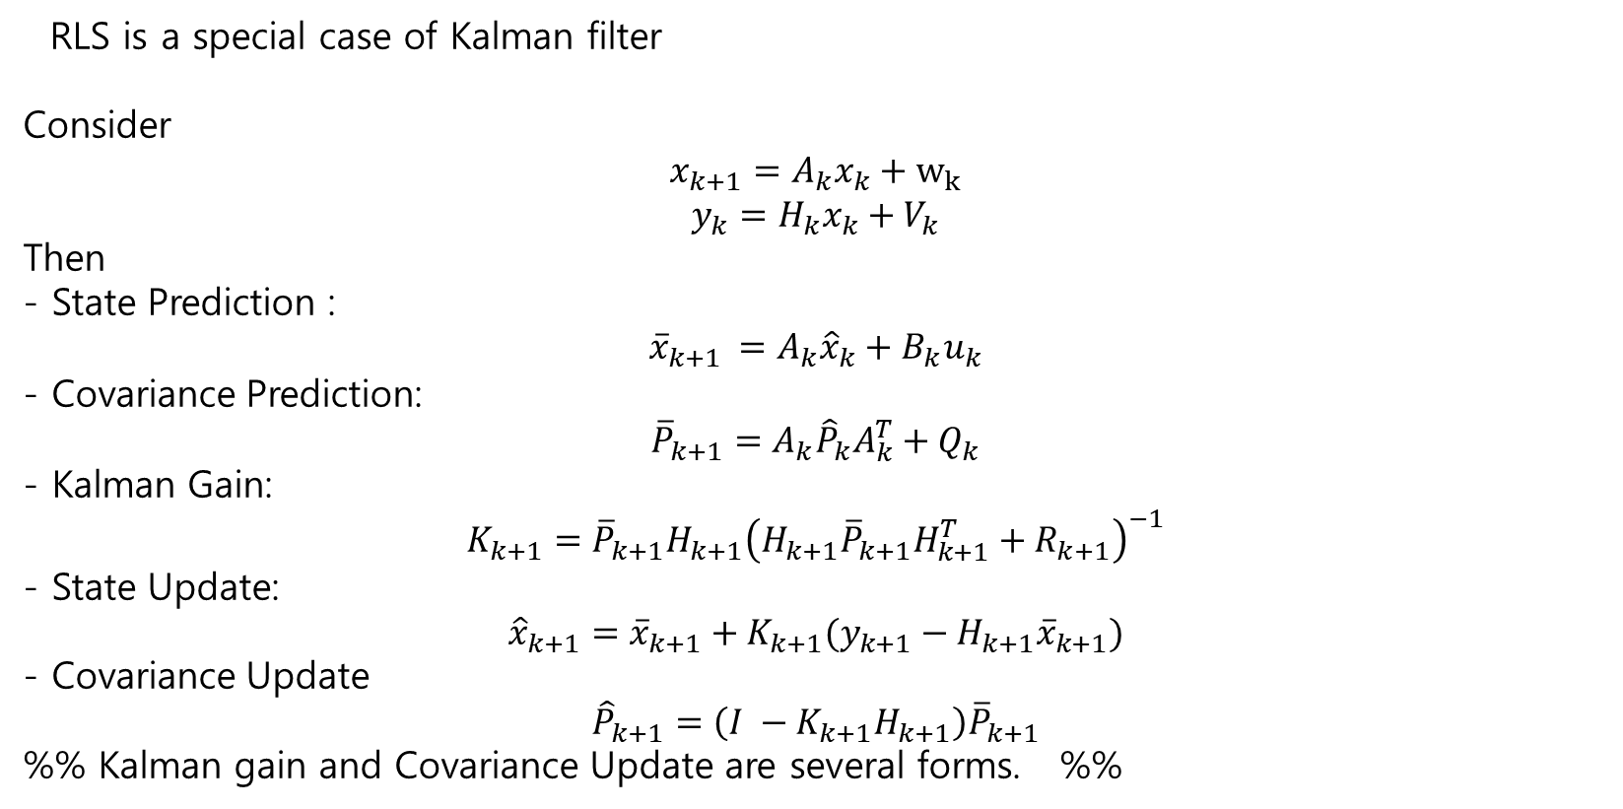
RLS is a special case of Kalman filter
Consider
$$x_{k+1}=A_{k}x_{k}+w_{k}$$
$$y_{k}=H_{k}x_{k}+V_{k}$$
Then
- State Prediction :
$${\overline{x}}_{k+1 }=A_{k}{\hat{x}}_{k}+B_{k}u_{k}$$
- Covariance Prediction:
$${\overline{P}}_{k+1}=A_{k}{\hat{P}}_{k}A_{k}^{T}+Q_{k}$$
- Kalman Gain:
$$K_{k+1}={\overline{P}}_{k+1}H_{k+1}{\left(H_{k+1}{\overline{P}}_{k+1}H_{k+1}^{T}+R_{k+1}\right)}^{−1}$$
- State Update:
$${\hat{x}}_{k+1}={\overline{x}}_{k+1}+K_{k+1}(y_{k+1}−H_{k+1}{\overline{x}}_{k+1})$$
- Covariance Update
$${\hat{P}}_{k+1}=\left(I −K_{k+1}H_{k+1}\right){\overline{P}}_{k+1}$$
%% Kalman gain and Covariance Update are several forms. %%

Slide 11
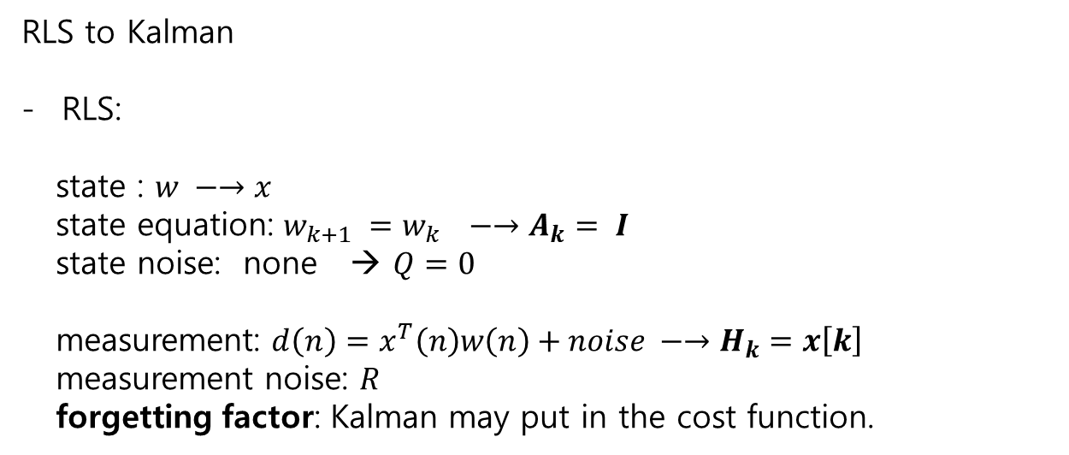
RLS to Kalman
RLS:
state : $w −→x$
state equation: $w_{k+1} =w_{k} −→A_{k}= I$
state noise: none → $Q=0$
measurement: $d\left(n\right)=x^{T}\left(n\right)w\left(n\right)+noise −→H_{k}=x\left[k\right]$
measurement noise: $R$
forgetting factor: Kalman may put in the cost function.

Slide 12
RLS to RL
 | RLS | Int RL
Decision Making | Parameter estimation | Learning a policy* | *Design optimal controller
Learning Signal | Desired Output (Supervised Learning) | Reward signal from the environment
Interaction | Passive learning from Input-Output Pairs | Active interaction with an environment
Feedback | Immediate error between prediction and target | Delayed and sparse rewards based on action’s consequences
Exploration | Primarily exploitation of adaptive filtering | Explicit exploration is crucial
Algorithm | Deterministic, recursive optimization | Stochastic or deterministic, iterative
Learning Goal | Minimized Least Squares | Min(Max) cumulative rewards.
Nature of problem | Identification, adaptive filtering | Sequential decision-making

