Slide 1
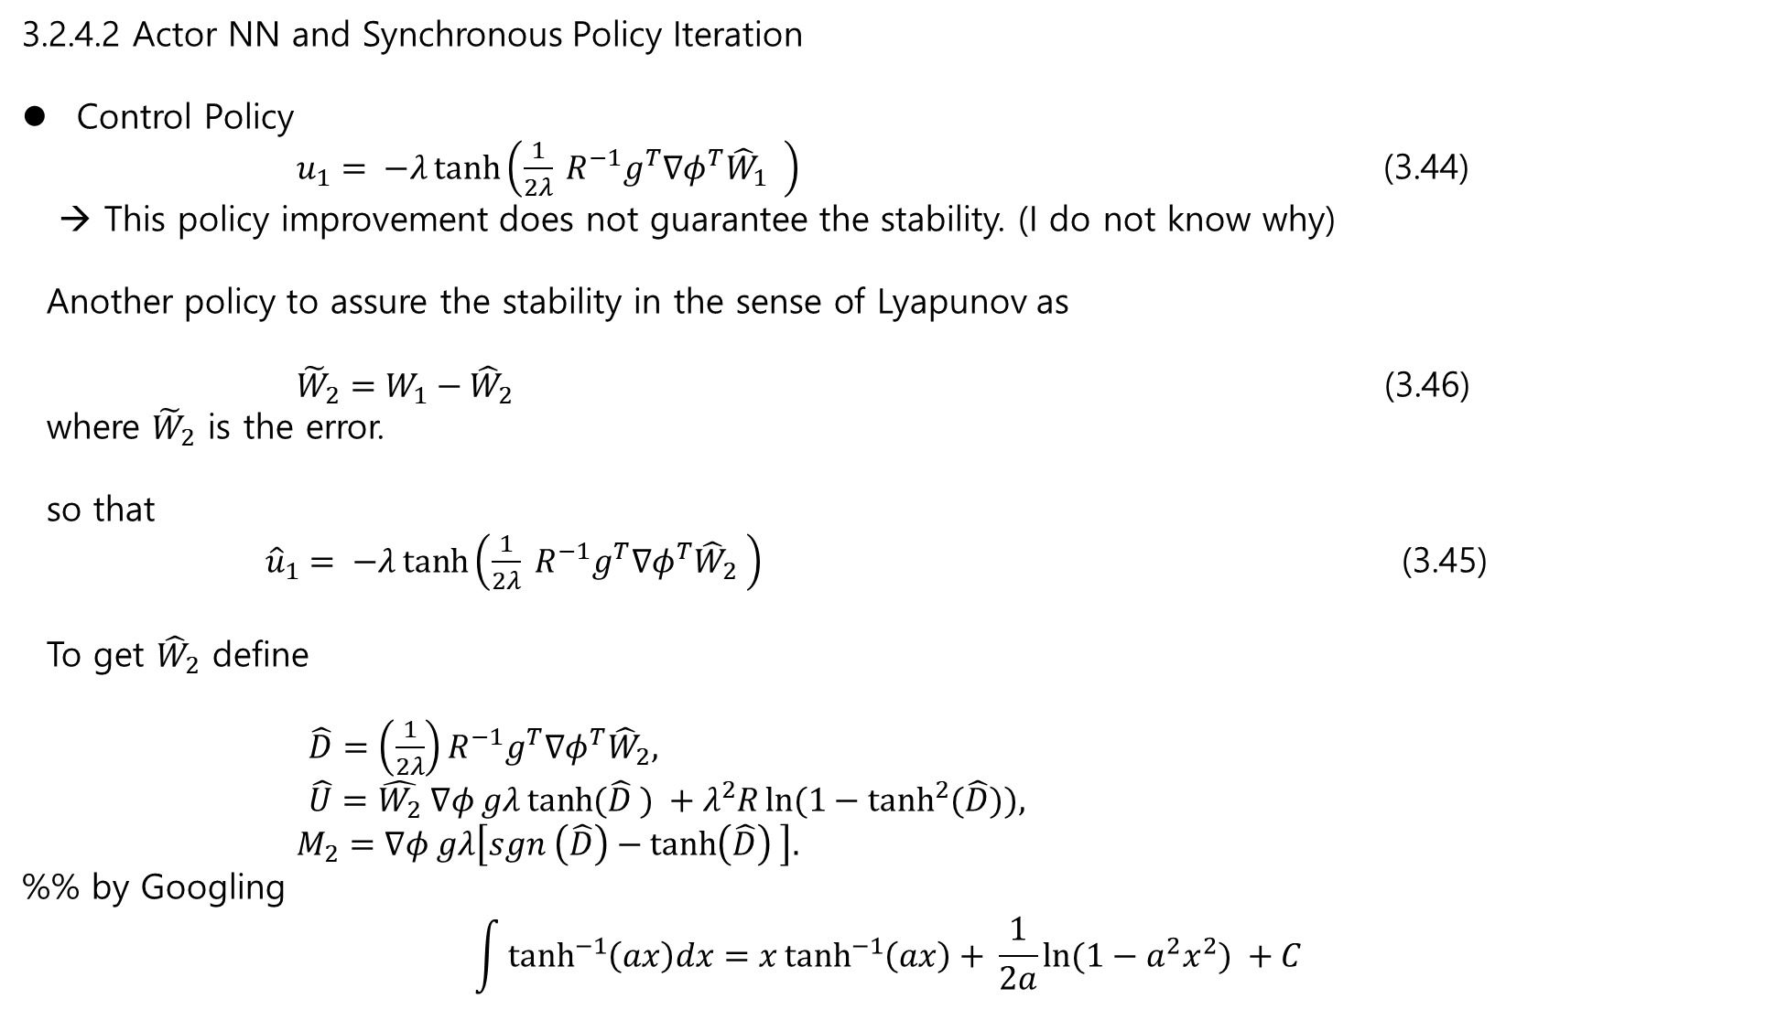
3.2.4.2 Actor NN and Synchronous Policy Iteration
Control Policy
$u_{1}= −λ\tanh\left(\frac{1}{2λ} R^{−1}g^{T}∇φ^{T}{\hat{W}}_{1} \right)$ (3.44)
→ This policy improvement does not guarantee the stability. (I do not know why)
Another policy to assure the stability in the sense of Lyapunov as
${\tilde{W}}_{2}=W_{1}−{\hat{W}}_{2}$ (3.46)
where ${\tilde{W}}_{2}$ is the error.
so that
${\hat{u}}_{1}= −λ\tanh\left(\frac{1}{2λ} R^{−1}g^{T}∇φ^{T}{\hat{W}}_{2} \right)$ (3.45)
To get ${\hat{W}}_{2}$ define
$\hat{D}=\left(\frac{1}{2λ}\right)R^{−1}g^{T}∇φ^{T}{\hat{W}}_{2},$
$\hat{U}=\hat{W_{2}} ∇φ gλ\tanh{(\hat{D} )} +λ^{2}R\ln{(1−\tanh^{2}{(\hat{D})), }}$
$M_{2}=∇φ gλ\left[sgn \left(\hat{D}\right)−\tanh\left(\hat{D}\right) \right].$
%% by Googling
$$\int{\tanh^{−1}\left(ax\right)dx=x\tanh^{−1}\left(ax\right)+ \frac{1}{2a}\ln{(1−a^{2}x^{2})} +C }$$

Slide 2
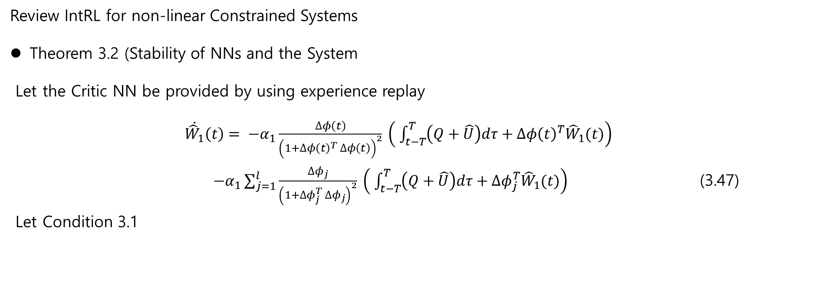
Review IntRL for non-linear Constrained Systems
Theorem 3.2 (Stability of NNs and the System
Let the Critic NN be provided by using experience replay
$\dot{{\hat{W}}_{1}}\left(t\right)= −α_{1}\frac{∆φ\left(t\right)}{{\left(1+∆φ{\left(t\right)}^{T} ∆φ\left(t\right)\right)}^{2}} \left( \int_{t−T}^{T}{\left(Q+\hat{U}\right)dτ}+∆φ{\left(t\right)}^{T}{\hat{W}}_{1}(t)\right)$
$−α_{1}\sum_{j=1}^{l}{\frac{∆φ_{j}}{{\left(1+∆φ_{j}^{T} ∆φ_{j}\right)}^{2}} \left( \int_{t−T}^{T}{\left(Q+\hat{U}\right)dτ}+∆φ_{j}^{T}{\hat{W}}_{1}(t)\right)}$ (3.47)
Let Condition 3.1

Slide 3
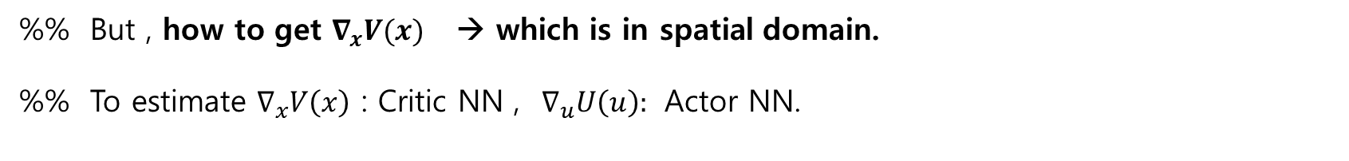
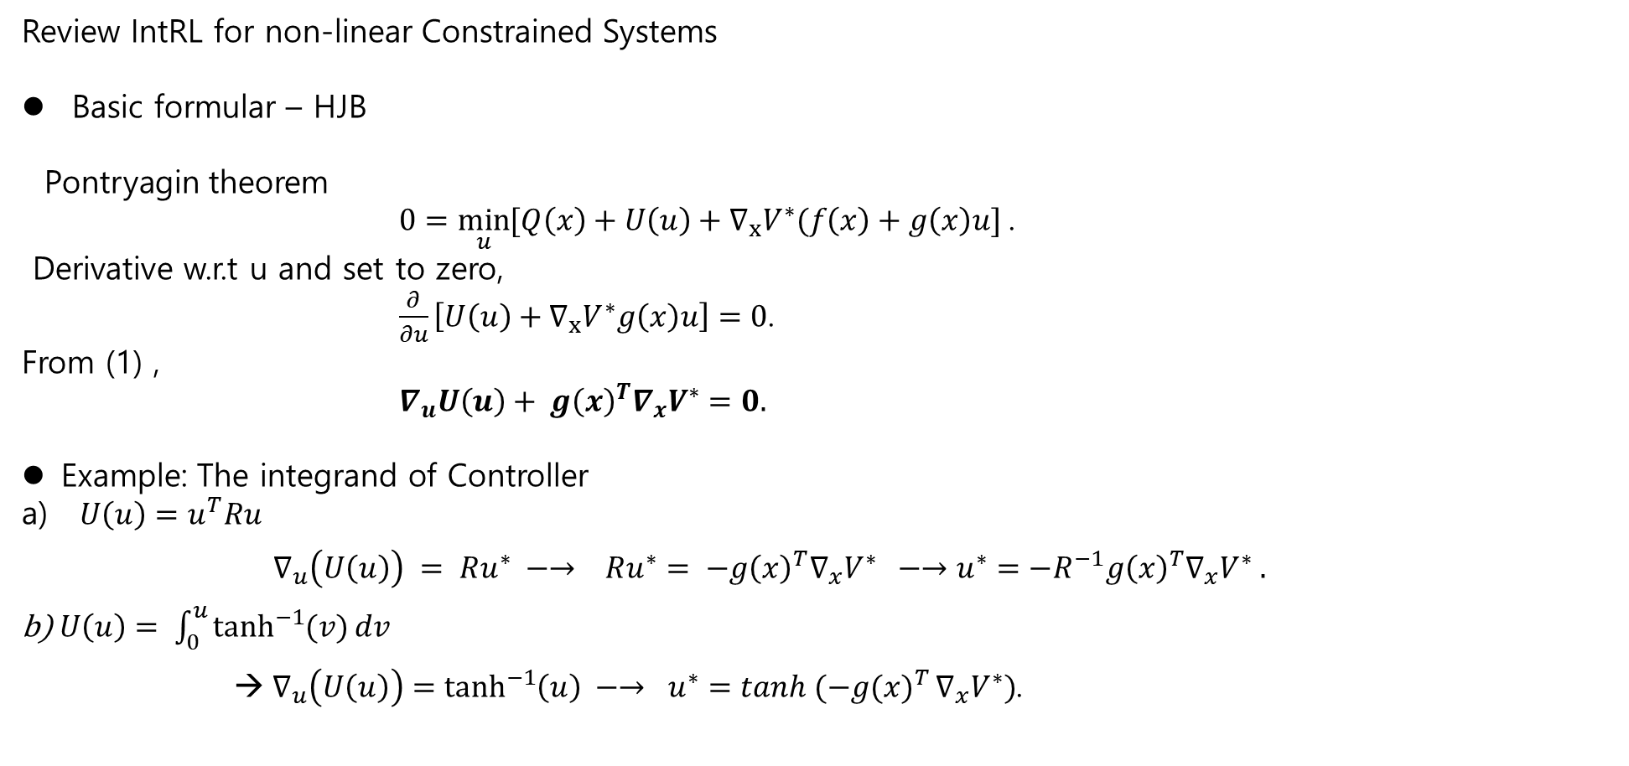
Review IntRL for non-linear Constrained Systems
Basic formular – HJB
Pontryagin theorem
$0=\min_{u}{[Q\left(x\right)+U\left(u\right)+∇_{x}V^{∗}(f\left(x\right)+g\left(x\right)u]}$.
Derivative w.r.t u and set to zero,
$\frac{∂}{∂u}\left[U\left(u\right)+∇_{x}V^{∗}g\left(x\right)u\right]=0$.
From (1) ,
$∇_{u}U\left(u\right)+ g{\left(x\right)}^{T}∇_{x}V^{∗}=0.$
Example: The integrand of Controller
$U\left(u\right)=u^{T}Ru$
$∇_{u}\left(U\left(u\right)\right) = Ru^{∗} −→ Ru^{∗}= −g{\left(x\right)}^{T}∇_{x}V^{∗} −→u^{∗}=−R^{−1}g{\left(x\right)}^{T}∇_{x}V^{∗} .$
b) $U\left(u\right)= \int_{0}^{u}{\tanh^{−1}{(v)}dv}$
$∇_{u}\left(U\left(u\right)\right)=\tanh^{−1}\left(u\right) −→ u^{∗}={\tanh{(−g(x)}}^{T}∇_{x}V^{∗})$.
%% But , how to get $∇_{x}V(x)$ → which is in spatial domain.
%% To estimate $∇_{x}V\left(x\right)$ : Critic NN , $∇_{u}U\left(u\right):$ Actor NN.

Slide 4

Review IntRL for non-linear Constrained Systems
3.2.1 Problem Formulation
$\dot{x}\left(t\right)=f\left(x\left(t\right)\right)+g(x\left(t\right)u\left(t\right), (3.1)$
$f\left(x\right)$: the drift dynamics
$g(x)$: the input dynamics
$Ω_{u}:$ $\left|u_{i}(t)\right|≤λ.$ The input constraints
$V(x\left(t\right))$: the performance index
$V\left(x\left(t\right)\right)= \int_{t}^{∞}{\left(Q\left(x\left(τ\right)\right)+U\left(u\left(τ\right)\right)\right)} dτ , Q\left(x\right). U\left(u\right)>0 (3.2)$
Find an $u^{∗}(t)$ to minimize $V(x\left(t\right))$.

Slide 5
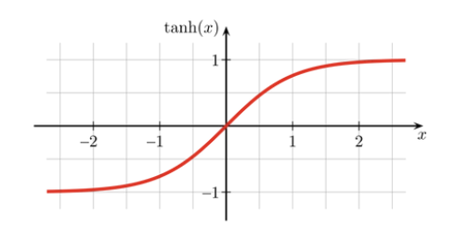
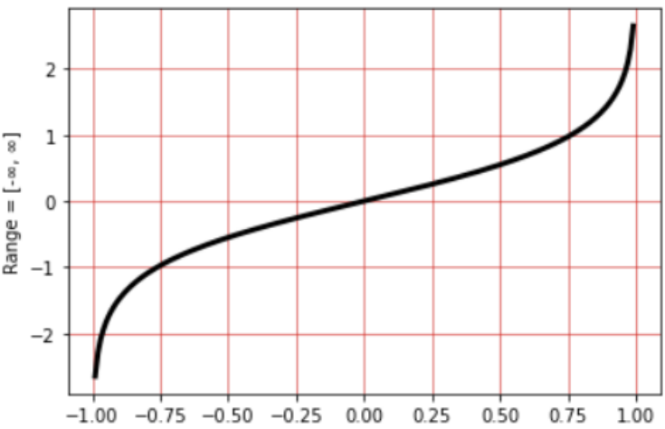
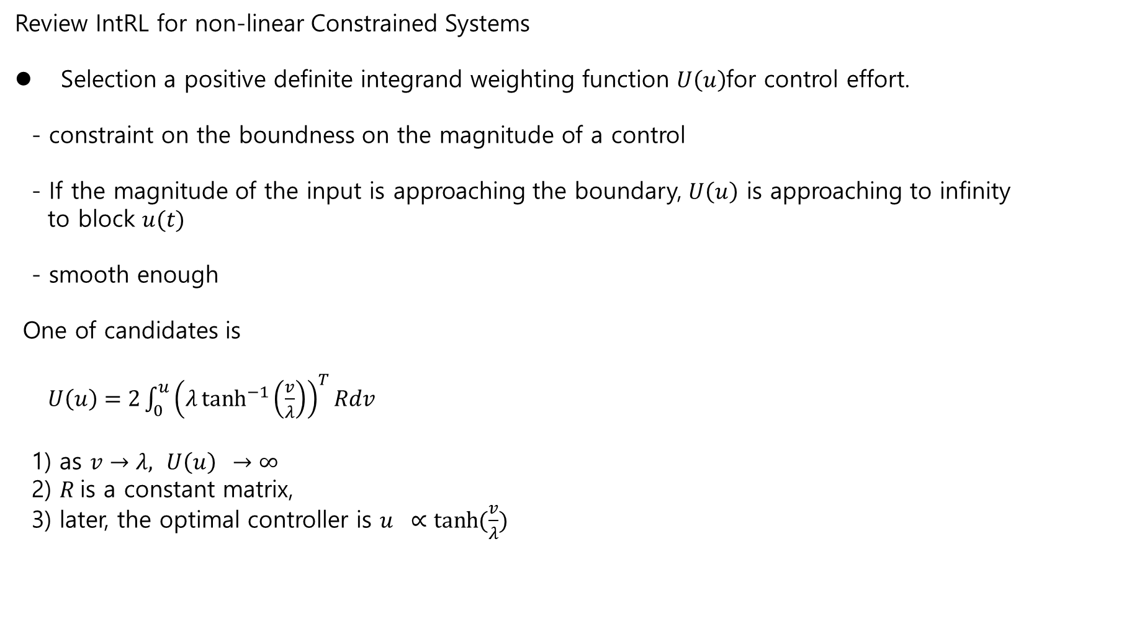
Review IntRL for non-linear Constrained Systems
Selection a positive definite integrand weighting function $U\left(u\right)$for control effort.
- constraint on the boundness on the magnitude of a control
- If the magnitude of the input is approaching the boundary, $U\left(u\right)$ is approaching to infinity
to block $u(t)$
- smooth enough
One of candidates is
$U\left(u\right)=2\int_{0}^{u}{{\left(λ\tanh^{−1}\left(\frac{v}{λ}\right)\right)}^{T}}Rdv$
1) as $v→λ,$ $U\left(u\right) →∞$
2) $R$is a constant matrix,
3) later, the optimal controller is $u ∝\tanh{(\frac{v}{λ}})$

Slide 6
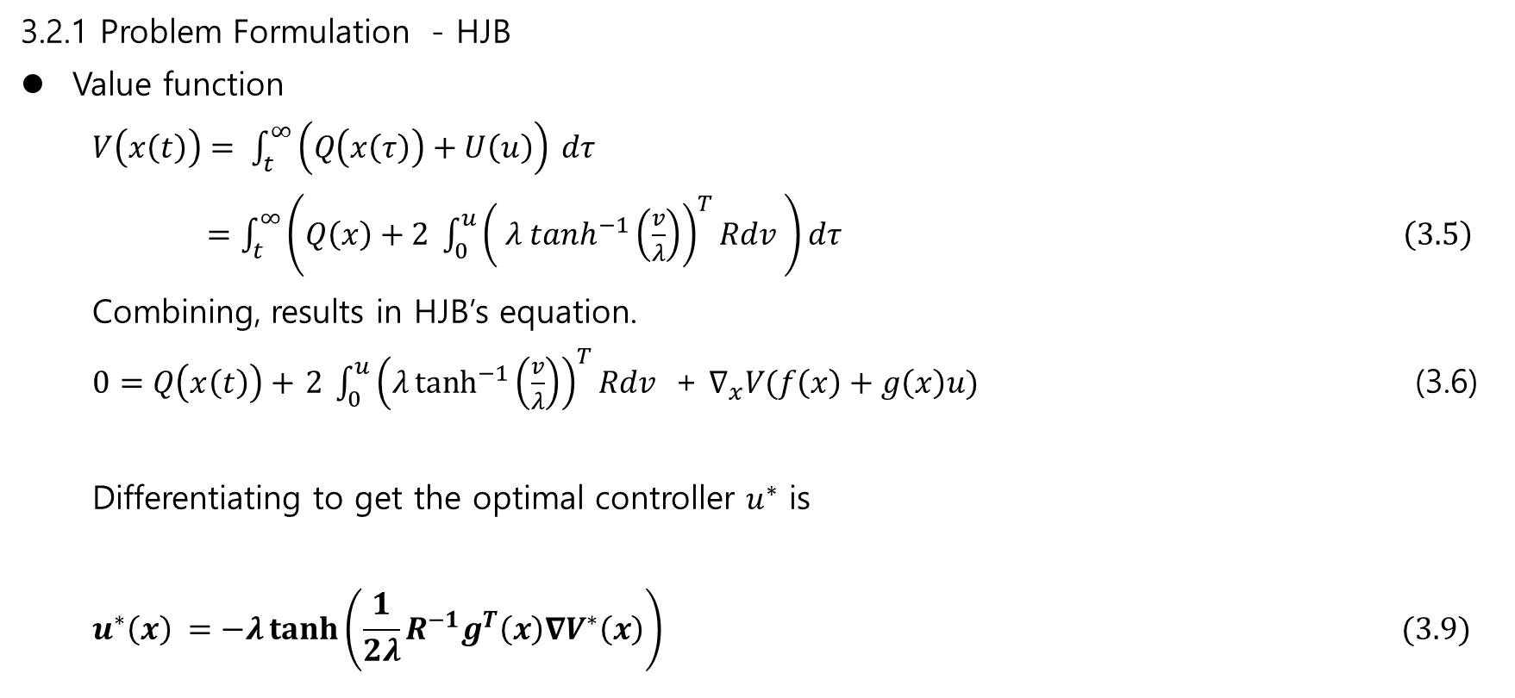
3.2.1 Problem Formulation - HJB
Value function
$V\left(x\left(t\right)\right)= \int_{t}^{∞}{\left(Q\left(x\left(τ\right)\right)+U\left(u\right)\right)} dτ$
$=\int_{t}^{∞}{\left(Q\left(x\right)+2 \int_{0}^{u}{{\left( λ\tanh^{−1}\left(\frac{v}{λ}\right)\right)}^{T}Rdv }\right)}dτ \left(3.5\right)$
Combining, results in HJB’s equation.
$0=Q\left(x\left(t\right)\right)+$ $2 \int_{0}^{u}{{\left(λ\tanh^{−1}\left(\frac{v}{λ}\right)\right)}^{T}Rdv }$ + $∇_{x}V(f\left(x\right)+g\left(x\right)u)$ (3.6)
Differentiating to get the optimal controller $u^{∗}$ is
$$u^{∗}\left(x\right) =−λ\tanh\left(\frac{1}{2λ}R^{−1}g^{T}\left(x\right)∇V^{∗}\left(x\right)\right) (3.9)$$

Slide 7
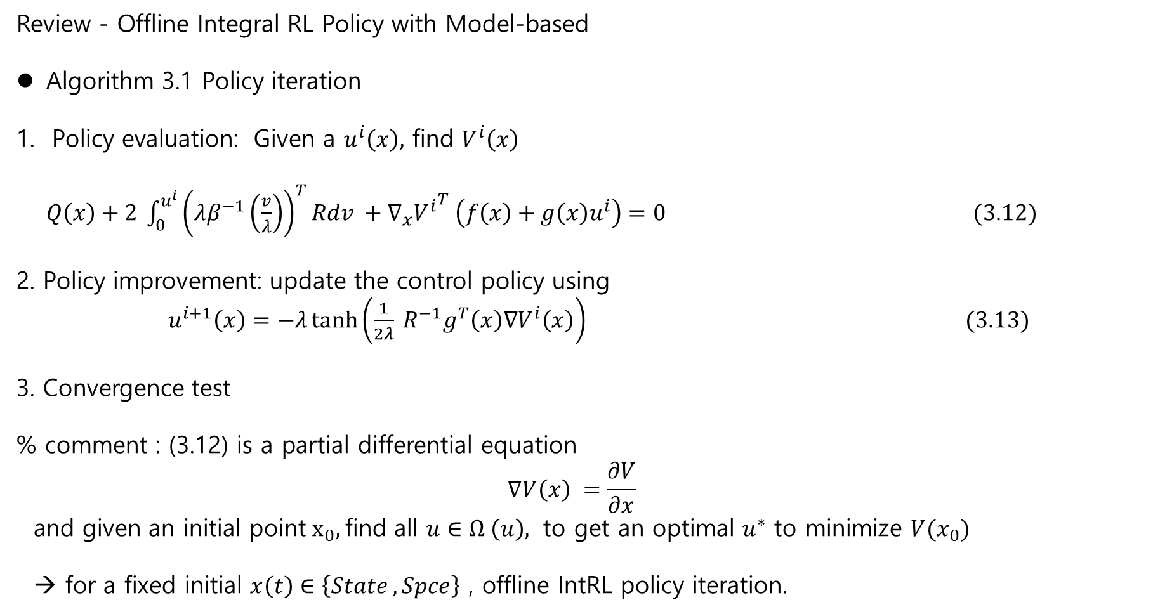
Review - Offline Integral RL Policy with Model-based
Algorithm 3.1 Policy iteration
Policy evaluation: Given a $u^{i}\left(x\right),$ find $V^{i}\left(x\right)$
$Q\left(x\right)+2 \int_{0}^{u^{i}}{{\left(λβ^{−1}\left(\frac{v}{λ}\right)\right)}^{T}Rdv }+∇_{x}{V^{i}}^{T} \left(f\left(x\right)+g\left(x\right)u^{i}\right)=0 (3.12)$
2. Policy improvement: update the control policy using
$u^{i+1}\left(x\right)=−λ\tanh\left(\frac{1}{2λ} R^{−1}g^{T}\left(x\right)∇V^{i}\left(x\right)\right) (3.13)$
3. Convergence test
% comment : (3.12) is a partial differential equation
$$∇V\left(x\right) =\frac{∂V}{∂x}$$
and given an initial point$x_{0},$find all $u∈Ω \left(u\right),$ to get an optimal $u^{∗}$ to minimize $V(x_{0})$
→ for a fixed initial $x\left(t\right)∈\left\{State , Spce\right\}$ , offline IntRL policy iteration.

Slide 8
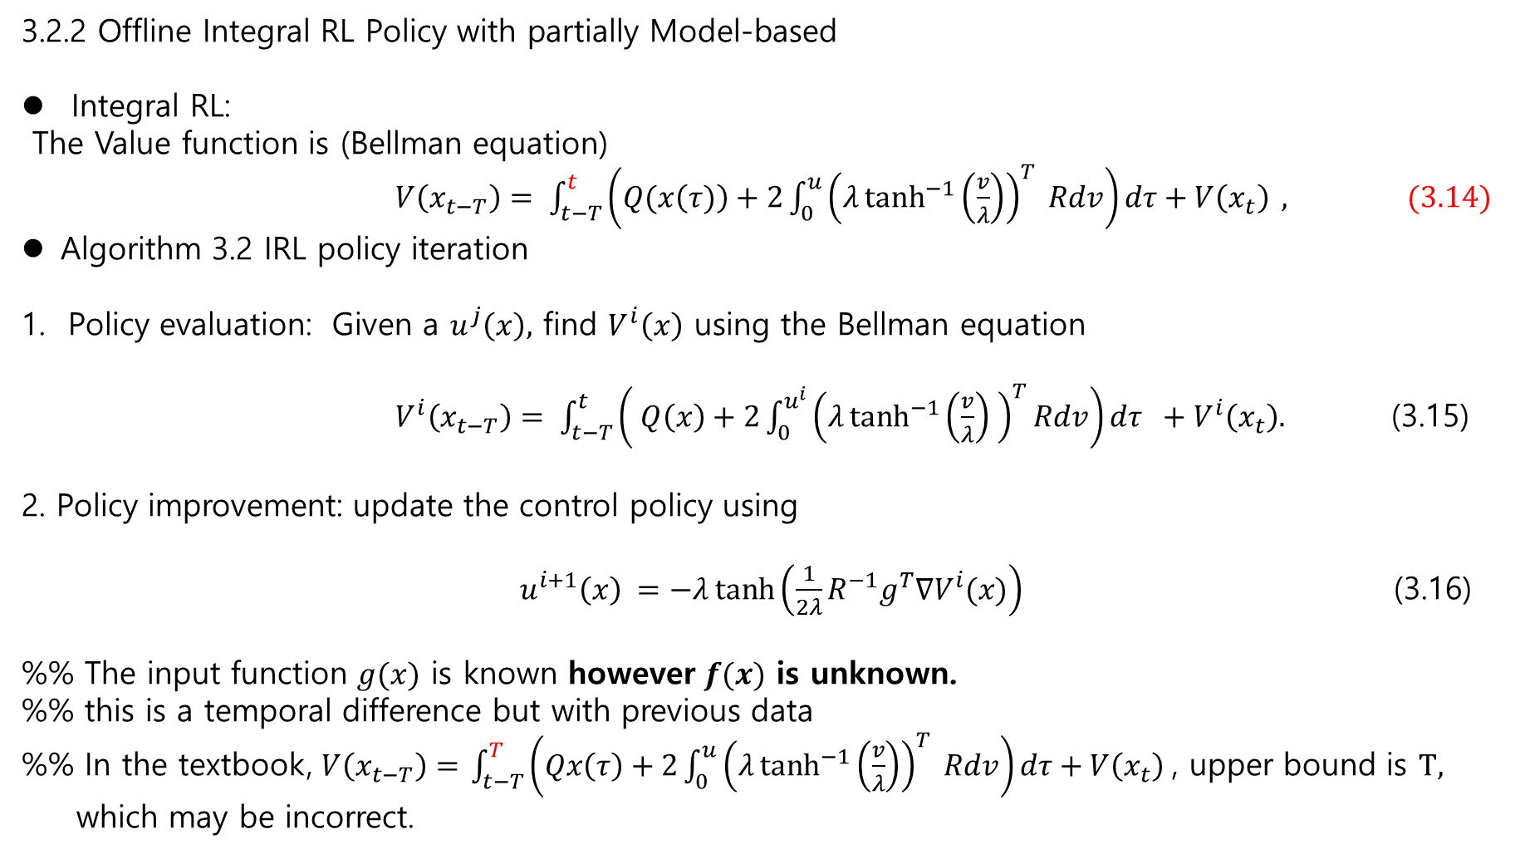
3.2.2 Offline Integral RL Policy with partially Model-based
Integral RL:
The Value function is (Bellman equation)
$V\left(x_{t−T}\right)= \int_{t−T}^{t}{\left(Q(x\left(τ)\right)+2\int_{0}^{u}{{\left(λ\tanh^{−1}\left(\frac{v}{λ}\right)\right)}^{T} Rdv}\right)dτ+V\left(x_{t}\right) }, (3.14)$
Algorithm 3.2 IRL policy iteration
Policy evaluation: Given a $u^{j}\left(x\right),$ find $V^{i}\left(x\right)$ using the Bellman equation
$V^{i}\left(x_{t−T}\right)= \int_{t−T}^{t}{\left( Q\left(x\right)+2\int_{0}^{u^{i}}{{\left(λ\tanh^{−1}\left(\frac{v}{λ}\right) \right)}^{T}Rdv}\right)dτ +V^{i}\left(x_{t}\right). }$ (3.15)
2. Policy improvement: update the control policy using
$u^{i+1}\left(x\right) =−λ\tanh\left(\frac{1}{2λ}R^{−1}g^{T}∇V^{i}(x)\right)$ (3.16)
%% The input function $g(x)$ is known however $f(x)$ is unknown.
%% this is a temporal difference but with previous data
%% In the textbook, $V\left(x_{t−T}\right)=$ $\int_{t−T}^{T}{\left(Qx\left(τ\right)+2\int_{0}^{u}{{\left(λ\tanh^{−1}\left(\frac{v}{λ}\right)\right)}^{T} Rdv}\right)dτ+V\left(x_{t}\right) }$, upper bound is $\text{T},$
which may be incorrect.

Slide 9
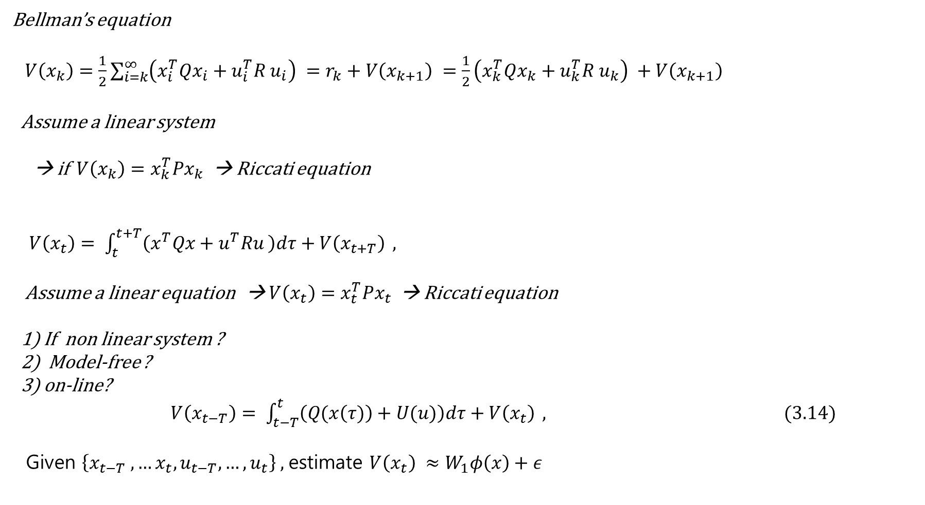
Bellman’s equation
$V\left(x_{k}\right)=\frac{1}{2}\sum_{i=k}^{∞}{\left(x_{i}^{T}Qx_{i}+u_{i}^{T}R u_{i}\right)} =r_{k}+V\left(x_{k+1}\right) =\frac{1}{2}\left(x_{k}^{T}Qx_{k}+u_{k}^{T}R u_{k}\right) +V\left(x_{k+1}\right)$
Assume a linear system
→ if $V\left(x_{k}\right)=x_{k}^{T}Px_{k}$ → Riccati equation
$V\left(x_{t}\right)= \int_{t}^{t+T}{\left(x^{T}Qx+u^{T}Ru \right)dτ+V\left(x_{t+T}\right) },$
Assume a linear equation → $V\left(x_{t}\right)=x_{t}^{T}Px_{t}$ → Riccati equation
1) If non linear system ?
2) Model-free ?
3) on-line?
$V\left(x_{t−T}\right)= \int_{t−T}^{t}{\left(Q(x\left(τ)\right)+U(u)\right)dτ+V\left(x_{t}\right) }, (3.14)$
Given $\left\{x_{t−T} ,…x_{t}, u_{t−T},…, u_{t}\right\} ,$estimate $V\left(x_{t}\right) ≈W_{1}φ\left(x\right)+ε$

Slide 10
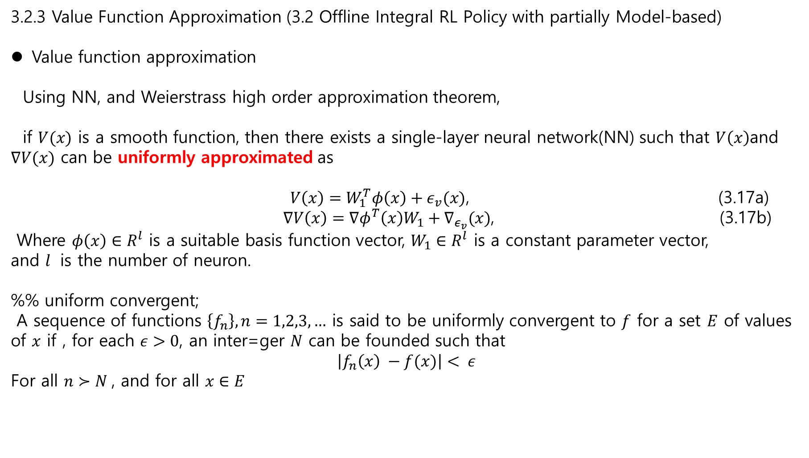
3.2.3 Value Function Approximation (3.2 Offline Integral RL Policy with partially Model-based)
Value function approximation
Using NN, and Weierstrass high order approximation theorem,
if $V(x)$ is a smooth function, then there exists a single-layer neural network(NN) such that $V\left(x\right)$and $∇V(x)$ can be uniformly approximated as
$V\left(x\right)=W_{1}^{T}φ\left(x\right)+ε_{v}(x)$, (3.17a)
$∇V\left(x\right)=∇φ^{T}\left(x\right)W_{1}+∇_{ε_{v}}(x)$, (3.17b)
Where $φ\left(x\right)∈R^{l}$ is a suitable basis function vector, $W_{1}∈R^{l}$ is a constant parameter vector,
and $l$ is the number of neuron.
%% uniform convergent;
A sequence of functions $\left\{f_{n}\right\}, n=1,2,3,…$ is said to be uniformly convergent to $f$ for a set $E$ of values of $x$ if , for each $ε>0$, an inter=ger $N$ can be founded such that
$$\left|f_{n}\left(x\right) −f(x)\right|< ε$$
For all $n≻N$, and for all $x∈E$

Slide 11
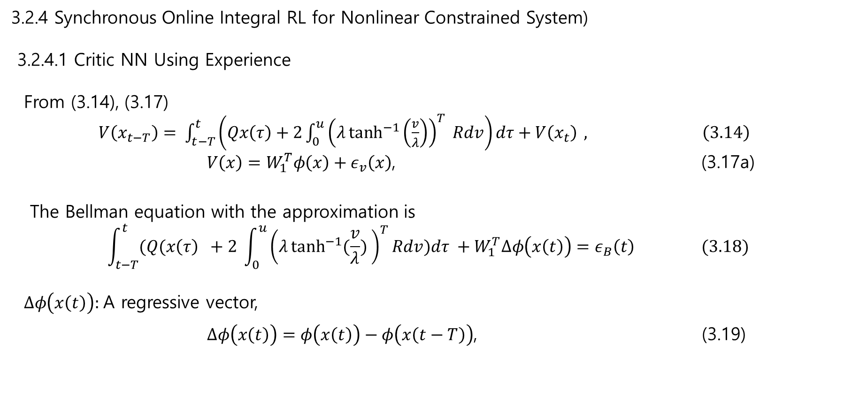
3.2.4 Synchronous Online Integral RL for Nonlinear Constrained System)
3.2.4.1 Critic NN Using Experience
From (3.14), (3.17)
$V\left(x_{t−T}\right)= \int_{t−T}^{t}{\left(Qx\left(τ\right)+2\int_{0}^{u}{{\left(λ\tanh^{−1}\left(\frac{v}{λ}\right)\right)}^{T} Rdv}\right)dτ+V\left(x_{t}\right) }, \left(3.14\right)$
$V\left(x\right)=W_{1}^{T}φ\left(x\right)+ε_{v}\left(x\right)$, (3.17a)
The Bellman equation with the approximation is
$$\int_{t−T}^{t}{(Q(x\left(τ\right) }+2 \int_{0}^{u}{{\left(λ\tanh^{−1}{(\frac{v}{λ})} \right)}^{T}Rdv})dτ +W_{1}^{T}∆φ\left(x\left(t\right)\right)=ε_{B}\left(t\right) (3.18)$$
$∆φ\left(x\left(t\right)\right):$A regressive vector,
$∆φ\left(x\left(t\right)\right)=φ\left(x\left(t\right)\right)−φ\left(x\left(t−T\right)\right)$, (3.19)

Slide 12
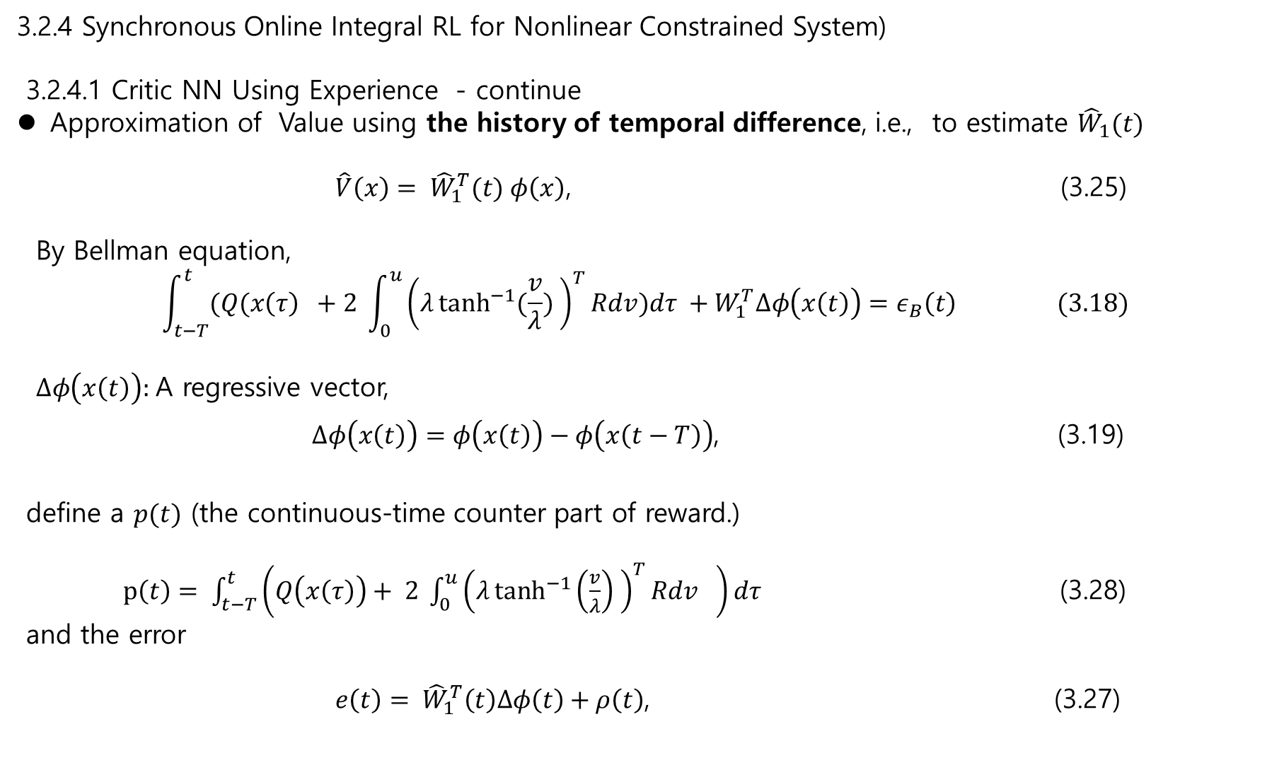
3.2.4 Synchronous Online Integral RL for Nonlinear Constrained System)
3.2.4.1 Critic NN Using Experience - continue
Approximation of Value using the history of temporal difference, i.e., to estimate ${\hat{W}}_{1}(t)$
$\hat{V}\left(x\right)= {\hat{W}}_{1}^{T}(t) φ\left(x\right)$, (3.25)
By Bellman equation,
$$\int_{t−T}^{t}{(Q(x\left(τ\right) }+2 \int_{0}^{u}{{\left(λ\tanh^{−1}{(\frac{v}{λ})} \right)}^{T}Rdv})dτ +W_{1}^{T}∆φ\left(x\left(t\right)\right)=ε_{B}\left(t\right) (3.18)$$
$∆φ\left(x\left(t\right)\right):$A regressive vector,
$∆φ\left(x\left(t\right)\right)=φ\left(x\left(t\right)\right)−φ\left(x\left(t−T\right)\right)$, (3.19)
define a $p(t)$ (the continuous-time counter part of reward.)
$p\left(t\right)= \int_{t−T}^{t}{\left(Q\left(x\left(τ\right)\right)+ 2 \int_{0}^{u}{{\left(λ\tanh^{−1}\left(\frac{v}{λ}\right) \right)}^{T}Rdv} \right)dτ }$ (3.28)
and the error
$e\left(t\right)= {\hat{W}}_{1}^{T}\left(t\right)∆φ\left(t\right)+ρ\left(t\right)$, (3.27)

Slide 13
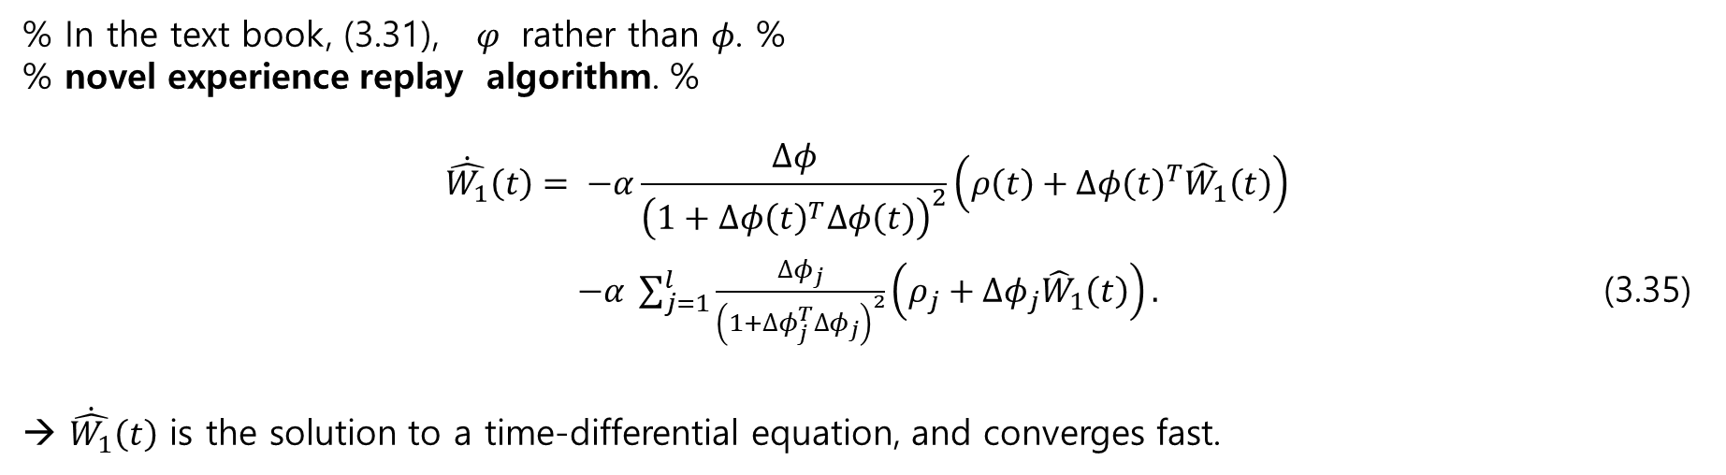
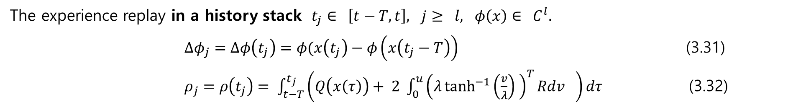
3.2.3 Value function Approximation
The experience replay in a history stack $t_{j}∈ \left[t−T, t\right], j≥ l, φ\left(x\right)∈ C^{l}.$
$∆φ_{j}=∆φ\left(t_{j}\right)=φ(x\left(t_{j}\right)−φ\left(x\left(t_{j}−T\right)\right)$ (3.31)
$ρ_{j}=ρ\left(t_{j}\right)= \int_{t−T}^{t_{j}}{\left(Q\left(x\left(τ\right)\right)+ 2 \int_{0}^{u}{{\left(λ\tanh^{−1}\left(\frac{v}{λ}\right) \right)}^{T}Rdv} \right)dτ }$ (3.32)
% In the text book, (3.31), $φ$ rather than $φ$. %
% novel experience replay algorithm. %
$$\dot{\hat{W_{1}}}\left(t\right)= −α\frac{∆φ}{{\left(1+∆φ{\left(t\right)}^{T}∆φ\left(t\right)\right)}^{2}}\left(ρ\left(t\right)+∆φ{\left(t\right)}^{T}{\hat{W}}_{1}\left(t\right)\right)$$
$−α \sum_{j=1}^{l}{\frac{∆φ_{j}}{{\left(1+∆φ_{j}^{T}∆φ_{j}\right)}^{2}}\left(ρ_{j}+∆φ_{j}{\hat{W}}_{1}\left(t\right)\right)}.$ (3.35)
→ $\dot{\hat{W_{1}}}\left(t\right)$ is the solution to a time-differential equation, and converges fast.

Slide 14
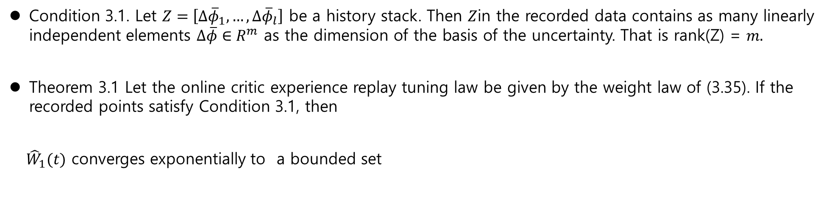
3.2.3 Value function Approximation
Condition 3.1. Let $Z=\left[∆{\overline{φ}}_{1},…,∆{\overline{φ}}_{l}\right]$ be a history stack. Then $Z$in the recorded data contains as many linearly independent elements $∆\overline{φ}∈R^{m}$ as the dimension of the basis of the uncertainty. That is rank(Z) = $m.$
Theorem 3.1 Let the online critic experience replay tuning law be given by the weight law of (3.35). If the recorded points satisfy Condition 3.1, then
${\hat{W}}_{1}(t)$ converges exponentially to a bounded set

Slide 15

3.2.3 Value function Approximation
Given a history data, in $t_{j} ∈ [t−T, t]$
How to estimate $W(t)$ , $V\left(x\left(t\right)\right) ≈W\left(t\right) φ(x)$ ?
1) Least Square.
2) similar to Filtering Problem (backward ? Smoothing ?) → Kalman / Unscented / important sampling.
3) Tensor method.
4) function approximation: Chebyshev / Gaussian approximation.
…..

Slide 16
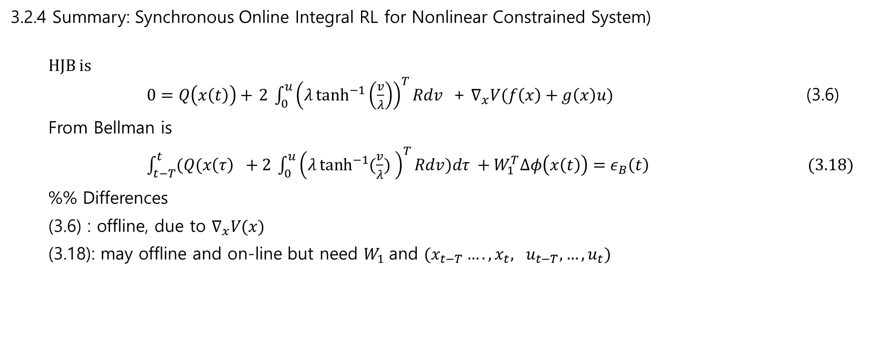
3.2.4 Summary: Synchronous Online Integral RL for Nonlinear Constrained System)
HJB is $0=Q\left(x\left(t\right)\right)+$ $2 \int_{0}^{u}{{\left(λ\tanh^{−1}\left(\frac{v}{λ}\right)\right)}^{T}Rdv }$ + $∇_{x}V(f\left(x\right)+g\left(x\right)u)$ (3.6)
From Bellman is
$\int_{t−T}^{t}{(Q(x\left(τ\right) }+2 \int_{0}^{u}{{\left(λ\tanh^{−1}{(\frac{v}{λ})} \right)}^{T}Rdv})dτ +W_{1}^{T}∆φ\left(x\left(t\right)\right)=ε_{B}\left(t\right) (3.18)$
%% Differences
(3.6) : offline, due to $∇_{x}V(x)$
(3.18): may offline and on-line but need $W_{1}$and $(x_{t−T}…., x_{t}, u_{t−T},…,u_{t})$

