Slide 1
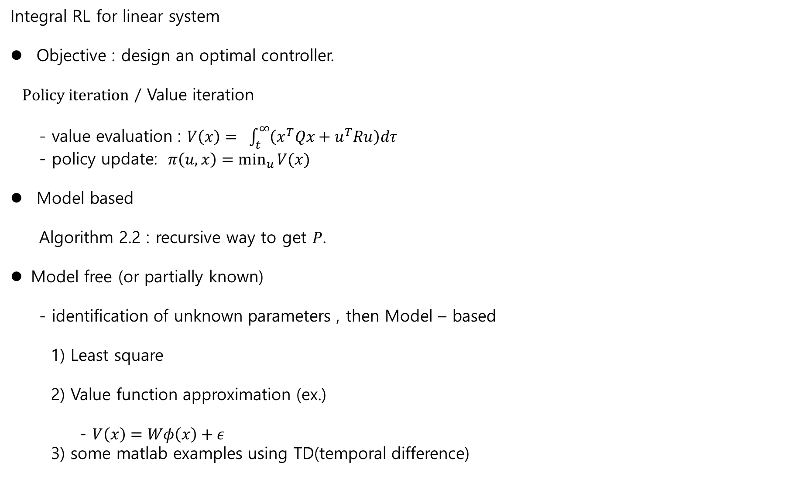
Integral RL for linear system
Objective : design an optimal controller.
$Policy iteration$ / Value iteration
- value evaluation : $V\left(x\right)= \int_{t}^{∞}{\left(x^{T}Qx+u^{T}Ru\right)dτ }$
- policy update: $π\left(u,x\right)=\min_{u}{V(x)}$
Model based
Algorithm 2.2 : recursive way to get $P$.
Model free (or partially known)
- identification of unknown parameters , then Model – based
1) Least square
2) Value function approximation (ex.)
- $V\left(x\right)=Wφ\left(x\right)+ε$
3) some matlab examples using TD(temporal difference)

Slide 2
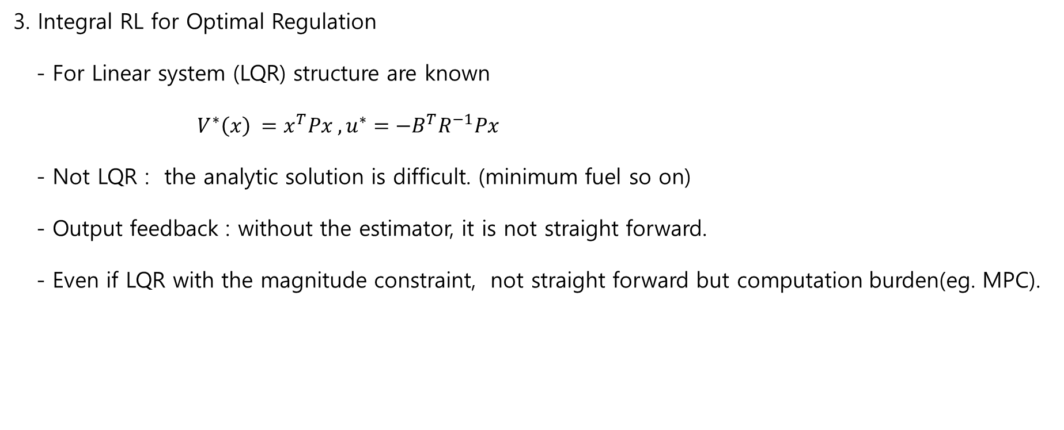
3. Integral RL for Optimal Regulation
- For Linear system (LQR) structure are known
$V^{∗}\left(x\right) =x^{T}Px , u^{∗}=−B^{T}R^{−1}Px$
- Not LQR : the analytic solution is difficult. (minimum fuel so on)
- Output feedback : without the estimator, it is not straight forward.
- Even if LQR with the magnitude constraint, not straight forward but computation burden(eg. MPC).

Slide 3
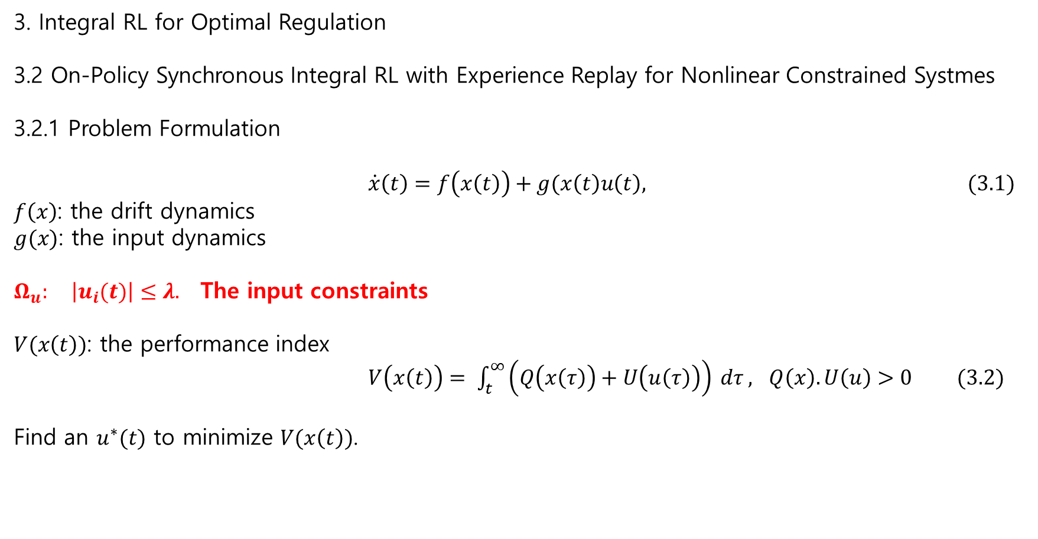
3. Integral RL for Optimal Regulation
3.2 On-Policy Synchronous Integral RL with Experience Replay for Nonlinear Constrained Systmes
3.2.1 Problem Formulation
$\dot{x}\left(t\right)=f\left(x\left(t\right)\right)+g(x\left(t\right)u\left(t\right), (3.1)$
$f\left(x\right)$: the drift dynamics
$g(x)$: the input dynamics
$Ω_{u}:$ $\left|u_{i}(t)\right|≤λ.$ The input constraints
$V(x\left(t\right))$: the performance index
$V\left(x\left(t\right)\right)= \int_{t}^{∞}{\left(Q\left(x\left(τ\right)\right)+U\left(u\left(τ\right)\right)\right)} dτ , Q\left(x\right). U\left(u\right)>0 (3.2)$
Find an $u^{∗}(t)$ to minimize $V(x\left(t\right))$.

Slide 4
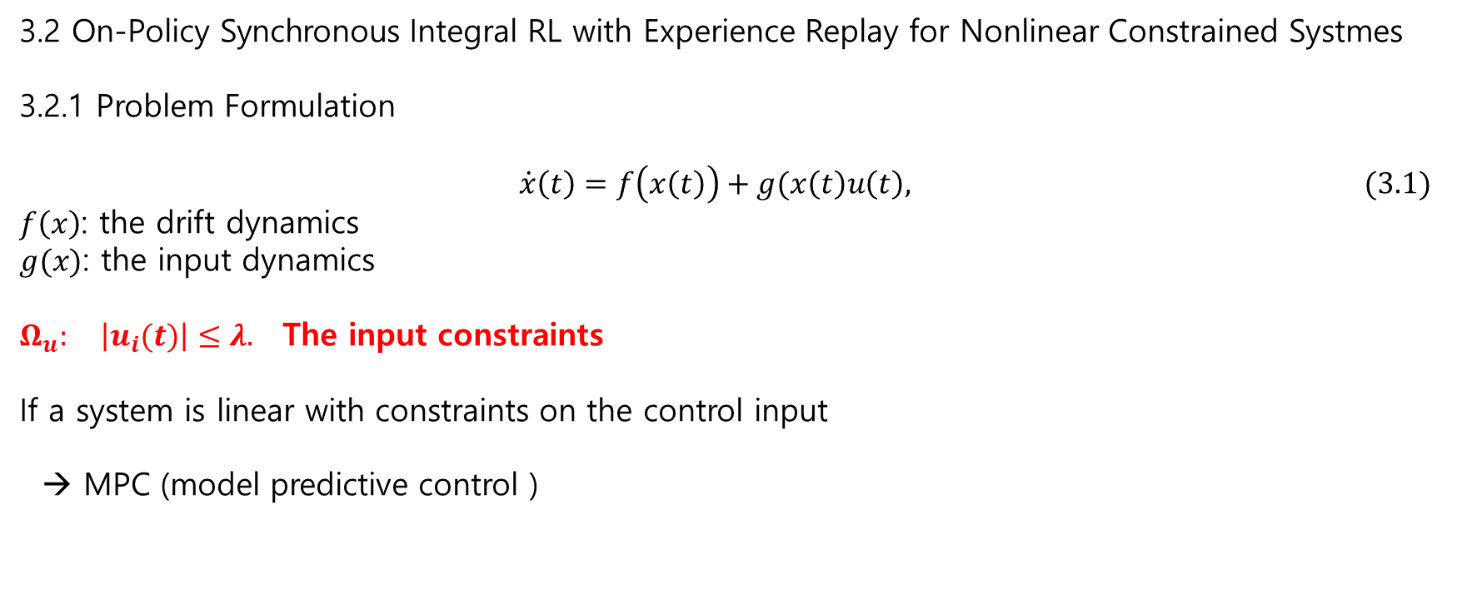
3.2 On-Policy Synchronous Integral RL with Experience Replay for Nonlinear Constrained Systmes
3.2.1 Problem Formulation
$\dot{x}\left(t\right)=f\left(x\left(t\right)\right)+g(x\left(t\right)u\left(t\right), (3.1)$
$f\left(x\right)$: the drift dynamics
$g(x)$: the input dynamics
$Ω_{u}:$ $\left|u_{i}(t)\right|≤λ.$ The input constraints
If a system is linear with constraints on the control input
→ MPC (model predictive control )

Slide 5
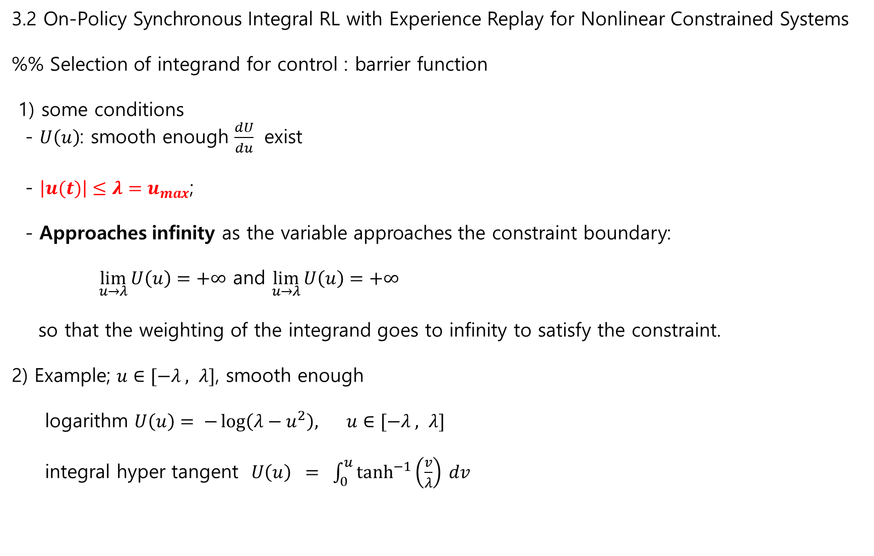
3.2 On-Policy Synchronous Integral RL with Experience Replay for Nonlinear Constrained Systems
%% Selection of integrand for control : barrier function
1) some conditions
- $U\left(u\right)$: smooth enough $\frac{dU}{du}$ exist
- $\left|u(t)\right|≤λ=u_{max}$;
- Approaches infinity as the variable approaches the constraint boundary:
$\lim_{u→λ}{U\left(u\right)}=+∞$ and $\lim_{u→λ}{U\left(u\right)}=+∞$
so that the weighting of the integrand goes to infinity to satisfy the constraint.
2) Example; $u∈[−λ , λ]$, smooth enough
logarithm $U\left(u\right)= −\log\left(λ−u^{2}\right), u∈[−λ , λ]$
integral hyper tangent $U\left(u\right) = \int_{0}^{u}{\tanh^{−1}\left(\frac{v}{λ}\right) dv }$

Slide 6
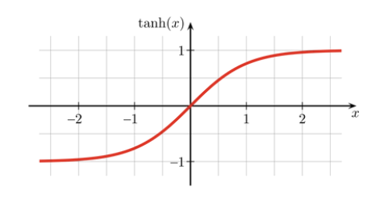
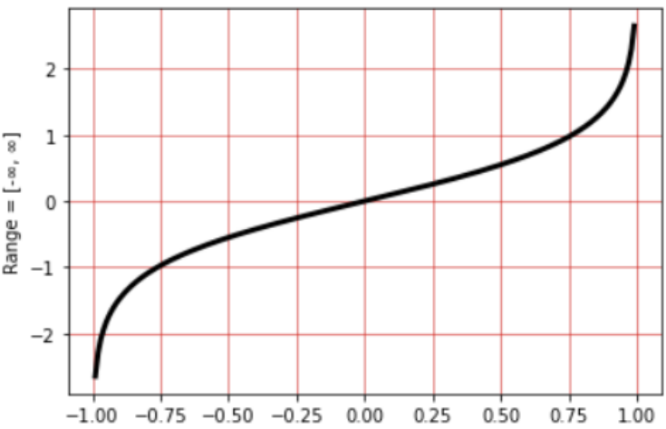

3.2 On-Policy Synchronous Integral RL with Experience Replay for Nonlinear Constrained Systems
$\tanh\left(x\right) =\frac{e^{x}−e^{−x}}{e^{x}+e^{−x}}$
$\tanh^{−1}\left(x\right)=\frac{1}{2}\ln{\frac{1+x}{1−x}}$
$\int{\tanh^{−1}{(x)}dx=x tanh^{−1}\left(x\right)+\frac{1}{2}\ln\left(1−x^{2}\right)+c , \left|x\right|<1 }$
$≈\frac{1}{2} x^{2}+0.15 x^{3}+C$.

Slide 7
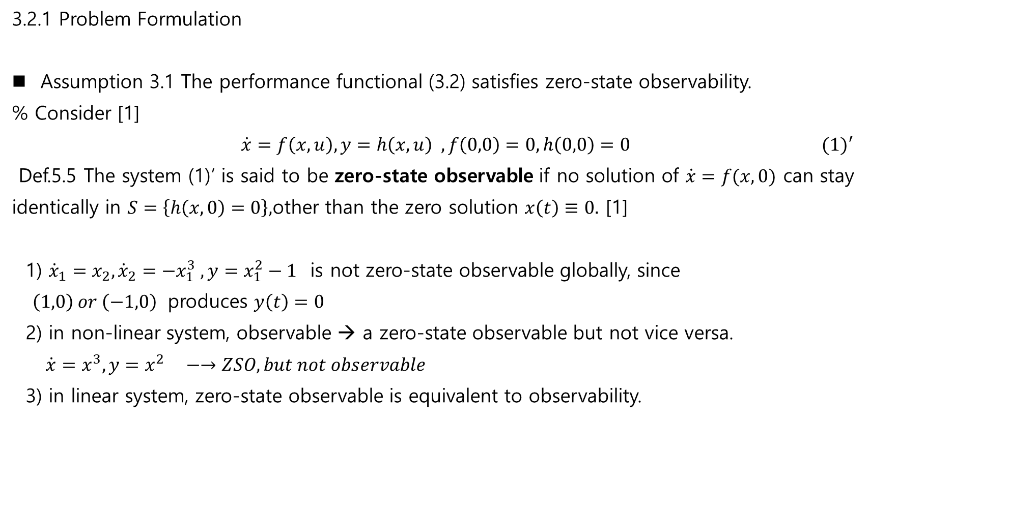
3.2.1 Problem Formulation
Assumption 3.1 The performance functional (3.2) satisfies zero-state observability.
% Consider [1]
$\dot{x}=f\left(x,u\right), y=h\left(x,u\right) , f\left(0,0\right)=0, h\left(0,0\right)=0 (1)′$
Def.5.5 The system (1)’ is said to be zero-state observable if no solution of $\dot{x}=f(x,0)$ can stay
identically in $S=\left\{h\left(x,0\right)=0\right\},$other than the zero solution $x\left(t\right)≡0.$ [1]
1) ${\dot{x}}_{1}=x_{2}, {\dot{x}}_{2}=−x_{1}^{3} , y=x_{1}^{2}−1$ is not zero-state observable globally, since
$\left(1,0\right) or \left(−1,0\right)$ produces $y\left(t\right)=0$
2) in non-linear system, observable → a zero-state observable but not vice versa.
$\dot{x}=x^{3}, y=x^{2} −→ZSO, but not observable$
3) in linear system, zero-state observable is equivalent to observability.

Slide 8
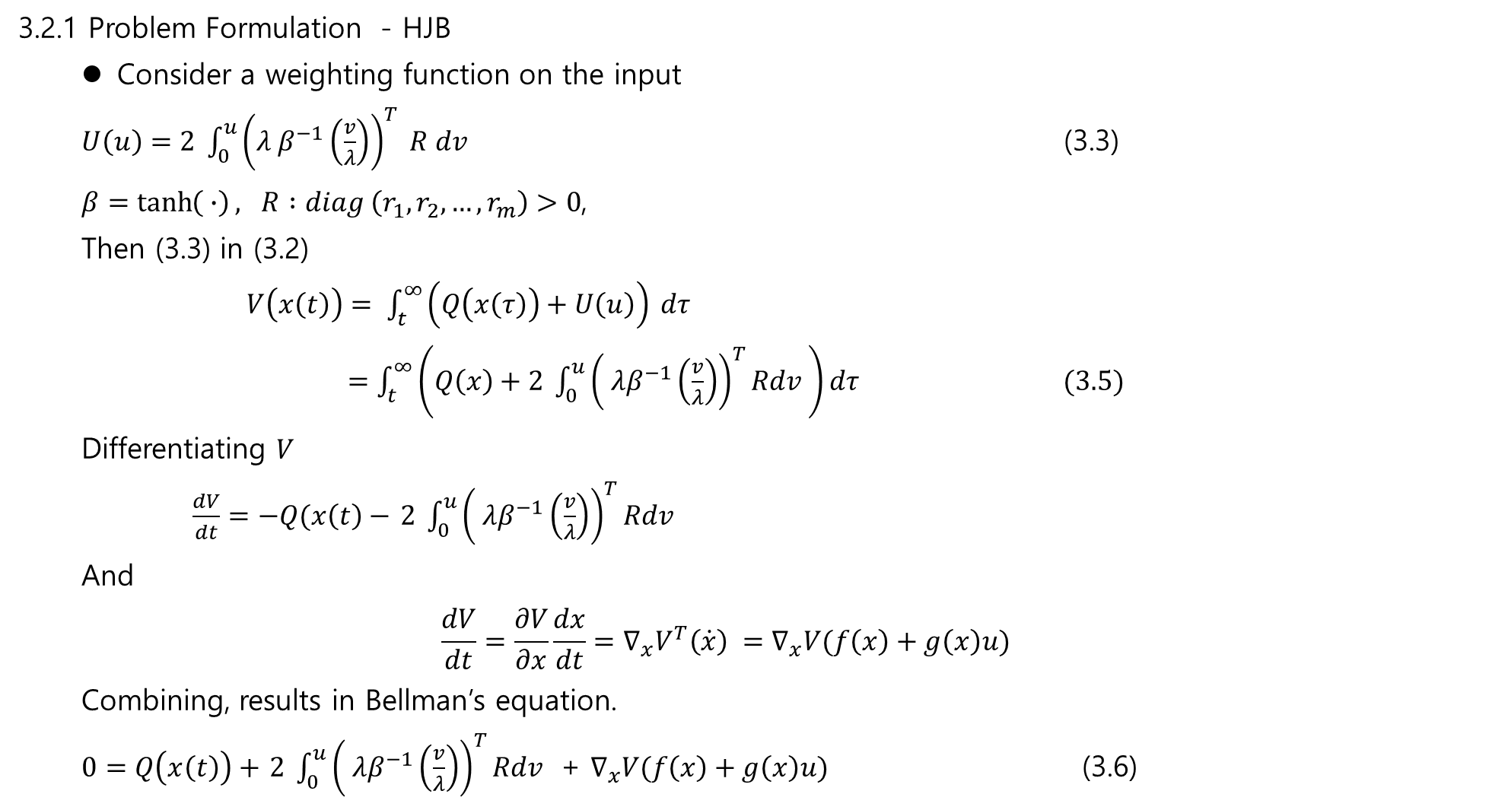
3.2.1 Problem Formulation - HJB
Consider a weighting function on the input
$U\left(u\right)=2 \int_{0}^{u}{{\left(λ β^{−1}\left(\frac{v}{λ}\right)\right)}^{T} R dv}$ (3.3)
$β=\tanh\left( ∙\right),$ $R :diag \left(r_{1}, r_{2},…,r_{m}\right)>0$,
Then (3.3) in (3.2)
$V\left(x\left(t\right)\right)= \int_{t}^{∞}{\left(Q\left(x\left(τ\right)\right)+U\left(u\right)\right)} dτ$
$=\int_{t}^{∞}{\left(Q\left(x\right)+2 \int_{0}^{u}{{\left( λβ^{−1}\left(\frac{v}{λ}\right)\right)}^{T}Rdv }\right)}dτ (3.5)$
Differentiating $V$
$\frac{dV}{dt}=−Q(x\left(t\right)−$ $2 \int_{0}^{u}{{\left( λβ^{−1}\left(\frac{v}{λ}\right)\right)}^{T}Rdv }$
And
$$\frac{dV}{dt}=\frac{∂V}{∂x}\frac{dx}{dt}=∇_{x}V^{T}\left(\dot{x}\right) =∇_{x}V(f\left(x\right)+g\left(x\right)u)$$
Combining, results in Bellman’s equation.
$0=Q\left(x\left(t\right)\right)+$ $2 \int_{0}^{u}{{\left( λβ^{−1}\left(\frac{v}{λ}\right)\right)}^{T}Rdv }$ + $∇_{x}V(f\left(x\right)+g\left(x\right)u)$ (3.6)

Slide 9
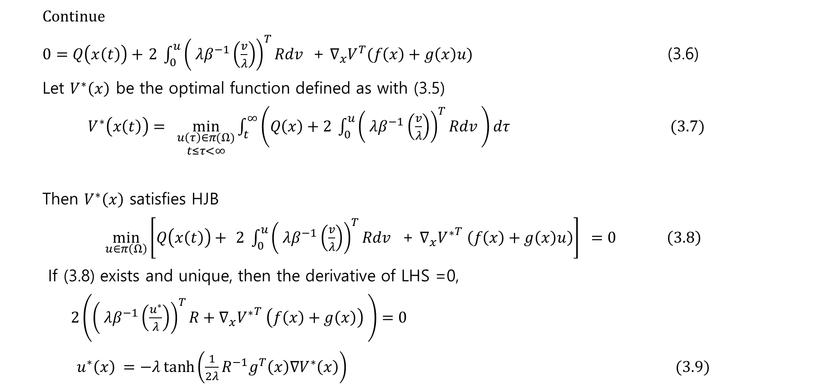
Continue
$0=Q\left(x\left(t\right)\right)+$ $2 \int_{0}^{u}{{\left( λβ^{−1}\left(\frac{v}{λ}\right)\right)}^{T}Rdv }$ + $∇_{x}V^{T}(f\left(x\right)+g\left(x\right)u)$ (3.6)
Let $V^{∗}\left(x\right)$ be the optimal function defined as with (3.5)
$V^{∗}\left(x\left(t\right)\right)= \min_{\begin{aligned}u\left(τ\right)∈π(Ω) \\ t≤τ<∞\end{aligned}}{\int_{t}^{∞}{\left(Q\left(x\right)+2 \int_{0}^{u}{{\left( λβ^{−1}\left(\frac{v}{λ}\right)\right)}^{T}Rdv }\right)}dτ} (3.7)$
Then $V^{∗}\left(x\right)$ satisfies HJB
$\min_{u∈π\left(Ω\right)}\left[Q\left(x\left(t\right)\right)+ 2 \int_{0}^{u}{{\left( λβ^{−1}\left(\frac{v}{λ}\right)\right)}^{T}Rdv }\text{ + }∇_{x}{V^{∗}}^{T} \left(f\left(x\right)+g\left(x\right)u\right)\right] =0 \left(3.8\right)$
If (3.8) exists and unique, then the derivative of LHS =0,
$2\left({\left( λβ^{−1}\left(\frac{u^{∗}}{λ}\right)\right)}^{T}R+∇_{x}{V^{∗}}^{T} \left(f\left(x\right)+g\left(x\right)\right) \right)=0$
$u^{∗}\left(x\right) =−λ\tanh\left(\frac{1}{2λ}R^{−1}g^{T}\left(x\right)∇V^{∗}\left(x\right)\right) (3.9)$

Slide 10

Continue
Then with (3.3)
$U\left(u^{∗}\right)=2 \int_{0}^{u^{∗}}{{\left(λβ^{−1}\left(\frac{v}{λ}\right)\right)}^{T}Rdv}$
$=λ∇{V^{∗}}^{T}\left(x\right) g\left(x\right)\tan\left(D^{∗}\right) +λ^{2}R\ln{(1 −\tanh^{2}{(D^{∗})), }}$
where
$D^{∗}=\left(\frac{1}{2λ}R^{−1}g^{T}\left(x\right)∇_{x}V^{∗}\left(x\right)\right)$
In conclusion HJB is
$H\left(x,u^{∗}, ∇V^{∗}\right)=Q\left(x\right)+∇V^{∗}\left(x\right) f\left(x\right)+λ^{2}R\ln{(1−\tanh^{2}{(D^{∗})) =0, V^{∗}(0)=0 }}$. (3.11)

Slide 11
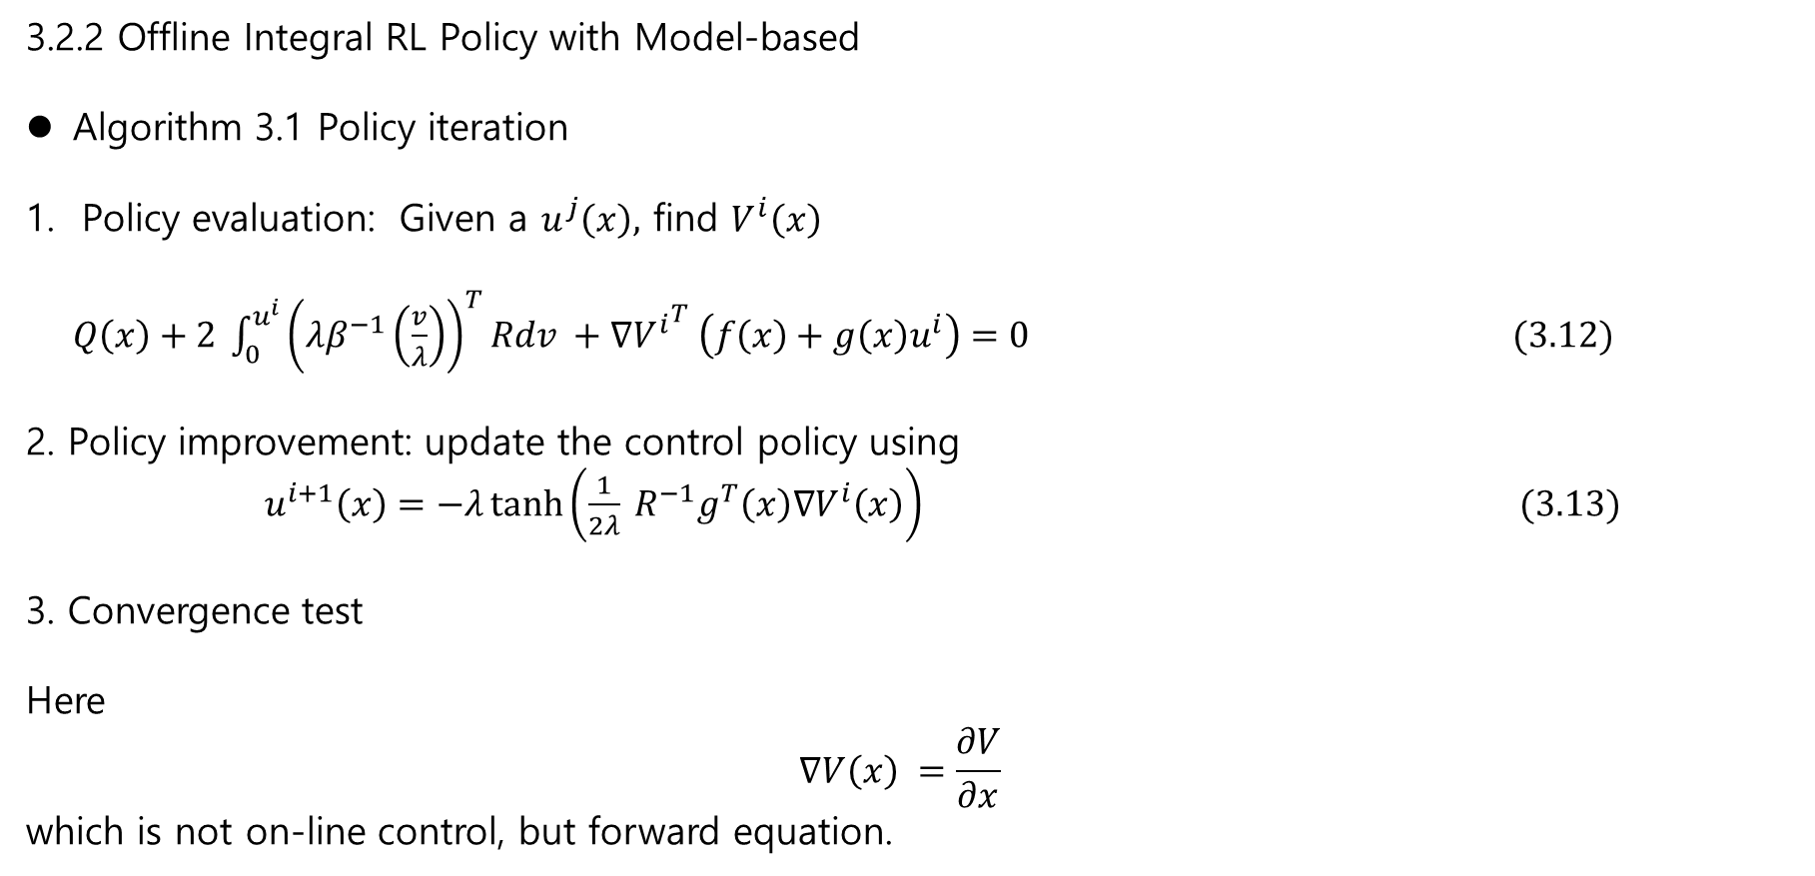
3.2.2 Offline Integral RL Policy with Model-based
Algorithm 3.1 Policy iteration
Policy evaluation: Given a $u^{j}\left(x\right),$ find $V^{i}\left(x\right)$
$Q\left(x\right)+2 \int_{0}^{u^{i}}{{\left(λβ^{−1}\left(\frac{v}{λ}\right)\right)}^{T}Rdv }+∇{V^{i}}^{T} \left(f\left(x\right)+g\left(x\right)u^{i}\right)=0 (3.12)$
2. Policy improvement: update the control policy using
$u^{i+1}\left(x\right)=−λ\tanh\left(\frac{1}{2λ} R^{−1}g^{T}\left(x\right)∇V^{i}\left(x\right)\right) (3.13)$
3. Convergence test
Here
$$∇V\left(x\right) =\frac{∂V}{∂x}$$
which is not on-line control, but forward equation.

Slide 12
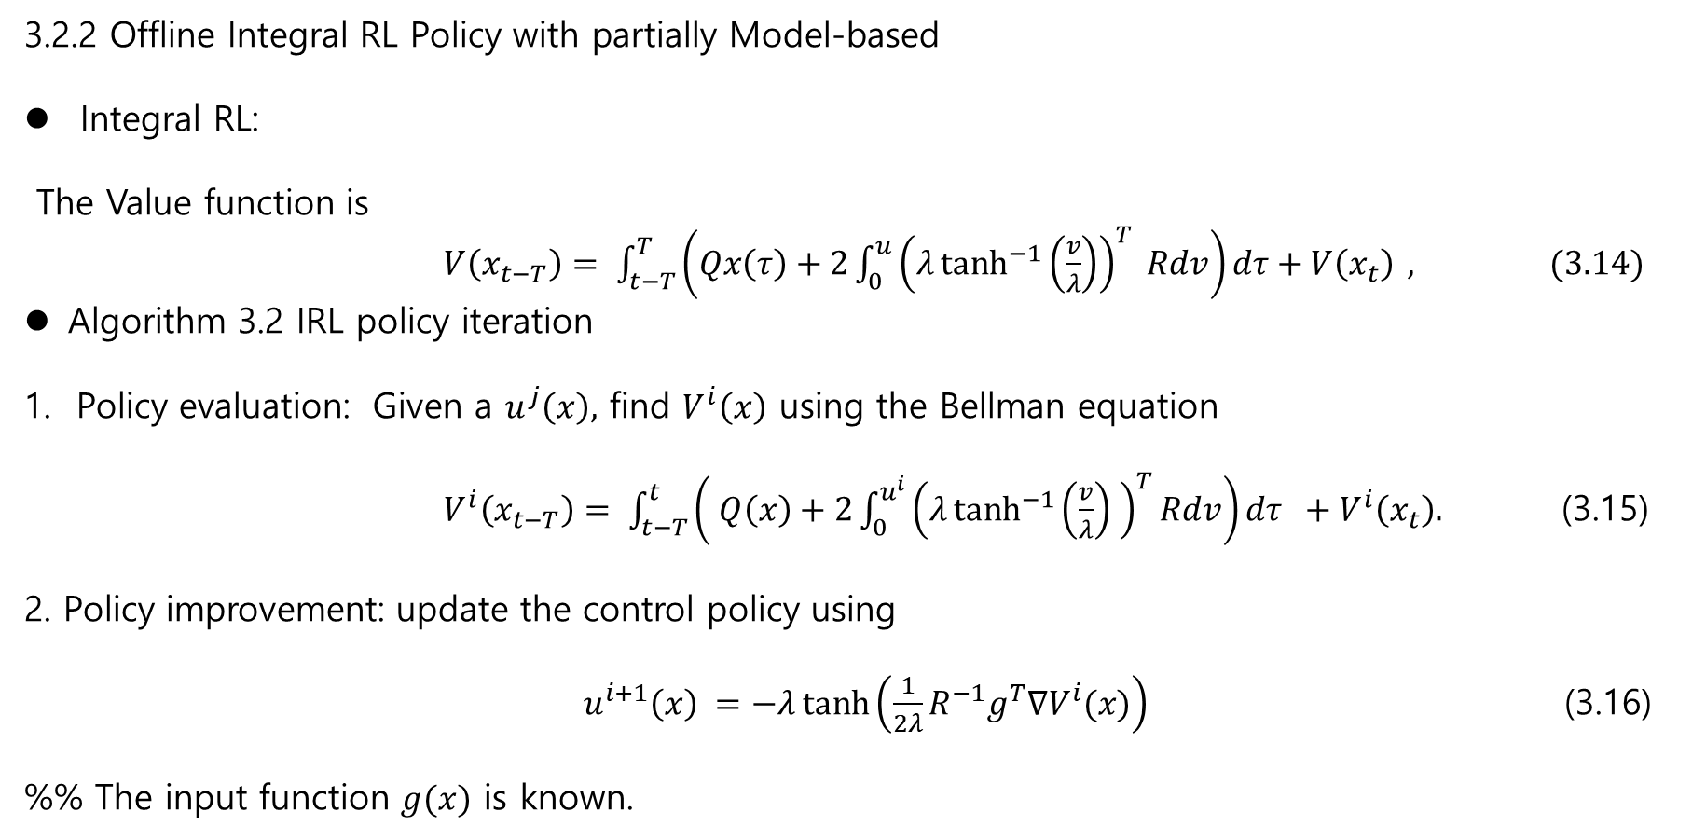
3.2.2 Offline Integral RL Policy with partially Model-based
Integral RL:
The Value function is
$V\left(x_{t−T}\right)= \int_{t−T}^{T}{\left(Qx\left(τ\right)+2\int_{0}^{u}{{\left(λ\tanh^{−1}\left(\frac{v}{λ}\right)\right)}^{T} Rdv}\right)dτ+V\left(x_{t}\right) }, (3.14)$
Algorithm 3.2 IRL policy iteration
Policy evaluation: Given a $u^{j}\left(x\right),$ find $V^{i}\left(x\right)$ using the Bellman equation
$V^{i}\left(x_{t−T}\right)= \int_{t−T}^{t}{\left( Q\left(x\right)+2\int_{0}^{u^{i}}{{\left(λ\tanh^{−1}\left(\frac{v}{λ}\right) \right)}^{T}Rdv}\right)dτ +V^{i}\left(x_{t}\right). }$ (3.15)
2. Policy improvement: update the control policy using
$u^{i+1}\left(x\right) =−λ\tanh\left(\frac{1}{2λ}R^{−1}g^{T}∇V^{i}(x)\right)$ (3.16)
%% The input function $g(x)$ is known.

Slide 13
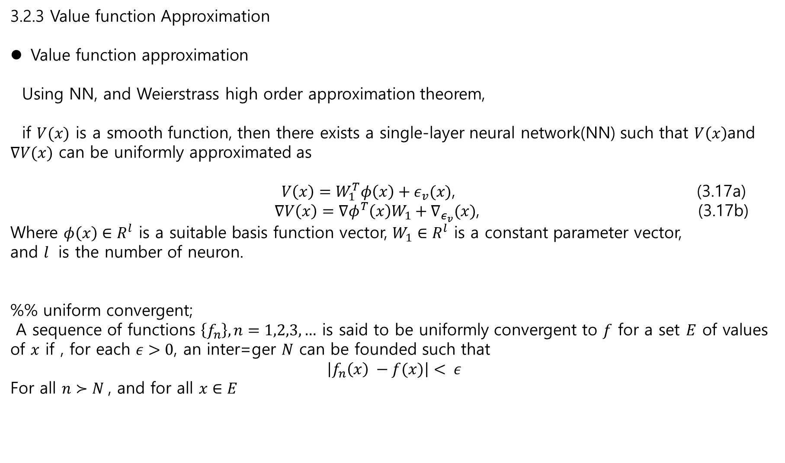
3.2.3 Value function Approximation
Value function approximation
Using NN, and Weierstrass high order approximation theorem,
if $V(x)$ is a smooth function, then there exists a single-layer neural network(NN) such that $V\left(x\right)$and $∇V(x)$ can be uniformly approximated as
$V\left(x\right)=W_{1}^{T}φ\left(x\right)+ε_{v}(x)$, (3.17a)
$∇V\left(x\right)=∇φ^{T}\left(x\right)W_{1}+∇_{ε_{v}}(x)$, (3.17b)
Where $φ\left(x\right)∈R^{l}$ is a suitable basis function vector, $W_{1}∈R^{l}$ is a constant parameter vector,
and $l$ is the number of neuron.
%% uniform convergent;
A sequence of functions $\left\{f_{n}\right\}, n=1,2,3,…$ is said to be uniformly convergent to $f$ for a set $E$ of values of $x$ if , for each $ε>0$, an inter=ger $N$ can be founded such that
$$\left|f_{n}\left(x\right) −f(x)\right|< ε$$
For all $n≻N$, and for all $x∈E$

Slide 14
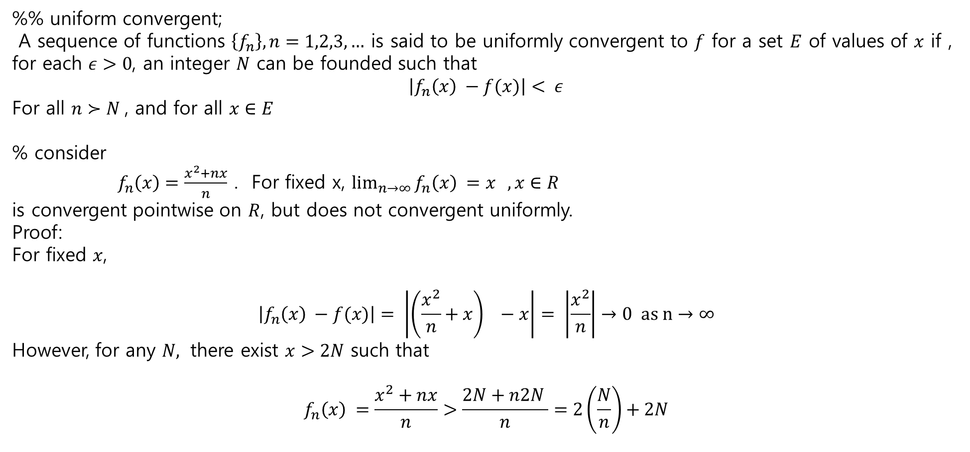
3.2.3 Value function Approximation
%% uniform convergent;
A sequence of functions $\left\{f_{n}\right\}, n=1,2,3,…$ is said to be uniformly convergent to $f$ for a set $E$ of values of $x$ if , for each $ε>0$, an integer $N$ can be founded such that
$$\left|f_{n}\left(x\right) −f(x)\right|< ε$$
For all $n≻N$, and for all $x∈E$
% consider
$f_{n}\left(x\right)=\frac{x^{2}+nx}{n}$ . For fixed x, $\lim_{n→∞}{f_{n}\left(x\right) =x } , x∈R$
is convergent pointwise on $R$, but does not convergent uniformly.
Proof:
For fixed $x$,
$$\left|f_{n}\left(x\right) −f(x)\right|= \left|\left(\frac{x^{2}}{n}+x\right) −x\right|= \left|\frac{x^{2}}{n}\right|→0 as n→∞$$
However, for any $N,$ there exist $x>2N$ such that
$$f_{n}\left(x\right) =\frac{x^{2}+nx}{n}>\frac{2N+n2N }{n}=2\left(\frac{N}{n}\right)+2N$$

Slide 15
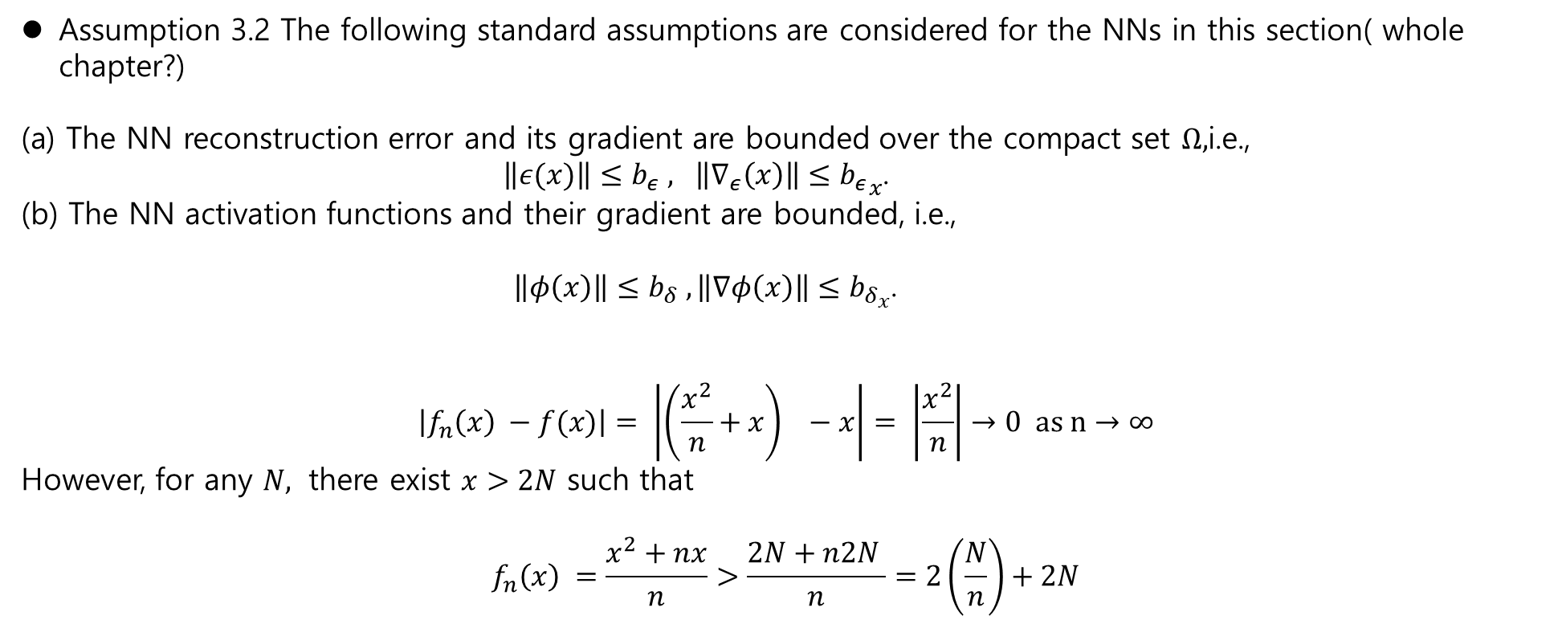
3.2.3 Value function Approximation
Assumption 3.2 The following standard assumptions are considered for the NNs in this section( whole chapter?)
The NN reconstruction error and its gradient are bounded over the compact set $Ω,$i.e.,
$\left\|ε(x)\right\|≤b_{ε} , \left\|∇_{ε}\left(x\right)\right\|≤{b_{ε}}_{x}$.
(b) The NN activation functions and their gradient are bounded, i.e.,
$\left\|φ\left(x\right)\right\|≤b_{δ} , \left\|∇φ\left(x\right)\right\|≤b_{δ_{x}}$.
$$\left|f_{n}\left(x\right) −f(x)\right|= \left|\left(\frac{x^{2}}{n}+x\right) −x\right|= \left|\frac{x^{2}}{n}\right|→0 as n→∞$$
However, for any $N,$ there exist $x>2N$ such that
$$f_{n}\left(x\right) =\frac{x^{2}+nx}{n}>\frac{2N+n2N }{n}=2\left(\frac{N}{n}\right)+2N$$

