Slide 1
Week_1 Review
- RL for feedback control system
- System: parameters are totally or partially unknown (model-free)
- Design an optimal feedback controller ( not interested in estimation system parameters) online (real time)
- How? In principle,
1) Optimal means to minimize a designer criterion which is a function of measurable outputs.
2) Interested time domain is assumed to be infinite time horizon.
(remember that the optimal control is time-backward by Bellman optimal condition).
3) Estimate the designer criterion (Value function) using measurements.
4) Design a control to minimize the estimate value function online.

Slide 2
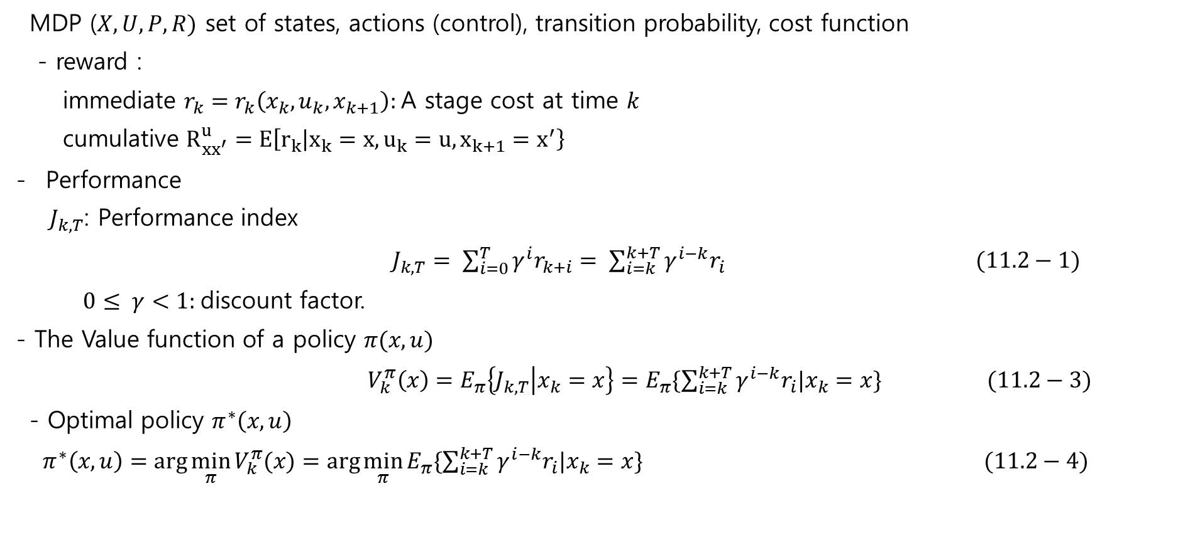
Review
MDP ($X,U,P,R)$ set of states, actions (control), transition probability, cost function
- reward :
immediate $r_{k}=r_{k}\left(x_{k}, u_{k}, x_{k+1}\right):$A stage cost at time $k$
cumulative $R_{xx^{′}}^{u}=E\left[r_{k} | x_{k}=x,u_{k}=u,x_{k+1}=x^{′}\right\}$
Performance
$J_{k,T}$: Performance index
$J_{k,T}= \sum_{i=0}^{T}{γ^{i}r_{k+i}= \sum_{i=k}^{k+T}{γ^{i−k}r_{i}}} (11.2−1)$
$0≤ γ<1:$discount factor.
- The Value function of a policy $π(x,u)$
$V_{k}^{π}\left(x\right)=E_{π}\left\{J_{k,T} | x_{k}=x\right\}=E_{π}\{\sum_{i=k}^{k+T}{γ^{i−k}r_{i}|x_{k}=x}\} (11.2−3)$
- Optimal policy $π^{∗}\left(x,u\right)$
$π^{∗}\left(x,u\right)=\arg{\min_{π}{V_{k}^{π}(x)}}=\arg{\min_{π}{E_{π}\{\sum_{i=k}^{k+T}{γ^{i−k}r_{i}|x_{k}=x}\} (11.2−4)}}$

Slide 3
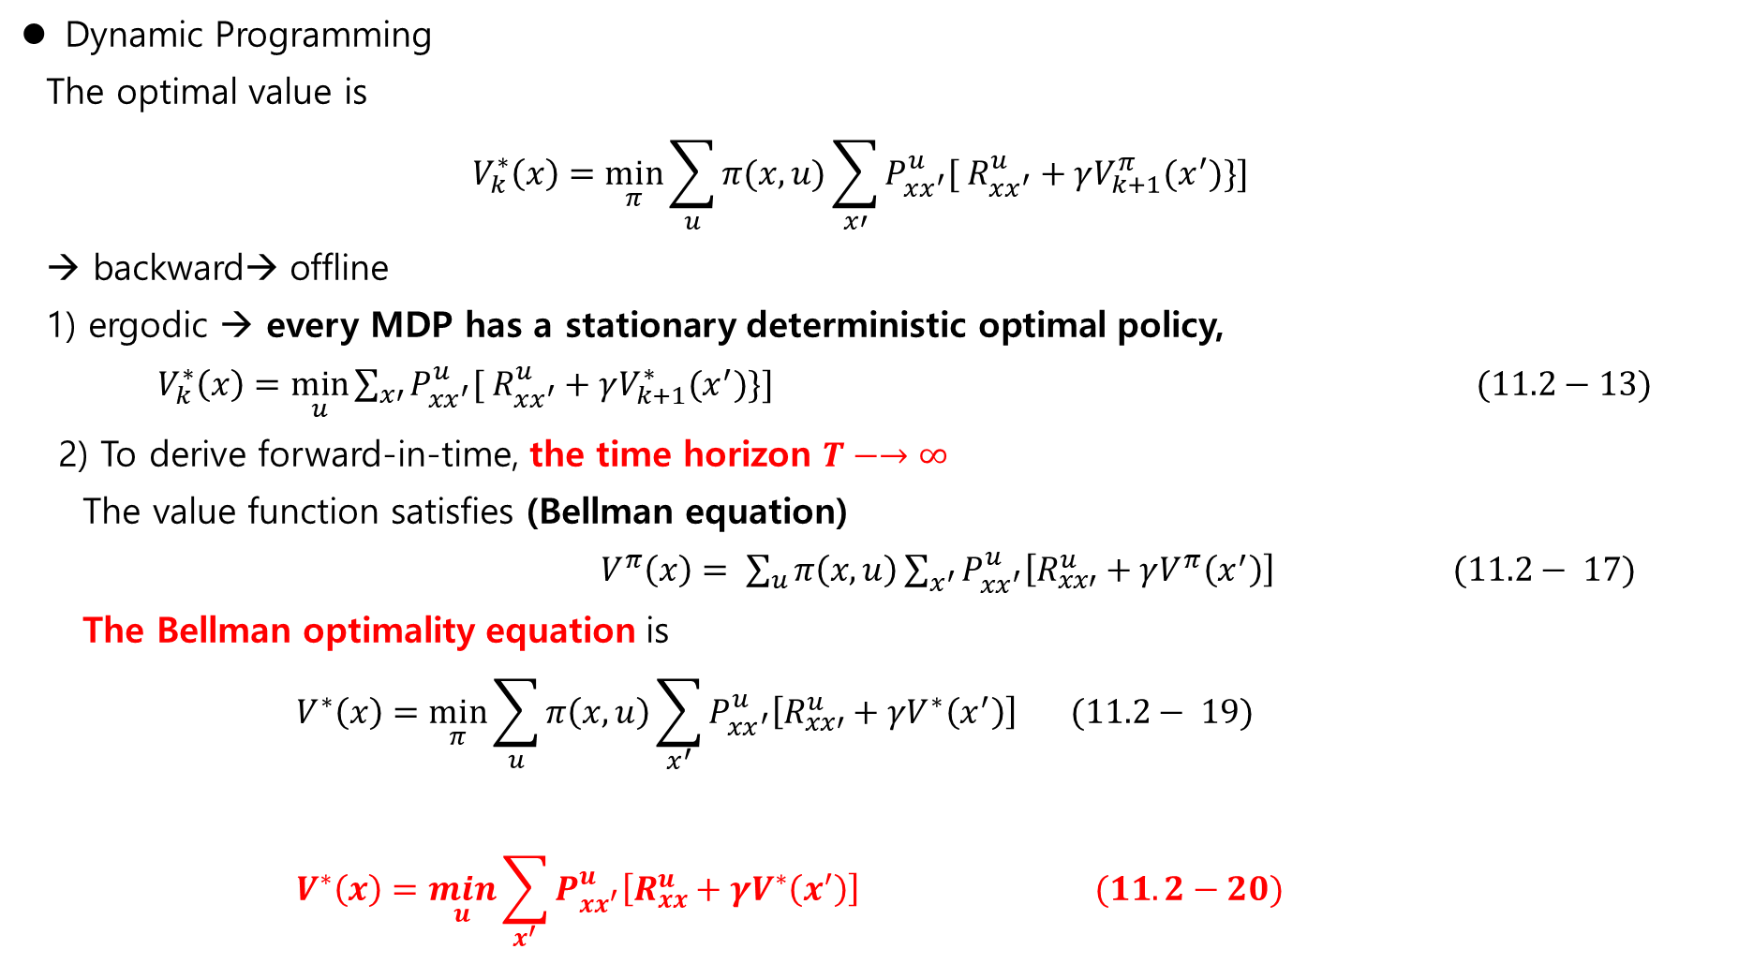
Review
Dynamic Programming
The optimal value is
$$V_{k}^{∗}\left(x\right)=\min_{π}{\sum_{u}{π(x,u)}\sum_{x′}{P_{xx^{′}}^{u}[ R_{xx^{′}}^{u}}+γV_{k+1}^{π}(x^{′})\}] }$$
→ backward→ offline
1) ergodic → every MDP has a stationary deterministic optimal policy,
$V_{k}^{∗}\left(x\right)=\min_{u}{\sum_{x′}{P_{xx^{′}}^{u}[ R_{xx^{′}}^{u}}+γV_{k+1}^{∗}(x^{′})\}] (11.2−13) }$
2) To derive forward-in-time, the time horizon $T−→∞$
The value function satisfies (Bellman equation)
$V^{π}\left(x\right)= \sum_{u}{π\left(x,u\right)}\sum_{x^{′}}{P_{xx^{′}}^{u}\left[R_{xx′}^{u}+γV^{π}\left(x^{′}\right)\right]} (11.2− 17)$
The Bellman optimality equation is
$$V^{∗}\left(x\right)=\min_{π}{\sum_{u}{π\left(x,u\right)}\sum_{x^{′}}{P_{xx^{′}}^{u}\left[R_{xx′}^{u}+γV^{∗}\left(x^{′}\right)\right]}} (11.2− 19)$$
$$V^{∗}\left(x\right)=\min_{u}{\sum_{x^{′}}{P_{xx^{′}}^{u}\left[R_{xx}^{u}+γV^{∗}\left(x^{′}\right)\right] (11.2−20)}}$$
If ergodic

Slide 4
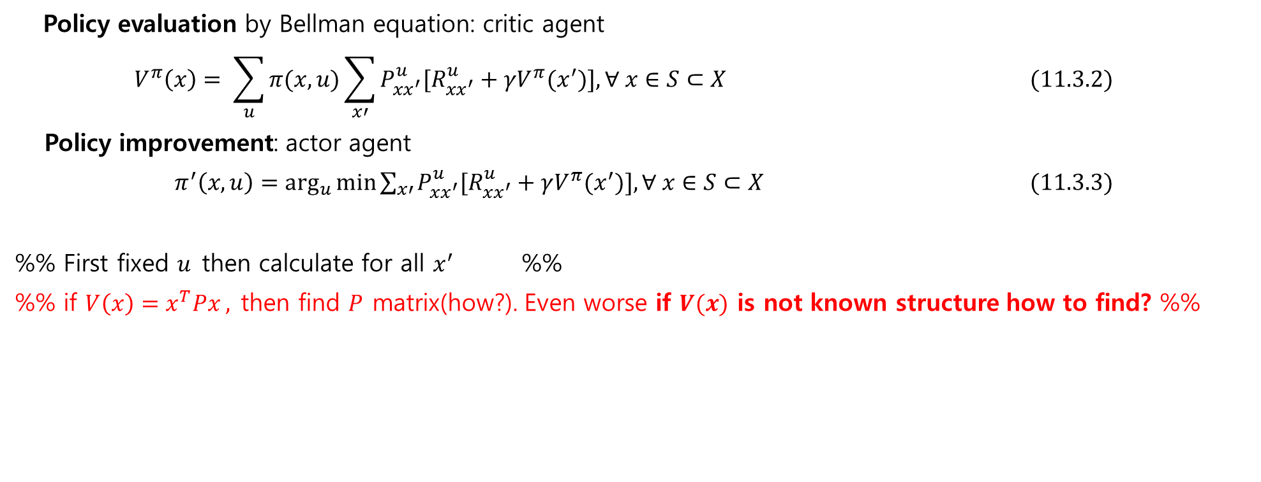
11.3 Policy Evaluation and Policy Improvement
Policy evaluation by Bellman equation: critic agent
$$V^{π}\left(x\right)= \sum_{u}{π(x,u)}\sum_{x′}{P_{xx^{′}}^{u}[R_{xx^{′}}^{u}+γV^{π}(x^{′})}], ∀ x∈S⊂X (11.3.2)$$
Policy improvement: actor agent
$π^{′}\left(x,u\right)=\arg_{u}{\min{\sum_{x′}{P_{xx^{′}}^{u}[R_{xx^{′}}^{u}+γV^{π}(x^{′})}], ∀ x∈S⊂X (11.3.3)}}$
%% First fixed $u$then calculate for all $x^{′}$ %%
%% if $V\left(x\right)=x^{T}Px ,$then find $P$ matrix(how?). Even worse if $V(x)$ is not known structure how to find? %%
Two methods
1) Policy Iteration(PI)
2) Value Iteration (VI)

Slide 5
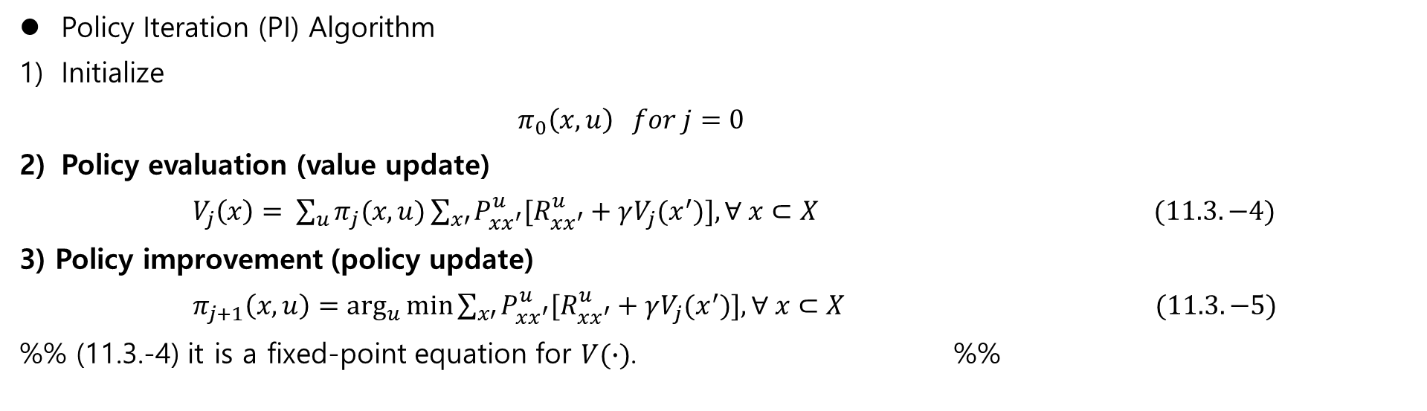
11.3 Policy Evaluation and Policy Improvement
Policy Iteration (PI) Algorithm
Initialize
$$π_{0}\left(x,u\right) for j=0$$
Policy evaluation (value update)
$V_{j}\left(x\right)= \sum_{u}{π_{j}(x,u)}\sum_{x′}{P_{xx^{′}}^{u}[R_{xx^{′}}^{u}+γV_{j}(x^{′})}], ∀ x⊂X (11.3.−4)$
3) Policy improvement (policy update)
$π_{j+1}\left(x,u\right)=\arg_{u}{\min{\sum_{x′}{P_{xx^{′}}^{u}[R_{xx^{′}}^{u}+γV_{j}(x^{′})}], ∀ x⊂X (11.3.−5)}}$
%% (11.3.-4) it is a fixed-point equation for $V(∙)$. %%

Slide 6
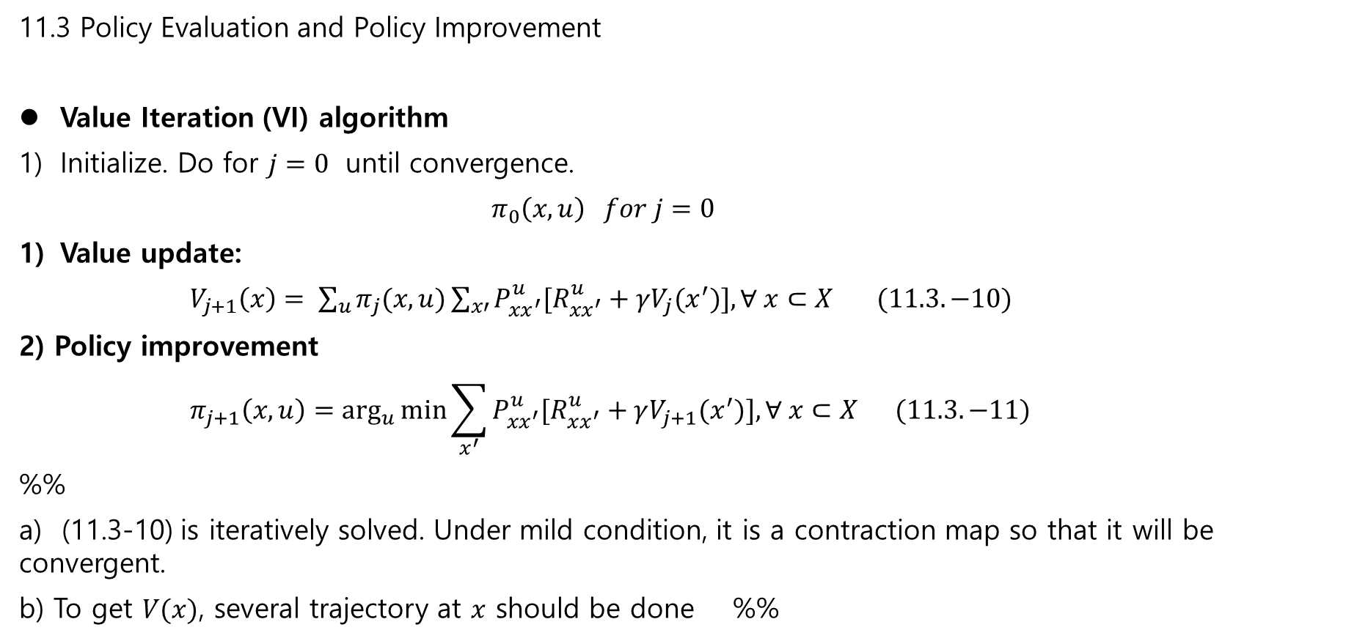
11.3 Policy Evaluation and Policy Improvement
Value Iteration (VI) algorithm
Initialize. Do for $j=0$ until convergence.
$$π_{0}\left(x,u\right) for j=0$$
Value update:
$V_{j+1}\left(x\right)= \sum_{u}{π_{j}(x,u)}\sum_{x′}{P_{xx^{′}}^{u}[R_{xx^{′}}^{u}+γV_{j}(x^{′})}], ∀ x⊂X (11.3.−10)$
2) Policy improvement
$$π_{j+1}\left(x,u\right)=\arg_{u}{\min{\sum_{x^{′}}{P_{xx^{′}}^{u}[R_{xx^{′}}^{u}+γV_{j+1}(x^{′})}], ∀ x⊂X (11.3.−11)}}$$
%%
a) (11.3-10) is iteratively solved. Under mild condition, it is a contraction map so that it will be convergent.
b) To get $V(x)$, several trajectory at $x$ should be done %%

Slide 7
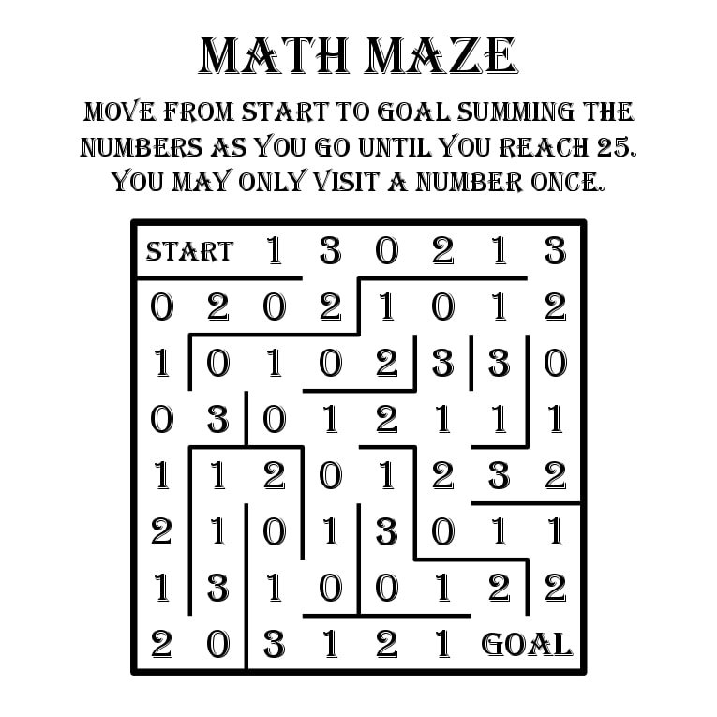
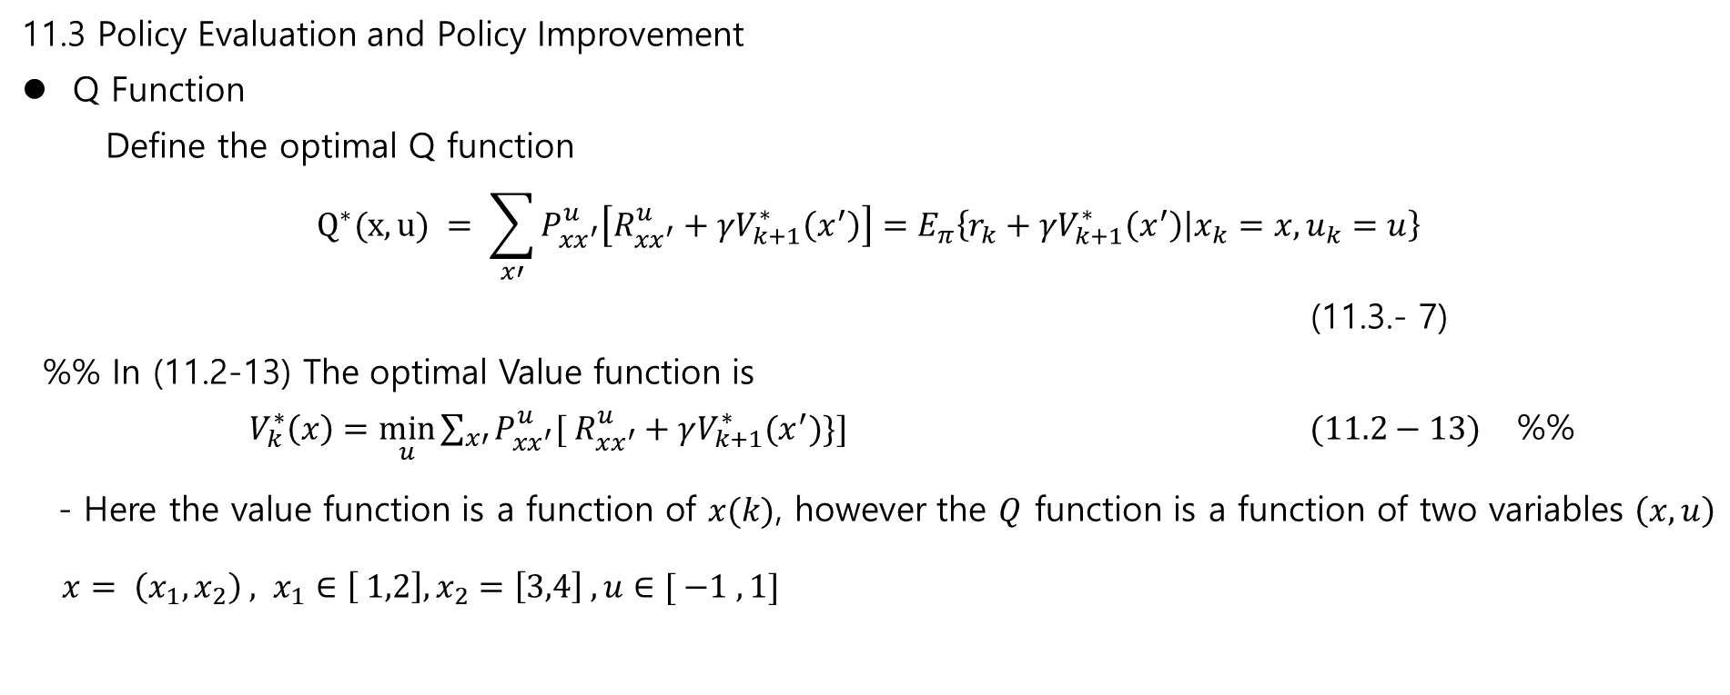
11.3 Policy Evaluation and Policy Improvement
Q Function
Define the optimal Q function
$$Q^{∗}(x,u) = \sum_{x′}{P_{xx^{′}}^{u}\left[R_{xx^{′}}^{u}+γV_{k+1}^{∗}\left(x^{′}\right)\right]=E_{π}\left\{r_{k}+γV_{k+1}^{∗}\left(x^{′}\right) | x_{k}=x, u_{k}=u\right\}}$$
(11.3.- 7)
%% In (11.2-13) The optimal Value function is
$V_{k}^{∗}\left(x\right)=\min_{u}{\sum_{x′}{P_{xx^{′}}^{u}[ R_{xx^{′}}^{u}}+γV_{k+1}^{∗}(x^{′})\}] (11.2−13)}$ %%
- Here the value function is a function of $x(k)$, however the $Q$ function is a function of two variables $\left(x,u\right)$
$x= \left(x_{1}, x_{2}\right) , x_{1}∈\left[ 1,2\right], x_{2}=\left[3,4\right] , u∈[ −1 ,1]$
Q(x,u) table
 | (1,3) | (1,4) | (2,3) | (2,4)
-1 | Q1 | Q2 | Q3 | Q4
1
1
-1 |  |  |  | Q16
Construct Q(x,u)

Slide 8
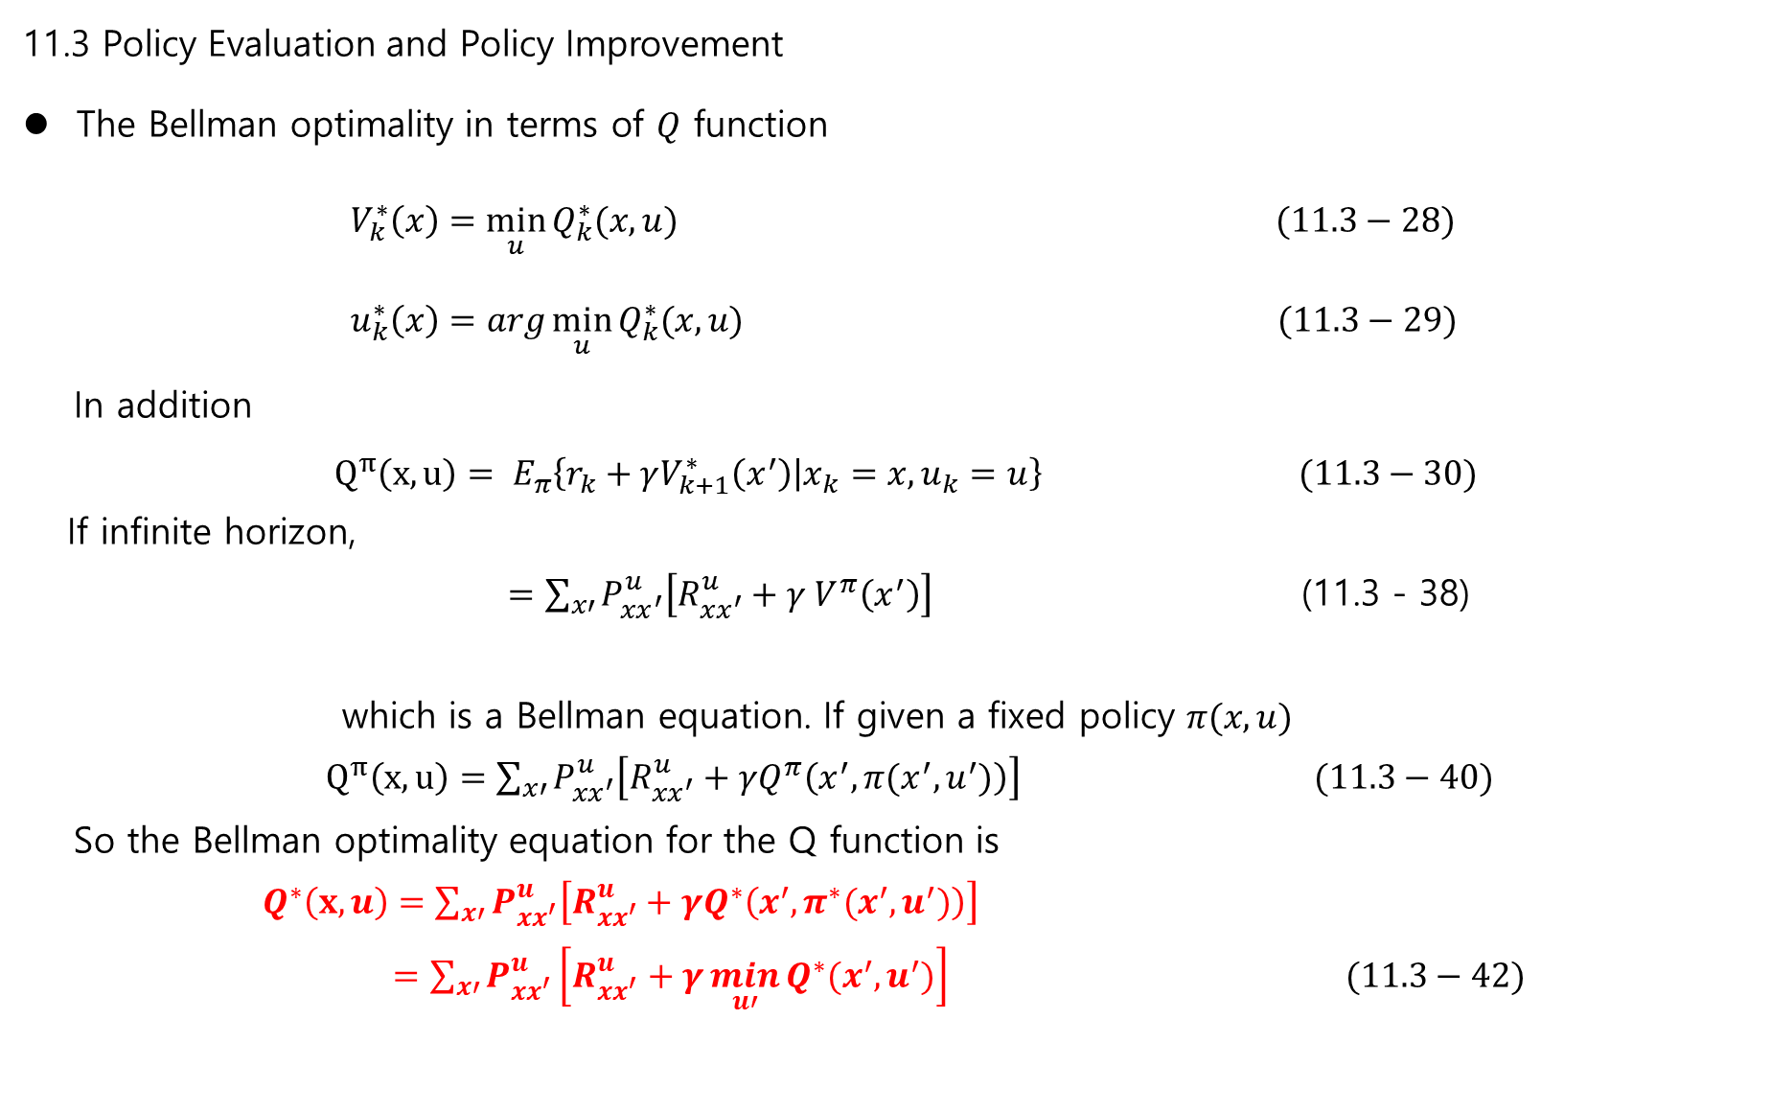
11.3 Policy Evaluation and Policy Improvement
The Bellman optimality in terms of $Q$ function
$V_{k}^{∗}\left(x\right)=\min_{u}{Q_{k}^{∗}(x,u)} (11.3−28)$
$u_{k}^{∗}\left(x\right)=arg\min_{u}{Q_{k}^{∗}(x,u)} (11.3−29)$
In addition
$Q^{π}\left(x,u\right)= E_{π}\left\{r_{k}+γV_{k+1}^{∗}\left(x^{′}\right) | x_{k}=x, u_{k}=u\right\} (11.3−30)$
If infinite horizon,
$=\sum_{x′}{P_{xx^{′}}^{u}\left[R_{xx^{′}}^{u}+γ V^{π}\left(x^{′}\right)\right]}$ (11.3 - 38)
which is a Bellman equation. If given a fixed policy $π(x,u)$
$Q^{π}\left(x,u\right)=\sum_{x′}{P_{xx^{′}}^{u}\left[R_{xx^{′}}^{u}+γQ^{π}\left(x^{′}, π(x^{′}, u^{′})\right)\right]} (11.3−40)$
So the Bellman optimality equation for the Q function is
$Q^{∗}\left(x,u\right)=\sum_{x′}{P_{xx^{′}}^{u}\left[R_{xx^{′}}^{u}+γQ^{∗}\left(x^{′}, π^{∗}(x^{′}, u^{′})\right)\right]}$
$=\sum_{x′}{P_{xx^{′}}^{u}\left[R_{xx^{′}}^{u}+γ\min_{u′}{Q^{∗}(x^{′}, u^{′})}\right]} (11.3−42)$

Slide 9
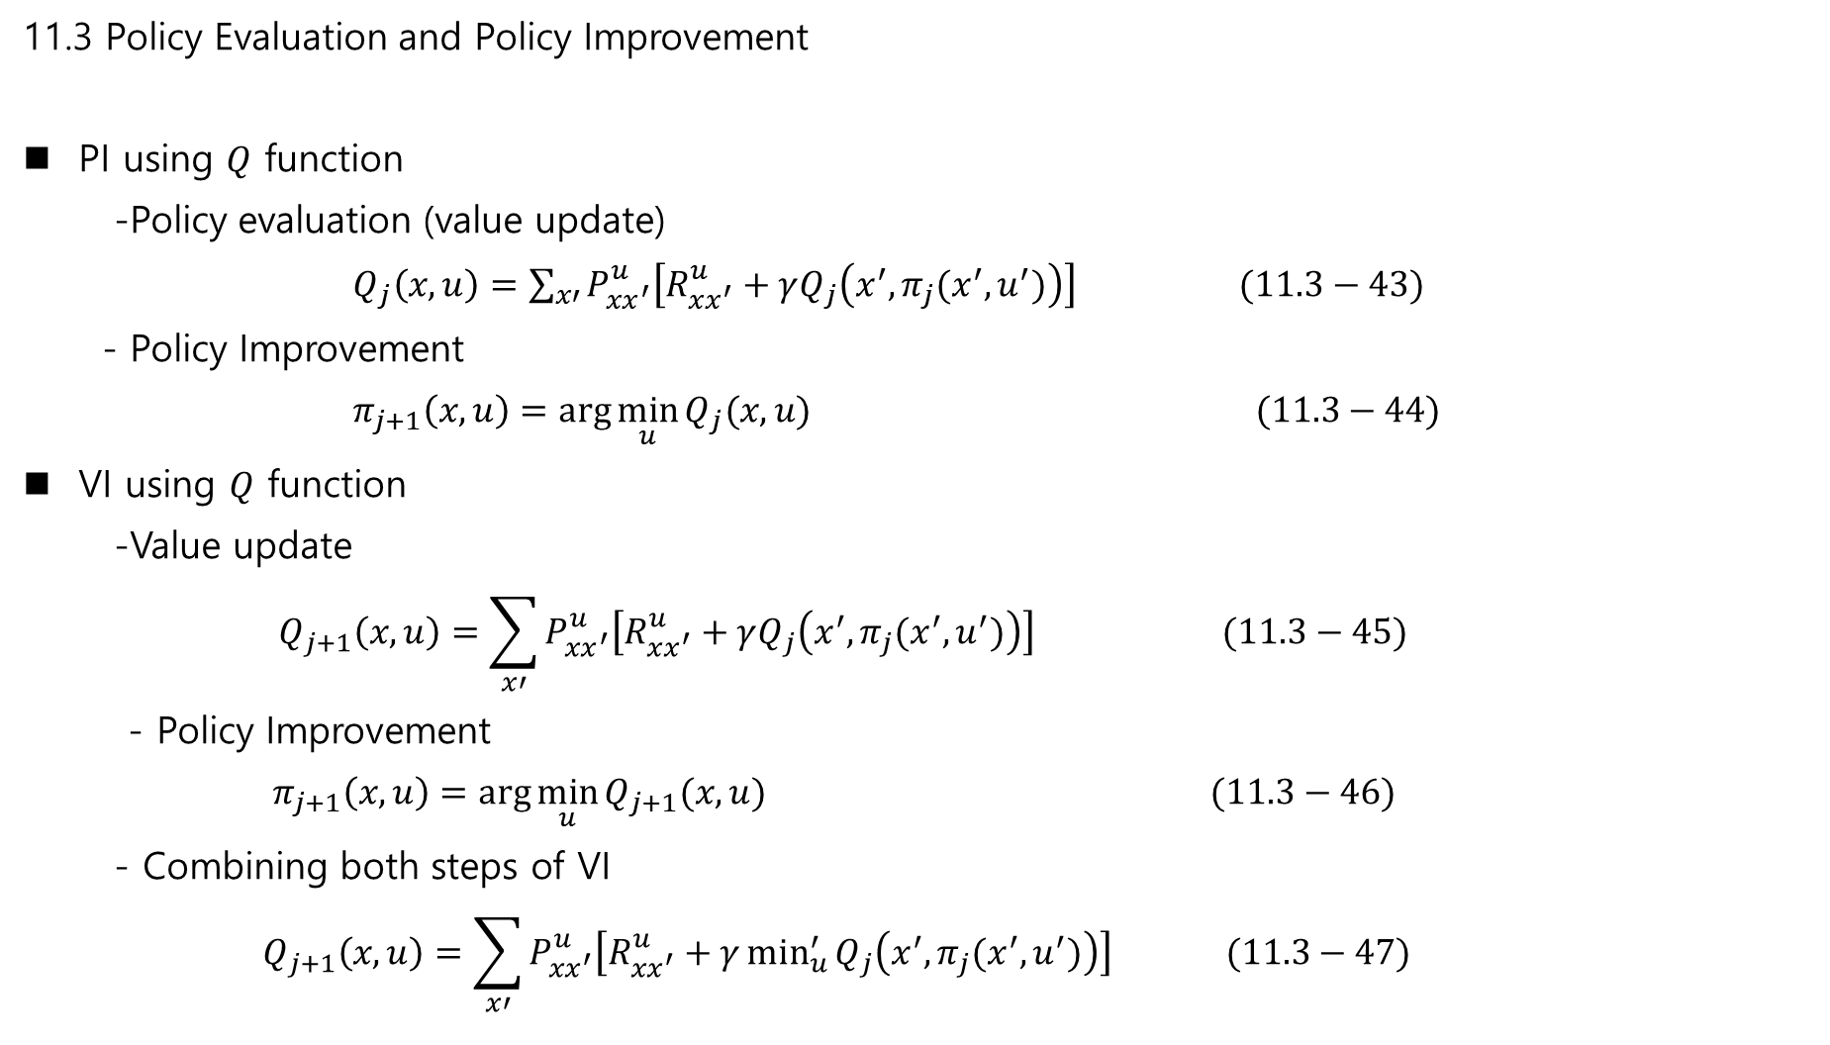
11.3 Policy Evaluation and Policy Improvement
PI using $Q$ function
-Policy evaluation (value update)
$Q_{j}\left(x,u\right)=\sum_{x′}{P_{xx^{′}}^{u}\left[R_{xx^{′}}^{u}+γQ_{j}\left(x^{′}, π_{j}(x^{′}, u^{′})\right)\right]} (11.3−43)$
- Policy Improvement
$π_{j+1}\left(x,u\right)=\arg{\min_{u}{Q_{j}(x,u)}} (11.3−44)$
VI using $Q$ function
-Value update
$$Q_{j+1}\left(x,u\right)=\sum_{x′}{P_{xx^{′}}^{u}\left[R_{xx^{′}}^{u}+γQ_{j}\left(x^{′}, π_{j}(x^{′}, u^{′})\right)\right]} (11.3−45)$$
- Policy Improvement
$π_{j+1}\left(x,u\right)=\arg{\min_{u}{Q_{j+1}(x,u)}} (11.3−46)$
- Combining both steps of VI
$$Q_{j+1}\left(x,u\right)=\sum_{x′}{P_{xx^{′}}^{u}\left[R_{xx^{′}}^{u}+γ\min_{u}^{′}{Q_{j}\left(x^{′}, π_{j}(x^{′}, u^{′})\right)}\right]} (11.3−47)$$

Slide 10
11.3 Policy Evaluation and Policy Improvement
Methods for Implementing PI and VI
System is known : Exact Solution: offline methods.
Monte Carlo learning: episodic tasks → maintaining exploration
→ iterative learning
3) System is unknown:
Temporal Difference
→ successively measurements!!

Slide 11
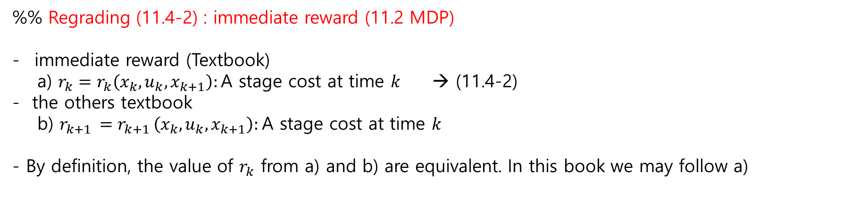
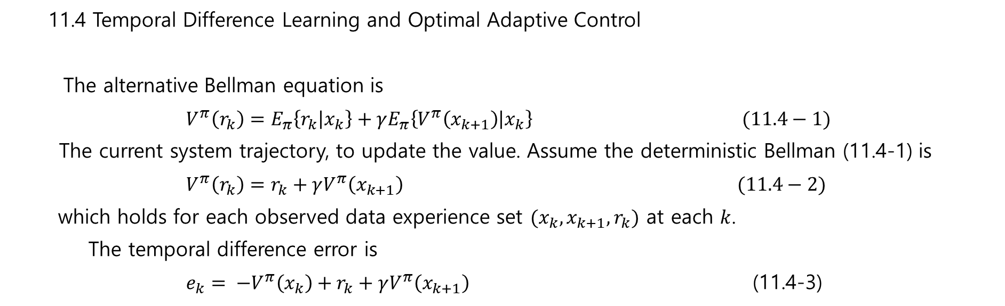
11.4 Temporal Difference Learning and Optimal Adaptive Control
The alternative Bellman equation is
$V^{π}\left(r_{k}\right)=E_{π}\left\{r_{k} | x_{k}\right\}+γE_{π}\left\{V^{π}\left(x_{k+1}\right) | x_{k}\right\} (11.4−1)$
The current system trajectory, to update the value. Assume the deterministic Bellman (11.4-1) is
$V^{π}\left(r_{k}\right)=r_{k}+γV^{π}\left(x_{k+1}\right) (11.4−2)$
which holds for each observed data experience set $(x_{k}, x_{k+1}, r_{k})$ at each $k$.
The temporal difference error is
$e_{k}= −V^{π}\left(x_{k}\right)+r_{k}+γV^{π}\left(x_{k+1}\right)$ (11.4-3)
%% Regrading (11.4-2) : immediate reward (11.2 MDP)
immediate reward (Textbook)
a) $r_{k}=r_{k}\left(x_{k}, u_{k}, x_{k+1}\right):$A stage cost at time $k$ → (11.4-2)
- the others textbook
b) $r_{k+1 }=r_{k+1 }\left(x_{k}, u_{k}, x_{k+1}\right):$A stage cost at time $k$
- By definition, the value of $r_{k}$ from a) and b) are equivalent. In this book we may follow a)

Slide 12
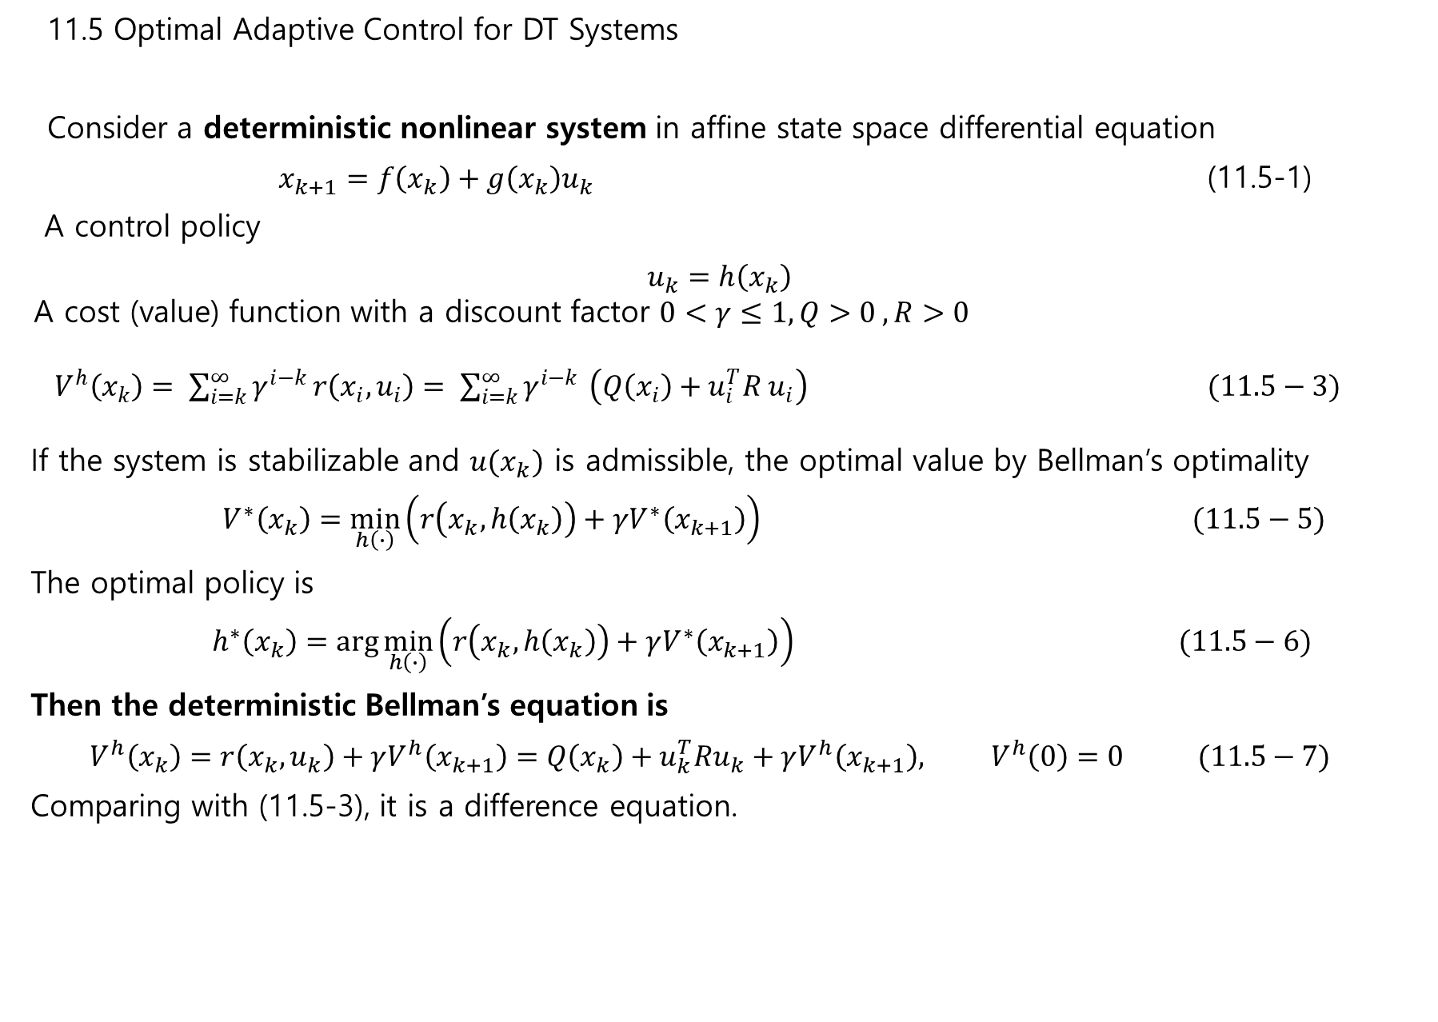
11.5 Optimal Adaptive Control for DT Systems
Consider a deterministic nonlinear system in affine state space differential equation
$x_{k+1}=f\left(x_{k}\right)+g\left(x_{k}\right)u_{k}$ (11.5-1)
A control policy
$$u_{k}=h\left(x_{k}\right)$$ A cost (value) function with a discount factor $0<γ≤1, Q>0 , R>0$
$V^{h}\left(x_{k}\right)= \sum_{i=k}^{∞}{γ^{i−k}}r\left(x_{i}, u_{i}\right)= \sum_{i=k}^{∞}{γ^{i−k }}\left(Q\left(x_{i}\right)+u_{i}^{T}R u_{i}\right) (11.5−3)$
If the system is stabilizable and $u(x_{k})$ is admissible, the optimal value by Bellman’s optimality
$V^{∗}\left(x_{k}\right)=\min_{h\left(∙\right)}\left(r\left(x_{k}, h\left(x_{k}\right)\right)+γV^{∗}\left(x_{k+1}\right)\right) (11.5−5)$
The optimal policy is
$h^{∗}\left(x_{k}\right)=\arg{\min_{h\left(∙\right)}\left(r\left(x_{k}, h\left(x_{k}\right)\right)+γV^{∗}\left(x_{k+1}\right)\right) } (11.5−6)$
Then the deterministic Bellman’s equation is
$$V^{h}\left(x_{k}\right)=r\left(x_{k},u_{k}\right)+γV^{h}\left(x_{k+1}\right)=Q\left(x_{k}\right)+u_{k}^{T}Ru_{k}+γV^{h}\left(x_{k+1}\right), V^{h}\left(0\right)=0 (11.5−7)$$
Comparing with (11.5-3), it is a difference equation.

Slide 13
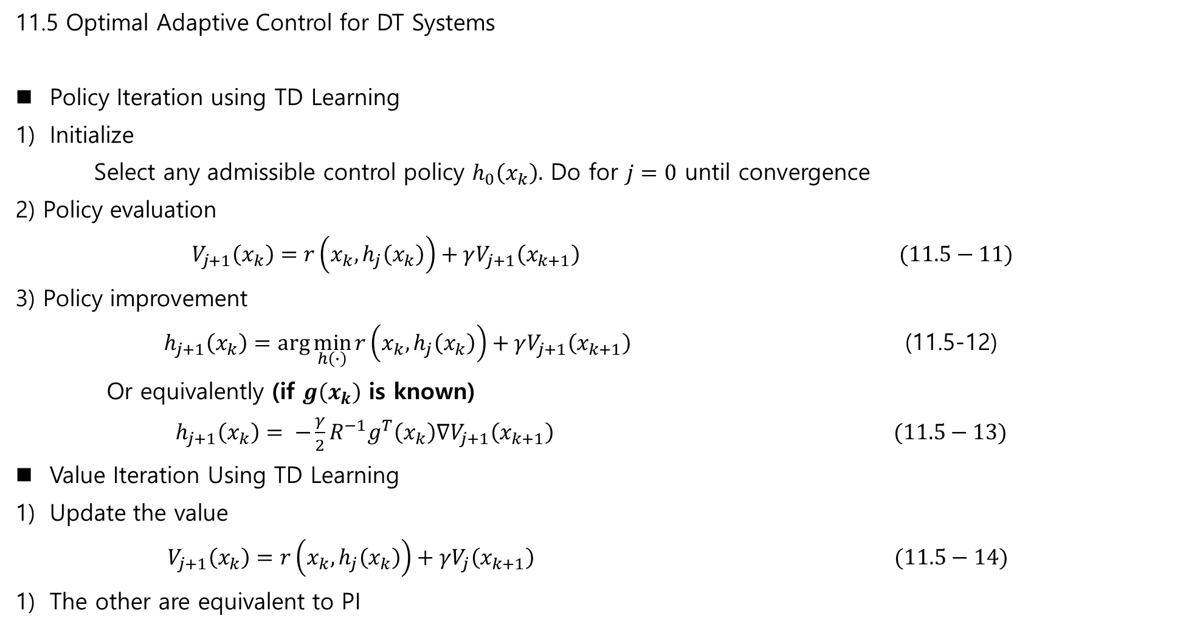
11.5 Optimal Adaptive Control for DT Systems
Policy Iteration using TD Learning
Initialize
Select any admissible control policy $h_{0}\left(x_{k}\right).$ Do for $j=0$ until convergence
2) Policy evaluation
$V_{j+1}\left(x_{k}\right)=r\left(x_{k},h_{j}\left(x_{k}\right)\right)+γV_{j+1}\left(x_{k+1}\right) (11.5−11)$
3) Policy improvement
$h_{j+1}\left(x_{k}\right)=\arg{\min_{h\left(∙\right)}{r\left(x_{k},h_{j}\left(x_{k}\right)\right)+γV_{j+1}\left(x_{k+1}\right) }}$ (11.5-12)
Or equivalently (if $g\left(x_{k}\right)$ is known)
$h_{j+1}\left(x_{k}\right)= −\frac{γ}{2}R^{−1}g^{T}\left(x_{k}\right)∇V_{j+1}\left(x_{k+1}\right) (11.5−13)$
Value Iteration Using TD Learning
Update the value
$V_{j+1}\left(x_{k}\right)=r\left(x_{k},h_{j}\left(x_{k}\right)\right)+γV_{j}\left(x_{k+1}\right) (11.5−14)$
The other are equivalent to PI

Slide 14
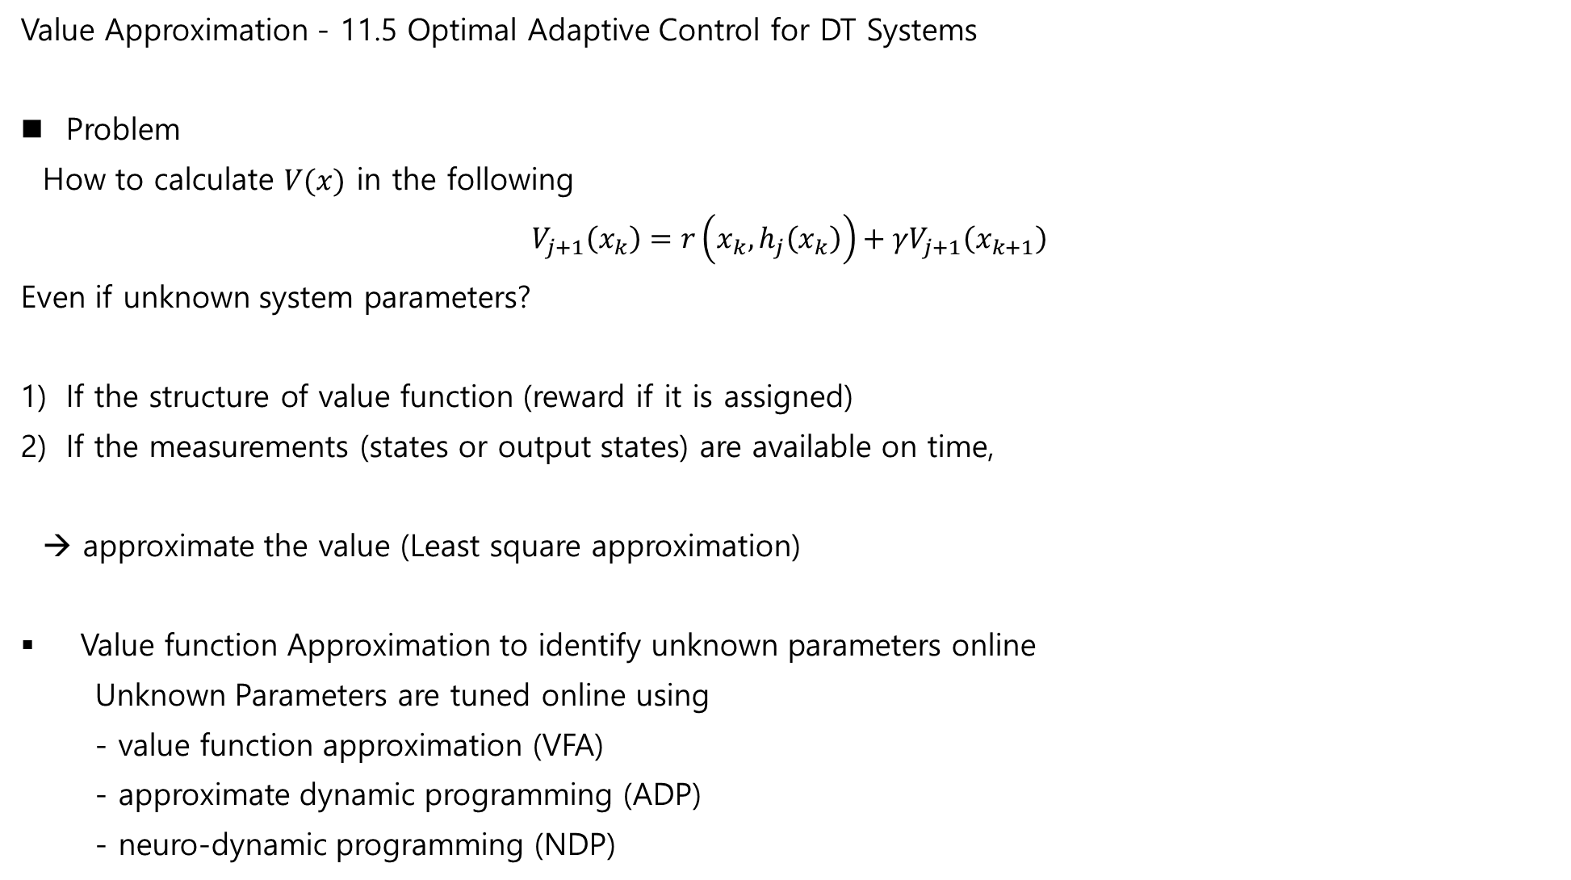
Value Approximation - 11.5 Optimal Adaptive Control for DT Systems
Problem
How to calculate $V(x)$ in the following
$$V_{j+1}\left(x_{k}\right)=r\left(x_{k},h_{j}\left(x_{k}\right)\right)+γV_{j+1}\left(x_{k+1}\right)$$
Even if unknown system parameters?
If the structure of value function (reward if it is assigned)
If the measurements (states or output states) are available on time,
→ approximate the value (Least square approximation)
Value function Approximation to identify unknown parameters online
Unknown Parameters are tuned online using
- value function approximation (VFA)
- approximate dynamic programming (ADP)
- neuro-dynamic programming (NDP)

Slide 15
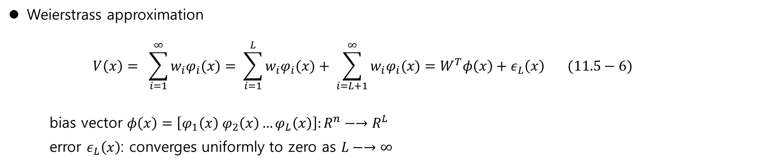
Value Approximation - 11.5 Optimal Adaptive Control for DT Systems
Weierstrass approximation
$$V\left(x\right)= \sum_{i=1}^{∞}{w_{i}φ_{i}(x)}= \sum_{i=1}^{L}{w_{i}φ_{i}(x)}+ \sum_{i=L+1}^{∞}{w_{i}φ_{i}(x)}=W^{T}φ\left(x\right)+ε_{L}\left(x\right) (11.5−6)$$
bias vector $φ\left(x\right)=\left[φ_{1}\left(x\right) φ_{2}\left(x\right)…φ_{L}\left(x\right)\right]:R^{n}−→R^{L}$
error $ε_{L}\left(x\right)$: converges uniformly to zero as $L−→∞$
NN:
basis: sigmoid, hyperbolic tangent, Gaussian radial basis function …

Slide 16
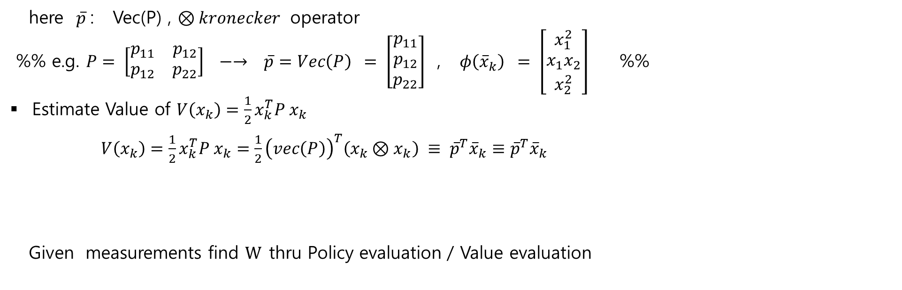
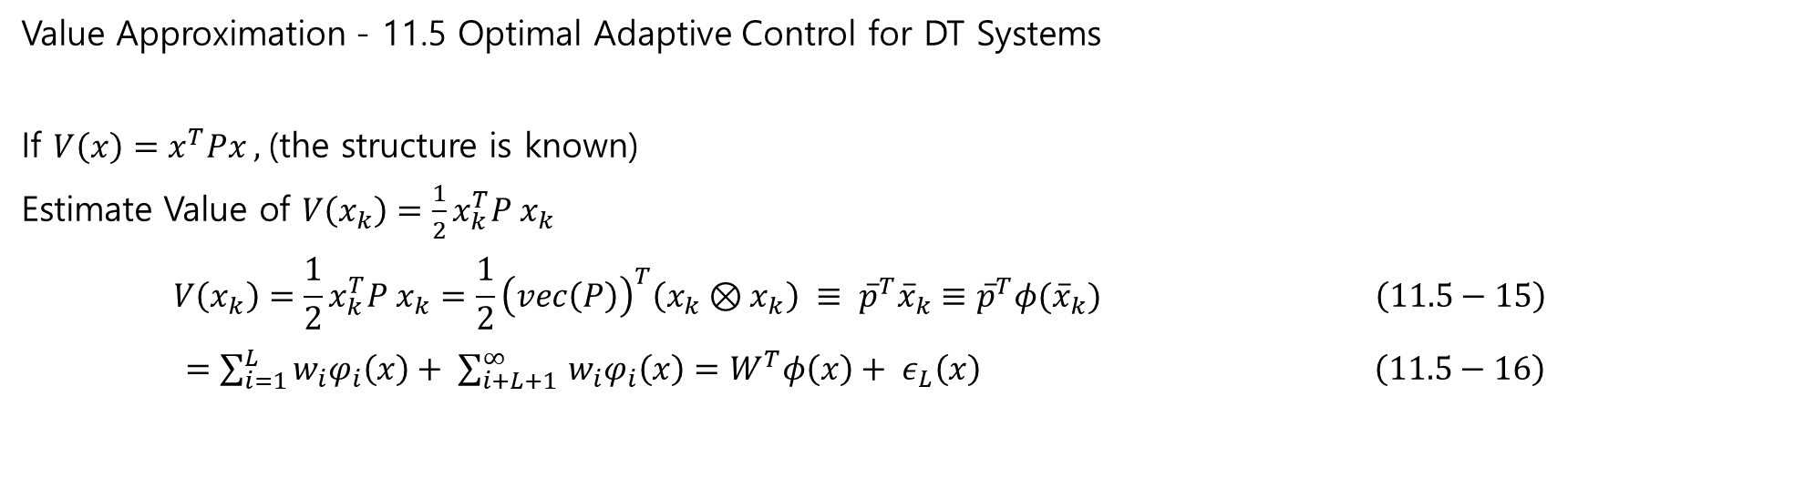
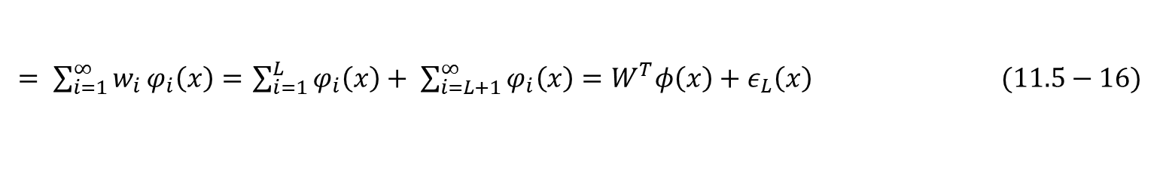
Value Approximation - 11.5 Optimal Adaptive Control for DT Systems
If $V\left(x\right)=x^{T}Px ,$(the structure is known)
Estimate Value of $V\left(x_{k}\right)=\frac{1}{2}x_{k}^{T}P x_{k}$
$$V\left(x_{k}\right)=\frac{1}{2}x_{k}^{T}P x_{k}=\frac{1}{2}{\left(vec\left(P\right)\right)}^{T}\left(x_{k}⊗x_{k}\right) ≡ {\overline{p}}^{T}{\overline{x}}_{k}≡{\overline{p}}^{T}φ({\overline{x}}_{k}) \left(11.5−15\right)$$
$=\sum_{i=1}^{L}{w_{i}φ_{i}\left(x\right)+ \sum_{i+L+1 }^{∞}{w_{i}φ_{i}\left(x\right)=W^{T}φ\left(x\right)+ ε_{L}\left(x\right) } } \left(11.5−16\right)$
here $\overline{p}$: Vec(P) , $⊗kronecker$ operator
%% e.g. $P= \left[\begin{matrix}p_{11} & p_{12} \\ p_{12} & p_{22}\end{matrix}\right] −→ \overline{p}=Vec\left(P\right) = \left[\begin{matrix}p_{11} \\ p_{12} \\ p_{22}\end{matrix}\right]$ , $φ\left({\overline{x}}_{k}\right) = \left[\begin{matrix}x_{1}^{2} \\ x_{1}x_{2} \\ x_{2}^{2}\end{matrix}\right]$ %%
Estimate Value of $V\left(x_{k}\right)=\frac{1}{2}x_{k}^{T}P x_{k}$
$V\left(x_{k}\right)=\frac{1}{2}x_{k}^{T}P x_{k}=\frac{1}{2}{\left(vec\left(P\right)\right)}^{T}\left(x_{k}⊗x_{k}\right) ≡ {\overline{p}}^{T}{\overline{x}}_{k}≡{\overline{p}}^{T}{\overline{x}}_{k}$
Given measurements find $W$thru Policy evaluation / Value evaluation
$= \sum_{i=1}^{∞}{w_{i}}φ_{i}\left(x\right)=$ $\sum_{i=1}^{L}{φ_{i}\left(x\right)+ \sum_{i=L+1}^{∞}{φ_{i}\left(x\right)=W^{T}φ\left(x\right)+ε_{L}\left(x\right) (11.5−16) }}$

Slide 17
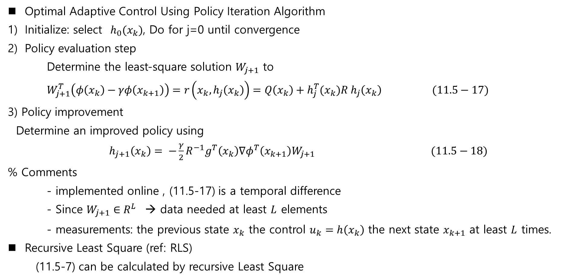
11.5 Optimal Adaptive Control for DT Systems
Optimal Adaptive Control Using Policy Iteration Algorithm
Initialize: select $h_{0}(x_{k})$, Do for j=0 until convergence
Policy evaluation step
Determine the least-square solution $W_{j+1}$ to
$W_{j+1}^{T}\left(φ\left(x_{k}\right)−γφ\left(x_{k+1}\right)\right)=r\left(x_{k}, h_{j}\left(x_{k}\right)\right)=Q\left(x_{k}\right)+h_{j}^{T}(x_{k})R h_{j}\left(x_{k}\right) (11.5−17)$
3) Policy improvement
Determine an improved policy using
$h_{j+1}\left(x_{k}\right)= −\frac{γ}{2}R^{−1}g^{T}\left(x_{k}\right)∇φ^{T}\left(x_{k+1}\right)W_{j+1} (11.5−18)$
% Comments
- implemented online , (11.5-17) is a temporal difference
- Since $W_{j+1}∈R^{L}$ → data needed at least $L$ elements
- measurements: the previous state $x_{k}$ the control $u_{k}=h\left(x_{k}\right)$ the next state $x_{k+1}$ at least $L$ times.
Recursive Least Square (ref: RLS)
(11.5-7) can be calculated by recursive Least Square

Slide 18
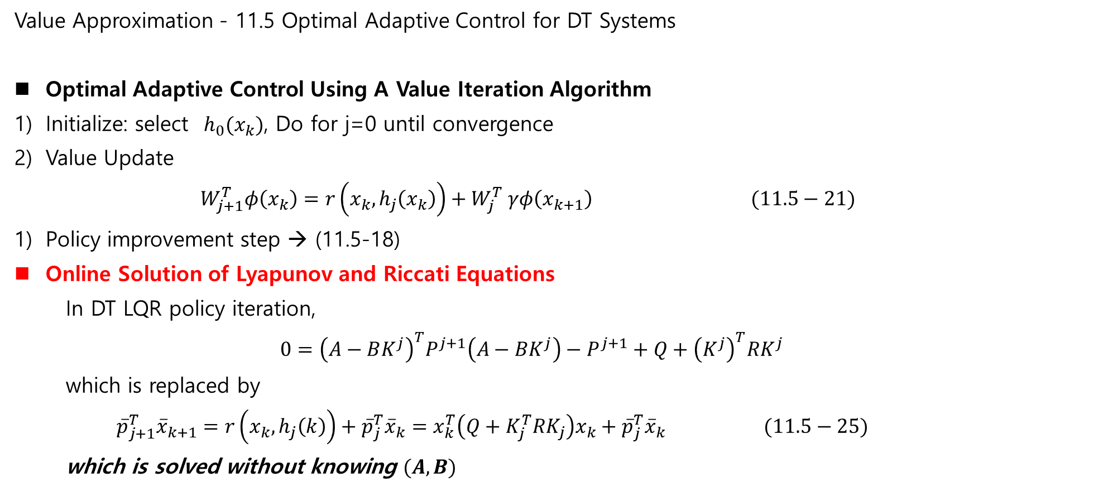
Value Approximation - 11.5 Optimal Adaptive Control for DT Systems
Optimal Adaptive Control Using A Value Iteration Algorithm
Initialize: select $h_{0}(x_{k})$, Do for j=0 until convergence
Value Update
$W_{j+1}^{T}φ\left(x_{k}\right)=r\left(x_{k}, h_{j}\left(x_{k}\right)\right)+W_{j}^{T} γφ\left(x_{k+1}\right) (11.5−21)$
Policy improvement step → (11.5-18)
Online Solution of Lyapunov and Riccati Equations
In DT LQR policy iteration,
$$0={\left(A−BK^{j}\right)}^{T}P^{j+1}\left(A−BK^{j}\right)−P^{j+1}+Q+{\left(K^{j}\right)}^{T}RK^{j}$$
which is replaced by
${\overline{p}}_{j+1}^{T}{\overline{x}}_{k+1}=r\left(x_{k},h_{j}\left(k\right)\right)+{\overline{p}}_{j}^{T}{\overline{x}}_{k}=x_{k}^{T}\left(Q+K_{j}^{T}RK_{j}\right)x_{k}+{\overline{p}}_{j}^{T}{\overline{x}}_{k} (11.5−25)$
which is solved without knowing $(A,B)$

Slide 19
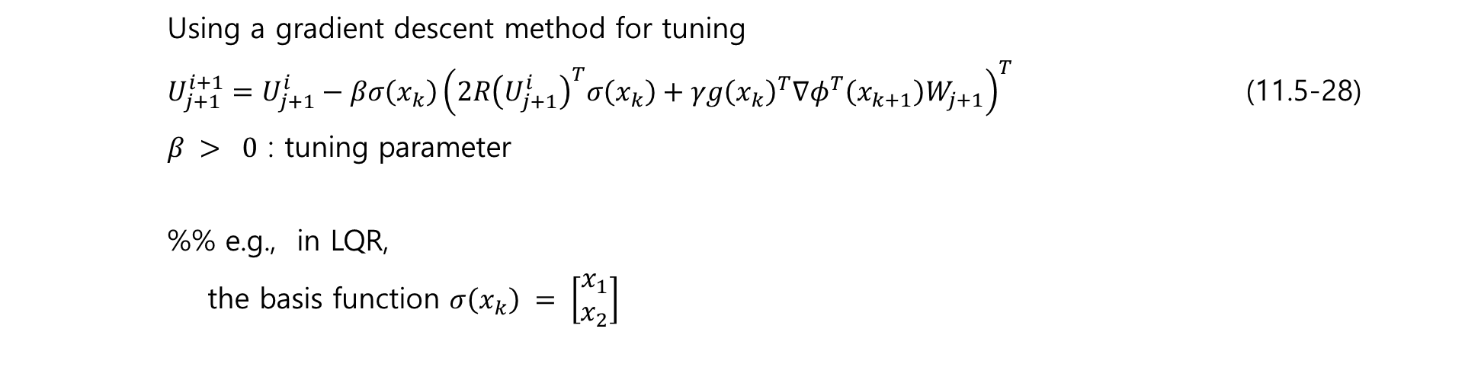
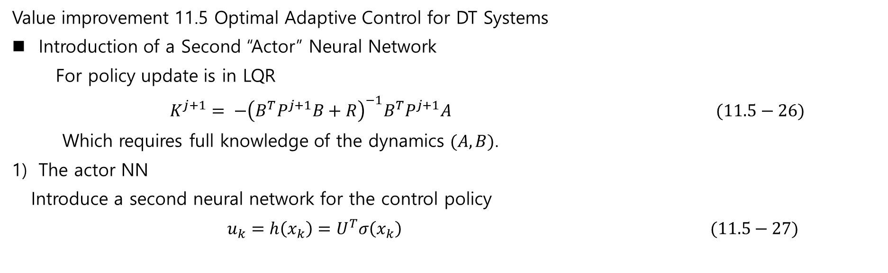
Value improvement 11.5 Optimal Adaptive Control for DT Systems
Introduction of a Second “Actor” Neural Network
For policy update is in LQR
$K^{j+1}= −{\left(B^{T}P^{j+1}B+R\right)}^{−1}B^{T}P^{j+1}A (11.5−26)$
Which requires full knowledge of the dynamics $(A,B)$.
The actor NN
Introduce a second neural network for the control policy
$$u_{k}=h\left(x_{k}\right)=U^{T}σ\left(x_{k}\right) (11.5−27)$$
Using a gradient descent method for tuning
$U_{j+1}^{i+1}=U_{j+1}^{i}−βσ\left(x_{k}\right){\left(2R{\left(U_{j+1}^{i}\right)}^{T}σ\left(x_{k}\right)+γg{\left(x_{k}\right)}^{T}∇φ^{T}\left(x_{k+1}\right)W_{j+1}\right)}^{T}$ (11.5-28)
$β > 0$ : tuning parameter
%% e.g., in LQR,
the basis function $σ\left(x_{k}\right) = \left[\begin{matrix}x_{1} \\ x_{2}\end{matrix}\right]$

Slide 20
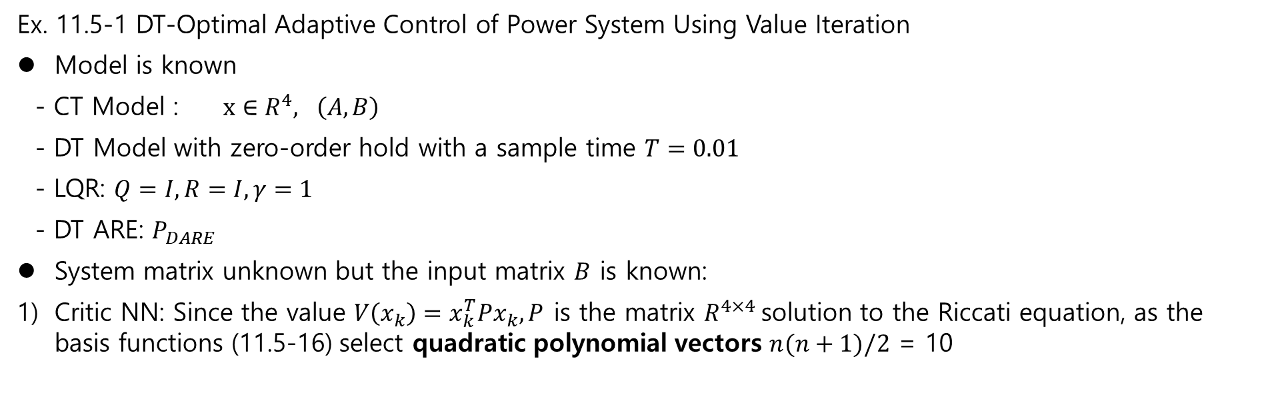
Ex. 11.5-1 DT-Optimal Adaptive Control of Power System Using Value Iteration
Model is known
- CT Model : $x∈R^{4}, \left(A,B\right)$
- DT Model with zero-order hold with a sample time $T=0.01$
- LQR: $Q=I, R=I, γ=1$
- DT ARE: $P_{DARE}$
System matrix unknown but the input matrix $B$ is known:
Critic NN: Since the value $V\left(x_{k}\right)=x_{k}^{T}Px_{k}, P$ is the matrix $R^{4×4}$solution to the Riccati equation, as the basis functions (11.5-16) select quadratic polynomial vectors $n(n+1)/2$ = 10

Slide 21
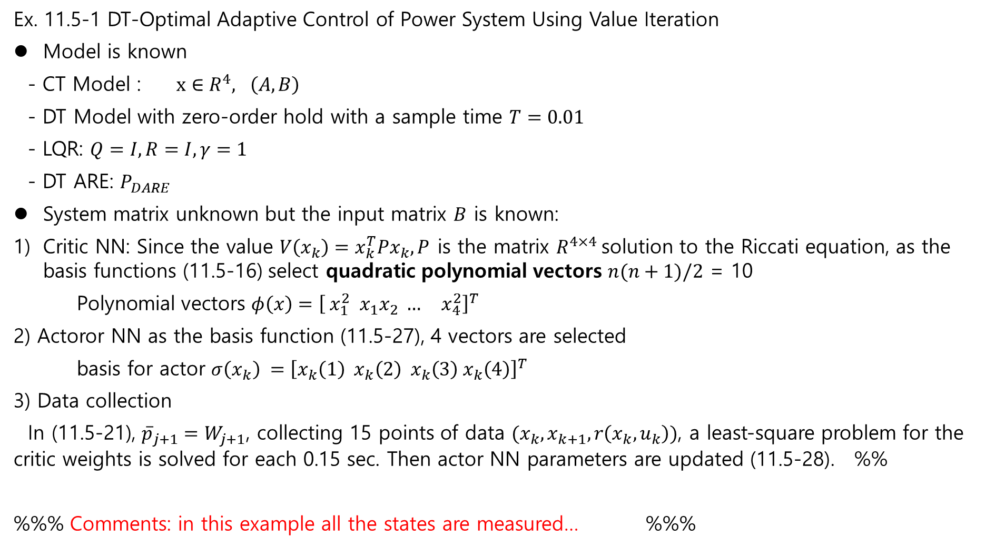
Ex. 11.5-1 DT-Optimal Adaptive Control of Power System Using Value Iteration
Model is known
- CT Model : $x∈R^{4}, \left(A,B\right)$
- DT Model with zero-order hold with a sample time $T=0.01$
- LQR: $Q=I, R=I, γ=1$
- DT ARE: $P_{DARE}$
System matrix unknown but the input matrix $B$ is known:
Critic NN: Since the value $V\left(x_{k}\right)=x_{k}^{T}Px_{k}, P$ is the matrix $R^{4×4}$solution to the Riccati equation, as the basis functions (11.5-16) select quadratic polynomial vectors $n(n+1)/2$ = 10
Polynomial vectors $φ\left(x\right)={\left[ x_{1}^{2} x_{1}x_{2} … x_{4}^{2}\right]}^{T}$
2) Actoror NN as the basis function (11.5-27), 4 vectors are selected
basis for actor $σ\left(x_{k}\right) ={\left[x_{k}\left(1\right) x_{k}\left(2\right) x_{k}\left(3\right) x_{k}\left(4\right)\right]}^{T}$
3) Data collection
In (11.5-21), ${\overline{p}}_{j+1}=W_{j+1}$, collecting 15 points of data $(x_{k}, x_{k+1}, r\left(x_{k}, u_{k}\right))$, a least-square problem for the critic weights is solved for each 0.15 sec. Then actor NN parameters are updated (11.5-28). %%
%%% Comments: in this example all the states are measured… %%%

Slide 22
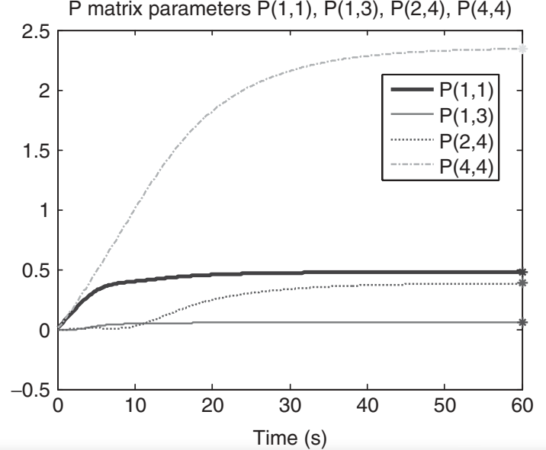
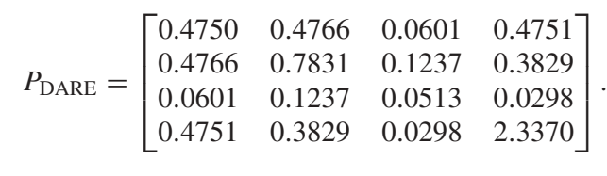
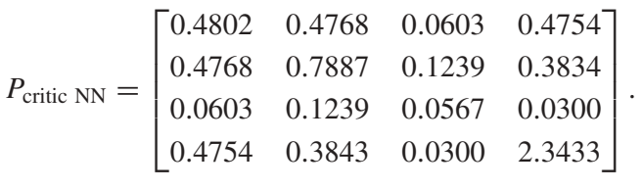


Ex. 11.5-1 DT-Optimal Adaptive Control of Power System Using Value Iteration
Results
System matrix is known, P DARE solution
System matrix is unknown :$P_{critic NN} :$
Trajectories of each elements of $P\left(t\right),P_{DARE}$
Looks good to estimate the value ? ….

