Slide 1
Optimal Control
- continuous system -
- June 2022 –
Prof. Seungnam Kim in ASTU

Slide 2
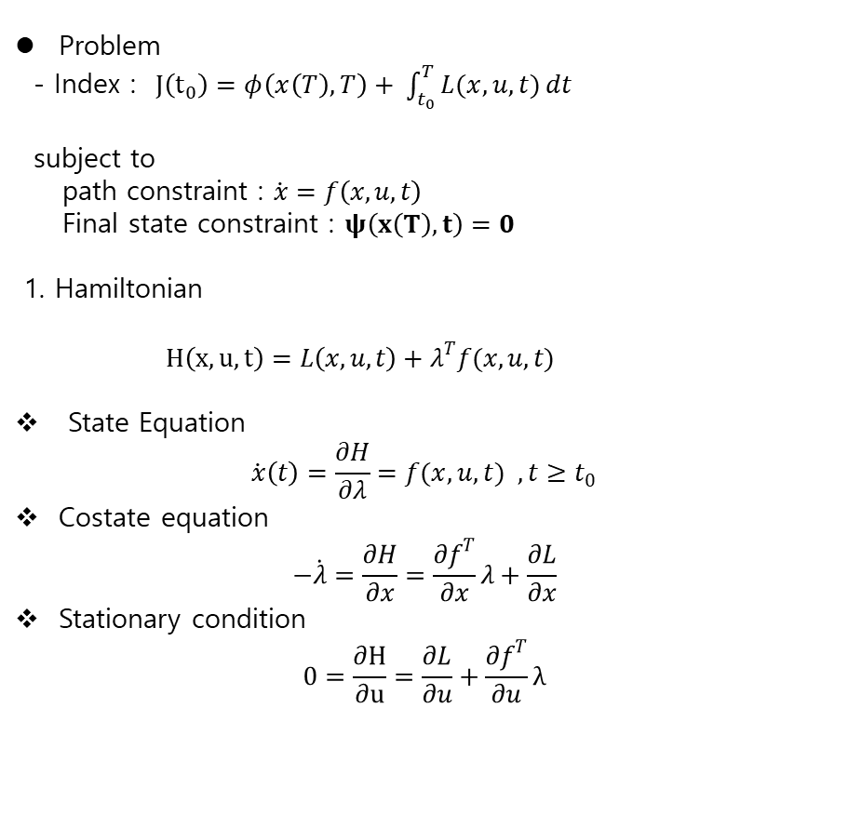
Optimal Control for CT systems
Problem
- Index : $J\left(t_{0}\right)=φ\left(x\left(T\right),T\right)+ \int_{t_{0}}^{T}{L(x,u,t)}dt$
subject to
path constraint : $\dot{x}=f\left(x,u,t\right)$
Final state constraint : $ψ\left(x\left(T\right),t\right)=0$
1. Hamiltonian
$H\left(x,u,t\right)=L\left(x,u,t\right)+λ^{T}f(x,u,t)$
State Equation
$$\dot{x}\left(t\right)=\frac{∂H}{∂λ}=f(x,u,t) , t≥t_{0}$$
Costate equation
$$−\dot{λ}=\frac{∂H}{∂x}=\frac{∂f^{T}}{∂x}λ+\frac{∂L}{∂x}$$
Stationary condition
$$0=\frac{∂H}{∂u}=\frac{∂L}{∂u}+\frac{∂f^{T}}{∂u}λ$$

Slide 3
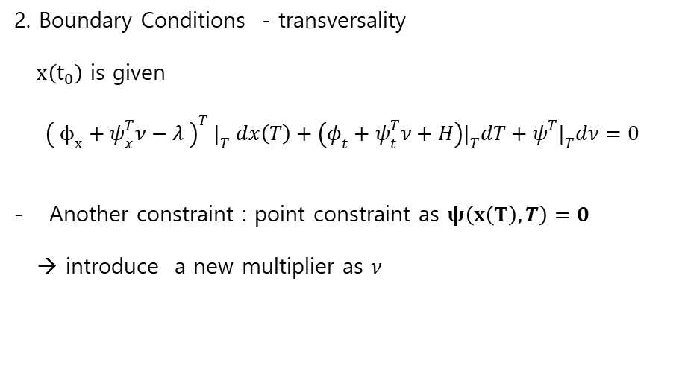
Optimal Control for CT systems
2. Boundary Conditions - transversality
$x\left(t_{0}\right)$ is given
$${\left( ϕ_{x}+ψ_{x}^{T}ν−λ \right)}^{T} |_{T} dx\left(T\right)+\left(φ_{t}+ψ_{t}^{T}ν+H\right)|_{T}dT+ψ^{T}|_{T}dν=0$$
Another constraint : point constraint as $ψ\left(x\left(T\right),T\right)=0$
→ introduce a new multiplier as $ν$

Slide 4

Optimal Control for CT systems
Ex. 3.2-1: Hamiltonian → Lagrange-Euler Equation
1.Problem
$$min J=min\int_{0}^{T}{L(x, \dot{x}},t) dt$$
2. Lagrange-Euler Necessary Cond.
$$\frac{∂L}{∂x}−\frac{d}{dt}\frac{∂L}{∂\dot{x}}=0 (1)$$
3. Hamiltonian
define $\dot{x}=u$.
$$J= \int_{0}^{T}{L(x, \dot{x}},t) dt=\int_{0}^{T}{L(x,u,t)} dt s.t. \dot{x}=u$$ Hamiltonian is
$$H=L\left(x,u,t\right)+λ^{T}u$$
The necessary conditions are
$$\dot{x}=H_{λ}=u$$
$$−\dot{λ}=H_{x}=\frac{∂L}{∂x}$$
$$0=\frac{∂H}{∂u}=\frac{∂L}{∂u}+λ$$
Hence
$$0=\frac{∂L}{∂x }+ \dot{λ}=\frac{∂L}{∂x}−\frac{d}{dt}\left(\frac{∂L}{∂u}\right)= \frac{∂L}{∂x}−\frac{d}{dt}\left(\frac{∂L}{∂\dot{x}}\right) −→(1)$$

Slide 5

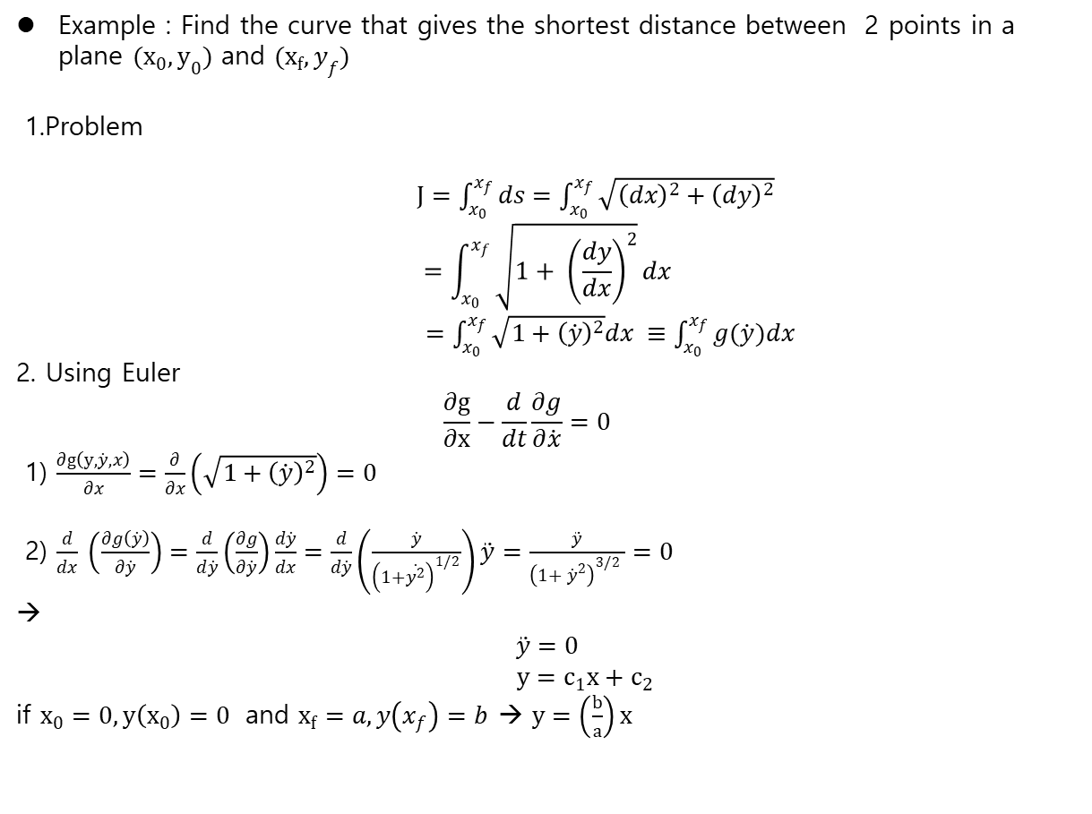
Example : Find the curve that gives the shortest distance between 2 points in a plane $(x_{0},y_{0})$ and $(x_{f}, y_{f})$
1.Problem
$J=\int_{x_{0}}^{x_{f}}{ds}=\int_{x_{0}}^{x_{f}}{\sqrt{{\left(dx\right)}^{2}+{\left(dy\right)}^{2}}}$ $$=\int_{x_{0}}^{x_{f}}{\sqrt{1+ {\left(\frac{dy}{dx}\right)}^{2}}dx}$$
$=\int_{x_{0}}^{x_{f}}{\sqrt{1+{\left(\dot{y}\right)}^{2}}dx} ≡\int_{x_{0}}^{x_{f}}{g(\dot{y})dx}$
2. Using Euler
$$\frac{∂g}{∂x}−\frac{d}{dt}\frac{∂g}{∂\dot{x}}=0$$
1) $\frac{∂g\left(y,\dot{y},x\right)}{∂x}=\frac{∂}{∂x}\left(\sqrt{1+{\left(\dot{y}\right)}^{2}}\right)=0$
2) $\frac{d}{dx} \left(\frac{∂g\left(\dot{y}\right)}{∂\dot{y}}\right)=\frac{d}{d\dot{y}}\left(\frac{∂g}{∂\dot{y}}\right)\frac{d\dot{y}}{dx}=\frac{d}{d\dot{y}}\left(\frac{\dot{y}}{{\left(1+\dot{y^{2}}\right)}^{1/2}}\right)\ddot{y}=\frac{\ddot{y}}{{\left(1+ {\dot{y}}^{2}\right)}^{3/2} }=0$
→
$$\ddot{y}=0$$
$y=c_{1}x+c_{2}$
if $x_{0}=0, y\left(x_{0}\right)=0$ and $x_{f}=a, y\left(x_{f}\right)=b$ → $y=\left(\frac{b}{a}\right)x$

Slide 6

CT LQR
Plant : $\dot{x}=Ax+Bu x\left(0\right)=x_{0}$
Performance Index : $J\left(t_{0}\right)=\frac{1}{2}x{\left(T\right)}^{T}S\left(T\right)x\left(T\right)+\frac{1}{2}\int_{t_{0}}^{T}{(x^{T}Q\left(t\right)x+u^{T}R\left(t\right)u )dt}$
Hamiltonian
$H=\frac{1}{2}\left(x^{T}Qx+u^{T}R u\right)+λ^{T}\left(Ax+Bu\right)$
1) State Equation
$$\dot{x}\left(t\right)=\frac{∂H}{∂λ}=Ax+Bu , t≥t_{0}$$
2) Costate equation
$$−\dot{λ}=\frac{∂H}{∂x}=Qx+A^{T}λ$$
3) Stationary condition
$$0=\frac{∂H}{∂u}=Ru+B^{T} λ$$
Hamiltonian Matrix
$H=\left[\begin{matrix}A & −BR^{−1}B^{T} \\ −Q & {−A}^{T}\end{matrix}\right] (3.4−14)$

Slide 7
CT LQR
3 cases are considered
1) Zero –input Cost
2) Fixed Final State
3) Free- final State

Slide 8
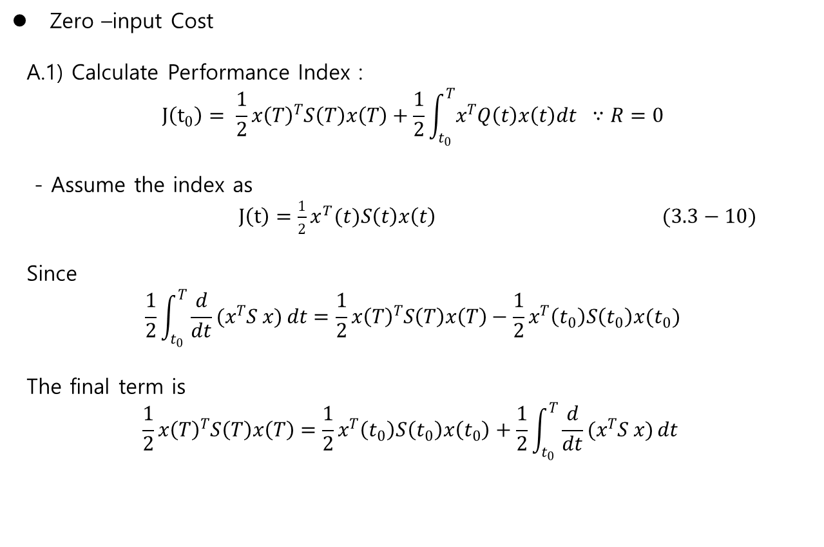
Zero –input Cost
Zero –input Cost
A.1) Calculate Performance Index :
$$J\left(t_{0}\right)= \frac{1}{2}x{\left(T\right)}^{T}S\left(T\right)x\left(T\right)+\frac{1}{2}\int_{t_{0}}^{T}{x^{T}Q\left(t\right)x\left(t\right)dt} ∵R=0$$
- Assume the index as
$J\left(t\right)=\frac{1}{2}x^{T}(t)S\left(t\right)x\left(t\right) (3.3−10)$
Since
$$\frac{1}{2}\int_{t_{0}}^{T}{\frac{d}{dt}(x^{T}S x)}dt=\frac{1}{2}x{\left(T\right)}^{T}S\left(T\right)x\left(T\right)−\frac{1}{2}x^{T}\left(t_{0}\right)S\left(t_{0}\right)x(t_{0})$$
The final term is
$$\frac{1}{2}x{\left(T\right)}^{T}S\left(T\right)x\left(T\right)=\frac{1}{2}x^{T}\left(t_{0}\right)S\left(t_{0}\right)x\left(t_{0}\right)+\frac{1}{2}\int_{t_{0}}^{T}{\frac{d}{dt}(x^{T}S x)}dt$$

Slide 9
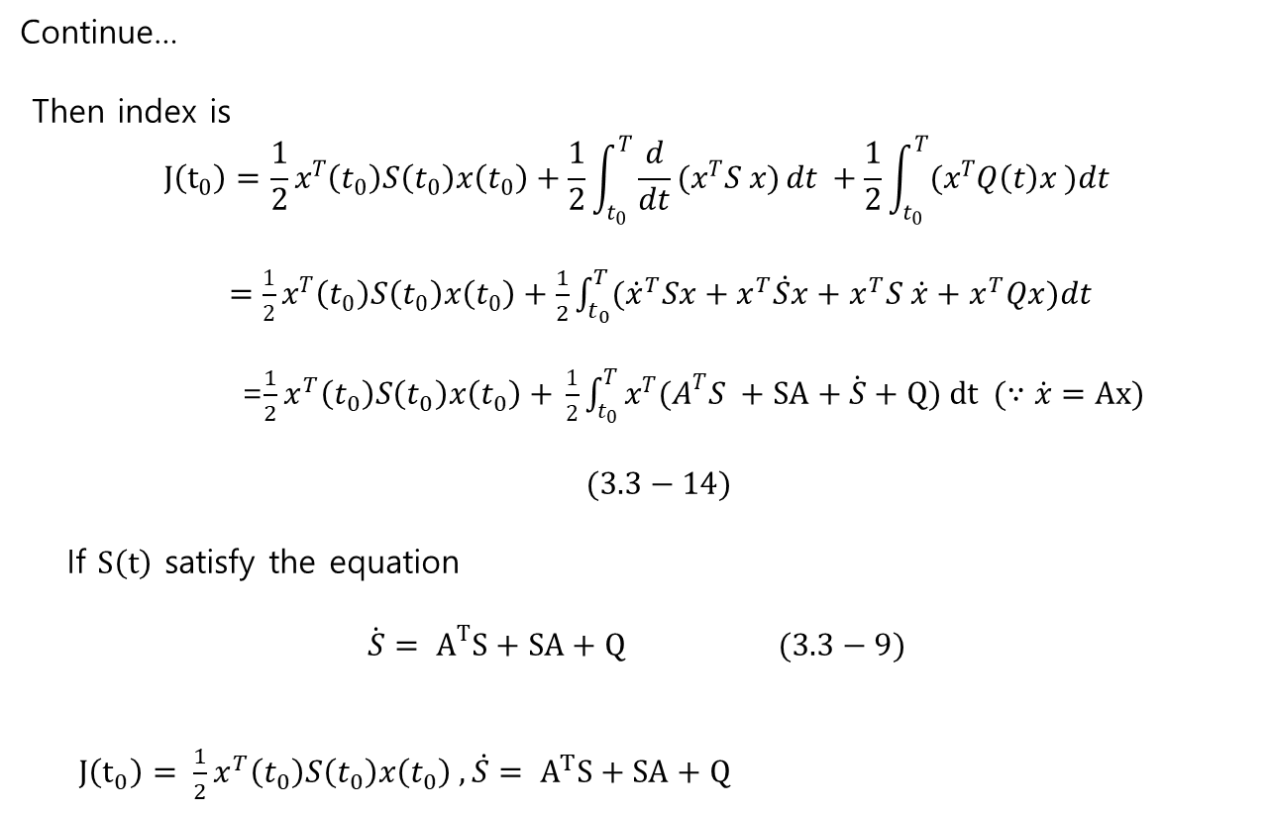
Zero –input Cost
Continue…
Then index is
$$J\left(t_{0}\right)=\frac{1}{2}x^{T}\left(t_{0}\right)S\left(t_{0}\right)x\left(t_{0}\right)+\frac{1}{2}\int_{t_{0}}^{T}{\frac{d}{dt}(x^{T}S x)}dt +\frac{1}{2}\int_{t_{0}}^{T}{(x^{T}Q\left(t\right)x )dt}$$
$=\frac{1}{2}x^{T}\left(t_{0}\right)S\left(t_{0}\right)x\left(t_{0}\right)+\frac{1}{2}\int_{t_{0}}^{T}{({\dot{x}}^{T}Sx+x^{T}\dot{S}x+x^{T}S \dot{x}+x^{T}Qx})dt$
=$\frac{1}{2}x^{T}\left(t_{0}\right)S\left(t_{0}\right)x\left(t_{0}\right)+$ $\frac{1}{2}\int_{t_{0}}^{T}{x^{T}(A^{T}S }+SA+\dot{S}+Q) dt (∵\dot{x}=Ax)$
$$(3.3−14)$$
If $S\left(t\right)$ satisfy the equation
$$\dot{S}= A^{T}S+SA+Q (3.3−9)$$
$J\left(t_{0}\right)= \frac{1}{2}x^{T}\left(t_{0}\right)S\left(t_{0}\right)x\left(t_{0}\right) ,\dot{S}= A^{T}S+SA+Q$

Slide 10

Zero –input Cost
A.2) Continuous Lyapunov equation
The solution to the equation (3.3-9) is
$$S\left(t\right)=e^{A^{T}\left(T−t\right)}S\left(T\right)e^{A\left(T−t\right)}+ \int_{t}^{T}{e^{A^{T}(T−τ)}Qe^{A\left(T−τ\right)}dτ} (3.3−14)$$
A.3) Observability
The steady state solution of $S$
$$0=A^{T}S+SA+Q$$
If $A$ is stable, and $(A, \sqrt{Q})$ is observable, then $S>0$

Slide 11

Zero –input Cost
% Observability
The following statements are equivalent
$(A,C)$ is observable
$\left[\begin{matrix}C \\ CA \\ \begin{matrix}⋮ \\ CA^{n−1}\end{matrix}\end{matrix} \right]$ has rank n
$\left[\begin{matrix}A−λI \\ C\end{matrix}\right]$ has full column rank
- If $Re\left(λ\left(A\right)\right)<0, A^{T}S+SA+CC^{T}=0$ ,$S>0$

Slide 12

Fixed final sate and Open loop control
Fixed final sate and Open loop control
- final state: $x\left(T \right)=r_{N}$
1) Modify Performance Index :
$$J\left(t_{0}\right)=\frac{1}{2}r_{N}^{T}S\left(T\right)r_{N}+\frac{1}{2}\int_{t_{0}}^{T}{(x^{T}Q\left(t\right)x+u^{T}R\left(t\right)u )dt}$$
$\min_{u}{J\left(t_{0}\right)=\min_{u}{\frac{1}{2}\int_{t_{0}}^{T}{(x^{T}Q\left(t\right)x+u^{T}R\left(t\right)u )dt}}}$
Let assume $\text{Q}\text{=0}$
$J\left(t_{0}\right)=\frac{1}{2}\int_{t_{0}}^{T}{(u^{T}R\left(t\right)u )dt}$
2) Hamiltonian
$H=\frac{1}{2}u^{T}Ru+λ^{T}(Ax+Bu)$

Slide 13

Fixed final sate and Open loop control
Continue..
$H=\frac{1}{2}u^{T}Ru+λ^{T}(Ax+Bu)$
Necessary conditions
$\dot{x}=Ax−BR^{−1}B^{T}λ$ (1)
$\dot{λ }= −A^{T}λ$ (2)
From (2)
$$λ\left(t\right)=e^{A^{T}\left(T−t\right)}λ(T)$$
Together from (1)
$$\dot{x}=Ax−BR^{−1}B^{T}e^{A^{T}\left(T−t\right)}λ\left(T\right) (3_$$
The solution to (3)
$$x\left(t\right)=e^{A\left(t−t_{0}\right)} − \int_{t_{0}}^{t}{e^{A\left(T−τ\right)}BR^{−1}B^{T}e^{A^{T}\left(T−τ\right)}dτ λ(T)}$$
$$=e^{A\left(T−t_{0}\right)}x\left(t_{0}\right)−G\left(t_{0}, T\right)λ\left(T\right)$$

Slide 14

Fixed final sate and Open loop control
Continue..
Controllability (Reachability) Grammian
$$x\left(t\right)=e^{A\left(T−t_{0}\right)}x\left(t_{0}\right)−G\left(t_{0}, T\right)λ\left(T\right)$$
$$G\left(t_{0}, T\right)= \int_{t_{0}}^{T}{e^{A\left(T−τ\right)}BR^{−1}B^{T}e^{A^{T}\left(T−τ\right)}dτ}$$
Since with $x\left(T \right)=r_{N}$
$$λ\left(T\right)= −G^{−1}(t_{0}, T)[ r_{N} −e^{A\left(T−t_{0}\right)}x(t_{0})]$$
So that the optimal control is
$$u^{∗}\left(t\right)=R^{−1}B^{T}e^{A^{T}\left(T−t\right)}G^{−1}\left(t_{0}, T\right)[r_{N}−e^{A\left(T−t_{0}\right)}x(t_{0}) ]$$
If $G\left(t_{0}, T\right)=P(t)$, then $P(t)$ is the solution to
$$\dot{P}=AP+PA^{T}+BR^{−1}B^{T}, P\left(t_{0}\right)=0$$
And
$$J^{∗}\left(t_{0}\right)=\frac{1}{2}d^{T} \left(t_{0}, T\right)G^{−1}\left(t_{0}, T\right)d\left(t_{0}, T\right)$$
Where
$d\left(t_{0}, T\right)=r_{N}−e^{A\left(T−t_{0}\right)}x\left(t_{0}\right)$

Slide 15

Fixed final sate and Open loop control
% Controllability
The following statements are equivalent
$(A,B)$ is controllable
$− [B AB A^{2}B…A^{n−1}B]$ has rank $n$
- $[A−λI B]$ has full row rank at every eigenvalue $λ(A)$
- $Re\left(λ\left(A\right)\right)<0 , AP+{PA}^{T}+BB^{T}=0 , P>0$

Slide 16

Free Final State
Free Final State
1) Performance Index
$$J\left(t_{0}\right)=\frac{1}{2}x{\left(T\right)}^{T}S\left(T\right)x\left(T\right)+\frac{1}{2}\int_{t_{0}}^{T}{(x^{T}Q\left(t\right)x+u^{T}R\left(t\right)u )dt}$$
2) Necessary Conditions
$$\dot{x}=Ax−BR^{−1}B^{T}λ \\ −\dot{λ}= Qx+A^{T}λ \\ u\left(t\right)= −R^{−1}B^{T}λ ∵ 0=H_{u}=L_{u}+f_{u}^{T}λ=Ru+B^{T}λ$$
3) Boundary conditions
In case of free final state,
$$λ\left(T\right)=\frac{∂φ}{∂x}|_{T}=S\left(T\right)x(T)$$
4) Optimal Controller
Assume
$$λ\left(t\right)=S\left(t\right)x(t)$$

Slide 17

Free Final State
Continue,…
$$λ\left(t\right)=S\left(t\right)x\left(t\right)$$
Then differentiating at each sides,
$$\dot{λ}=\dot{S}x+S \dot{x}=\dot{S}x+S(Ax−BR^{−1}B^{T}S x)$$
Rearranging it
$$−\dot{S}=A^{T}S+SA−SBR^{−1}B^{T}S+Q , t≤T$$
which is called as Riccati equation
The optimal controller is
$$u\left(t\right)= −R^{−1}B^{T}S x\left(t\right)$$
Kalman gain is
$$K\left(t\right)=R^{−1}B^{T}S\left(t\right)$$
where we have
$$u\left(t\right)= −K\left(t\right)x\left(t\right)$$
→ Closed loop State Feedback !

Slide 18
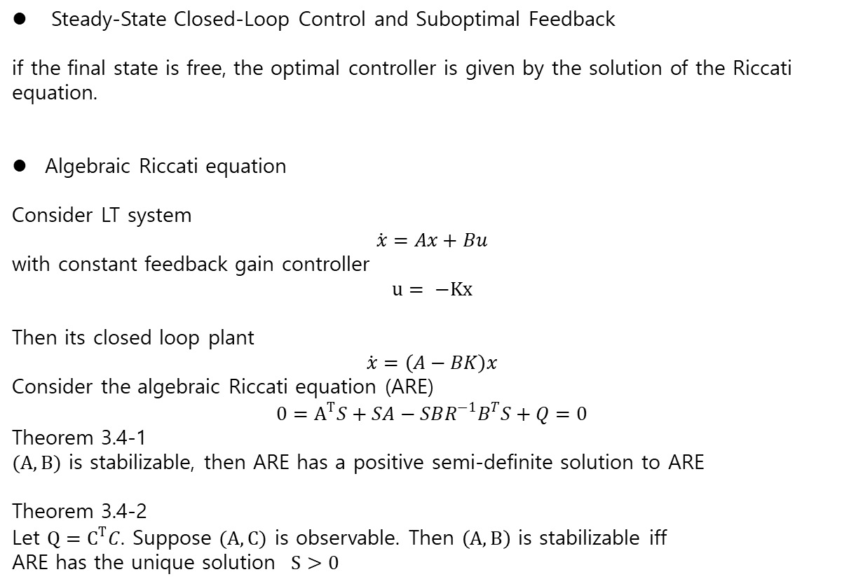
Free Final State
Steady-State Closed-Loop Control and Suboptimal Feedback
if the final state is free, the optimal controller is given by the solution of the Riccati equation.
Algebraic Riccati equation
Consider LT system
$$\dot{x}=Ax+Bu$$
with constant feedback gain controller
$$u= −Kx$$
Then its closed loop plant
$$\dot{x}=\left(A−BK\right)x$$
Consider the algebraic Riccati equation (ARE)
$$0=A^{T}S+SA−SBR^{−1}B^{T}S+Q=0$$
Theorem 3.4-1
$(A,B)$ is stabilizable, then ARE has a positive semi-definite solution to ARE
Theorem 3.4-2
Let $Q=C^{T}C$. Suppose $(A,C)$ is observable. Then $\left(A,B\right)$ is stabilizable iff
ARE has the unique solution $S>0$

