Slide 1
Scope
Reinforcement Learning (RL)
Optimal Control : “Lewis”
Ch.6 : Dynamic Programming
Ch.11 : Reinforcement Learning
Prerequisite : Machine Learning with Python
Textbook :
“Introduction to machine learning with python” , 2016, O’Reilly
2) Goals
- Learn and code supervised machine learning algorithms
- Learn and code un-supervise machine learning algorithms
- Learn and simulate deep learning (Neural Network) algorithms
- Apply to Optimal Controls

Slide 2
AI/ machine Learning
Artificial Intelligence
Intelligence:
the ability to learn or understand or to deal with new or
trying situations :
Artificial Intelligence
Human intelligence
Computer intelligence – Artificial Intelligence
Machine Learning
Learning is the process of acquiring new understanding, knowledge, behaviors, skills, values, attitudes, and preferences.^{[1]} The ability to learn is possessed by humans, animals, and some machines;
Machine learning : Learn thru a computer
-→ computer science : software

Slide 3

Scope
ML
- In general “Static” → no feedback
- Optimization Problem :
Classical Optimization : $\min_{x}{f(x)} ; \text{"}\text{f}\text{" }\text{is} \text{given}$
ML : $"f“$ is unknown but “Data” is given
Reinforcement Learning
: One of ML
: Dynamic data
: Feedback

Slide 4
Supervised learning
Supervised learning
- automate decision-making processes by generalizing from known examples. Known input / known output : new input → what output
1) Classification

Slide 5
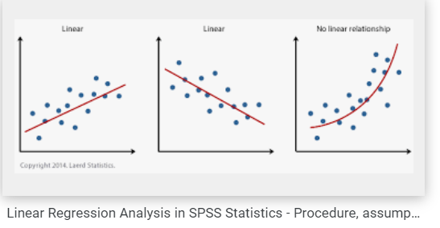
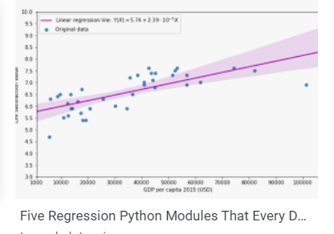

Supervised - Regression
Supervised learning
- automate decision-making processes by generalizing from known examples.
2) Regression
measured a new $x_{i} ,$ what $f\left(x_{i}\right)$

Slide 6
Unsupervised Learning
Unsupervised learning
- only the input data is known, and no known output data is given to the algorithm.
Shape ?
Size ?

Slide 7
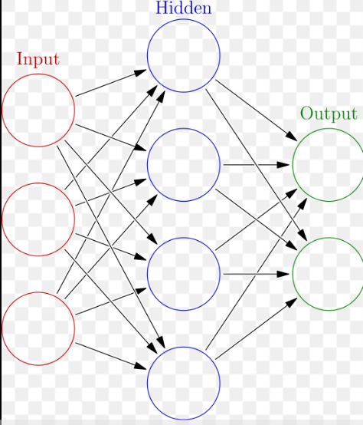
ANN
Artififical Neural Network
Artificial neural networks (ANNs), usually simply called neural networks (NNs), are computing systems inspired by the biological neural networks that constitute animal brains.
An ANN is based on a collection of connected units or nodes called artificial neurons, which loosely model the neurons in a biological brain. Each connection, like the synapses in a biological brain, can transmit a signal to other neurons

Slide 8
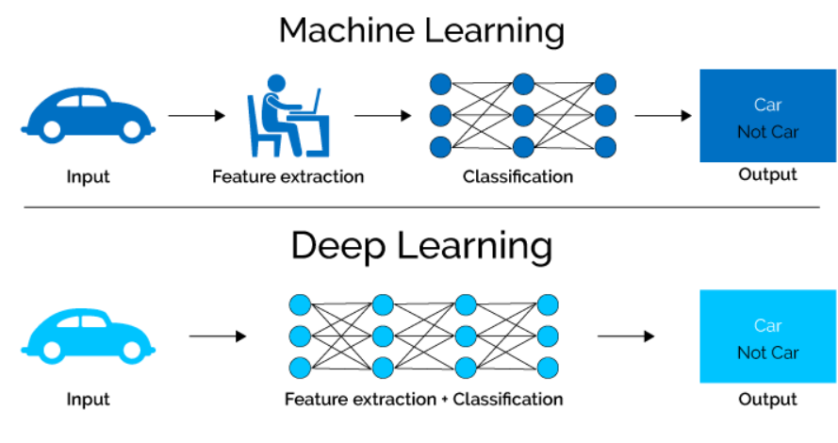
DL
Deep learning
Deep learning is a subset of machine learning, which is essentially a neural network with three or more layers. - IBM
https://i0.wp.com/semiengineering.com/wp-content/uploads/2018/01/MLvsDL.png?ssl=1

Slide 9
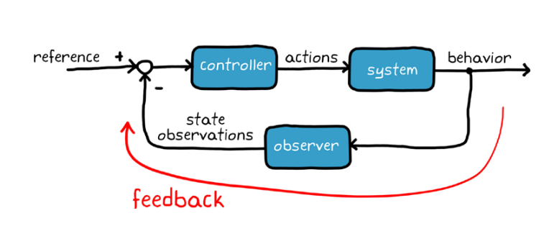
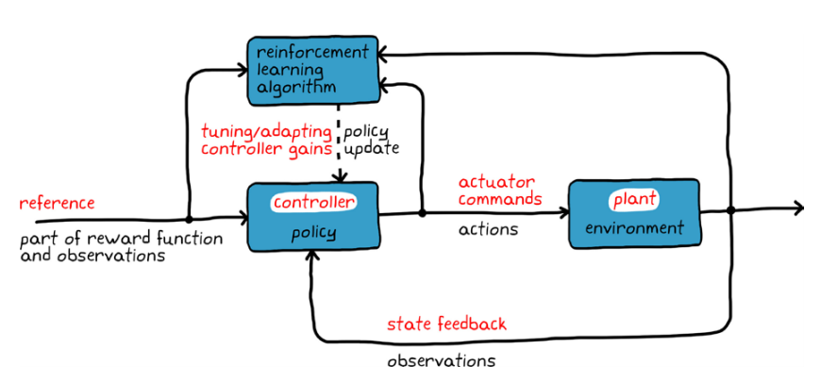
RL - Concept
Reinforcement learning
[1] General Control Problem
general | RL
controller | policy
plant | environment
state | state reward
control | action
[1]: NE 10-3 Reinforcement learning with matlab

Slide 10
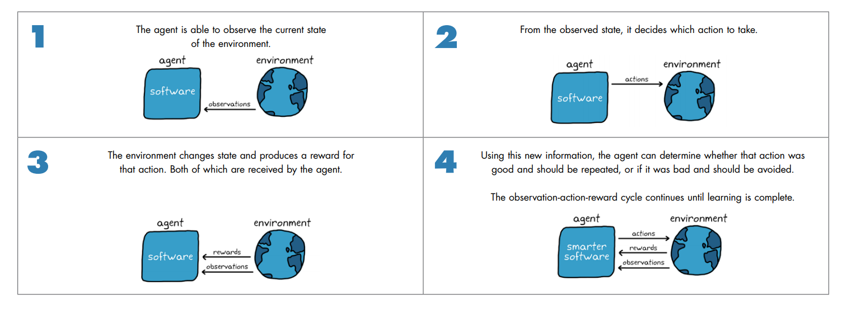
RL - Concept
Machine learning – Reinforcement Learning
[1]: NE 10-3 Reinforcement learning with matlab

Slide 11
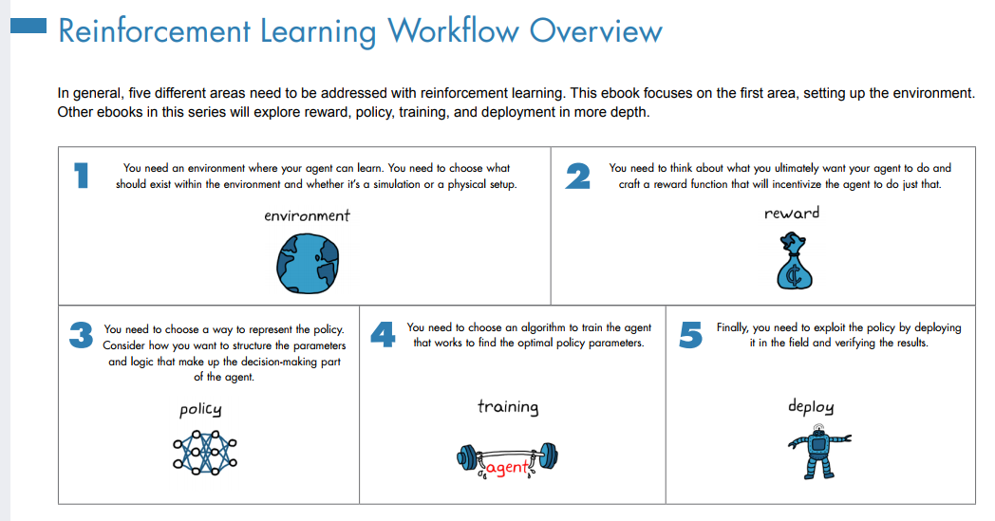
RL - Concept
Off – line Reinforcement learning
[1]: NE 10-3 Reinforcement learning with matlab

Slide 12
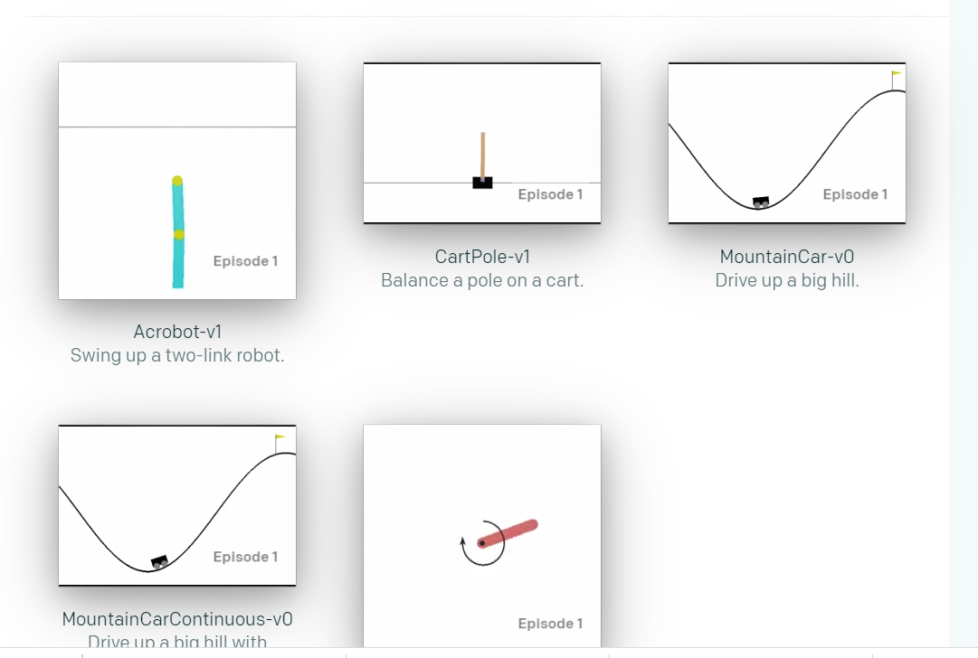
RL - Concept
https://gym.openai.com/

Slide 13
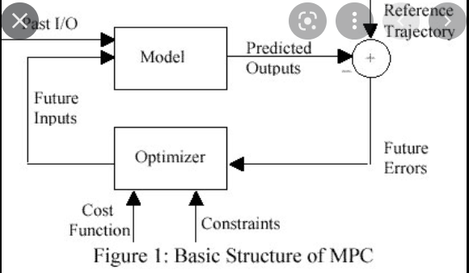
RL - Concept
Model Predictive Control : Reinforcement L
- Uncertain system (time varying)
- in finite time, apply the optimal control ←→ Learning procedure to
find optimal reward policy

Slide 14
RL - Tools
Jupyter notebook https://jupyter.org/
running code in the browser
Numpy https://numpy.org/devdocs/user/quickstart.html
multidimensional array, mathematical functions
SciPy https://scipy.org/
Scientific computing , optimization,..
Matplotlib https://matplotlib.org/
the primary scientific plotting library

Slide 15
RL - Tools
Pandas https://pandas.pydata.org/
data wrangling and analysis
Gym https://gym.openai.com/
developing and comparing Reinforcement Learning
Keras https://keras.io/
Deep learning API
Tensorflow
Deep learning API by google

Slide 16
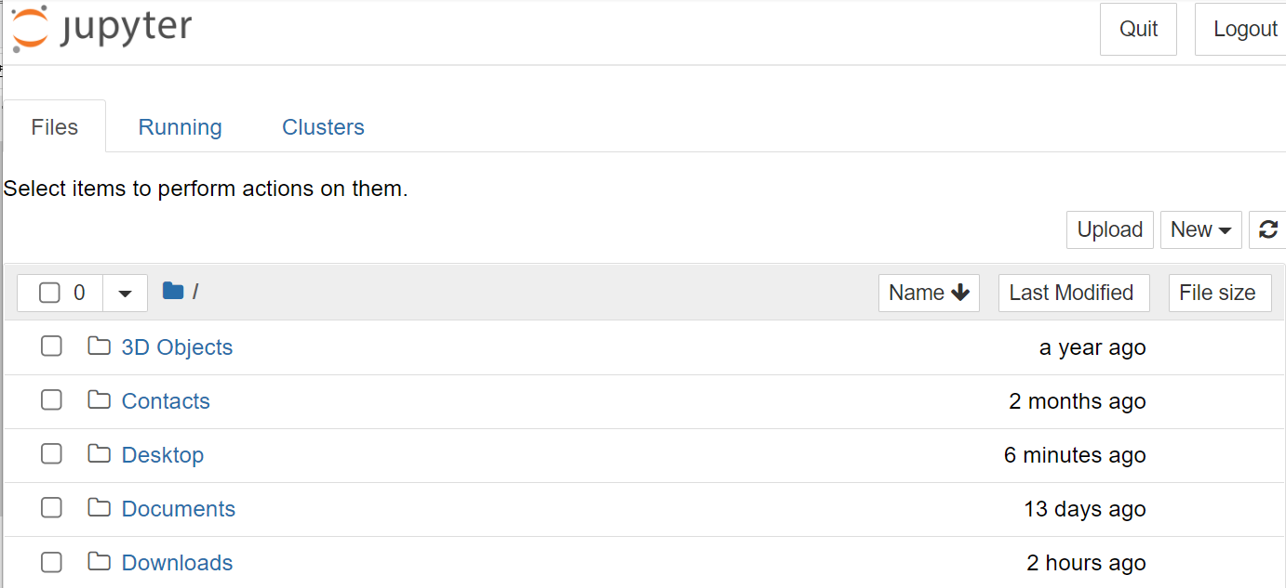
Jupyter Notebook
Open : Anaconda – Jupyter notebook
Copy http://,... And paste it in google
data wrangling and analysis
Gym https://gym.openai.com/
developing and comparing Reinforcement Learning
3. Go to the working dir.

Slide 17
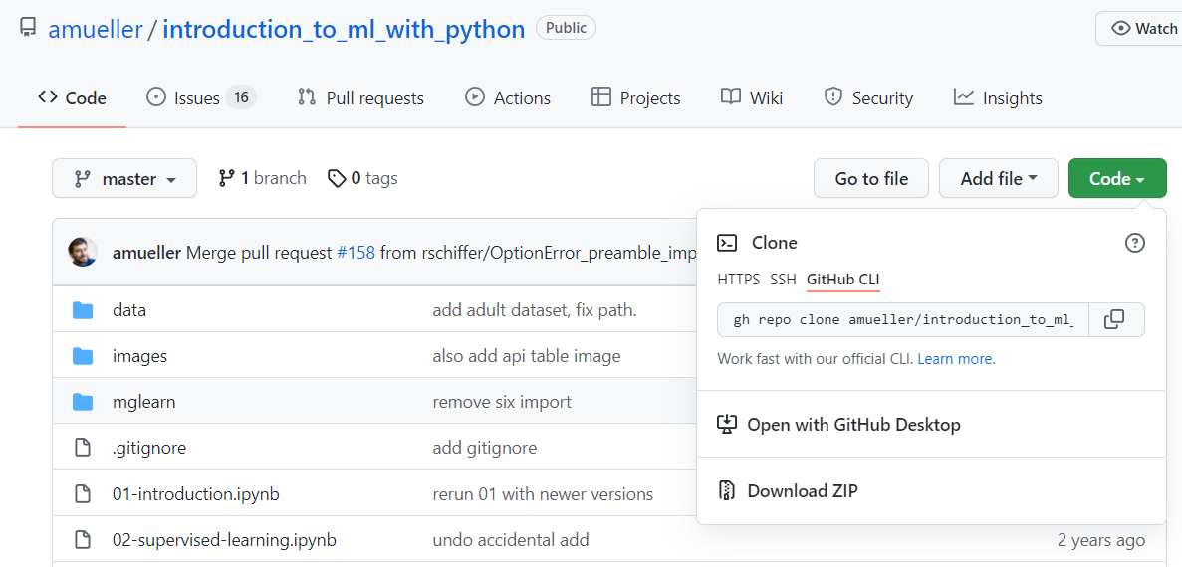
Jupyter Notebook
3. To download “ Introduction,…” go to “github,..”
https://github.com/amueller/introduction_to_ml_with_python
4. Download all in ZIP in your working dir.
%% pdf version is available. Plz download it

Slide 18
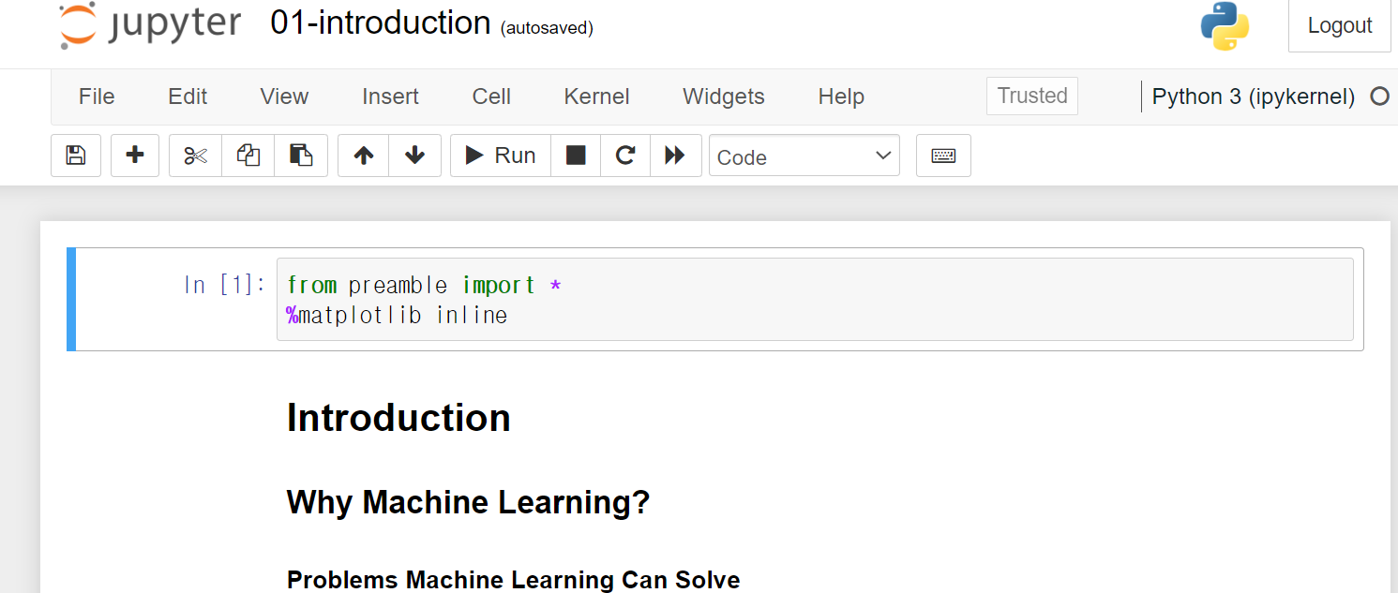
Jupyter Notebook
Unzipped the files
Open
https://github.com/amueller/introduction_to_ml_with_python
4. Download all in ZIP in your working dir.
5. Go to the DIR unzipped
5. Click the notebook file ,”01-introduction.ipynb

Slide 19
Jupyter Notebook
Run a notebook file :
In an excutetable file,
- (python) code : “Run”
- Markdown text : type in Markdown format ( similar to “Live Editor “ of matlab)
Save and shutdown

