Slide 1
Optimal Control
- Time Optimal -
- June 2022 –
Prof. Seungnam Kim in ASTU

Slide 2

Ch.5 Final Time Free and Contrained Control
General Boundary Conditions : Transversality conditions
$${\left(φ_{x}−ψ_{x}^{T}ν−λ\right)}^{T}|_{T} dx\left(T\right)+\left(φ_{t}+ψ_{t}^{T}+H\right)|_{T}dT=0 (5.1−1)$$
- Final state fixed but final time free
- Final state and time are free and independent
- Final time and final sate are free but dependent as
$$x\left(T\right)=p\left(T\right) , T is free$$

Slide 3
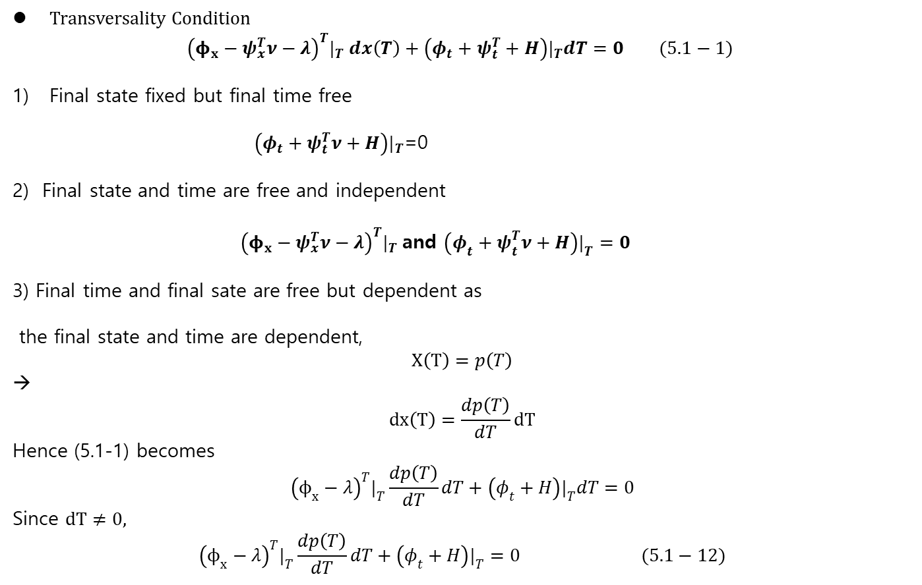
Ch.5 Final Time Free and Contrained Control
Transversality Condition
$${\left(φ_{x}−ψ_{x}^{T}ν−λ\right)}^{T}|_{T} dx\left(T\right)+\left(φ_{t}+ψ_{t}^{T}+H\right)|_{T}dT=0 (5.1−1)$$
Final state fixed but final time free
$\left(φ_{t}+ψ_{t}^{T}ν+H\right)|_{T}$=0
2) Final state and time are free and independent
${\left(φ_{x}−ψ_{x}^{T}ν−λ\right)}^{T}|_{T}$and $\left(φ_{t}+ψ_{t}^{T}ν+H\right)|_{T}=0$
3) Final time and final sate are free but dependent as
the final state and time are dependent,
$$X\left(T\right)=p\left(T\right)$$
→
$$dx\left(T\right)=\frac{dp\left(T\right)}{dT}dT$$
Hence (5.1-1) becomes
$${\left(ϕ_{x}−λ\right)}^{T}|_{T}\frac{dp\left(T\right)}{dT}dT+\left(φ_{t}+H\right)|_{T}dT=0$$
Since $dT≠0,$
$${\left(ϕ_{x}−λ\right)}^{T}|_{T}\frac{dp\left(T\right)}{dT}dT+\left(φ_{t}+H\right)|_{T}=0 (5.1−12)$$

Slide 4
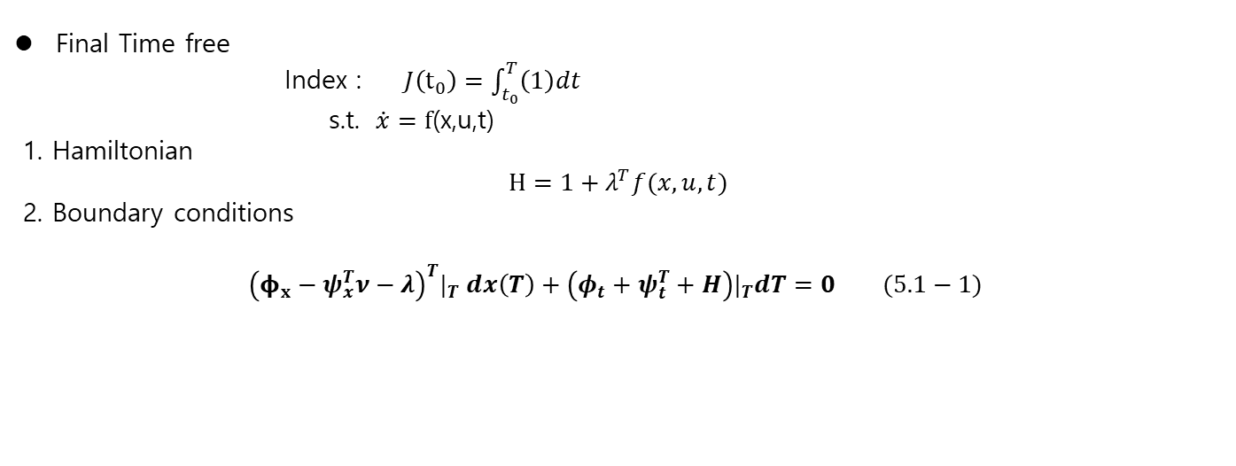
Ch.5 Final Time Free and Contrained Control
Final Time free
Index : $J\left(t_{0}\right)=\int_{t_{0}}^{T}{\left(1\right)dt}$
s.t. $\dot{x}=f$(x,u,t)
1. Hamiltonian
$$H=1+λ^{T}f(x,u,t)$$
2. Boundary conditions
$${\left(φ_{x}−ψ_{x}^{T}ν−λ\right)}^{T}|_{T} dx\left(T\right)+\left(φ_{t}+ψ_{t}^{T}+H\right)|_{T}dT=0 (5.1−1)$$

Slide 5

Ch.5 Final Time Free and Contrained Control
Ex.5.12 Zermelo’s problem (fixed state free final time)
1. problem :
- a UAV flying in a horizontal plane
$$\dot{x}=V\cos{θ(t)}$$
$\dot{y}=V\sin{θ\left(t\right)+u}$
$V:$ UAV’s speed, constant
$θ(t)$: UAV’s heading , controllable
u$:$wind speed, constant
Find the minimum time from $\left(x_{0}, y_{0}\right)=(0,0)$ to $\left(x_{f}, y_{f}\right)=(1,0)$
i.e., $\min_{θ}{J}=\min_{θ}{\int_{t_{0}}^{t_{f}}{\left(1\right)dt}}$
2. Necessary Conditions
Hamiltonian:
$$H=1+λ_{x}\left(Vcos θ\right)+λ_{y}(V sinθ+u)$$

Slide 6

Ch.5 Final Time Free and Contrained Control
Continue ..
- Hamiltonian:
$$H=1+λ_{x}\left(Vcos θ\right)+λ_{y}(V sinθ+u)$$
- Stationary Conditions
$−{\dot{λ}}_{x}=\frac{∂H}{∂x}=0 −→λ_{x}= c_{1}$
$$−\dot{λ_{y}}=\frac{∂H}{∂y}=0−→λ_{y}=c_{2} \\ 0=\frac{∂H}{∂θ}= −λ_{x}V sin θ+λ_{y}V cos θ$$
Hence
$$\tan{θ}=\frac{λ_{2}}{λ_{1}}−→θ −→ constant$$
If $\left(x_{f}, y_{f}\right)=\left(1,0\right), \dot{x}=V\cos{θ(t)}$ → $x\left(t\right)=(V cos θ$) t → $1=\left(Vcos θ\right)t_{f}$
$$t_{f}=\frac{1}{Vcos θ}$$
$\dot{y}=V\sin{θ\left(t\right)+u}$ → $y\left(t\right)=(V\sin{θ+u)t −→\sin{θ=−u/V} }$
$$\cos{θ=\frac{\sqrt{V^{2}−u^{2}}}{V}, θ=−arc\sin{\frac{u}{V}}}$$

Slide 7
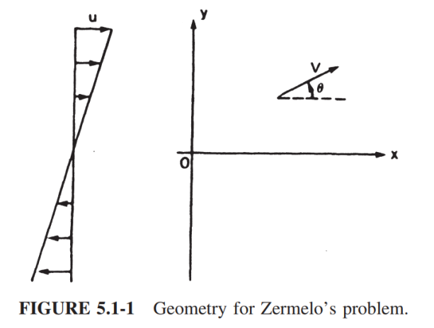

Ch.5 Final Time Free and Contrained Control
Original Zermelo’s problem:
The wind speed $u$ is not a constant but linear along x-axis as
$$u=\frac{V}{h} y$$
Hamiltonian
$H=1+λ_{x}\left(Vcos\left(θ\right)+\frac{Vy}{h}\right)+λ_{y}V\sin{θ}$
- Necessary Conditions
$$−{\dot{λ}}_{x}=H_{x}=0$$
$$−{\dot{λ}}_{y}=H_{y}=\frac{λ_{x}V}{h}$$
Transversality Condition:
$H\left(T\right)=0$

Slide 8
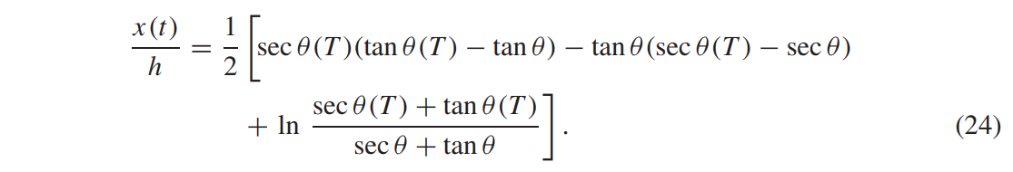
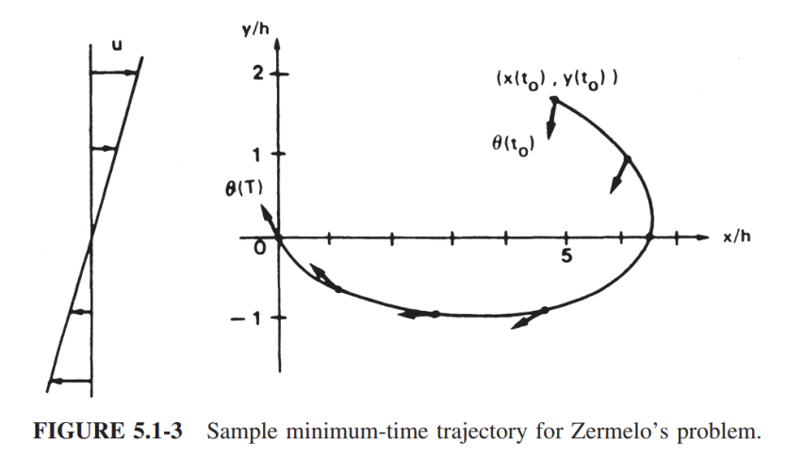

Ch.5 Final Time Free and Contrained Control
Continue..
2) The solution in the book
$\frac{y\left(t\right)}{h}=\sec{θ\left(T\right)}−\sec{θ\left(t\right)}$

Slide 9

Ch.5 Final Time Free and Contrained Control
Pontryagin’s minimum principle
$$\dot{x}=f\left(x,y,t\right)$$
$$J\left(t_{0}\right)=φ\left(x_{T},T\right)+ \int_{0}^{T}{L(x,u,t)}dt$$
- If $u\left(t\right)$ is unconstrained,
$$H_{u}=0$$
- If $u(t)$ is constrainned, i.e., $u\left(t\right)∈ Ψ$, $Ψ$ is an admissible region, then
$$H\left(x^{∗}, u^{∗}, λ^{∗}, t\right)≤H\left(x^{∗}, u, λ^{∗},t\right), ∀ u ∈Ψ$$

Slide 10
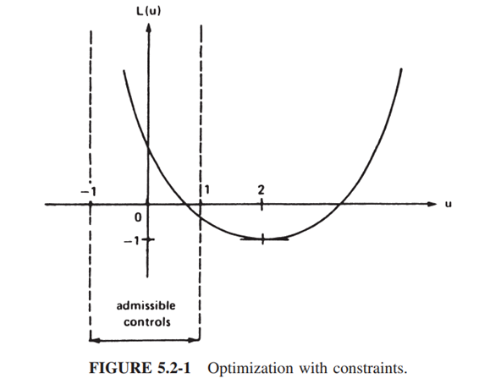

Ch.5 Final Time Free and Contrained Control
Ex. 5.2-1 Optimization with constraints
$$\min_{u}{L }, L=\frac{1}{2}u^{2}−2u+1$$
subject to
$$\left|u(t)\right|≤1$$
If $u^{∗}=1, L\left(u^{∗}\right)=−\frac{1}{2} , ∀ u∈Ψ$,

Slide 11

Ch.5 Final Time Free and Contrained Control
Bang- bang Control
1) Problem
$$\dot{x}=Ax+Bu, J\left(t_{0}\right)= \int_{t_{0}}^{T}{1 dt}, \left|u\right|≤1$$
2) Hamiltonian
$$H=L+λ^{T}\left(Ax+Bu\right)$$
3) Necessary condition
- $0=H_{u}=B^{T}λ −→no information of \text{"}\text{u}“$
- By Pontryagin’s law
$$1+{\left(λ^{∗}\right)}^{T}\left(Ax^{∗}+Bu^{∗}\right)≤1+{\left(λ^{∗}\right)}^{T}\left(Ax^{∗}+Bu\right)$$
${\left(λ^{∗}\right)}^{T}Bu^{∗}≤{\left(λ^{∗}\right)}^{T}Bu$
Assume $u ∈ R$ a scalar case
$${b^{T}λ^{∗}u}^{∗} ≤ b^{T}λu ∀ \left|u\right|≤1$$
If $\left(b^{T}λ^{∗}\right)>0−→u^{∗} = −1$
And $\left(b^{T}λ^{∗}\right)<0−→u^{∗} = 1$
$u^{∗} = −sgn \left(b^{T}λ\right) (5.2−14)$

Slide 12

Ch.5 Final Time Free and Contrained Control
Ex. 5.2-3 Bang-bang Control of systems
1. Problem
$$\dot{y}=v$$
$$\dot{v}=u$$
$$J\left(t_{0}\right)= \int_{t_{0}}^{T}{1 dt}, \left|u\right|≤1$$
Find the control to $\left(y\left(t_{0}\right), v\left(t_{0}\right)\right) −→\left(0.0 \right) ∀ y\left(t_{0}\right), v\left(t_{0}\right)$ in minimum time
2. Hamiltonian
$$H=1+λ_{y}v+λ_{v}u$$
3. Necessary conditions
$${−\dot{λ}}_{y}=0$$
$$−{\dot{λ}}_{v}=λ_{y}$$
4. The transcersality condition
$$0=H\left(T\right)=1+λ_{y}\left(T\right)v\left(T\right)+λ_{v}\left(T\right)u\left(T\right)=1+ λ_{v}\left(T\right)u\left(T\right)∵v\left(T\right)=0$$

Slide 13

Ch.5 Final Time Free and Contrained Control
Continue,,,
$${−\dot{λ}}_{y}=0 −→ λ_{y}=constant$$
$$−{\dot{λ}}_{v}=λ_{y} −→ linear in time$$
$$0=H\left(T\right)=1+λ_{y}\left(T\right)v\left(T\right)+λ_{v}\left(T\right)u\left(T\right)=1+ λ_{v}\left(T\right)u\left(T\right)∵v\left(T\right)=0$$
Application by Pontryagin’s
$$1+λ_{y}^{∗}v^{∗}+λ_{v}^{∗}u^{∗}≤ 1+λ_{y}^{∗}v^{∗}+λ_{v}^{∗}u$$
→
$$λ_{v}^{∗}u^{∗}≤ λ_{v}^{∗}u$$
And $\left|u\right|≤1$
$$u^{∗}\left(t\right)=−sgn(λ_{v}\left(t\right))$$
$$Since λ_{y} is linear ;$$
$sgn(λ_{v}\left(t\right)$) =sign {(+), (-) , (+ to -), (- to +)} → $u^{∗}=\{−1, +1, −1 to+1, +1 to −1\}$

Slide 14
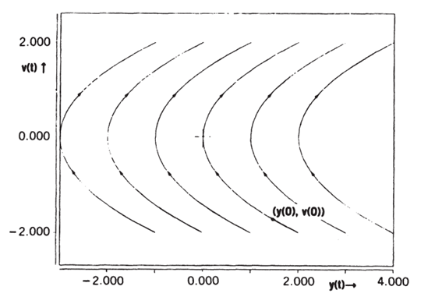
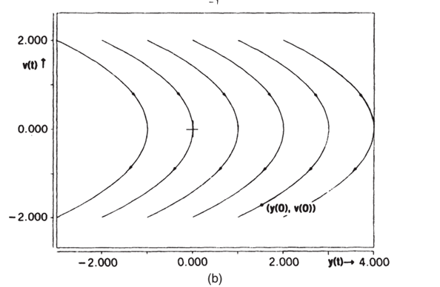

Ch.5 Final Time Free and Contrained Control
5. Application to phase plane rather than solving the necessary conditions
Since $u^{∗}\left(t\right)= +1 or−1$
$$v\left(t\right)=v\left(0\right)+ut \\ y\left(t\right)=y\left(0\right)+v\left(0\right)t+\frac{1}{2}ut^{2}$$
deleting “t” ,
$$u\left(y−y\left(0\right)\right)=v\left(0\right)\left(v−v\left(0\right)\right)+\frac{1}{2}{\left(v−v\left(0\right)\right)}^{2}$$
this is a family of parabola trajectories through $(y\left(0\right), v\left(0\right))$

Slide 15
Ch.5 Final Time Free and Contrained Control
5. Application to phase plane rather than solving the necessary conditions
Since $u^{∗}\left(t\right)= +1 or−1$
$$v\left(t\right)=v\left(0\right)+ut \\ y\left(t\right)=y\left(0\right)+v\left(0\right)t+\frac{1}{2}ut^{2}$$
deleting “t” ,
$$u\left(y−y\left(0\right)\right)=v\left(0\right)\left(v−v\left(0\right)\right)+\frac{1}{2}{\left(v−v\left(0\right)\right)}^{2}$$
this is a family of parabola trajectories through $(y\left(0\right), v\left(0\right))$

Slide 16
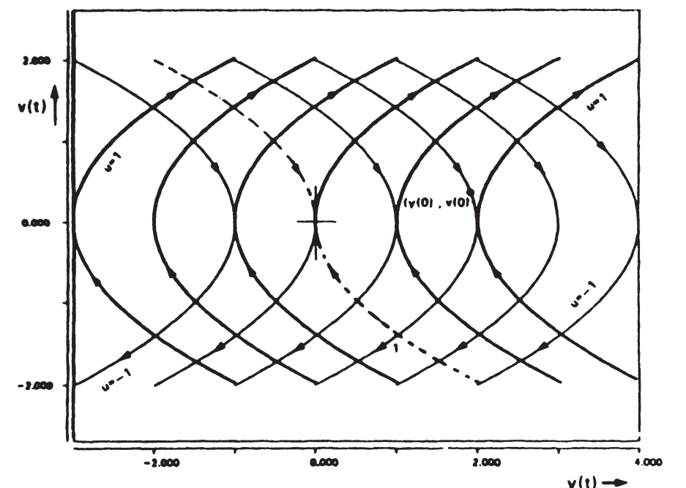
Ch.5 Final Time Free and Contrained Control

Slide 17
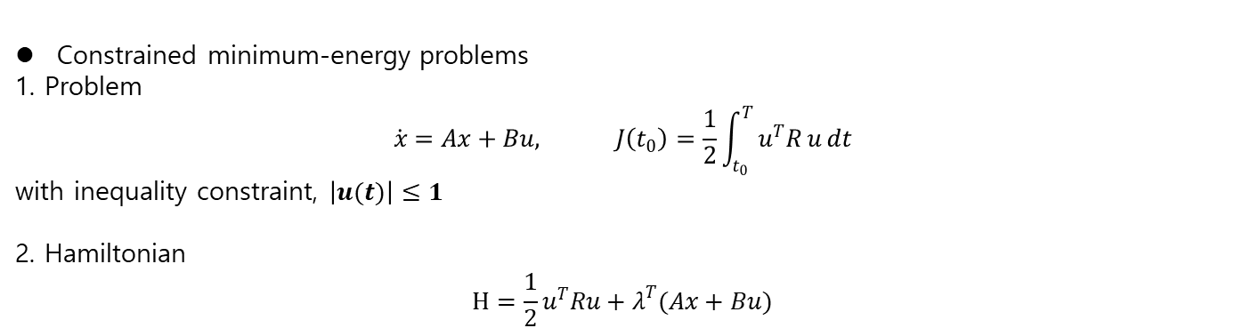
Ch.5 Final Time Free and Constrained Control
Constrained minimum-energy problems
1. Problem
$$\dot{x}=Ax+Bu, J\left(t_{0}\right)=\frac{1}{2}\int_{t_{0}}^{T }{u^{T}R u}dt$$
with inequality constraint, $\left|u(t)\right|≤1$
2. Hamiltonian
$$H=\frac{1}{2}u^{T}Ru+λ^{T}(Ax+Bu)$$

Slide 18

Ch.5 Final Time Free and Constrained Control
Continue..
Lemma :
$$\arg{\min_{u}{u^{T}Ru}}=\arg{\min_{u}{u^{T}u}} R=R^{T}>0$$
Proof :
since $R>0. ∃ M , D s.t. D= {MRM}^{−1}=MR M^{T} , D=diag\left(d_{ii}\right)$
Hence $$u^{T}Ru =u^{T}M^{T}D Mu ={\left(Mu\right)}^{T}D \left(Mu\right)= \sum{d_{ii}\left(v^{T}v\right)}$$
which implies
$$\arg{\min_{u}{u^{T}Ru }=} \arg{\min_{v}{(v^{T}v)}} ∵ d_{ii}>0$$
Now $$v^{T}v ={\left(Mu\right)}^{T}\left(Mu \right)=u^{T}M^{T}Mu=u^{T}u$$
Therefore
$$\arg{\min_{u}{u^{T}Ru}}=\arg{\min_{u}{u^{T}u}}$$

Slide 19

Ch.5 Final Time Free and Constrained Control
Continue..
3) Optimal Controller
Pontryagin’s minimum Principle
$\frac{1}{2}{\left(u^{∗}\right)}^{T}R u^{∗}+{\left(λ^{∗}\right)}^{T}Bu^{∗}≤\frac{1}{2}u^{T}Ru+λ^{T}Bu , ∀u ∈Ψ (5.2−38)$
Adding $\frac{1}{2}λ^{T}BR^{−1}B^{T}λ,$(5.2-38) is
$$\frac{1}{2}u^{T}Ru+λ^{T}Bu+\frac{1}{2}λ^{T}BR^{−1}B^{T}λ=\frac{1}{2}{\left(u+R^{−1}B^{T}λ\right)}^{T}R\left(u+R^{−1}B^{T}λ\right) ≡\frac{1}{2}w^{T}R w (5.2−39)$$
From the Lemma,
$$\arg{\min_{u}{\frac{1}{2}u^{T}Ru+λ^{T}\left(Ax+Bu\right)}} \\ =\arg{\min_{u}{\frac{1}{2}{\left(u+R^{−1}B^{T}λ\right)}^{T}R\left(u+R^{−1}B^{T}λ\right)}} \\ =arg\min_{u}{w^{T}Rw} \\ =\arg{\min_{u}{w^{T}w }} \\ =\arg{\min_{u}{{\left(u+R^{−1}B^{T}λ\right)}^{T}\left(u+R^{−1}B^{T}λ\right)}}$$

Slide 20

Ch.5 Final Time Free and Constrained Control
Continue..
From
$$\arg{\min_{u}{{\left(u+R^{−1}B^{T}λ\right)}^{T}\left(u+R^{−1}B^{T}λ\right)}}$$
The optimal controller is
If $\left|R^{−1}B^{T}λ\right|≤1$
$$u^{∗}= −R^{−1}B^{T}λ$$
If $R^{−1}B^{T}λ>1$
$$u^{∗}= −1$$
If $R^{−1}B^{T}λ < −1$
$$u^{∗}= 1$$
To get the optimal controller, $λ^{∗}$ should be calculated as in the previous chapter.

