Slide 1
Optimal Control
- continuous system (tracking) -
- June 2022 –
Prof. Seungnam Kim in ASTU

Slide 2

Optimal Control for CT systems
Problem
$\dot{x}=Ax+Bu$, $y=Cx\left(t\right) \sim \sim >r\left(t\right), t∈ [0, T]$
Index : $J\left(t_{0}\right)=\frac{1}{2}{\left(Cx\left(T\right)−r\left(T\right)\right)}^{T}P\left(Cx\left(T\right)−r\left(T\right)\right)…$ $$+\frac{1}{2}\int_{t_{0}}^{T}{\left[{\left(Cx−r\right)}^{T}Q\left(Cx−r\right)+u^{T}Ru\right]dt} P,Q≥0, R>0$$
1. Hamiltonian
$$H= {\frac{1}{2}\{\left(Cx−r\right)}^{T}Q\left(Cx−r\right)+u^{T}Ru\} +λ^{T}(Ax+Bu)$$
2. Necessary conditions
$$\dot{x}=H_{λ}=Ax+Bu \left(4.1−10\right) \\ −\dot{λ}=H_{x}=\frac{∂}{∂x }\left\{{\frac{1}{2}\left(Cx−r\right)}^{T}Q\left(Cx−r\right)+λ^{T}\left(Ax+Bu\right)\right\} \\ =A^{T}λ+ C^{T}Q\left(Cx−r\right) (4.1−11) \\ 0= H_{u}=Ru−B^{T}λ (4.1−12)$$
Hamiltonian Matrix
$$\left[\begin{matrix}\dot{x} \\ \dot{λ}\end{matrix}\right]=\left[\begin{matrix}A & −BR^{−1}B^{T} \\ {−C}^{T}QC & {−A}^{T}\end{matrix}\right]\left[\begin{matrix}x \\ λ\end{matrix}\right]+ \left[\begin{matrix}0 \\ C^{T}Q\end{matrix}\right]r (4.1−{12}^{′})$$

Slide 3

Optimal Control for CT systems
2. Optimal Solution
$K\left(t\right)=R^{−1}B^{T}S\left(t\right)$
$$−\dot{S}=A^{T}S+SA−SBR^{−1}B^{T}S+C^{T}QC , S\left(T\right)=C^{T}PC \left(Table 4.1−1\right)$$
$−\dot{v}={\left(A−BK\right)}^{T} v+C^{T}Qr , v\left(T\right)=C^{T}P r\left(T\right)$
$u= −Kx+R^{−1}B^{T}v$
So the optimal trajectory is
$$\dot{x}=\left(A−BK\left(t\right)\right)x+BR^{−1}B^{T}v (4.1−14)$$
Minimum cost
$$J\left(t\right)=\frac{1}{2}x^{T}\left(T\right)S\left(t\right)−x^{T}ν\left(t\right)+w\left(t\right)$$
where
$$−\dot{w}\left(t\right)=\frac{1}{2}r^{T}Qr−\frac{1}{2}ν^{T}BR^{−1}B^{T}ν , w\left(T\right)=\frac{1}{2}r^{T}Pr(T) \left(4.1−15, 16\right)$$

Slide 4
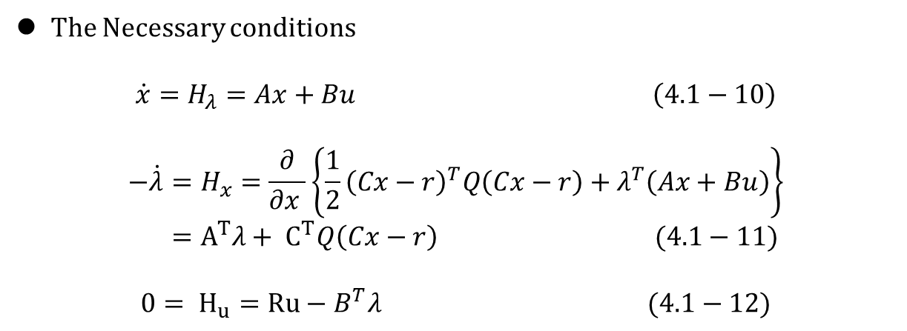
Optimal Control for CT systems
The Necessary conditions
$$\dot{x}=H_{λ}=Ax+Bu \left(4.1−10\right)$$
$$−\dot{λ}=H_{x}=\frac{∂}{∂x }\left\{{\frac{1}{2}\left(Cx−r\right)}^{T}Q\left(Cx−r\right)+λ^{T}\left(Ax+Bu\right)\right\} \\ =A^{T}λ+ C^{T}Q\left(Cx−r\right) (4.1−11)$$
$$0= H_{u}=Ru−B^{T}λ (4.1−12)$$

Slide 5
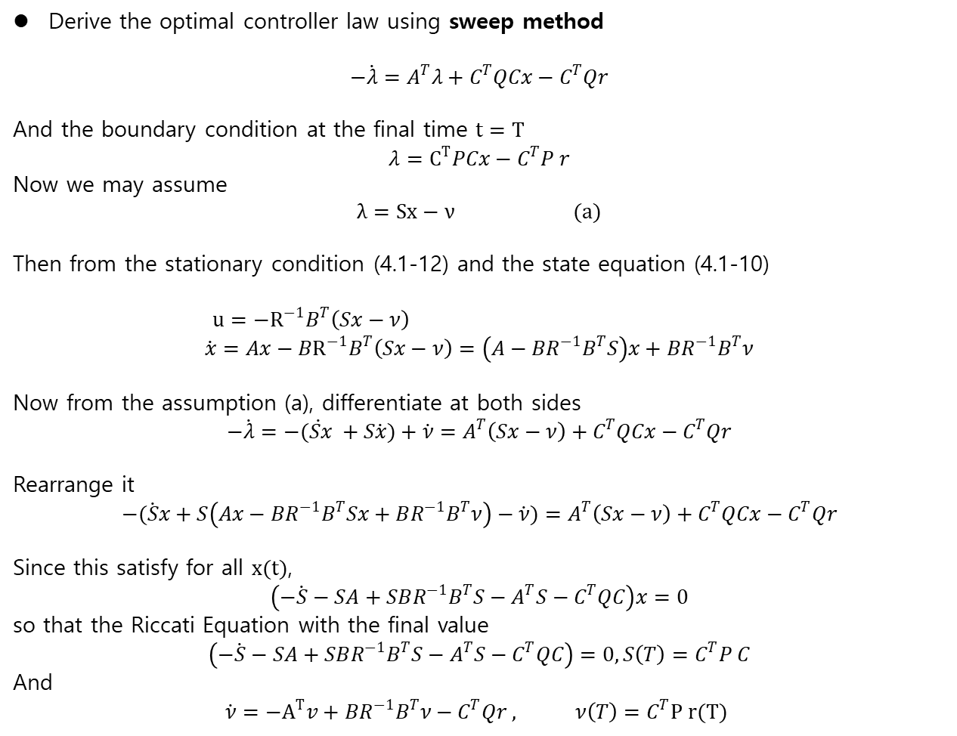
Optimal Control for CT systems
Derive the optimal controller law using sweep method
$$−\dot{λ}=A^{T}λ+C^{T}QCx−C^{T}Qr$$
And the boundary condition at the final time $t=T$
$$λ=C^{T}PCx−C^{T}P r$$
Now we may assume
$$λ=Sx−ν (a)$$
Then from the stationary condition (4.1-12) and the state equation (4.1-10)
$u=−R^{−1}B^{T}\left(Sx−ν\right)$
$$\dot{x}=Ax−BR^{−1}B^{T}\left(Sx−ν\right)=\left(A−BR^{−1}B^{T}S\right)x+BR^{−1}B^{T}ν$$
Now from the assumption (a), differentiate at both sides
$$−\dot{λ}=−\dot{(Sx }+S\dot{x})+\dot{ν}=A^{T}\left(Sx−ν\right)+C^{T}QCx−C^{T}Qr$$
Rearrange it
$$−(\dot{S}x+S\left(Ax−BR^{−1}B^{T}Sx+BR^{−1}B^{T}ν\right)−\dot{ν})=A^{T}\left(Sx−ν\right)+C^{T}QCx−C^{T}Qr$$
Since this satisfy for all $x(t)$,
$$\left(−\dot{S}−SA+SBR^{−1}B^{T}S−A^{T}S−C^{T}QC\right)x=0$$
so that the Riccati Equation with the final value
$$\left(−\dot{S}−SA+SBR^{−1}B^{T}S−A^{T}S−C^{T}QC\right)=0, S\left(T\right)=C^{T}P C$$
And
$$\dot{ν}=−A^{T}v+BR^{−1}B^{T}ν−C^{T}Qr , ν\left(T\right)=C^{T}P r(T)$$

Slide 6
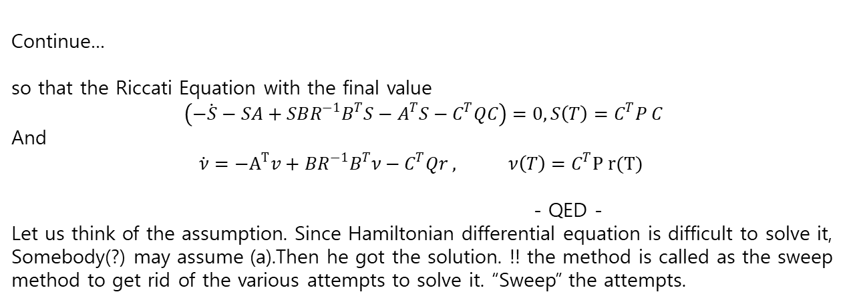
Optimal Control for CT systems
Continue…
so that the Riccati Equation with the final value
$$\left(−\dot{S}−SA+SBR^{−1}B^{T}S−A^{T}S−C^{T}QC\right)=0, S\left(T\right)=C^{T}P C$$
And
$$\dot{ν}=−A^{T}v+BR^{−1}B^{T}ν−C^{T}Qr , ν\left(T\right)=C^{T}P r(T)$$
- QED -
Let us think of the assumption. Since Hamiltonian differential equation is difficult to solve it, Somebody(?) may assume (a).Then he got the solution. !! the method is called as the sweep method to get rid of the various attempts to solve it. “Sweep” the attempts.

Slide 7

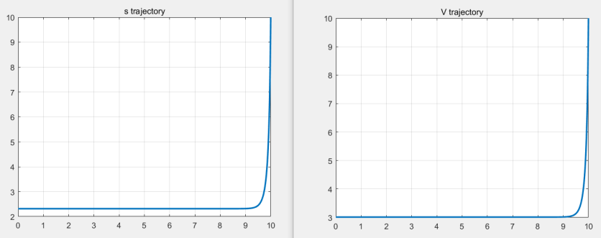
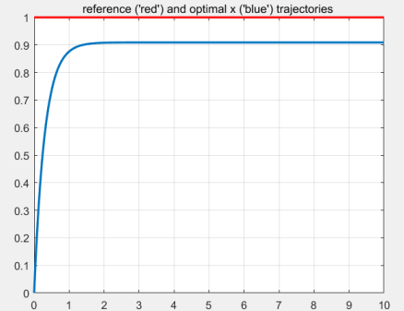

Ex.4.1-1 Scalar
$$\dot{x}=ax+br$$
$$J\left(0\right)=\frac{1}{2}p{\left(x\left(T\right)−r\left(T\right)\right)}^{2}+\frac{1}{2}\int_{0}^{T}{(q{\left(x−r\right)}^{2}+Ru^{2}}) du$$
If $a=1,b=1, T=10, P=10, R=1$
1) $r\left(t\right)=sint (t), q=10$
2) $r\left(t\right)=step$

Slide 8
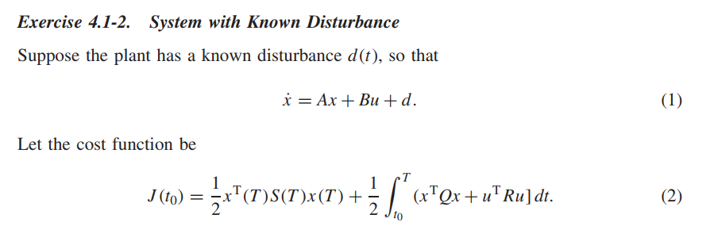
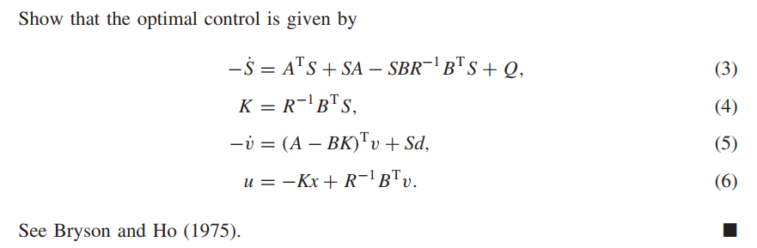
CT – Final State Fixed

Slide 9
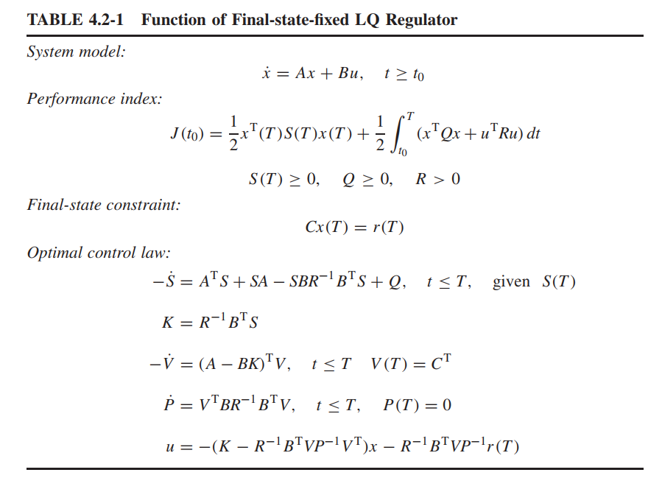
CT – Final State Fixed

Slide 10

Fixed final sate and Open loop control
Continue..
$H=\frac{1}{2}u^{T}Ru+λ^{T}(Ax+Bu)$
Necessary conditions
$\dot{x}=Ax−BR^{−1}B^{T}λ$ (1)
$\dot{λ }= −A^{T}λ$ (2)
From (2)
$$λ\left(t\right)=e^{A^{T}\left(T−t\right)}λ(T)$$
Together from (1)
$$\dot{x}=Ax−BR^{−1}B^{T}e^{A^{T}\left(T−t\right)}λ\left(T\right) (3_$$
The solution to (3)
$$x\left(t\right)=e^{A\left(t−t_{0}\right)} − \int_{t_{0}}^{t}{e^{A\left(T−τ\right)}BR^{−1}B^{T}e^{A^{T}\left(T−τ\right)}dτ λ(T)}$$
$$=e^{A\left(T−t_{0}\right)}x\left(t_{0}\right)−G\left(t_{0}, T\right)λ\left(T\right)$$

Slide 11

Fixed final sate and Open loop control
Continue..
Controllability (Reachability) Grammian
$$x\left(t\right)=e^{A\left(T−t_{0}\right)}x\left(t_{0}\right)−G\left(t_{0}, T\right)λ\left(T\right)$$
$$G\left(t_{0}, T\right)= \int_{t_{0}}^{T}{e^{A\left(T−τ\right)}BR^{−1}B^{T}e^{A^{T}\left(T−τ\right)}dτ}$$
Since with $x\left(T \right)=r_{N}$
$$λ\left(T\right)= −G^{−1}(t_{0}, T)[ r_{N} −e^{A\left(T−t_{0}\right)}x(t_{0})]$$
So that the optimal control is
$$u^{∗}\left(t\right)=R^{−1}B^{T}e^{A^{T}\left(T−t\right)}G^{−1}\left(t_{0}, T\right)[r_{N}−e^{A\left(T−t_{0}\right)}x(t_{0}) ]$$
If $G\left(t_{0}, T\right)=P(t)$, then $P(t)$ is the solution to
$$\dot{P}=AP+PA^{T}+BR^{−1}B^{T}, P\left(t_{0}\right)=0$$
And
$$J^{∗}\left(t_{0}\right)=\frac{1}{2}d^{T} \left(t_{0}, T\right)G^{−1}\left(t_{0}, T\right)d\left(t_{0}, T\right)$$
Where
$d\left(t_{0}, T\right)=r_{N}−e^{A\left(T−t_{0}\right)}x\left(t_{0}\right)$

Slide 12

Fixed final sate and Open loop control
% Controllability
The following statements are equivalent
$(A,B)$ is controllable
$− [B AB A^{2}B…A^{n−1}B]$ has rank $n$
- $[A−λI B]$ has full row rank at every eigenvalue $λ(A)$
- $Re\left(λ\left(A\right)\right)<0 , AP+{PA}^{T}+BB^{T}=0 , P>0$

Slide 13

Free Final State
Free Final State
1) Performance Index
$$J\left(t_{0}\right)=\frac{1}{2}x{\left(T\right)}^{T}S\left(T\right)x\left(T\right)+\frac{1}{2}\int_{t_{0}}^{T}{(x^{T}Q\left(t\right)x+u^{T}R\left(t\right)u )dt}$$
2) Necessary Conditions
$$\dot{x}=Ax−BR^{−1}B^{T}λ \\ −\dot{λ}= Qx+A^{T}λ \\ u\left(t\right)= −R^{−1}B^{T}λ ∵ 0=H_{u}=L_{u}+f_{u}^{T}λ=Ru+B^{T}λ$$
3) Boundary conditions
In case of free final state,
$$λ\left(T\right)=\frac{∂φ}{∂x}|_{T}=S\left(T\right)x(T)$$
4) Optimal Controller
Assume
$$λ\left(t\right)=S\left(t\right)x(t)$$

Slide 14

Free Final State
Continue,…
$$λ\left(t\right)=S\left(t\right)x\left(t\right)$$
Then differentiating at each sides,
$$\dot{λ}=\dot{S}x+S \dot{x}=\dot{S}x+S(Ax−BR^{−1}B^{T}S x)$$
Rearranging it
$$−\dot{S}=A^{T}S+SA−SBR^{−1}B^{T}S+Q , t≤T$$
which is called as Riccati equation
The optimal controller is
$$u\left(t\right)= −R^{−1}B^{T}S x\left(t\right)$$
Kalman gain is
$$K\left(t\right)=R^{−1}B^{T}S\left(t\right)$$
where we have
$$u\left(t\right)= −K\left(t\right)x\left(t\right)$$
→ Closed loop State Feedback !

Slide 15
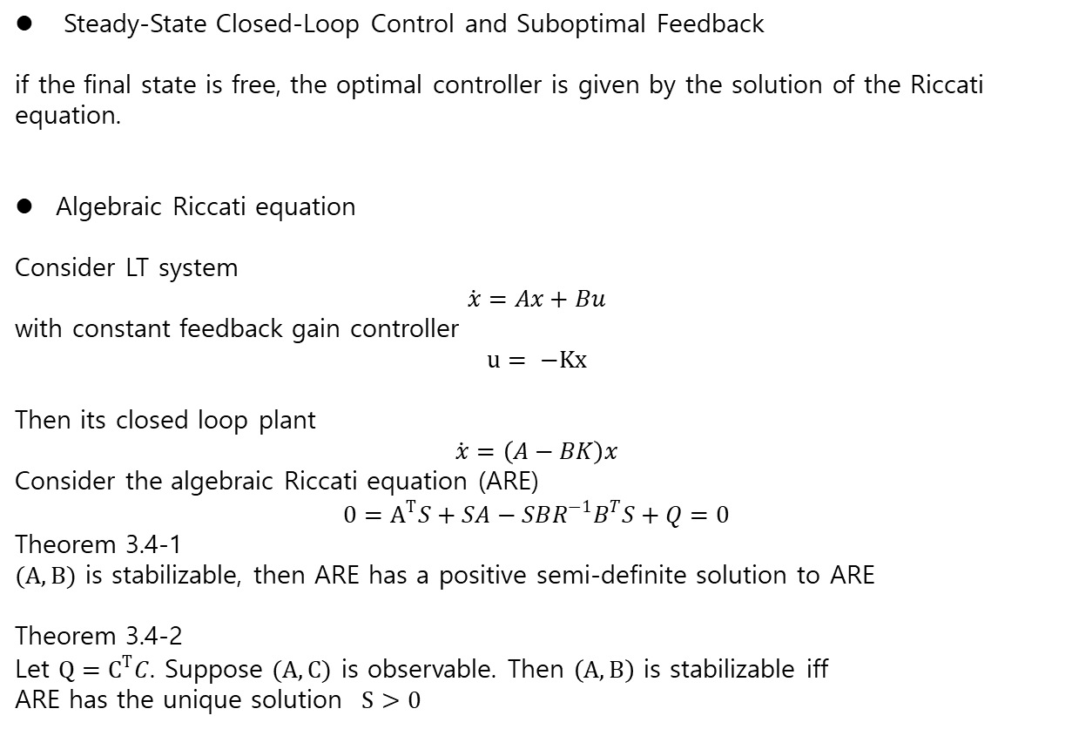
Free Final State
Steady-State Closed-Loop Control and Suboptimal Feedback
if the final state is free, the optimal controller is given by the solution of the Riccati equation.
Algebraic Riccati equation
Consider LT system
$$\dot{x}=Ax+Bu$$
with constant feedback gain controller
$$u= −Kx$$
Then its closed loop plant
$$\dot{x}=\left(A−BK\right)x$$
Consider the algebraic Riccati equation (ARE)
$$0=A^{T}S+SA−SBR^{−1}B^{T}S+Q=0$$
Theorem 3.4-1
$(A,B)$ is stabilizable, then ARE has a positive semi-definite solution to ARE
Theorem 3.4-2
Let $Q=C^{T}C$. Suppose $(A,C)$ is observable. Then $\left(A,B\right)$ is stabilizable iff
ARE has the unique solution $S>0$

