Slide 1
Review
Supervised learning
K-NN(nearest neighbor)
Linear Model – Regression
1) OLS / Ridge / Lasso
2) Classification
Support Vector machine(SVM)
Decision Tree
1) Regression

Slide 2
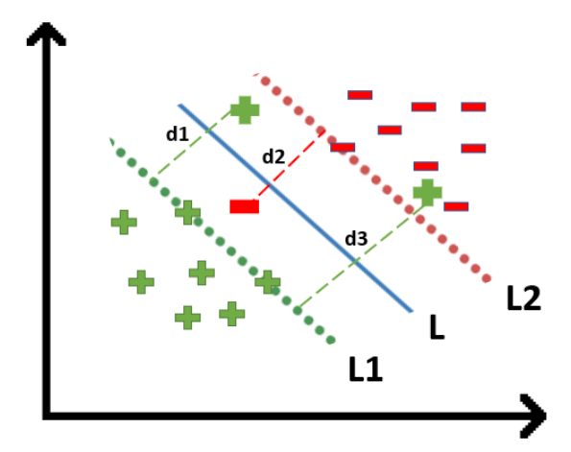

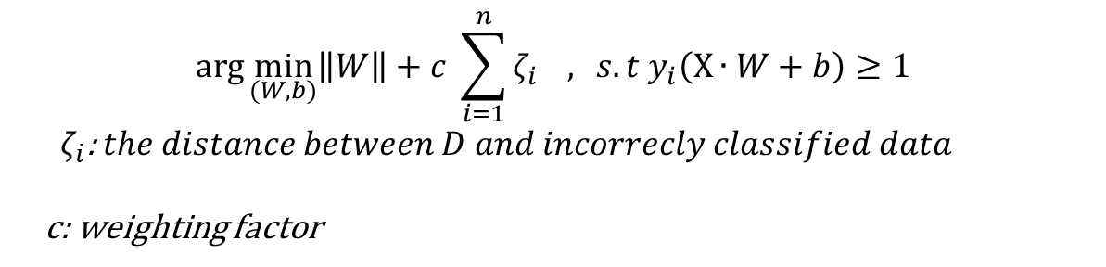
Review
Supervised Learning
Hard Margin SVM
Soft Margin SVM
- to regulate the incorrect classification
$$\arg{\min_{(W, b)}\left\|W\right\| } s.t y_{i}\left(X∙W+b\right)≥1$$
$$\arg{\min_{(W, b)}\left\|W\right\|+c \sum_{i=1}^{n}{ζ_{i}} , } s.t y_{i}\left(X∙W+b\right)≥1$$
${ ζ}_{i}$: $the distance between D and incorrecly classified data$
c: weighting factor

Slide 3
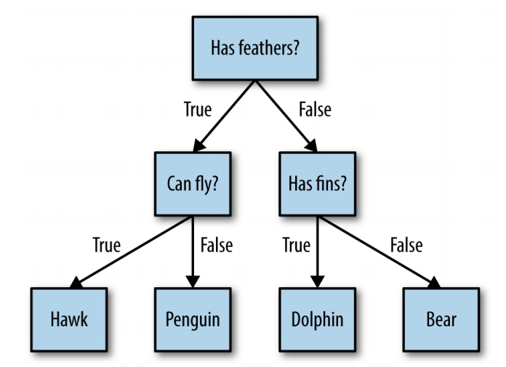

Review - Decision Tree - Entropy
Supervised Learning
Entropy
$Entropy=E= \sum{−p_{i}\log{p_{i}}}$ , where log base is 2
- If $E$is large , more uncertainty, less information
Entropy ~ complexity :
More complex → more uncertain
- Less Entropy (less complexity) → less uncertainty

Slide 4
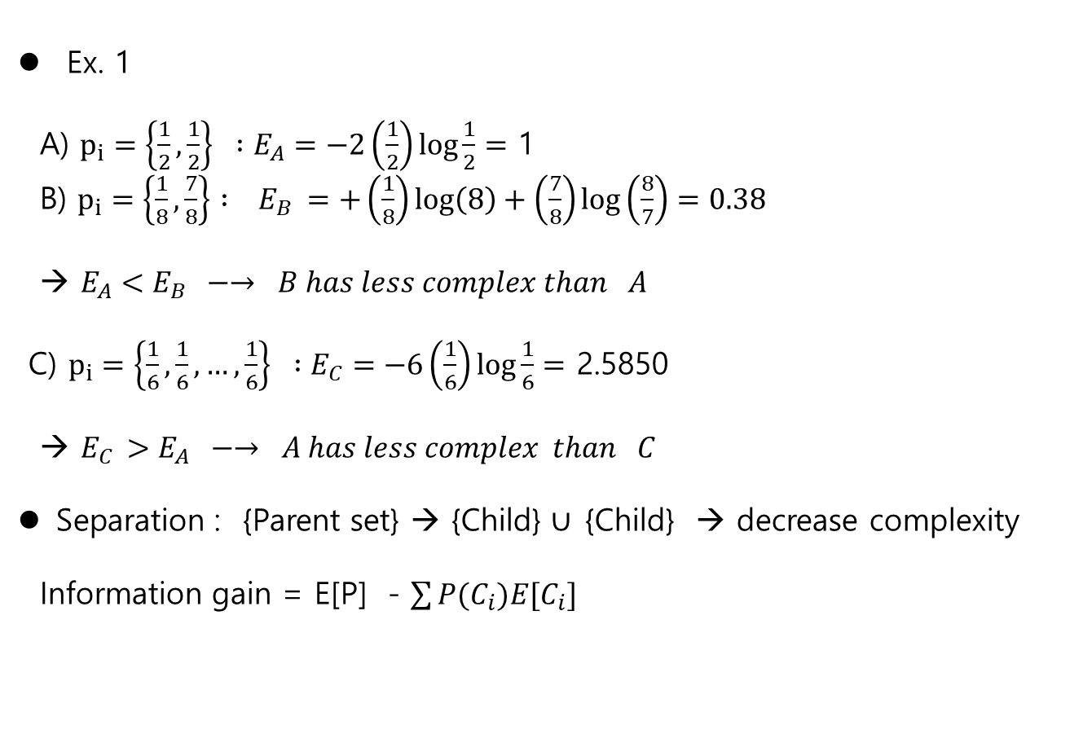
Decision Tree - Entropy
Supervised Learning
Ex. 1
A) $p_{i}=\left\{\frac{1}{2},\frac{1}{2}\right\} :E_{A}=−2\left(\frac{1}{2}\right)\log{\frac{1}{2}}=$ 1
B) $p_{i}=\left\{\frac{1}{8},\frac{7}{8}\right\} : E_{B} =+\left(\frac{1}{8}\right)\log\left(8\right)+\left(\frac{7}{8}\right)\log\left(\frac{8}{7}\right)=0.38$
→ $E_{A}<E_{B} −→ B has less complex than A$
C) $p_{i}=\left\{\frac{1}{6},\frac{1}{6},…,\frac{1}{6}\right\} :E_{C}=−6\left(\frac{1}{6}\right)\log{\frac{1}{6}}=$ 2.5850
→ $E_{C }>E_{A} −→ A has less complex than C$
Separation : {Parent set} → {Child} $∪ \text{\{}\text{Child}\text{\} }$ → decrease complexity
Information gain = E[P] - $\sum{P(C_{i})E[C_{i}]}$

Slide 5
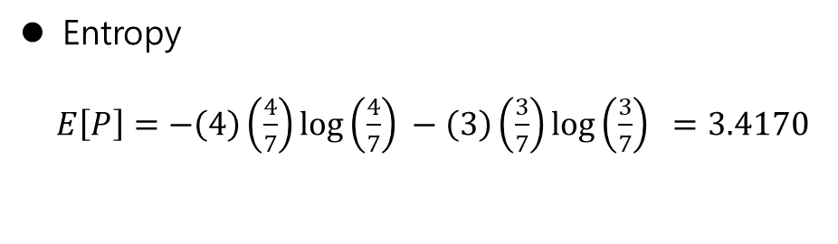
Decision Tree- Entropy
Supervised Learning
-
+++
- - -
Entropy
$E\left[P\right]=−\left(4\right)\left(\frac{4}{7}\right)\log\left(\frac{4}{7}\right) −\left(3\right)\left(\frac{3}{7}\right)\log\left(\frac{3}{7}\right) =3.4170$

Slide 6
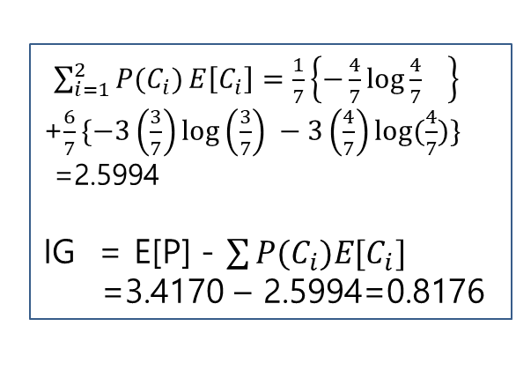
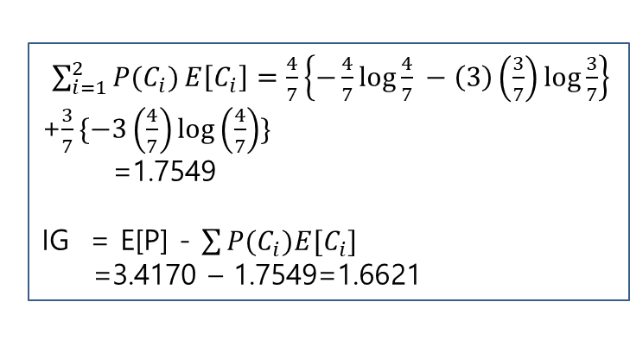
Decision Tree- Decision Boundary
Supervised Learning
Decision boundary : information Gain(IG)
-
+++
- - -
-
+++
- - -
A
B
-
+++
- - -
-
+ + + -
- - -
$\sum_{i=1}^{2}{P(C_{i})}E\left[C_{i}\right]=\frac{1}{7}\left\{−\frac{4}{7}\log{\frac{4}{7}} \right\}$
+$\frac{6}{7}\{−3\left(\frac{3}{7}\right)\log\left(\frac{3}{7}\right) −3\left(\frac{4}{7}\right)log⁡(\frac{4}{7})\}$
=2.5994
IG = E[P] - $\sum{P(C_{i})E[C_{i}]}$
=3.4170 – 2.5994=0.8176
$\sum_{i=1}^{2}{P(C_{i})}E\left[C_{i}\right]=\frac{4}{7}\left\{−\frac{4}{7}\log{\frac{4}{7}} −\left(3\right)\left(\frac{3}{7}\right)\log{\frac{3}{7}}\right\}$
+$\frac{3}{7}\{−3\left(\frac{4}{7}\right)\log\left(\frac{4}{7}\right)\}$
=1.7549
IG = E[P] - $\sum{P(C_{i})E[C_{i}]}$
=3.4170 – 1.7549=1.6621
Boundary B is better than A

Slide 7
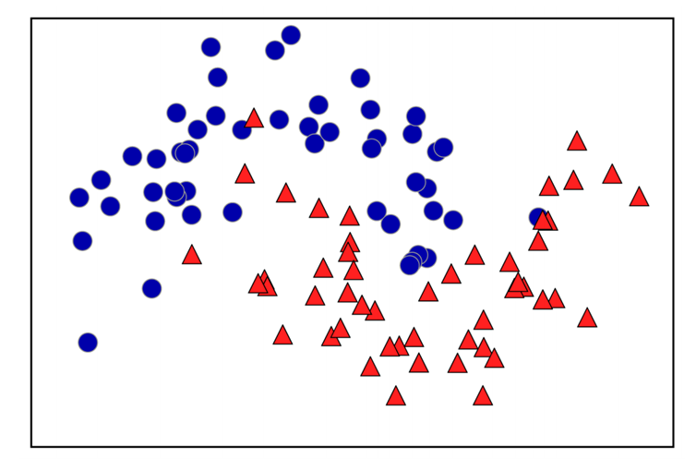
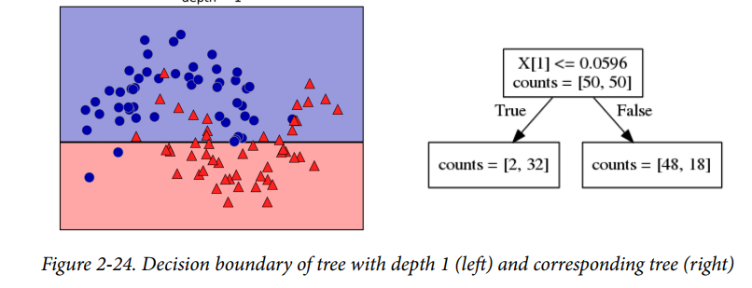
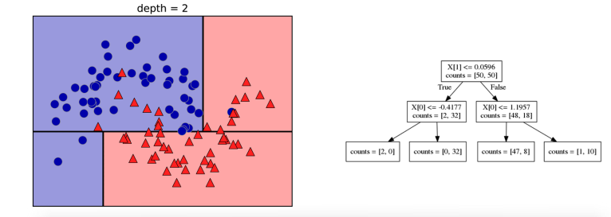
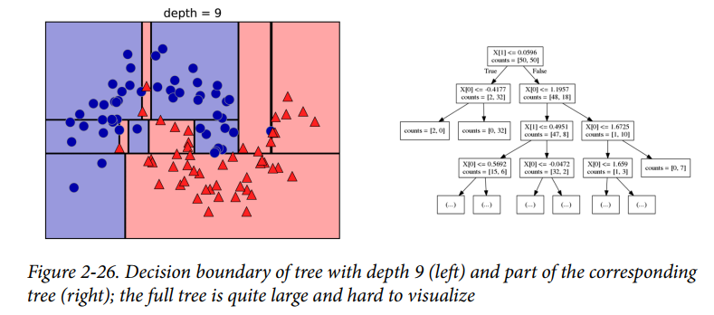
Decision Tree- Decision Boundary
Supervised Learning
Example – w/o code

Slide 8
Decision Tree- Decision Boundary
Supervised Learning
Pros and Cons
1) Pro
- easily visualized and understood (at least for small trees)
- invariant to scaling of the data, continuous, discrete, binary features.
2) Cons
- Over fitted

Slide 9
Decision Tree - Random Forest
Supervised Learning
Concepts
1. Build trees randomly – bootstrap sampling
Given the data set, build several trees using “Bootstrap sampling”
i.e., To randomly select samples so that each tree is a little bit different
** bootstrapping : a self-starting process that is supposed to continue or grow without external input.
1) example: [ a, b,c, d] 2) build another tree
→ [ b] [b,b,a,c]
→[ b,a ]
→[ b, a, b]
→ [b,a,b,c]

Slide 10
Decision Tree - Random Forest
Supervised Learning
Concepts
2. Aggregation
At each tree, the predicted output are decided as “Decision Tree”
→ The aggregate (majority vote) the outputs to get the prediction

Slide 11

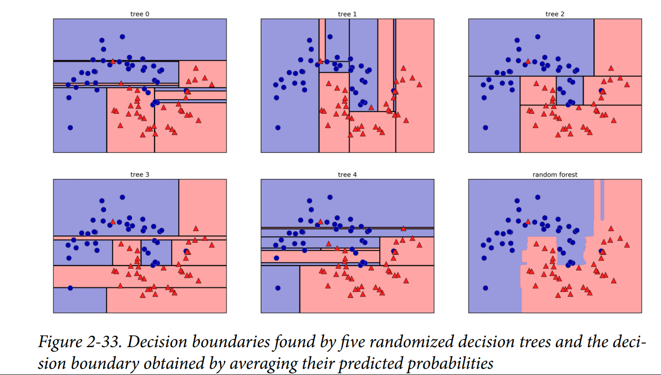
Decision Tree - Random Forest
Supervised Learning
Example (p.84)
-5 trees
-average

Slide 12
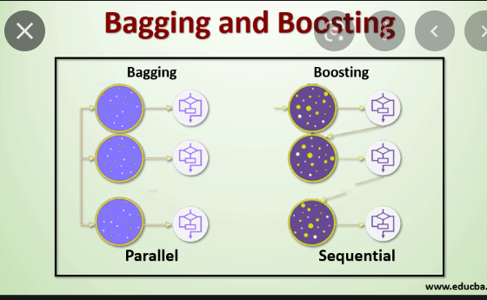
Decision Tree - Gradient Boosting Tree
Supervised Learning
Gradient Boosting
- boosting : (google) an ensemble learning method that combines a set of weak learners into a strong learner to minimize training error.
** bagging (random forest)
bootstapping (sampling) and aggregation
P.91
“ Gradient Boosted Decision
Most powerful and widely used models
For supervised learning”

Slide 13
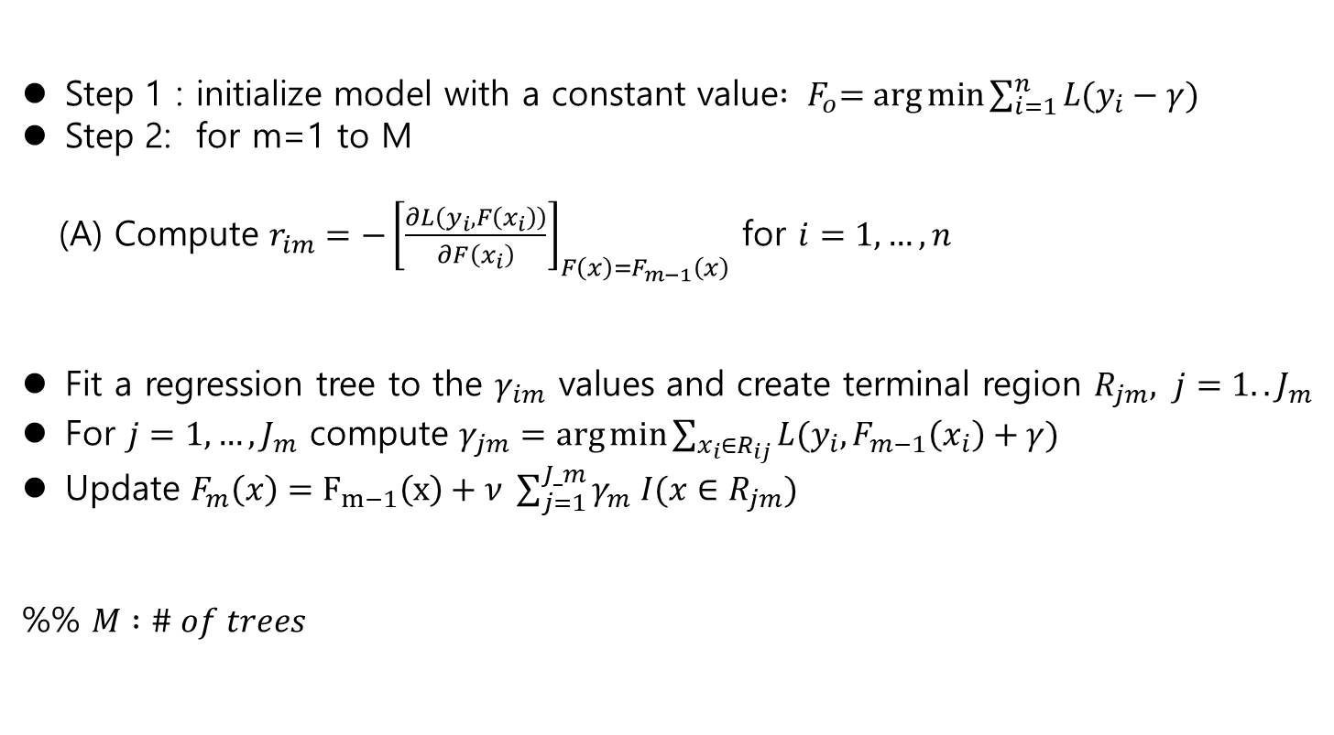
Decision Tree - Gradient Boosting Tree
Supervised Learning
Step 1 : initialize model with a constant value${ : F}_{o}=\arg{\min{\sum_{i=1}^{n}{L(y_{i}−γ)}}}$
Step 2: for m=1 to M
(A) Compute $r_{im}=−{\left[\frac{∂L\left(y_{i}, F\left(x_{i}\right)\right)}{∂F\left(x_{i}\right)}\right]}_{F\left(x\right)=F_{m−1}\left(x\right)}$ for $i=1,…,n$
Fit a regression tree to the $γ_{im}$ values and create terminal region $R_{jm}, j=1..J_{m}$
For $j=1,…, J_{m}$ compute $γ_{jm}=\arg{\min{\sum_{x_{i}∈R_{ij}}{L(y_{i}, F_{m−1}\left(x_{i}\right)+γ)}}}$
Update $F_{m}\left(x\right)=F_{m−1}\left(x\right)+ν \sum_{j=1}^{J_m}{γ_{m} I(x∈R_{jm})}$
%% $M :\# of trees$

Slide 14
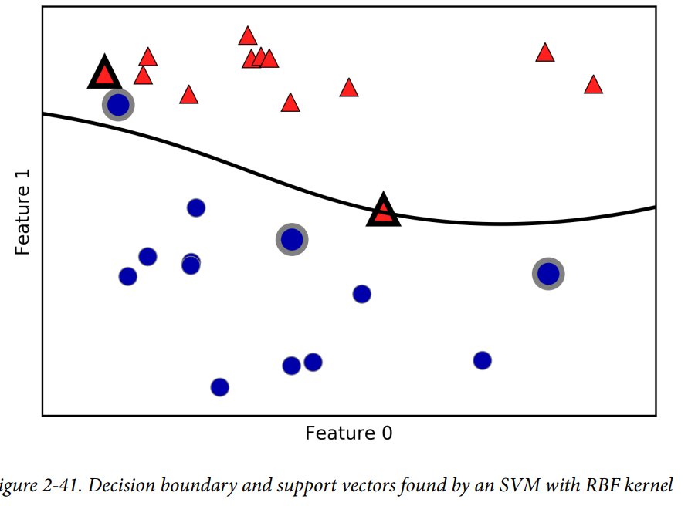

Non-linear SVM
Supervised Learning
Kernelized Support Vector Machine
Linear SVM
$d= {\left\|x_{1}−x_{2}\right\|}_{2}^{2}$
Kernelized SVM
$d= {exp⁡(γ\left\|x_{1}−x_{2}\right\|}_{2}^{2})$

Slide 15
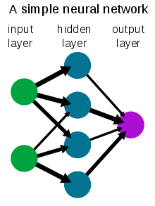
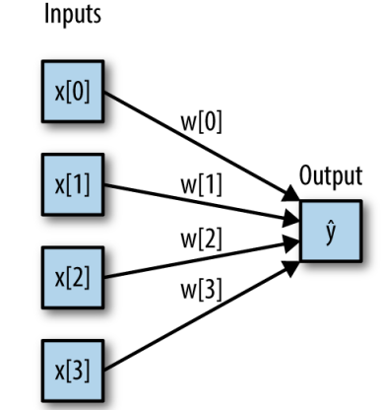
Neural Network
Supervised Learning
Neural Network(Neural Science)
==Deep Learning(Except Neural Science)
Nomenclature
branch(synapse)
Node (Neuron)
Layer : Input – Hidden – Output
https://en.wikipedia.org/wiki/Neural_network

Slide 16
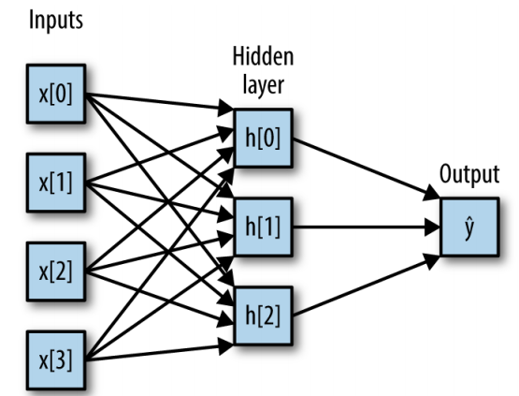
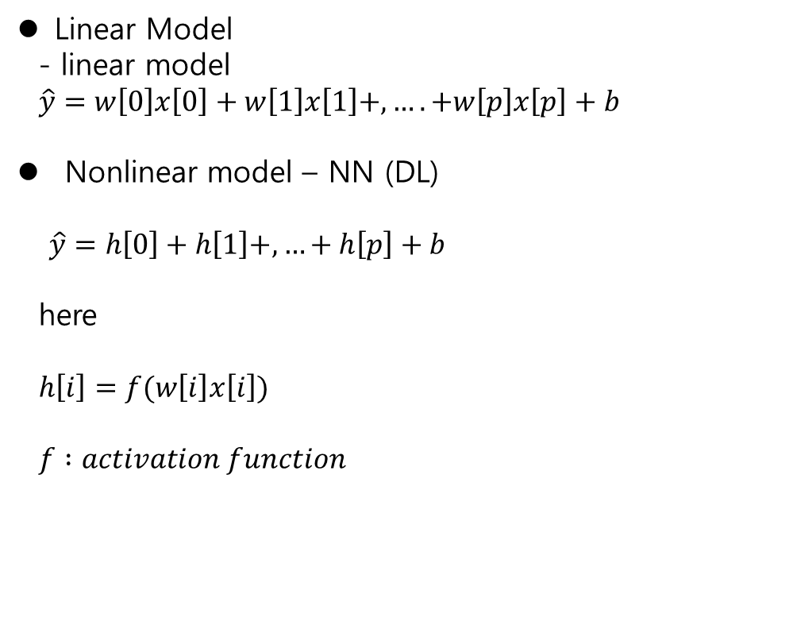
Neural Network
Linear Model
- linear model
$\hat{y}=w\left[0\right]x\left[0\right]+w\left[1\right]x\left[1\right]+,….+w\left[p\right]x\left[p\right]+b$
Nonlinear model – NN (DL)
$\hat{y}=h\left[0\right]+h\left[1\right]+,…+h\left[p\right]+b$
here
$h\left[i\right]=f(w\left[i\right]x\left[i\right])$
$f :activation function$
https://en.wikipedia.org/wiki/Neural_network

Slide 17
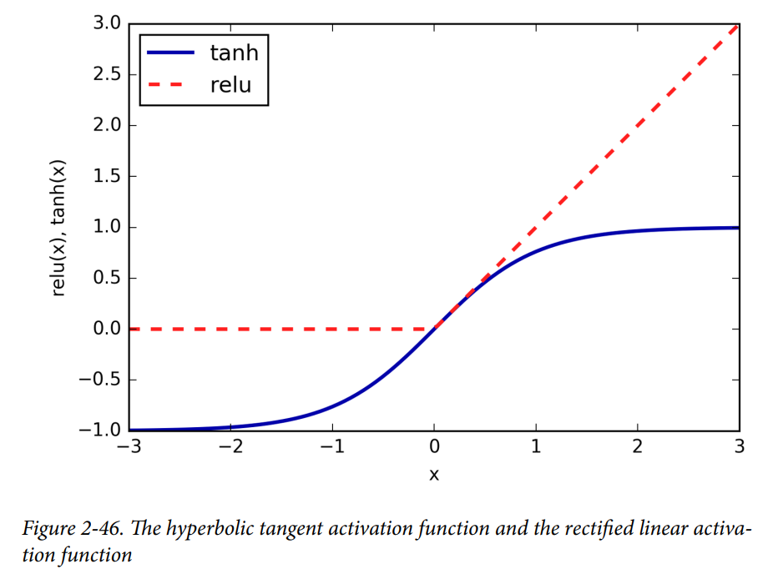

Neural Network
Activation Function $f(x)$
$\tanh\left(x\right)=\frac{e^{−x}+e^{x} }{2}$
reLu(aka, also known as, rectifying non-linear Unit)
$relu\left(x\right)=\max\left(0,x\right)$
https://en.wikipedia.org/wiki/Neural_network

Slide 18
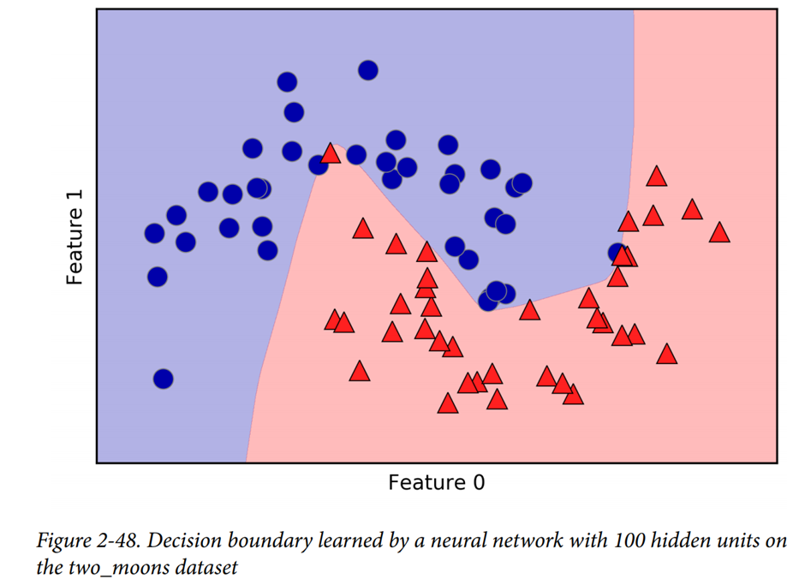
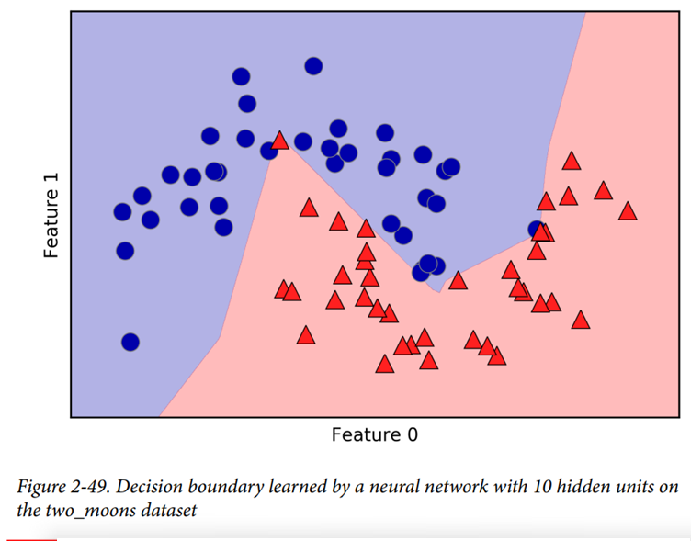
Neural Network
Ex. (p106)
1) L : 100 hidden nodes
R : 10 hidden nodes → more ragged
aka: also known as

Slide 19
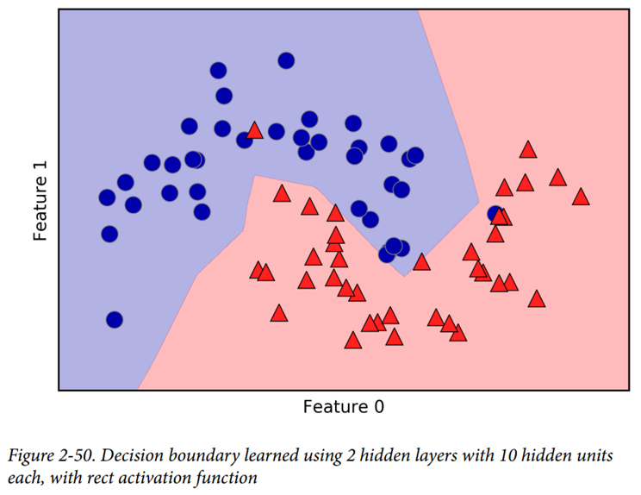
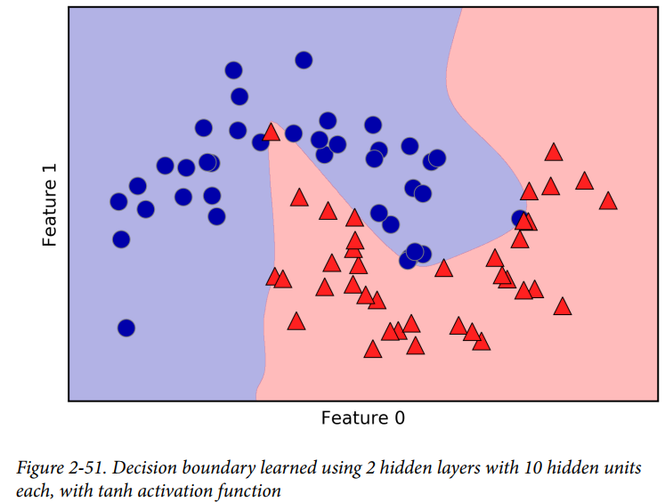
Neural Network
Ex. (p106)
2 hidden layers 10 hidden units
- activation function
L : reLu(x)
R : tanh(x)
aka: also known as

Slide 20
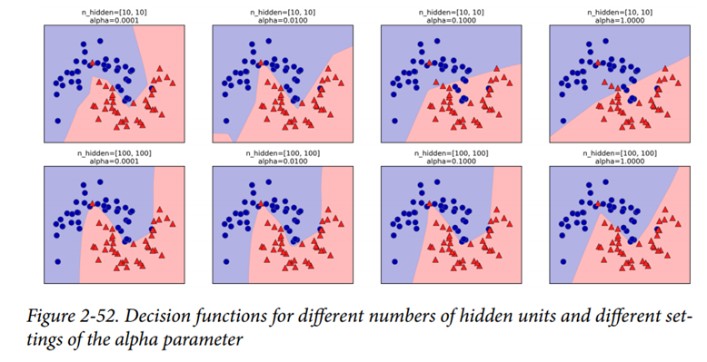
Neural Network
Various cases
aka: also known as

Slide 21
Unsupervised Learning
Introduction : in contrast to “Supervised learning”, No supervise.
→ Data is only input.
Application
: transformation of dataset i.e., dimension reduction,
: finding parts of components of data, i.e., the topic extraction on text
: clustering algorithm, images are grouped into a same person
(face detection , digit identification)
aka: also known as

Slide 22
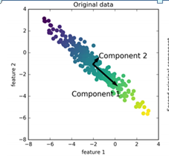
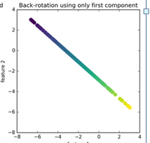
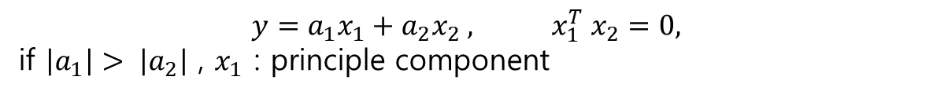

Review
Supervised learning
Principle component
Dimension Reduction
$y \left( dimesion=2\right) −→ \hat{y}=y^{T}x_{1} −→dimension 1$
$$y=a_{1}x_{1}+a_{2}x_{2} , x_{1}^{T} x_{2}=0,$$
if $\left|a_{1}\right|> \left|a_{2}\right|$ , $x_{1}$ : principle component

Slide 23
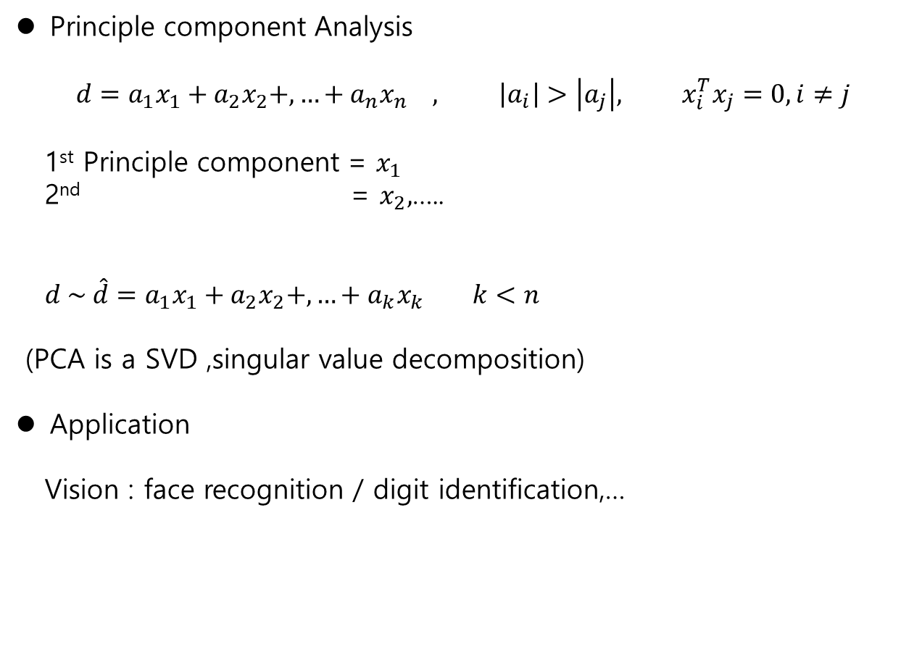
Review
Supervised learning
Principle component Analysis
$$d=a_{1}x_{1}+a_{2}x_{2}+,…+a_{n}x_{n} , \left|a_{i}\right|>\left|a_{j}\right|, x_{i}^{T}x_{j}=0, i≠j$$
1st Principle component = $x_{1}$
2nd = $x_{2},$…..
$d \sim \hat{d}=a_{1}x_{1}+a_{2}x_{2}+,…+a_{k}x_{k} k<n$
(PCA is a SVD ,singular value decomposition)
Application
Vision : face recognition / digit identification,…

Slide 24

Dimensionality Reduction ,Feature Extraction
Principal Component
Problem
Given data, $d_{i}$ find
$d_{i}=a_{1i}x_{1}+{a_{2i}x}_{2}+,…,+a_{ni}x_{n}$ , $D=AX$
Find s.t $x_{i}^{T}x_{j}=0 , \left|λ_{i}\right|> \left|λ_{j}\right|, i<j$
$d_{i}=λ_{1}x_{1}+λ_{2}x_{2}+,…,+λ_{n}x_{n}$
2. Concept to get the solution
If $A^{T}=A$ → eigenvector is orthogonal
→ covariance matrix $C$ is symmetric and its eigenvector is orthogonal !!

Slide 25
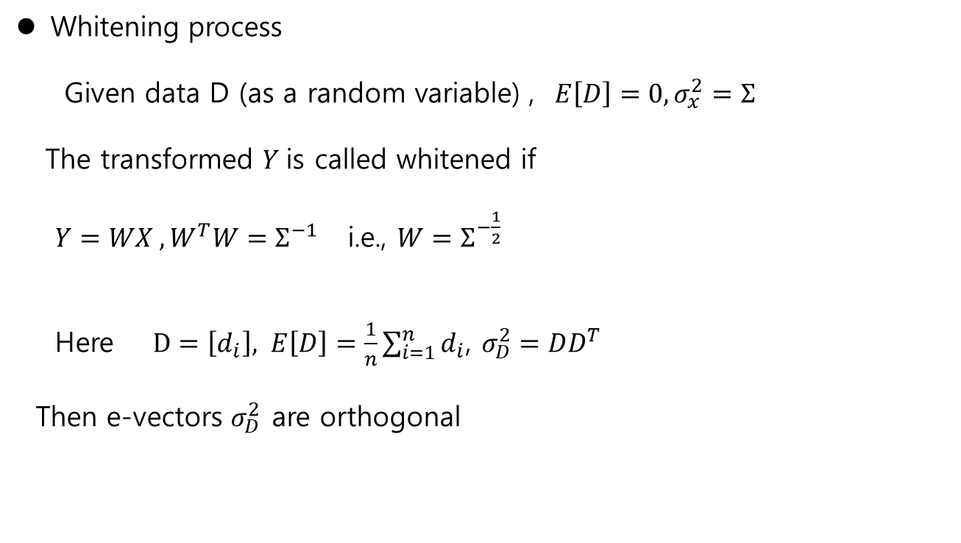
Dimensionality Reduction ,Feature Extraction
Whitening process
Given data D (as a random variable) , $E\left[D\right]=0, σ_{x}^{2}=Σ$
The transformed $Y$is called whitened if
$Y=WX , W^{T}W=Σ^{−1}$ i.e., $W=Σ^{−\frac{1}{2}}$
Here $D=\left[d_{i}\right], E\left[D\right]=\frac{1}{n}\sum_{i=1}^{n}{d_{i}}$, $σ_{D}^{2}=DD^{T}$
Then e-vectors $σ_{D}^{2}$ are orthogonal

Slide 26

Dimensionality Reduction ,Feature Extraction
Procedure
1. Delete the bias
as $\overline{D}=D−E\left[D\right]$
2. Whitening Process of $Y$ with $W$
$Y=W\overline{D}$ (e-values of $Y$ is equivalent to that of $\overline{D})$
3. Find eigenvectors of $Y$
$y_{i}=λ_{1}x_{1}+λ_{2}x_{2}+,…+λ_{n}x_{n}$
4. choose PCA up to k
$$y_{i}\sim {\hat{y}}_{i}=λ_{1}x_{1}+ …+λ_{k}x_{k}$$

Slide 27
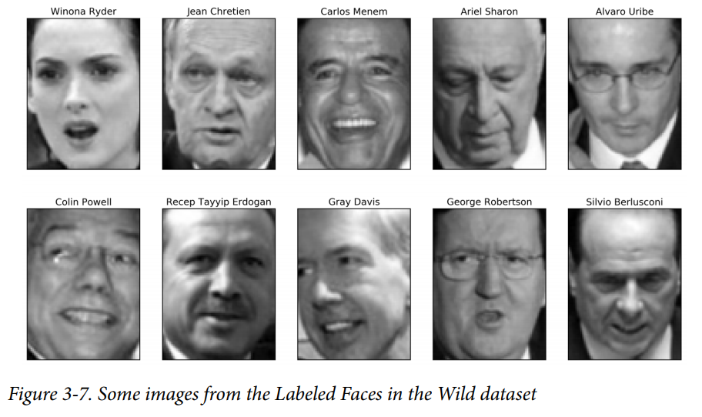
Dimensionality Reduction ,Feature Extraction
Face identification : Example (p.146)
pixel : 87x65 → at least 65 x 65 eigenvectors = 4225 (dimensions! )
→ Reduce the dimension

Slide 28
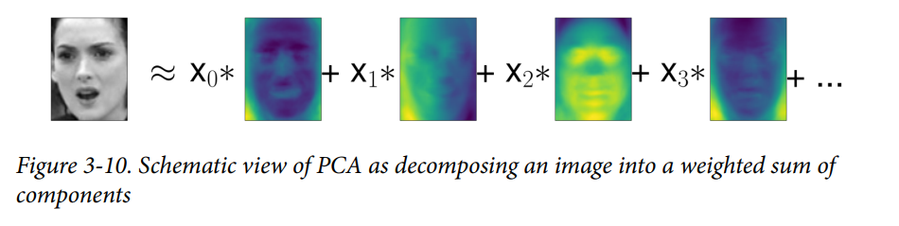
Dimensionality Reduction ,Feature Extraction
Face identification (p.153):

Slide 29
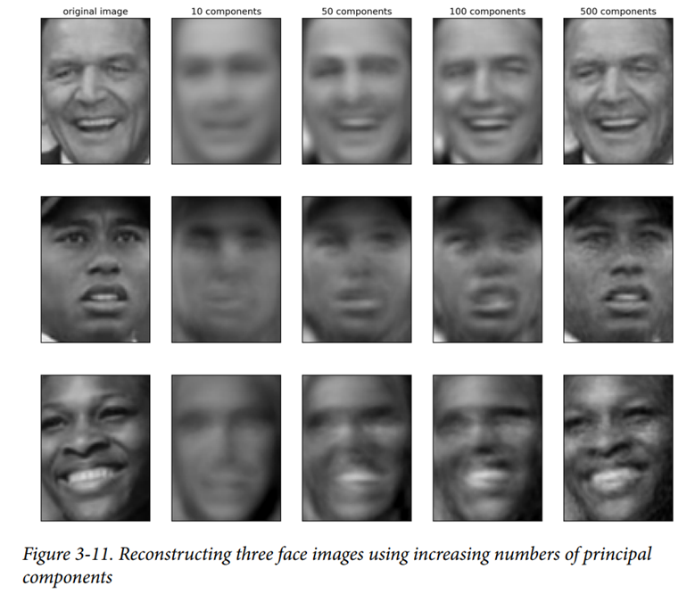
Dimensionality Reduction ,Feature Extraction
Face identification : Example (p.153)

Slide 30

Dimensionality Reduction ,Feature Extraction
Signal Decomposition / Approximation
PCA : orthogonal basis , i.e., $x_{i}^{T}x_{j}=0 in Ehcliden Space$
Fourier : orthogonal basis, i.e., $\sin{x}\sin{2x ,\sin{3x,…, \cos{x ,\cos{2x,…}}}}$
Signal decomposition
observed sum of these
→ decomposition 3 signals

Slide 31
Dimensionality Reduction ,Feature Extraction
ICA
Independent Component Analysis
the signals summed with different sources may be decomposed into
each source, using “non-Gaussian” property
→ Blind Source Separation

