Slide 1
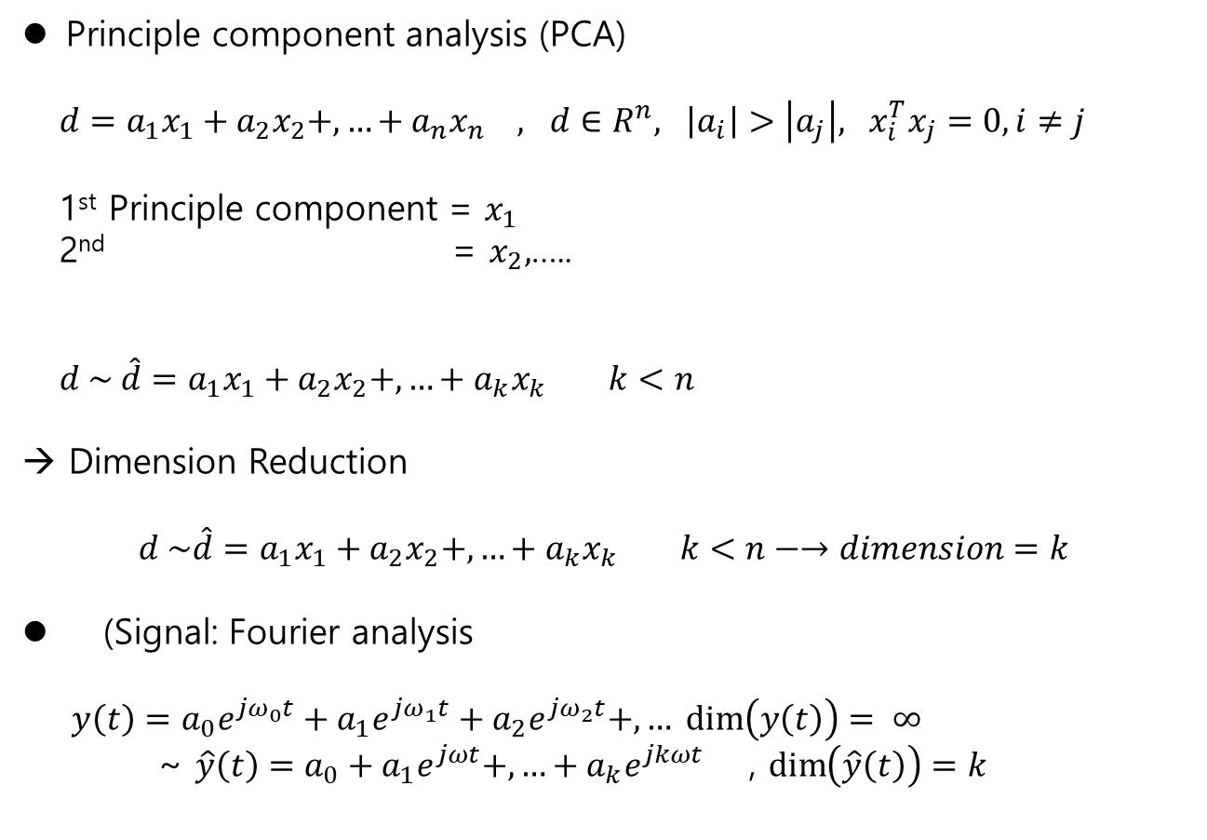
Review
Unsupervised learning
Principle component analysis (PCA)
$d=a_{1}x_{1}+a_{2}x_{2}+,…+a_{n}x_{n} , d∈R^{n}, \left|a_{i}\right|>\left|a_{j}\right|, x_{i}^{T}x_{j}=0, i≠j$
1st Principle component = $x_{1}$
2nd = $x_{2},$…..
$d \sim \hat{d}=a_{1}x_{1}+a_{2}x_{2}+,…+a_{k}x_{k} k<n$
→ Dimension Reduction
$$d \sim \hat{d}=a_{1}x_{1}+a_{2}x_{2}+,…+a_{k}x_{k} k<n−→dimension=k$$
(Signal: Fourier analysis
$y\left(t\right)=a_{0}e^{jω_{0}t}+{a_{1}e}^{jω_{1}t}+a_{2}e^{jω_{2}t}+,… \dim\left(y\left(t\right)\right)= ∞$
~ $\hat{y}\left(t\right)=a_{0}+{a_{1}e}^{jωt}+,…+a_{k}e^{jkωt}$ , $\dim\left(\hat{y}\left(t\right)\right)=k$

Slide 2

Dimensionality Reduction ,Feature Extraction
Unsupervised learning
Procedure
1. Delete the bias
as $\overline{D}=D−E\left[D\right]$
2. Whitening Process of $Y$ with $W$
$Y=W\overline{D}$ (e-values of $Y$ is equivalent to that of $\overline{D})$
3. Find eigenvectors of $Y$
$y_{i}=λ_{1}x_{1}+λ_{2}x_{2}+,…+λ_{n}x_{n}$
4. choose PCA up to k
$$y_{i}\sim {\hat{y}}_{i}=λ_{1}x_{1}+ …+λ_{k}x_{k}$$

Slide 3
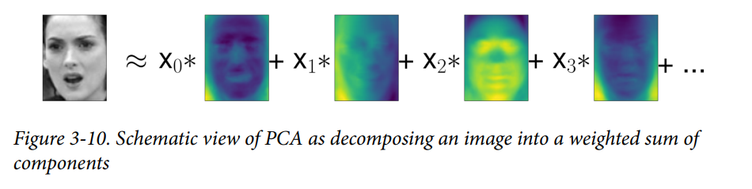
Dimensionality Reduction ,Feature Extraction
Unsupervised learning
Face identification (p.153):
% eigenface analysis
- SVD (singular value decomposition)

Slide 4
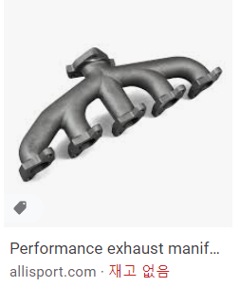
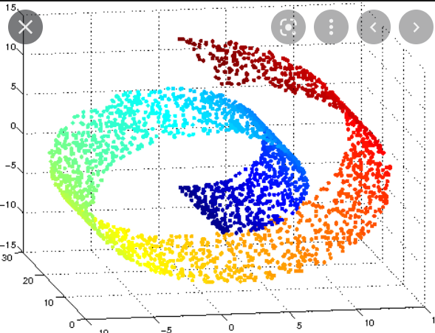
Manifold learning with t-SNE
Unsupervised learning
Manifold Learning with t-SNE
a manifold is a topological space that locally resembles Euclidean space near each point.
- locally resemble
https://en.wikipedia.org/wiki/Manifold

Slide 5
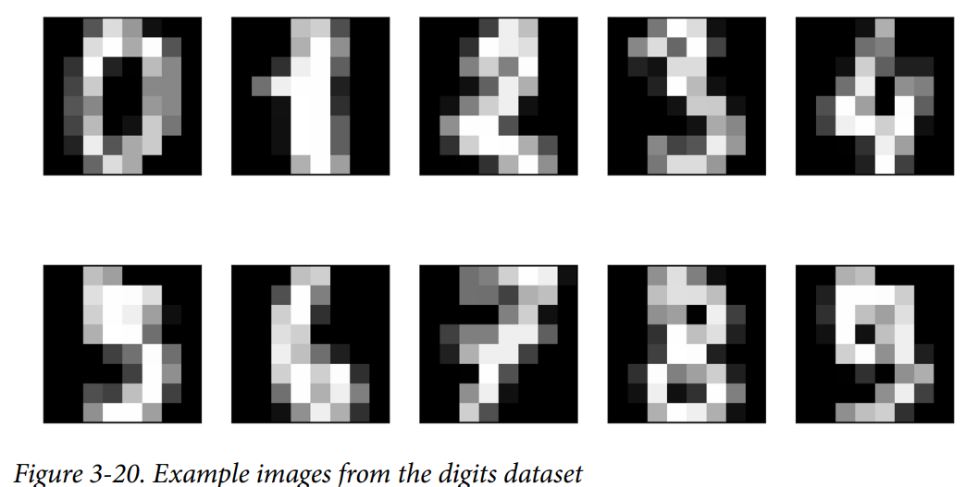
Manifold learning with t-SNE
Unsupervised learning
Ex. (p.163) Digit clustering with PCA :
- hand written digit : 8x8 gray scale image
- using PCA 2-components,
https://en.wikipedia.org/wiki/Manifold

Slide 6
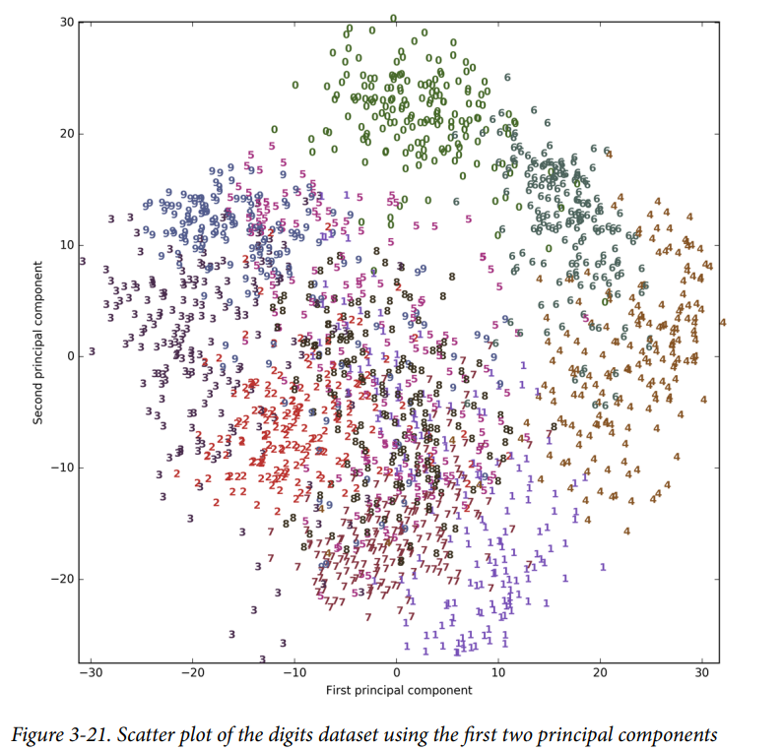
Manifold learning with t-SNE
Unsupervised learning
Ex. (p.163) Digit clustering with PCA :
- overlapped , difficult to cluster,
https://en.wikipedia.org/wiki/Manifold

Slide 7
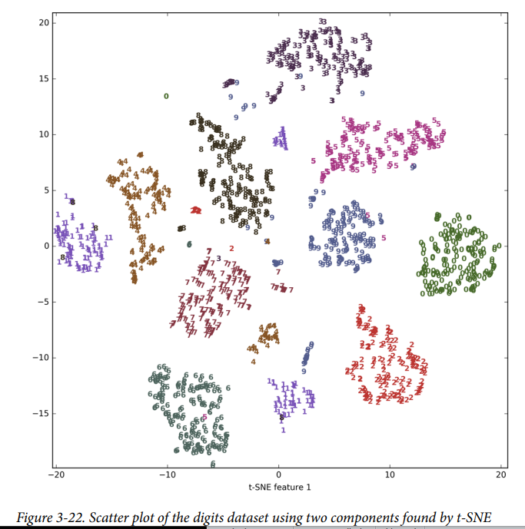
K-means clustering
Unsupervised learning
Ex. P165 Ex.p166
https://en.wikipedia.org/wiki/Manifold

Slide 8
Manifold learning with t-SNE
Unsupervised learning
t-SNE :
Stochastic Neighboring Embedding
Two clusters
https://en.wikipedia.org/wiki/Manifold

Slide 9
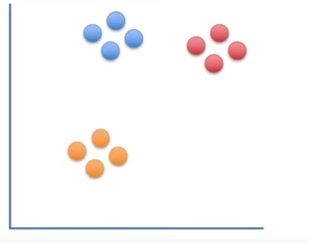
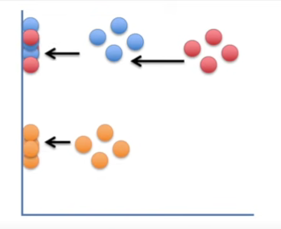
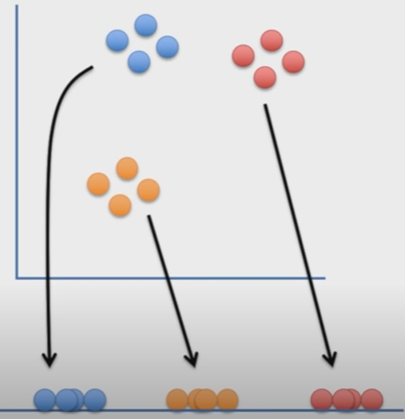
Manifold learning with t-SNE
Unsupervised learning
t-SNE :
Stochastic Neighboring Embedding
Two dimension → one dimension
→ just projection (like PCA) not preserved the clustering
Data is in 2D just projection failed 1D by t-sne
https://www.youtube.com/watch?v=NEaUSP4YerM

Slide 10
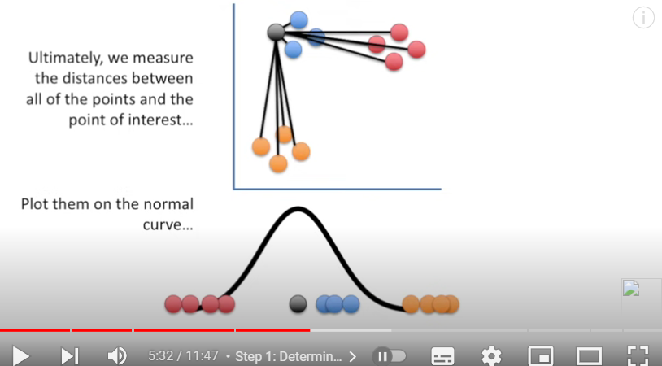
Manifold learning with t-SNE
Unsupervised learning
t-SNE :
https://www.youtube.com/watch?v=NEaUSP4YerM

Slide 11
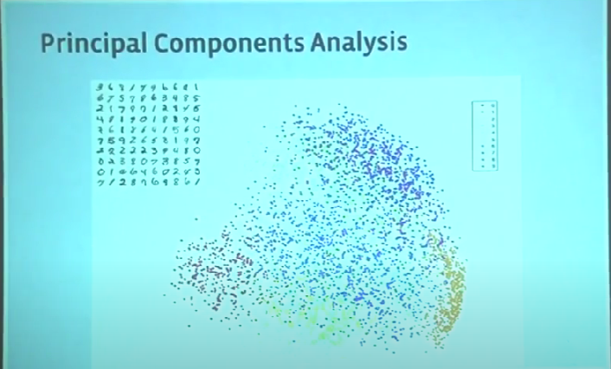
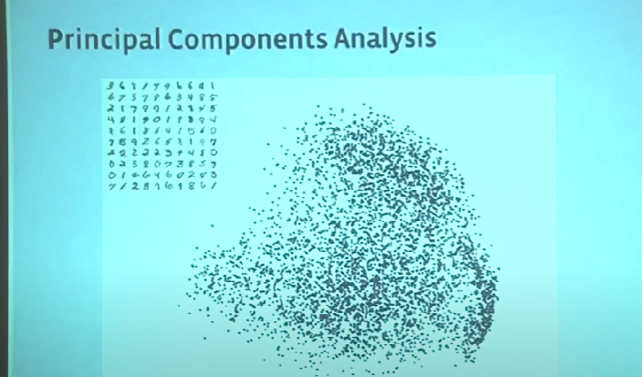
Manifold learning with t-SNE
Unsupervised learning
t-SNE :
https://www.youtube.com/watch?v=NEaUSP4YerM

Slide 12
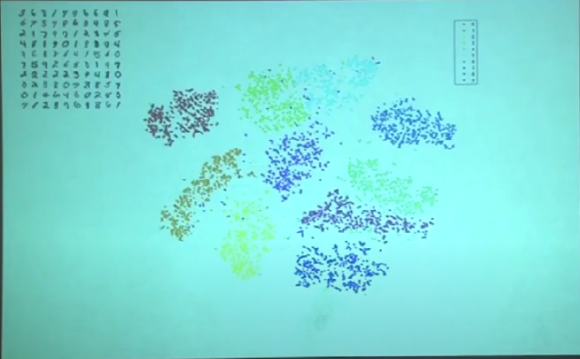
Manifold learning with t-SNE
Unsupervised learning
t-SNE :
https://www.youtube.com/watch?v=NEaUSP4YerM

Slide 13
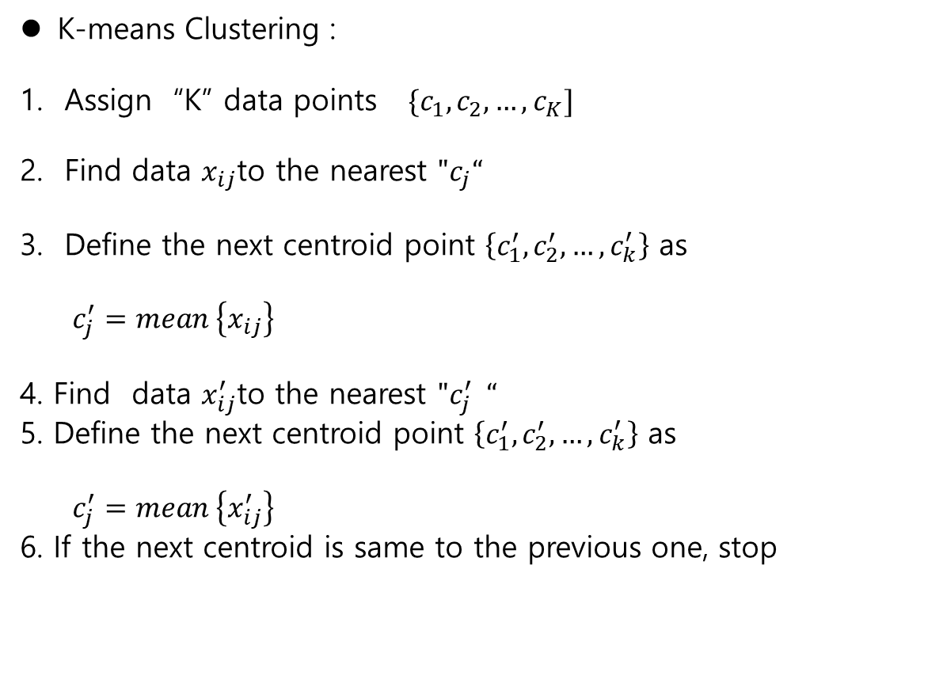
K-means clustering
Unsupervised learning
K-means Clustering :
Assign “K” data points $\{c_{1}, c_{2},…, c_{K}]$
Find data $x_{ij}$to the nearest ${"c}_{j}“$
Define the next centroid point $\left\{c_{1}^{′},c_{2}^{′},…, c_{k}^{′}\right\}$ as
$c_{j}^{′}=mean \left\{x_{ij}\right\}$
4. Find data $x_{ij}^{′}$to the nearest ${"c}_{j}^{′} “$
5. Define the next centroid point $\left\{c_{1}^{′},c_{2}^{′},…, c_{k}^{′}\right\}$ as
$c_{j}^{′}=mean \left\{x_{ij}^{′}\right\}$
6. If the next centroid is same to the previous one, stop
https://en.wikipedia.org/wiki/Manifold

Slide 14
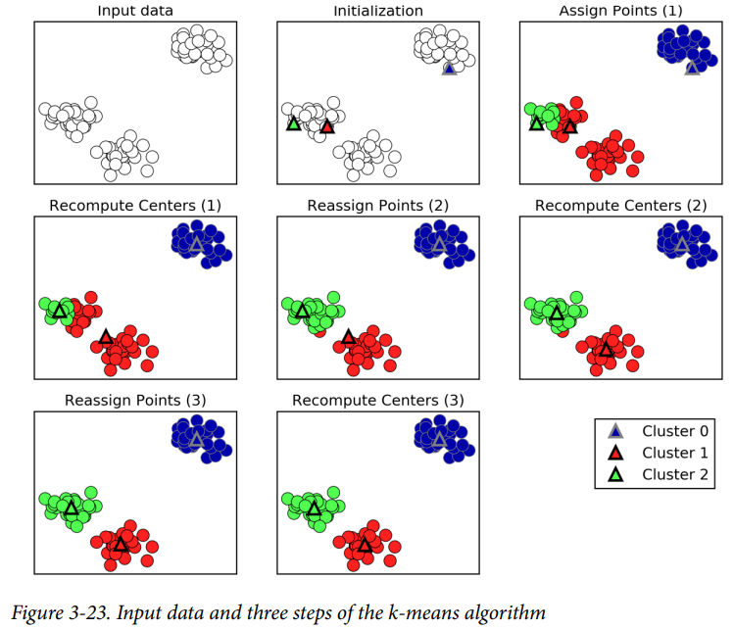
K-means clustering
Unsupervised learning
Ex. P 171
https://en.wikipedia.org/wiki/Manifold

Slide 15
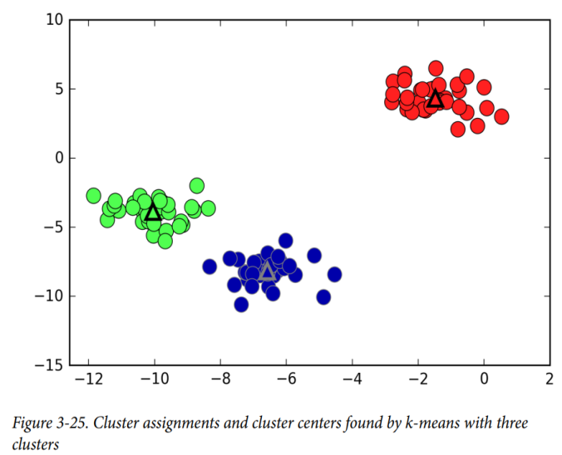
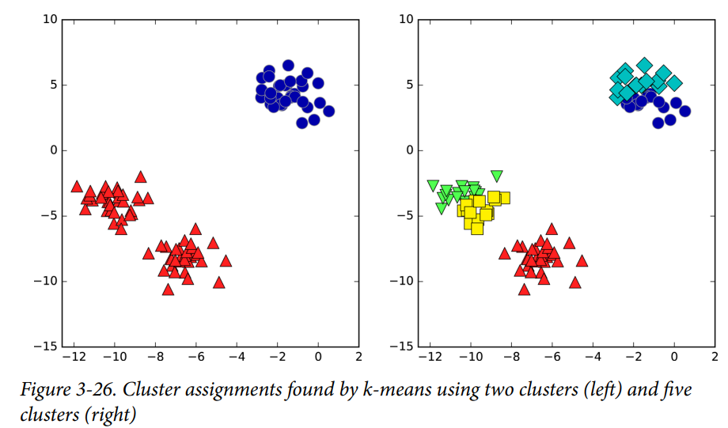
K-means clustering
Unsupervised learning
Ex. P 171
K=3 clusters
Ex. P172
K=2 or 5 clusters
https://en.wikipedia.org/wiki/Manifold

Slide 16
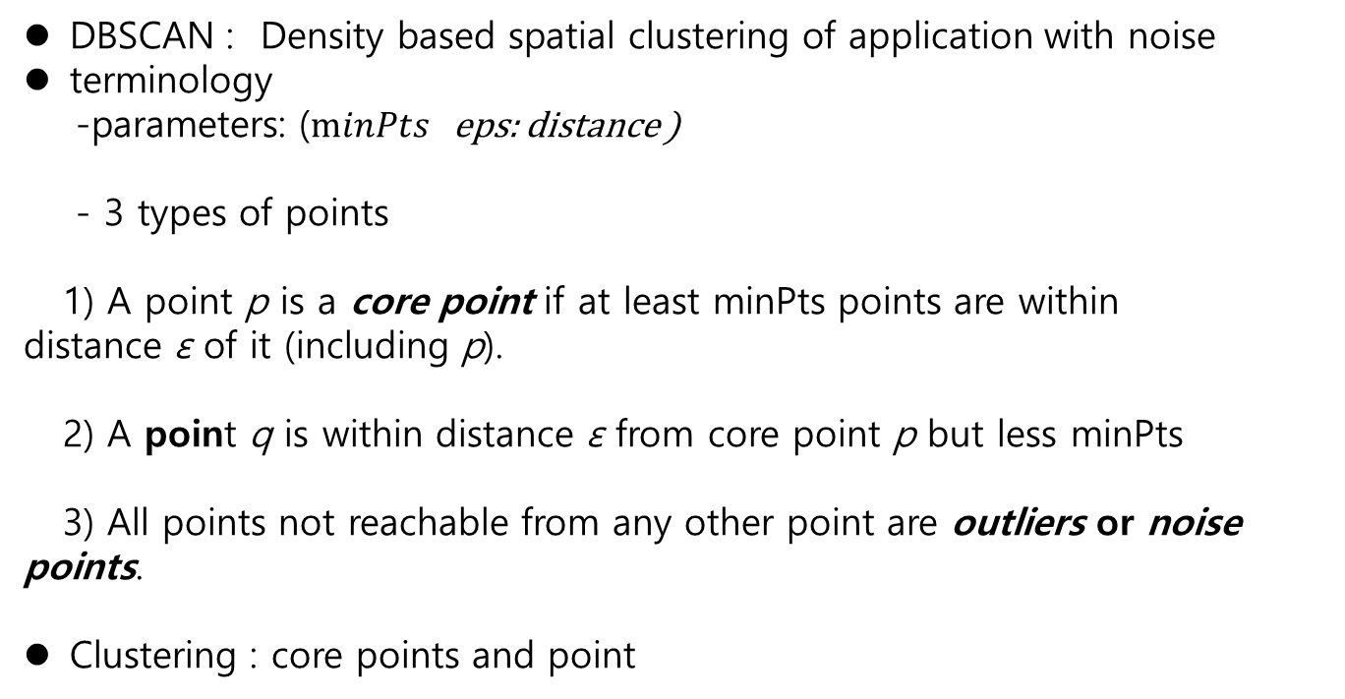
DBSCAN
Unsupervised learning
DBSCAN : Density based spatial clustering of application with noise
terminology
-parameters: ($minPts$ eps: distance )
- 3 types of points
1) A point p is a core point if at least minPts points are within distance ε of it (including p).
2) A point q is within distance ε from core point p but less minPts
3) All points not reachable from any other point are outliers or noise points.
Clustering : core points and point
https://en.wikipedia.org/wiki/DBSCAN

Slide 17
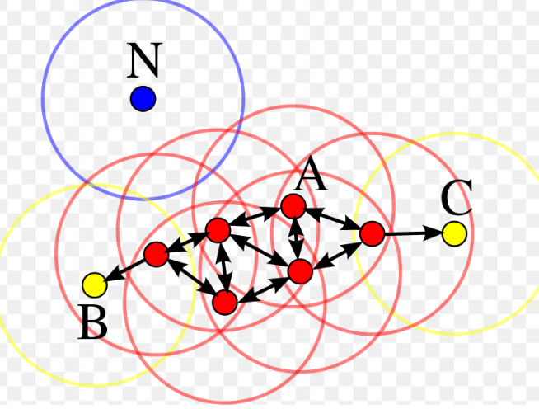
DBSCAN
Unsupervised learning
Google example:
- Cluster
{Core points : red
Points(boundary) : yellow}
- Noise(outlier)
https://en.wikipedia.org/wiki/DBSCAN

Slide 18
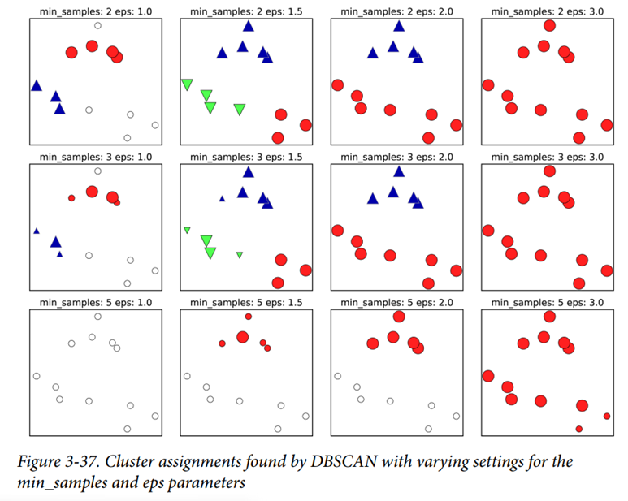
DBSCAN
unsupervised learning
Ex.(p188)
https://en.wikipedia.org/wiki/DBSCAN

Slide 19
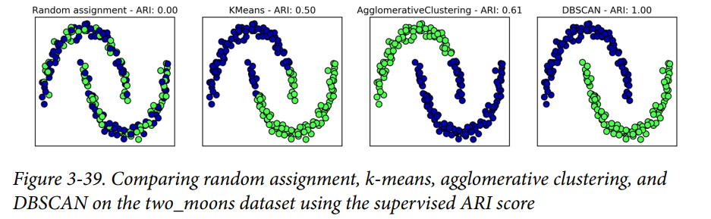
DBSCAN
Unsupervised learning
Comparing and Evaluation Clustering
- ex.(p.192)
https://en.wikipedia.org/wiki/DBSCAN

Slide 20
Remark
unsupervised learning
Unsupervised machine learning
- AI :
Sensor : Vision / Speech
Actuator : robotics – humanoid
- Vision
openCV : picture / video data handling
- digit identification
- face identification
- automatic car driving
signal processing
- speech recognition
Virtual human (vision / Speech)

Slide 21
Remark
unsupervised learning
Big data
- google search
- document / books
- speaking
Machine learning ….
- learning
- thinking
- problem solving
→ replace human activity by machine

