Slide 1
Optimal Control
- June 2022 –
Prof. Seungnam Kim in ASTU

Slide 2
Fundamental Law in “Optimal Control”
Hamilton-Jacobi-Bellman
Pontryagin minimum principle
Contents
Static Optimal problem : Euler-Lagrange equation
Dynamic Optimal problem
Discrete System / Continuous System
Dynamic programming
Reinforcement Learning : MDP
Reference
- “Optimal control” 3rd edition, F.Lewis, 2012; the main textbook
-“Applied Optimal Control: Optimization, Estimation and Control”, E.Bryson,1975.
-“Data DrivenScience and Engineering”, S.J.Brunton, 2019
-“Introduction to Machine Learning with Python”, Andreas, C. Muller, 2017

Slide 3
S/W tools
- Matlab / Chebfun;
- Jupyter notebook
All are open …
- reference books are free : b-ok
- materials :
github/snkim0701 → repository →,…,

Slide 4

Static Optimization
Without Constraint
A scalar performance index $L\left(u\right),$
$$\min_{u}{L\left(u\right), u∈ R^{n}}$$
. Taylor Series
$dL=L_{u}^{T} du+\frac{1}{2}du^{T}L_{uu}du+O\left(3\right)$
Gradient: $L_{u}=\frac{∂L}{∂u}$
Hessian: $L_{uu} =\frac{∂^{2}L}{∂u^{2}}$

Slide 5

Static Optimization
With Constraint
A scalar performance index $L\left(u\right),$
$$\min_{u}{L\left(u\right), u∈ R^{n}}$$
Subject to
$f\left(x,u\right)=0$
Lagrange Multiplier $λ$
- define the Hamiltonian $H$
$H\left(x,u, λ\right)=L\left(x,u\right)+λf\left(x,u\right)$
by Taylor series
$dH=\frac{∂H}{∂x}dx+\frac{∂H}{∂u}du+\frac{∂H}{∂λ}dλ$
$\frac{∂H}{∂x}=0,\frac{∂H}{∂u}=0,\frac{∂H}{∂λ}=0$

Slide 6
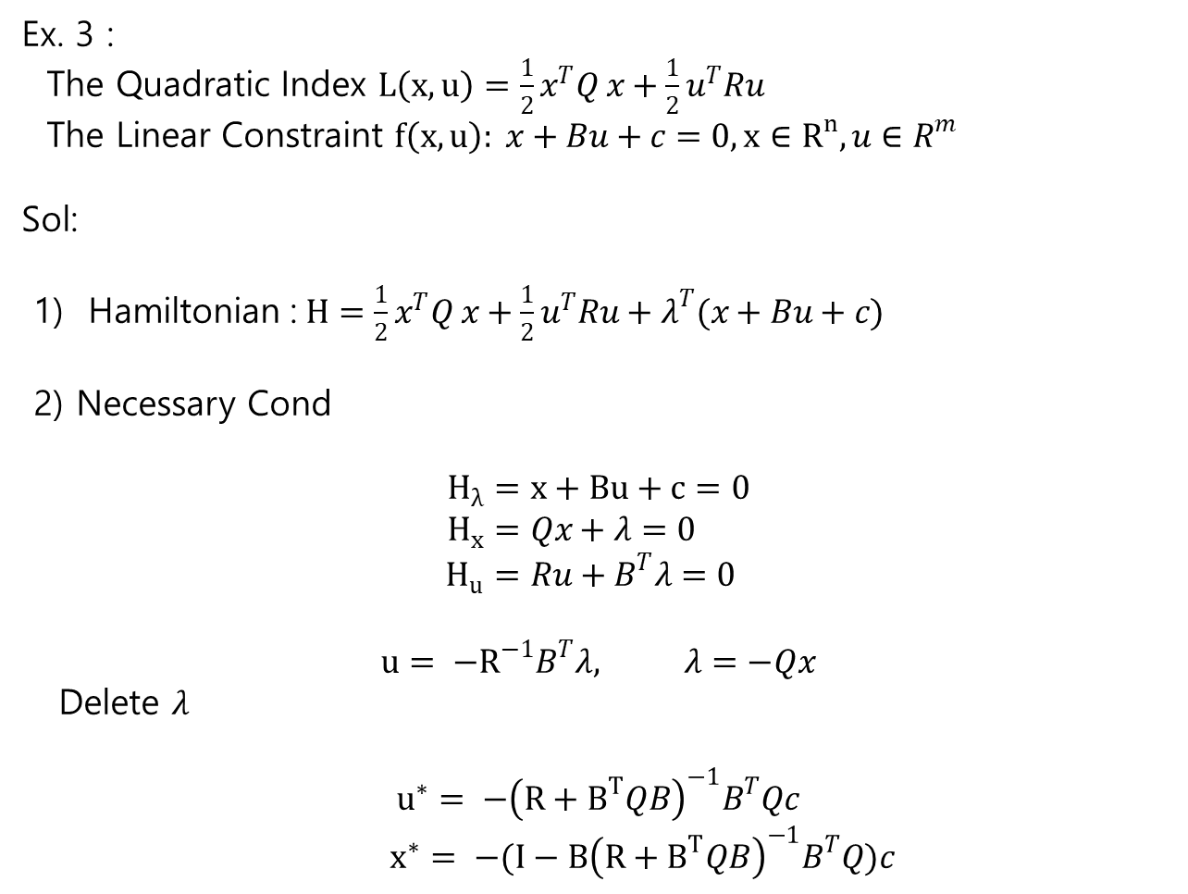
Static Optimization
Ex. 3 :
The Quadratic Index $L\left(x,u\right)=\frac{1}{2}x^{T}Q x+\frac{1}{2}u^{T}Ru$
The Linear Constraint $f\left(x,u\right): x+Bu+c=0, x∈R^{n}, u∈R^{m}$
Sol:
1) Hamiltonian :$H=\frac{1}{2}x^{T}Q x+\frac{1}{2}u^{T}Ru+λ^{T}(x+Bu+c)$
2) Necessary Cond
$$H_{λ}=x+Bu+c=0 \\ H_{x}=Qx+λ=0 \\ H_{u}=Ru+B^{T}λ=0$$
$$u= −R^{−1}B^{T}λ, λ=−Qx$$
Delete $λ$
$$u^{∗}= −{\left(R+B^{T}QB\right)}^{−1}B^{T}Qc$$
$x^{∗}= −(I−B{\left(R+B^{T}QB\right)}^{−1}B^{T}Q)c$

Slide 7

Static Optimization
3) $L^{∗}\left(x^{∗}, u^{∗}\right) =\frac{1}{2}{x^{∗}}^{T}Q x^{∗}+\frac{1}{2}{u^{∗}}^{T}Ru^{∗}$
$$x^{∗}= −\left(I−B{\left(R+B^{T}QB\right)}^{−1}B^{T}Q\right)c$$
$λ^{∗}=Qx^{∗}=\left(Q−QB{\left(R+B^{T}QB\right)}^{−1}B^{T}Q\right)c$
$$={\left(Q^{−1}+BR^{−1}B^{T}\right)}^{−1}c$$
And
$L^{∗}=\frac{1}{2}c^{T}\left[Q−QB{\left(R+B^{T}QB\right)}^{−1}B^{T}Q\right]c=\frac{1}{2}c^{T}λ^{∗}$

Slide 8

Static Optimization
Numerical Method
Gradient Descent (data-driven, p125)
-Problem
min $f\left(x\right), x∈R^{n}$
-Gradient Descent
Necessary Condition
$∇\left(f\left(x^{∗}\right)\right)=0$
→ negative direction !
$x_{k+1}=x_{k} −δ ∇f(x_{k})$
→ pick an initial $x_{0} −→iterative until \left|x_{k+1}−x_{k}\right|<ε$

Slide 9

Static Optimization
Numerical Method
2) Newton’s Method
Taylor series
$f\left(x_{k}+δ\right) \sim f\left(x_{k}\right)+f^{′}\left(x_{k}\right)δ+\frac{1}{2}f^{′′}\left(x_{k}\right)δ^{2}$
$$x_{k+1}=x_{k}+δ$$
to optimize to select $δ$
$$0=\frac{d}{dδ}\left( f(x_{k}+δ)\right)=f^{′}\left(x_{k}\right)+f^{′′}\left(x_{k}\right)δ$$
$$δ= −f^{′}\left(x_{k}\right)/f^{′′}(x_{k})$$
The next step is chosen as
$$x_{k+1}=x_{k} −f^{′}\left(x_{k}\right)/f^{′′}(x_{k})$$

Slide 10
Static Optimization
Numerical Method
3) Tool’s
- Chebfun
-- Numerical Tools ….

Slide 11

Static Optimization
Matlab Data Handling
$y=x^{2} , x∈\left[−2 5\right] ;$
plot y over x
Generate sample points
$x=linspace\left(−2,5,10\right)$
define a function
f = x.^2
or anonymous function
$f=@\left(x\right)x.^{2};$
plot(f)
2) Symbolic math
syms x
g = x^2
fplot(g,[-2 5])

Slide 12
Static Optimization
Chebfun

Slide 13
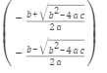

Static Optimization
Symbolic math
- algebric equation : $ax^{2}+bx+c =0$
syms a b c x
eqn = a*x^2 + b*x +c ==0;
solx = solve(eqn,x)
- system equation
- differential equation

Slide 14
RL - Tools
Jupyter notebook https://jupyter.org/
running code in the browser
Numpy https://numpy.org/devdocs/user/quickstart.html
multidimensional array, mathematical functions
SciPy https://scipy.org/
Scientific computing , optimization,..
Matplotlib https://matplotlib.org/
the primary scientific plotting library

Slide 15
RL - Tools
Pandas https://pandas.pydata.org/
data wrangling and analysis
Gym https://gym.openai.com/
developing and comparing Reinforcement Learning
Keras https://keras.io/
Deep learning API
Tensorflow
Deep learning API by google

Slide 16
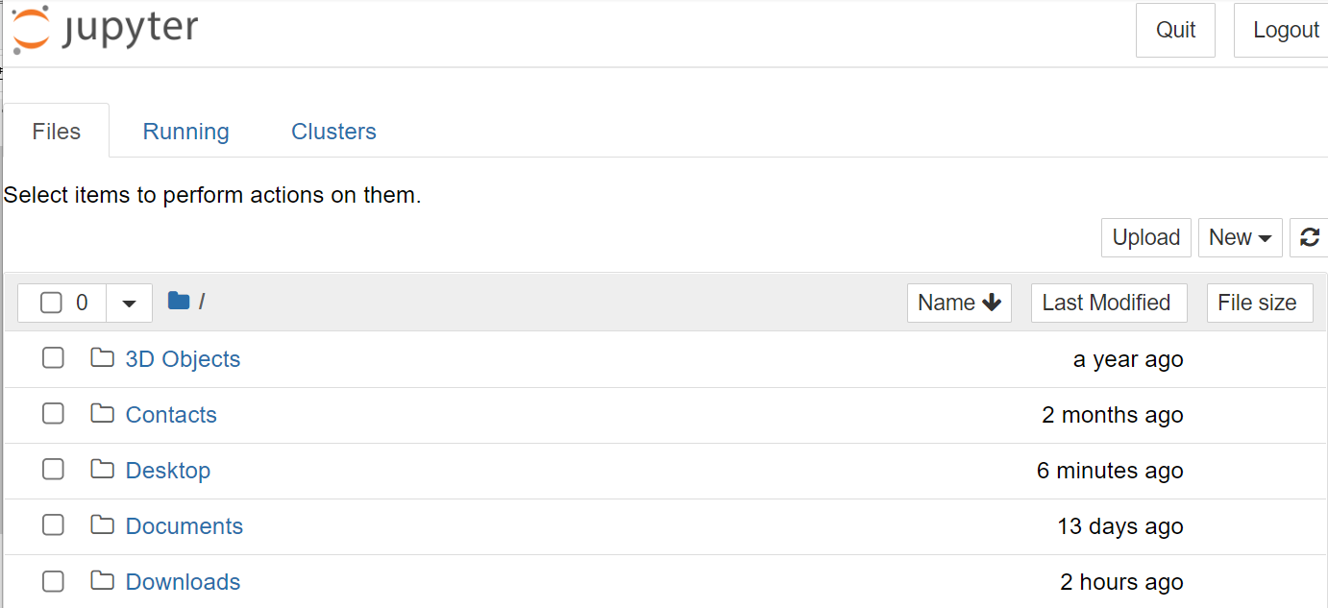
Jupyter Notebook
Open : Anaconda – Jupyter notebook
Copy http://,... And paste it in google
data wrangling and analysis
Gym https://gym.openai.com/
developing and comparing Reinforcement Learning
3. Go to the working dir.

Slide 17
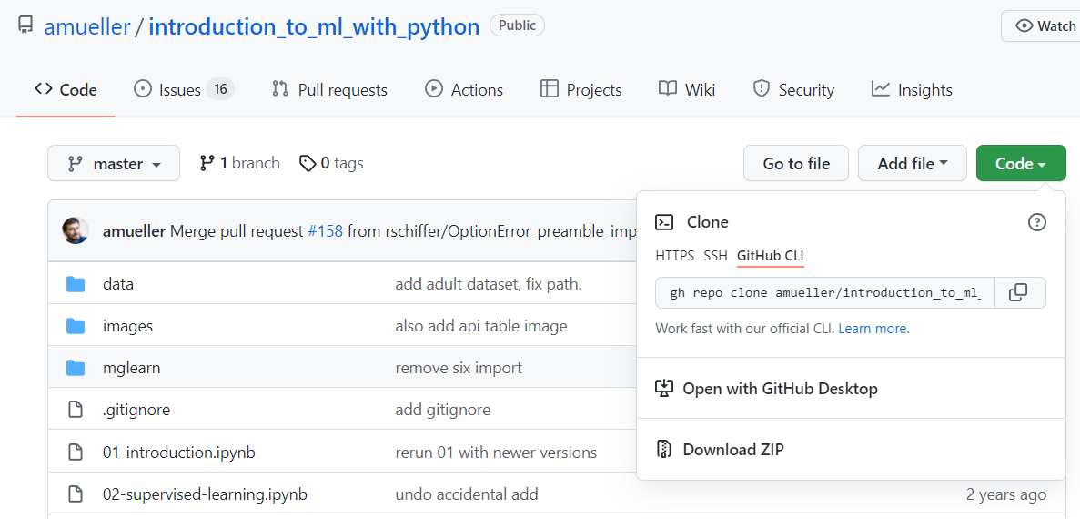
Jupyter Notebook
3. To download “ Introduction,…” go to “github,..”
https://github.com/amueller/introduction_to_ml_with_python
4. Download all in ZIP in your working dir.
%% pdf version is available. Plz download it

Slide 18
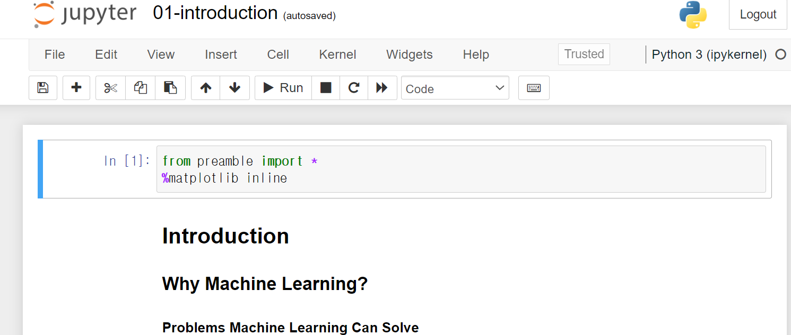
Jupyter Notebook
Unzipped the files
Open
https://github.com/amueller/introduction_to_ml_with_python
4. Download all in ZIP in your working dir.
5. Go to the DIR unzipped
5. Click the notebook file ,”01-introduction.ipynb

Slide 19
Jupyter Notebook
Run a notebook file :
In an excutetable file,
- (python) code : “Run”
- Markdown text : type in Markdown format ( similar to “Live Editor “ of matlab)
Save and shutdown

