Slide 1
Optimal Control
- Discrete Time System-
- June 2022 –
Prof. Seungnam Kim in ASTU

Slide 2
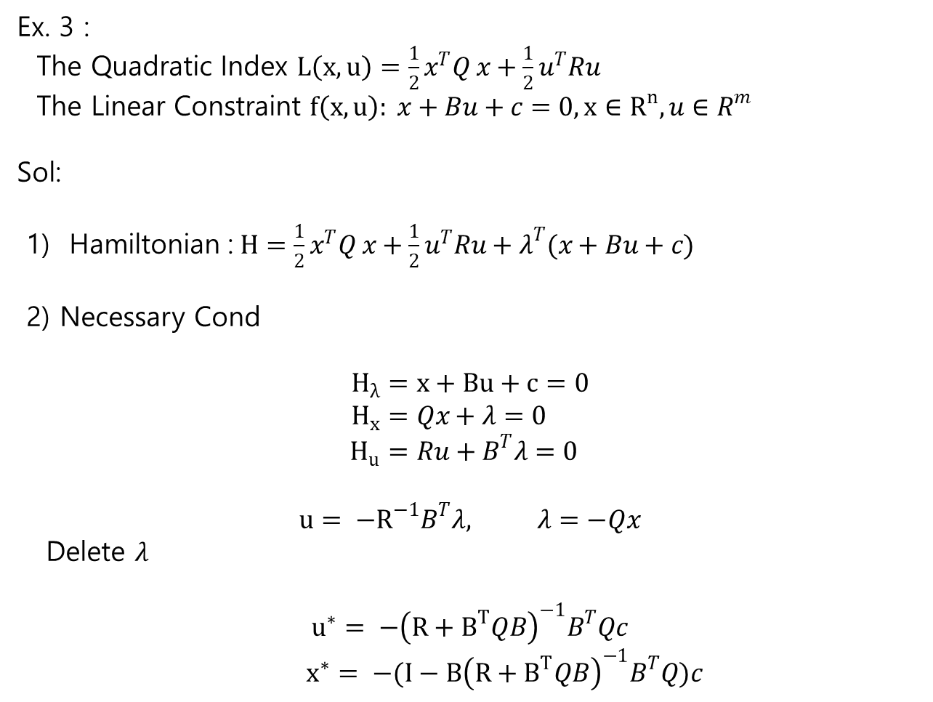
Static Optimization
Ex. 3 :
The Quadratic Index $L\left(x,u\right)=\frac{1}{2}x^{T}Q x+\frac{1}{2}u^{T}Ru$
The Linear Constraint $f\left(x,u\right): x+Bu+c=0, x∈R^{n}, u∈R^{m}$
Sol:
1) Hamiltonian :$H=\frac{1}{2}x^{T}Q x+\frac{1}{2}u^{T}Ru+λ^{T}(x+Bu+c)$
2) Necessary Cond
$$H_{λ}=x+Bu+c=0 \\ H_{x}=Qx+λ=0 \\ H_{u}=Ru+B^{T}λ=0$$
$$u= −R^{−1}B^{T}λ, λ=−Qx$$
Delete $λ$
$$u^{∗}= −{\left(R+B^{T}QB\right)}^{−1}B^{T}Qc$$
$x^{∗}= −(I−B{\left(R+B^{T}QB\right)}^{−1}B^{T}Q)c$

Slide 3

Ch.2 Optimal Control of Discrete-Time System
2.1 Solution of General DT System
1) problem
--The plant $x_{k+1}=f^{k}\left(x_{k}, u_{k}\right), { x}_{0}$
--The associated scalar performance index,
$$J_{i}=φ\left(N,x_{N}\right)+ \sum_{k=i}^{N−1}{L^{k}(x_{k}, u_{k})}$$
Find $u^{∗}$
$\min_{u}{J_{i}}$
in case of :
The final time: fixed / free / infinite
The final state: fixed / free / tracking

Slide 4

Dynamic DT system
Solution
1) Define an augmented index
$$J^{a}=φ\left(N,x_{N}\right)+ \sum_{k=i}^{N−1}{[ L^{k}\left(x_{k},u_{k}\right)+λ_{k+1}^{T}( f^{k}\left(x_{k},u_{k}\right)−x_{k+1}) ]}$$
Define The Hamiltonian
$$H^{k}\left(x_{k},u_{k}\right)=L^{k}\left(x_{k},u_{k}\right)+λ_{k+1}^{T}f^{k}\left(x_{k},u_{k}\right) (2.1−4)$$

Slide 5
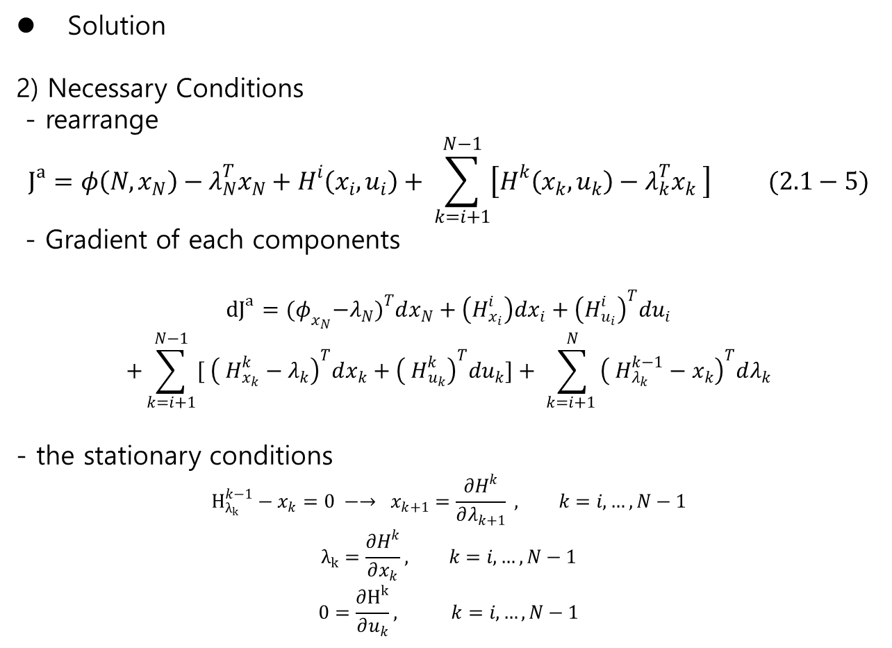
Dynamic DT system
Solution
2) Necessary Conditions
- rearrange
$$J^{a}=φ\left(N,x_{N}\right)−λ_{N}^{T}x_{N}+H^{i}\left(x_{i},u_{i}\right)+ \sum_{k=i+1}^{N−1}{\left[H^{k}\left(x_{k}, u_{k}\right)−λ_{k}^{T}x_{k} \right]} (2.1−5)$$
- Gradient of each components
$${dJ}^{a}={(φ}_{x_{N}}−λ_{N})^{T}dx_{N}+\left(H_{x_{i}}^{i}\right)dx_{i}+{\left(H_{u_{i}}^{i}\right)}^{T}du_{i}$$
$$+\sum_{k=i+1}^{N−1}{[ {\left( H_{x_{k}}^{k}−λ_{k}\right)}^{T}dx_{k}+{\left( H_{u_{k}}^{k}\right)}^{T}du_{k}]}+ \sum_{k=i+1 }^{N}{{\left( H_{λ_{k}}^{k−1}−x_{k}\right)}^{T}dλ_{k}}$$
- the stationary conditions
$$H_{λ_{k}}^{k−1}−x_{k}=0 −→ x_{k+1}=\frac{∂H^{k}}{∂λ_{k+1}} , k=i,…,N−1$$
$$λ_{k}=\frac{∂H^{k}}{∂x_{k}}, k=i,…, N−1$$
$$0=\frac{∂H^{k}}{∂u_{k}}, k=i,…, N−1$$

Slide 6

Static Optimization
Solution
2) Necessary Conditions
- Boundary conditions
$${\left(\frac{∂ϕ}{∂x_{N}}−λ_{N}\right)}^{T}dx_{N}=0 \\ {\left(\frac{∂H^{i}}{∂x_{i}}\right)}^{T}dx_{i}=0$$
-- at the initial points
→ in general they are fixed
$dx_{i}=0$
--at the final points
1) fixed : $dx_{N}=0$
2) free : $\frac{∂ϕ}{∂x_{N}}−λ_{N}= 0 −→λ_{N}=\frac{∂φ}{∂x_{N}}$

Slide 7
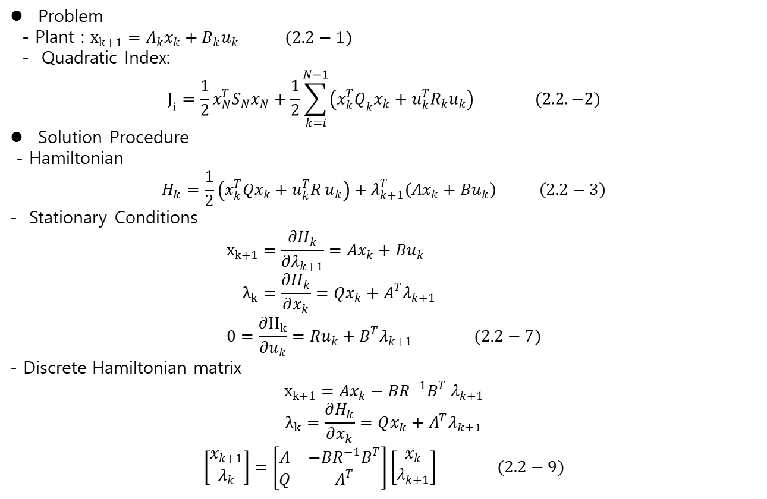
2.2 Discrete Time Linear Quadratic Regulator
Problem
- Plant : $x_{k+1}=A_{k}x_{k}+B_{k}u_{k} (2.2−1)$
- Quadratic Index:
$$J_{i}=\frac{1}{2}x_{N}^{T}S_{N}x_{N}+\frac{1}{2}\sum_{k=i}^{N−1}{\left(x_{k}^{T}Q_{k}x_{k}+u_{k}^{T}R_{k}u_{k}\right)} (2.2.−2)$$
Solution Procedure
- Hamiltonian
$$H_{k}=\frac{1}{2}\left(x_{k}^{T}Qx_{k}+u_{k}^{T}R u_{k}\right)+λ_{k+1}^{T}\left(Ax_{k}+Bu_{k}\right) \left(2.2−3\right)$$
- Stationary Conditions
$$x_{k+1}=\frac{∂H_{k}}{∂λ_{k+1}}=Ax_{k}+Bu_{k} \\ λ_{k}=\frac{∂H_{k}}{∂x_{k}}=Qx_{k}+A^{T}λ_{k+1} \\ 0=\frac{∂H_{k}}{∂u_{k}}=Ru_{k}+B^{T}λ_{k+1} (2.2−7)$$
- Discrete Hamiltonian matrix
$$x_{k+1}=Ax_{k}−BR^{−1}B^{T} λ_{k+1}$$
$$λ_{k}=\frac{∂H_{k}}{∂x_{k}}=Qx_{k}+A^{T}λ_{k+1}$$
$$\left[\begin{matrix}x_{k+1} \\ λ_{k}\end{matrix}\right]=\left[\begin{matrix}A & −BR^{−1}B^{T} \\ Q & A^{T}\end{matrix}\right]\left[\begin{matrix}x_{k} \\ λ_{k+1}\end{matrix}\right] (2.2−9)$$

Slide 8

2.2 Discrete Time Linear Quadratic Regulator
Hamiltonian Matrix
- Discrete Hamiltonian matrix
$$H=\left[\begin{matrix}A & −BR^{−1}B^{T} \\ Q & A^{T}\end{matrix}\right]$$
Backward Difference equation
$$\left[\begin{matrix}x_{k} \\ λ_{k}\end{matrix}\right]=\left[\begin{matrix}A^{−1} & A^{−1}BR^{−1}B^{T} \\ QA^{−1} & A^{T}+QA^{−1}BR^{−1}B^{T}\end{matrix}\right]\left[\begin{matrix}x_{k+1} \\ λ_{k+1}\end{matrix}\right] (2.2−11)$$
- Continuous HM(in Chapter.3)
$H=\left[\begin{matrix}A & −BR^{−1}B^{T} \\ −Q & {−A}^{T}\end{matrix}\right] (3.4−14)$

Slide 9

2.2 Discrete Time Linear Quadratic Regulator
1. Zero input case : $R=0$
- at $k=N$
$$J_{N}=\frac{1}{2}x^{T}S_{N}x_{N}$$
at $k=N−1$
$$J_{N−1}=\frac{1}{2}x^{T}S_{N}x_{N}+\frac{1}{2}x_{N−1}^{T}Qx_{N−1} \\ =\frac{1}{2}x_{N−1}^{T} \left(A^{T}S_{N}A+Q\right)x_{N−1} (2.2−18)$$
- Define
$$S_{N−1}=A^{T}S_{N}A+Q$$
$$J_{N−1}=\frac{1}{2}x_{N−1}^{T}S_{N−1}x_{N−1}$$
- Intuitively
$$S_{k}=A^{T}S_{k+1}A_{k}+Q , k<N \left(2.2−21\right)$$
so that
$$J_{k}=\frac{1}{2}x_{k}^{T}S_{k}x_{k} , \left[k, N\right] (2.2−22)$$
→ Observability Lyapunov Equation
If the system is stable and observable,
→ if $k−→∞$
$J_{∞}=\frac{1}{2}x_{0}^{T}Sx_{0} , (2.2−22)$ $S=A^{T}SA+Q \left(2.22−26\right)$

Slide 10

2.2 Discrete Time Linear Quadratic Regulator
2. The final state is free
- Hamiltonian
$\left[\begin{matrix}x_{k+1} \\ λ_{k}\end{matrix}\right]=\left[\begin{matrix}A & −BR^{−1}B^{T} \\ Q & A^{T}\end{matrix}\right]\left[\begin{matrix}x_{k} \\ λ_{k+1}\end{matrix}\right] (2.2−9)$
Boundary condition ${\left(\frac{∂ϕ}{∂x_{N}}−λ_{N}\right)}^{T}dx_{N}=0$
$$λ_{N}=\frac{∂φ}{∂x_{N}}=\frac{∂}{∂x_{N}}\left(\frac{1}{2}x_{N}^{T}S_{N}x_{N}\right)=S_{N}x_{N}$$
- Assume $λ_{k}=S_{k}x_{k}$
$λ_{k}=S_{k}x_{k}= Qx_{k}+A^{T}λ_{k+1}$
→ $S_{k}={Q+A}^{T}S_{k+1}{\left(I+BR^{−1}B^{T}S_{k+1}\right)}^{−1}A$
$S_{k}=A^{T}\left[S_{k+1}−S_{k+1}B{\left(B^{T}S_{k+1}B+R\right)}^{−1}B^{T}S_{k+1}\right]A+Q$
$S_{k}=A^{T}{\left(S_{k+1}^{−1}+BR^{−1}B^{T}\right)}^{−1}A+Q (2.2−54)$
- Optimal Controller
$$u_{k}= −{\left(B^{T}S_{k+1}B+R\right)}^{−1}B^{T}S_{k+1}Ax_{k}={−K}_{k}x_{k} (2.2−58)$$
- Optimal Index
$$J_{k}^{∗}=\frac{1}{2}x_{k}^{T}S_{k}x_{k} (2.2−69)$$

Slide 11

Table 2.1-1, 2.2-1 Non-linear / Linear Optimal Controller
System model:
$$x_{k+1}=f^{k}\left(x_{k}, u_{k}\right), x_{k+1}=A_{k}x_{k}+B_{k}u_{k} k>i$$
Performance Index
$$J_{i}=φ\left(N,x_{N}\right)+ \sum_{k=i}^{N−1}{L^{k}\left(x_{k}, u_{k}\right)} , J_{i}=\frac{1}{2}x_{N}^{T}S_{N}x_{N}+\frac{1}{2}\sum_{k=i}^{N−1}{\left(x_{k}^{T}Q_{k}x_{k}+u_{k}^{T}R_{k}u_{k} \right)} , S_{N}≥0, Q_{k}≥0, R_{k}>0$$
Hamiltonian: $H^{k}=L^{k}+λ_{k+1}^{T}f^{k}$
State equation: $x_{k+1}=\frac{∂H^{k}}{∂λ_{k+1}}=f^{k}\left(x_{k}, u_{k}\right), =A_{k}x_{k}+B_{k}u_{k} \left(2.1−9a\right)$
Costate equation: $λ_{k}=\frac{∂H^{k}}{∂x_{k}}={\left(\frac{∂f^{k}}{∂x_{k}}\right)}^{T}λ_{k+1}+\frac{∂L^{k}}{∂x_{k}} =Q_{k}x_{k}+A_{k}^{T}λ_{k+1}(2.1−9b)$
Stationary w.r.t u : $0=\frac{∂H_{k}}{∂u_{k}}=Ru_{k}+B^{T}λ_{k+1} (2.2−7)$
Hamiltonian Matrix
$$\left[\begin{matrix}x_{k+1} \\ λ_{k}\end{matrix}\right]=\left[\begin{matrix}A & −BR^{−1}B^{T} \\ Q & A^{T}\end{matrix}\right]\left[\begin{matrix}x_{k} \\ λ_{k+1}\end{matrix}\right] (2.2−9)$$
Due to stationarity condition on controller
$$0=\frac{∂H^{k}}{∂u_{k}}={\left(\frac{∂f^{K}}{∂u_{k}}\right)}^{T}λ_{k+1}+\frac{∂L^{k}}{∂u_{k}}=R_{k}u_{k}+B_{k}^{T}λ_{k+1} (2.1−9c)$$
Boundary conditions: ${\left(\frac{∂ϕ}{∂x_{N}}−λ_{N}\right)}^{T}dx_{N}=0 (2.1−8a)$
If final state free
$$S_{k}=A^{T}[S_{k+1}−S_{k+1}B{\left(B^{T}S_{k+1}B+R\right)}^{−1}B^{T}S_{k+1}]A+Q$$
$$K_{k}={\left(B^{T}S_{k+1}B+R \right)}^{−1}B^{T}S_{k+1}A \left(2.2−60\right)$$

Slide 12

Matlab
Matlab Data Handling
problem :
$y=x^{2} , x∈\left[−2 5\right] ;$
plot y over x
Sampling method
Generate sample points
$x=linspace\left(−2,5,10\right)$
define a function
f = x.^2
or anonymous function
$f=@\left(x\right)x.^{2};$
plot(f)
2) Without sampling, i.e., no explicit sample points
syms x
g = x^2
fplot(g,[-2 5])

Slide 13
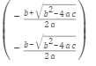

Symbolic math
Symbolic math
- algebric equation : $ax^{2}+bx+c =0$
syms a b c x
eqn = a*x^2 + b*x +c ==0;
solx = solve(eqn,x)
Differentiation
syms x
f = sin(x)^2;
diff(f)
Integration
f = sin(x);
g = sin(x)^2;
h = sin(x^2);
int(f)
int(g)
- system equation
- differential equation

Slide 14
Chebfun
Chebfun
https://www.chebfun.org/

Slide 15
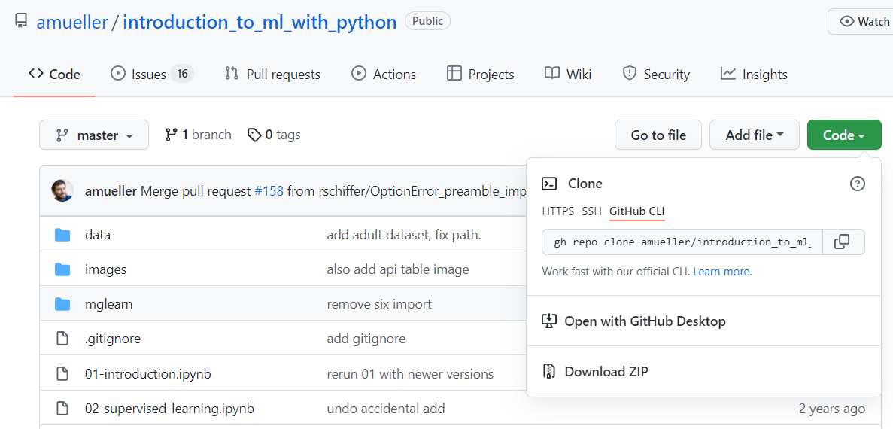
Jupyter Notebook
3. To download “ Introduction,…” go to “github,..”
https://github.com/amueller/introduction_to_ml_with_python
4. Download all in ZIP in your working dir.
%% pdf version is available. Plz download it

Slide 16
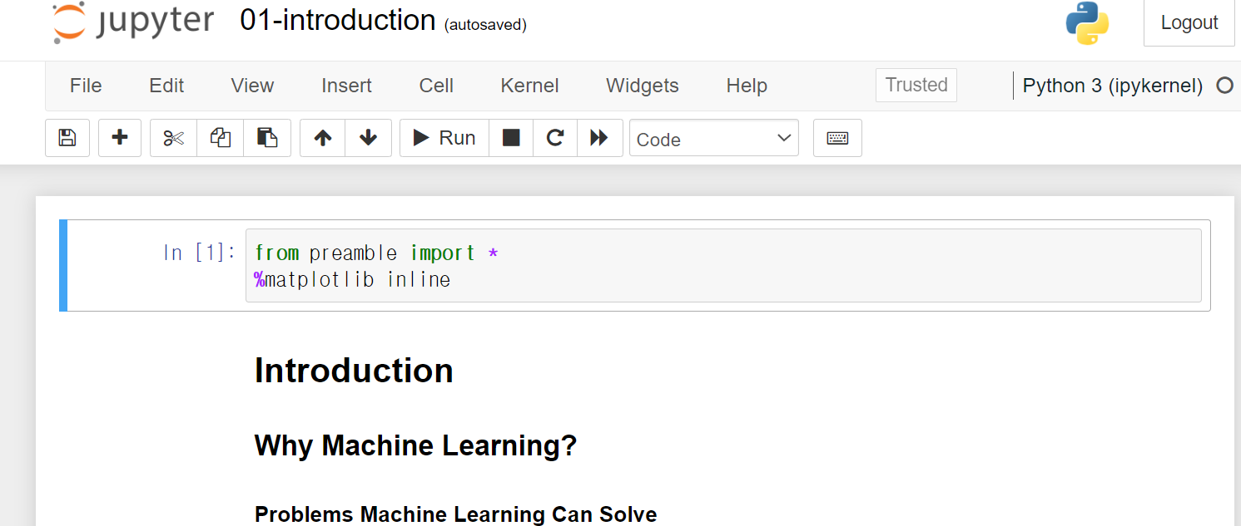
Jupyter Notebook
Unzipped the files
Open
https://github.com/amueller/introduction_to_ml_with_python
4. Download all in ZIP in your working dir.
5. Go to the DIR unzipped
5. Click the notebook file ,”01-introduction.ipynb

Slide 17
Jupyter Notebook
Run a notebook file :
In an excutetable file,
- (python) code : “Run”
- Markdown text : type in Markdown format ( similar to “Live Editor “ of matlab)
Save and shutdown

