Slide 1
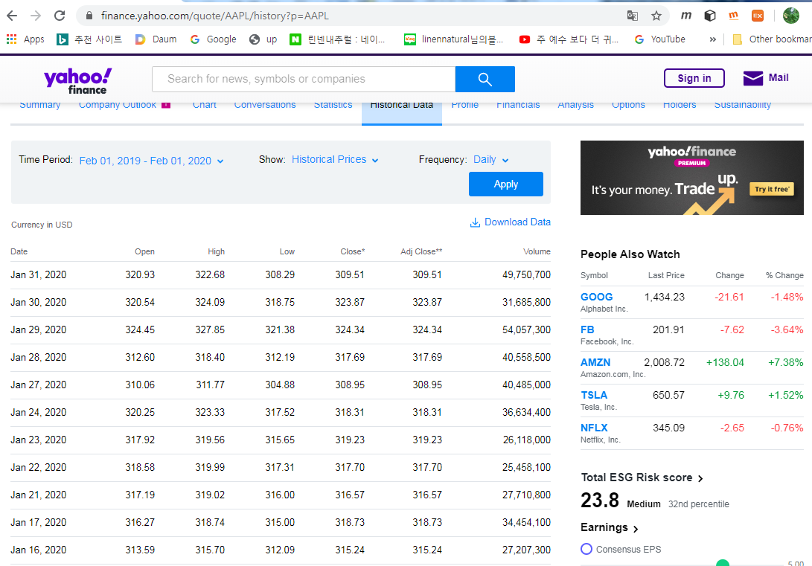
Web search

Slide 2
Download to your PC as AAPL.csv
Date | Open | High | Low | Close | Adj Close | Volume
1/18/2019 | 157.5 | 157.880005 | 155.98 | 156.82 | 154.4987 | 33751000
1/22/2019 | 156.410004 | 156.729996 | 152.62 | 153.3 | 151.0308 | 30394000
1/23/2019 | 154.149994 | 155.139999 | 151.7 | 153.92 | 151.6416 | 23130600
1/24/2019 | 154.110001 | 154.479996 | 151.74 | 152.7 | 150.4396 | 25441500
1/25/2019 | 155.479996 | 158.130005 | 154.32 | 157.76 | 155.4247 | 33535500
1/28/2019 | 155.789993 | 156.330002 | 153.66 | 156.3 | 153.9864 | 26192100
1/29/2019 | 156.25 | 158.130005 | 154.11 | 154.68 | 152.3903 | 41587200
1/30/2019 | 163.25 | 166.149994 | 160.23 | 165.25 | 162.8039 | 61109800
1/31/2019 | 166.110001 | 169 | 164.56 | 166.44 | 163.9762 | 40739600
2/1/2019 | 166.960007 | 168.979996 | 165.93 | 166.52 | 164.0551 | 32668100
2/4/2019 | 167.410004 | 171.660004 | 167.28 | 171.25 | 168.715 | 31495500
2/5/2019 | 172.860001 | 175.080002 | 172.35 | 174.18 | 171.6017 | 36101600
2/6/2019 | 174.649994 | 175.570007 | 172.85 | 174.24 | 171.6608 | 28239600
2/7/2019 | 172.399994 | 173.940002 | 170.34 | 170.94 | 168.4097 | 31741700
2/8/2019 | 168.990005 | 170.660004 | 168.42 | 170.41 | 168.6075 | 23820000
2/11/2019 | 171.050003 | 171.210007 | 169.25 | 169.43 | 167.6379 | 20993400
2/12/2019 | 170.100006 | 171 | 169.7 | 170.89 | 169.0824 | 22283500
2/13/2019 | 171.389999 | 172.479996 | 169.92 | 170.18 | 168.3799 | 22490200

Slide 3
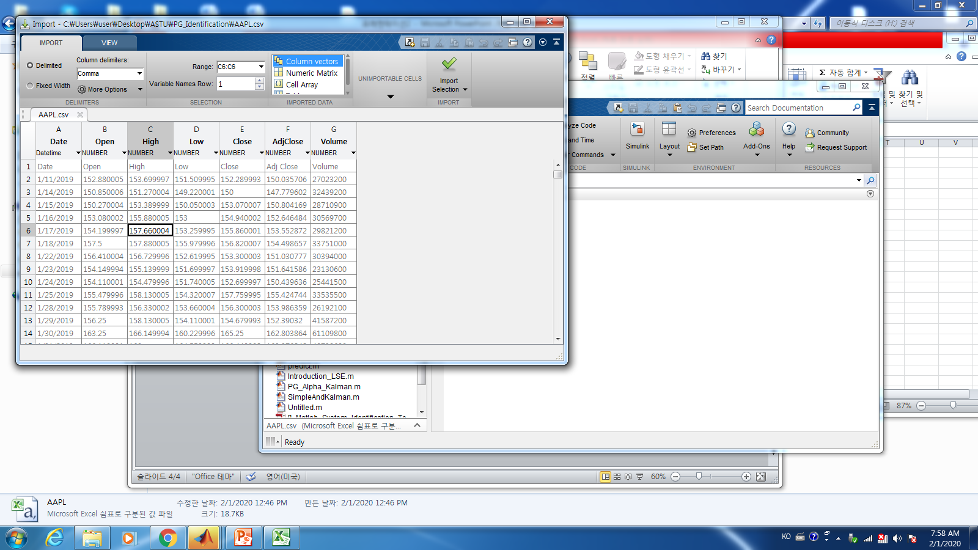
Matlab open AAPL.csv

Slide 4
Download the file in your working directory.
clear all; clc;
data=csvread('AAPL.csv',1,1);
whos
close = data(:,5);
plot(close); grid on
title('apple stock price')
Name Size Bytes Class Attributes
data 252x6 12096 double

Slide 5
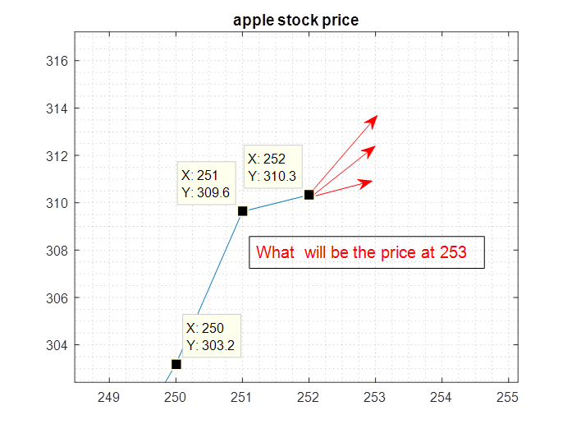
The problem
The prediction of the stock price given the previous data.

Slide 6
The prediction is important.
- the stock price
- the collision avoidance of the moving vehicles
- the missile guidance to attack the enemy airplanes
- and so on.

Slide 7
The prediction logic
Given the present measurements, estimate of the rate of
the change of the previous measurements
Simple model(first order)
Prediction = present measurement + the estimate of the rate
→ How to estimate of the rate is important.

Slide 8
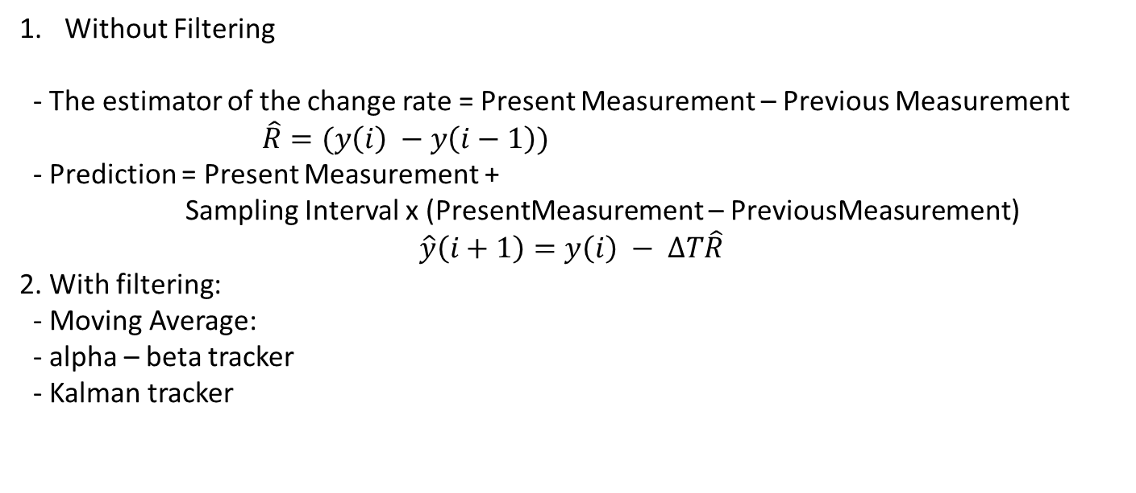
Estimation of the rate of the change
Without Filtering
- The estimator of the change rate = Present Measurement – Previous Measurement
$\hat{R}=(y\left(i\right) −y\left(i−1\right))$
- Prediction = Present Measurement +
Sampling Interval x (PresentMeasurement – PreviousMeasurement)
$$\hat{y}\left(i+1\right)=y\left(i\right) − ∆T\hat{R}$$
2. With filtering:
- Moving Average:
- alpha – beta tracker
- Kalman tracker

Slide 9
Moving Average: depend on the window size.
%%
Win =10;
figure(2)
n = length(close);
a=1;
b=1/Win*ones(1,Win);
MovFilter =filter(b,a,close);
plot(1:n,close,'b',1:n, MovFilter,'r'); grid minor
title('real stock(blue), moving(red)')
rawlPredition_253 = close(252,1) +(close(252,1) - close(251,1))
MovPredition_253 = close(252,1) +(MovFilter(252,1) - MovFilter(251,1))

Slide 10
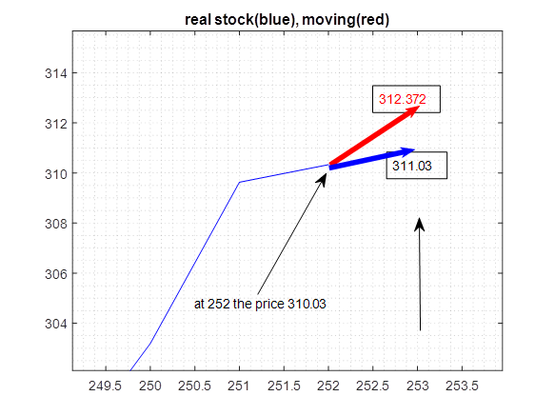
%% alpha - beta tracker
alpha = 0.1;
beta = 2*(2-alpha) -4*sqrt(1-alpha);
CorPo(1) = close(1); % the price
CorVel(1) = 5; % rate of the price
n = length(close);
dt = 1;
% (alpha-beta tracker)
for i = 1:n-1;
% Prediction
PrePo = CorPo(i) + dt*CorVel(i) ;
PreVel = CorVel(i); % since velocity is constant
Res = close(i) - PrePo; % innivaion process
% correction
xh = PrePo + alpha*Res; %
vh = PreVel + beta/dt *Res;
CorPo(i+1) = xh;
CorVel(i+1) = vh;
end
plot(1:n, close,'b', 1:n, CorPo,'r'); grid minor
title('real stock(blue), alpha filter(red)')
alphaPrediction_253 = close(252,1) + CorVel(1,252)
311.58

Slide 11
Comparison
At 253, the predictions are
Without filtering : 311.03
Moving average: 312.37
Alpha-beta tracker: 311.58
Which one is the best estimator?
It depends on the model.
The variance of the estimators among these case is the smallest of alpha beta tracker.
Moreover, if the model is the constant speed with noise, it is almost sure the alpha-beta tracker is the best.
However the kalman tracker is better than the alpha-beta tracker. One of the de-merits of the kalman is that we need to know the characteristic of the noise, whereas
The alpha-beta does not need it.

Slide 12

Applications of alpha – beta tracker
Car collision avoidance algorithm
Assume the car A,B moving with direction and speed.
1) Whether Car-A and Car-B will be collided.
2) If there is a collision, how to change the direction and speed of car-A?
Direction with speed
Collision place
Car-A
Direction with speed
Car-B

