Slide 1


Bayes’ Theorem (“Bayes’ Theorem)
- Bayes(1701~1761), Laplace developed,
- until 20th century, rejecting Bayesianism as unscientific.
- 2012 : “It is Time to Stop Teaching Frequenctism to Non-Statistisians”,
- 2004 : “What is Bayesian statistics”
- Bayesian : one of the critical concepts for data analysis
Conditional Probability and the Intersection Probability
- Where is event(A|B) ?
NO!!
- event (A | B) means
event B is not a random
variable. It is measured
Whereas
event (
means event A and B
are random variables.
$$A∩B$$
B
A
$A∩B$) )

Slide 2
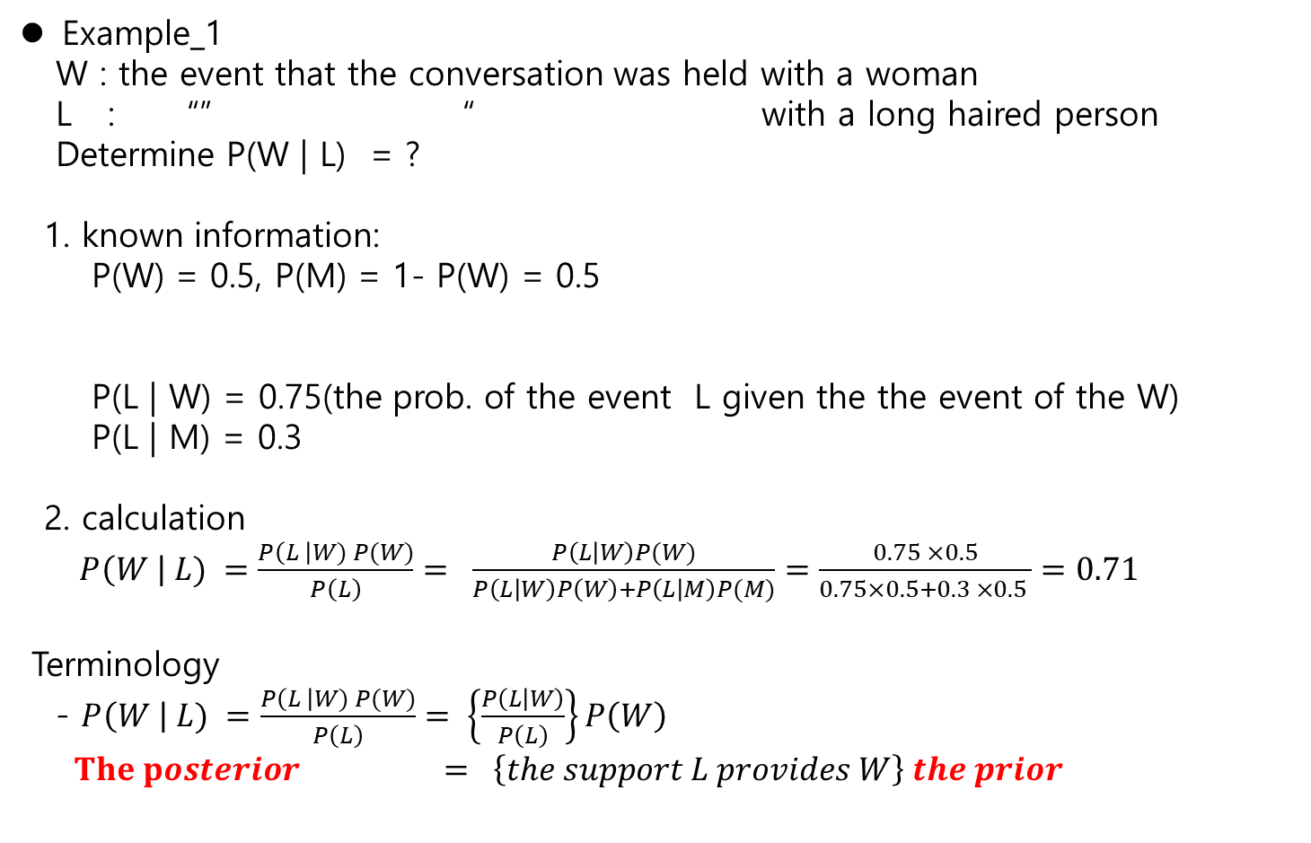
Example_1
W : the event that the conversation was held with a woman
L : “” “ with a long haired person
Determine P(W | L) = ?
1. known information:
P(W) = 0.5, P(M) = 1- P(W) = 0.5
P(L | W) = 0.75(the prob. of the event L given the the event of the W)
P(L | M) = 0.3
2. calculation
$P\left(W \right| L) =\frac{P\left(L \right|W) P(W)}{P\left(L\right)}= \frac{P\left(L | W\right)P(W)}{P\left(L | W\right)P\left(W\right)+P\left(L | M\right)P(M)}=\frac{0.75 ×0.5}{0.75×0.5+0.3 ×0.5 }=0.71$
Terminology
- $P\left(W \right| L) =\frac{P\left(L \right|W) P(W)}{P\left(L\right)}= \left\{\frac{P\left(L | W\right)}{P\left(L\right)}\right\}P\left(W\right)$
$The posterior = \left\{the support L provides W\right\} the prior$
%% $P\left(L \right| W) + P \left(\overline{L} \right|W) =1 but P\left(L \right| W) + P \left(L \right|\overline{W}) ≠1$

Slide 3
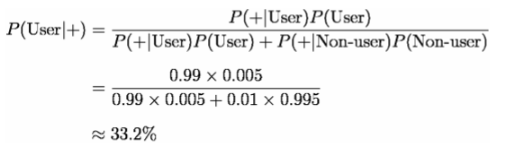
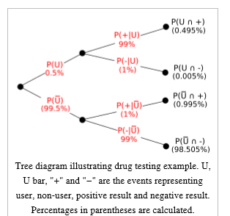
Ex_2
- drug test : (drug user, not user)
Measurement data P( positive | user) = 0.99 , P( negative | non user) = 0.99
P( non user) = 0.005
Problem: a random person’s drug test ,if it is positive, what is the probability he or she is a drug user?
!! The drug test is positive, it is more likely
He /she is not drug user.

Slide 4
Jake’s Post : Frequentism vs Bayesianism : When Results Differ
Ex._2 : Bayesian Billiard Game(17C, by Bayesian , 1763,..
- two players, Alice, Bob
- superviser : Carol , mark the line at starting game, and during the game throw the ball
Rule :
- ball to the left , Alice gets a point, to the right, Bob gets a point
- The first person to reach 6 points wins the game
Data :
- At present, 8 rolls, A = 5, B = 3
Problem :
- The probability that Bob will win
Carol
Curtain
Alice
Bob

Slide 5
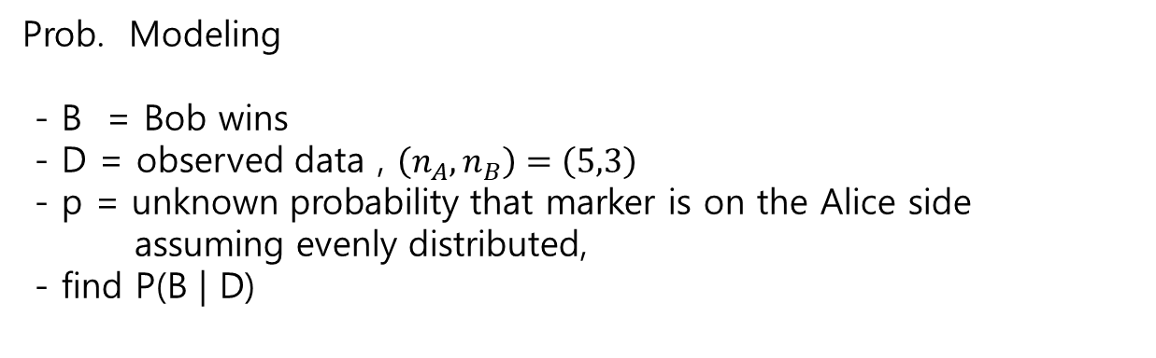
Prob. Modeling
- B = Bob wins
- D = observed data , $\left(n_{A}, n_{B}\right)=\left(5,3\right)$
- p = unknown probability that marker is on the Alice side
assuming evenly distributed,
- find P(B | D)
for Bob to win, the only case is
3 more rolls and All Bob should win .

Slide 6
If p is known, let the marker is at the center of the table, p = 1/2.
then the Prob. of Bob’s win is
P(Bob wins) = ( 1- ½)³ = 1/8
P(Alice wins) = 1- 1/8 = 7/8
We do not know P(p), but we do know the outputs of 8 trials.

Slide 7
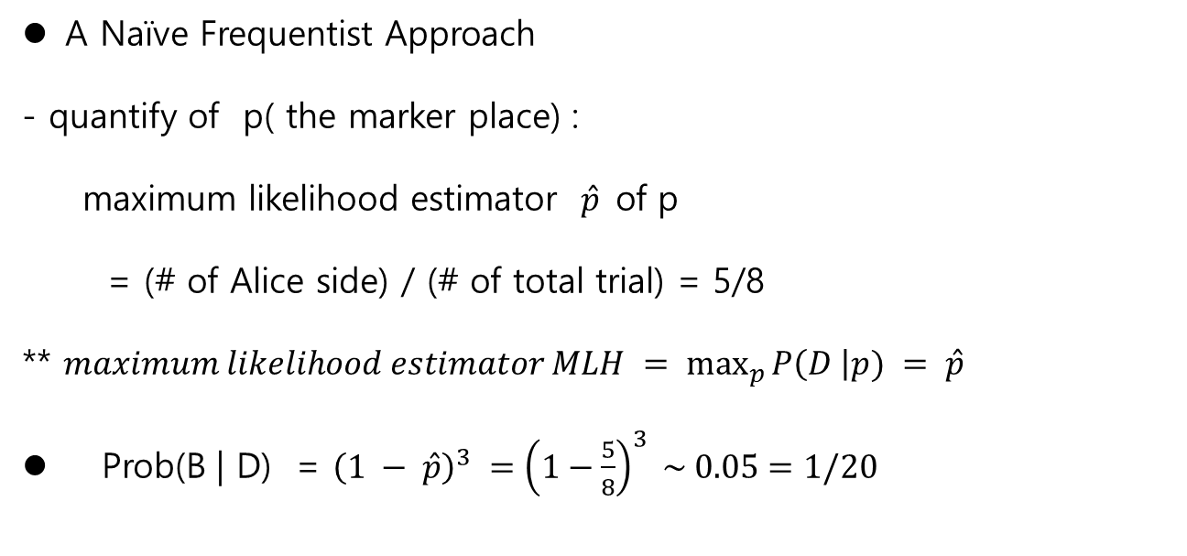
A Naïve Frequentist Approach
- quantify of p( the marker place) :
maximum likelihood estimator $\hat{p}$of p
= (# of Alice side) / (# of total trial) = 5/8
** $maximum likelihood estimator MLH = \max_{p}{P\left(D \right|p) = \hat{p} }$
Prob(B | D) = ${\left(1 − \hat{p}\right)}^{3} ={\left(1−\frac{5}{8}\right)}^{3} \sim 0.05=1/20$

Slide 8
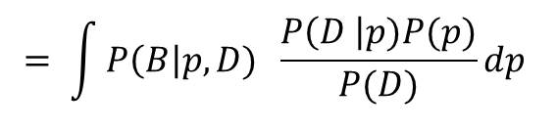

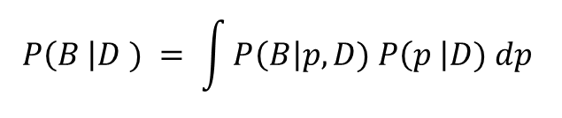

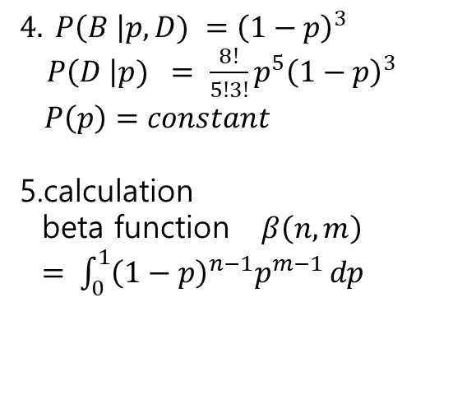
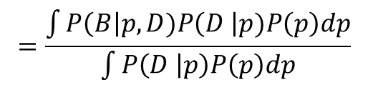
Bayesian Approach
Conditional Prob:
Bayes’ rule
3. Probability identity
$$P\left(B \right|D ) = \int{P\left(B\right|p,D) P\left(p \right|D) dp }$$
$$= \int{P\left(B\right|p,D) \frac{P\left(D \right|p)P(p)}{P(D)}dp }$$
$$=\frac{\int{P\left(B\right|p,D)P\left(D \right|p)P\left(p\right)dp}}{\int{P\left(D | p\right)P\left(p\right)dp}}$$
$4. P\left(B \right|p, D) ={\left(1−p\right)}^{3}$ $P\left(D \right|p) = \frac{8!}{5!3!}p^{5}{\left(1−p\right)}^{3}$
$P\left(p\right)=constant$
5.calculation
beta function $β\left(n,m\right)$
$= \int_{0}^{1}{{\left(1−p\right)}^{n−1}p^{m−1 }dp}$
$$= \frac{\int_{0}^{1}{{\left(1−p\right)}^{6}p^{5}dp}}{\int_{0}^{1}{{\left(1−p\right)}^{3}p^{5}dp}}$$
$=0.09 ∼\frac{1}{10}$

Slide 9
In conclusion
1) If we know the P(p) , let’s say it is P(p) = ½
Then P(B) = 1/8 = 0.125
2) If we do not know P(p), but 8 trials output are known,
2.1) by MLH , as frequentist uses
The Prob(B) = 0.05 ~ 1/20.
2.2) as Bayesian
The Prob(B) = 0.09 ~ 1/10
Which is the correct answer? How do you prove it?
Jake claims (and Bayes, others,…) Bayes are correct and proves
Monte Carlo simulation

Slide 10
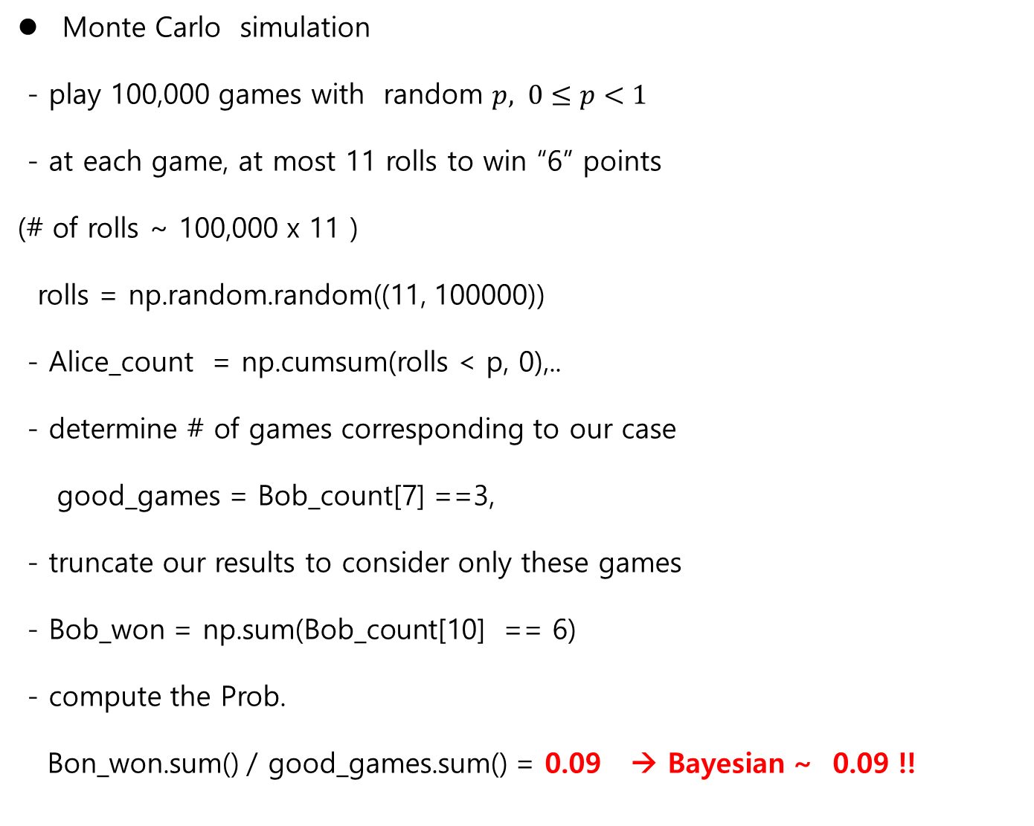
Monte Carlo simulation
- play 100,000 games with random $p, 0≤p<1$
- at each game, at most 11 rolls to win “6” points
(# of rolls ~ 100,000 x 11 )
rolls = np.random.random((11, 100000))
- Alice_count = np.cumsum(rolls < p, 0),..
- determine # of games corresponding to our case
good_games = Bob_count[7] ==3,
- truncate our results to consider only these games
- Bob_won = np.sum(Bob_count[10] == 6)
- compute the Prob.
Bon_won.sum() / good_games.sum() = 0.09 → Bayesian ~ 0.09 !!

Slide 11
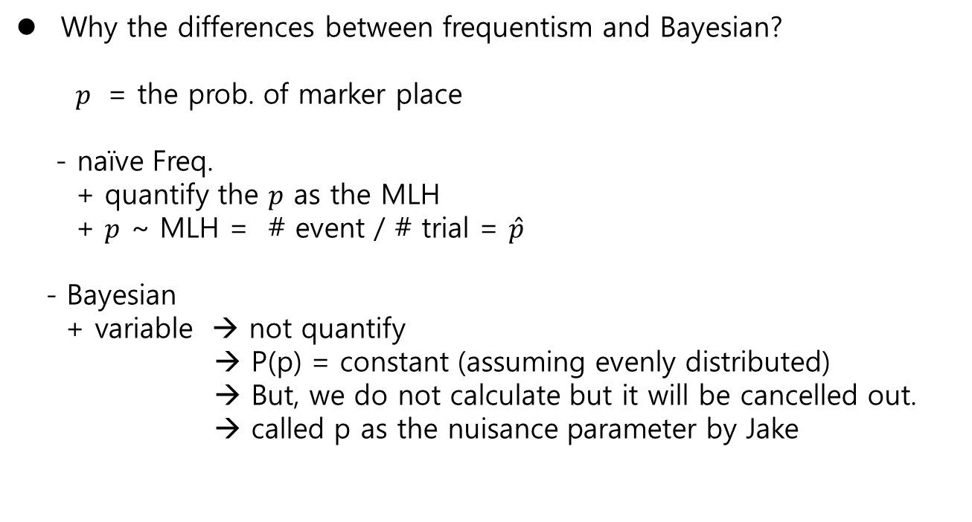
Why the differences between frequentism and Bayesian?
$p$ = the prob. of marker place
- naïve Freq.
+ quantify the $p$ as the MLH
+ $p$ ~ MLH = # event / # trial = $\hat{p}$
- Bayesian
+ variable → not quantify
→ P(p) = constant (assuming evenly distributed)
→ But, we do not calculate but it will be cancelled out.
→ called p as the nuisance parameter by Jake

Slide 12
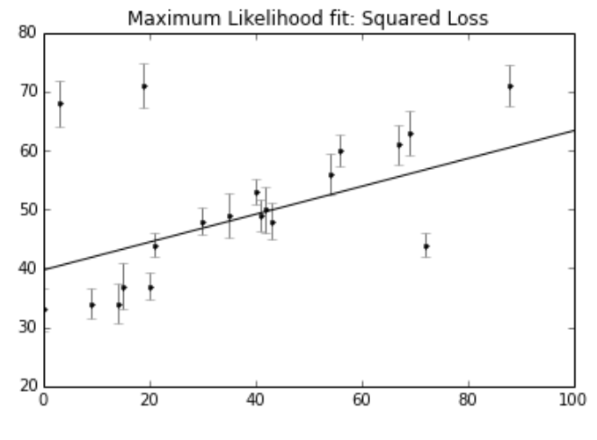
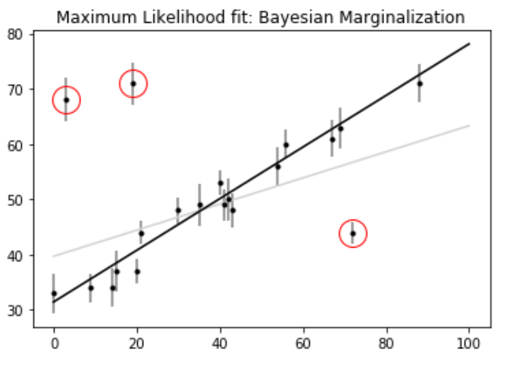
Others example
- linear fitting :
Frequestist / Bayesian
Bayesian : Markov Chain Monte Carlo simulation
- and others … Unfortunately I do not understand MCMC until now…

Slide 13
next meetings
- Friday , at 4pm
- subject :
1) S.Kim : MCMC(Markov Chain Monte Carlo)
2) Pycon : python conference / every year / around the world (South
Africa!!)
- many utubes since 2014…
- many new ideas using python generally young researchers
- introduce and summarize Jake’s Pycon utubes (2014, 1.6G)
every members should take 1 utubes to introduce for us…
Hope next volunteer?
3) We need real data in Africa.
- ASTU servo? Generator on/off? CCTV ????
- Government? Organization?
- African Union??

