Slide 1
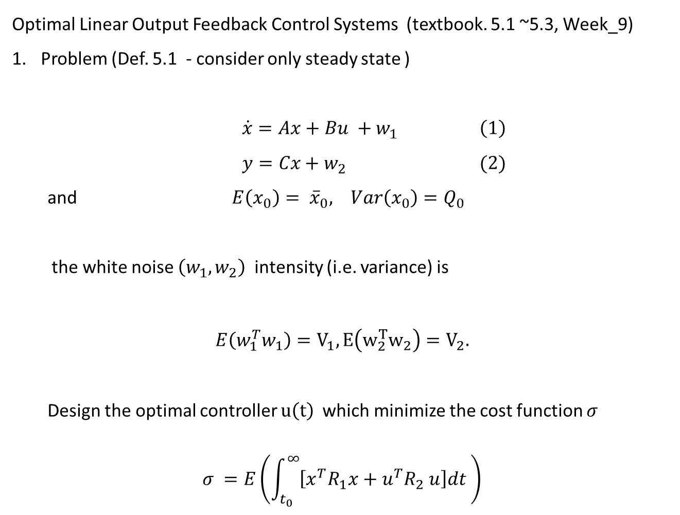
Optimal Linear Output Feedback Control Systems (textbook. 5.1 ~5.3, Week_9)
Problem (Def. 5.1 - consider only steady state )
$\dot{x}=Ax+Bu +w_{1} \left(1\right)$
$y=Cx+w_{2} (2)$
and $E\left(x_{0}\right)= {\overline{x}}_{0}, Var\left(x_{0}\right)=Q_{0}$
the white noise $\left(w_{1}, w_{2}\right)$intensity (i.e. variance) is
$$E\left(w_{1}^{T}w_{1}\right)=V_{1}, E\left(w_{2}^{T}w_{2}\right)=V_{2}.$$
Design the optimal controller $u\left(t\right)$which minimize the cost function $σ$
$$σ =E\left(\int_{t_{0}}^{∞}{\left[x^{T}R_{1}x+u^{T}R_{2} u\right]dt }\right)$$

Slide 2
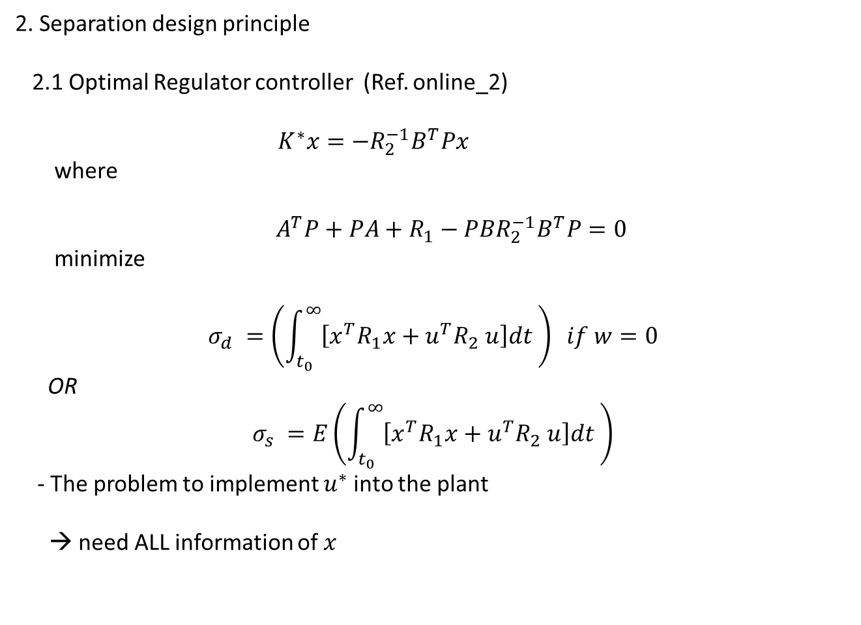
2. Separation design principle
2.1 Optimal Regulator controller (Ref. online_2)
$$K^{∗}x=−R_{2}^{−1}B^{T}Px$$
where
${ A}^{T}P+PA+R_{1}−PBR_{2}^{−1}B^{T}P=0$
minimize
$$σ_{d} =\left(\int_{t_{0}}^{∞}{\left[x^{T}R_{1}x+u^{T}R_{2} u\right]dt }\right) if w=0$$
OR
$$σ_{s} =E\left(\int_{t_{0}}^{∞}{\left[x^{T}R_{1}x+u^{T}R_{2} u\right]dt }\right)$$
- The problem to implement $u^{∗}$ into the plant
→ need ALL information of $x$

Slide 3

2. Separation design principle
2.2 Optimal Observer (Ref online_3)
The optimal observer as $\dot{\hat{x}}\left(t\right)=A\hat{x}+Bu+L\left(y−C\hat{x}\right)$
$$L^{∗}=−QC^{T}V_{2}^{−1}$$
$AQ+QA^{T}+V_{1}−QC^{T}V_{2}^{−1}CQ=0$
minimize
$$\min_{L}{E\left(e^{T}W e\right) , W≥ 0}, e =x− \hat{x}$$
- $E\left(e^{T}W e\right)=trace of (ee^{T})W$
$=\sum_{i=1}^{n}{E{\left(x_{i} − {\hat{x}}_{i}\right)}^{2} if W=I }$

Slide 4
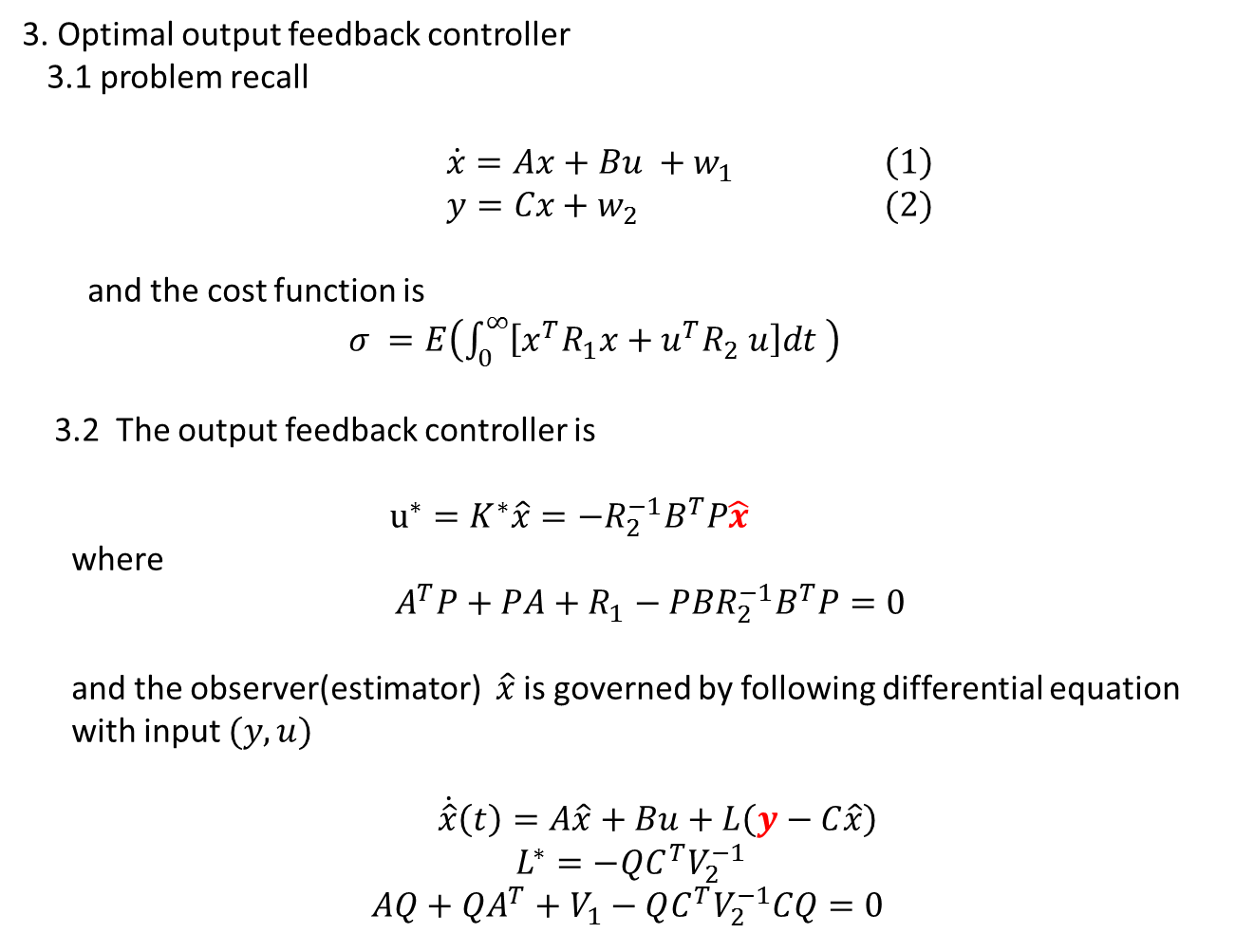
3. Optimal output feedback controller
3.1 problem recall
$\dot{x}=Ax+Bu +w_{1} \left(1\right)$
$y=Cx+w_{2} (2)$
and the cost function is
$σ =E\left(\int_{0}^{∞}{\left[x^{T}R_{1}x+u^{T}R_{2} u\right]dt }\right)$
3.2 The output feedback controller is
$u^{∗}=K^{∗}\hat{x}=−R_{2}^{−1}B^{T}P\hat{x}$
where
$${ A}^{T}P+PA+R_{1}−PBR_{2}^{−1}B^{T}P=0$$
and the observer(estimator) $\hat{x}$ is governed by following differential equation
with input $(y, u)$
$\dot{\hat{x}}\left(t\right)=A\hat{x}+Bu+L\left(y−C\hat{x}\right)$
$$L^{∗}=−QC^{T}V_{2}^{−1}$$
$AQ+QA^{T}+V_{1}−QC^{T}V_{2}^{−1}CQ=0$

Slide 5
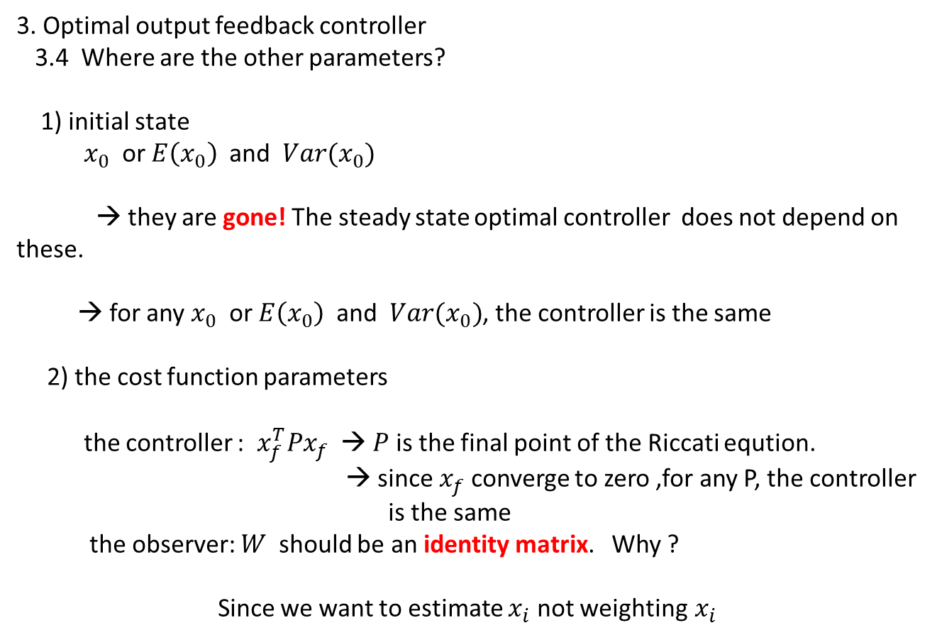
3. Optimal output feedback controller
3.4 Where are the other parameters?
1) initial state
$x_{0}$ or $E\left(x_{0}\right)$and $Var(x_{0})$
→ they are gone! The steady state optimal controller does not depend on these.
→ for any $x_{0}$ or $E\left(x_{0}\right)$and $Var(x_{0})$, the controller is the same
2) the cost function parameters
the controller : $x_{f}^{T}Px_{f}$ → $P$ is the final point of the Riccati eqution.
→ since $x_{f}$ converge to zero ,for any P, the controller
is the same
the observer: $W$ should be an identity matrix. Why ?
Since we want to estimate $x_{i}$ not weighting$x_{i}$

Slide 6
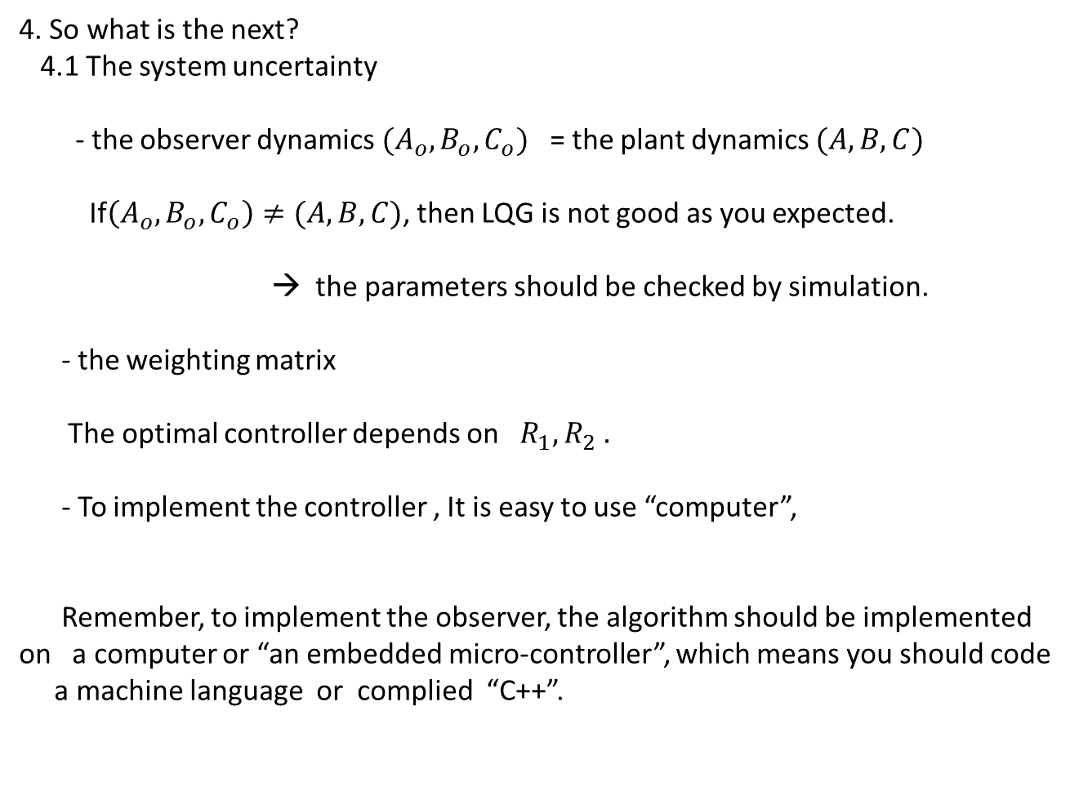
4. So what is the next?
4.1 The system uncertainty
- the observer dynamics $(A_{o},B_{o},C_{o})$ = the plant dynamics $(A,B,C)$
If$\left(A_{o},B_{o},C_{o}\right)≠(A,B,C)$, then LQG is not good as you expected.
→ the parameters should be checked by simulation.
- the weighting matrix
The optimal controller depends on $R_{1}, R_{2} .$
- To implement the controller , It is easy to use “computer”,
Remember, to implement the observer, the algorithm should be implemented on a computer or “an embedded micro-controller”, which means you should code
a machine language or complied “C++”.

