Slide 1
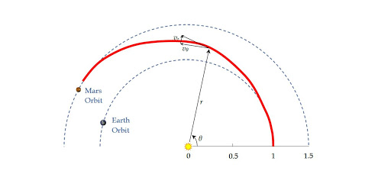
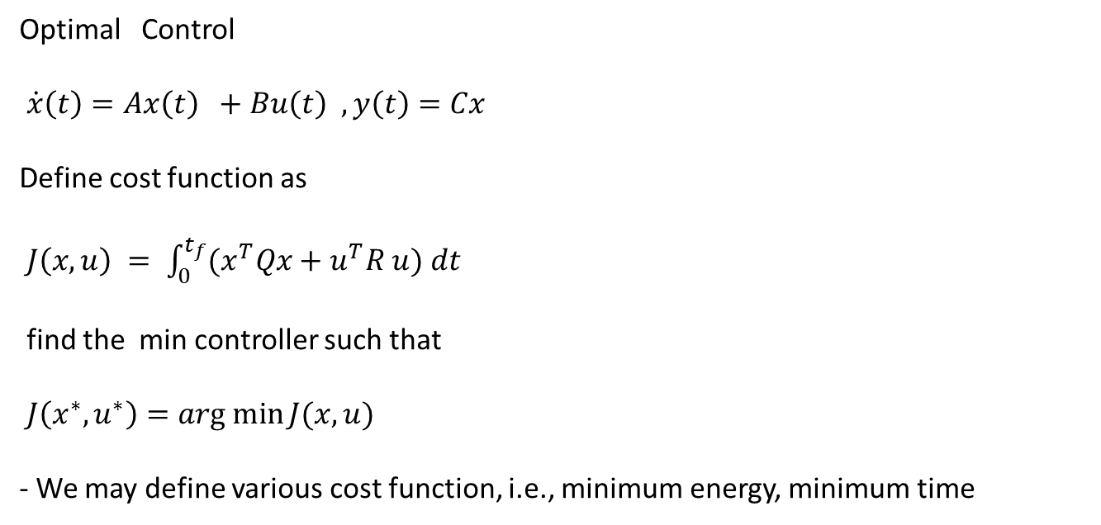
Optimal Control
$\dot{x}\left(t\right)=Ax\left(t\right) +Bu\left(t\right) , y\left(t\right)=Cx$
Define cost function as
$J\left(x,u\right) = \int_{0}^{t_{f}}{{(x}^{T}Qx+u^{T}R u) dt }$
find the min controller such that
$J\left(x^{∗}, u^{∗}\right)=arg min{J(x,u)}$
- We may define various cost function, i.e., minimum energy, minimum time

Slide 2
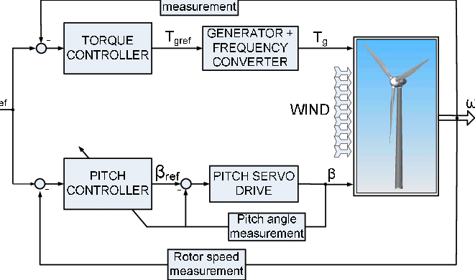
Objective: maximum wind power
input : unknown wind speed, direction

Slide 3
Course Description
- Advanced Linear Algebra: Vector Space and subspaces, Independence, Basis
- Variational Calculus: Euler equation, Hamiltonian Jacobian Bellman Optimal
Principle
- Linear Quadratic Regulation Optimal Control: Lyapunov , Riccati Equation,
Linear Quadratic Gaussian controller: Optimal state reconstruction(Kalman Estimator), Separation Principle
Identification of parameter, Adaptive Gain Scheduling
- Lab: Matlab / Simulink / Symbolic math

Slide 4
Textbooks and References Linear Algebra: G.Strang, ” Differential Equations and Linear Algebra”, Wellesley- Cambridge Press,2014.Chapter 4 to Chapter 8 2. Calculus of Variation: Terje Sund, “Lectures on Optimal Control Theory”, https://www.mn.uio.no/math/tjenester/kunnskap/kompendier/controltheory.pdf 3. Kwakernaak and Sivan,” Linear Optimal Control System”, 1972 4. Undergraduate Lecture Notes on LQG/LQR controller design “https://www.academia.edu/6945404/Undergraduate_Lecture_Notes_on_LQG_LQR_controller_design” 5. Introduction to Adaptive Control https://uomustansiriyah.edu.iq/media/lectures/5/5_2019_02_11!10_06_27_AM.pdf %% github.com/snkim0701/ Optimal-adaptive-control Linear ,… it is too large to upload github..Plz, downloas by yourself

