Slide 1
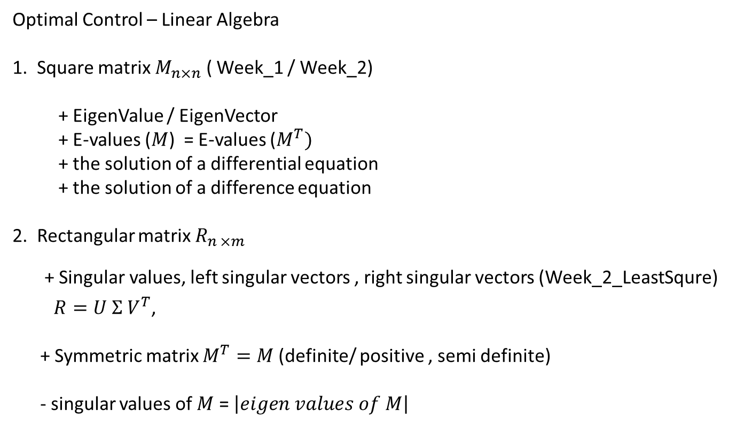
Optimal Control – Linear Algebra
1. Square matrix $M_{n×n}$ ( Week_1 / Week_2)
+ EigenValue / EigenVector
+ E-values ($M$) = E-values ($M^{T})$
+ the solution of a differential equation
+ the solution of a difference equation
2. Rectangular matrix $R_{n ×m }$
+ Singular values, left singular vectors , right singular vectors (Week_2_LeastSqure)
$R=U Σ V^{T}$,
+ Symmetric matrix $M^{T}=M$(definite/ positive , semi definite)
- singular values of $M$ = $\left|eigen values of M\right|$

Slide 2
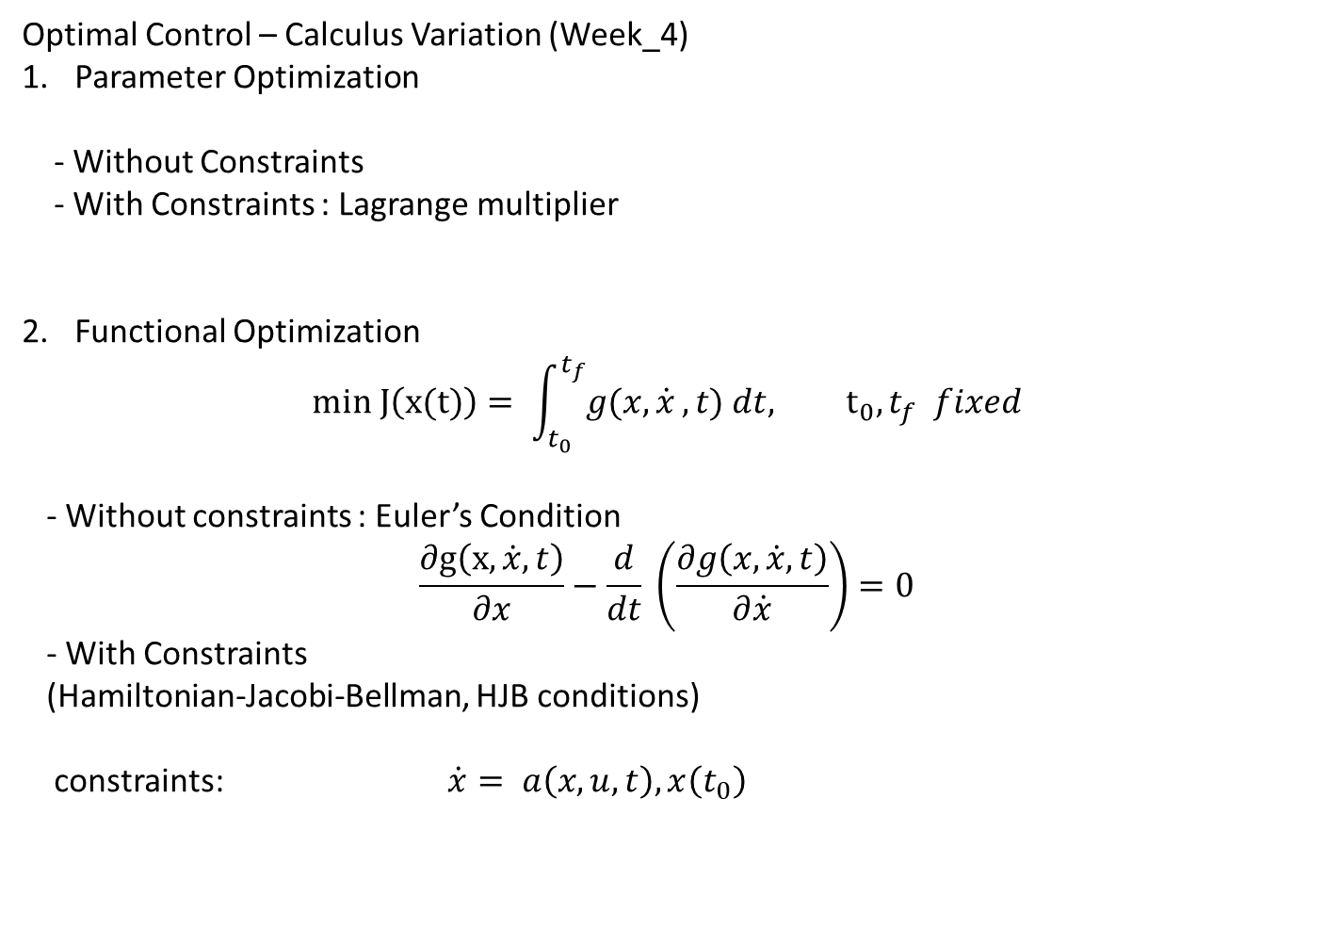
Optimal Control – Calculus Variation (Week_4)
Parameter Optimization
- Without Constraints
- With Constraints : Lagrange multiplier
Functional Optimization
$$min J\left(x(t)\right)= \int_{t_{0}}^{t_{f}}{g(x, \dot{x}}, t) dt, t_{0}, t_{f} fixed$$
- Without constraints : Euler’s Condition
$$\frac{∂g\left(x,\dot{x},t\right)}{∂x}−\frac{d}{dt} \left(\frac{∂g\left(x,\dot{x},t\right)}{∂\dot{x}}\right)=0$$
- With Constraints
(Hamiltonian-Jacobi-Bellman, HJB conditions)
constraints: $\dot{x}= a\left(x,u,t\right), x\left(t_{0}\right)$

Slide 3

HJB - Linear quadratic system (Week_4)
$\dot{x}=Ax+Bu$
$$J=\frac{1}{2}x{\left(t_{f}\right)}^{T}Hx\left(t_{f}\right)+\frac{1}{2}\int_{t_{0}}^{t_{f}}{\left\{x^{T}Qx+u^{T}Ru\right\}dt}, t_{f}:fixed$$
- The optimal solution
$u\left(t\right)=−R^{−1}B^{T}Px$
where
$−\dot{P}=Q+PA+A^{T}P−PBR^{−1}B^{T}P, P\left(t_{f}\right)=H$
Instead of the initial point, the final point is known
Backward equation

Slide 4
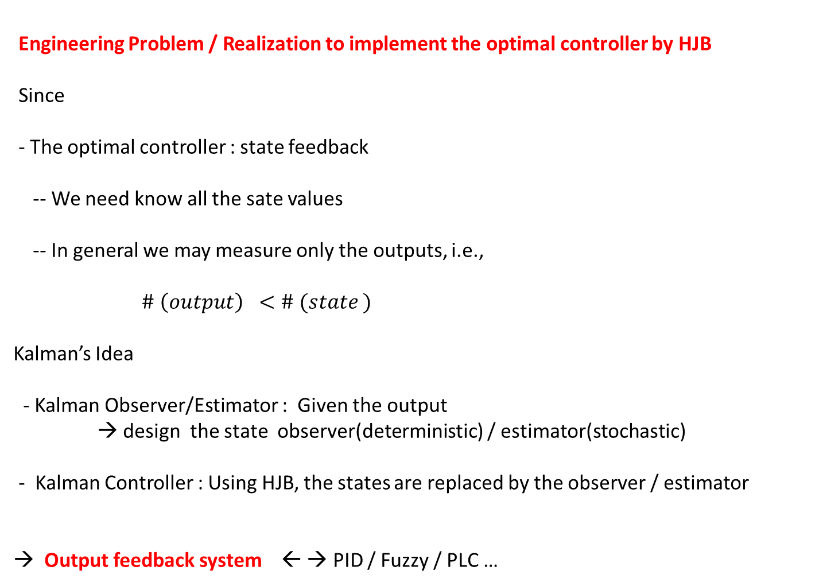
Engineering Problem / Realization to implement the optimal controller by HJB
Since
- The optimal controller : state feedback
-- We need know all the sate values
-- In general we may measure only the outputs, i.e.,
$\# \left(output\right) <\# (state )$
Kalman’s Idea
- Kalman Observer/Estimator : Given the output
→ design the state observer(deterministic) / estimator(stochastic)
- Kalman Controller : Using HJB, the states are replaced by the observer / estimator
→ Output feedback system ← → PID / Fuzzy / PLC …

Slide 5
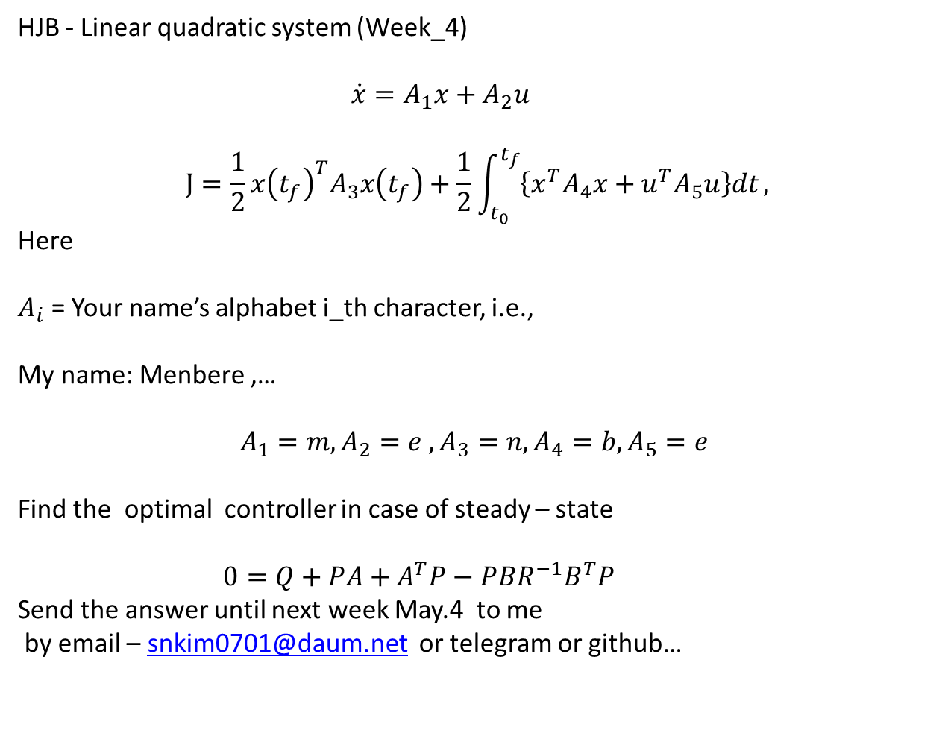
Home assignment _3_online
HJB - Linear quadratic system (Week_4)
$\dot{x}=A_{1}x+A_{2}u$
$$J=\frac{1}{2}x{\left(t_{f}\right)}^{T}A_{3}x\left(t_{f}\right)+\frac{1}{2}\int_{t_{0}}^{t_{f}}{\left\{x^{T}A_{4}x+u^{T}A_{5}u\right\}dt},$$
Here
$A_{i}$ = Your name’s alphabet i_th character, i.e.,
My name: Menbere ,…
$$A_{1}=m, A_{2}=e , A_{3}=n, A_{4}=b, A_{5}=e$$
Find the optimal controller in case of steady – state
$0=Q+PA+A^{T}P−PBR^{−1}B^{T}P$
Send the answer until next week May.4 to me
by email – snkim0701@daum.net or telegram or github…

Slide 6

Linear System Theory (Week_5)
$$\dot{x}=Ax+Bu, \\ y=cx$$
1. The solution: Theorem 1.4
$y\left(t\right)=Ce^{t}x\left(0\right)+C\int_{0}^{t}{e^{A\left(t−τ\right)}Bu\left(τ\right)dτ} (1−70)$
2. The stability :
- Lyapunov stability (Def 1.1.) : $\dot{x}=f(x,t)$
- The asymptotic Stability(Def 1.2.) : $\dot{x}=Ax$
+ The conditions: (Theorem 1.14)

Slide 7

Linear System Theory (Week_5, Week-5_2)
$$\dot{x}=Ax+Bu, \\ y=cx$$
3. The controllability:(Definition 1.11, Theorem 1.23))
- $rank\left( P\right)=rank\left( \left[ B, AB,A^{2}B,…,A^{n−1 }B\right]\right)=n$
4. The Observability: (Def.1.17, Theorem 1.32)
- rank $\left(Q\right)=rank\left(\left[C, CA, CA^{2},…, CA^{n−1}\right]\right)=n$

