Slide 1

Linear Quadratic Regulator Problem (Textbook. Ch.3.3 ~3.6 , Week_5~8)
1. Problem
$\dot{x}=Ax+Bu (1)$
$$J(u)=\frac{1}{2}\int_{0}^{∞}{\left\{x^{T}Qx+u^{T}Ru\right\}dt}$$
Find the optimal
$$u\left(t\right), s.t.$$
$$J\left(u^{∗}\right)=min J\left(u\right)$$
2.Solution
$$u^{∗}=−R^{−1}B^{T}Px (2)$$
where
${ A}^{T}P+PA+Q−PBR^{−1}B^{T}P=0 (3)$

Slide 2
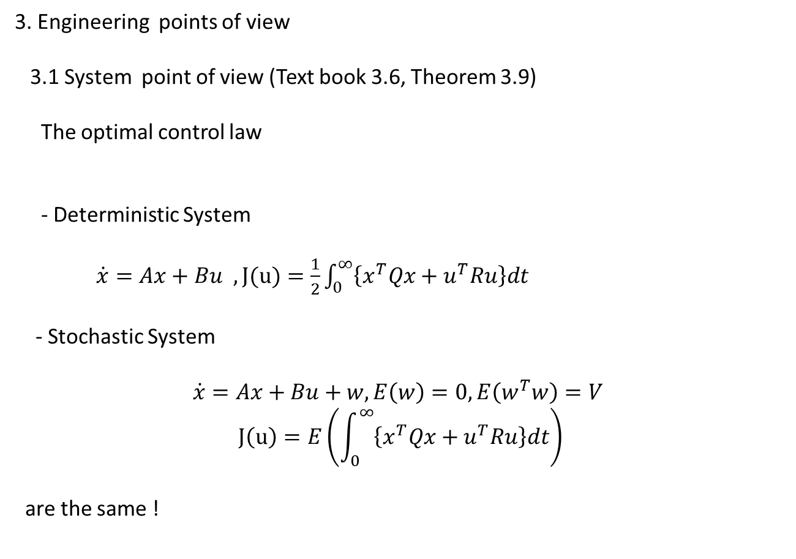
3. Engineering points of view
3.1 System point of view (Text book 3.6, Theorem 3.9)
The optimal control law
- Deterministic System
$\dot{x}=Ax+Bu , J(u)=\frac{1}{2}\int_{0}^{∞}{\left\{x^{T}Qx+u^{T}Ru\right\}dt}$
- Stochastic System
$$\dot{x}=Ax+Bu+w, E\left(w\right)=0, E\left(w^{T}w\right)=V$$
$$J\left(u\right)=E\left(\int_{0}^{∞}{\left\{x^{T}Qx+u^{T}Ru\right\}dt}\right)$$
are the same !

Slide 3
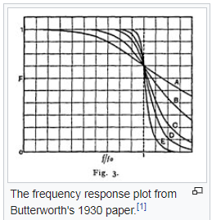
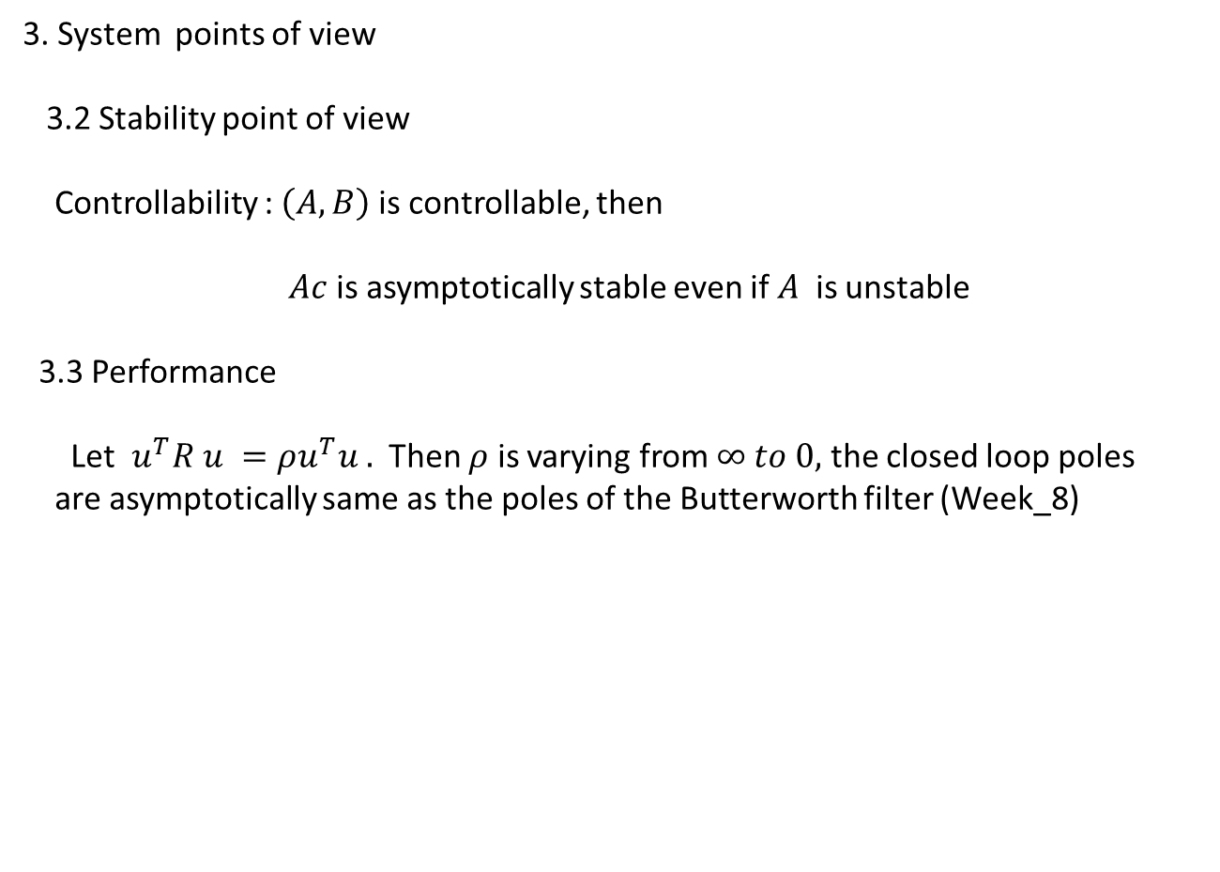
3. System points of view
3.2 Stability point of view
Controllability : $\left(A,B\right)$ is controllable, then
$Ac$ is asymptotically stable even if $A$ is unstable
3.3 Performance
Let $u^{T}R u =ρu^{T}u .$ Then $ρ$ is varying from $∞ to 0,$ the closed loop poles
are asymptotically same as the poles of the Butterworth filter (Week_8)

Slide 4
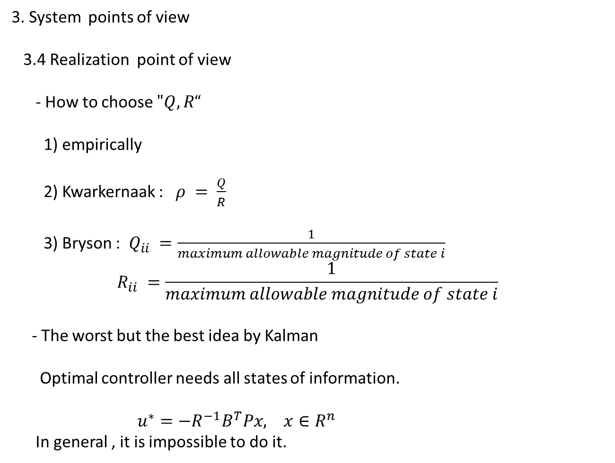
3. System points of view
3.4 Realization point of view
- How to choose $"Q, R“$
1) empirically
2) Kwarkernaak : $ρ = \frac{Q}{R}$
3) Bryson : $Q_{ii} =\frac{1}{maximum allowable magnitude of state i}$
$$R_{ii} =\frac{1}{maximum allowable magnitude of state i}$$
- The worst but the best idea by Kalman
Optimal controller needs all states of information.
$u^{∗}=−R^{−1}B^{T}Px, x∈R^{n}$
In general , it is impossible to do it.

