Slide 1
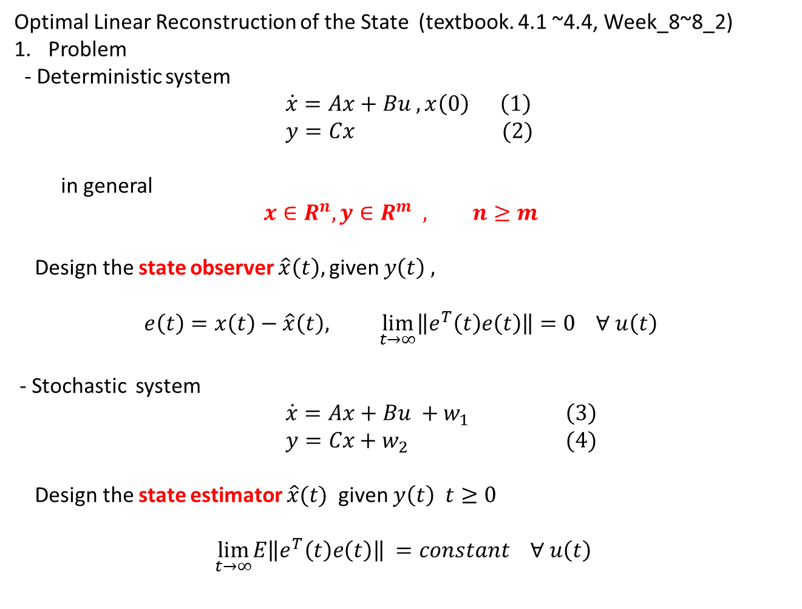
Optimal Linear Reconstruction of the State (textbook. 4.1 ~4.4, Week_8~8_2)
Problem
- Deterministic system
$\dot{x}=Ax+Bu , x\left(0\right) \left(1\right)$
$y=Cx (2)$
in general
$$x∈R^{n}, y∈R^{m} , n≥m$$
Design the state observer $\hat{x}\left(t\right),$given $y\left(t\right) ,$
$$e\left(t\right)=x\left(t\right)−\hat{x}\left(t\right), \lim_{t→∞}\left\|e^{T}\left(t\right)e\left(t\right)\right\|=0 ∀ u\left(t\right)$$
- Stochastic system
$\dot{x}=Ax+Bu +w_{1} \left(3\right)$
$y=Cx+w_{2} (4)$
Design the state estimator $\hat{x}(t)$ given $y\left(t\right) t≥0$
$$\lim_{t→∞}E\left\|e^{T}\left(t\right)e\left(t\right)\right\| =constant ∀ u\left(t\right)$$

Slide 2

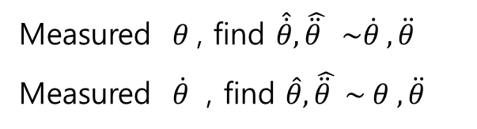
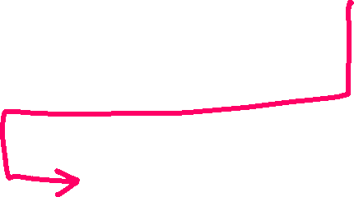
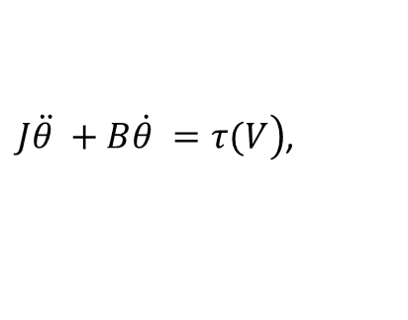

Example
Measured $θ$, find $\hat{\dot{θ}}, \hat{\ddot{θ} } \sim \dot{θ} , \ddot{θ}$
Measured $\dot{θ}$ , find $\hat{θ}, \hat{\ddot{θ} } \sim θ , \ddot{θ}$
$\left.J\ddot{θ }+B\dot{θ }=τ(V\right)$,
Input:Voltage
DC motor
$$\hat{θ}, \hat{\dot{θ}}, \hat{\ddot{θ} } \sim θ, \dot{θ}, \ddot{θ}$$
DC motor Model
Observer

Slide 3
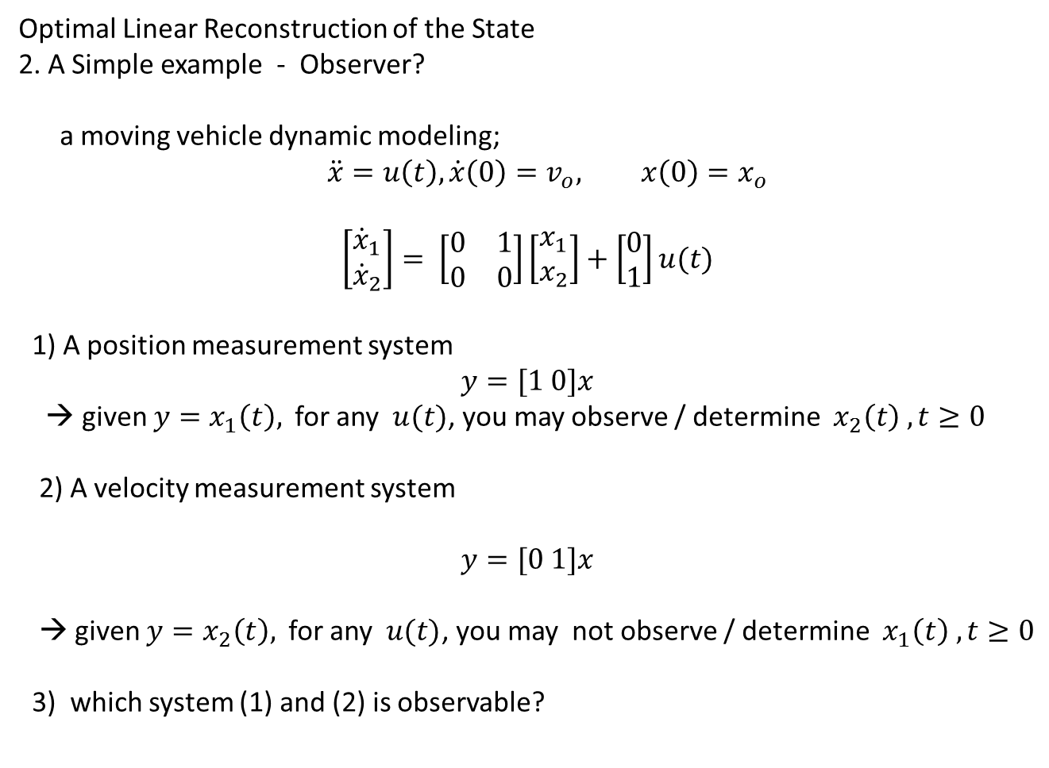
Optimal Linear Reconstruction of the State
2. A Simple example - Observer?
a moving vehicle dynamic modeling;
$$\ddot{x}=u\left(t\right),\dot{x}\left(0\right)=v_{o}, x\left(0\right)=x_{o}$$
$$\left[\begin{matrix}{\dot{x}}_{1} \\ {\dot{x}}_{2}\end{matrix}\right]= \left[\begin{matrix}0 & 1 \\ 0 & 0\end{matrix}\right]\left[\begin{matrix}x_{1} \\ x_{2}\end{matrix}\right]+\left[\begin{matrix}0 \\ 1\end{matrix}\right]u(t)$$
1) A position measurement system
$$y=[1 0]x$$
→ given $y=x_{1}\left(t\right),$for any $u(t)$, you may observe / determine $x_{2}\left(t\right) , t≥0$
2) A velocity measurement system
$$y=[0 1]x$$
→ given $y=x_{2}\left(t\right),$for any $u(t)$, you may not observe / determine $x_{1}\left(t\right) , t≥0$
3) which system (1) and (2) is observable?

Slide 4
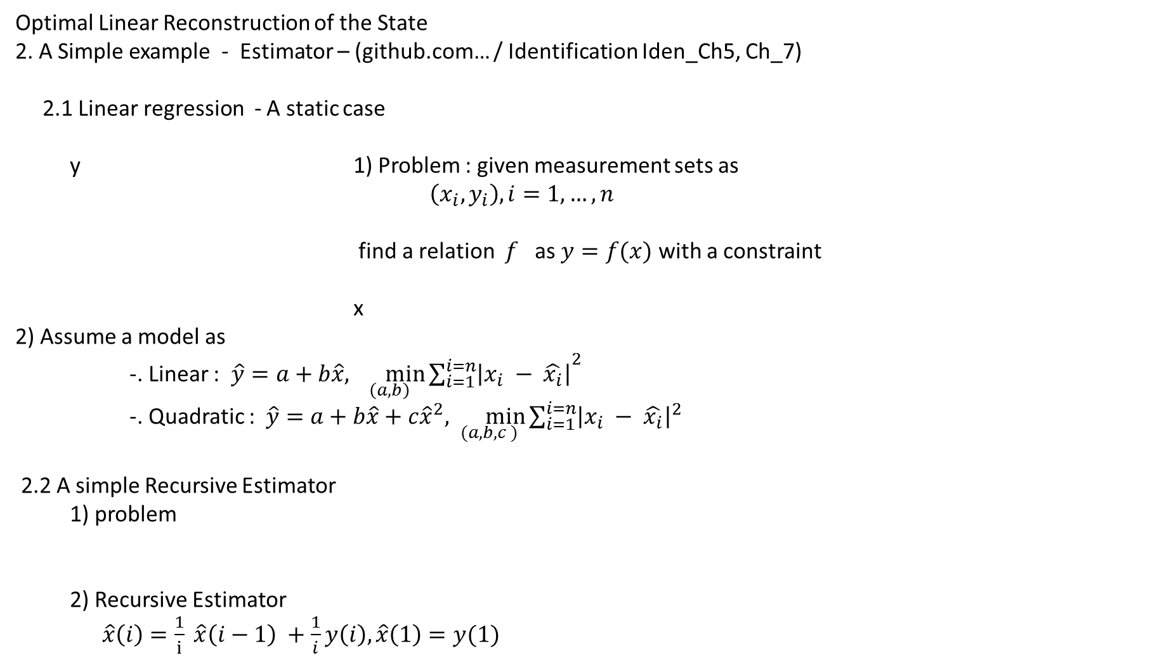
Optimal Linear Reconstruction of the State
2. A Simple example - Estimator – (github.com… / Identification Iden_Ch5, Ch_7)
2.1 Linear regression - A static case
y 1) Problem : given measurement sets as
$\left(x_{i}, y_{i}\right), i=1,…,n$
find a relation $f$ as $y=f(x)$ with a constraint
x
2) Assume a model as
-. Linear : $\hat{y}=a+b\hat{x}, {\min_{\left(a,b\right)}{\sum_{i=1}^{i=n}{\left|x_{i} − \hat{x_{i}}\right|}}}^{2}$
-. Quadratic : $\hat{y}=a+b\hat{x}+c{\hat{x}}^{2}, \min_{(a,b,c )}{\sum_{i=1}^{i=n}{{\left|x_{i} − \hat{x_{i}}\right|}^{2}}}$
2.2 A simple Recursive Estimator
1) problem
2) Recursive Estimator
$\hat{x}\left(i\right)=\frac{1}{i} \hat{x}\left(i−1\right) +\frac{1}{i}y\left(i\right),\hat{x}\left(1\right)=y(1)$
$y\left(i\right) =x+e\left(i\right)$, given $y\left(i\right),$ find $x, x is a constant$

Slide 5
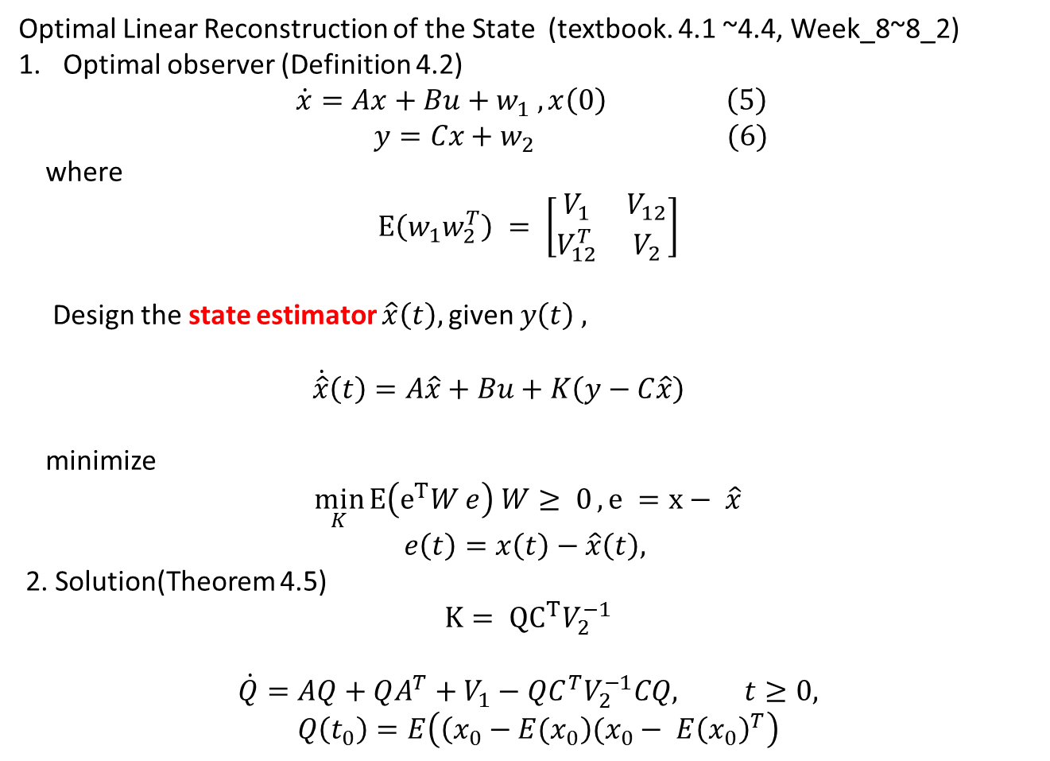
Optimal Linear Reconstruction of the State (textbook. 4.1 ~4.4, Week_8~8_2)
Optimal observer (Definition 4.2)
$$\dot{x}=Ax+Bu+w_{1} , x\left(0\right) \left(5\right)$$
$y=Cx+w_{2} (6)$
where
$$E\left(w_{1}w_{2}^{T}\right) = \left[\begin{matrix}V_{1} & V_{12} \\ V_{12}^{T} & V_{2}\end{matrix}\right]$$
Design the state estimator $\hat{x}\left(t\right),$given $y\left(t\right) ,$
$\dot{\hat{x}}\left(t\right)=A\hat{x}+Bu+K\left(y−C\hat{x}\right)$
minimize
$$\min_{K}{E\left(e^{T}W e\right) W≥ 0}, e =x− \hat{x}$$
$$e\left(t\right)=x\left(t\right)−\hat{x}\left(t\right),$$
2. Solution(Theorem 4.5)
$$K= {QC}^{T}V_{2}^{−1}$$
$$\dot{Q}=AQ+QA^{T}+V_{1}−QC^{T}V_{2}^{−1}CQ, t≥0,$$
$$Q\left(t_{0}\right)=E\left(\left(x_{0}−E(x_{0}\right)(x_{0}− E{\left(x_{0}\right)}^{T}\right)$$

Slide 6
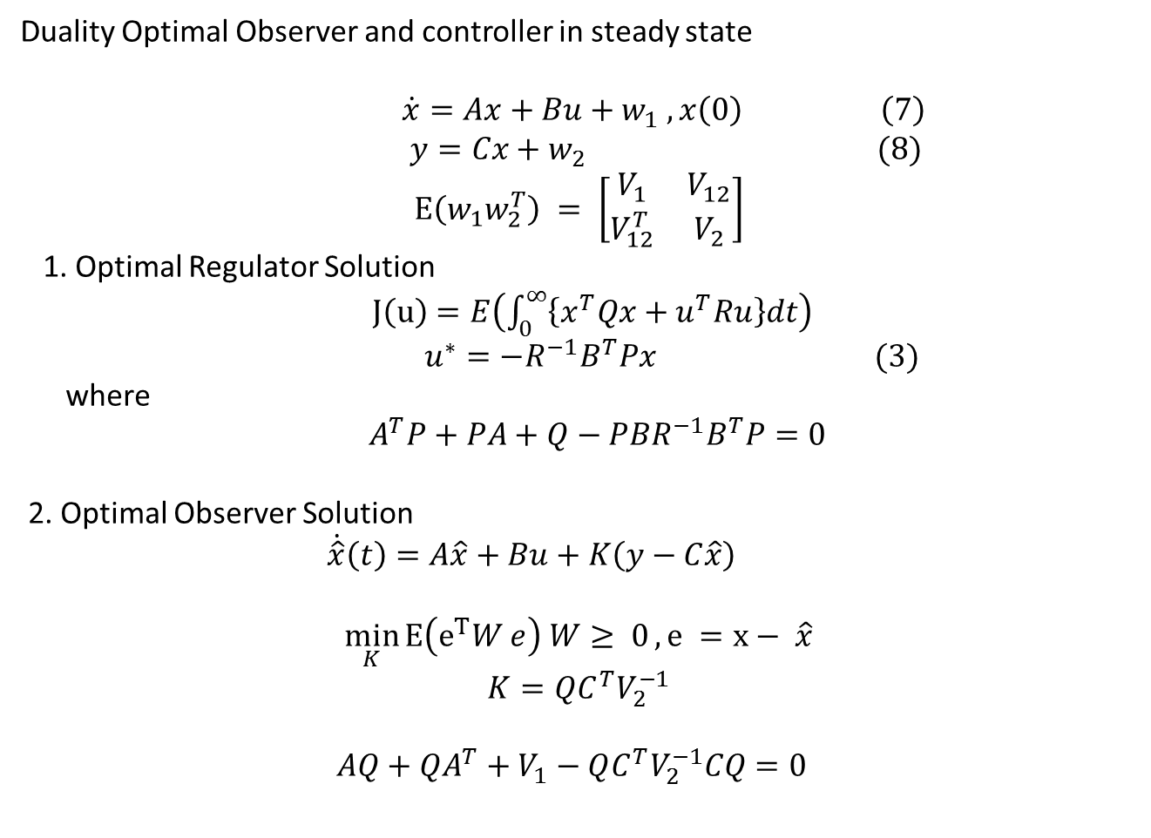
Duality Optimal Observer and controller in steady state
$\dot{x}=Ax+Bu+w_{1} , x\left(0\right) \left(7\right)$
$y=Cx+w_{2} (8)$
$$E\left(w_{1}w_{2}^{T}\right) = \left[\begin{matrix}V_{1} & V_{12} \\ V_{12}^{T} & V_{2}\end{matrix}\right]$$
1. Optimal Regulator Solution
$J\left(u\right)=E\left(\int_{0}^{∞}{\left\{x^{T}Qx+u^{T}Ru\right\}dt}\right)$
$u^{∗}=−R^{−1}B^{T}Px (3)$
where
${ A}^{T}P+PA+Q−PBR^{−1}B^{T}P=0$
2. Optimal Observer Solution
$\dot{\hat{x}}\left(t\right)=A\hat{x}+Bu+K\left(y−C\hat{x}\right)$
$$\min_{K}{E\left(e^{T}W e\right) W≥ 0}, e =x− \hat{x}$$
$$K=QC^{T}V_{2}^{−1}$$
$$AQ+QA^{T}+V_{1}−QC^{T}V_{2}^{−1}CQ=0$$

