Slide 1
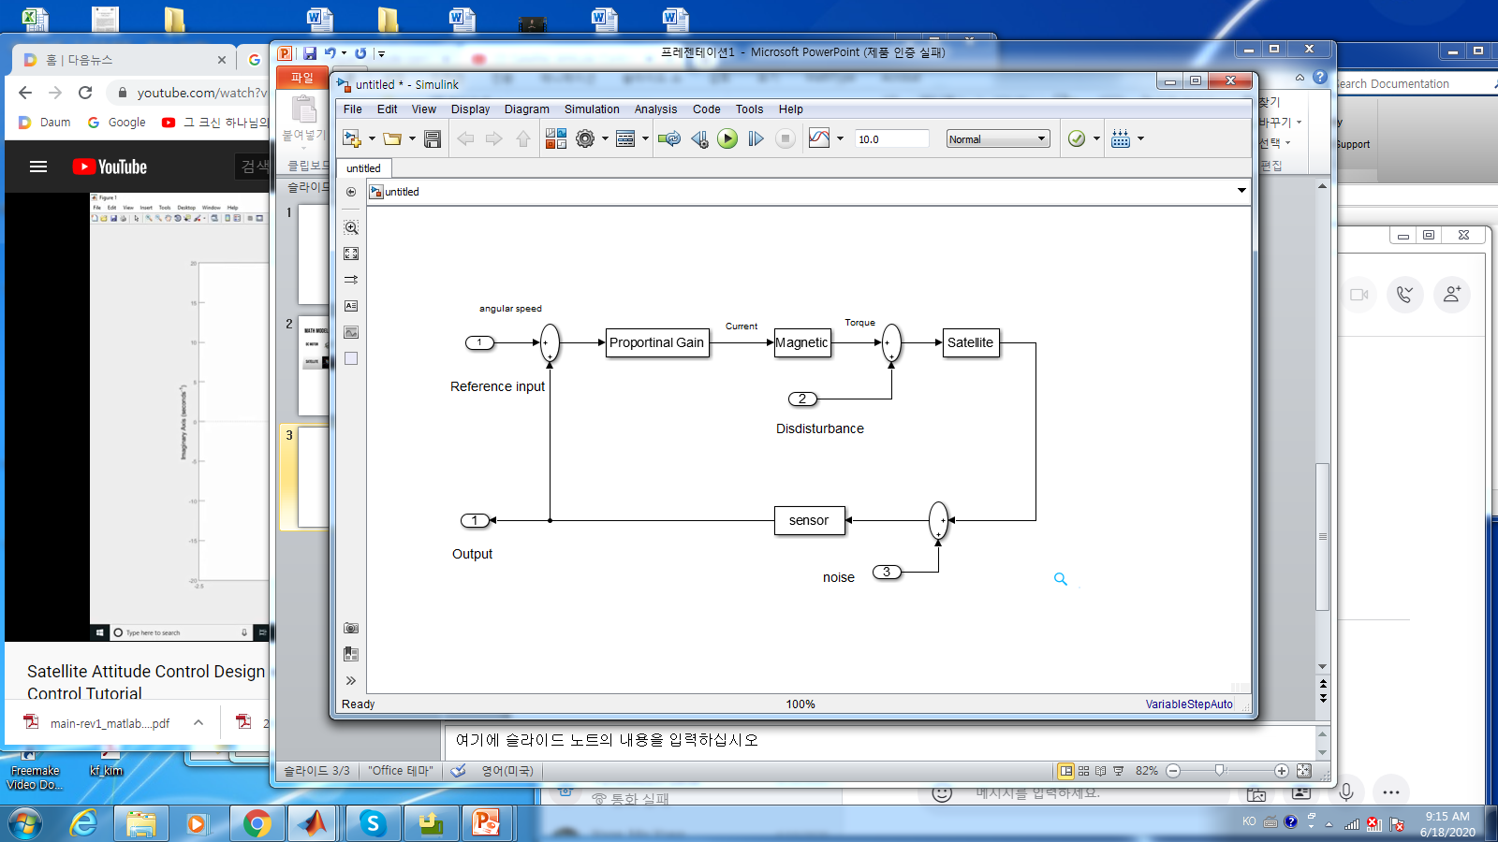
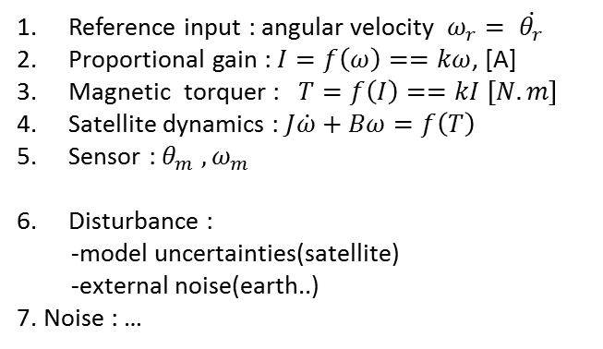
Control objectives :
1. Stabilizing the satellite dynamics
2. tracking problem: input == output
3. minimize the errors, fast the rising time , not too much over shoot,…
4. Optimal control : minimize the cost (electric power,…)
Reference input : angular velocity $ω_{r}= \dot{θ_{r}}$
Proportional gain : $I=f\left(ω\right)==kω$, [A]
Magnetic torquer : $T=f\left(I\right)==kI \left[N.m\right]$
Satellite dynamics : $J\dot{ω}+Bω=f\left(T\right)$
Sensor : $θ_{m} , ω_{m}$
Disturbance :
-model uncertainties(satellite)
-external noise(earth..)
7. Noise : …
One example of controllers – “PID”

Slide 2
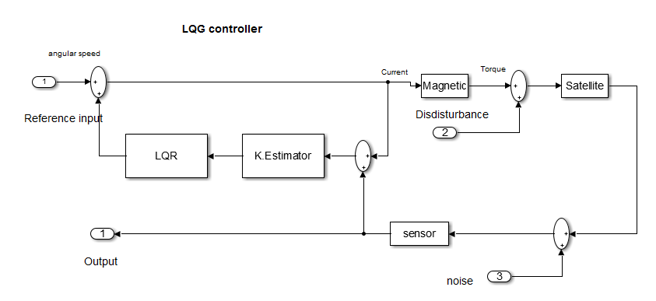
Using Kalman Filter(Estimator) , attitude control Block Diagram

Slide 3
 | Controller input | Effect | Controller Gain
Classic Control(PID) | Output feedback |  | constant
Modern | Output feedback | State feedback
(Alpha-Beta) | ‘’ |  | constant
LQR/LQG | ‘’
- linear | ‘’ |  | varying
- non-linear EK | ‘’ |  | varying
- non-linear Unscented | ‘’ | better >> EK | varying
MPC (auto driving) |  |  | varying

Slide 4
Simulation
- Program in the loop simulation (PILS)
- Hardware in the loop simulation (HILS) -- real time simulation
+ In our case, almost all is done
+ need wireless Tx/Rx tools
Development algorithm
- Absolutely need to use matlab / simulink
- at least PG

Slide 5
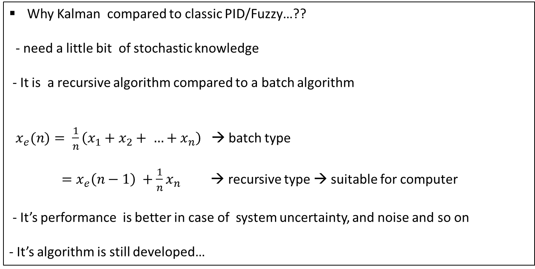
Why Kalman compared to classic PID/Fuzzy…??
- need a little bit of stochastic knowledge
- It is a recursive algorithm compared to a batch algorithm
$x_{e}(n)= \frac{1}{n}\left(x_{1}+x_{2}+ …+x_{n}\right)$ → batch type
$=x_{e}\left(n−1\right) +\frac{1}{n}x_{n}$ → recursive type → suitable for computer
- It’s performance is better in case of system uncertainty, and noise and so on
- It’s algorithm is still developed…

