Slide 1


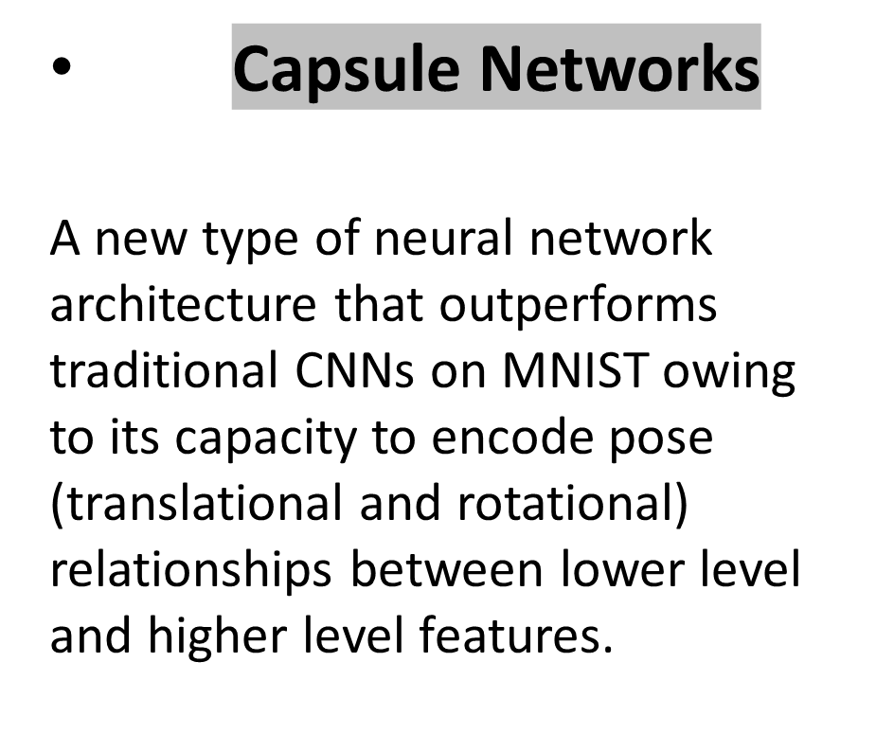
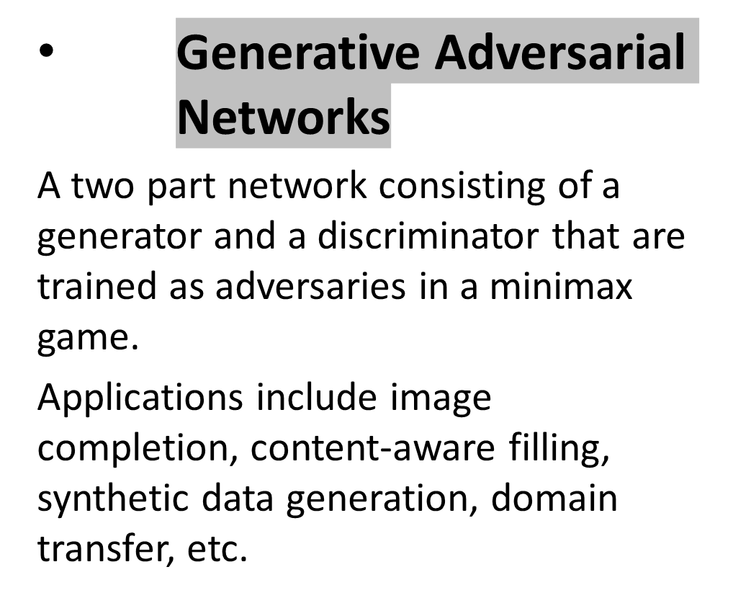
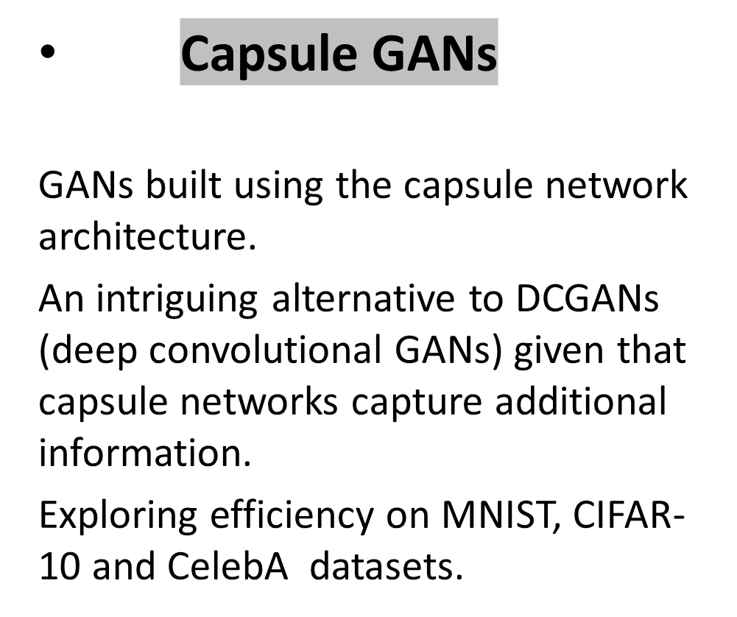
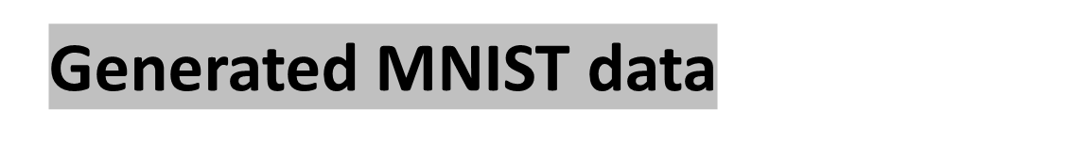
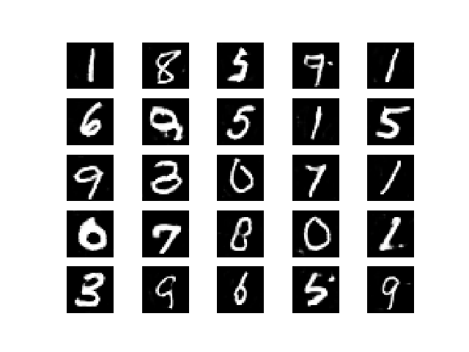
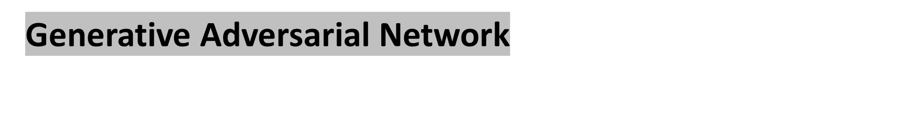
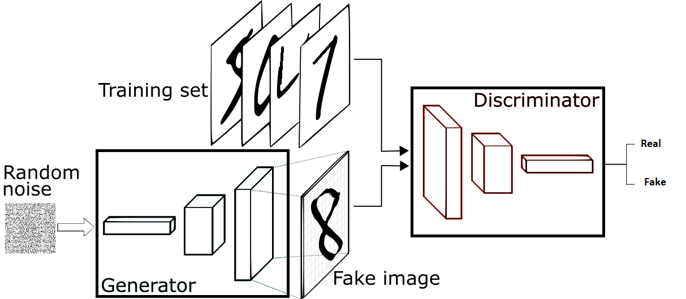
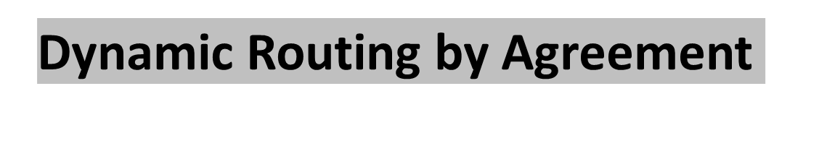
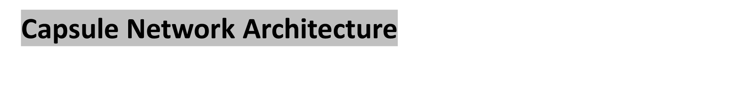
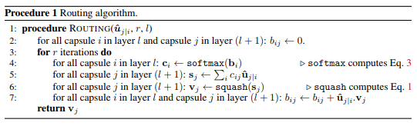
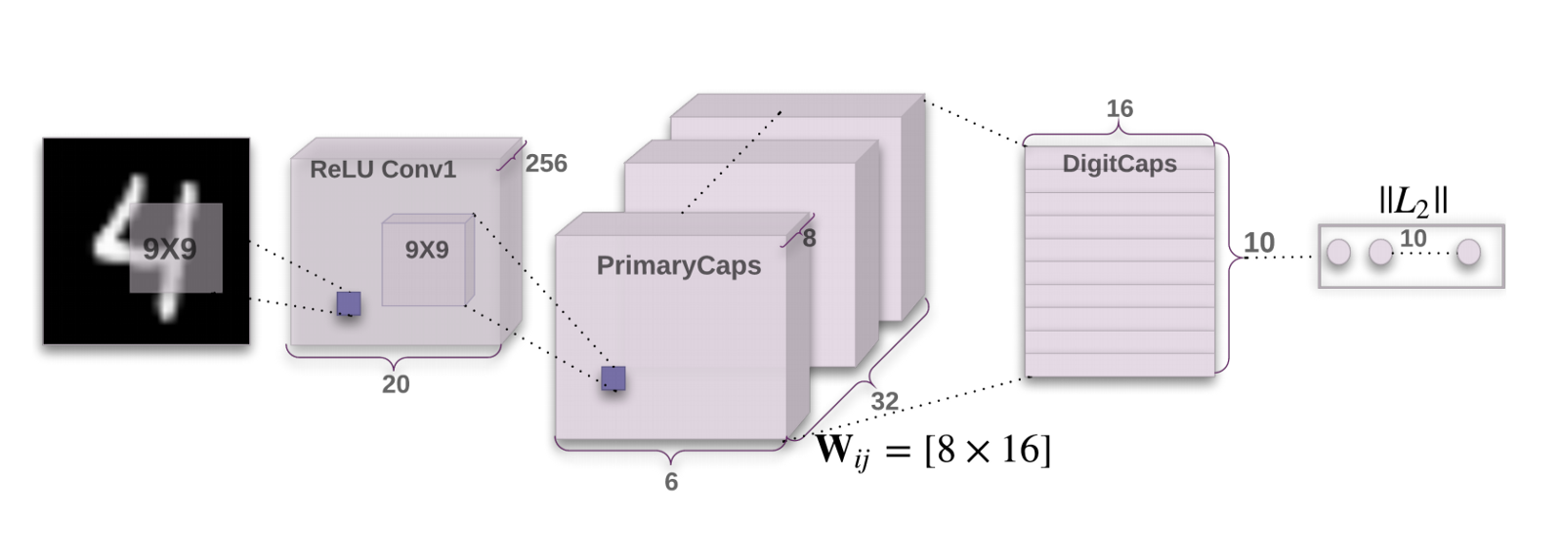




Exploring the Efficiency of Capsule Networks in GANs
Nitin Kishore Sai Samala, nsamala@cs.umass.edu
Sruthi Chilamakuri, schilamakuri@cs.umass.edu
CICS, University of Massachusetts Amherst
Motivation
Experimental Results
Capsule Networks outperform CNNs; Capsule GANs may produce better results than DCGANs
The loss function used in capsule networks is provided in Eq. 4.
Tk is an indicator variable which is equal to 1 if object of class k exists in the image and 0 otherwise. m+ and m- are hyperparameters and are set to 0.9 and 0.1 respectively.

