Slide 1
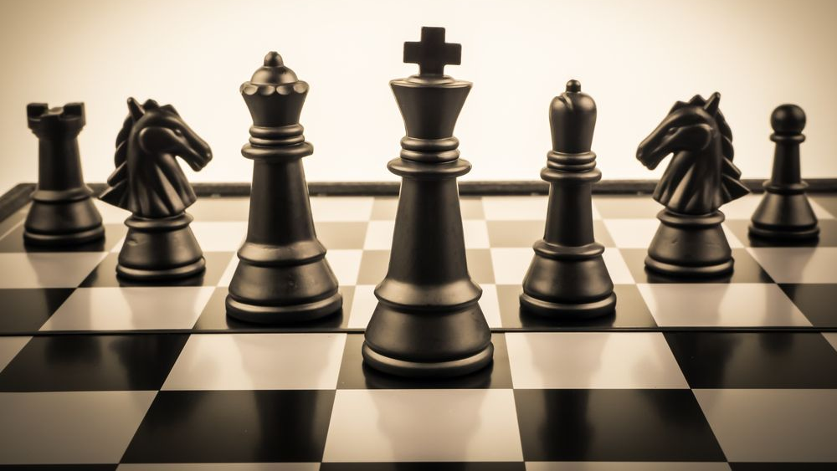
Chillin Programmers
Stoyan Kolev, Emil Ribarev, Georgi Georgiev, Ivelin Bachvarov, Alexander Dinev, Vasil Mladenov, Kalin Chervenkov

Slide 2
Team members
Stoyan Kolev
Emil Ribarev
Alexander Dinev
Georgi Georgiev
Ivelin Bachvarov
Kalin Chervenkov
Vasil Mladenov

Slide 3

Idea of the project
We wanted to create a chess game. It purpose is to introduce people to the basic rules of this great game.

Slide 4
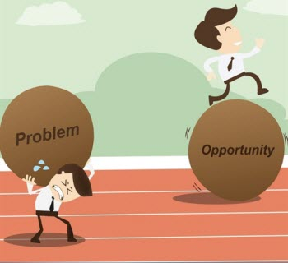
Problems with the project
We didn't face that much problems. Only that we had to think about the algorithm of the game.

Slide 5
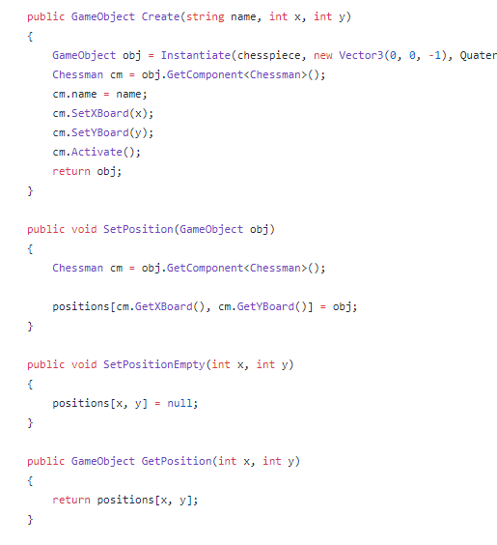
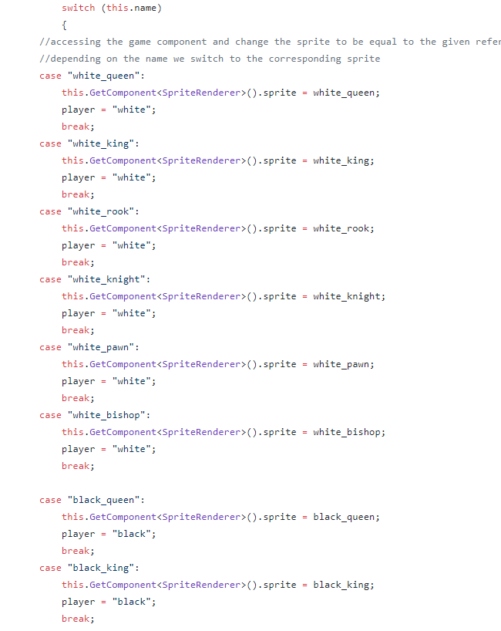
Part of the code

Slide 6






Used technologies

Slide 7

Advantages and disadvantages of the Game

Slide 8

Future ideas

Slide 9

Thank you for your attention!

