Slide 1



TeamsOnBudget
School Management System

Slide 2
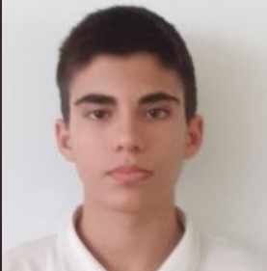
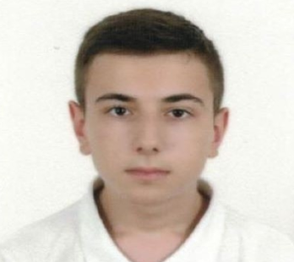
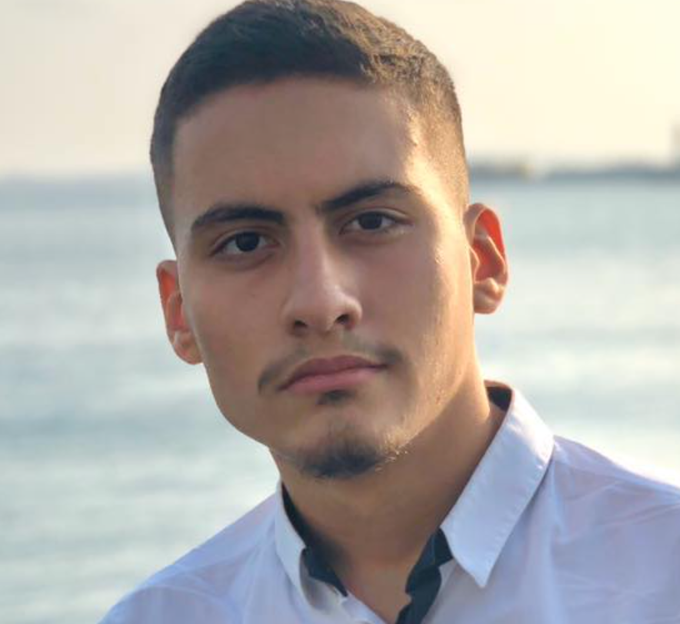
Project Participants
Name: Stoyan Kolev
Name: Alexander Dinev
Email: SNKolev18@codingburgas.bg
Email: AGDinev18@codingburgas.bg
QA & Scrum Master
Backend Developer
Name: Atanas Burmov
Email: AABurmov18@codingburgas.bg
Frontend Developer

Slide 3
Project Idea
TeamsOnBudget
School Management System

Slide 4







Softwares&Coding

Slide 5

Future Ideas

Slide 6
Thank you for your attention!

