Slide 1

UE19CS204 – Web Technologies Mini Project
Project Title – My trips & Travels
Section - F
Samriddhi Sharma- PES2UG19CS358
Sonit Kumar Pradhan- PES2UG19CS399
S Sneha- PES2UG19CS344
GITHUB Link - https://github.com/snkprdhn/MernStack

Slide 2
Abstract
Motivation:
Most people find it harrowing to plan multiple future trips, usually noting down their thoughts and things to be done here and there which often gets lost.
People who like to travel, also like to keep a log of the places they’ve visited, restaurants they liked and tourist spots they’d like to visit again.
Instead of writing these fleeting thoughts on bits and pieces of paper, users will find it much easier to organize their thoughts using Mytrips & Travels.
A “diary” of previous trips that includes the description and of the places visited by the users.
The user could jot down their experience and any details that they especially liked or disliked, Places they’d like to revisit etc.

Slide 3
The user could plan their future trips, add a description, or note down the places that they’d like to visit.
They could note down a few things to be done and edit them out once they’re done
Or If a future trip gets cancelled, one has the option to delete that log.

Slide 4
Technologies Used
MERN
MongoDB: A document-based open source database. MongoDB atlas used to host the database.
Express: A web application framework for Node.js.
React: A JavaScript front-end library for building user interfaces.
Node.js: JavaScript run-time environment that executes JavaScript code outside of a browser (such as a server).
Nodemon
Mongoose
Bootstrap
Date-picker(react- datepicker)
Axios

Slide 5
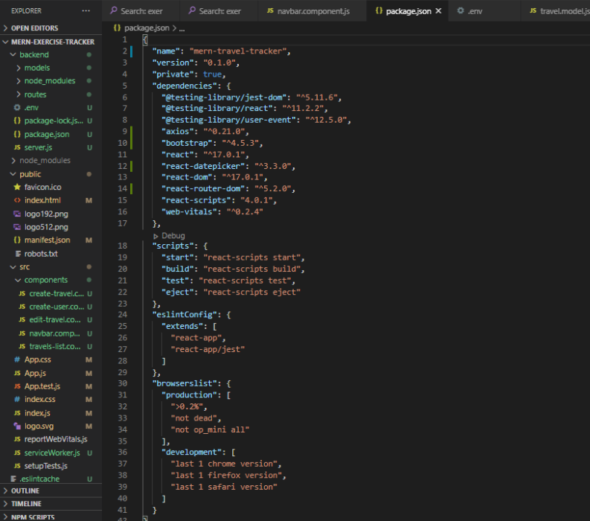

Slide 6
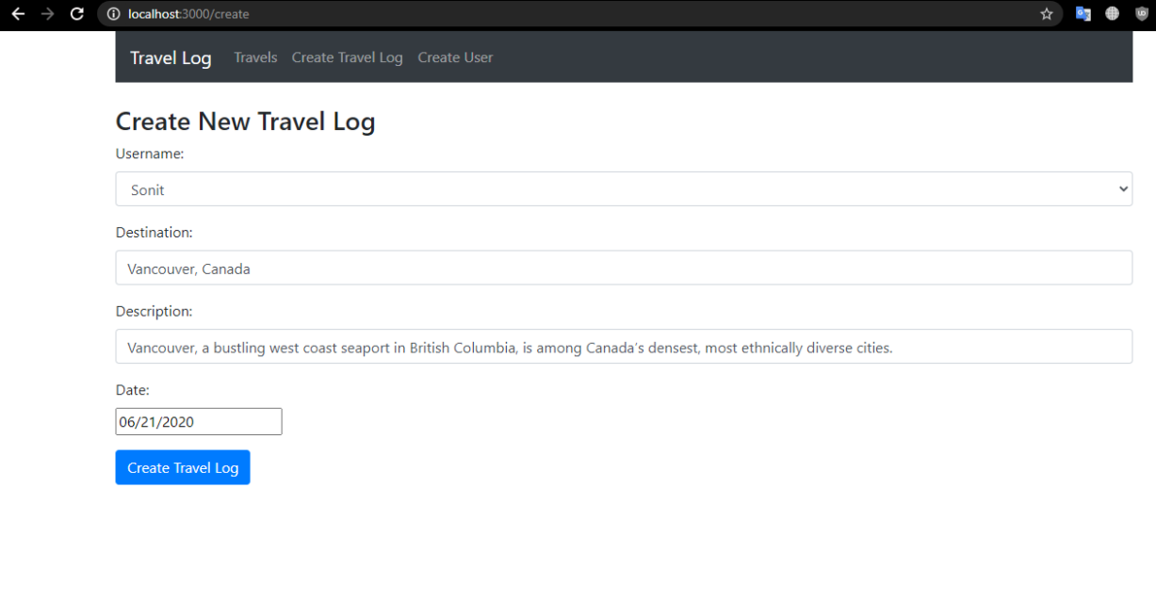

Slide 7
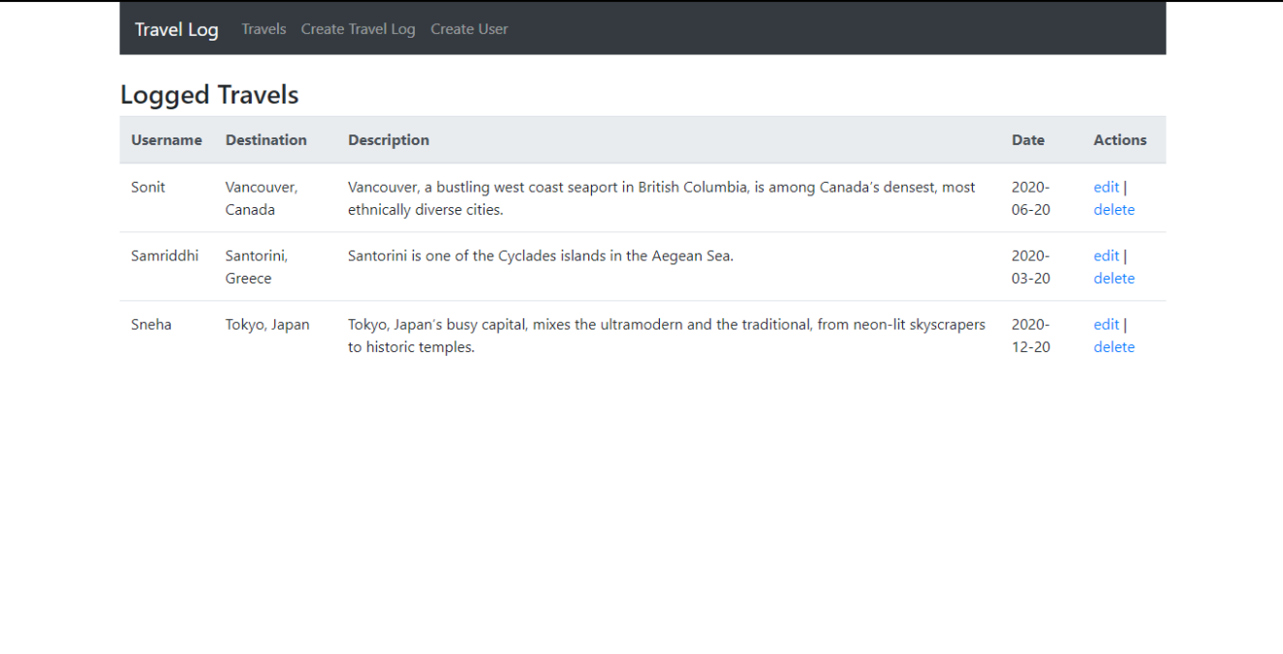

Slide 8
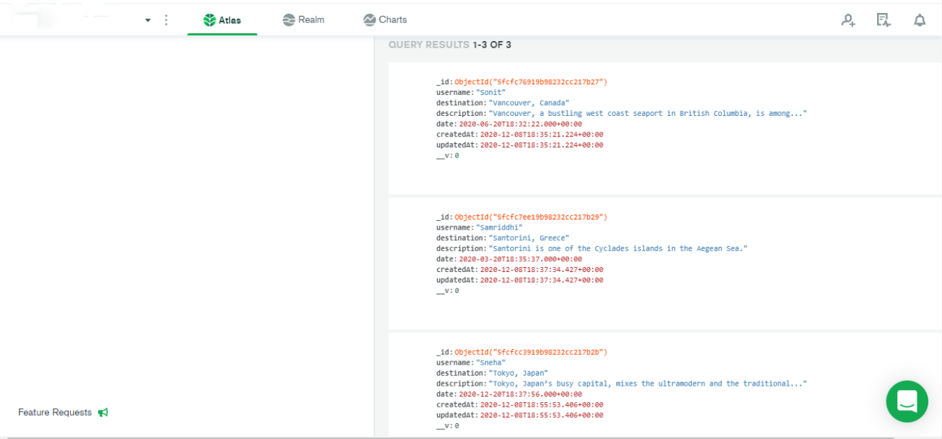

Slide 9
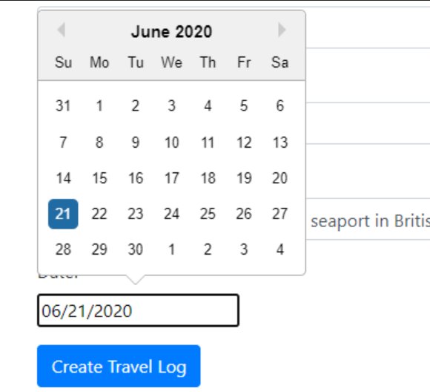
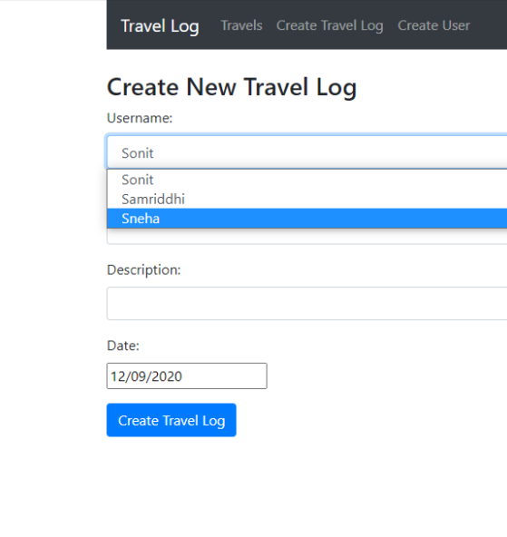

Slide 10
Member Contributions
Sonit Kumar Pradhan — CS399---Backend Development
Samriddhi Sharma—CS358---Frontend Development, ppt
S Sneha —CS344---Frontend

Slide 11


