Slide 1
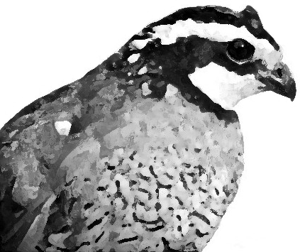
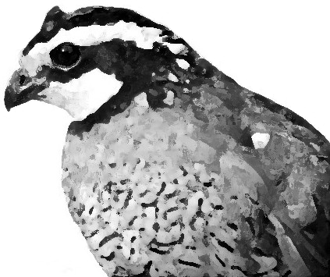
An Introduction to the COLIN Optimization Interface
William Hart
Discrete Algorithms and Math Dept
Sandia National Laboratories
wehart@sandia.gov

Slide 2
Motivation
Claim: we need a standard, modular interface for general-purpose optimizers
Optimization methods are widely applied in many disciplines
  Non-experts are often the biggest users!
Many different optimization codes have been developed
  There are many different optimization strategies
  Implementations of any one strategy reflect different design trade-offs
  User interfaces can be very different, even for the same of optimization strategy!
Most optimization solver experts are not user-interface experts ... so why should we expect their software to be generally easy to use by naive users?

Slide 3
Motivation (cont’d)
Idea: couple two (or more) optimizers together
Example: memetic evolutionary algorithms
  EA performs global search
  Local optimizer called to refine solutions
Note: we need a standard interface to initialize and launch the local optimizer!

Slide 4
Object-Oriented Design
Claim: Such a general interface should employ OO design principles
  Code modularity (encapsulation)
  Code reuse (sharing, inheritance)
Advantages of OO for optimization (Meza)
  Simpler user-interface
    Problem, Solver objects
  Better program interface for user
    E.g. reverse-communication violates standard coding practices
  Facilitate the development of new solvers
    Algorithmic components can be modularized
  Algorithmic components can be reused
    E.g. Line searches

Slide 5
Current OO Optimization Software
Many different OO optimization solvers have been implemented
  MOOCHO – reduced SQP
  TAO – large-scale quasi-Newton
  COOOL – general nonlinear optimization
  DAKOTA – design engineering toolkit
  SGOPT – stochastic global optimization
  PICO – parallel branch-and-bound
  GAlib – genetic algorithms
Problem: different software packages use different OO abstractions!
Example: representing arrays
stl::vector, BasicArray, DakotaArray, …

Slide 6
COLIN
Idea: provide a common interface for optimization libraries
  Easily extensible C++ components to wrap third-party solvers
  Facilitates plug-and-play of optimizers for hybrid methods
  Can specify real parameters for generic search domains
  Dynamic mapping between problem domains
Note: our goal is not to create the ‘best’ OO optimization class heirarchy … whatever that means

Slide 7
COLIN Major Classes
Generic optimization solver class
OptSolver
Generic optimization problem class
OptProblem
Internal class used to manage the interface to a user’s application code
OptApplication

Slide 8
A simple COLIN Example
// A test function
double func(vector<double>& point);
// Create and setup an optimization problem class
OptProblem<vector<double> > prob;
OptSetup(prob, func);
prob.set_parameter(“domain”, “[-1.0,1.0]^3”)
// Create and setup a sMC optimizer
sMC<vector<double> > opt;
opt.set_problem(prob);
opt.set_parameter(“max_neval”,100);
opt.reset();
// Perform minimization and print the best value
opt.minimize();
cout << opt.min_val() << endl;

Slide 9
Domain Mapping
Problem:
  A user defines an application with a specific domain type
  Different solver objects may use different domain types
  It is unreasonable to ask the user to adapt their application code for each solver
Solution:
  support a generic domain mapping functionality

Slide 10
Domain Mapping Example
// Mapping function
template<>
void map_domain(vector<double>& x, const array<double>& y)
{ for (int i=0; i<y.size(); i++) x[i] = y[i]; }
// Problem with domain vector<double>
OptProblem<vector<double> > prob;
// Solver with domain array<double>
sMC<array<double> > opt;
// Set a problem with a domain that is mapped by the
// map_domain() template function
opt.set_problem(prob);

Slide 11
Hybrid Solvers
Observations:
  Need a standard solver interface
  May require domain mapping both to and from the application domain type

Slide 12
Hybrid Solver Example
// Local solver with domain array<double>
PatternSearch<array<double> > local_opt;
// Main solver with domain vector<double>
sMC<vector<double> > opt;
// Setup the local optimizer
opt.set_solver(local_opt);
// Mapping functions
template<>
void map_domain(array<double>& x, const vector<double>& y)
{ for (int i=0; i<y.size(); i++) x[i] = y[i]; }
template<>
void map_domain(vector<double>& x, const array<double>& y)
{ for (int i=0; i<y.size(); i++) x[i] = y[i]; }

Slide 13
Domain Traits
Problem:
  A user may wish to optimize using an opaque data type
  A solver may not know whether this data type supports operations like differentiation
Solution:
  Templated domain traits

Slide 14
Domain Traits Example
// Definition of a generic class definition
class DomainClass { vector<double> x; vector<int> y; }
// Define domain traits for derivative information
template <>
bool OptDomainTraits<DomainClass>::derivative_flag=true;
// Define problem
double func(DomainClass& fn);
OptProblem<DomainClass> prob;
OptSetup(prob,func);
// Compute gradient information with this domain
DomainClass point;
vector<double> grad;
prob.EvalG(point,grad);

Slide 15
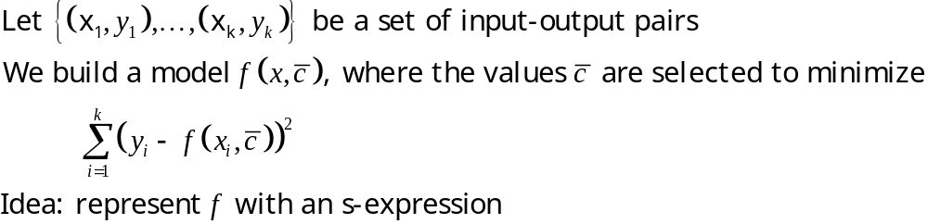
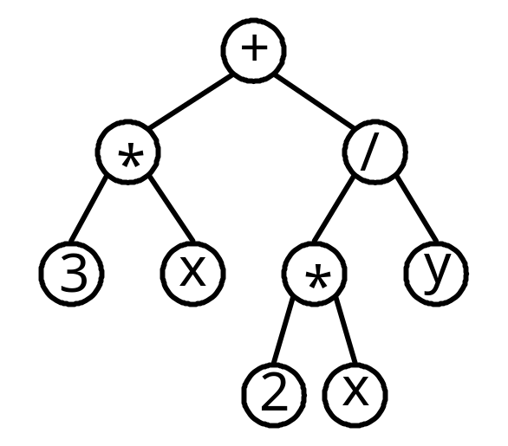
Application Example
Problem: nonlinear least squares using genetic programming

Slide 16

Application Example (cont’d)
Observation:
  Can decompose search into two parts
    Functional form
    Value of
  The functional form may be differentiable with respect to the c_{i}
Design of a hybrid evolutionary algorithm
  Standard genetic program to search for s-expressions
  Local search to optimize
COLIN Impact:
  Many different local search methods can be applied
  Domain mapping simplifies the application of local search

Slide 17
Coliny Library
Coliny: an optimization library of COLIN optimizers
  Integrates most SGOPT optimizers directly
  Wrappers for a growing number of third-party methods
SGOPT
DAKOTA
OPT++
AMPL
DOT
COLIN
Excel
APPS
NEOS
Cobyla

Slide 18
Coliny Impact
COLIN provides optimization middle-ware that eliminates the need for separate interfaces for each new optimization toolkit
SGOPT
DAKOTA
OPT++
AMPL
DOT
Excel
APPS
NEOS
Cobyla

Slide 19
Final Thoughts
COLIN has had significant impact on my optimization software development
  Mixed-domain hybrid optimization is easy
    Discrete-continuous modeling of docking
  Standard interfaces have made it easy for me to integrate Coliny solvers into other applications
    E.g. standard parameterization mechanism
  It doesn’t take too much effort to ‘Colinize’ a solver
    It has taken 200-600 lines of code
  COLIN provides support for implicit algorithmic parallelism
    E.g. this is exploited by Sandia’s DAKOTA toolkit

Slide 20
Availability
COLIN and Coliny are a packages in the Acro optimization repository
  software.sandia.gov/Acro

