Slide 1




DAKOTA + Application Parallelism
GOAL: Learn how to manage DAKOTA parallelism on clusters, with applications running in serial or parallel
Understand most common use cases for running DAKOTA (serial or parallel) with application (serial or parallel)
Review relevant approaches, input decks, and scripts
Challenges in “job tiling” on clusters and current status
Discuss potential improvements to job tiling by having DAKOTA manage resource lists, what else?
References: “Parallel Computing” in DAKOTA User’s Manual; Dakota/examples/parallelism/Case*
Sandia is a multiprogram laboratory operated by Sandia Corporation, a Lockheed Martin Company,
for the United States Department of Energy’s National Nuclear Security Administration
under contract DE-AC04-94AL85000.

Slide 2
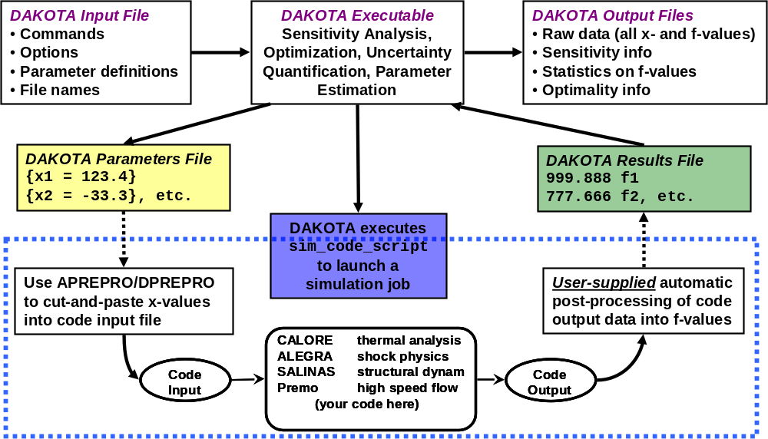
Parallelism Discussion Scope
Principally discuss DAKOTA and evaluation level parallelism (algorithmic coarse-grained parallelism) from a practical perspective to better help users
Assume an external
application driven
via fork interface
and a driver script:
Want to launch
application evals
in batches until
all jobs complete
Not intended as a discussion of all of DAKOTA’s parallel partitioning capability (concurrent iterators, analyses); also won’t address edge cases like Redstorm

Slide 3
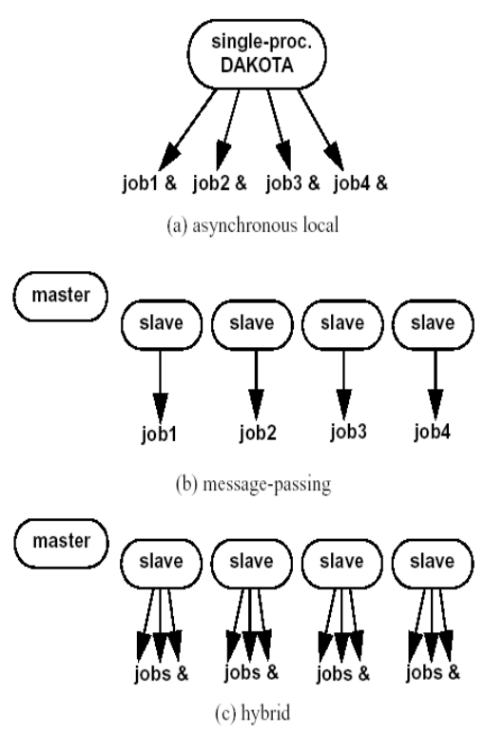
MPI vs. Local Parallelism
How/Where Evaluation Script is Called
Extremely common source of user confusion: difference between running DAKOTA with MPI and performing asynchronous local evaluations
DAKOTA run in serial
asynchronous
evaluation_concurrency = 4
DAKOTA run in parallel
mpirun –np 4 dakota foo.i
(no asynchronous)
Hybrid: DAKOTA run in parallel
mpirun –np 4 dakota foo.i
asynchronous
evaluation_concurrency = 3
Enhancement: manage workdirs and nodefiles for users
arrow denotes forking user’s evaluation script to run the application (potentially in serial or parallel)

Slide 4
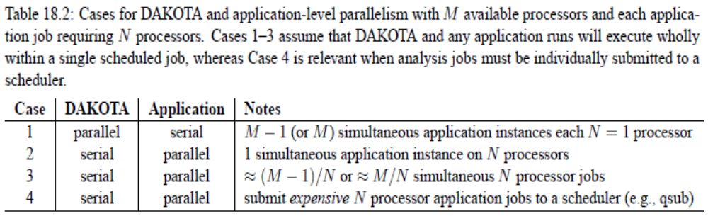
User’s Manual:
Application Parallelism Use Cases
Perhaps surprising: cases 1 and 4 are the predominant modes utilized (however 4 can break down for optimization)
Case 3: simultaneous parallel application evaluations within allocation; multiple scenarios available (depending on MPI for app) and increasingly in demand (will discuss last)

Slide 5
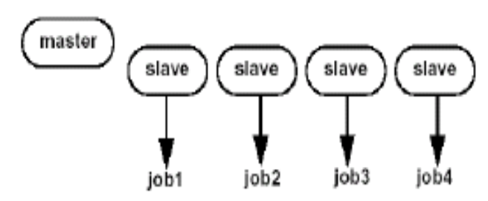
Case 1: DAKOTA Parallel,
M Simultaneous Serial App Runs
How would you specify the start of the DAKOTA job?
  mpiexec –n 4 dakota foo.in
How would you specify evaluation concurrency?
(see Case 1 files: none specified)
Given a cluster with 6 nodes and 4 processors per node, how would you run 1 DAKOTA instance per node, each launching 4 serial application runs?
  mpiexec –n 6 –pernode dakota foo.in
  evaluation_concurrency = 4
Potential gotchas (modules, application must truly be serial (not call MPI_Init), user confusion over dedicated master vs. static scheduling w/ M-1 or M jobs, respectively): cannot use a code compiled with MPI as will likely conflict with resources dedicated to DAKOTA

Slide 6
Case 4: DAKOTA Serial,
Submit N Processor Jobs to Queue
Idea: run DAKOTA on a login node (fork essential) and in the analysis driver, include a call to qsub to run a parallel analysis on N processors
How would you execute DAKOTA? In serial on a login node, create and execute a qsub script in the analysis_drver
For non-feedback algorithms (e.g., LHS), how would you manage evaluation concurrency and waiting on completed evaluations? Return a dummy results.out to dakota.
For feedback algorithms (e.g., optimization)? (see FM.bat)
Probably wait with a sleep/check loop until job completes
Gotchas (queuing time, interactive session unavailable)

Slide 7
Case 2: DAKOTA Serial,
Single N Processor Job at a Time
Request N processors from the resource manager
DAKOTA runs in serial, want to launch one application evaluation at a time using all N available processors
How do we launch the application for each evaluation?
mpiexec –n N a.out
Possible issue: application needs to be run with correct modules (compilers, MPI) loaded and they are different from DAKOTA; how to resolve?
# put in the driver script:
# (source not needed on TLCCs)
source /opt/modules/default/init/bash # (or csh, etc.)
module switch mpi mpi/mvapich-0.9.8_ofed_intel-10.1-f015-c015

Slide 8
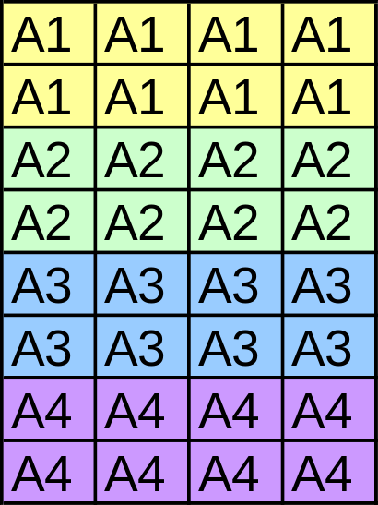
Case 3: DAKOTA Serial,
Tile N Processor Jobs
Given an allocation of M = S*N processors, schedule S simultaneous jobs
Example: 32 reserved processors, S=4 simultaneous N=8 processor application runs
When an application run completes, need to schedule another job on the freed block of processors (avoid oversubscribing any CPU)
Three approaches: OpenMPI or SLURM relative node, Wyckoff’s (OSC) mpiexec –server (for M*PICH), management of machine files
Many possible workarounds for special cases, e.g., TLCC 16ppn, can easily schedule 4, 8, or 16 CPU application runs and tie to specific nodes

Slide 9
Case 3 Common Characteristics
Example: 32 reserved processors, S=4 simultaneous N=8 processor application runs
Ignore implementation details for now
How would you achieve this in terms of:
  running dakota?
  (serial) dakota foo.in
  recall: running DAKOTA in parallel and forking a parallel application is unsupported!
  asynchronous evaluation_concurrency?
  = 4
  launching application?
  mpiexec –n 8 a.out (with details ahead)

Slide 10
Case 3 Mechanics:
OpenMPI or SLURM relative node-based
In DAKOTA, specify local_evaluation_static_scheduling with asynchronous evaluation_concurrency = 4 as before (guarantees completed evaluation will be replaced with one congruent modulo the eval concurrency)
In the driver script, perform integer arithmetic to launch the job on the right relative starting node. For example, want job 3 to start on processor 17 and run on 17—24. When job 3 completes want job 7 to replace and run on the same processors.
Works with OpenMPI 1.3.3 or newer, or SLURM srun.

Slide 11
Case 3 Mechanics:
OSC mpiexec/M*PICH
mpiexec –server (daemon) mode added 6 years ago under SNL contract to Wyckoff (v0.80 or newer)
Only works with MPICH, MVAPICH (not OpenMPI)
Execution flow:
  Start and background an mpiexec daemon
  mpiexec –server &
  which will serve sets of processors to requestors
  Start DAKOTA in serial with appropriate concurrency
  In the analysis script, run the application with
  mpiexec –n 8 a.out
  which will contact the daemon for an allocation of resources on which to run and return them when the application exits
Similar behavior should be possible with srun (SLURM) for M*PICH applications and orted for OpenMPI v1.3 or greater (mostly untested or unfruitful so far)

Slide 12
Case 3 Mechanics: Machine File Management-based
When job starts, parse available resource list (e.g., $SLURM_NODELIST or $PBS_NODEFILE) into a single list
Divide the resources into S files (applicNodeFile.*), each containing N resources
For each evaluation, lock a nodefile, run the application using the nodefile, free the nodefile
Many variations possible, including specializations where the application size N either divides the number of processors per node or is a multiple of
Only works when machinefiles are respected, e.g., OpenMPI < 1.3 with tight torque integration ignores machinefiles.

Slide 13
Status of Case 3 Job Tiling
(on SNL Clusters)
 | Application uses MPICH or MVAPICH | Application uses OpenMPI
NWCC, TBIRD | Before DAKOTA mpiexec –server & coupled with driver mpiexec –n 8 a.out | No known solution (due to tight integration of OpenMPI and torque); unless application uses OpenMPI 1.3 or newer
TLCC | srun -n 8 --nodelist=./machines a.out (relative node is also known to work) SLURM supports mpiexec –server like behavior, but untested | mpiexec –n 8 +$RELNODE OR mpiexec -n 8 –machinefile ./machines (OpenMPI 1.3 or newer)
RedSky | ??? | ???

Slide 14
Development Plans
Provide more example scripts. Consider framework script, where the user just provides their script to be called from the DAKOTA script?
DAKOTA 5.0 includes capability for creating working directories automatically from template directories, but not managing parallel scheduling.
Manage machine files for users in tiling case (or make certain mpiexec, srun, or orted approaches will work on all clusters of interest).
Document how to do application tiling on each cluster.
Other suggestions/issues?

