Slide 1
Dynamic and Self-Optimizing Control Plane for Software Defined Coalitions
Y. Richard Yang
DAIS ITA Kickoff Meeting
Cardiff, U.K.
Dec. 5, 2016

Slide 2


Big Picture
Control Plane
Control Plane
Resource Plane (Compute, Network and Storage Resources)
Resource Plane (Compute, Network and Storage Resources)
Substantial challenges
Dynamism => dynamic resource plane, dynamic control plane
Coalition (interdomain) => balance between security and collaboration
Multi-resources (SDN -> SDC) => integrated resource control
Software-defined (SD) => Substantial programmability
Each challenge also provides opportunities
Dynamism => controlled dynamicity; Coalition => more shared resources
Multi-resources => trade scarcity w/ abundance; SD => higher agility/efficiency

Slide 3
Key Architecture Element: Self-Optimizing Dynamicity
Fundamental principles:
Fundamental tradeoff among key metrics (e.g., CAP Theorem); Capacity Requirements of Control-Resource Channel, …
Understand
Cope
Use
Self-optimizing adaptation:
Robust control architecture (opportunistic central control, integrated dedicated CR channel and fate-sharing in-band resource channel, …)
Systematic exploration of controlled dynamicity:
Controlled placement of controllers
Controlled placement of assets to enhance the controller-resource channel
Controlled mobility to enhance capacity of the resource plane
Controlled mobile data
Controlled mobile code (network forwarding elem., NVF, analytics)

Slide 4
Key Architecture Element: Infrastructure w/ Coalition
Fundamental principles, e.g.,
Fundamental limits on aggregation of local-interests and global coordination (e.g., Arrow’s Impossibility Theorem);
Basic results, in specific settings, to guarantee collaboration stability (e.g., P-graph in interdomain routing)
Understand
Design
Basic infrastructure building blocks:
Organization mechanism, e.g.,
trusted clearing house (e.g., SD exchange), peer-to-peer, hierarchical
Information exchanged, e.g.,
raw state such as topo, computed state such as path vector
query/response vs pub vs pub/sub
Hosting infrastructure, e.g.,
information flow control, secure multi-party computation

Slide 5
From Concepts to Realization
Develop programming abstractions and tools to realize SDC control
E.g., programming language based SDC control programming
Control
Programming
Pre-deployment Verification
Monitoring
Develop fundamental tools to verify/analyze design before SDC actual deployment effects
Develop built-in tools to monitor system operations

Slide 6
SDC Programming Abstraction as Integrator
Programming Abstractions & Tools
Fundamental Principles
Mission Scenario
Integration of theory and practice
Integration of human intelligence and machine intelligence
SDC Operation

Slide 7
SDC Programming Focus Areas
Programming model at controller
Programming model for coordination
Control Plane
Control Plane
Programming model at individual resource node
s
f(s)
Current state s’
Aggregation Control
Local Control
Global Control
Resource Plane
Network Resource CtrlModel
Compute Resource CtrlModel
Storage Resource CtrlModel
Mobility Resource CtrlModel
Resource Plane

Slide 8
(Near-Term) SDC Programming Abstraction Components
Coalition State Abstraction (Q5; P5 declr request)
Autonomy Maximization SDC Program Generation
Controller Autoscaling (Q5)
From Low-Level Datapath-Aware Programming to High-Level Datapath Agnostic Programming (Q2: L2-L7 ODL project; Q3: SDR+P4; other L8/transformation later)
Data-Change-Centric Programming to Data Dynamicity-Agnostic Programming (Q1—ODL project; P2)
Fault-Tolerant Fragmentation-Aware Data Store
Notes:
1. Remove programming complexity; 2. More options for system to hide dynamicity (maintain a view). 3. Better failure recovery.

Slide 9
Backup: Details

Slide 10
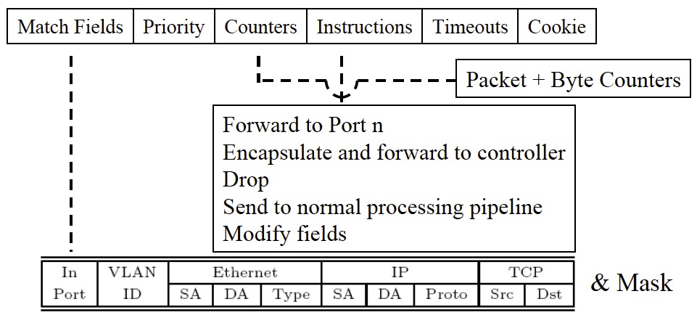

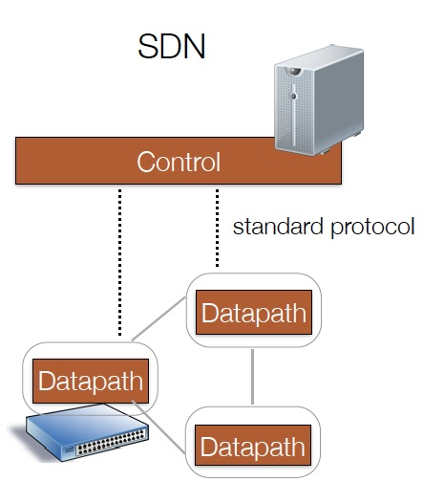
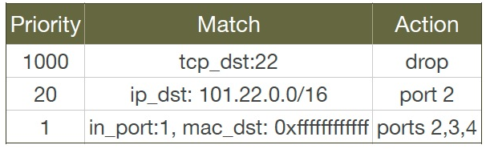
Example: Network Resource Control
How to program?
Low-level TCAM based match-action computing model with limited resources
Notes:
Route onPacket( pkt )

Slide 11


Example Policy
badPort = 22 // policy hostTbl = {A:1,B:2, C:3,D:4} // net view
def onPacket(p):
if badPort == p.tcp_dst: drop
else: forward([hostTbl(p.eth_dst)])
1
2
3
4
A
B
C
D
Assume only packets to A,B,C,D can appear.

Slide 12
All Manual (Human-Intelligence) Control Programming
hostTbl = {A:1,B:2,C:3,D:4}
def onPacket(p):
if 22 == p.tcp_dst: // drop
installNetRule({‘match':{'tcp_dst':22}, ‘action’:[]})
else: // forward([hostTbl(p.eth_dst)])
installNetRule({‘match’: {‘eth_dst’:p.eth_dst, ’tcp_dst’!=22},
‘action’:[hostTbl(p.eth_dst)]})
match does not support logic negation

Slide 13
All Manual (Human-Intelligence) Control Programming
hostTbl = {A:1,B:2,C:3,D:4}
def onPacket(p):
if 22 == p.tcp_dst: // drop
installRule({‘priority’:1, ‘match’:{'tcp_dst':22}, ‘action’:[]})
else: // forward([hostTbl(p.eth_dst)])
installRule({‘priority’:0, ‘match’: {‘eth_dst’:p.eth_dst},
‘action’:[hostTbl(p.eth_dst)]})

Slide 14
Does the Inserted Code Work?
Switch
EthDst:A,
TcpDst:80
{`priority`:0,’match’:{‘eth_dst’:A},'action':[1]}
EthDst:A,
TcpDst:22
A security bug!
Controller
def onPacketIn(p):
if 22 == p.tcp_dst: drop
installRule({`priority`:1,’match’:{‘tcp_dst':22},'action':[]})
else:
installRule({`priority`:0,’match’:{‘eth_dst’:p.eth_dst},
'action':[hostTbl(p.eth_dst)]})
forward([hostTbl(p.eth_dst)])
Notes:
Unfortunately, this program has a bug. To see where the program goes wrong, let’s watch what happens when we connect this controller to a single switch and let two packets arrive. Both packets have destination mac A. The red packet is to TCP destination 80, while the green packet is to TCP destination 22. When the red packet arrives, the switch has an empty flow table and sends the packet to the controller. The controller determines that the packet should be forwarded to the next hop, and installs the appropriate rule. The red packet returns to the switch and moves onward. Now, the port 22 packet arrives at the switch, and instead of being dropped or sent to the controller, it matches the low priority rule for Ethernet destination A and is therefore forwarded onward. This violates the user’s intentions and may represent a security violation.

Slide 15
High-Level SDC Control Programming Abstraction: Initial Design (SDN)
Consider each pkt as a request
- Network as a single virtual server
- Network functions expressed in general purpose language
- Network functions (logically) invoked on each new pkt, returning how network handles that request
- Realization of return is opaque, computed by system

Slide 16
SDC Control Programming: Example
Per-packet programming model
Standard+Custom protocols
void f(Packet p) {
if ( !permit(p) ) p.route = null;
else {
EndpointProp sedp = hostTable(p.ip.ipSrc());
EndpointProp dedp = hostTable(p.ip.ipDst());
int rate = p.te.vRate(); // custom protocol
QoSRoute qr = routingAlg(sedp, dedp, rate);
p.route = qr.route; p.vrate = qr.rate;
}
}
QoSRoute routingAlg(EndpointProp s, EndpointProp d, int r) {
if ( allowedRate(s, d) < r ) // authorization
r = allowedRate(s, d);
return QoSRouting(s, d, r);
}
Meta header to control cross layers
Unspecified realization: Source-routing, compile, or on-demand at switches

Slide 17

How to Derive Code from a High-Level Description?
A library-wrapper approach: Only requirement is onPacket uses a simple library to access pkt attributes:
Library provides both convenience and more importantly, decision dependency!
Notes:
On the other hand implementing algorithmic policies is challenging.
We know that naive solutions -- process every packet at controller or use only exact match rules -- perform poorly.
Static analysis to determine layout of flow tables is possible, but has drawbacks; in particular static analysis of general purpose language programs is typically conservative. Furthermore, relying on static analysis will cause the system to become substantially dependent on the source language in which we write algorithmic policies.

Slide 18
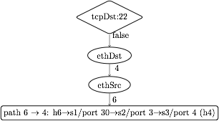


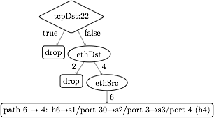
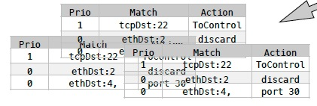
Dynamic Tracing: Abstraction to Flow Tables
1. Observes decision dependency of onPacket on pkt attributes.
2. Builds a trace tree (TT), a universal (general), partial decision tree representation of any onPacket.
3. Compile trace tree to generate flow tables (FTs).
Notes:
Instead, we introduce Maple, a system that implements algorithmic policies using a fully dynamic compilation method and which does not depend on the source language used to express the algorithmic policy.
Maple works by repeatedly executing the user’s algorithmic policy f on packets entering the network, generalizing the outcome to other packets by observing traces of data accesses made during the execution.
Maple then accumulates these traces into a trace tree, which is a partial decision tree of the input algorithmic policy, f.
Finally, Maple compiles flow tables (FTs) for all the switches in the network from the trace tree. The compilation is done so that packets for which Maple has not yet successfully inferred a forwarding decision are sent back to the controller to ensure that Maple continues to execute f and refine its trace tree.

Slide 19
Policy
EthSrc:1,
EthDst:2,
TcpDst:80
Route onPacket(Packet p) {
if (p.tcpDstIs(22))
return null();
else {
Location sloc =
hostTable(p.ethSrc());
Location dloc =
hostTable(p.ethDst());
Route path =
myRoutingAlg(
topology(),sloc,dloc);
return path;
}
}
Assert: TcpDst==22
false
Read: EthSrc
1
Read: EthDst
2
path1
Notes:
We use the example Java algorithmic policy to illustrate the tracing method. Suppose Maple executes the algorithmic policy on a packet with Ethernet source 1, Ethernet dest 2 and tcp destination 80. As the packet moves through the policy, Maple collects a trace of the execution.
When this packet arrives at the check on tcp destination, Maple records the assertion, and its outcome. In this case, the outcome is false. The program proceeds to the else branch, where it reads the source and destination addresses, both of which Maple logs. Finally, the program returns the computed path.

Slide 20
Policy
Trace Tree
EthDst:1,
TcpDst:22
Route onPacket(Packet p) {
if (p.tcpDstIs(22))
return null();
else {
Location sloc =
hostTable(p.ethSrc());
Location dloc =
hostTable(p.ethDst());
Route path =
myRoutingAlg(
topology(),sloc,dloc);
return path;
}
}
Assert: TcpDst==22
Assert: TcpDst==22
true
null
true
false
Read: EthSrc
?
1
Read: EthDst
2
path1
Notes:
Maple then uses this trace to begin generating the Trace Tree. In this case, Maple still doesn’t know what will happen if the assertion is true, and it therefore adds a placeholder under the true branch.
Now, if we execute f on a packet to tcp destination 22, the assertion is true, and the packet is dropped. Maple logs this new trace and uses it to refine its Trace Tree, filling in the true branch of the assertion.

Slide 21
Policy
Trace Tree
EthDst:1,
TcpDst:22
Route onPacket(Packet p) {
if (p.tcpDstIs(22))
return null();
else {
Location sloc =
hostTable(p.ethSrc());
Location dloc =
hostTable(p.ethDst());
Route path =
myRoutingAlg(
topology(),sloc,dloc);
return path;
}
}
Assert: TcpDst==22
Assert: TcpDst==22
true
null
true
false
Read: EthSrc
null
1
Read: EthDst
2
path1
Notes:
Maple then uses this trace to begin generating the Trace Tree. In this case, Maple still doesn’t know what will happen if the assertion is true, and it therefore adds a placeholder under the true branch.
Now, if we execute f on a packet to tcp destination 22, the assertion is true, and the packet is dropped. Maple logs this new trace and uses it to refine its Trace Tree, filling in the true branch of the assertion.

Slide 22
Trace Tree Formal Spec
Assert: TcpDst==22
A tree w/ 4 types of nodes
T node: assertion on packet attributes
V node: multi-way branching on a packet attribute
L node: leaf node labeled w/ action
? node: unknown
TT search: traverse tree for a given packet to determine action or no answer
TT correctness: if TT records an answer for a given packet, the answer is the same as the original algorithm
true
false
Read: EthSrc
?
1
Read: EthDst
2
path1

Slide 23
Trace Tree => Flow Table
tcpDst ==22
True
False
drop
ethDst
match:{tcpDst==22}
4
2
drop
ethSrc
match:{tcpDst!=22, ethDst:2}
6
port 30
match:{tcpDst!=22, ethDst:4,ethSrc:6}
Notes:
The basic compilation algorithm is actually very simple, and we explain it here in the context of an example trace tree. For simplicity the leaves are labeled with switch-specific actions, such as forward on some ports or drop.
The basic algorithm generates one rule for each execution of f, and each execution of f is stored as a path from the root of the trace tree to a leaf. For example, the right-most path in this tree resulted from an execution that observed that tcpDst!=22 and ethDst==4 and ethSrc==6.
The leaf stores the action and the match condition can be obtained from the path from the root to the leaf. In this case, we would want to match on tcpDst!=22, ethDst==4 and ethSrc==6. Of course, as we described earlier, we cannot match on tcpDst!=22, and so instead we will generate a rule at some higher priority that matches on the condition which we wish to negate. This rule, which we call a “barrier rule” ensures that the rule for the execution which we are considering only fires when the condition is false.
We observe that all the rules that require tcpDst!=22 are under the False branch of the assertion node and all the rules that require tcpDst==22 are under the True branch of the assertion node. Therefore, we can determine the priority level of the barrier rule by first generating rules and assigning priorities to the False branch of the node, and then assigning the priority of the barrier rule to have the next higher priority. Then we can assign priorities to the True branch. Hence, by generating rules in-order from False to True, we can correctly assign priorities to rules.
Finally, since the subtree under the True branch may not completely describe how to handle all tcpDst==22 packets, some packets with tcpDst==22 may fall through to the reach the barrier rule. Therefore, the action for the barrier rule must be ToController, so that we can continue to trace f correctly.

Slide 24
Trace Tree => Flow Table
tcpDst ==22
True
False
drop
ethDst
match:{tcpDst==22}
4
2
drop
ethSrc
match:{tcpDst!=22, ethDst:2}
6
port 30
barrier rule:
match:{tcpDst!=22, ethDst:4,ethSrc:6}
match:{tcpDst==22}
action:ToController
Priority

Slide 25
Trace Tree => Flow Table
One can use simple, classical in-order tree traversal to automatically generate (using machine intelligence) flow table rules!
tcpDst ==22
3
1
True
False
2
ethDst
drop
match:{tcpDst==22}
4
2
drop
ethSrc
match:{tcpDst!=22, ethDst:2}
6
port 30
barrier rule:
match:{tcpDst!=22, ethDst:4,ethSrc:6}
match:{tcpDst==22}
action:ToController
Priority

