Slide 1

FAST: Simplifying SDN Programming using a Data-Driven Function Store
Kai Gao, Chen Gu, Charlie Proctor, Qiao Xiang, Y. Richard Yang
Systems & Networking Lab (SNLab)

Slide 2
Let's write a simple OpenDaylight program!
// pseudo code
public void findPath(Ipv4Address src, Ipv4Address dst,
int requiredBw) {
srcNode, dstNode = mapToNode(src, dst);
topology = readTopology();
bw_src(x) = (x == srcNode ? +inf : 0); // array of bw
pq.add(srcNode);
while (!pq.isEmpty()) {
n = pq.pop();
if (bw_src(n) < requiredBw)
return failure
if (n == dstNode)
// construct the path by keep track of last-hops
return setupFlowRules(path);
for (e(n->m): n.neighbors) {
if (min(e.bw, bw_src(n)) > bw_src(m)) {
updateBw(m, min(e.bw, bw_src(n)));
if (!pq.contains(m))
pq.add(m);
last-hop(m) = n;
}
}
}
return failure
}
Look for a path that satisfies the band-width requirement with the maximumbandwidth
It seems to be correct
But it is NOT if there is dynamics!
Notes:
A real ODL code, show missing each part would cause disastrous result, but with FAST, all parts can be handled without users worrying about it.
F0: Shortest Path Routing implemented in ODL (Complex)
F1: Shortest Path Routing implemented in FAST (Simpler)

Slide 3
Identify data dependency
public void findPath(Ipv4Address src, Ipv4Address dst,
int requiredBw) {
srcNode, dstNode = mapToNode(src, dst);
topology = readTopology();
bw_src(x) = (x == srcNode ? +inf : 0);
pq.add(srcNode);
while (!pq.isEmpty()) {
n = pq.pop();
if (bw_src(n) < requiredBw)
return failure
if (n == dstNode)
return setupFlowRules(path);
for (e(n->m): n.neighbors) {
if (min(e.bw, bw_src(n)) > bw_src(m)) {
updateBw(m, min(e.bw, bw_src(n)));
...
}
}
}
return failure
}
RED: dependency
Functions
Parameters
Data read from the datastore, i.e., information source
BLUE: program output
Data written to the datastore, i.e., information sink

Slide 4
Handling data changes
public void findPath(Ipv4Address src, Ipv4Address dst,
int requiredBw) {
srcNode, dstNode = mapToNode(src, dst);
topology = readTopology();
bw_src(x) = (x == srcNode ? +inf : 0);
pq.add(srcNode);
while (!pq.isEmpty()) {
n = pq.pop();
if (bw_src(n) < requiredBw)
return failure
if (n == dstNode)
return setupFlowRules(path);
for (e(n->m): n.neighbors) {
if (min(e.bw, bw_src(n)) > bw_src(m)) {
updateBw(m, min(e.bw, bw_src(n)));
...
}
}
}
return failure
}
Register listeners for data changes
Seems not so hard
...
broker.registerDataChangeListener(..., parameters, listener, ...);
broker.registerDataChangeListener(..., nodeMap, listener, ...);
broker.registerDataChangeListener(..., topology, listener, ...);
...
public void onDataChanged(event) {
findPath(currentSrc, currentDst, currentRequiredBw);
// with current IP->AP mapping, current topology
// and current link bandwidth
}

Slide 5
Handling data changes
public void findPath(Ipv4Address src, Ipv4Address dst,
int requiredBw) {
srcNode, dstNode = mapToNode(src, dst);
topology = readTopology();
bw_src(x) = (x == srcNode ? +inf : 0);
pq.add(srcNode);
while (!pq.isEmpty()) {
n = pq.pop();
if (bw_src(n) < requiredBw)
return failure
if (n == dstNode)
return setupFlowRules(path);
for (e(n->m): n.neighbors) {
if (min(e.bw, bw_src(n)) > bw_src(m)) {
updateBw(m, min(e.bw, bw_src(n)));
...
}
}
}
return failure
}
Register listeners for data changes
Seems not so hard, REALLY?
Must clean up the side-effects
...
broker.registerDataChangeListener(..., parameters, listener, ...);
broker.registerDataChangeListener(..., nodeMap, listener, ...);
broker.registerDataChangeListener(..., topology, listener, ...);
...
public void onDataChanged(event) {
removeFlowRulesIfExists(oldPath);
findPath(currentSrc, currentDst, currentRequiredBw);
}

Slide 6
Now we want a little efficiency
public void findPath(Ipv4Address src, Ipv4Address dst,
int requiredBw) {
srcNode, dstNode = mapToNode(src, dst);
topology = readTopology();
bw_src(x) = (x == srcNode ? +inf : 0);
pq.add(srcNode);
while (!pq.isEmpty()) {
n = pq.pop();
if (bw_src(n) < requiredBw)
return failure
if (n == dstNode)
return setupFlowRules(path);
for (e(n->m): n.neighbors) {
if (min(e.bw, bw_src(n)) > bw_src(m)) {
updateBw(m, min(e.bw, bw_src(n)));
...
}
}
}
return failure
}
Register listeners for data changes
Clear the side-effects of the program
Monitor coarse-grained dependencies
False-positive
...
broker.registerDataChangeListener(..., parameters, listener, ...);
broker.registerDataChangeListener(..., nodeMap, listener, ...);
broker.registerDataChangeListener(..., topology, listener, SUBTREE);
...
public void onDataChanged(event) {
removeFlowRulesIfExists(oldPath);
findPath(currentSrc, currentDst, currentRequiredBw);
}

Slide 7
Now we want a little efficiency
public void findPath(Ipv4Address src, Ipv4Address dst,
int requiredBw) {
srcNode, dstNode = mapToNode(src, dst);
topology = readTopology();
bw_src(x) = (x == srcNode ? +inf : 0);
pq.add(srcNode);
while (!pq.isEmpty()) {
n = pq.pop();
if (bw_src(n) < requiredBw)
return failure
if (n == dstNode)
return setupFlowRules(path);
for (e(n->m): n.neighbors) {
if (min(e.bw, bw_src(n)) > bw_src(m)) {
updateBw(m, min(e.bw, bw_src(n)));
...
}
}
}
return failure
}
Register listeners for data changes
Clear the side-effects of the program
Filter out irrelevant data changes in the callback function
...
broker.registerDataChangeListener(..., parameters, listener, ...);
broker.registerDataChangeListener(..., nodeMap, listener, ...);
broker.registerDataChangeListener(..., topology, listener, SUBTREE);
...
public void onDataChanged(event) {
if (oldPath.isNotAffectedBy(event)) return;
removeFlowRulesIfExists(oldPath);
findPath(currentSrc, currentDst, currentRequiredBw);
}

Slide 8
Now we want a little more efficiency
public void findPath(Ipv4Address src, Ipv4Address dst,
int requiredBw) {
srcNode, dstNode = mapToNode(src, dst);
touch(binding(src)); touch(binding(dst));
topology = readTopology();
bw_src(x) = (x == srcNode ? +inf : 0);
pq.add(srcNode); touch(srcNode);
while (!pq.isEmpty()) {
n = pq.pop();
if (bw_src(n) < requiredBw)
return failure
if (n == dstNode)
return setupFlowRules(path);
for (e(n->m): n.neighbors) {
touch(e); touch(m);
if (min(e.bw, bw_src(n)) > bw_src(m)) {
updateBw(m, min(e.bw, bw_src(n)));
...
}
}
}
return failure
}
Register listeners for data changes
Clear the side-effects of the program
Filter irrelevant data change in the callback function
Monitor only relevant data changes
only the data that are “touched”
...
for (mapping in touched(nodeMap))
broker.registerDataChangeListener(..., mapping, listener, ...);
for (n in touched(nodes))
broker.registerDataChangeListener(..., n, listener, SUBTREE);
for (l in touched(links))
broker.registerDataChangeListener(..., l, listener, SUBTREE);
...
public void onDataChanged(event) {
if (oldPath.isNotAffectedBy(event)) return;
removeFlowRulesIfExists(oldPath);
findPath(currentSrc, currentDst, currentRequiredBw);
}

Slide 9
Now we want a little more efficiency
public void findPath(Ipv4Address src, Ipv4Address dst,
int requiredBw) {
srcNode, dstNode = mapToNode(src, dst);
touch(binding(src)); touch(binding(dst));
topology = readTopology();
bw_src(x) = (x == srcNode ? +inf : 0);
pq.add(srcNode);
touch(srcNode);
while (!pq.isEmpty()) {
n = pq.pop();
if (bw_src(n) < requiredBw)
return failure
if (n == dstNode)
return setupFlowRules(path);
for (e(n->m): n.neighbors) {
touch(e); touch(m); touch(e.bw);
if (min(e.bw, bw_src(n)) > bw_src(m)) {
updateBw(m, min(e.bw, bw_src(n)));
...
}
}
}
return failure
}
Register listeners for data changes
Clear the side-effects of the program
Filter irrelevant data change in the callback function
Monitor only relevant data changes
only the data that are touched
and only the "touched" attributes
...
for (n in touched(nodes))
broker.registerDataChangeListener(..., n, listener, BASE)
broker.registerDataChangeListener(..., n.neighbors, listener, ONE)
for (l in touched(links))
broker.registerDataChangeListener(..., l, listener, BASE);
broker.registerDataChangeListener(..., l.bw, listener, BASE);
...
public void onDataChanged(event) {
if (oldPath.isNotAffectedBy(event)) return;
removeFlowRulesIfExists(oldPath);
findPath(currentSrc, currentDst, currentRequiredBw);
}

Slide 10
We make the code correct, and COMPLEX
Question: can we write a correct ODL program that is also simple and efficient?

Slide 11
Can this program work?
public void findPath(Ipv4Address src, Ipv4Address dst,
int requiredBw) {
srcNode, dstNode = mapToNode(src, dst);
topology = readTopology();
bw_src(x) = (x == srcNode ? +inf : 0);
pq.add(srcNode);
while (!pq.isEmpty()) {
n = pq.pop();
if (bw_src(n) < requiredBw)
return failure
if (n == dstNode)
return setupFlowRules(path);
for (e(n->m): n.neighbors) {
if (min(e.bw, bw_src(n)) > bw_src(m)) {
updateBw(m, min(e.bw, bw_src(n)));
...
}
}
}
return failure
}
RED: the dependent data
Parameters
Data read from the datastore (or more generally, the information source)
BLUE: the output of the program
Data written to the datastore (or more generally, the information sink)

Slide 12
This is what we have
public void findPath(Ipv4Address src, Ipv4Address dst,
int requiredBw) {
srcNode, dstNode = mapToNode(src, dst);
touch(binding(src)); touch(binding(dst));
topology = readTopology();
bw_src(x) = (x == srcNode ? +inf : 0);
pq.add(srcNode);
touch(srcNode);
while (!pq.isEmpty()) {
n = pq.pop();
if (bw_src(n) < requiredBw)
return failure
if (n == dstNode)
return setupFlowRules(path);
for (e(n->m): n.neighbors) {
touch(e); touch(m); touch(e.bw);
if (min(e.bw, bw_src(n)) > bw_src(m)) {
updateBw(m, min(e.bw, bw_src(n)));
...
}
}
}
return failure
}
...
broker.registerDataChangeListener(..., parameters, listener, ...);
for (mapping in touched(nodeMap))
broker.registerDataChangeListener(..., mapping, listener, ...);
for (n in touched(nodes))
broker.registerDataChangeListener(..., n, listener, ONE);
for (l in touched(links))
broker.registerDataChangeListener(..., l, listener, ONE);
broker.registerDataChangeListener(..., l.bw, listener, BASE)
...
public void onDataChanged(event) {
if (oldPath.isNotAffectedBy(event)) return;
removeFlowRulesIfExists(oldPath);
findPath(currentSrc, currentDst, currentRequiredBw);
}

Slide 13
This is what we want
public void findPath(Ipv4Address src, Ipv4Address dst,
int requiredBw) {
srcNode, dstNode = mapToNode(src, dst);
touch(binding(src)); touch(binding(dst));
topology = readTopology();
bw_src(x) = (x == srcNode ? +inf : 0);
pq.add(srcNode);
touch(srcNode);
while (!pq.isEmpty()) {
n = pq.pop();
if (bw_src(n) < requiredBw)
return failure
if (n == dstNode)
return setupFlowRules(path);
for (e(n->m): n.neighbors) {
touch(e); touch(m); touch(e.bw);
if (min(e.bw, bw_src(n)) > bw_src(m)) {
updateBw(m, min(e.bw, bw_src(n)));
...
}
}
}
return failure
}
Motivation: can we automatically generate all the crossed code?
...
broker.registerDataChangeListener(..., parameters, listener, ...);
for (mapping in touched(nodeMap))
broker.registerDataChangeListener(..., mapping, listener, ...);
for (n in touched(nodes))
broker.registerDataChangeListener(..., n, listener, ONE);
for (l in touched(links))
broker.registerDataChangeListener(..., l, listener, ONE);
broker.registerDataChangeListener(..., l.bw, listener, BASE)
...
public void onDataChanged(event) {
if (oldPath.isNotAffectedBy(event)) return;
removeFlowRulesIfExists(oldPath);
findPath(currentSrc, currentDst, currentRequiredBw);
}

Slide 14
FAST to the rescue
Question: can we write a correct ODL program that is also simple and efficient?
Answer: YES, with FAST

Slide 15
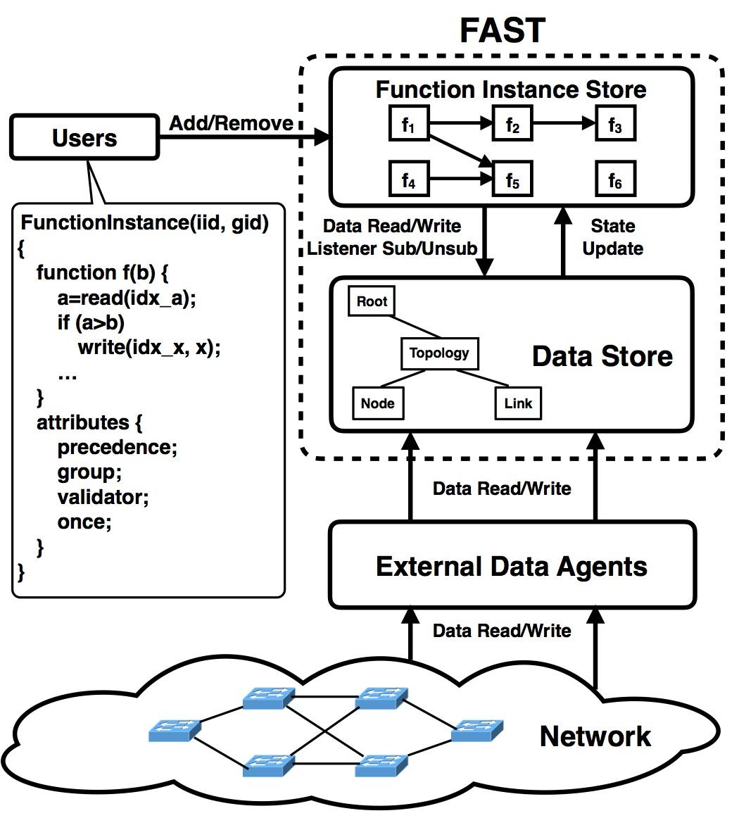
The FAST programming model
Users submit/delete instances at function instance store
Instances access ODL datastore through FAST API
Attributes to support modular programming and composition

Slide 16
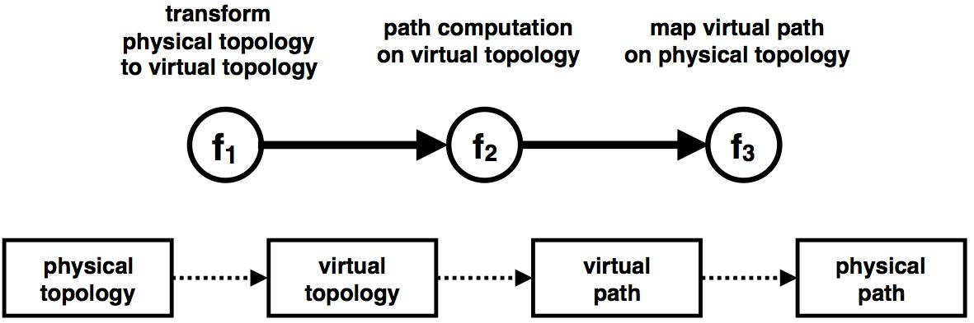
Precedence
Express data dependency between input/output of different function instances

Slide 17
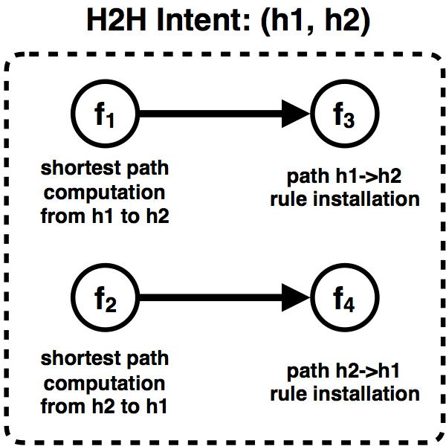
Group
Group as a datastore transaction

Slide 18
A Closer Look Under the Hood

Slide 19
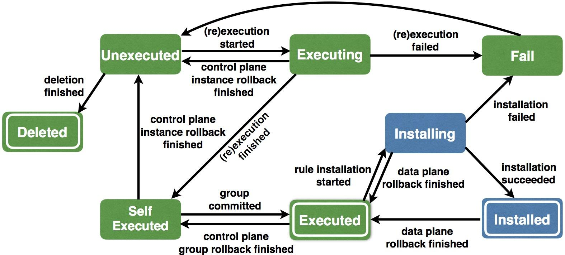
Instance finite state machine

Slide 20
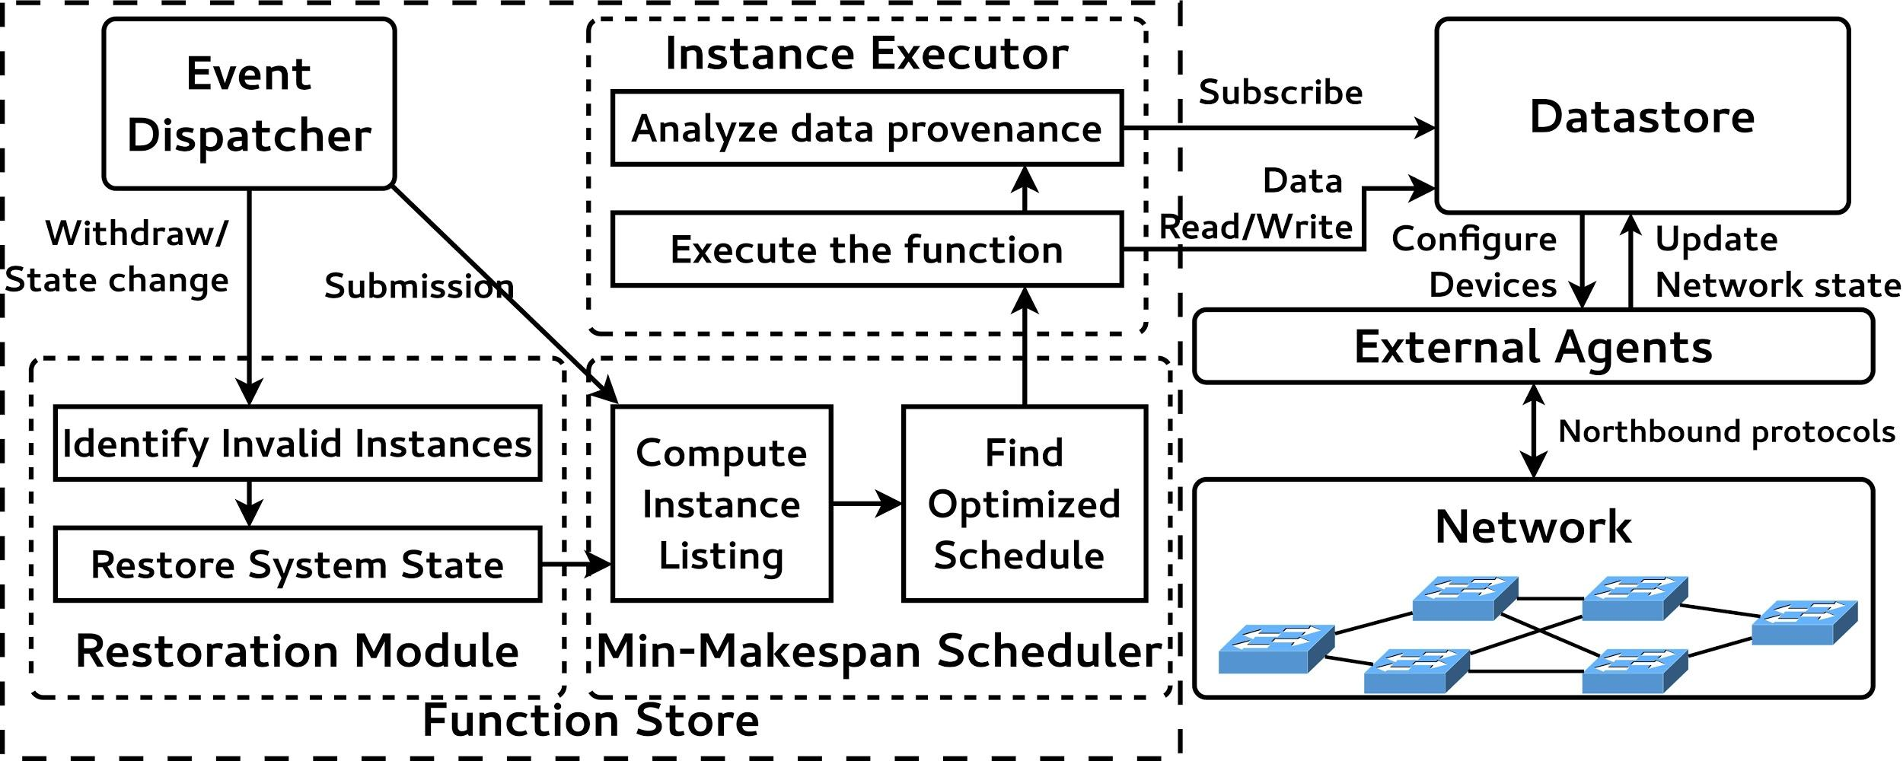
Components

Slide 21
public void findPath(Ipv4Address src, Ipv4Address dst,
int requiredBw) {
srcNode, dstNode = mapToNode(src, dst);
topology = readTopology();
bw_src(x) = (x == srcNode ? +inf : 0);
pq.add(srcNode);
while (!pq.isEmpty()) {
n = pq.pop();
if (bw_src(n) < requiredBw)
return failure
if (n == dstNode)
return setupFlowRules(path);
for (e(n->m): n.neighbors) {
if (min(e.bw, bw_src(n)) > bw_src(m)) {
updateBw(m, min(e.bw, bw_src(n)));
...
}
}
}
return failure
}
RED: the dependent data
Functions
Parameters
Data read from the datastore (or more general, the information source)
Automatically track the dependency
BLUE: the output of the program
Data written to the datastore (or more general, the information sink)
Automatically restore the state

Slide 22
Automatic dependency tracking
Requirements:
Capture all the data access
Learn the relationship between data and function instances
Challenges:
How to get fine-grained dependency tracking with ODL DataObject?
How to track primitive types
How good we can get regarding the fine-grained dependency tracking
Solutions:
Java proxy with BA/BI codec
Information flow/Taint analysis [work-in-progress]

Slide 23
Automatic restoration
Requirements:
Clear all side-effects of dirty function instances
Challenges:
How to identify all “dirty” function instances
How to restore to the correct state
Basic ideas:
Trace “dirty” function instances using data dependency graph
Keep records of ODL data tree modifications [work-in-progress]

Slide 24
Efficient Control-Data-Plane Co-Scheduling
Requirements:
Maintain the consistency between control plane and data plane
Reduce group commit conflicts
Minimize the schedule makespan
Challenges:
Stochastic instance execution time
Scheduling principles:
Execute instance that writes to data plane first [work-in-progress]
Execute instances in ongoing groups first

Slide 25
Faster, higher, stronger
Use cases
Conflict resolution framework
Data accountability
Debug an application on a running ODL
...
Solutions
Data access redirection with customized aggregator to resolve conflicts
Leverage the data dependency graph
Data access redirection and isolation

Slide 26
Develop FAST Apps
Option 1: Maven archetype
Option 2: A customized browser-based IDE
Tutorial
https://wiki.opendaylight.org/view/SDN_Programming_using_High_Level_Programming_Abstractions

Slide 27
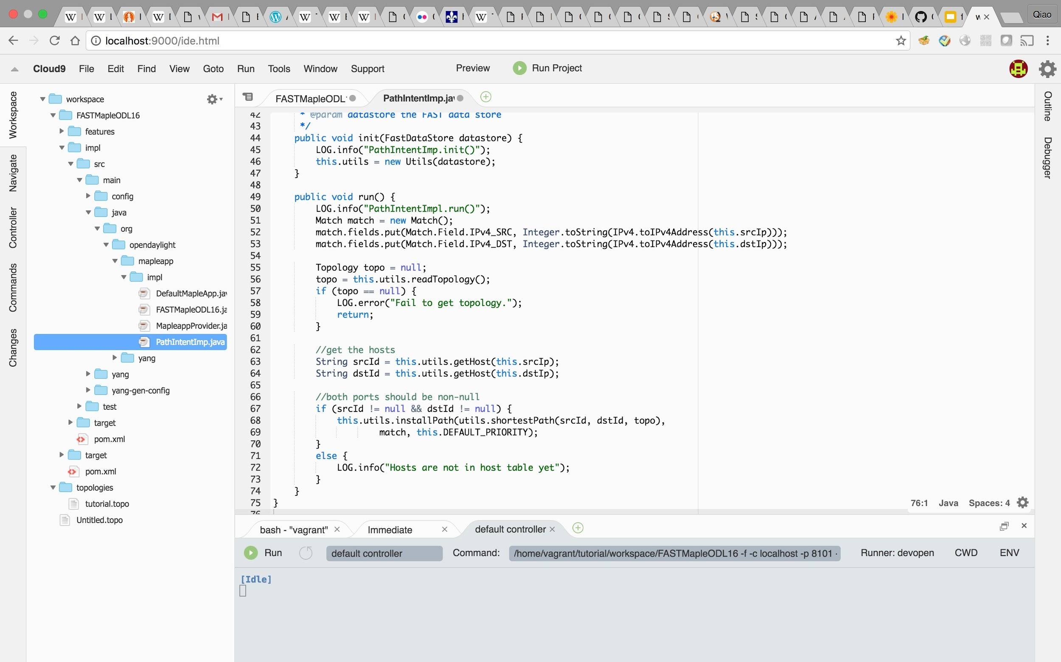
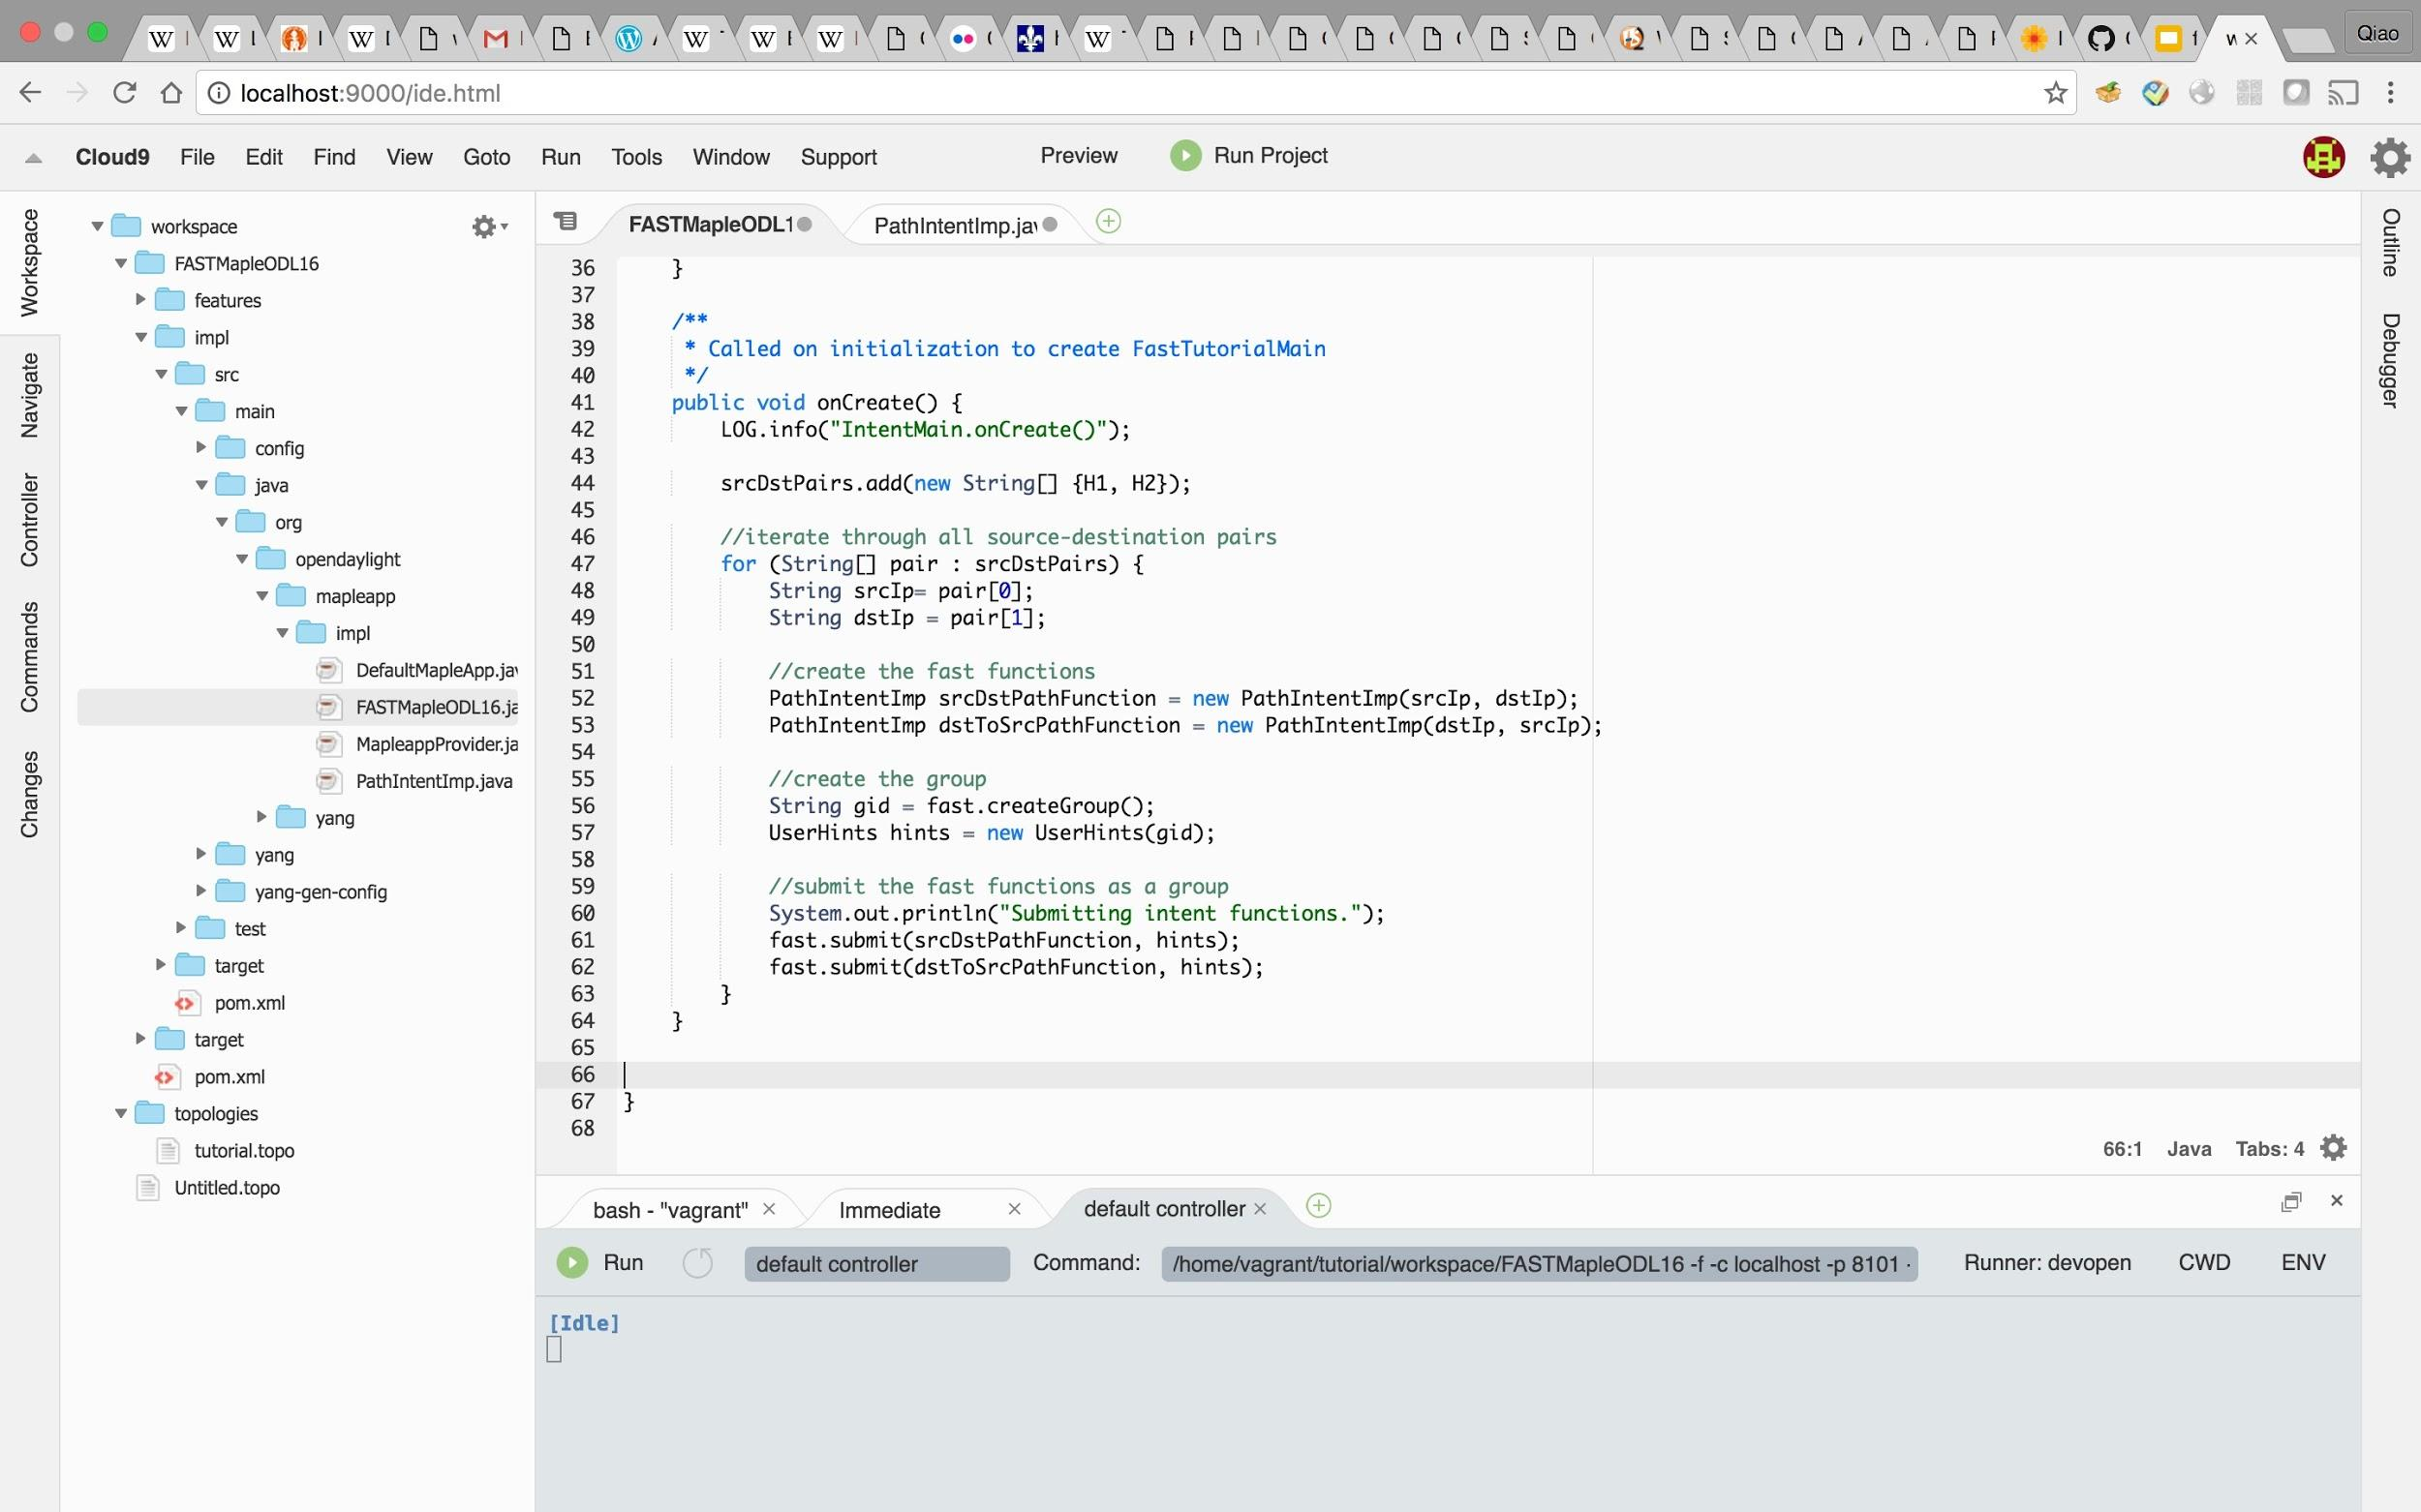
IDE for FAST-Maple Programming
Example: a simple Host2Host app

Slide 28
Demo: Host2Host App

Slide 29
THANK YOU
Q & A

