Slide 1

ExaO: Software Defined Data Distribution for Exascale Sciences
CERN,
California Institute of Technology,
Yale University

Slide 2
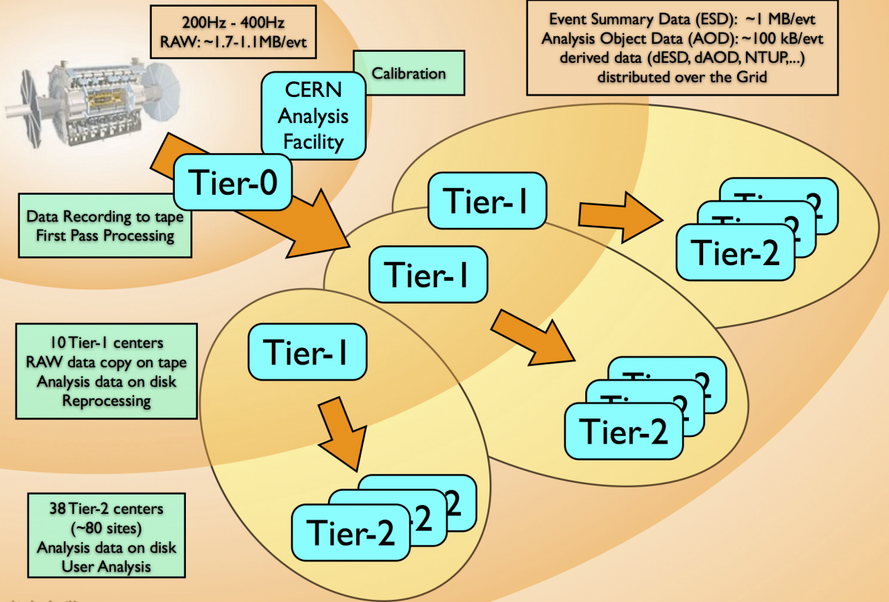
The Compact Muon Solenoid Computing Model
Large raw datasets are collected from LHC at the Tier-0 site.
RECO and AOD datasets are distributed to Tier-1 sites for secure storage.
RECO, AOD and simulation datasets are transferred among Tier-1, Tier-2 and Tier-3 sites for analysis.

Slide 3
PhEDEx: CMS Data Transfer Service
Automating data management and movement in CMS
Managing over 63 million files with an average of 2.6GB file size
over 160PB of data in total
Dataset consisting hundreds to thousands files
400-500 dataset transfer requests per day
Users submit dataset transfer requests through Web interface
Request pattern: one-to-one, one-to-many, many-to-one
Centralized system for making global data movement decisions based on history statistics

Slide 4
Limitation of PhEDEx
Built on top of traditional multi-domain networks
Inflexible infrastructures
Lack of real-time, global network view
Infeasible of end-to-end data flow orchestration
Inflexible, static dataset level scheduling
Traditional client/server mode to select source for all files at once
Complete ignorance of destination sites’ potential as file providers
No network resource allocation scheme
Performance
Low concurrency, low link utilization, long transfer delay

Slide 5
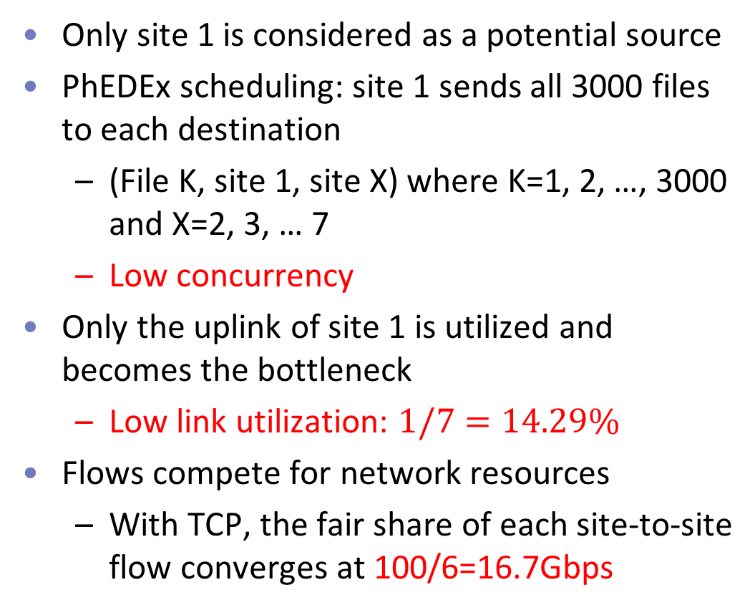
Example: Distributing Dataset X to All the Sites in PhEDEx
Dataset X (3000 50GB files)
Bottleneck
Only site 1 is considered as a potential source
PhEDEx scheduling: site 1 sends all 3000 files to each destination
(File K, site 1, site X) where K=1, 2, …, 3000 and X=2, 3, … 7
Low concurrency
Only the uplink of site 1 is utilized and becomes the bottleneck
Low link utilization: $1/7=14.29\%$
Flows compete for network resources
With TCP, the fair share of each site-to-site flow converges at 100/6=16.7Gbps
CMS Needs A More Efficient, Flexible Data Transfer Service
Notes:
Inflexible and static scheduling decision cause low link utility

Slide 6
Design Challenges for An Flexible, Efficient Data Transfer Service
Provision of a global, real-time, inter-domain network view
Flexible, dynamic scheduling with high transfer concurrency
Efficient orchestration among end-to-end data flows with high network resource utilization
Solution?
ExaO: A Software Defined Data Transfer Orchestrator

Slide 7
ExaO: Software Defined Data Transfer Orchestrator
PhEDEx
ExaO
No real-time, global network view
Application-Layer Traffic Optimization (ALTO)
Collect complete network state at different domains (OpenDaylight)
Compute real-time routing information at different domains (ALTO-SPCE)
Compute global, on-demand, minimal, equivalent abstract routing state (ATLO-RSA)
Dataset level scheduling
Destination sites cannot become candidate sources until receiving the whole dataset
Low concurrency
Scheduler
Centralized, dynamic, network-aware file level scheduling
Leverage destination sites as candidate sources after file reception
High concurrency
No network resource allocation scheme
Data flows compete for network resources
Low utilization
Scheduler and Transfer Execution Nodes (TEN)
Global, dynamic rate allocation among data flows (Scheduler)
End host rate limiting to enforce allocation (TEN)
Notes:
Minimally invasive change on end host groups
Real-time, dynamic resource allocation under the existence of other network traffic
Not CMS or HEP specific, hence support any data intensive sciences.
Dataset distribution to N destination:
Maximal link utilization in the testbed
N times faster than dataset level scheduling

Slide 8
Components of ExaO
RESTful-API
allow users submit and manage transfer request through different interface
ALTO
collect on-demand, real-time, minimal abstract routing information from different domains
ExaO Scheduler
centralized, efficient file-level scheduling and network resource allocation
FDT
efficient data transfer tools on end hosts
Monalisa
Distributed monitoring infrastructure for real time monitoring of each flow, transfer
Transfer Execution Nodes
enforce scheduling and rate allocation decisions at end hosts
enforce resource allocation in the network

Slide 9
ExaO Workflow
Users submit, track and manage dataset transfer requests
User Requests

Slide 10
ExaO Workflow
Users submit, track and manage dataset transfer requests
Scheduler queries NEW requests via ExaO RESTful interface
Scheduler queries ALTO controllers for routing state
User Requests
Routing Query
Routing Query
Routing Query

Slide 11
ExaO Workflow
Users submit, track and manage dataset transfer requests
Scheduler queries NEW requests via ExaO RESTful interface
Scheduler queries ALTO controllers for routing state
ALTO controller collects complete network state and computes on-demand, minimal, abstract routing state in response to query
Routing ACK
Routing ACK
Routing ACK

Slide 12
ExaO Workflow
Users submit, track and manage dataset transfer requests
Scheduler queries NEW requests via ExaO RESTful interface
Scheduler queries ALTO controllers for routing state
ALTO controller collects complete network state and computes on-demand, minimal, abstract routing state in response to query
Scheduler makes centralized, dynamic, file-level scheduling and global network resource allocation decisions
Schedule Decisions
Schedule Decisions
Schedule Decisions
Schedule Decisions

Slide 13
ExaO Workflow
Users submit, track and manage dataset transfer requests
Scheduler queries NEW requests via ExaO RESTful interface
Scheduler queries ALTO controllers for routing state
ALTO controller collects complete network state and computes on-demand, minimal, abstract routing state in response to query
Scheduler makes centralized, dynamic, file-level scheduling and global network resource allocation decisions
Transfer Execution Nodes (TEN) query updated scheduling and allocation decisions
TEN instruct efficient data transfer tools on end hosts (e.g., FDT) to enforce scheduling and allocation decisions
TEN Query
TEN instruction
TEN instruction
TEN ininstruction
TEN instruction

Slide 14
ExaO Workflow
Users submit, track and manage dataset transfer requests
Scheduler queries NEW requests via ExaO RESTful interface
Scheduler queries ALTO controllers for routing state
ALTO controller collects complete network state and computes on-demand, minimal, abstract routing state in response to query
Scheduler makes centralized, dynamic, file-level scheduling and global network resource allocation decisions
Transfer Execution Nodes (TEN) query updated scheduling and allocation decisions
TEN instruct efficient data transfer tools on end hosts (e.g., FDT) to enforce scheduling and allocation decisions
MonALISA sensors monitor data transfer status and send update back
Transfer Status
Transfer Status
Transfer Status

Slide 15
Practical Concerns
Minimally invasive change on end host groups
Real-time, dynamic resource allocation under the existence of other network traffic
Not CMS or HEP specific, hence support any data intensive sciences
Dataset distribution to N destination:
Maximal link utilization in the testbed
N times faster than dataset level scheduling

Slide 16
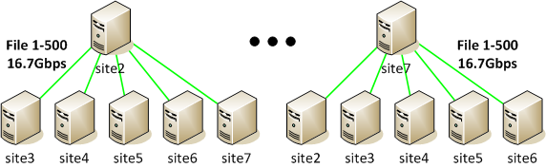
Example: Distributing Dataset X to All the Sites in ExaO
Dataset X (3000 50GB files)
Site 1 is the only source at the beginning
Each site can become a file provider once receiving files
Site 1 sends 3000/6=500 unique files to each destination site
Limit the rate of each (site 1, site X) flow as 100/6=16.7Gbps
Uplink utilization: 100%
Site X (X=2, 3, …, 7):
becomes a source to other destination sites after receiving a unique file from site 1
sends the received file to all other 5 destination sites, each at (100-16.7)/5=16.7Gbps
Uplink utilization: is 83.3%
Total link utilization: 6/7=85.71%
6 times of PhEDEx
Maximum

Slide 17
Demo:
A user submits a request:
{
“DatasetName”: “A”,
“Destination”: {“Site 2”, “Site 3”, “Site 4”, “Site 5”, “Site 6”, “Site 7”}
}
ExaO receives this request and makes online file-level scheduling to maximize network utilization
Audience observe the scheduling decision made by ExaO and the high link utilization from testbed UI, and observe the status of file transfers through Monalisa

Slide 18
Thank You!

Slide 19
Backup slides

Slide 20
ExaO: Software Defined Data Transfer Orchestrator
Leverage the emerging SDN technique to realize end-to-end orchestration of data flows involving multiple host groups at different domains
Key Features
On-demand, dynamic, minimal network state abstraction to provide global, real-time, inter-domain network view
Centralized, file-level transfer scheduling to achieve high transfer concurrency
Global, dynamic network resource allocation among flows to achieve high network utilization and low transfer delay

Slide 21
ExaO: Software Defined Data Transfer Orchestrator
PhEDEx
ExaO
No real-time, global network view
Application-Layer Traffic Optimization (ALTO)
Collect real-time routing information at different domains (ALTO-SPCE)
Compute minimal, equivalent abstract routing state (ATLO-RSA)
Dataset level scheduling
Destination sites cannot become candidate sources until receiving the whole dataset
Low concurrency
Scheduler
Centralized file level scheduling
Destination sites become candidate sources after receiving files
High concurrency
No network resource allocation scheme
Low utilization
Scheduler and Transfer Execution Nodes (TEN)
Global, dynamic rate allocation among transfers (Scheduler)
End host rate limiting to enforce allocation (TEN)
Notes:
Minimally invasive change on end host groups
Real-time, dynamic resource allocation under the existence of other network traffic
Not CMS or HEP specific, hence support any data intensive sciences.
Dataset distribution to N destination:
Maximal link utilization in the testbed
N times faster than dataset level scheduling

Slide 22

ExaO Workflow
Users submit, track and manage dataset transfer requests
Scheduler queries NEW requests via ExaO RESTful interface
Scheduler queries ALTO controllers for routing state
ALTO controller collects complete network state
ALTO controller computes on-demand, minimal, abstract routing state in response to query
Scheduler makes centralized, dynamic, file-level scheduling and global network resource allocation decisions
Transfer Execution Nodes (TEN) query updated scheduling and allocation decisions
TEN instruct efficient data transfer tools on end hosts (e.g., FDT) to enforce scheduling and allocation decisions
MonALISA sensors monitor data transfer status and send update back
PhEDEx
ASO
Batch
ExaO
RESTful Interface
Database
Scheduler
Transfer Execution Nodes
Kibana
Monitoring
MonALISA
ALTO Controller
ALTO Controller
ALTO Controller
FDTDaemon
FDTDaemon
FDTDaemon
MLSensor
MLSensor
MLSensor

Slide 23
Architecture of ExaO
Query new requests
ExaO
Rest Interface
ExaO
Rest Interface
ExaO
Rest Interface
ExaO
Rest Interface
Scheduler
PhEDEx
ExaO
RESTful Interface
Dynamic Scheduling
Query abstract routing state
Users submit dataset transfer requests
Update database
Query updated scheduling
ExaO
Rest Interface
ExaO
Rest Interface
FDTDaemon
ASO
DB
Transfer Execution Nodes
ALTO
MLSensor
Update database
Compute complete and abstract routing state
Kibana Monitoring
Kibana Monitoring
Kibana Monitoring
Batch
Enforce scheduling
Collect complete network state
Monitor Transfer Status
Monalisa
FDTDaemon
FDTDaemon
MLSensor
MLSensor

