Slide 1
RCPL INTEGRATED EHS MANAGEMENT SYSTEM
Executive & Leadership Safety Review · Reliance Consumer Products Ltd · Campa Cola CSD Plant
Every chart in this deck is a native PowerPoint chart — right-click any chart → Edit Data to change the numbers, the chart redraws automatically.

Slide 2




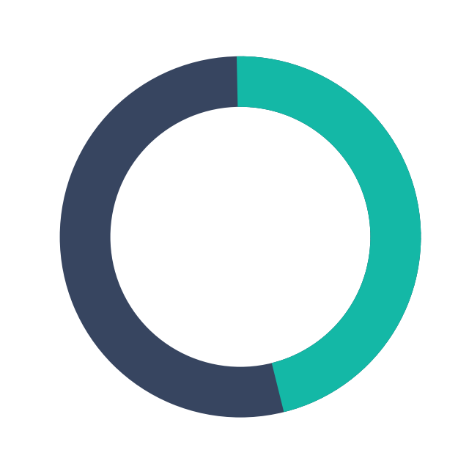
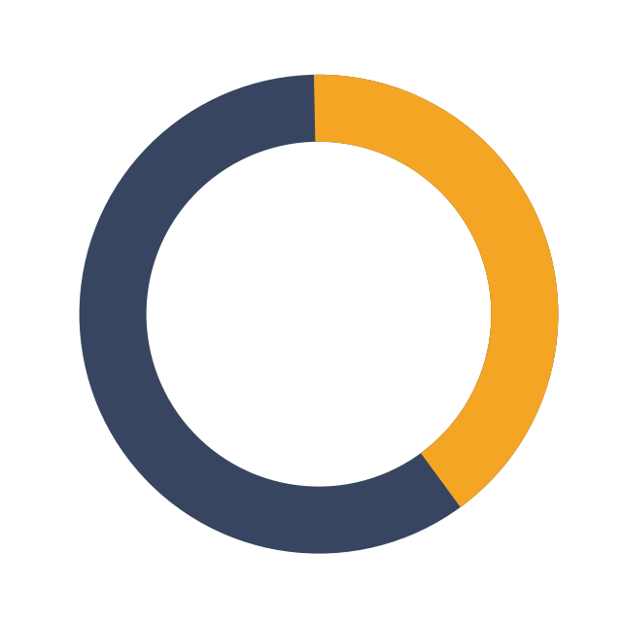
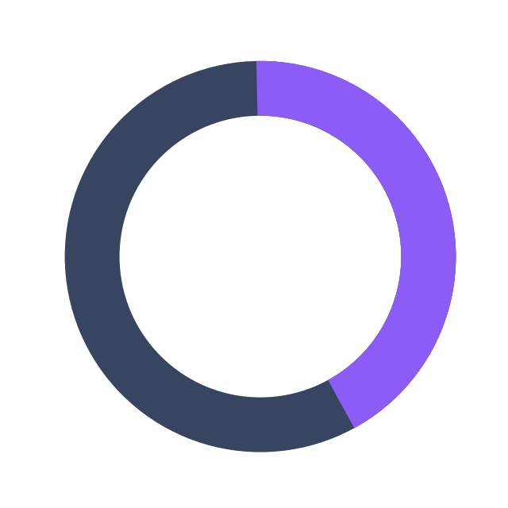




🧭 CORPORATE SAFETY SCORECARD
RCPL
Headline KPIs for this reporting period
2.2
1.0
48
699
Target ≤ 1.0
Target ≤ 2.0
12-month total
12-month total
TRIR
LTIFR
TOTAL INCIDENTS
LOST DAYS
45.8%
39.6%
41.7%
30
Target ≥ 95%
Target ≥ 90%
Target ≥ 90%
Higher = healthier culture
TRAINING COMPLIANCE
OBS CLOSURE
CA CLOSURE
NEAR MISS (LEADING)

Slide 3
📈 12-MONTH TREND ANALYSIS
RCPL
Incident volume, injury rate and leading-vs-lagging activity
Leading:Lagging ratio this year: 6.0 proactive activities for every reported incident. World-class programs track this ratio explicitly, not just the incident count.

Slide 4
🏭 DEPARTMENT PERFORMANCE & ROOT CAUSE
RCPL
Sorted worst-first, per dashboard-design best practice

Slide 5
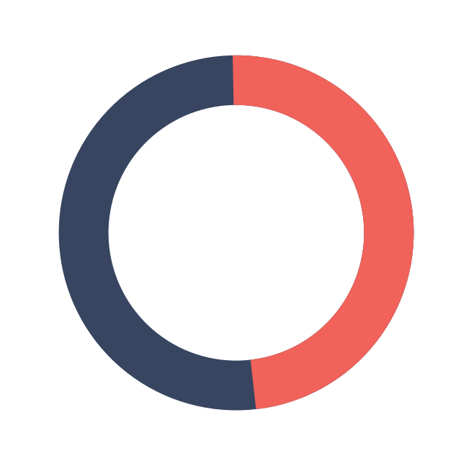
🎯 COMPLIANCE GAUGES & SYSTEM HEALTH
RCPL
Target attainment across the safety management system
45.8%
39.6%
41.7%
47.9%
TRAINING
OBS CLOSURE
CA CLOSURE
PTW COMPLIANCE
Reading the gauges: a ring at 100% means fully compliant this period. World-class plants keep every gauge above 90% and treat two consecutive months below target as an automatic leadership review trigger.
11
Medical Treatment + Restricted Work + LTI + Fatality
RECORDABLE INCIDENTS (12-MONTH)

Slide 6

🧍 BODY INJURY MAPPING & SAFETY PYRAMID
RCPL
Where injuries occur on the body (12-month, real data)
6
FRONT VIEW
Fatality — 1 (2%)
5
Lost Time Injury — 0 (0%)
1
4
8
Restricted Work — 5 (10%)
7
Markers are sized by count — the bigger the circle, the more injuries recorded at that location. Back and Hand/Finger are this period's priority zones for targeted PPE/ergonomics review.
Medical Treatment — 5 (10%)
6
First Aid — 7 (15%)
Near Miss — 30 (62%)
"Multiple": 11 incidents involved more than one body region (not shown on the figure — typically the most serious cases, priority for root-cause review).

Slide 7
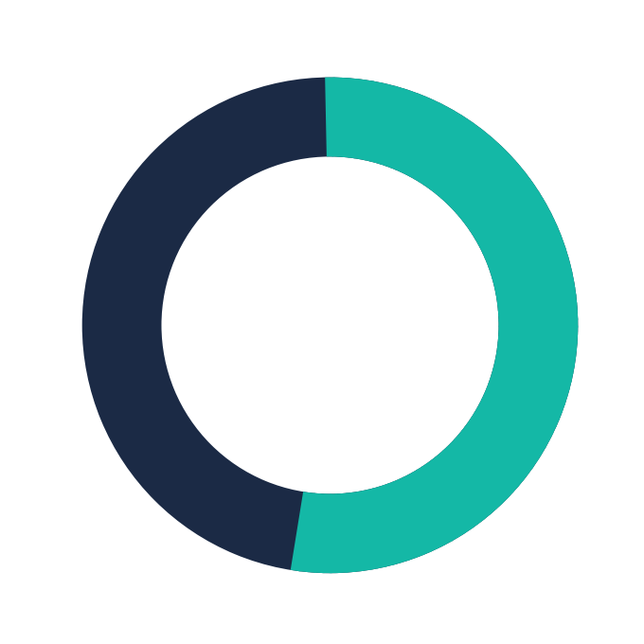
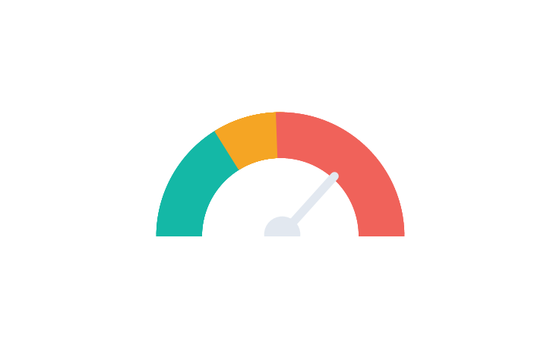
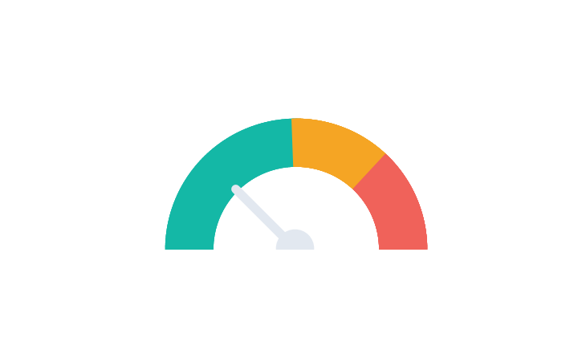
⏱ RISK MATRIX, INJURY-RATE GAUGES & DAYS-SINCE-INCIDENT
RCPL
Risk matrix from real data; days-since-incident is an illustrative sample counter
47
DAYS SINCE LAST LOST-TIME INCIDENT (illustrative)
TRIR: 2.20
LTIFR: 1.00
INCIDENT RISK RATING × DEPARTMENT (real data, 12-month)
Risk \ Dept | Admin | Constructi | Contractor | Engineerin | Logistics | Maintenanc
Critical | 0 | 0 | 1 | 0 | 1 | 0
High | 1 | 0 | 2 | 0 | 0 | 2
Medium | 1 | 5 | 0 | 1 | 4 | 2
Low | 2 | 2 | 2 | 2 | 1 | 2
Darker red = more incidents at that Risk Rating × Department intersection. Every cell is directly editable (click once, type a new number). Bullet-graph gauges above show TRIR/LTIFR against green/amber/red performance zones — a faster board-level read than a plain number.

Slide 8
🔎 KEY INSIGHTS FOR LEADERSHIP
RCPL
Auto-generated from this period's data — edit freely
TRIR is 2.20 and LTIFR is 1.00 against targets of ≤1.0 and ≤2.0 — requires attention.
Construction has the lowest department safety score (64/100) — recommend a focused review of training, observation-closure and CA-closure rates there. Engineering leads at 97/100.
"Inadequate Procedure" is the leading root cause (13 of 48 incidents) — a targeted corrective-action campaign here would have outsized impact on next quarter's TRIR.
Training Compliance (45.8%), Obs Closure (39.6%) and CA Closure (41.7%) are all below the 90-95% world-class benchmark — these are the levers that move TRIR down over the next 2 quarters.
Leading:Lagging ratio is 6.0:1 this year — 288 proactive activities recorded against 48 incidents.

Slide 9

📋 HOW TO USE THIS DECK
RCPL
Corporate review format — fully editable
Right-click any chart → "Edit Data" (opens a mini Excel sheet) → change a number → the chart redraws instantly.
All KPI-card numbers and insight text are plain text boxes — click once to select, click again to edit.
This deck reflects the same underlying dataset as the RCPL Integrated EHS Excel system and the web app in progress — use whichever format suits the meeting: this PPT for a board readout, the web app for live daily/monthly entry.
Recommended cadence: refresh this deck monthly from the web app's export, or ask me to regenerate it any time your data changes.

