Slide 1
About Me - Name : Soham Mankad Current Organization : L & T Infotech LTD Designation : Senior Software Engineer Exp Summary - Working in Banking Domain related projects for 3 years using server side technologies like Core Java, Spring, Spring Boot, Oracle RDBMS, PLSQL, Shell Scripting etc.
JAVA based Project Architecture & Design using a Case Study

Slide 2
Agenda -
1. Why Java & is it still Relevant in current Market ?
2. Benefits of using Java ( OOPS, API’s, Community support)
3. Frameworks using Java.
4. Overview of Project Case Study.
5. Glance over at architecture and design of Sample Project.
6. Q & A.
7. Resources & References.

Slide 3
Why Java & is it still Relevant in current Market ?
~ 90% of companies in the Fortune500 employ Java in their operations
1. Android Apps - Written in Java programming language, with Google's Android API, which is similar to JDK.
2. Finance Sector - Java is widely used in banking and financial services sector being secured and capable of handling huge volumes of data with stability. Banks like J.P. Morgan, Morgan Stanley, Goldman Sachs, Citi are using Java or Java based frameworks.
3. Ecommerce – Top tech companies like Amazon, Apple, Google, LinkedIn, Facebook rely on Java and its JVM products. Indian Tech companies like Flipkart, Paytm etc also use Java in their applications.
4. Embedded Space, Big Data, NLP are some other domains where Java is preferred.

Slide 4
Benefits of using Java
1. Easy to get started with and gradually master.
2. Object Oriented. Based on Objects, Polymorphism, Inheritance, Encapsulation, Abstraction.
3. Frameworks like Spring Boot reduce Boiler Plate Code to huge extents.
4. Wide developer community Support. Pretty much resolution for any Error encountered, will have a solution in some or other forum.
5. Loads of API’s like Apache Commons, Jackson, POI, Oval, Xstream, DBCP, Java Mail, JUnit, Mockito etc.
6. From Java 9 onwards, Java supports Modularized development.

Slide 5
Frameworks using Java
1. Spring – DI based framework using IOC and has an array of features like auto configuration, Spring Security, MVC structure.
2. Spring Boot - Spring boot is an RAD framework which internally manages the configuration which needs to be done in Spring thus reducing manual configuration effort. Its based on principle of Convention over configuration.
3. Hibernate – It is implementation of JPA and ORM tool that maps Java Classes to tables and fields to columns(except associations which join tables)
4. Hadoop – Hadoop uses MapReduce Programming model for distributed processing of Massive amounts of data.

Slide 6
Overview of Project
Reconciliation System –
In General, Reconciliation means two set of records are in sync or agreement.
In Banking Reconciliation generally means Reconciliation of Banks Account with its Books/Ledger.

Slide 7
Why Reconciliation is Required ?
Bank Reconciliation is record that transaction amounts are debited and credited as expected and that the balance with Bank matches its financial statements.
All Fees charged by Banks are also included in this process.
It is an effective tool in detection of frauds.
Useful Financial Reporting and gives clear picture of Cash Flows in Banks.
This is process is used widely for all kinds of Assets like Stocks, Positions, Transactions etc.

Slide 8
Use Case Diagram -

Slide 9
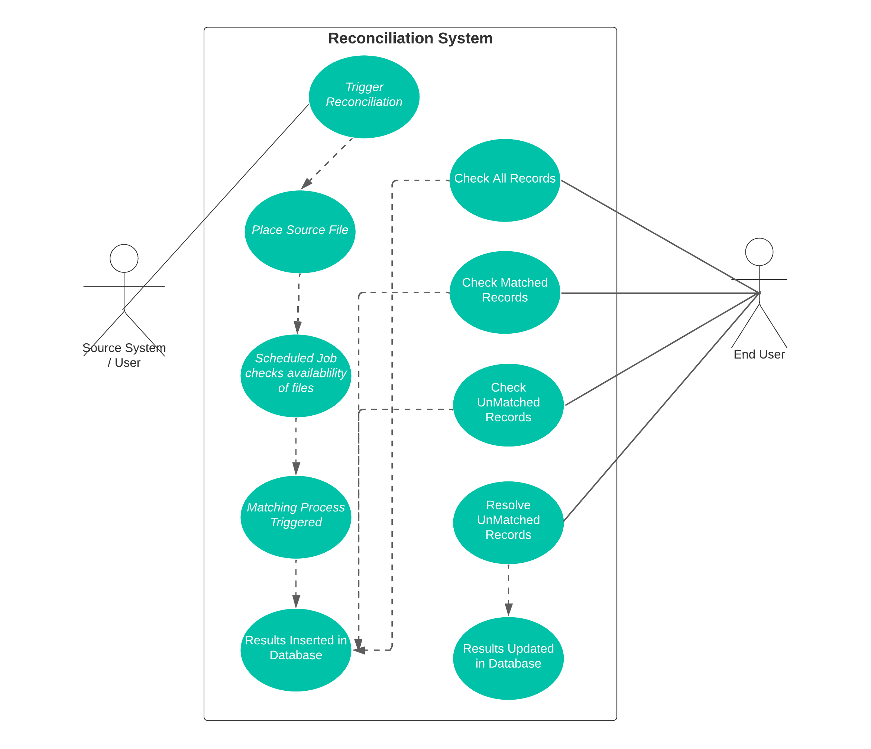

Slide 10
Q & A

Slide 11
Resources & References –
Java Tutorials –
1. Java Tutorial by Durga Soft - https://youtu.be/eTXd89t8ngI
2. Java Tutorial for Beginners - https://youtu.be/8cm1x4bC610
3. OCP 11 book – https://www.amazon.com/gp/product/1119584701
Spring Boot Tutorial –
1. Official Documentation - https://www.baeldung.com/spring-boot
2. Udemy Course by in28Minutes - https://www.udemy.com/course/spring-boot-tutorial-for-beginners/
More on Reconciliations –
1. Intellimatch Reconciliations - https://www.fisglobal.com/-/media/fisglobal/files/pdf/brochure/intellimatch-reconciliations-revolutionized-brochure.pdf
2. TLM - https://www.smartstream-stp.com/what-is-transaction-lifecycle-management-tlm/

Slide 12
Thank You !!

