Slide 1

MIND BLOOM
Mental Health Affirmation Journal
CSCI 5828: Foundations of Software Engineering
TEAM 4
Team Members: Almene, Megha, Qazim, Pranay, Rigved, Sneha

Slide 2
Project Overview
Supports user’s mental health through daily journaling and affirmations
Users can make daily journal entries as per their current mood
The app will generate affirmations tailored for each user as per their mood
Main purpose of the app is to promote retrospection and emotional well-being

Slide 3
Project Overview
Affirmations generated using OpenAI API as per the mood input by the user
Emphasis on user privacy as the journal entries are private.

Slide 4
Features
Secure
User-authentication
1
Daily journaling to record user's feelings for mood tracking
2
Receive mood-based affirmations that match user's feelings
3
Inspirational quotes are collected and analyzed daily
4
Journal history to review past entries as per entry dates
5
Mood details page to view journal entries and affirmations sorted as per mood
6
Integrated a calendar feature to help users navigate through their daily journal entries
7
A pie chart summarizing users' journal entries and highlights most frequent mood
8

Slide 5
Technologies Used
Project planning
Git Hub-Code Management
Git Hub- User Stories: Tasks Tracking
Slack – Communication
Idealogy
Started with creating a user authentication and login page.
Created the database schema using Prisma ORM
Implemented a ‘collector’ to fetch quotes from OpenAI’s API, followed by ‘analyzer’ that will analyze these quotes as per user moods

Slide 6
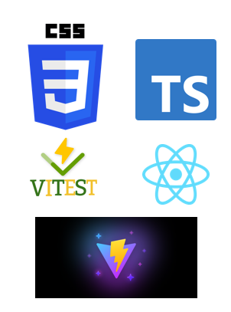
Technologies Used
Languages
  React, Typescript
Build tool
  Vite
Testing tools
  Testing done using Vitest
Front-end
  Front-end built using React for an interactive UI, with Typescript to ensure least possible bugs
  React Router for in-app navigation
  Tailwind CSS for stylizing custom themes
  React Hook Form to handle user requests

Slide 7

Technologies Used
Back-end
  Built using Express.js for handling routes, authentication, and journaling
  JWT manages user sessions securely
  Data stored in PostgreSQL
Data persistence
  Prisma ORM keeps database schema in sync with the code
  Helping in applying changes to the database through automated migrations
Messaging
  The app doesn’t use a dedicated messaging queue
  Internal modules within the app (e.g. collector & analyzer) communicate via API calls
Production
  Deployed front-end using Vercel
  Back-end deployed on Google Cloud Platform (CGP)

Slide 8

Technologies Used
Continuous Integration (CI)
  GitHub Actions is used as our CI platform to automate tasks like building and testing the project.
  Custom npm scripts (e.g., build, test, migrate) are triggered as part of the CI pipeline, ensuring consistent execution and reducing manual errors.
  Our collector and analyzer components are integrated into the CI workflow, allowing automated checks and analysis on every push or pull request.
Monitoring
  No dedicated monitoring system
  checkStatus.ts runs before tests to ensure that the system is operational
  Handled logs manually during development
Continuous Deployment (CD)
  Deployed front-end using Vercel, solved deployment issues by using the command ‘npm i --force’
  Back-end deployed on GCP

Slide 9
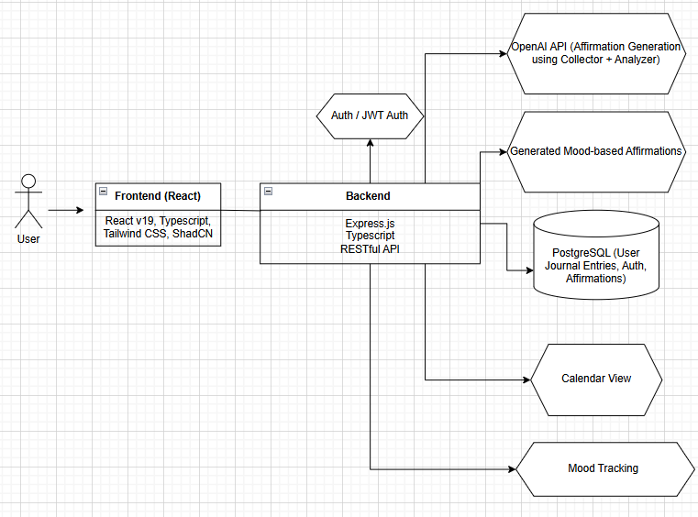
High Level Design (Architecture)

Slide 10
Demo https://drive.google.com/file/d/1pfuuRZDJ_70X7X8Pm7n8CO5yRuN87O3M/view?usp=sharing

Slide 11
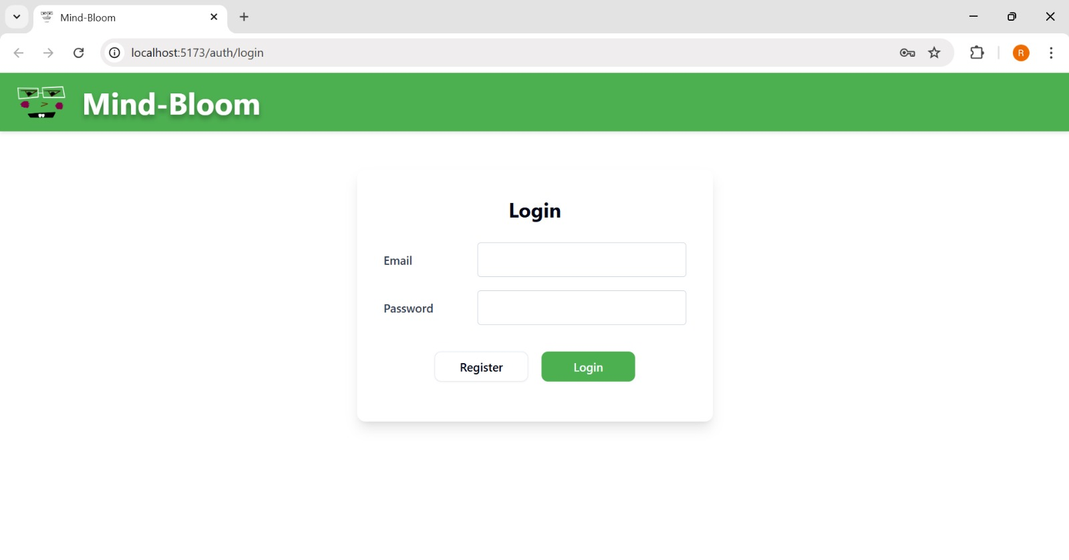
Login Page

Slide 12
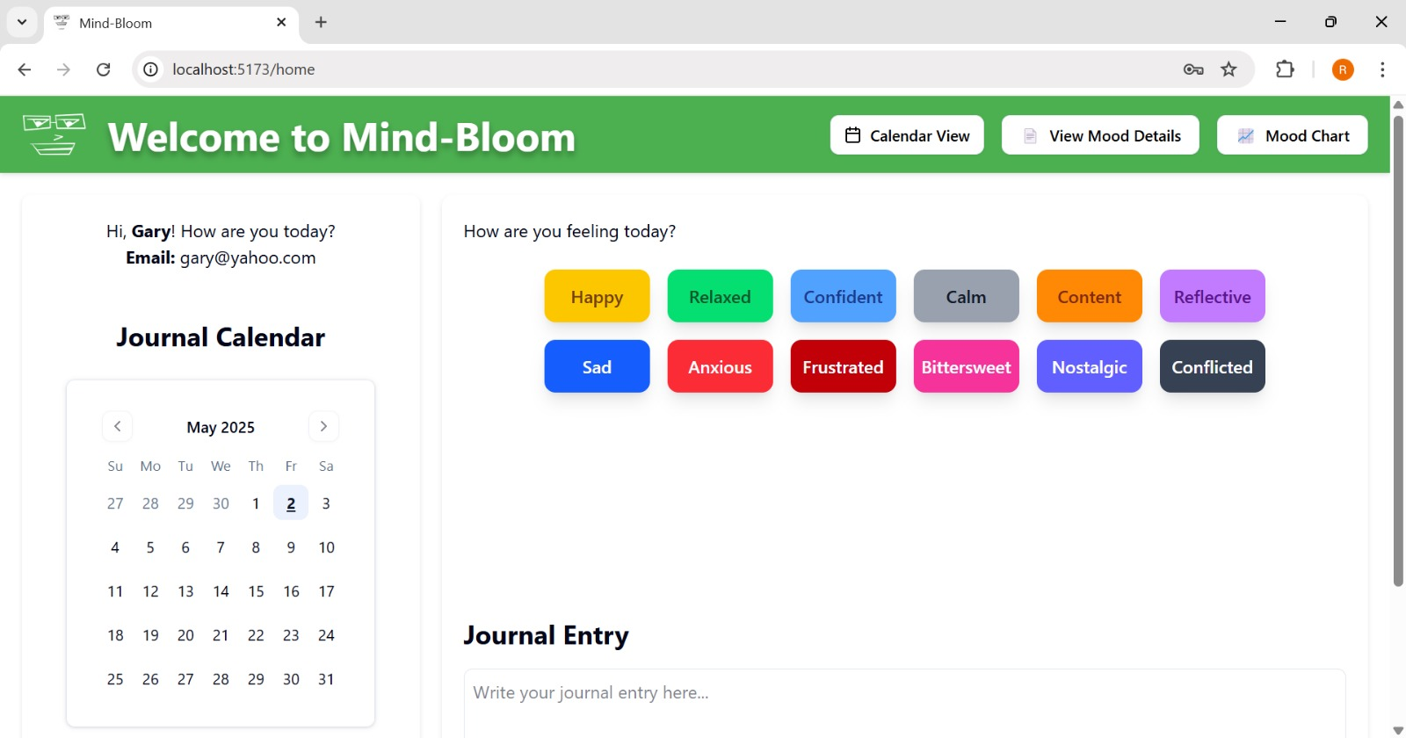
Home Page

Slide 13
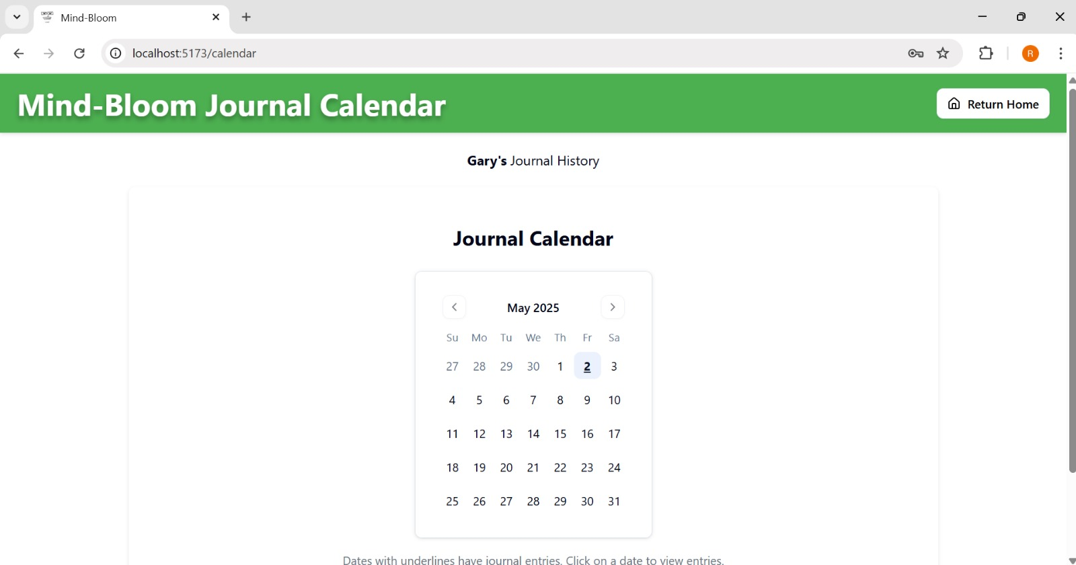
Journal Calendar

Slide 14
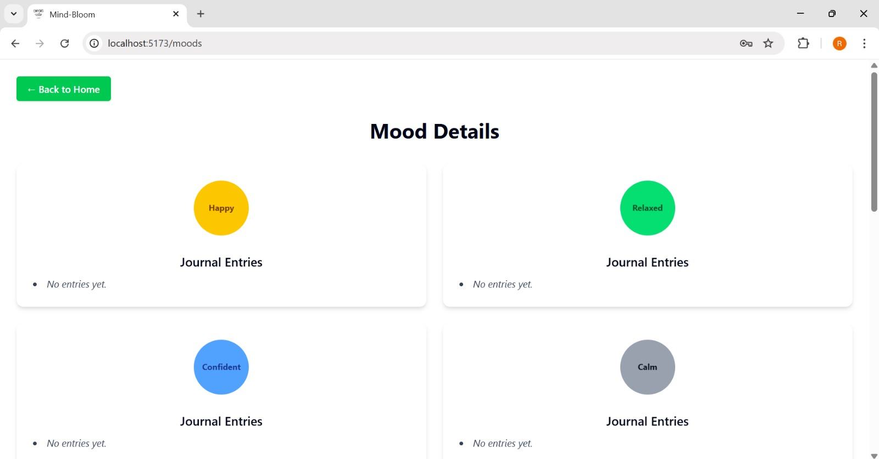
Mood Details

Slide 15
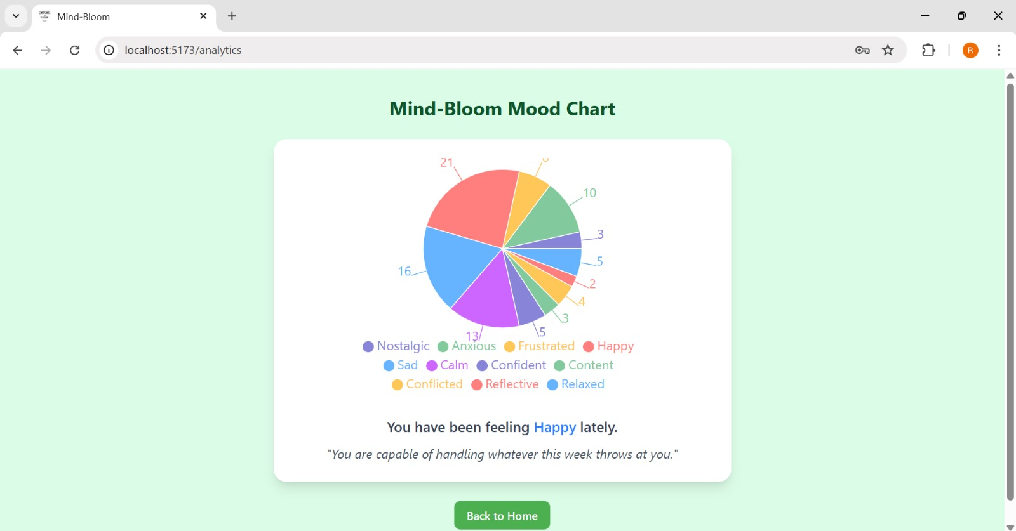
Mood Chart

Slide 16
Retrospective
What Was Confusing?
Prisma Session Errors: Encountered session bugs; resolved through collaborative debugging.
Frontend Deployment to Vercel:
Deployment failed due to outdated dependencies. Resolved with `npm install --force`.
Prisma Deployment with Supabase on GCP: Faced `prisma generate` errors. Fixed by removing local client dependency during deployment.
🙂
😐
😕
What Went Well?
Calendar Integration: Used an outdated React calendar package, but it worked well for journal tracking.
Collector & Analyzer Implementation: Initially seemed complex, but easy to implement once logic was defined.
What didn’t go Well?
Timestamp Bug in Journal Entries:
Entries saved to the previous day. Temporary fix applied with hardcoded MST timezone.
Errors while implementing Job scheduler: Facing node errors while adding a job scheduler to GCP to automate the collector and analyzer.

Slide 17
THANK YOU!

