Slide 1
Progressive Download vs. Adaptive Streaming

Slide 2
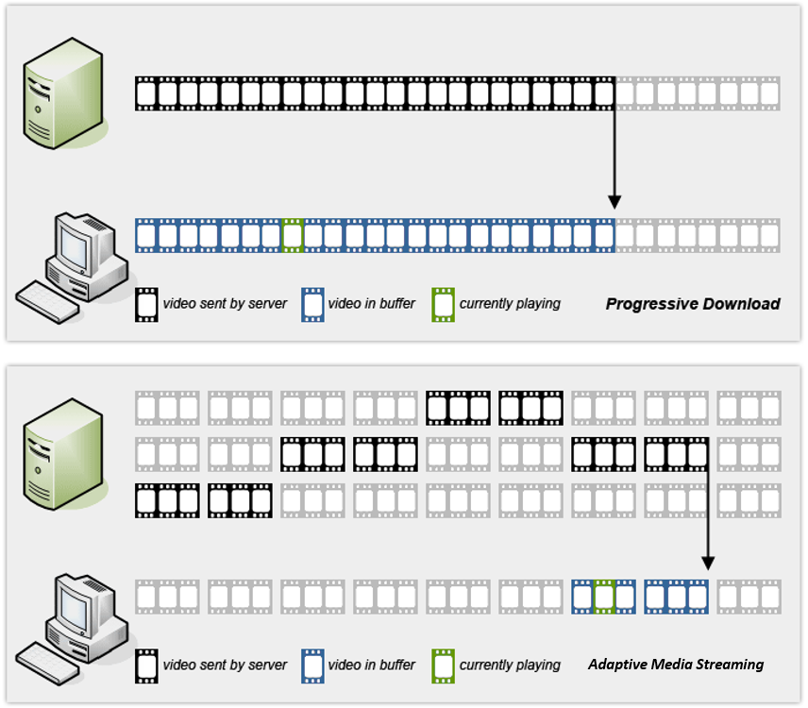
Server
4096 Kbps
Client
Playhead
^
^
Progressive Download
Server
4096 Kbps
2048 Kbps
1024 Kbps
Client
Playhead
^
^
Adaptive Streaming

Slide 3
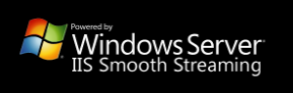


Adaptive Streaming Protocols
(Silverlight)
Apple HLS
(iOS and Android) – HLS Player (ffplay.exe and mplayerhq.hu can both play HLS streams)
Link to MPEG-DASH Reference Player

Slide 4
HLS | Smooth Streaming | MPEG-DASH
Manifest: M3U8 playlist | Manifest: XML file (*.ism/*.ismc) | Manifest: Media Presentation Description (MPD)
Video: H264 | Video: VC-1 or H.264 | Video: Codec agnostic
Audio: MP3 or HE-AAC | Audio: AAC or WMA | Audio: Codec agnostic
Container: MPEG-2 | Container: MP4 (*.ismv/*.isma) | Container: MP4 or MPEG-2
Server: Any | Server: Microsoft IIS Additional: Only quality files are stored but server virtually splits them up into chunks at playback | Server: Any

Slide 5

Adaptive Streaming Feature Comparison

