Slide 1
Can intrapopulation stage structure allow more species to coexist in a community?
Izabel Eriksson Reuterborg
Supervisor: Claus Rüffler
Notes:
You know, one of the hardest things I’ve had to deal with during this last year has been answering the question: ”So what actually is your project about?” But I hope that today, with 20 minutes of your undivded attention I will finaly succeed.
My name – Claus’s name - and title

Slide 2
Intrapopulation stage structure
Notes:
Now there are many forms of intrapopulation stage structure but what my thesis concerns is species that undergo an ontogenetic niche shift.

Slide 3
Ontogenetic niche shift
Two distinct niches during lifetime
Morphology
Behaviour
Habitat
Over 80 % species
Complete metamorphosis
a.k.a. Complex life cyle
Notes:
Now there are many forms of intrapopulation stage structure but what my thesis concerns is species that undergo an ontogenetic niche shift. Which are species that during their lifetime shift their behaviour, morphology or something else dramatically enough that they occupy another niche. Although its a widespread phenomona most theoritical models exploring consumer resource interactions seldom account for this stage structure.

Slide 4
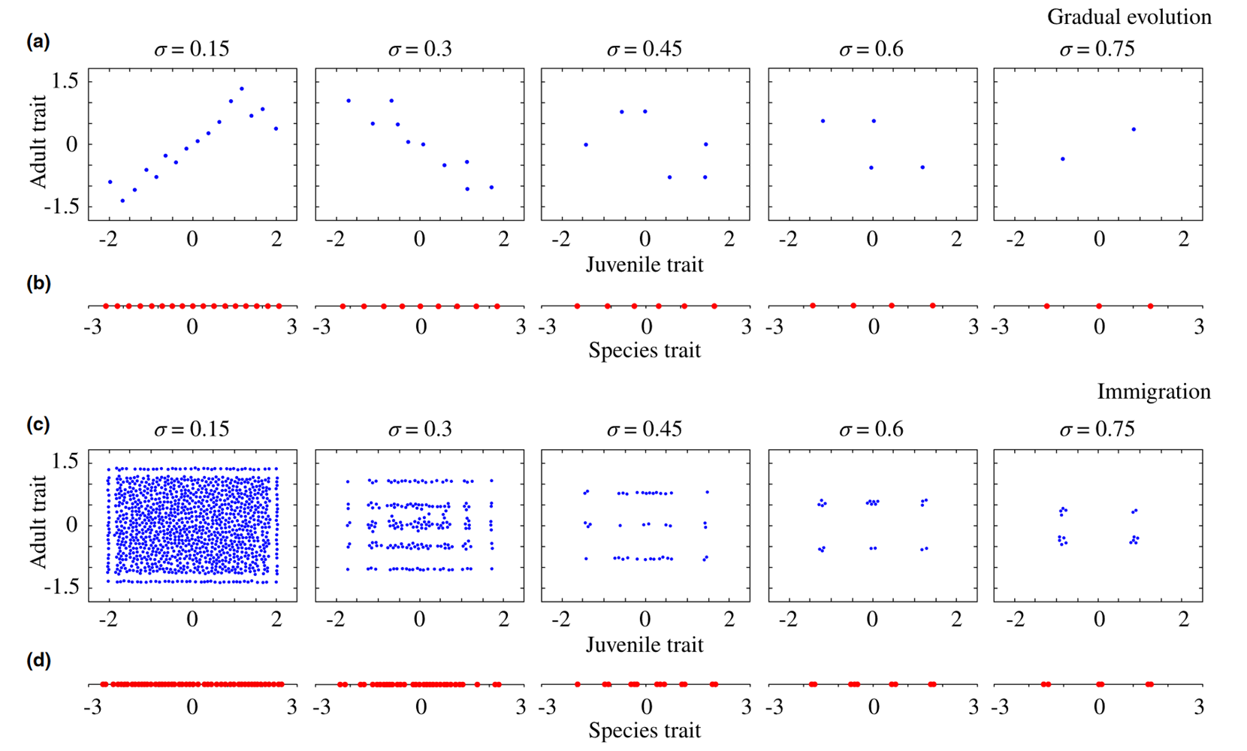
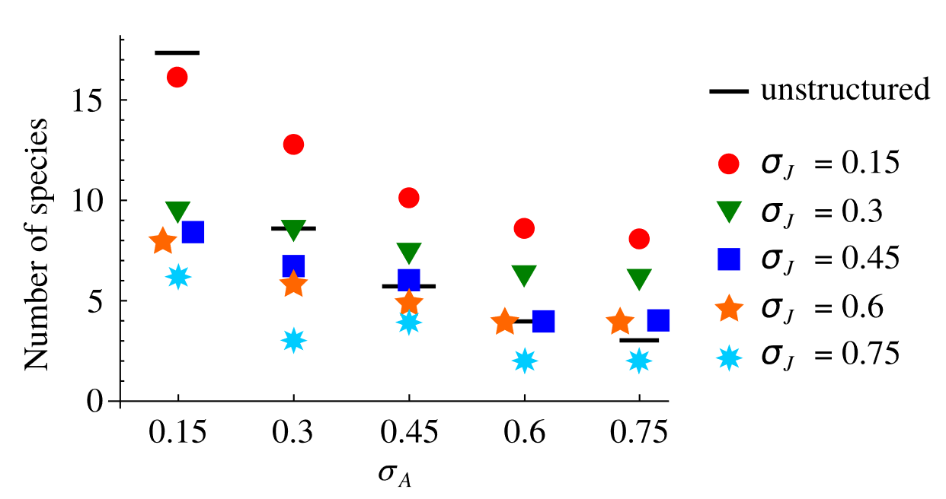
Ontogenetic niche shift - effects
Species coexistence (Wilbur, 1980, Loreau and Ebenhoh, 1994, Saltini et al., 2023, Vasconcelos et al., 2022)
Couple ecosystems (Schreiber and Rudolf, 2008)
Food-web stability (Rudolf and Lafferty, 2011, Mougi 2017)

Slide 5
Ontogenetic niche shift - effects
Species coexistence (Wilbur, 1980, Loreau and Ebenhoh, 1994, Saltini et al., 2023, Vasconcelos et al., 2022)
Couple ecosystems (Schreiber and Rudolf, 2008)
Food-web stability (Rudolf and Lafferty, 2011, Mougi 2017)
Notes:
The inspiration behind my thesis was a model by Saltini et al. That looked at the number of species that coexisted in communties with either simple or complex organisms. They also compared the difference between communties built up through immigration and communities built up under gradual evolution: Saltinis findings.

Slide 6
Aims
Explore how communities of complex organisms whose life stages can evolve independently differ from communities of simple organisms
Immigration vs Gradual Evolution
Different Resource distributions
Model differences
(I) Discrete time consumer population dynamics
(II) No logisitc resource growth
Notes:
Now there are many forms of intrapopulation stage structure but what my thesis concerns is species that undergo an ontogenetic niche shift. Which are species that during their lifetime shift their behaviour, morphology or something else dramatically enough that they occupy another niche

Slide 7
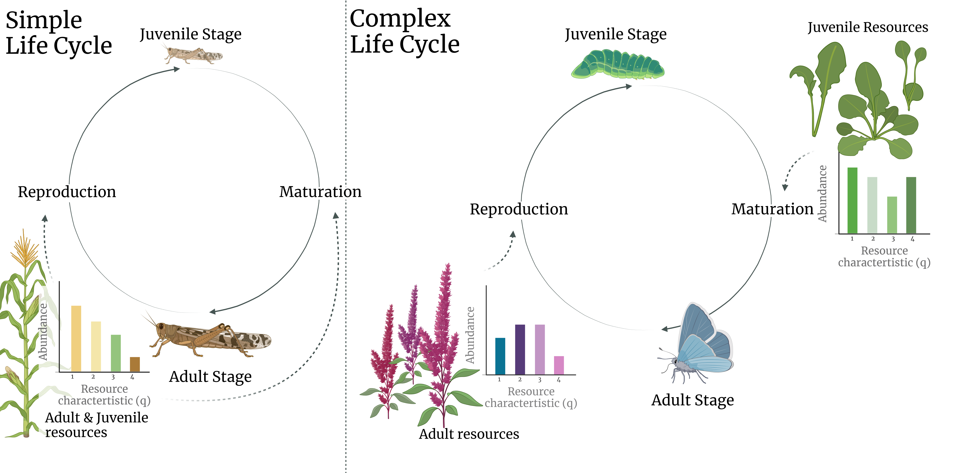
Notes:
So how will this model work? Well I will have two different models, one for simple life cycles, and one for complex life cycles.

Slide 8
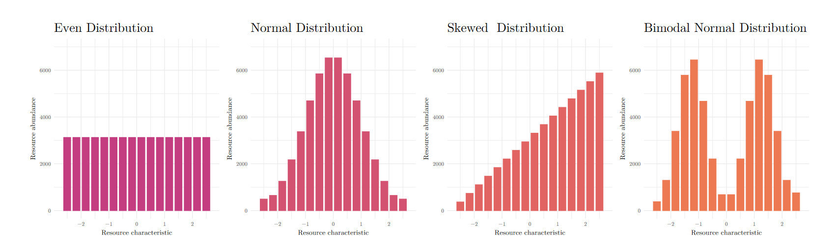
Notes:
Now these are the four rseource distributions I used during my simulations. Species could have traits that matched these resources.

Slide 9
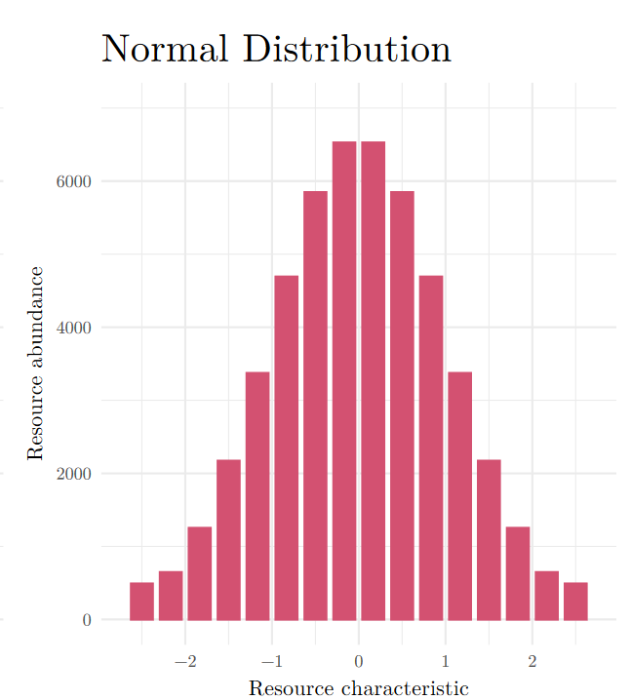
Which would do best?
-2
0
Notes:
Now these are the four rseource distributions I used during my simulations. Species could have traits that matched these resources.

Slide 10
Which would do best?
0.1
-2
-0.1
0
0.2
Notes:
Now these are the four rseource distributions I used during my simulations. Species could have traits that matched these resources.

Slide 11
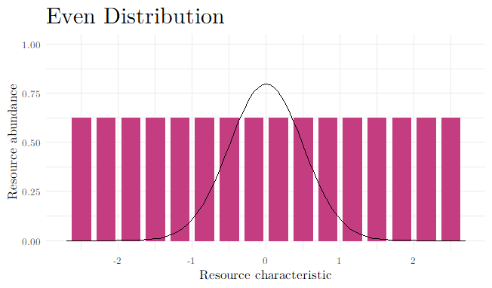
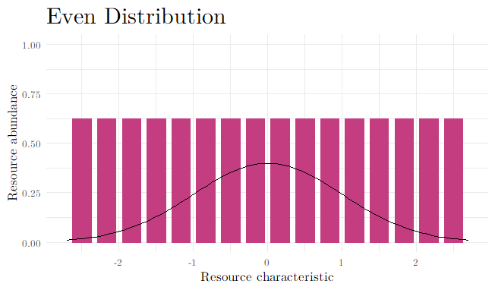
σ = low σ = high
Niche width or Generalism
Notes:
So species ability to feed on resources will be affected by their niche width, or sigma. As well as their trait value.

Slide 12
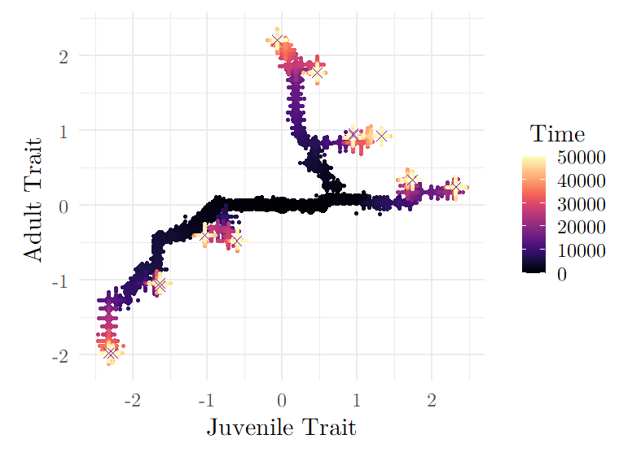
Notes:
Here is how one simulation might progess. It starts from one species, this species has two traits, which influence how many offspring it can have. There is a chance that some of these offspring will have new traits, that it has mutated. The offsprings chance of survival to adulthood will be influenced by its traits. Now a species own traits is not the only thing affecting how well it does. Of course other species around it will also affect it. So my simulations attempt to model both ecological and evolutionary dynamics

Slide 13
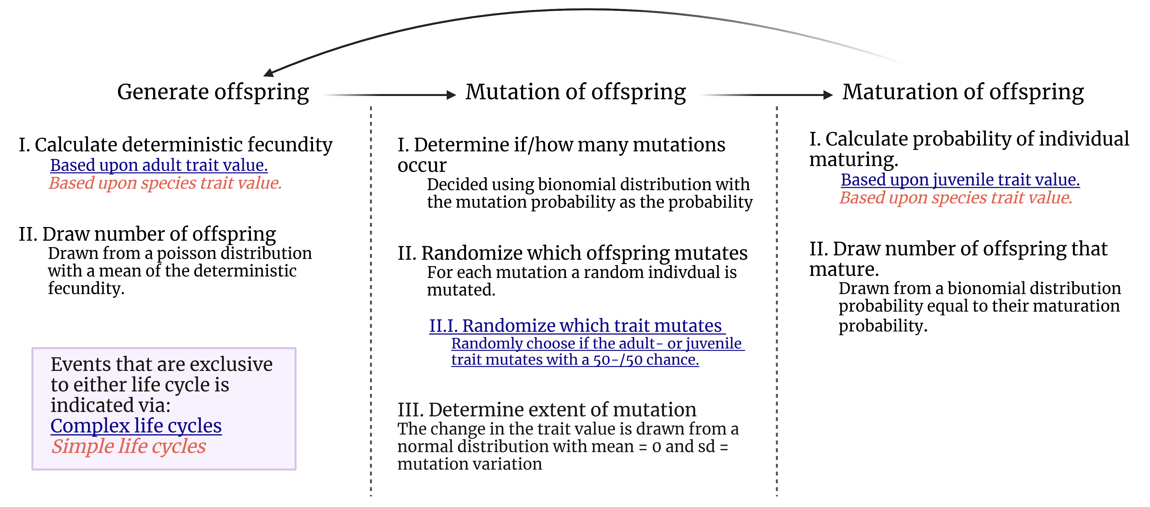

Slide 14
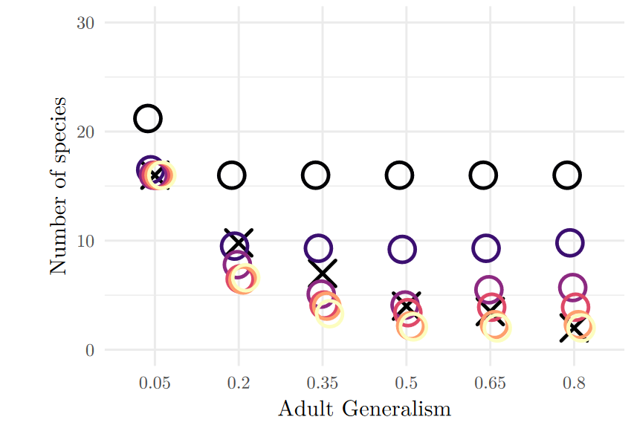
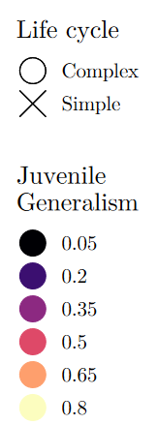
Results
Gradual Evolution

Slide 15
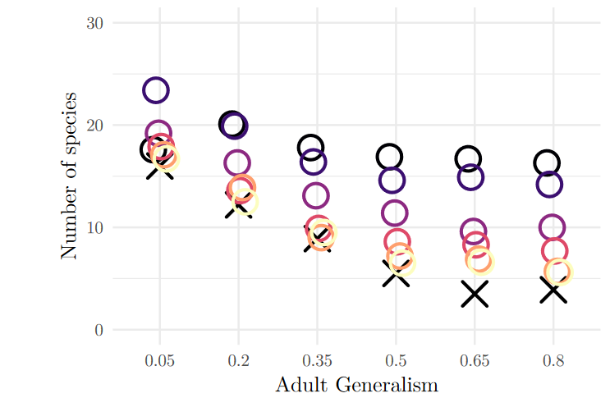
Results
Gradual Evolution
Immigration

Slide 16
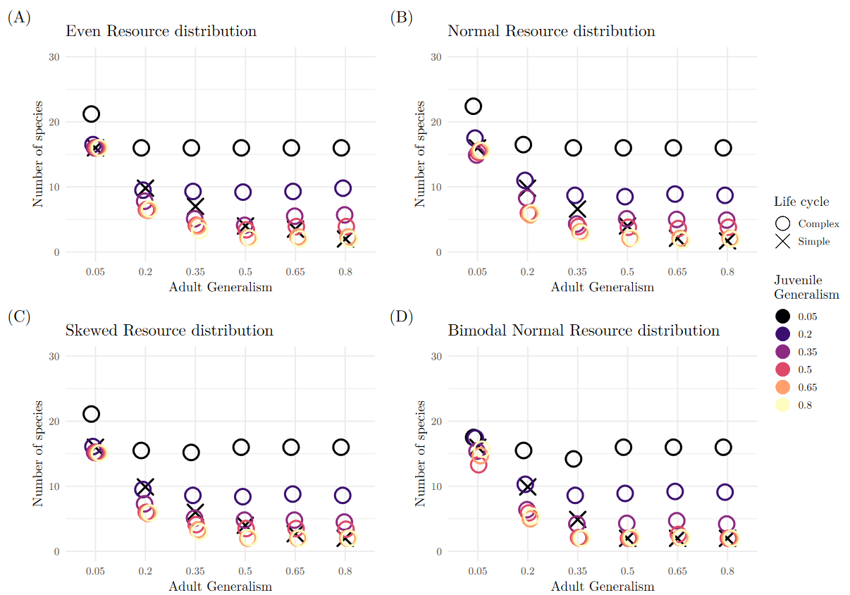
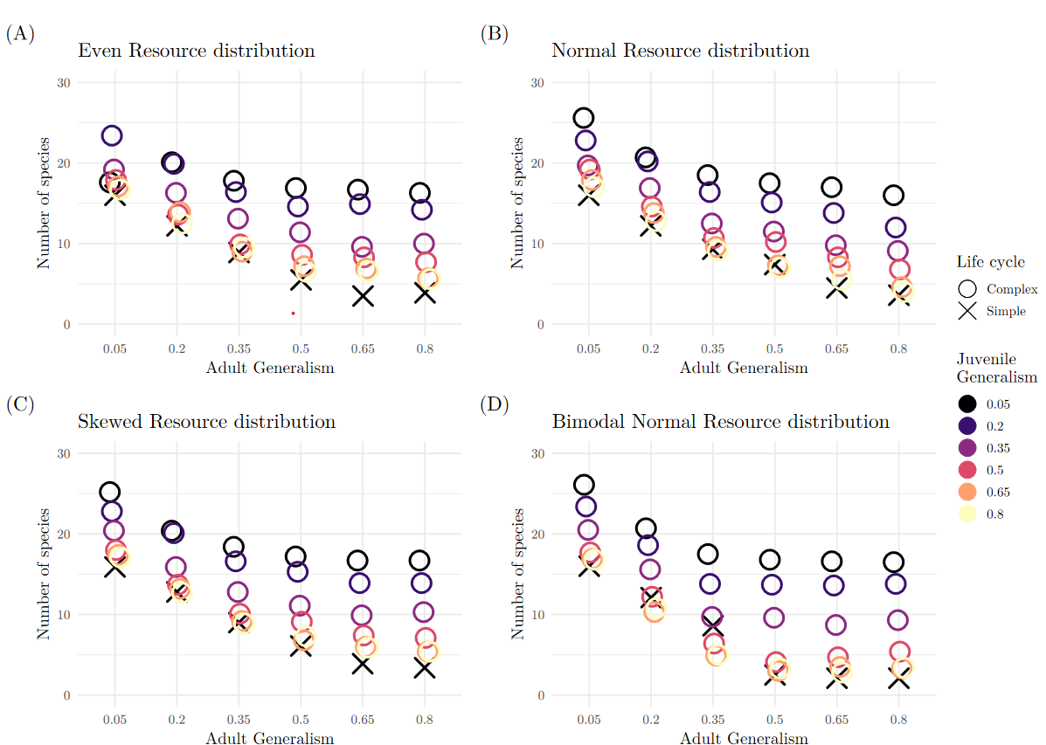
Results
Gradual Evolution
Immigration

Slide 17
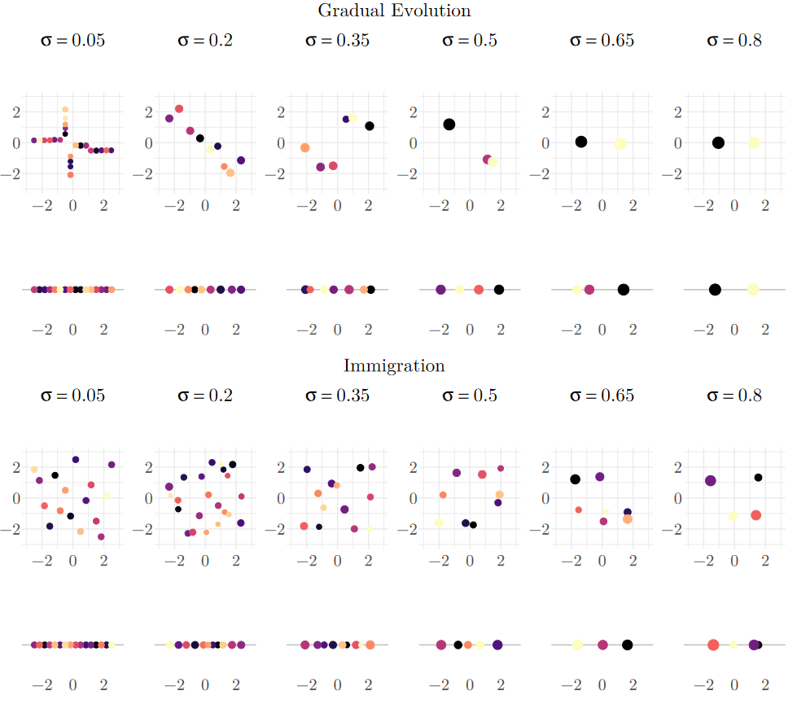
Results

Slide 18
Ontogenetic niche shift - effects
Species coexistence (Wilbur, 1980, Loreau and Ebenhoh, 1994, Saltini et al., 2023, Vasconcelos et al., 2022)
Couple ecosystems (Schreiber and Rudolf, 2008)
Food-web stability (Rudolf and Lafferty, 2011, Mougi 2017)
Notes:
The inspiration behind my thesis was a model by Saltini et al. That looked at the number of species that coexisted in communties with either simple or complex organisms. They also compared the difference between communties built up through immigration and communities built up under gradual evolution: Saltinis findings.

Slide 19
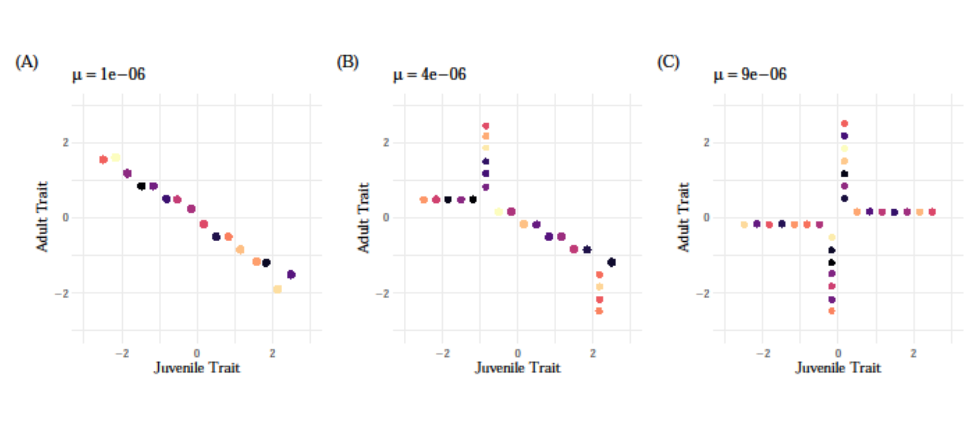
Single axis – Mixed – Two axes
Results

Slide 20
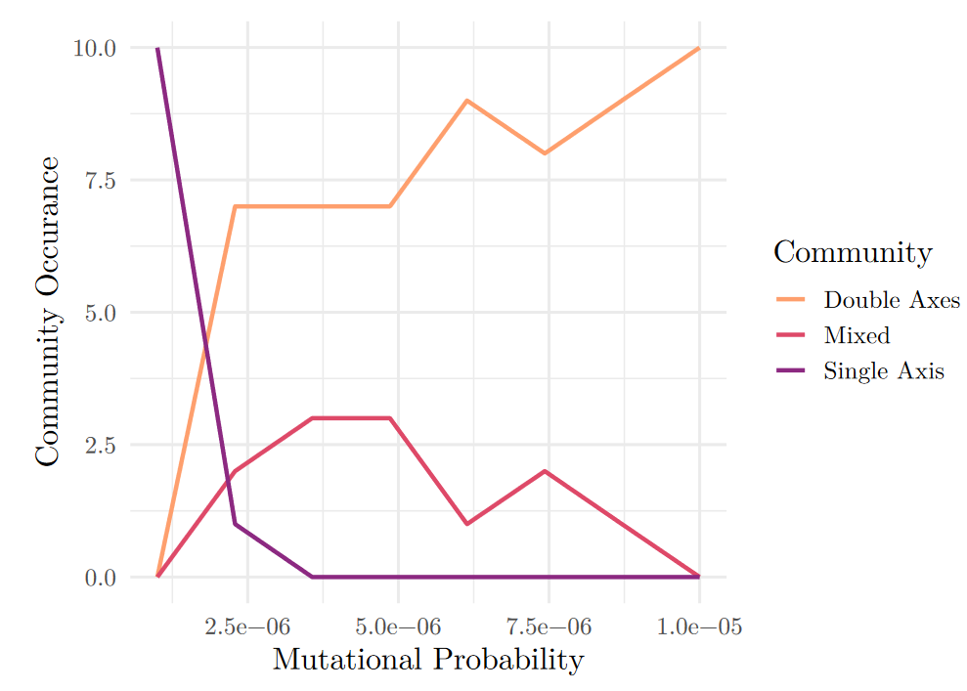
Results

Slide 21
Mutation Probability
Mutation Speed
Separation between Evolutionary and Ecological time scales
Assumption in many models
Notes:
What is mutational probability?

Slide 22
Conclusions
Complex life cycles can lead to higher species coexistence when:
(I) Communities are built through immigration
(II) One of the life stages has a lower niche width than the simple life cycle
(III) The separation between evolutionary and ecological timescales are relaxed

Slide 23
Can intrapopulation stage structure allow more species to coexist in a community?
Yes! (under certain conditions)
Izabel Eriksson Reuterborg
Supervisor: Claus Rüffler
Notes:
You know, one of the hardest things I’ve had to deal with during this last year has been answering the question: ”So what actually is your project about?” But I hope that today, with 20 minutes of your undivded attention I will finaly succeed.
My name – Claus’s name - and title

Slide 24
Can intrapopulation stage structure allow more species to coexist in a community?
Questions?
Izabel Eriksson Reuterborg
Supervisor: Claus Rüffler
Notes:
You know, one of the hardest things I’ve had to deal with during this last year has been answering the question: ”So what actually is your project about?” But I hope that today, with 20 minutes of your undivded attention I will finaly succeed.
My name – Claus’s name - and title

Slide 25
References
Abrams, P. 1983. The Theory of Limiting Similarity. Annual Review of Ecology and Systematics 14:359–376. Abrams, P. A., and C. Rueffler. 2009. Coexistence and limiting similarity of consumer species competing for a linear array of resources. Ecology 90:812–822. Ackermann, M., and M. Doebeli. 2004. Evolution of niche width and adaptive diversification. Evolution 58:2599–2612. Anaya-Rojas, J. M., R. D. Bassar, B. Matthews, J. F. Goldberg, L. King, D. Reznick, and J. Travis. 2023. Does the evolution of ontogenetic niche shifts favour species coexistence? An empirical test in Trinidadian streams. Journal of Animal Ecology 92:1601–1612. Bassar, R. D., J. Travis, and T. Coulson. 2017. Predicting coexistence in species with continuous ontogenetic niche shifts and competitive asymmetry. Ecology 98:2823–2836. Butlin, R., J. Bridle, and D. Schluter. 2009. Speciation and Patterns of Diversity. Cambridge University Press, Cambridge, United Kingdom. Chesson, P. 2000. Mechanisms of Maintenance of Species Diversity. Annual Review of Ecology and Systematics 31:343–366. Dieckmann, U., and M. Doebeli. 1999. On the origin of species by sympatric speciation. Nature 400:354–357. Geritz, S. A. H., E. Kisdi, G. Mesz ́ena, and J. A. J. Metz. 1998. Evolutionarily singular strategies and the adaptive growth and branching of the evolutionary tree. Evolutionary ecology 12:35–57. Loreau, M., and W. Ebenhoh. 1994. Competitive Exclusion and Coexistence of Species with Complex Life Cycles. Theoretical Population Biology 46:58–77. Mesz ́ena, G., M. Gyllenberg, L. P ́asztor, and J. A. J. Metz. 2006. Competitive exclusion and limiting similarity: A unified theory. Theoretical Population Biology 69:68–87. Miller, T. E., and V. H. Rudolf. 2011. Thinking inside the box: community-level consequences of stage-structured populations. Trends in Ecology & Evolution 26:457–466.
Mougi, A. 2017. Persistence of a stage-structured food-web. Scientific Reports 7:11055. Otto, S. P., and T. Day. 2007. A biologist’s guide to mathematical modeling in ecology and evolution. Princeton University Press, Princeton. R Core Team. 2023. R: A Language and Environment for Statistical Computing. R Foundation for Statistical Computing, Vienna, Austria. Rainford, J. L., M. Hofreiter, D. B. Nicholson, and P. J. Mayhew. 2014. Phylogenetic Distribution of Ex- tant Richness Suggests Metamorphosis Is a Key Innovation Driving Diversification in Insects. PLoS ONE 9:e109085. Rudolf, V. H. W., and K. D. Lafferty. 2011. Stage structure alters how complexity affects stability of ecological networks. Ecology Letters 14:75–79. Rueffler, C., T. J. M. Van Dooren, O. Leimar, and P. A. Abrams. 2006. Disruptive selection and then what? Trends in Ecology & Evolution 21:238–245. Saltini, M., P. Vasconcelos, and C. Rueffler. 2023. Complex life cycles drive community assembly through immigration and adaptive diversification. Ecology letters 26:1084–1094. 17
Schmid, M., C. Rueffler, L. Lehmann, and C. Mullon. 2024. Resource variation within and between patches: Where exploitation competition, local adaptation and kin selection meet. The American Naturalist 203:E19– E34. Schreiber, S., and V. H. W. Rudolf. 2008. Crossing habitat boundaries: coupling dynamics of ecosystems through complex life cycles. Ecology Letters 11:576–587. Sherratt, E., M. Vidal-Garc ́ıa, M. Anstis, and J. S. Keogh. 2017. Adult frogs and tadpoles have different macroevolutionary patterns across the Australian continent. Nature ecology & evolution 1:1385–1391. Vasconcelos, P., M. Saltini, and C. Rueffler. 2022. Consequences of life-cycle complexity to the potential for evolutionary branching. Weissing, F. J., P. Edelaar, and G. S. van Doorn. 2011. Adaptive speciation theory: a conceptual review. Behavioral Ecology and Sociobiology 65:461–480. Werner, E. E. 1988. Size, Scaling, and the Evolution of Complex Life Cycles. Pages 60–81 in B. Ebenman and L. Persson, eds. Size-Structured Populations. Springer, Berlin, Heidelberg. Werner, E. E., and J. F. Gilliam. 1984. The Ontogenetic Niche and Species Interactions in Size-Structured Populations. Annual review of ecology and systematics 15:393–425. Wilbur, H. M. 1980. Complex Life Cycles. Annual review of ecology and systematics 11:67-93

Slide 26
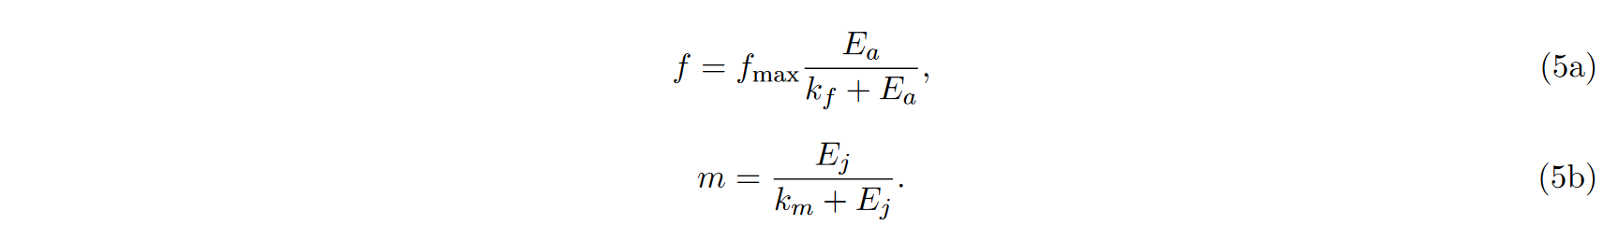
Equations

