Slide 1

TYPES OF DATABASES

Slide 2

Objectives
What is a database
Identify Types of databases (based on relationship of the data).
How to access the database

Slide 3
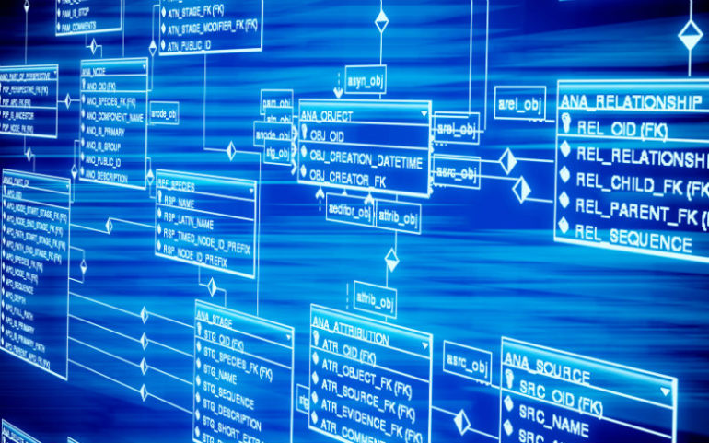
What is a database?
Database - organized collection of data, generally stored and accessed electronically from a computer system. Where databases are more complex they are often developed using formal design and modeling techniques.

Slide 4

Types of databases
(Data rerelationship)
Hierarchical
Relational
Object-oriented

Slide 5
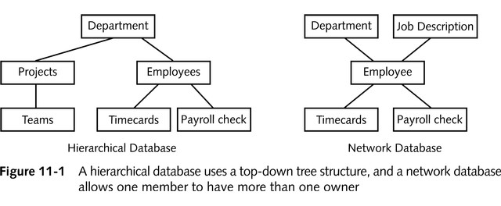
Hierarchical Databases

Slide 6
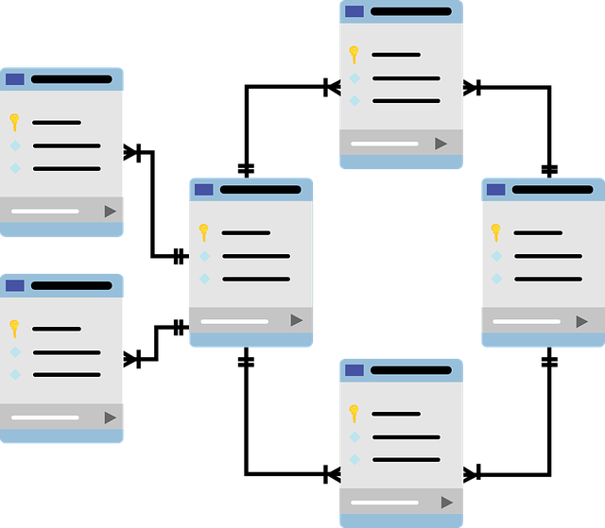
Relational Databases
Holds data in a group of tables that can be related to one another by columns they have in common
Column headings are called field names
Rows are called records, which are made up of individual fields
Each row of data can be identified uniquely by the content of one or more fields (primary key)
Result of a database search is called a query

Slide 7
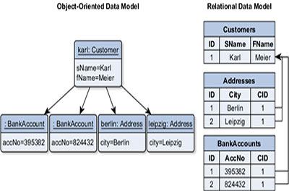
Object-oriented DataBase
Holds objects such as BLOB (Binary Large Object) data types that hold video clips, graphics, photographs, and other large binary data

Slide 8
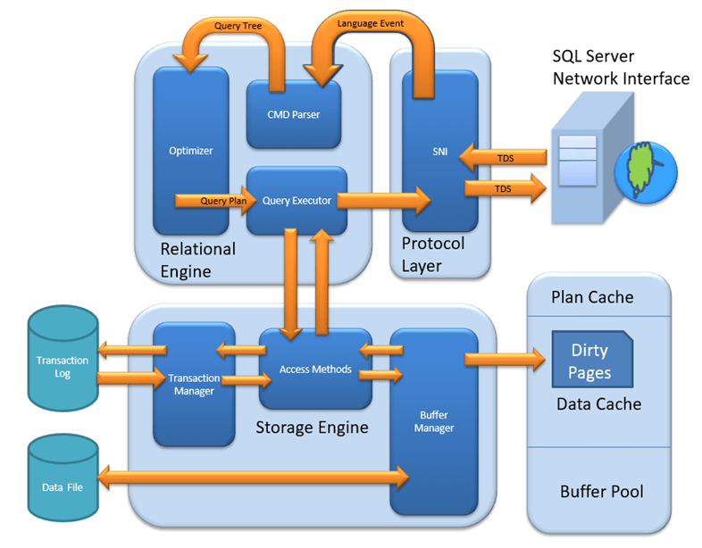
Use SQL (Structured Query Language) to Access Data
The standard for the command set used to interface with most databases
Database engine
  Applications software that provides a user with an interface to the DBMS
Database server
  Computer that contains the database and the DBMS

Slide 9
Summary
Type of databases (based on relationship of the data)
Database models (based on management software)
How to access the database (SQL)

Slide 10
Thank for attention

