Slide 1
CS 117: Computer Communications Networks:
The Physical Layer
Fall 2003
Instructor: Prof. Revaz Dzhanidze PhD.
3732K BH, Ph: 4-4579 revazd@cs.ucla.edu
TA:Justin Lomheim; 3704 BH: 5-8658 jlomheim@cs.ucla.edu

Slide 2
Office Hours (tentative)
Professor R. Dzhanidze 10:00-12:00 AM
Thursdays 3732K BH
TA - Lab 1 A Mondays 2:00-3:00 PM; 3704 BH
TA - Lab 1 B Mondays 3:00-4:00 PM; 3704 BH
TA – also, immediately prior and after labs (for a short period of time)
Additional lab time may be scheduled by appointment with the TA.
The TA may announce additional lab time during the quarter.
Newsgroup and Website
http://www.cs.ucla.edu/classes/fall03/cs117
ucla.classes.cs.cs117 - available on CSnet and SEASnet news servers

Slide 3
Course Objectives
To provide fundamental knowledge of the theory underlying optical, wire cable and wireless data communication systems relevant to digital data communications.
To provide hands-on experience by performing a series of laboratory experiments with a number of important laboratory instruments.
To gain experience in preparing formal technical projects and reports based upon laboratory experiments.

Slide 4
UNITS
CS 117 is a 6 unit course.
Workload
Weekly
• 4 hours lecture
• 3 hours prelab and homework
• 2 hours lab experiment
• 2 hours experiment report
• 6 hours outside study
Quarterly
• 9 hours course project

Slide 5
Course Projects
Project topics will be assigned to each student after all necessary experiments and reports have been completed by the student with a passing grade. Each student must turn in individually a single project. The project should be typed and spell-checked (no hand-written projects will be accepted). The graphs may be hand-drawn, but they should be neat and readable. The project should comply with the structural requirements set forth in the class handouts (an example class project and requirements can be found under the "Laboratory Project Sample" heading - there are also some guidelines just prior to the sample project).
Laboratory Experiments
Lab 1 - Signals in frequency and time domains
Lab 2 - Transmission Line Characteristics
Lab 3 - Amplitude Modulation (AM) & Frequency modulation (FM)
Lab 4 - Fiber-Optic in Digital Communication Systems
Lab 5 - Demodulation Regeneration of AM and FM signals
Lab 6 - Dense Wavelength Division Multoplexing (DWDM)
Lab 7 - 802.11b Wireless Experiment (tentative)

Slide 6
Grading
Grading:
Prelab and Homework (PH)=20%
Midterm (Md)=15%
Project (P)=40%
Final (F)=25%
Final Grade (FG) 100%

Slide 7
Recommended References
R Dzhanidze: Course Notes for CS 117. 2003.
Course Reader Material; 1137 Westwood Blvd. (310) 443 3300.
A. Tannenbaum. “Computer Networks”. Prentice Hall PTR. 2002.
W. Stallings. Data and Computer Communications. Prentice-Hall, 1996
M. Liu. "Principles and Applications of Optical Communications", Irwin 1996.

Slide 8
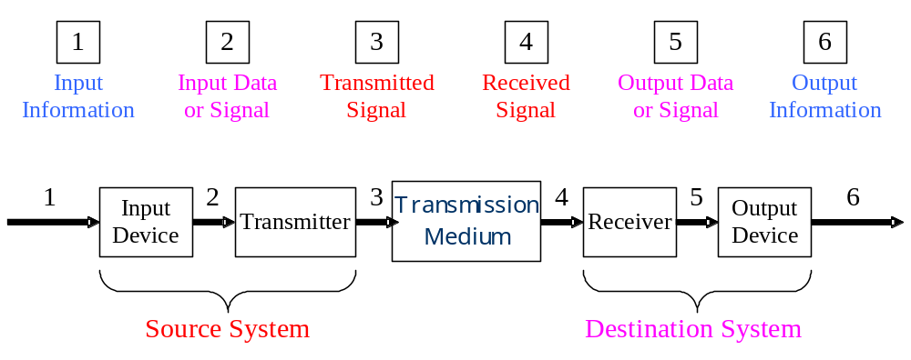
Thursdays
Communication Link
Data Communication Link

Slide 9
Lecture Schedule B.
Thursdays 2-3:50 PM
All Lectures in 9436 BH;
October 2nd; Lec#1: Signals in Time and Frequency Dom.
October 9th; Lec#2: Transmission Line Characteristics.
October 16th; Lec#3: AM and FM
October 23th; Lec#4: Fiber Optic Communication Link
October 30th; Lec#5: Optical Link Interfaces
November 6th; Lec#6: Demodulation of AM & FM Signals
November 13th Lec#7: DWDM Multiplex.
November 20nd; Concluding Lecture
November 27th; Holiday

Slide 10
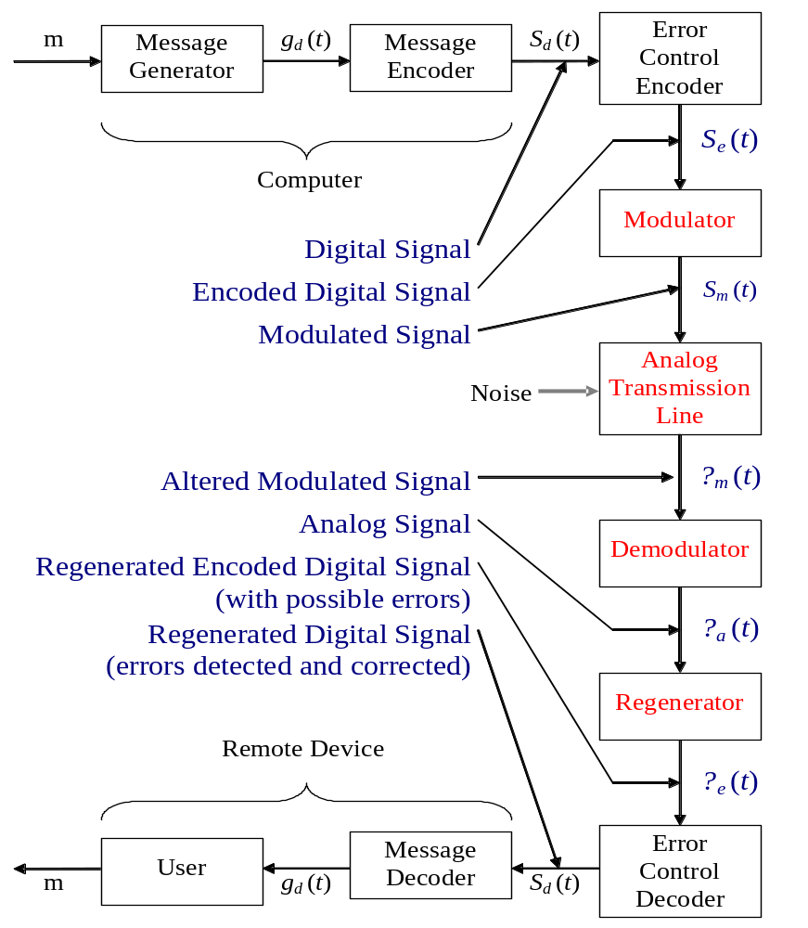
Example of a Computer Communication Systems
Tuesdays

Slide 11
Lecture Schedule A.
Tuesdays 2-3:50 PM
All Lectures in 9436 BH;
September 25th; Lec. #1: Introduction to CS 117 Course
Lec #2: Introduction to Computer communications
and Networking
September 30th; Lec #3: Data Link Layer protocols
October 7th; Lec #4: Network Layer in the Internet & TCP
October 14th; Lec #5: MAC Sublayer and LANs
October 21st; Midterm
October 28th; Lec #6: Wireless Communication Channel
November 4th Lec #7: Wireless LAN & MAC Layers
November 11th; Holiday
November 18th; Lec #8: Cellular LANs and The Mobile Telephones
November 25th; Lec. #9: Bluetooth Communications
December 9; Finals

Slide 12
2. Introduction to Data Communications and Networking
1. Communication Link
2. General Definition
3. Example of Computer Communication
Systems
4. Networking a. Telephone Network
b. Computer Networks
c. Cable Television
d. Wireless Networks.
5. Communication Standards a. System Interconnection
6. OSI/RM
7. Layer Descriptions
8. The TCP/IP Reference Model a. Protocol Hierarchies
9. Packet Switching and Circuit Switching
10. Connection-oriented and Connectionless
Services

Slide 13
3. Data Link Layer Protocols
1. Introduction
2. DLL Design | Network Layer Services Flow Control
3. Elementary DLL Protocols | Stop-and-Wait Protocol Simplex Protocol for Noisy Channels Sliding Window Protocols A One-bit Sliding Window A Protocol Using Go Back N
4. Network Layer in the Internet
5. Function of the IP Protocol | The Internet Protocol
6. The Gateways and Hosts
7. End-to-End Connectivity
8. The Internet Transport Protocol: UDP | Go-Back-N Sender, Receiver Windows
9. The Internet Transport Protocol: TCP | a. Framing b. link access c. TCP Flow Control d. TCP e. Congestion Control f. Error Detection g. Error Correction

Slide 14
4. MAC Sublayer and LANs
1. Introduction | a. multiplexing b. multiple access
2. Multiple Access Controla. | a. Pure aloha. b. Slotted Aloha
3. CSMA
4. CSMA/CD | a. 10BASE-2 Ethernet b. 10BASE-T Ethernet c. Switched Ethernet
5. Fast Ethernetsa. | a. 100BASE-TX Ethernet b. 10BASE-T4 Ethernet c. Gigabit Ethernet
6. Ethernet Limitations
7. Token Ring Networks | a. Multistation Access Unit b. Basic TRN operation. c. TRN Token and Frame Format d. TRN Operation
8. FDDI | a. FDDI Frame
9. Speed of LANs
10. Appendix | a. LAN Topologies
11. Conclusion

Slide 15
5. Digital and Analog Communications Network Services
2 a. LANs
2 b. Campus Networks
2 c. MANs
2 d. WANs
3 a. Circuits and Virtual Circuits
3 b. SVC Information Transfer
4 a. Development of Networks
4 b. Connectivity of the Analog Networks
4 c. Voice Network Technology
5 a. Analog and Digital Signals
5 b. Analog-to-Digital Conversation
5 c. Muxing Signals Up
7 a. Circuit Termination Equipment
7 b. DTE-to-DCE Interconnection
7 c. DCE-to-DCE Connection
8 a. Modem Concepts
8 b. UART
8 c. RS-232
8 d. Modem Signals
8 e. Modems and Modem Protocols
8 f. Modulation
8 g. Modem Operations
8 h. Timing
8 i. Data Compression and Error Control
8 j. Modem Compatibility
9 a. WANs Applications
10 a. Fundamentals of Microwave Comm.s
10 b. Microwave Comm. Components
11 a. Linking to a Satellite
11 b. Satellite Frequency Ranges
11 c. Bandwidth
1. Introduction
2. Classification of Networks
3. Physical and Logical Circuits
4. Voice Networks
5. Computer Data and the
Voice Network
6. Integration of Services
7. Connecting to WAN circuits
8. Connecting to Analog
Networks. Modems
9. End-to-End Connectivity
10. Microwave Communications
11. Satellite Communications
12. Conclusion

Slide 16
6. Communication Network Connectivity
1. Telecommunications
2. Classification of Networks
3. Physical and Logical Circuits
4. Voice Networks
5. Computer Data and the Voice Network
6. Integration of Services
7. Connecting to WAN circuits
8. Connecting to Analog Networks
9. End-to-End Connectivity
10. Microwave Communications
11. Satellite Communications
12. Conclusion

Slide 17
7. Wireless Communication Channel
1. Introduction?
2. Review of Modulation Techniques
3. Principles of Spread Spectrum Transmission
4. Types of Spread Spectrum Modulation
5. Direct Sequence Spread Spectrum Modulation
6. Application of DSSS in CDMA Cellular Service
7. Frequency Hopping Spread Spectrum (FHSS) Modulation
Details of Frequency Hoping Strategy in BreezeCom
Equipment
Data Transmission and Antenna Theory
10. Antenna Selection
11. Wireless Link Budget Analysis
12. Conclusion
13. Appendix

Slide 18
8. Wireless LANs and
Medium Access Control
1. Introduction
2. Wireless communication protocol stack
3. MAC Sublayer Protocol
4. Medium Access with Collision Avoidance (CSMA/CA)
5. The 802.11 Frame Structure
6. Details of Frequency Hoping Strategy in
BreezeCom Equipment
7. Structure of the Laboratory Wireless LAN
8. Conclusion

Slide 19
9. Cellular Netwotks,
The Mobile Telephone System
1. Introduction
2. First Generation Mobile Phones: Analog Voice
3. Second-Generation Mobile Phones: Digital; Voice
4. GSM-The Global System for Mobile Communications
5. Third-Generation Mobile Phones: Digital Voice and Data
2 a. Advanced Mobile Phone System
2 b. Channels
2 c. Call Managementa.
3 a. D-AMPS
4 a. CDMA-Code
Division Multiple
Access

Slide 20
10. Bluetooth Communications
1. Introduction
2. The Bluetooth Protocol Stock
  TCS (Telephony Control Protocol Specification)
  SDP (Service Discovery Protocol)
  WAP (Wireless Access Protocol)
  RFCOMM
  L2CAP
  The Host Controller Interface
  The Link Manager
  The Baseband and Link Controller
  The Radio
3. The OSI Reference Model
4. The Physical Layer
5. Piconets and Scatternets
6. Master-to-Slave Role Switching
7. Voice and Data Links
8. Discovering Bluetooth Devices
9. Conclusion

