Slide 1
suricata install
이경문

Slide 2
Why?
platform마다 compile & install 이 각기 다름
한번 익혀 두는 것이 좋음
https://redmine.openinfosecfoundation.org/projects/suricata/wiki/Suricata_Installation

Slide 3
Pre-installation requirements
sudo apt-get -y install libpcre3 libpcre3-dbg libpcre3-dev \
build-essential autoconf automake libtool libpcap-dev libnet1-dev \
libyaml-0-2 libyaml-dev zlib1g zlib1g-dev libcap-ng-dev libcap-ng0 libmagic-dev

Slide 4
HTP
wget http://www.openinfosecfoundation.org/download/libhtp-0.2.3.tar.gz
tar -xzvf libhtp-0.2.3.tar.gz
cd libhtp-0.2.3
./configure
make
sudo make install

Slide 5
IPS
sudo apt-get -y install libnetfilter-queue-dev libnetfilter-queue1 libnfnetlink-dev libnfnetlink0

Slide 6
Download suricata
wget http://www.openinfosecfoundation.org/download/suricata-1.4.4.tar.gz
tar -xvzf suricata-1.4.4.tar.gz
cd suricata-1.4.4

Slide 7
Compile and install the engine
./configure --enable-nfqueue --prefix=/usr --sysconfdir=/etc --localstatedir=/var

Slide 8
Auto setup
./configure
make
sudo make install-conf
sudo make install-rules
sudo make install-full

Slide 9
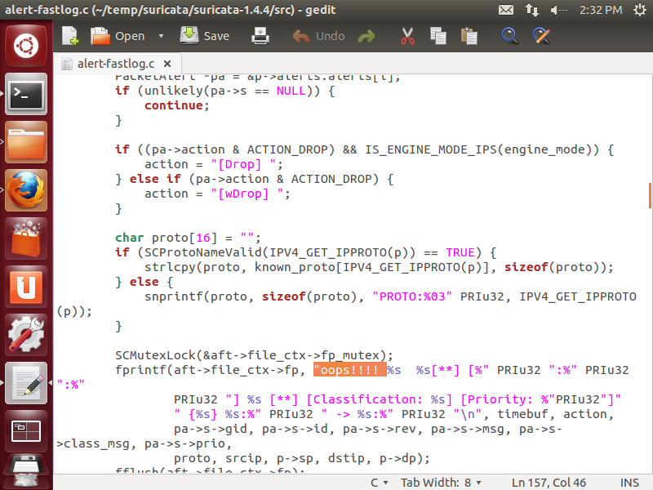
log source 변경
src/alert-fastlog.c 파일의 AlertFastLogIPv4 함수 하단의 fprintf 문에 테스트 코드를 추가하여 컴파일하고, 수정된 컴파일 모듈이 제대로 실행이 되는지 확인한다.

