Slide 1
BB-229
Writing Code With Your Data:
Basics of Data-Driven
Programming Techniques
Joe Matise
NORC at the University of Chicago
https://github.com/snoopy369/SESUG-2016

Slide 2
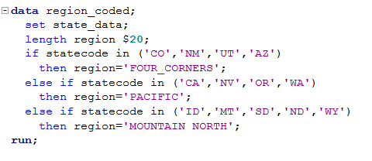
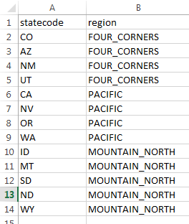
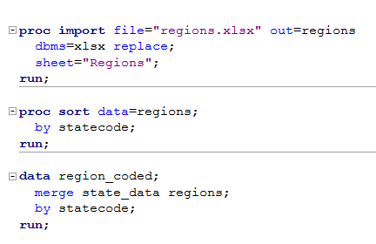
Data-Driven Programming
What is Data Driven Programming?
Moving information out of code, into data

Slide 3
Why Data-Driven Programming?
Less maintenance
Shorter and simpler code
Easier to understand
Run, maintained by non-programmer

Slide 4
Why Not Data-Driven Programming?
Enjoy typing
Job Security

Slide 5
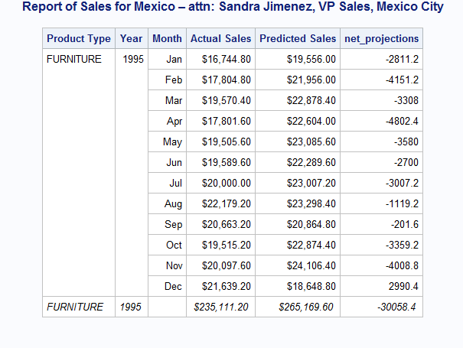
Our Example

Slide 6
Our Example (cont)
Uses data from SASHELP.PRDSAL2
Summarize ACTUAL and PREDICT by PRODTYPE, MONTH, YEAR
Separate report per COUNTRY, with some grouping to define REGIONs

Slide 7
Our Example: Initial Code
Data
data prdsal2_regions;
set sashelp.prdsal2;
select(country);
when('Mexico') region=1;
when('Canada') do;
if state in ('Ontario','Quebec') then region=2;
else region=3;
end;
when ('U.S.A.') do;
if state in ('New York') then region=4;
else if state in ('Illinois') then region=5;
else if state in ('North Carolina','Texas','Florida')
then region=6;
else region=7;
end;
otherwise;
end;
run;

Slide 8
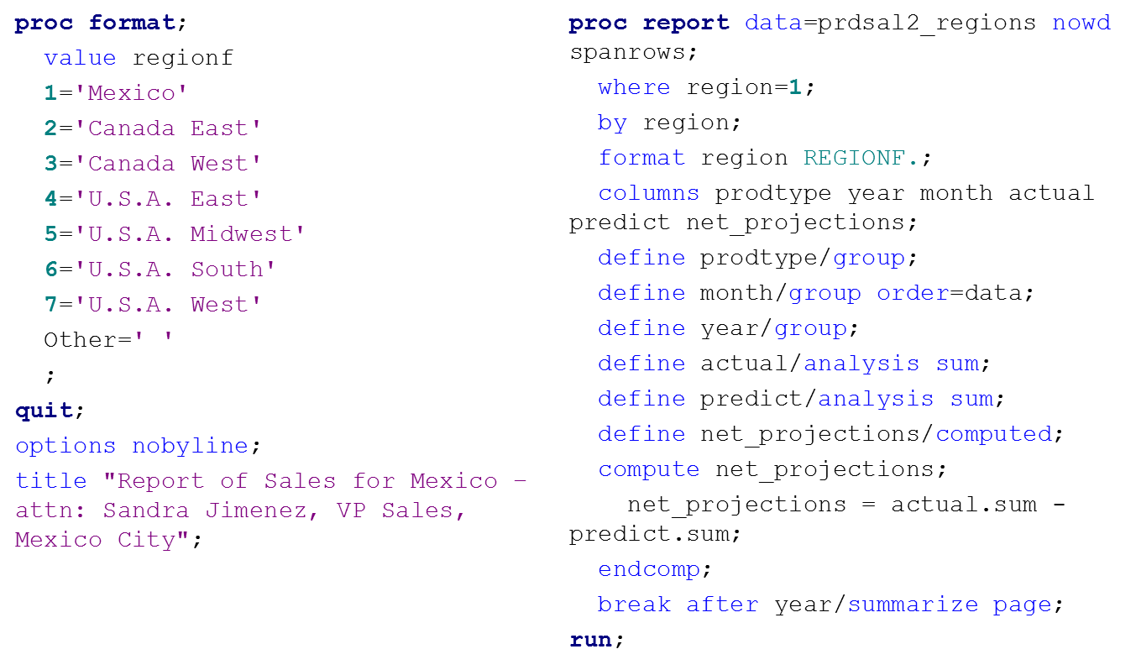
Our Example: Initial Code
Data

Slide 9
Using an External File
Store relationships like Country <-> Region in a data file rather than in code
  Easier to maintain relationships
  Easier to see relationships
  Code itself is simplified

Slide 10
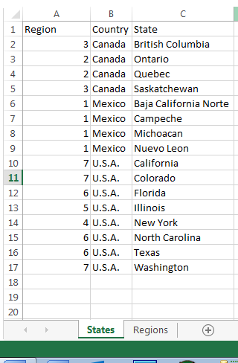
Using an External File
data prdsal2_regions;
set sashelp.prdsal2;
select(country);
when('Mexico') region=1;
when('Canada') do;
if state in ('Ontario','Quebec') then region=2;
else region=3;
end;
when ('U.S.A.') do;
if state in ('New York') then region=4;
else if state in ('Illinois') then region=5;
else if state in ('North Carolina','Texas','Florida')
then region=6;
...

Slide 11
Using an External File, cont.
libname mydata xlsx "C:\Users\matise-joe\Documents\SESUG2016 BB229 Data.xlsx";
proc sort data=mydata.states out=states;
by country state;
run;
proc sort data=sashelp.prdsal2 out=prdsal2;
by country state;
run;
data prdsal2_regions;
merge prdsal2 states;
by country state;
run;

Slide 12
Using an External File, cont.
  Other options for adding the information:
  Format (use CNTLIN option)
  Hash table
  SQL (JOIN or UPDATE)
  Set statement

Slide 13
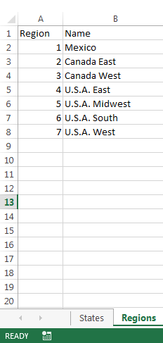
Importing Formats
proc format;
value regionf
1='Mexico'
2='Canada East'
3='Canada West'
4='U.S.A. East'
5='U.S.A. Midwest'
6='U.S.A. South'
7='U.S.A. West'
Other=' '
;
quit;

Slide 14
Importing Formats, cont.
data for_format;
set mydata.regions;
start = region;
label = name;
fmtname = 'REGIONF';
output;
if _n_=1 then do;
hlo='o';
label=' ';
output;
end;
run;
proc format cntlin=for_format;
quit;

Slide 15
Calling a Repeated Macro:
A Control File
  Write a macro for the section of repeated code, with parameters for the portions that change
  Store the information needed to populate those parameters in an external file (such as excel)
  Call the macro programmatically from the data in the external file

Slide 16
Calling a Repeated Macro, cont.
%macro run_region_report(region=, to=);
title "Report of Sales for #byval(region) – attn: &to.";
proc report data=prdsal2_regions nowd spanrows;
where region=&region.;
by region;
format region REGIONF.;
columns prodtype year month actual predict net_projections;
define prodtype/group;
define month/group order=data;
define year/group;
define actual/analysis sum;
define predict/analysis sum;
define net_projections/computed;
compute net_projections;
net_projections = actual.sum - predict.sum;
endcomp;
break after year/summarize page;
run;
%mend run_region_report;

Slide 17
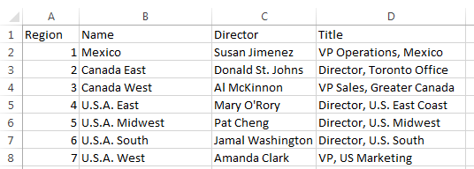
Calling a Repeated Macro, cont.
proc sql;
select
cats('%run_region_report(region=',region,',to=%nrbquote(',
director,'-',title,'))')
into :report_list separated by ' '
from mydata.regions
;
quit;
&report_list.

Slide 18
Some Other Tricks
Other methods of writing code
  CALL EXECUTE
  %INCLUDE
Summary PROCs can be helpful in writing code (FREQ, MEANS)
Dictionary Tables/Views

Slide 19
Takeaways
Data-driven code is easier, simpler, faster
Look for opportunities to move to data
Keep learning new tools
Data consistency becomes key
Don’t over-complicate!

Slide 20
Questions?
Further reading (list in paper)
Contact author:
  SAS-L (sas-l@listserv.uga.edu)
  Stack Overflow (www.stackoverflow.com)
  Email (Matise.Joe@gmail.com)
Thanks!

