Slide 1
Circuit Learning
presenter:吳宥璁 宋哲寬

Slide 2
Problem formulation
(ICCAD 2019)
Input
Black Box
Output
Black box
unlimited try
find minimal Boolean logic circuit represent the input-output relation
http://iccad-contest.org/2019/problems.html

Slide 3
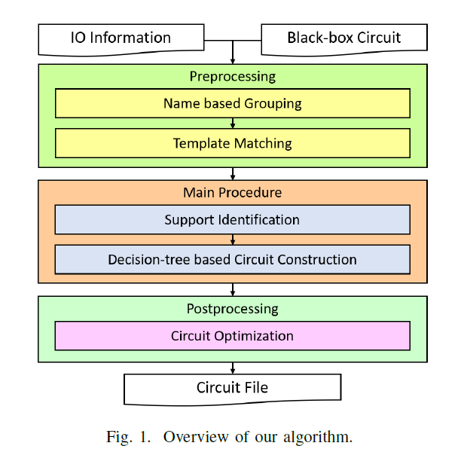
Previous Work
Circuit Learning for Logic Regression on High Dimensional Boolean Space
Pei-Wei Chen;Yu-Ching Huang;Cheng-Lin Lee;Jie-Hong Roland Jiang 2020 57th ACM/IEEE Design Automation Conference (DAC)

Slide 4
Framework
Based on knowing nothing information about input and output but the number
Seperate the Outputs, process on one output each time

Slide 5
Framework
Support Identification
Random generate a pattern
Flip each input to form a new pattern
XOR the outputs to check the input is in output
Repeat for N times

Slide 6
Framework
Decision-Tree Based Circuit Construction
For each output build one tree
At each node choose the input which most frequently changing the output when flipping it, until touch the constant node.
Collect the constant “1” node to form sum-of-product

Slide 7
Bottleneck
Black-Box IO bottleneck
It’s time-consuming to re-simulate the patterns at each decision node

Slide 8
consider F = ab+ efgh
Root
a
~a
b
~b
e
~e
need 6 layer to find all onset
e
~e
f
~f
f
~f
g
~g
g
~g
h
~h
h
~h

Slide 9
we want to use smaller layer to find the onset
Root
Root
e
~e
a
~a
f
~f
b
~b
g
~g
h
~h

Slide 10
Prime
For each output. aim to find “prime” to reduce the search space

Slide 11
New method
Use two kinds of decision tree.
One searches from most frequently variable
One searches from least frequently variable

Slide 12
New method
When finding one cube
use the cube’s negation to establish the constraint
Need storing the exploring node information
Re-construct the tree until finding next cube

Slide 13
Single pattern flipping
Random generate a single pattern, flip a input at each time. Find the inputs which cause variation (from 1 to 0) to form a cube.
Generate lots of cubes by lots of “single” patterns
Group cube by their common inputs.

Slide 14
Single pattern flipping
Fix the “group cube” to find the support.
If support set is small, then Brute force.
Otherwise, recursively do the single pattern flipping

Slide 15
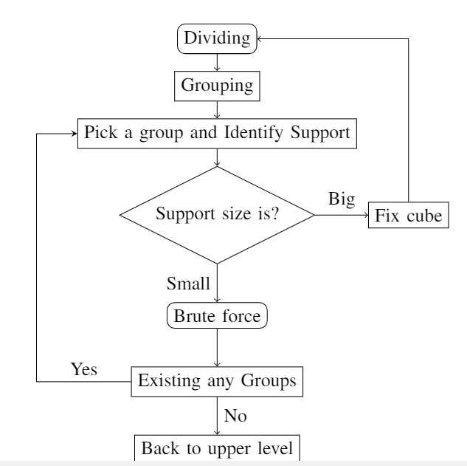
Single pattern flipping flow

Slide 16
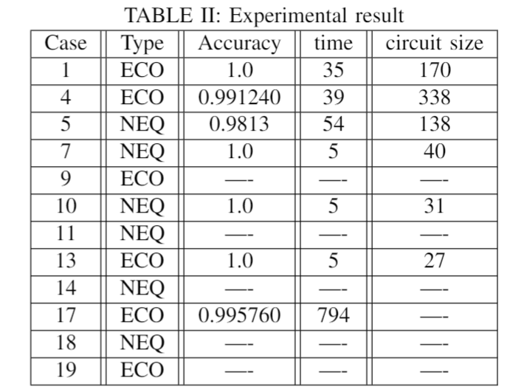
Result(reproduce)
time constraint : 3600s, test_size = 100k

Slide 17
Q&A

