Slide 1

ChatAVR
Pax challenge @

Slide 2
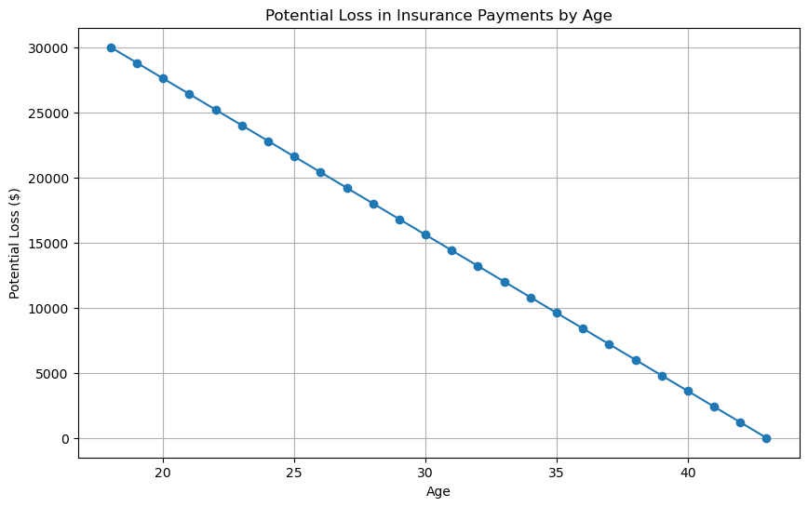
Background
Average age of life insurance buyers are 43 years old¹
Average monthly cost of life insurance is 100 CHF/month²
Average attention span is 47 seconds³
Younger generations do not have patience for reading documentation
Need a way to have friendly way to interact with documentation without clicking on all the links
Why not have central index of truth for easy answers?
BEAR DEATH FACT:
A 71-year-old woman from California, became the state's first recorded fatality from a black bear attack.
https://lewisellis.com/industries/life-insurance-annuities/the-characteristics-of-people-who-buy-life-insurance/
https://en.comparis.ch/lebensversicherung/default
https://www.apa.org/news/podcasts/speaking-of-psychology/attention-spans
Notes:
Why did we choose the challenge?

Slide 3
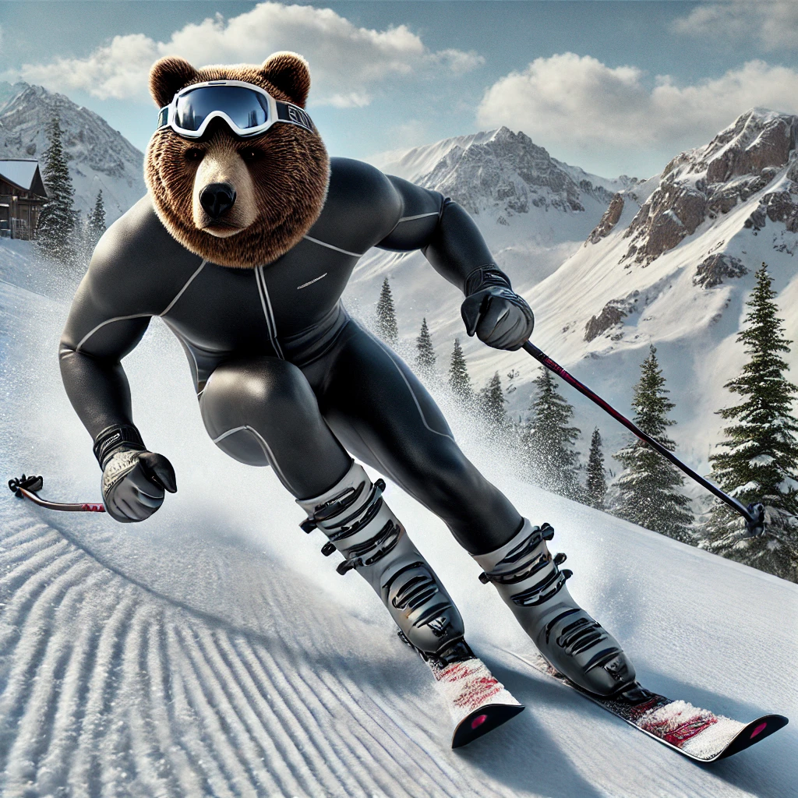
How do we get attention?
Targetted ads using TikTok¹
Gender
Age: 18-24, 25-34, 35-44 (get our three target groups)
Location (can be specific as city): Basel
Interests (get tailored videos)
Cell phone carrier: insure living in Switzerland
Create cool video of activities like ski tricks and voice over: want some of that life insurance (pssst… key kid)
BEAR DEATH FACT:
A teenager in Romania was mauled to death by a bear while hiking in the Bucegi mountains.
https://ads.tiktok.com/help/article/ad-targeting
Image generated by DALL-E

Slide 4

ChatAVB.com
What is the purpose of the application?
What are we offering?
PAX disability insurance
PAX life insurance
PAX savings life insurance
TRY IT OUT NOW →
BEAR DEATH FACT:
The "Ninja Bear," officially designated as "OSO18," was notorious in Japan's Hokkaido region
for attacking dozens of cows and evading capture for years

Slide 5

What is NAVBÄR
Friendly chat bear who want to help you select the bear insurance
Indexed webpage and documentation to provide detailed responses to questions
BEAR DEATH FACT:
Grizzly No. 399, a beloved bear in Grand Teton National Park, was killed by a vehicle,
leading to a community vigil in her honor.

Slide 6
Team
Fabrizio Parrillo
Alex Rovner
Niluka Piyasinghe
Normand Overney
Kevin Yar
BEAR DEATH FACT:
Hugh Glass, a 19th-century fur trapper, survived a grizzly bear mauling and crawled over 200 miles to safety,
inspiring the film "The Revenant."

