Slide 1

NAVBÄR
Pax challenge @

Slide 2
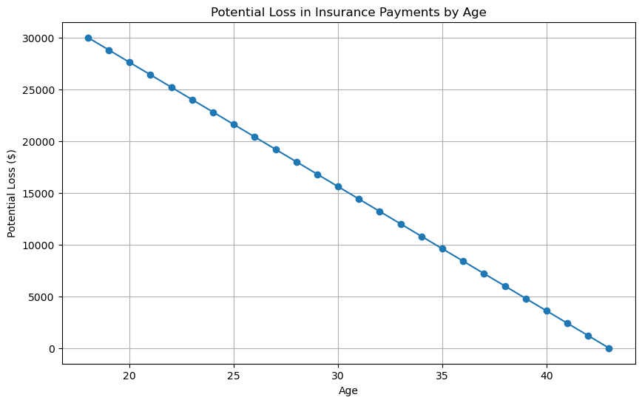
Background
Average age of life insurance buyers are 43 years old¹
Average monthly cost of life insurance is 100 CHF/month²
Average attention span is 47 seconds³
Younger generations do not have patience for reading documentation
Need a way to have friendly way to interact with documentation without clicking on all the links
Why not have central index of truth for easy answers?
BEAR DEATH FACT:
A 71-year-old woman from California, became the state's first recorded fatality from a black bear attack.
https://lewisellis.com/industries/life-insurance-annuities/the-characteristics-of-people-who-buy-life-insurance/
https://en.comparis.ch/lebensversicherung/default
https://www.apa.org/news/podcasts/speaking-of-psychology/attention-spans
Notes:
Why did we choose the challenge?

Slide 3
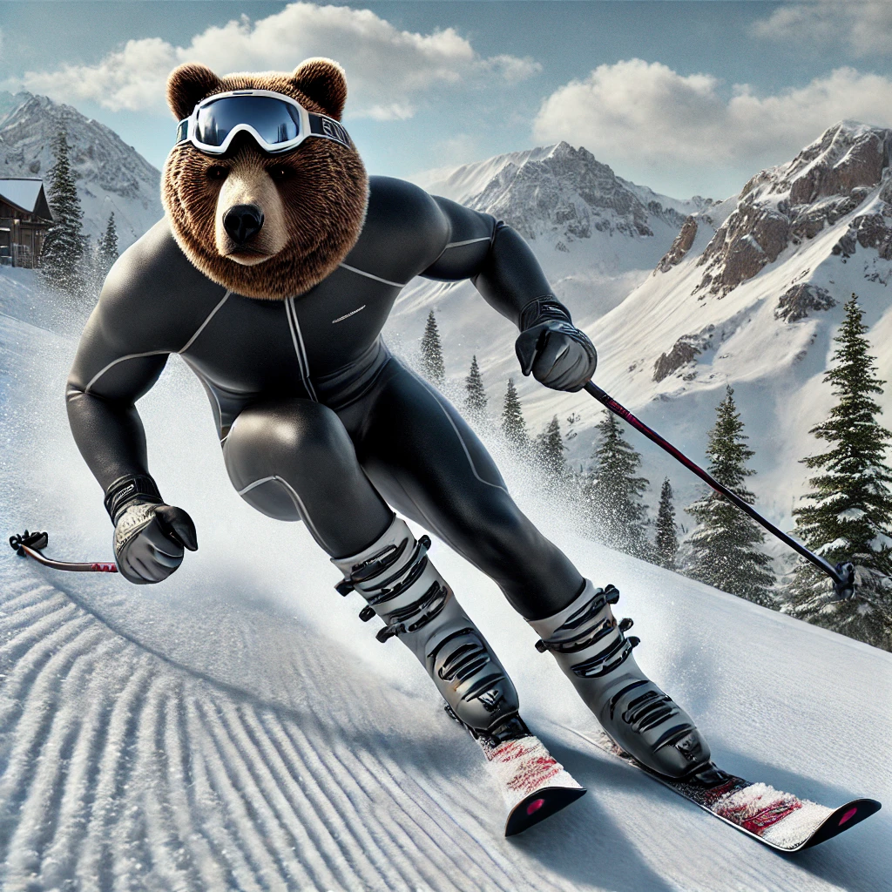
How do we get attention?
Targetted ads using TikTok¹
Gender
Age: 18-24, 25-34, 35-44 (get our three target groups)
Location (can be specific as city): Basel
Interests (get tailored videos)
Cell phone carrier: insure living in Switzerland
Create cool video of activities like ski tricks and voice over: want some of that life insurance (pssst… key kid)
BEAR DEATH FACT:
A teenager in Romania was mauled to death by a bear while hiking in the Bucegi mountains.
https://ads.tiktok.com/help/article/ad-targeting
Image generated by DALL-E

Slide 4

ChatAVB.com
Chat with NAVBÄR now →
What is the purpose of the application?
What are we offering from PAX?
disability insurance
life insurance
savings life insurance
children's insurance
payout plan
BEAR DEATH FACT:
The "Ninja Bear," officially designated as "OSO18," was notorious in Japan's Hokkaido region
for attacking dozens of cows and evading capture for years

Slide 5

What is NAVBÄR
Friendly chat bear who want to help you select the bear insurance
Indexed webpage and documentation to provide detailed responses to questions
Microsoft AI search
ChatGPT 4o
RAG
BEAR DEATH FACT:
Grizzly No. 399, a beloved bear in Grand Teton National Park, was killed by a vehicle,
leading to a community vigil in her honor.

Slide 6
Team
Fabrizio Parrillo
Alex Rovner
Niluka Piyasinghe
Normand Overney
Kevin Yar
BEAR DEATH FACT:
Hugh Glass, a 19th-century fur trapper, survived a grizzly bear mauling and crawled over 200 miles to safety,
inspiring the film "The Revenant."

