Slide 1
My little Reddit “bot” - in Python
Steve Brorens (@snori74)

Slide 2
LinuxUpskillChallenge.org
A month-long course aimed at those who aspire to get Linux-related jobs in industry - junior Linux sysadmin, devops-related work and similar.
Server focussed and commandline, designed to be well-suited to a Windows or Apple person as well as those that already using Linux in some form.

Slide 3
LinuxUpskillChallenge.org
Repeats each month
Starts on the first Monday of the month
Twenty “bite-sized” lessons, one each workday
Just the last four lessons are available
....and completely free!

Slide 4
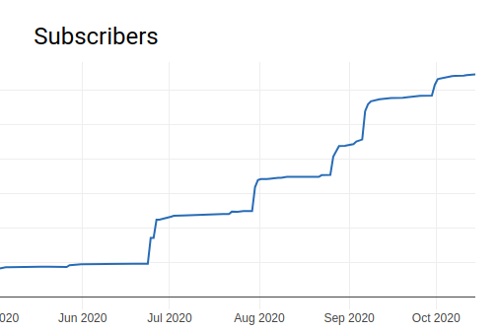
500+ sign ups each month

Slide 5
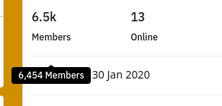
Sign-ups – in 8 months

Slide 6
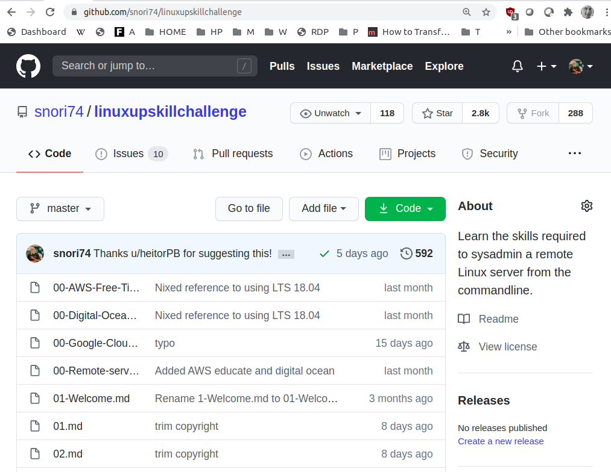
Course content kept in GitHub

Slide 7
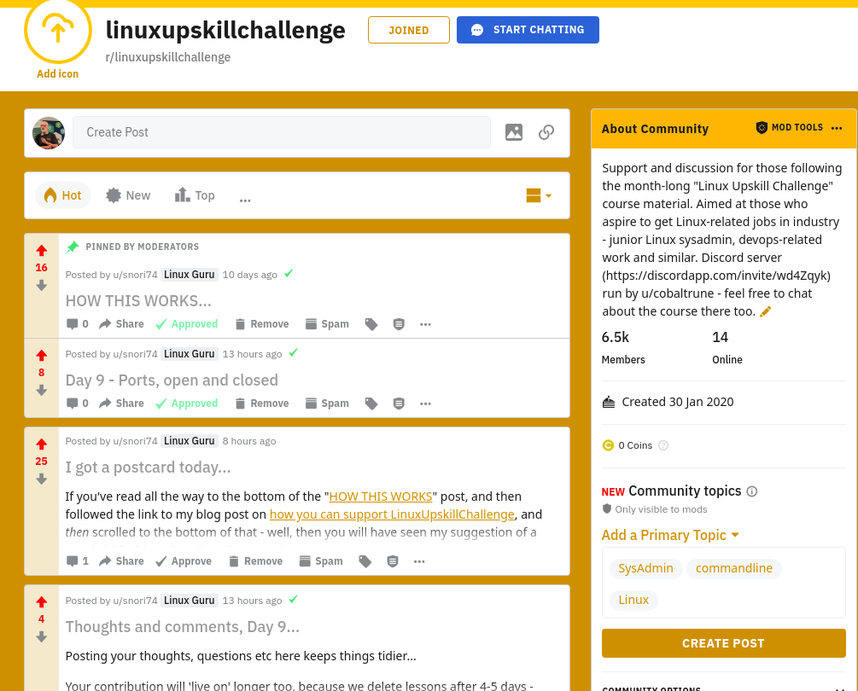
...and posted to Reddit

Slide 8
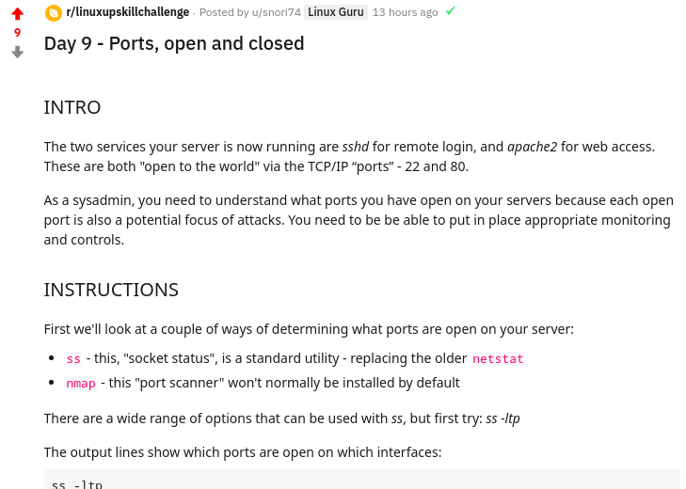
...like this:

Slide 9
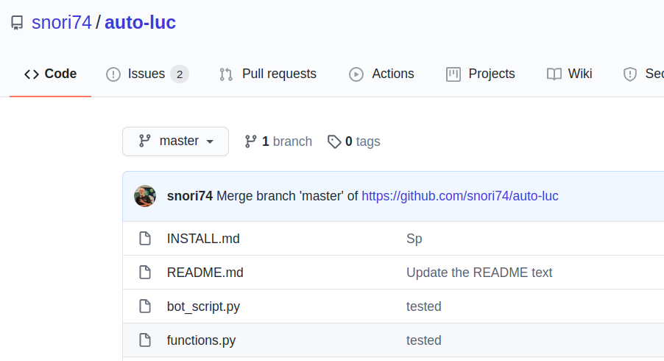
The “bot” code is also on GitHub:

Slide 10
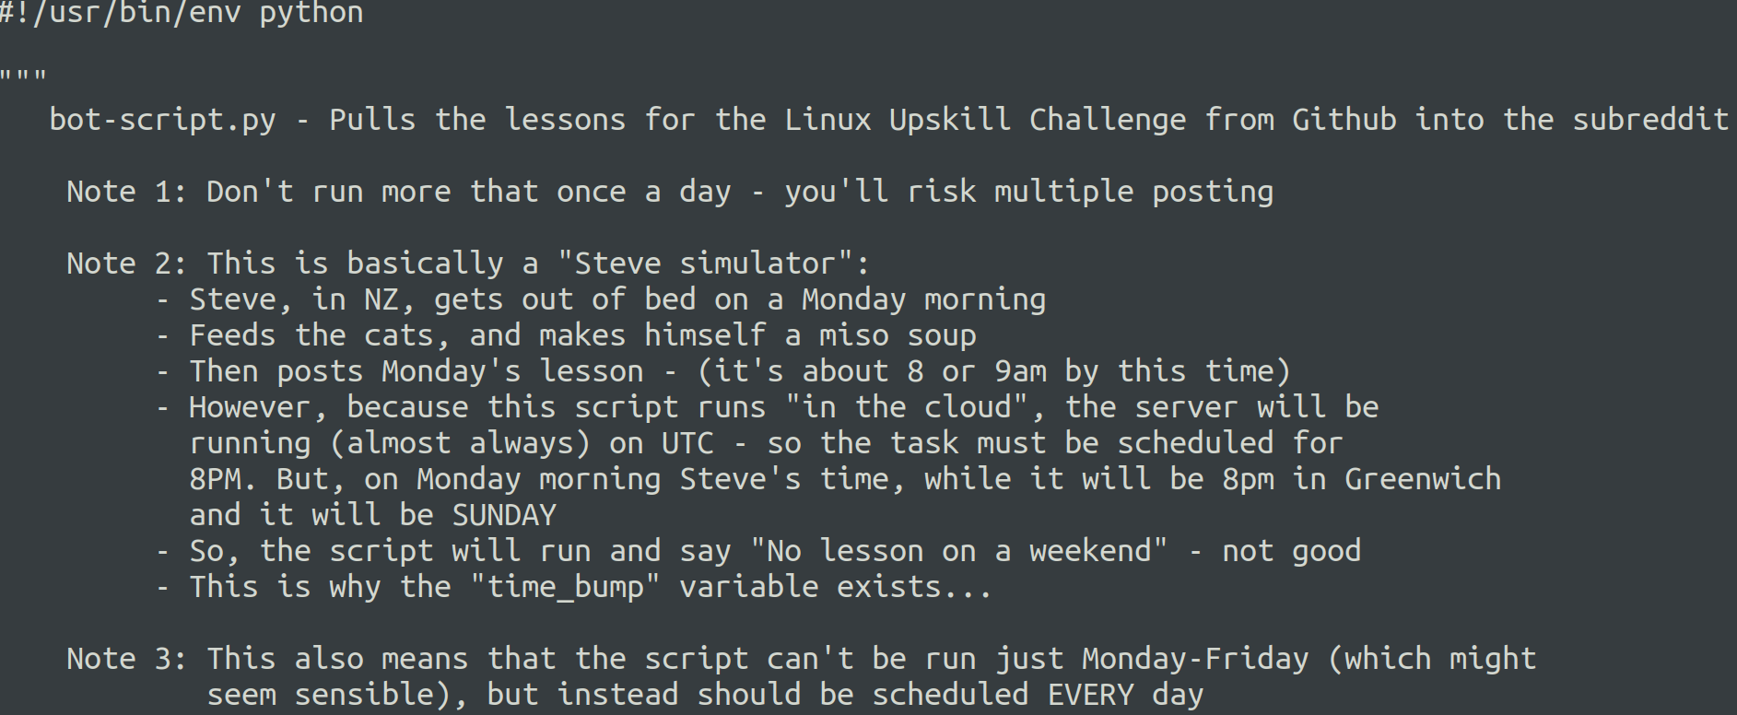
The Python code:

Slide 11
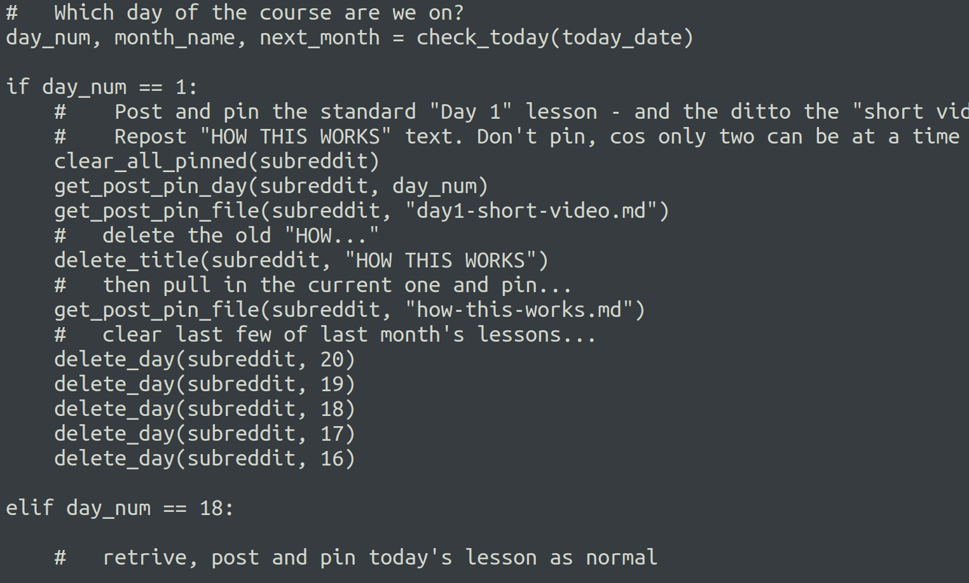
...and more

Slide 12
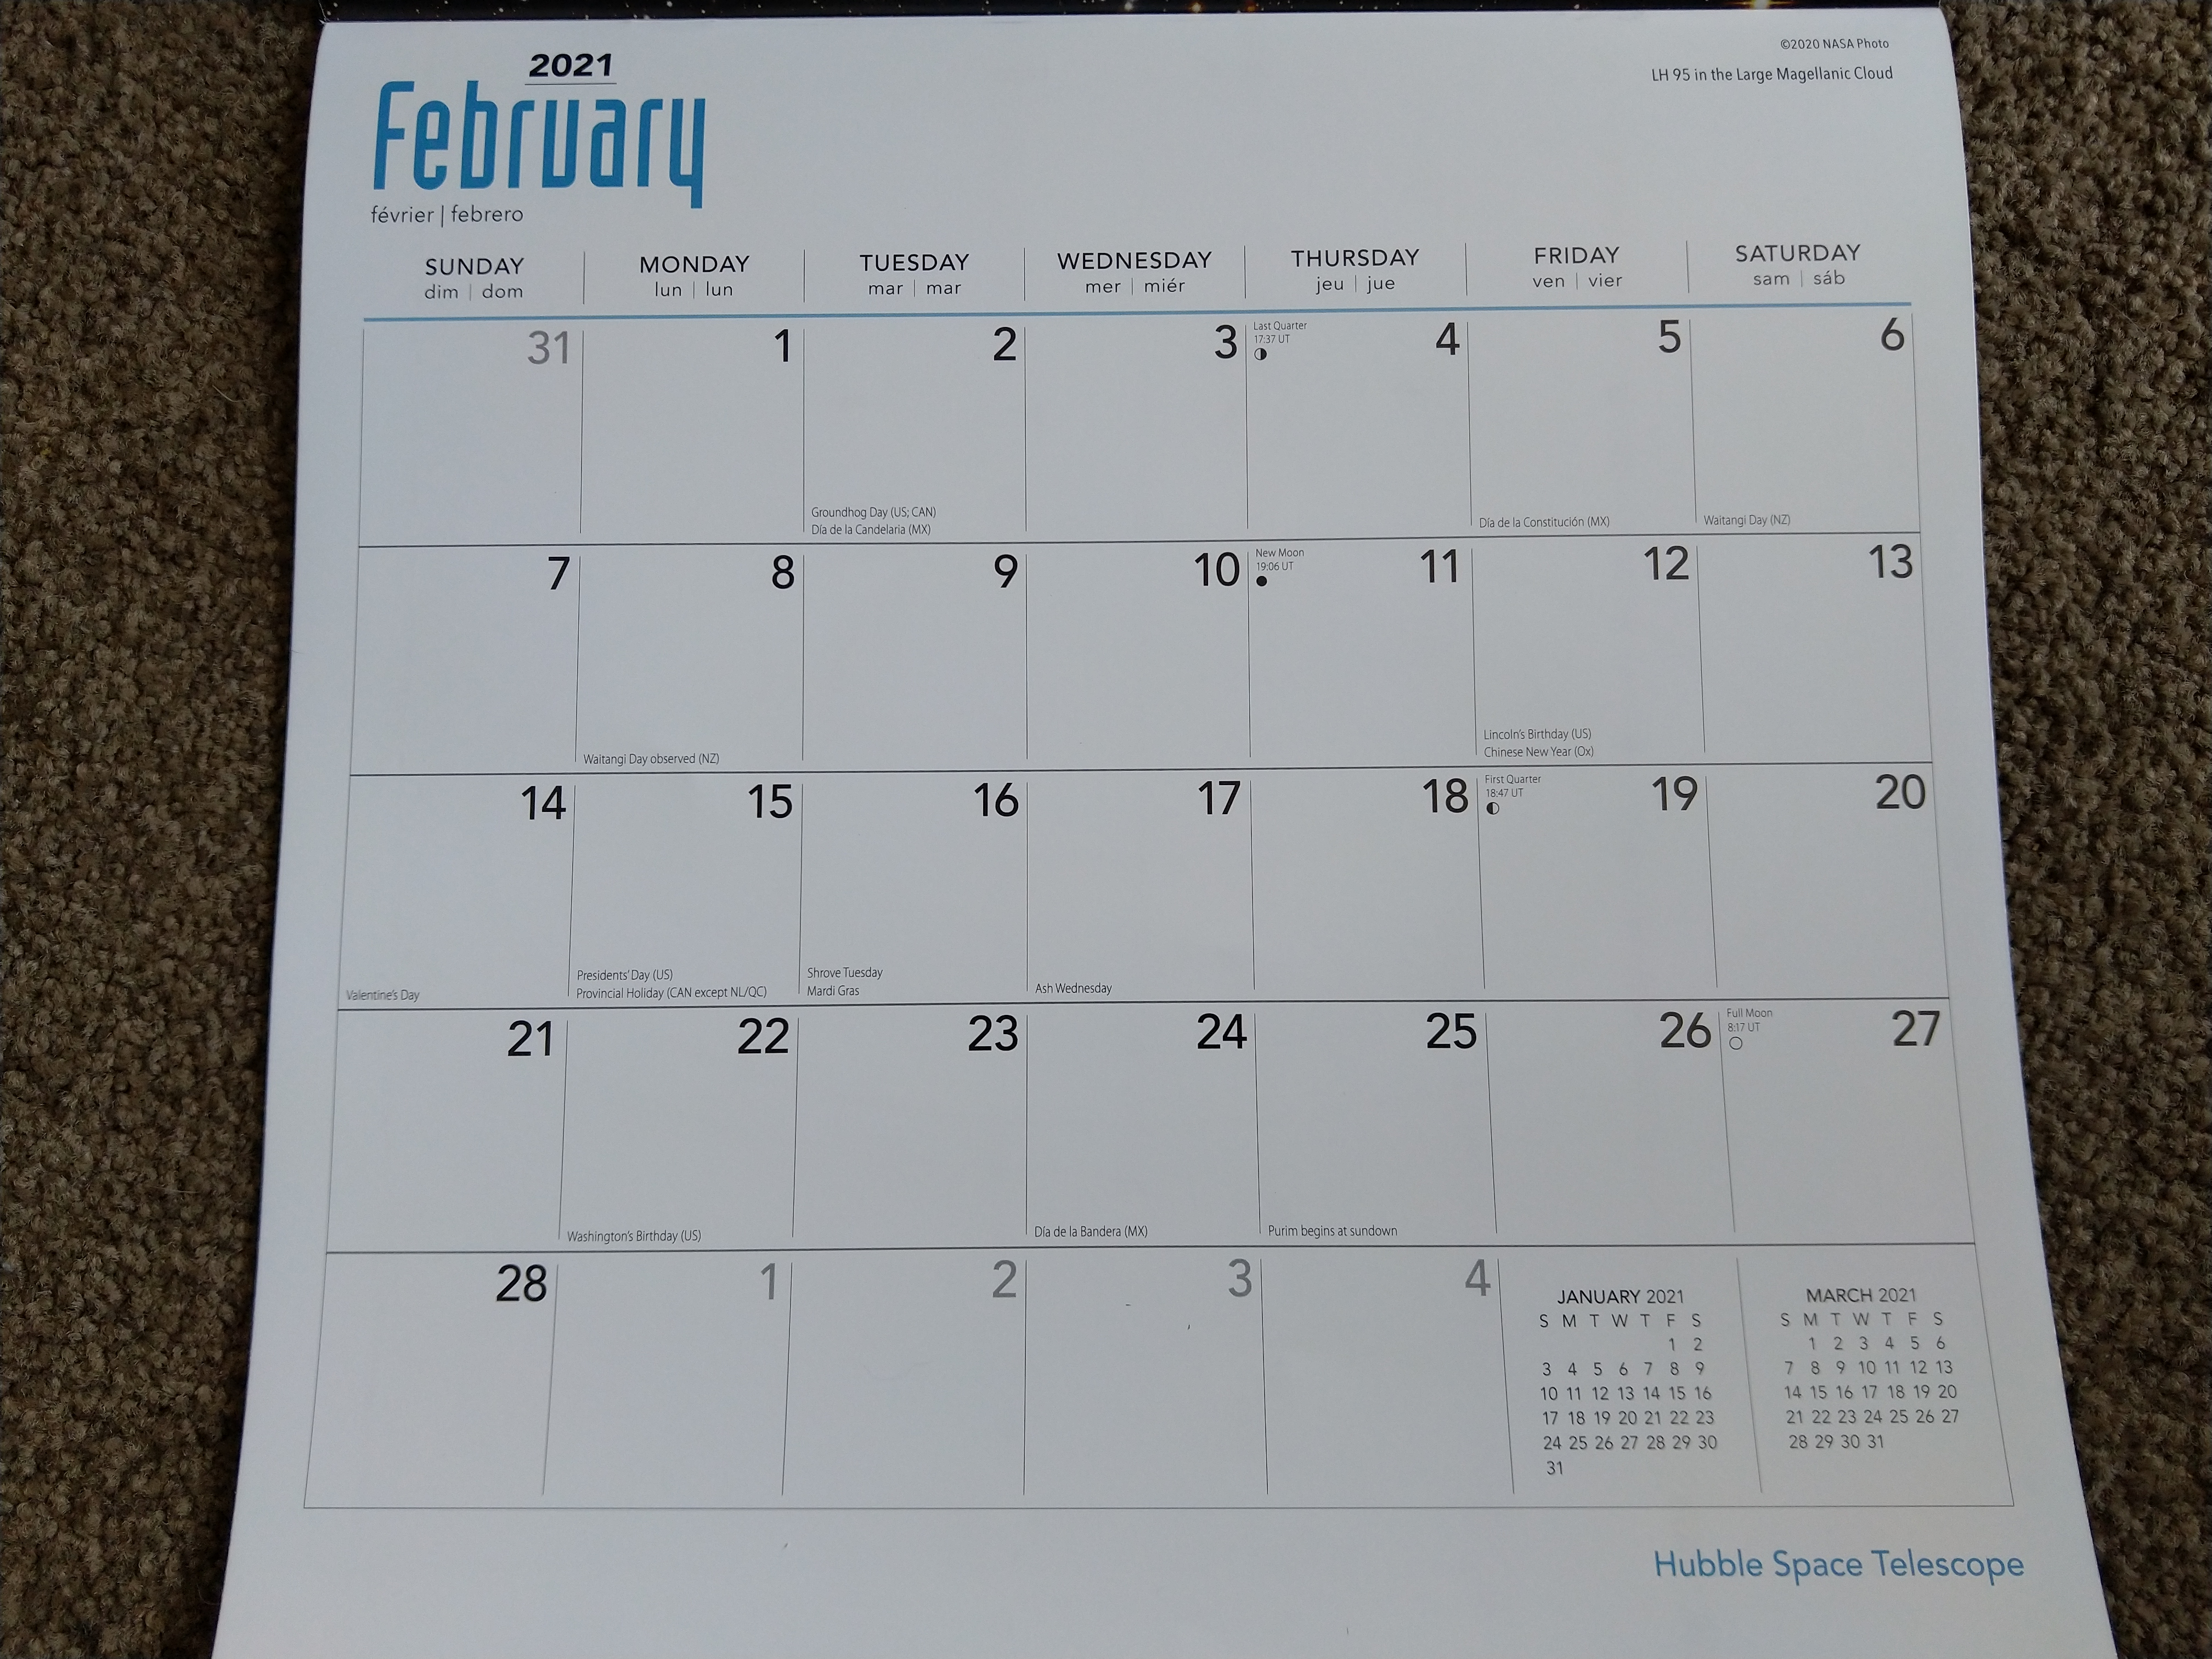
How you think it works...

Slide 13
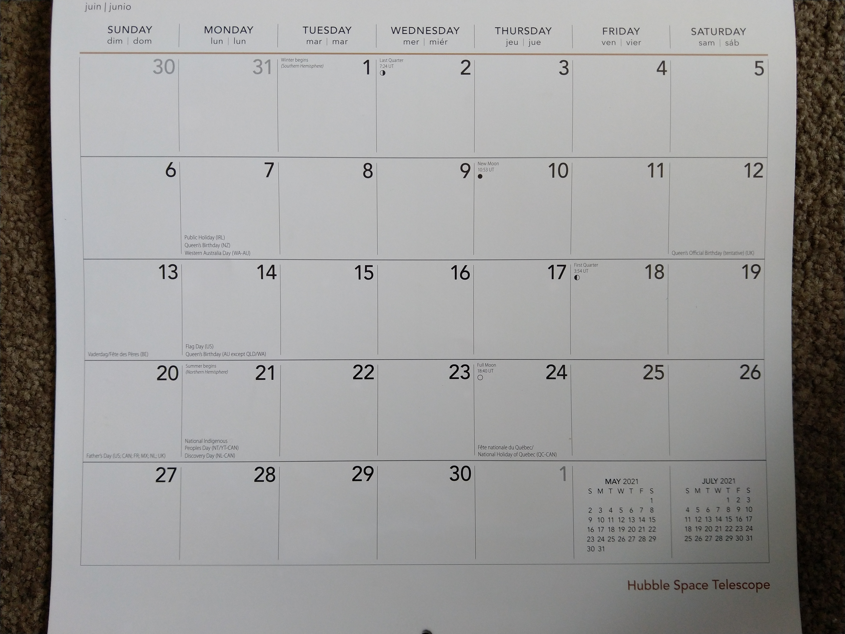
...but sometime you get this!

Slide 14
..including some “corner cases”...
Starts as late as the 7th of the month
Last lessons of <MONTH> are in <MONTH+1>
A whole week's gap at the end

Slide 15
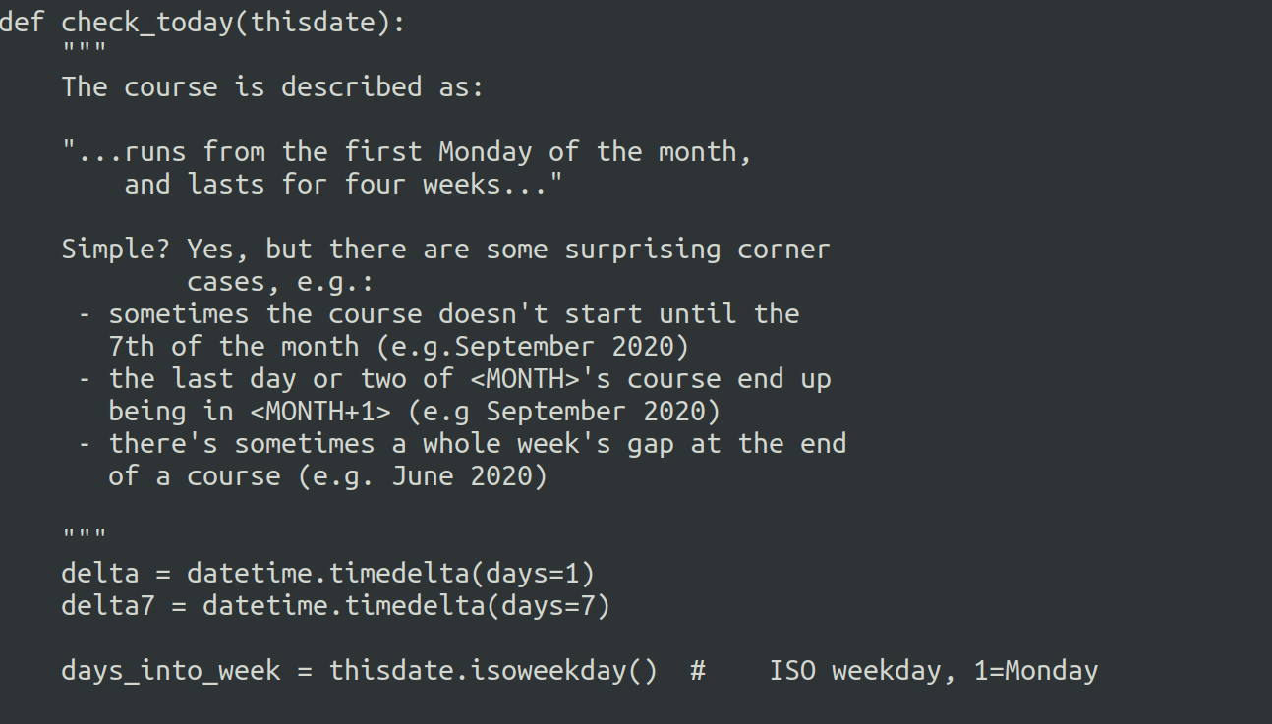
Document the “corner cases”

Slide 16
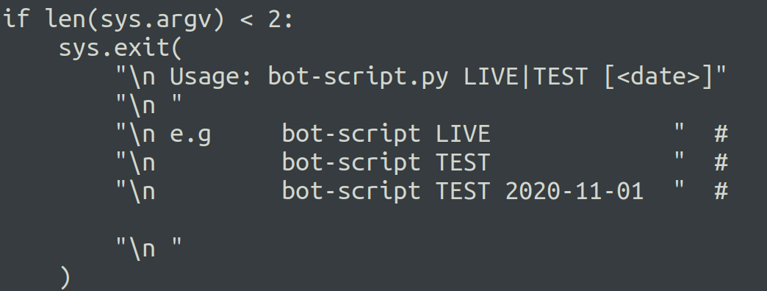
Testing

Slide 17
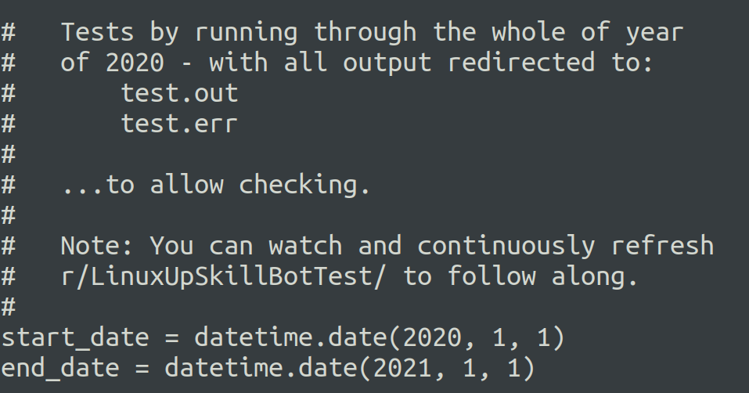
Testing

Slide 18
Summary
LinuxUpskillChallenge.org
github.com/snori74/auto-luc
r/linuxupskillchallenge
- Steve Brorens (@snori74)

