Slide 1
Shree Hari Jewels — Complete ERP Guide
Every Module · Every Step · With Screenshots ERP: https://shri-hari-jewels.vercel.app | Store: https://shri-hari-jewels.vercel.app/shop/shree-hari-jewels

Slide 2
What's Inside This Guide
Step 1: Part 1 — Getting Started: Login, Dashboard, Settings, Branches
Step 2: Part 2 — Central Stock: Add products, add units, entry verification
Step 3: Part 3 — Raw Materials: Metal lots, certified stones, bulk stone stock
Step 4: Part 4 — Production: Motifs, Designs (6-stage builder), Production Runs (10 stages), Karigar settlements
Step 5: Part 5 — Stock Transfer: Scan & send, sent list, proforma, incoming receive
Step 6: Part 6 — Sales & CRM: POS, custom orders, customers, invoices
Step 7: Part 7 — Reports: GST, stock valuation, ageing, analytics
Step 8: Part 8 — Online Store: Website setup, customer journey, web order fulfillment

Slide 3
Part 1
Getting Started
Login · Dashboard · Settings · Branches

Slide 4
How to Log In
Step 1: Open https://shri-hari-jewels.vercel.app/login in your browser
Step 2: Enter your User ID or email (e.g. admin@shreehari.com)
Step 3: Enter your password → click Sign In
Step 4: If 2FA is enabled, enter the 6-digit code from your authenticator app
Step 5: You land on the Dashboard — your home screen
Each staff member has a role (Admin, Store, Production Manager, etc.) that controls which menus they see.

Slide 5
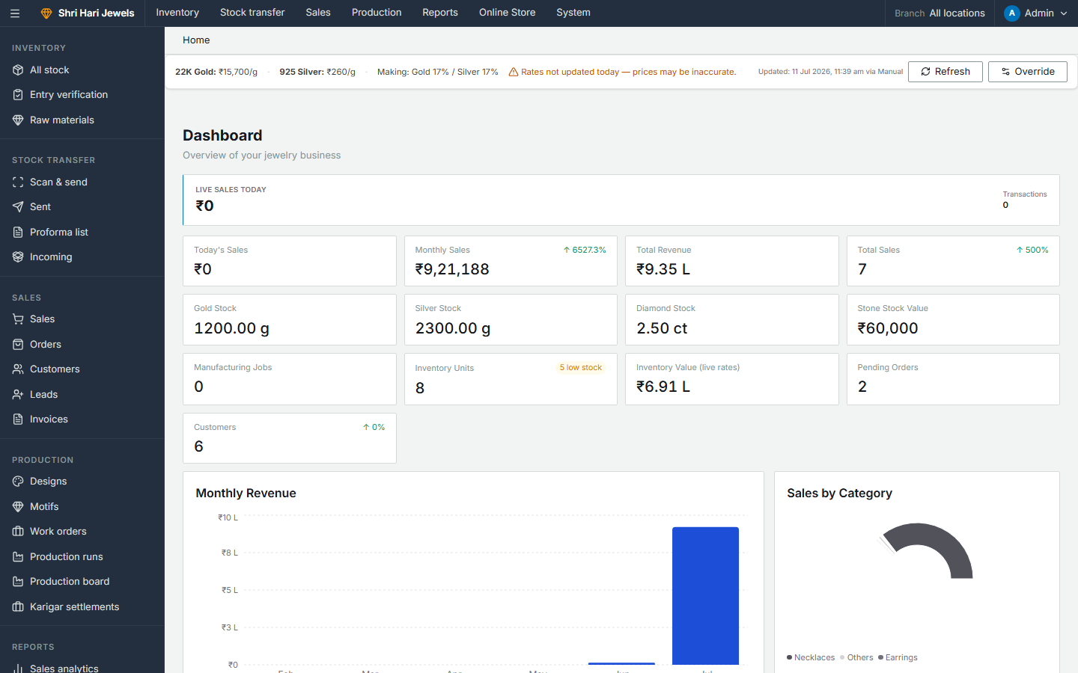
Dashboard — Your Home Screen
Steps:
• See overview stats: stock, sales, pending orders
• Market rate banner shows live gold/silver prices
• Sidebar gives access to all modules
• Switch branch from top bar if you have multiple locations
ERP → Dashboard

Slide 6
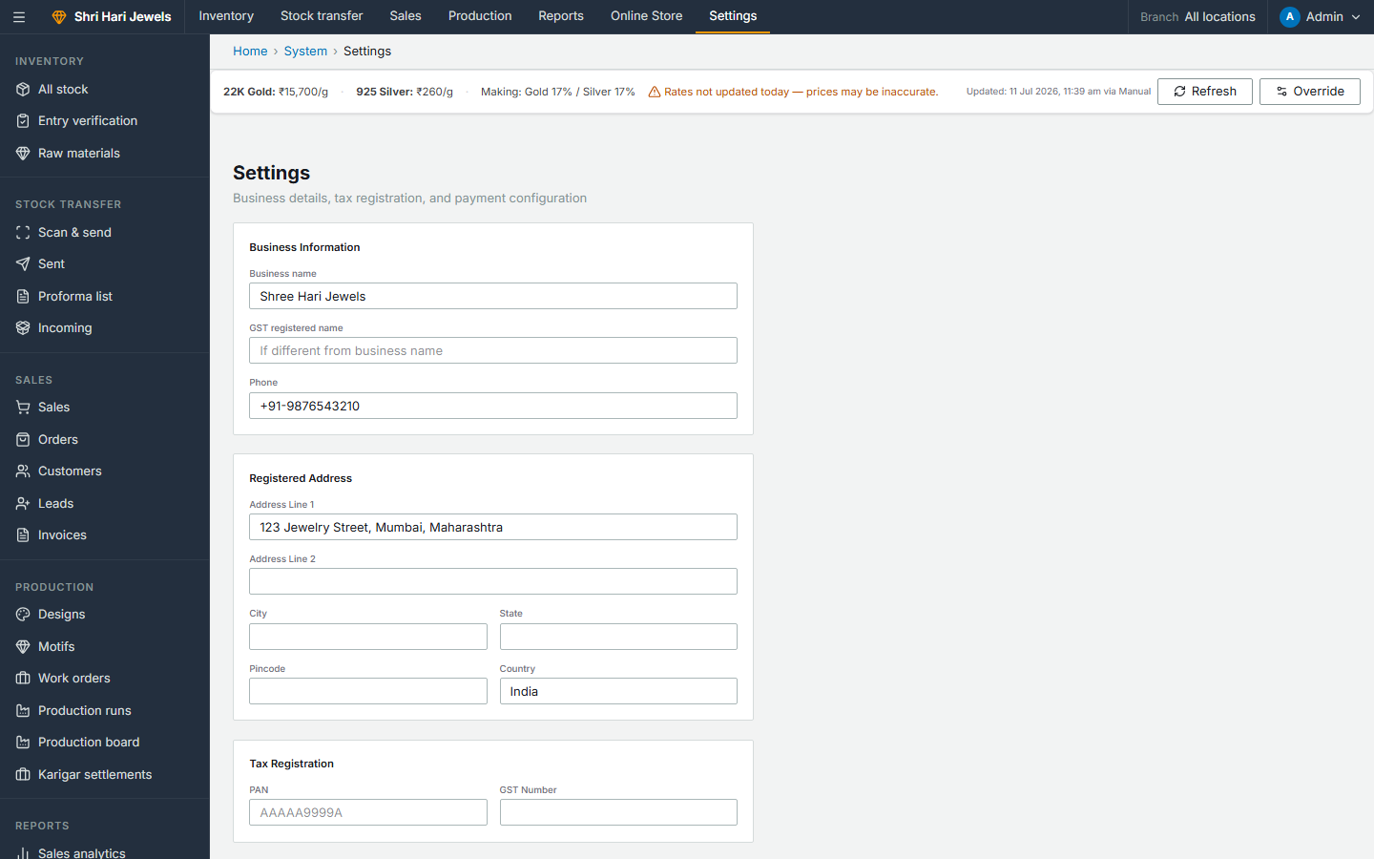
Settings — Business Configuration
Steps:
• Set business name, GST number, PAN, bank details
• Configure making charge % for gold and silver
• Set discount approval threshold (discounts above this need admin approval)
• Manage users: create staff, assign roles and branches
ERP → System → Settings

Slide 7
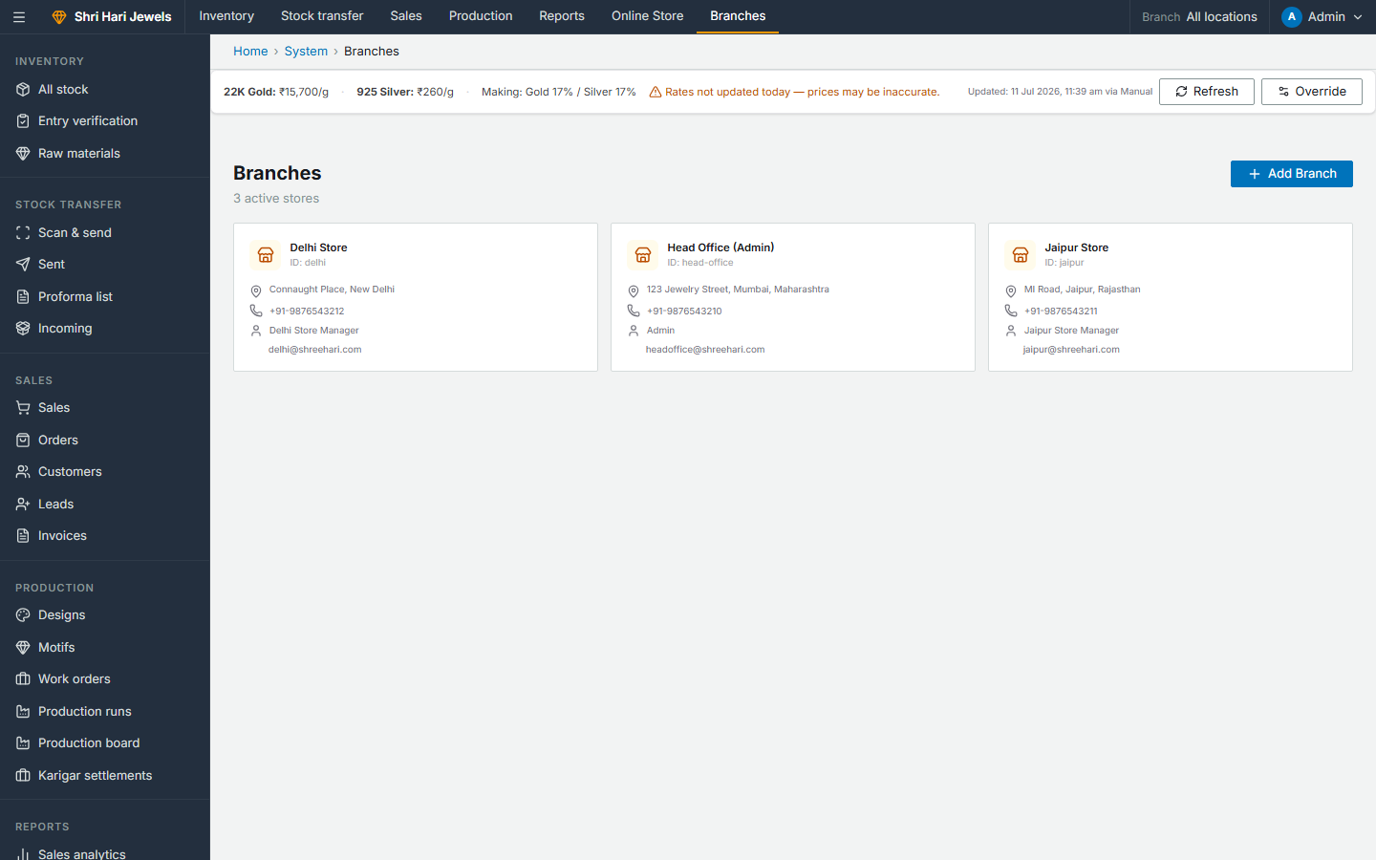
Branches — Store Locations
Steps:
• View all branches: head office + store locations
• Add new branch with name, address, GST
• Assign staff users to specific branches
• Stock and sales are scoped by branch
ERP → System → Branches

Slide 8
Part 2
Central Stock (Finished Goods)
Every piece tracked by unique item code

Slide 9
Stock Entry — Full Workflow
Step 1: Create a Product SKU (metal, purity, weight, making charges) → /inventory/new
Step 2: Add physical units to that SKU → each unit gets a unique item code
Step 3: Units go to Pending Verification status → appear in Entry Verification
Step 4: Verifier sets list price per unit using live market rates
Step 5: After verification → units become Available and can be sold or transferred
List price = market rate × weight + making charges (auto-calculated).

Slide 10
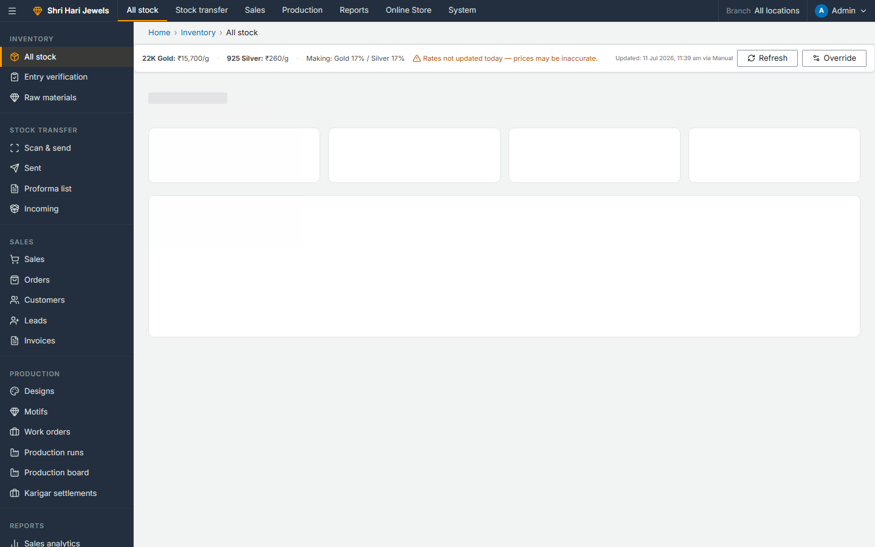
All Stock — View Central Inventory
Steps:
• See all products with stock counts
• Filter by metal, category, branch, status
• Click item code to see full history (sales, transfers, status changes)
• Click Add Stock to create new product SKU
ERP → Inventory → All stock

Slide 11
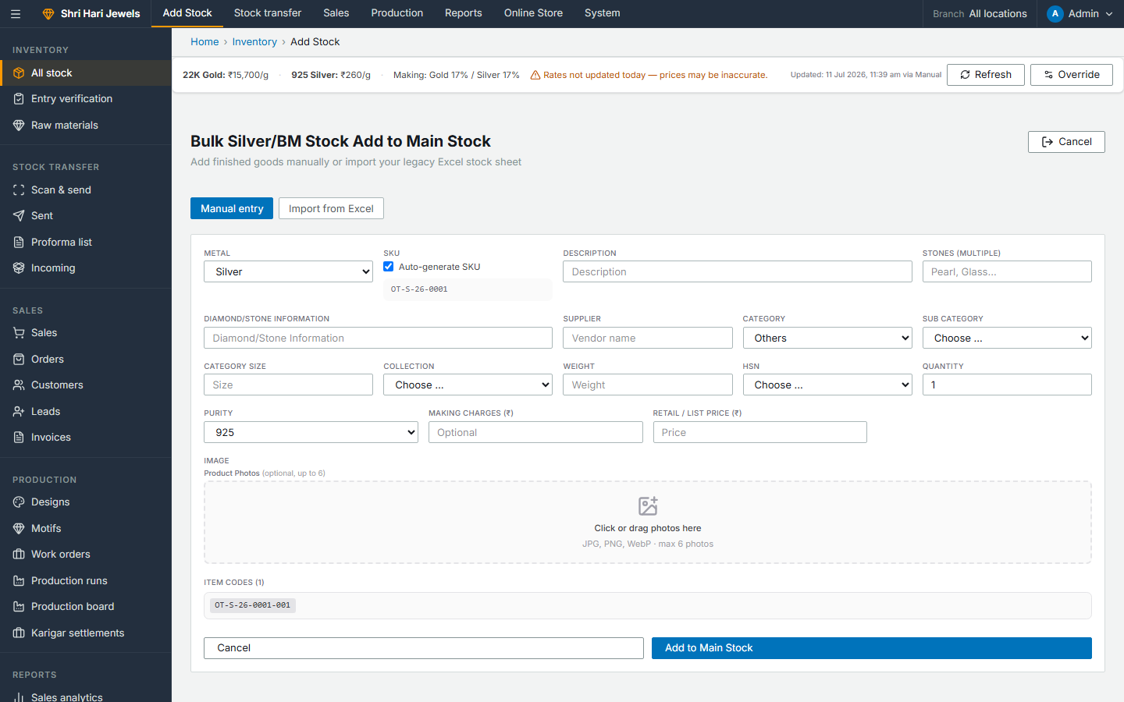
Add Stock — Create New Product SKU
Steps:
• Enter product name, SKU code, category
• Select metal type and purity (22K Gold, 925 Silver, etc.)
• Enter gross weight and making charge %
• Upload product images
• Save → product created (0 units initially)
ERP → Inventory → Add Stock

Slide 12
Add Units to a Product
Step 1: From All Stock, open a product → click Add Units
Step 2: Scan or type item codes for each physical piece (or auto-generate)
Step 3: Each unit creates an Entry Voucher line (status: Pending Verification)
Step 4: All units for this batch share one Entry Voucher
Step 5: Go to Entry Verification to set prices and approve

Slide 13
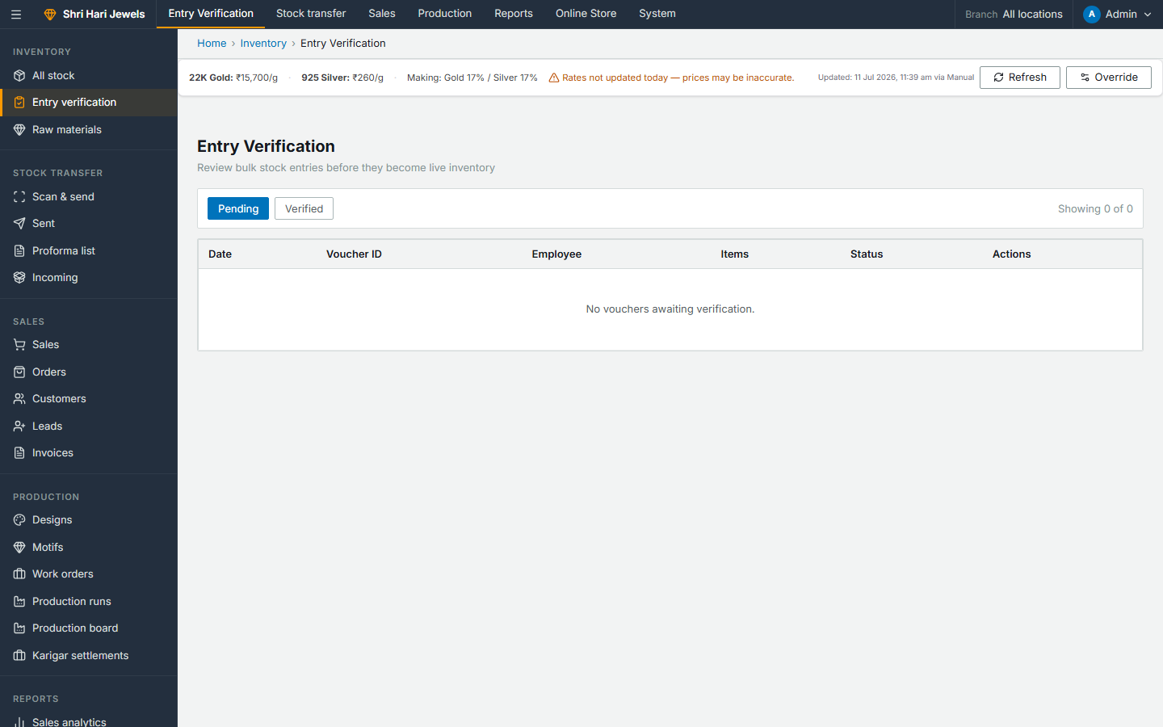
Entry Verification — Approve New Stock
Steps:
• Lists all pending entry vouchers awaiting verification
• Open a voucher → see all units with weights
• System suggests list price from market rates — adjust if needed
• Click Verify → all units become Available
• Product stock count updates automatically
ERP → Inventory → Entry verification

Slide 14
Part 3
Raw Materials
Metal lots · Certified stones · Bulk stone stock

Slide 15
Raw Materials — What They Are Used For
Step 1: Metal Lots: raw gold/silver/platinum purchased from vendors — used in production runs
Step 2: Certified Stones: GIA/IGI certified diamonds/gems with certificate numbers
Step 3: Bulk Stone Stock: uncertified stones tracked by pieces or carat weight
Step 4: When a production run starts, metal is deducted automatically from metal lots
Step 5: Stones are issued to karigars during the Stone Setting production stage

Slide 16
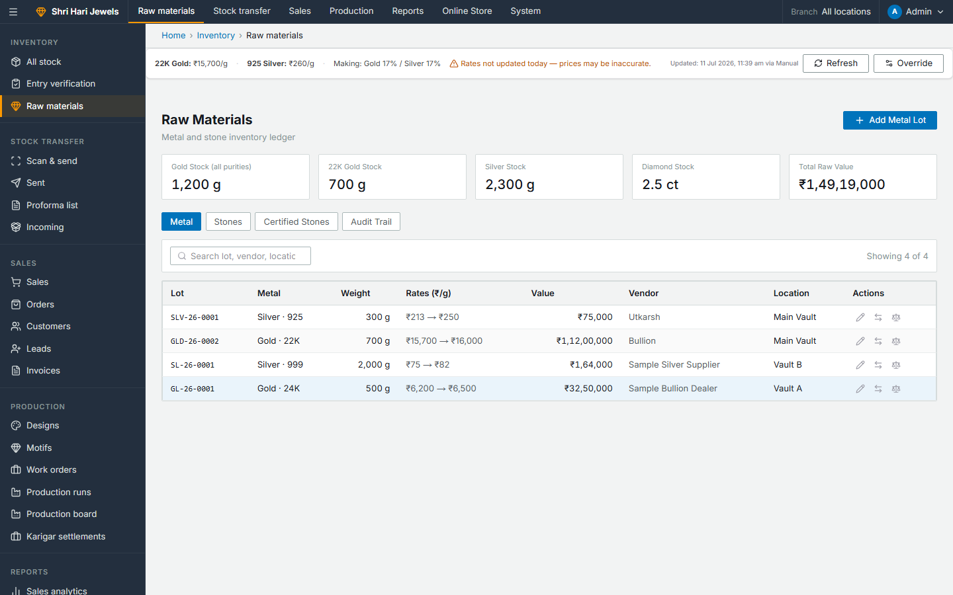
Raw Inventory — Metal & Stones
Steps:
• Metal Lots tab: add gold/silver lots with purity, weight, purchase rate, vendor
• Certified Stones tab: add stones with certificate, carat, color, clarity
• Bulk Stone Stock tab: track stones by type, pieces, weight, rate basis
• Market rates banner shows current gold/silver prices used everywhere
ERP → Inventory → Raw materials

Slide 17
Add a Metal Lot
Step 1: Click Add Metal Lot
Step 2: Select metal type (Gold / Silver / Platinum) and purity (22K, 18K, 925, etc.)
Step 3: Enter weight in grams, purchase rate per gram, vendor name
Step 4: Select storage location (branch)
Step 5: Save → lot available for production run deduction

Slide 18
Part 4
Production
Motifs → Designs → Production Runs → Karigar Settlements

Slide 19
Production Pipeline Overview
Step 1: Step A: Build Motif Library — reusable components (pendant motif, earring hook, etc.)
Step 2: Step B: Create Design — 6-stage builder (SKU → CAD → Motifs → Mold → Photo → Complete)
Step 3: Step C: Submit design for approval (Approved required before production)
Step 4: Step D: Create Production Run — select design + number of sets
Step 5: Step E: Progress through 10 workshop stages with karigars
Step 6: Step F: On completion → finished goods auto-created in central stock
Step 7: Step G: Karigar settlements — pay wastage cost + making wages

Slide 20
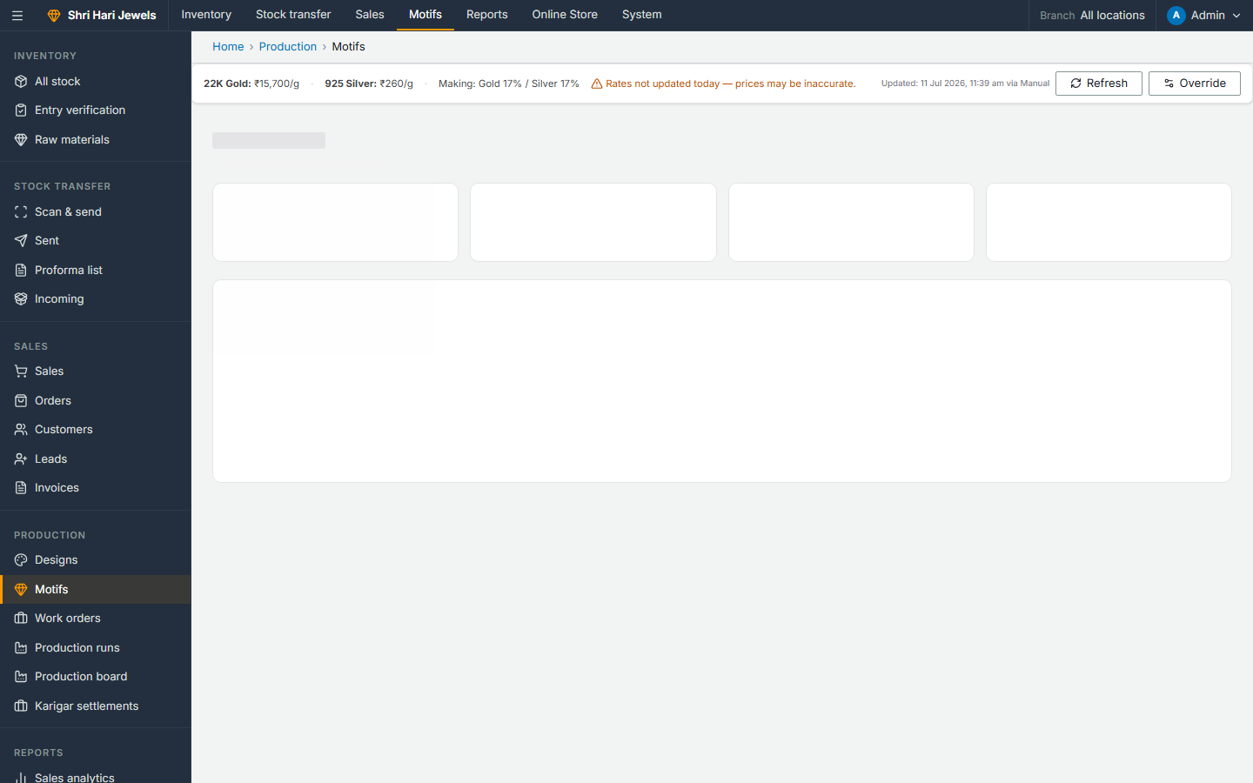
Motif Library
Steps:
• Reusable jewellery components with metal, weight, stones, making cost
• Price auto-calculates from market rates
• Import motifs from Excel in bulk
• Used as building blocks when creating design BOMs
ERP → Production → Motifs

Slide 21
Create a New Design — 6 Stages
Step 1: Stage 1 SKU: Define design code, category, target metal and weight
Step 2: Stage 2 CAD: Upload CAD files, mark design as CAD-ready
Step 3: Stage 3 Motifs: Add motif elements to BOM — qty, weight, unit value per element
Step 4: Stage 4 Mold Making: Track mold creation
Step 5: Stage 5 Photo: Upload product photos
Step 6: Stage 6 Complete: Submit for approval → Admin approves or rejects

Slide 22
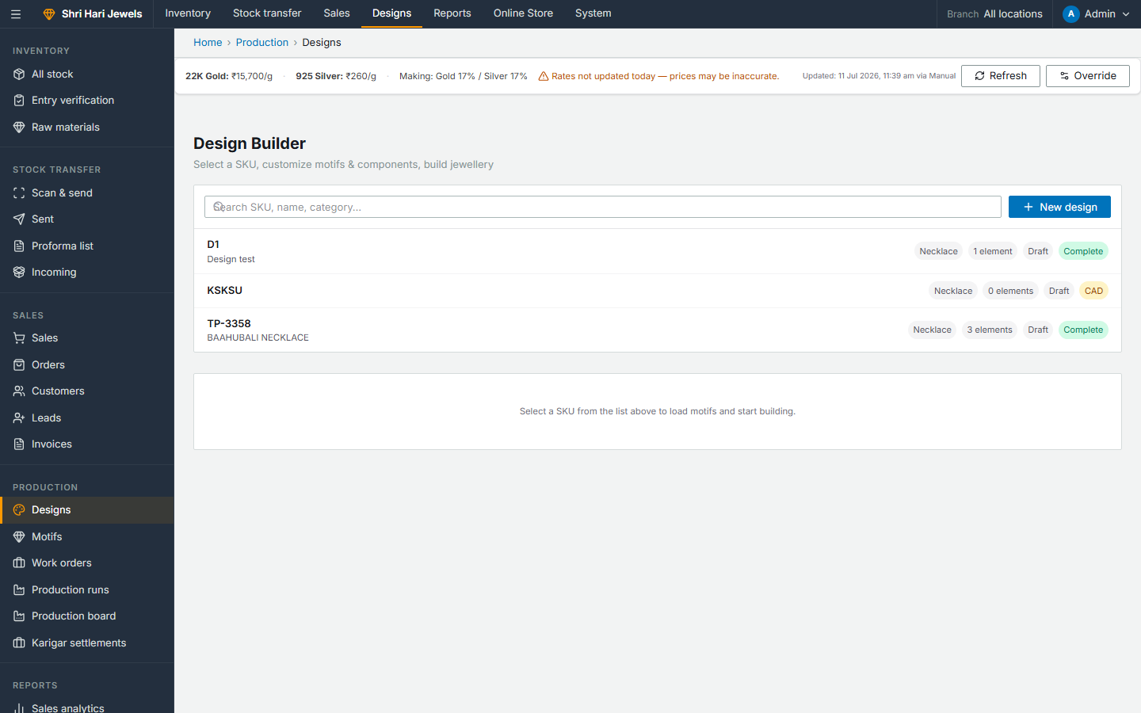
Designs List & New Design
Steps:
• See all designs with approval status (Draft / Pending / Approved / Rejected)
• Click New Design to start the 6-stage builder
• Open a design → walk through each builder stage
• BOM shows total metal and stone requirements per piece
ERP → Production → Designs

Slide 23
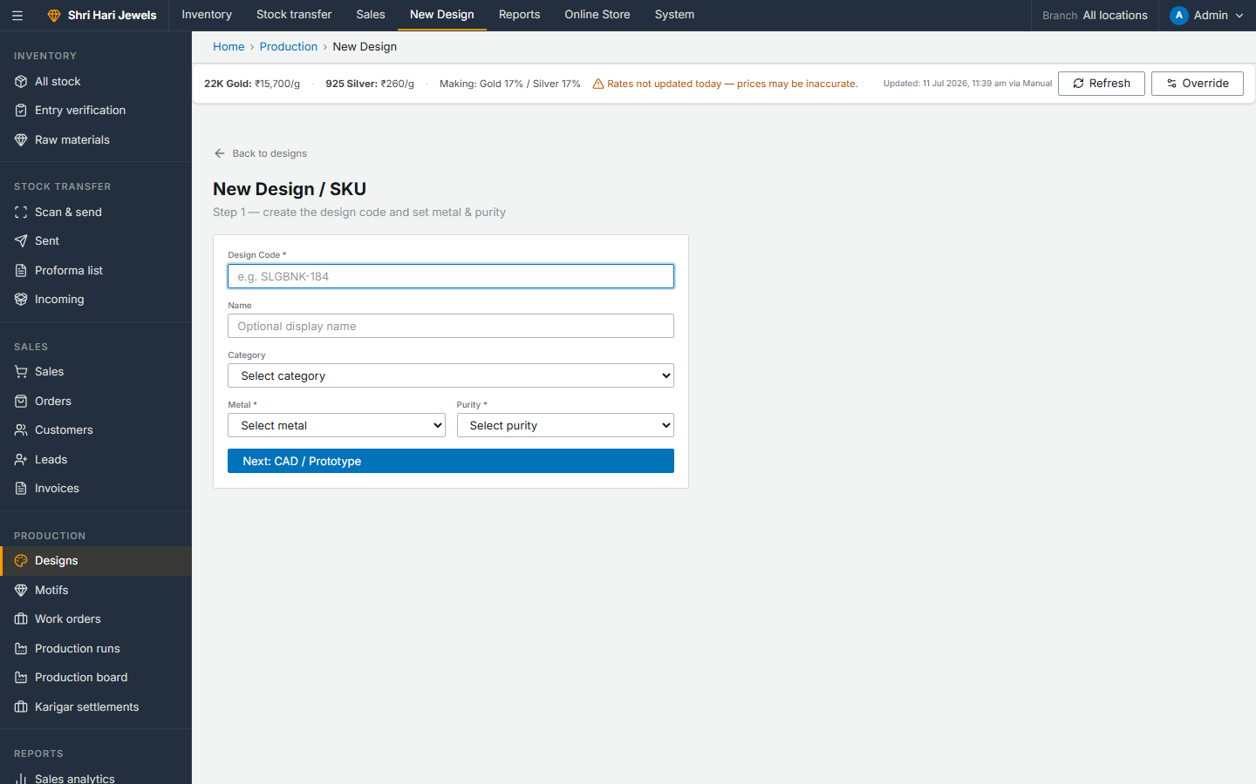
New Design Form
Steps:
• Enter design code and name
• Select category and metal type
• Set target weight — used to calculate BOM requirements
• After saving, open Design Builder to complete all 6 stages
ERP → Production → Designs → New Design

Slide 24
Create a Production Run
Step 1: Go to Production Runs → New Production Run
Step 2: Select an Approved design
Step 3: Enter number of sets (pieces) to manufacture
Step 4: System previews metal & stone requirements (BOM × sets)
Step 5: On create: metal deducted immediately from raw inventory
Step 6: Run appears on Production Board with all items to track

Slide 25

Production Runs List
Steps:
• All active and completed production runs
• See design, sets count, current stage, status
• Click a run to open stage worksheets
• New Production Run button top-right
ERP → Production → Production runs

Slide 26
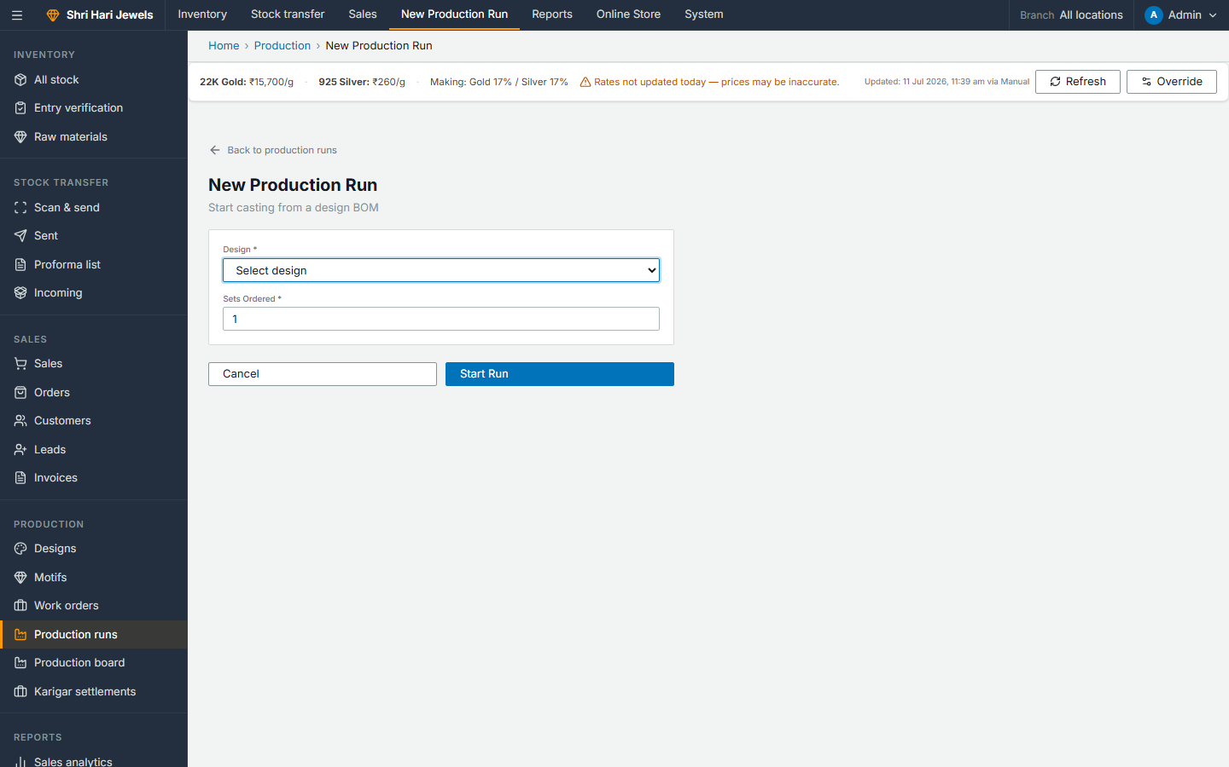
New Production Run
Steps:
• Select approved design from dropdown
• Enter number of sets to produce
• Preview shows total metal and stone needed
• Confirm → run created, metal reserved/deducted
ERP → Production → Production runs → New

Slide 27
10 Production Stages (Workshop Workflow)
Step 1: 1. Wax Pattern — create wax model from mold
Step 2: 2. Casting — metal casting; issue metal to karigar
Step 3: 3. Filing — shape and file the cast piece
Step 4: 4. Soldering — join components, add findings
Step 5: 5. Stone Setting — set stones; issue stone stock to karigar
Step 6: 6. Polishing — final polish and finish
Step 7: 7. Rhodium / Plating — optional plating step
Step 8: 8. QC — quality check; pass or reject for rework
Step 9: 9. Hallmarking — BIS hallmark if required
Step 10: 10. Packaging — final pack → triggers finished goods creation in stock

Slide 28

Production Board — Active Runs Dashboard
Steps:
• Visual board of all active production runs
• See which stage each run is at
• Click a run to open its stage worksheet
• Karigars update items at each stage
ERP → Production → Production board

Slide 29
Karigar Settlements
Step 1: After each production stage, record metal issued to and returned from karigar
Step 2: System calculates metal wastage (issued − returned − expected)
Step 3: Wastage cost = wastage weight × current metal rate
Step 4: Making wage = per-piece making charge × pieces completed
Step 5: Karigar Settlements page shows all pending settlements
Step 6: Mark as paid once settled with the karigar

Slide 30
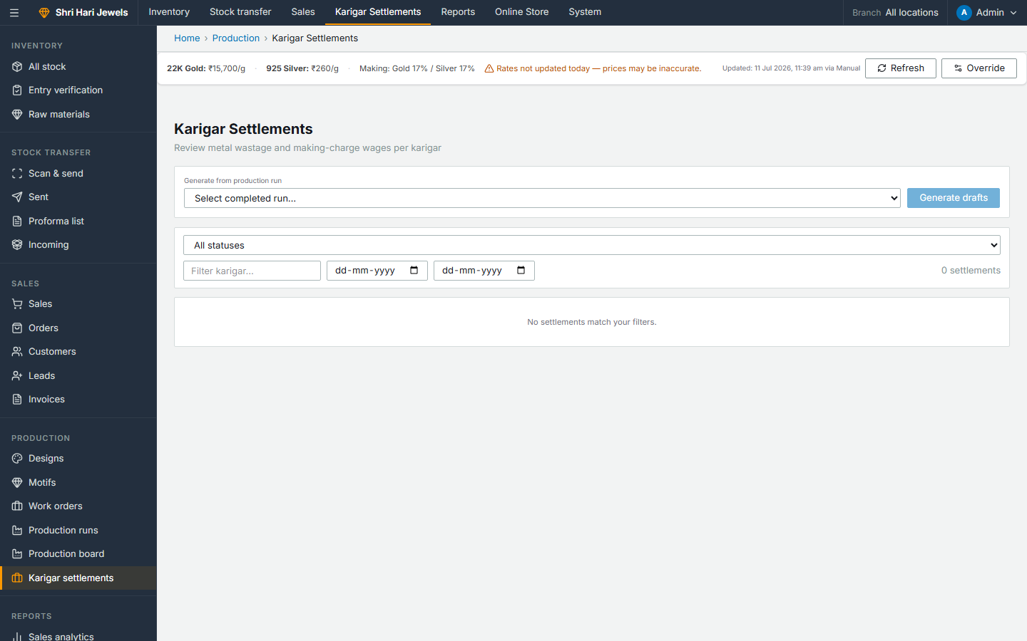
Karigar Settlements
Steps:
• Lists all karigar settlements by production run and stage
• Shows wastage weight, wastage cost, making wage payable
• Filter by karigar name or run
• Mark settlement as Paid when done
ERP → Production → Karigar settlements

Slide 31
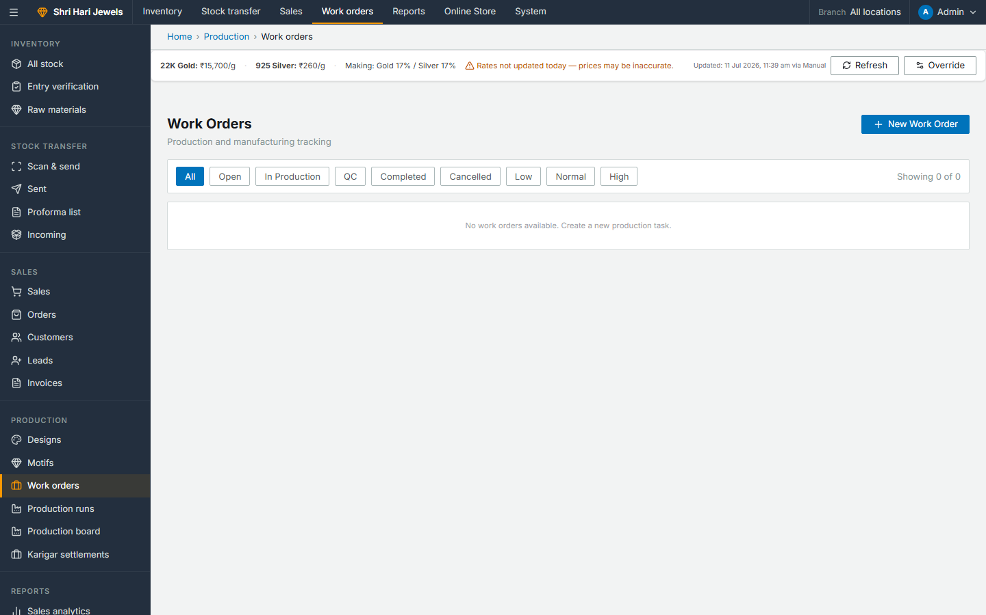
Work Orders
Steps:
• Internal workshop tasks — repairs, custom jobs, modifications
• Create work order → assign to karigar
• Track status: Open → In Production → QC → Completed
• Can link to a customer order for custom jewellery jobs
ERP → Production → Work orders

Slide 32
Part 5
Stock Transfer
Move stock from head office to branch stores

Slide 33
Stock Transfer — Full Workflow
Step 1: Head office: Scan & Send — scan item codes, select destination branch
Step 2: Choose document type: Wholesale GST Invoice / Delivery Challan / Stock Transfer Note
Step 3: Transfer created → units status changes to In Transit
Step 4: Fill shipping details and GST fields → invoice PDF generated
Step 5: Receiving branch: Incoming — scan and accept (full or partial) or reject items
Step 6: Accepted units become Available at the destination branch

Slide 34
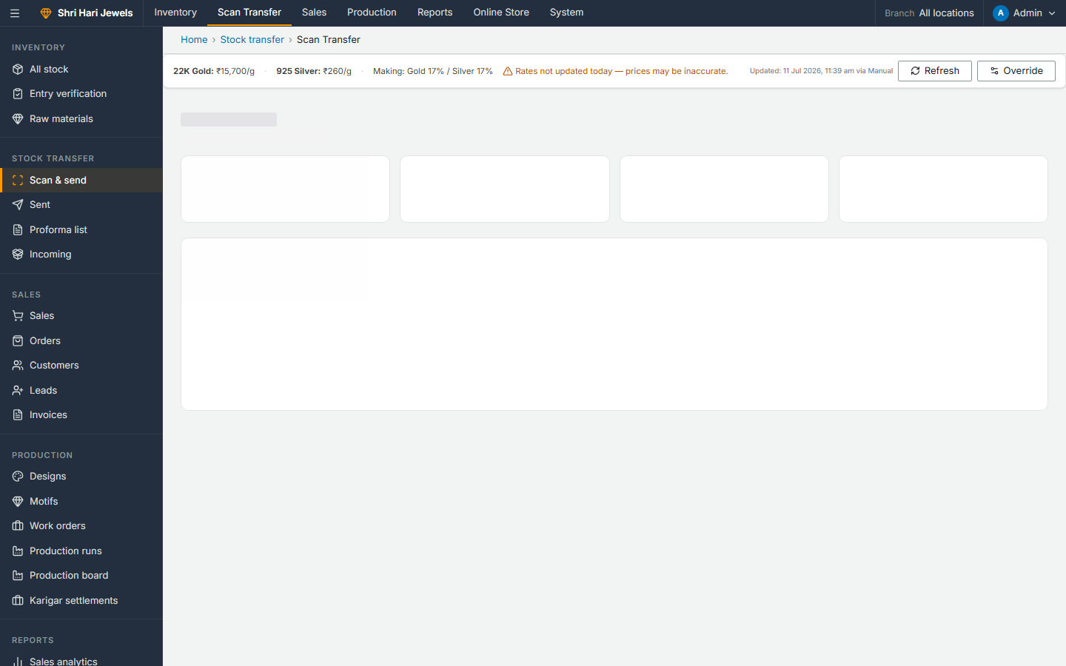
Scan & Send — Create a Transfer
Steps:
• Scan or type item codes of units to transfer
• Select destination branch or customer branch
• Choose document type (GST Invoice / Challan / STN)
• Review items → Create Transfer
• Units immediately go to In Transit status
ERP → Stock transfer → Scan & send

Slide 35
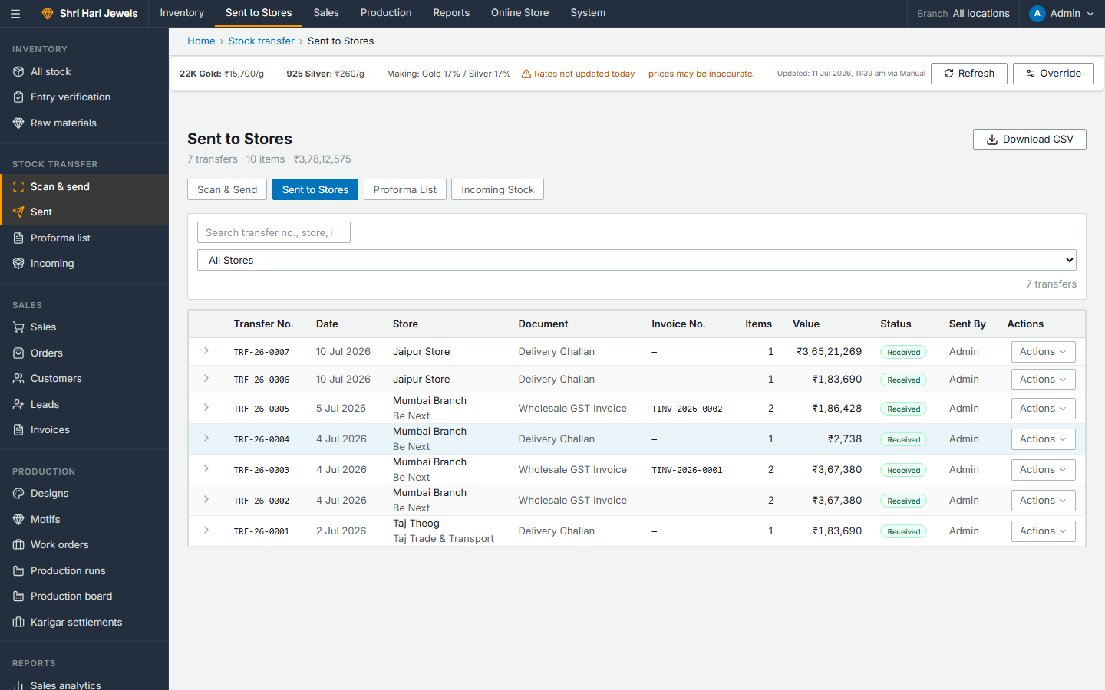
Sent Transfers — Track Outgoing Stock
Steps:
• All transfers sent from your branch
• See status: Pending / Accepted / Rejected / Partial
• Click a transfer to add shipping details or download invoice PDF
• Proforma list shows transfers awaiting acceptance
ERP → Stock transfer → Sent

Slide 36
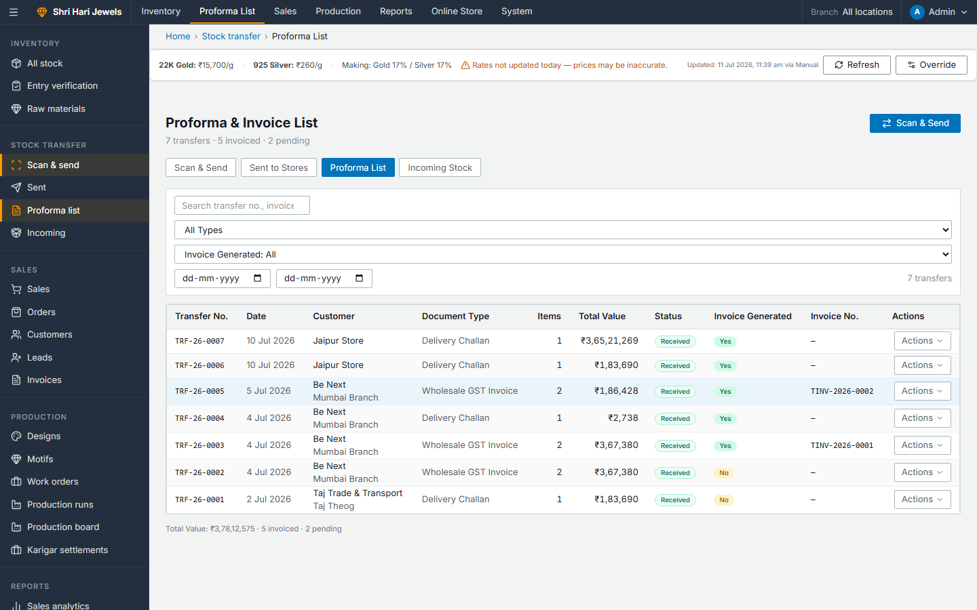
Proforma List — Pending Transfer Invoices
Steps:
• Transfers sent but not yet accepted by receiving branch
• Fill courier/shipping details before sending goods
• Generate and download GST invoice or delivery challan PDF
ERP → Stock transfer → Proforma list

Slide 37
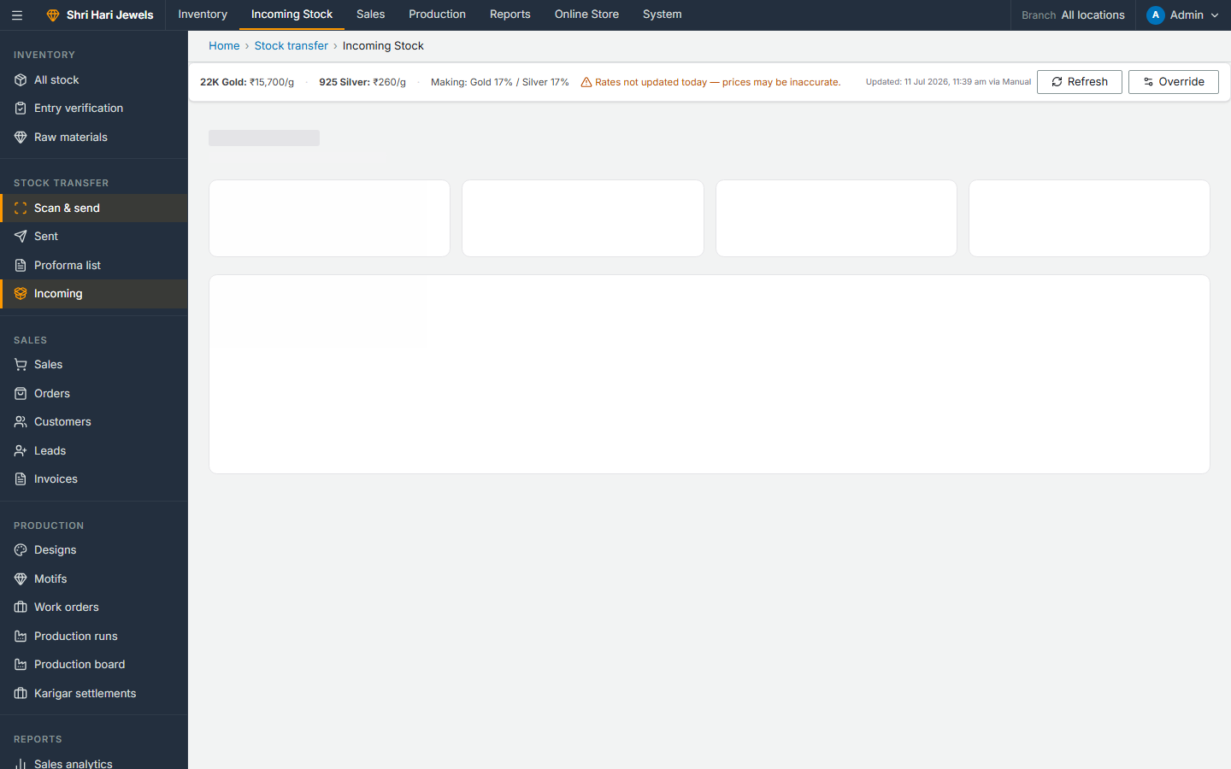
Incoming Stock — Receive at Branch
Steps:
• Transfers sent TO your branch appear here
• Open a transfer → scan item codes to receive
• Accept all, accept partial, or reject damaged items
• Accepted units become Available at your branch
ERP → Stock transfer → Incoming

Slide 38
Part 6
Sales & CRM
POS · Custom Orders · Customers · Invoices

Slide 39
In-Store Sale (POS) — Step by Step
Step 1: Open Sales page → scan physical item code (barcode or manual entry)
Step 2: System shows live price breakdown: metal value + making charges
Step 3: Add more items to cart if needed
Step 4: Apply discount — if above threshold, admin approval required
Step 5: Select or create customer (search by mobile / email / GST)
Step 6: Choose payment: Cash / UPI (Razorpay QR) / Card
Step 7: Complete sale → unit marked Sold, GST invoice auto-generated

Slide 40
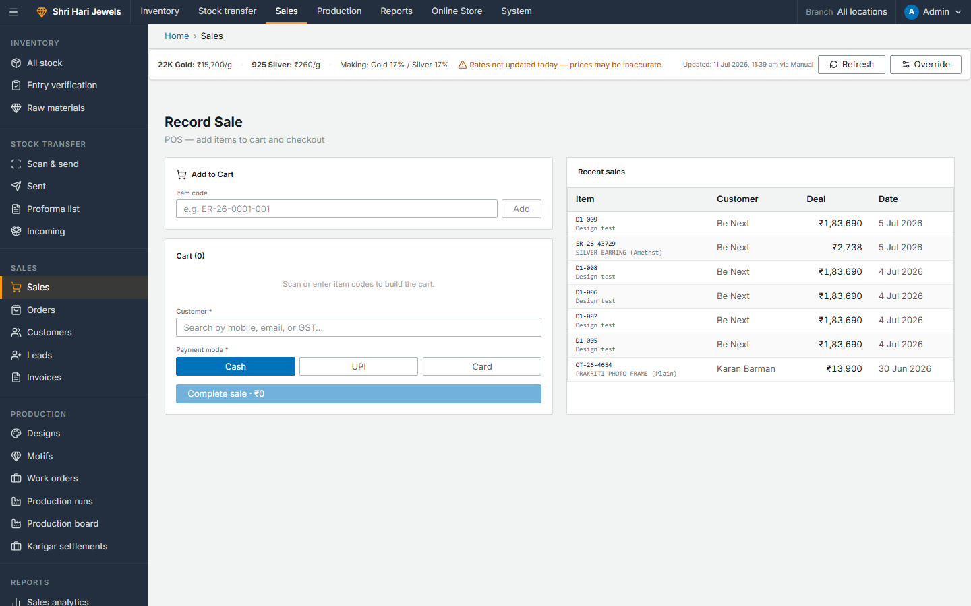
Sales — Point of Sale
Steps:
• Scan item code → item appears in cart with live price
• Apply discount, select customer, choose payment mode
• UPI: QR code generated → customer pays → webhook confirms
• Old gold exchange credit can be applied to reduce total
ERP → Sales → Sales (POS)

Slide 41
Custom Customer Order — Step by Step
Step 1: Go to Orders → New Order
Step 2: Select existing customer or create new one
Step 3: Enter order description, estimated total, due date, notes
Step 4: Order status progresses: Pending → Designing → Production → QC → Ready → Delivered
Step 5: Create Work Orders and/or Production Runs linked to this order
Step 6: Track payment: Unpaid / Partial / Paid

Slide 42

Orders List
Steps:
• All custom jewellery orders with status and due dates
• Filter by status, customer, date range
• Click New Order to create
ERP → Sales → Orders

Slide 43
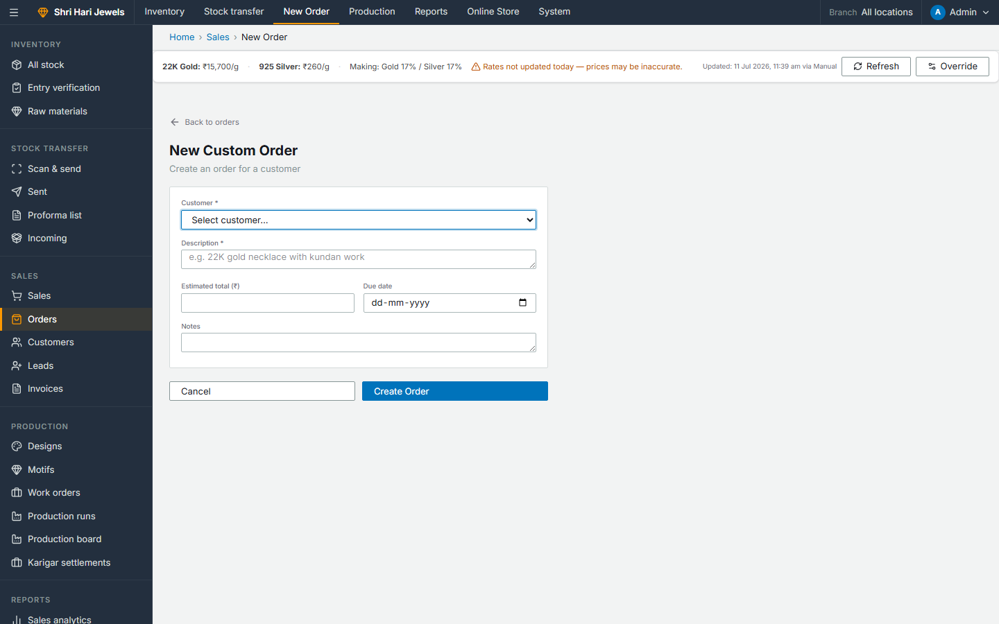
New Order Form
Steps:
• Select customer from dropdown or create inline
• Enter description of custom jewellery piece required
• Set estimated total and due date
• Save → order created in Pending status
ERP → Sales → Orders → New Order

Slide 44
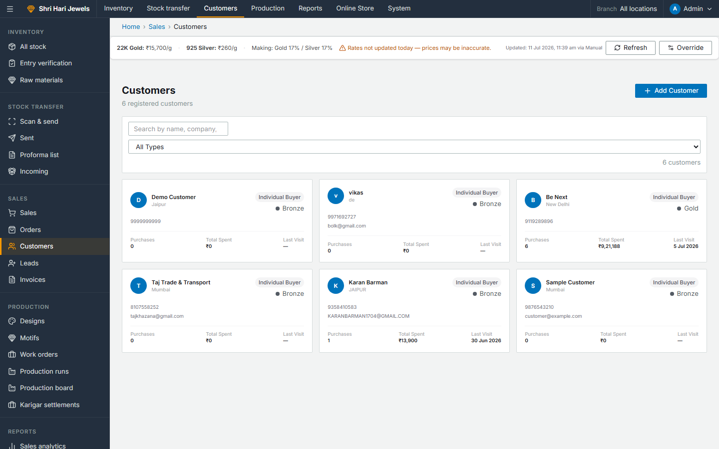
Customers — CRM
Steps:
• All customers: individual buyers and B2B clients
• Add customer with billing address, GST/PAN, bank details
• Customer branches for B2B clients with multiple offices
• Customer record shared across POS, orders, and web checkout
ERP → Sales → Customers

Slide 45
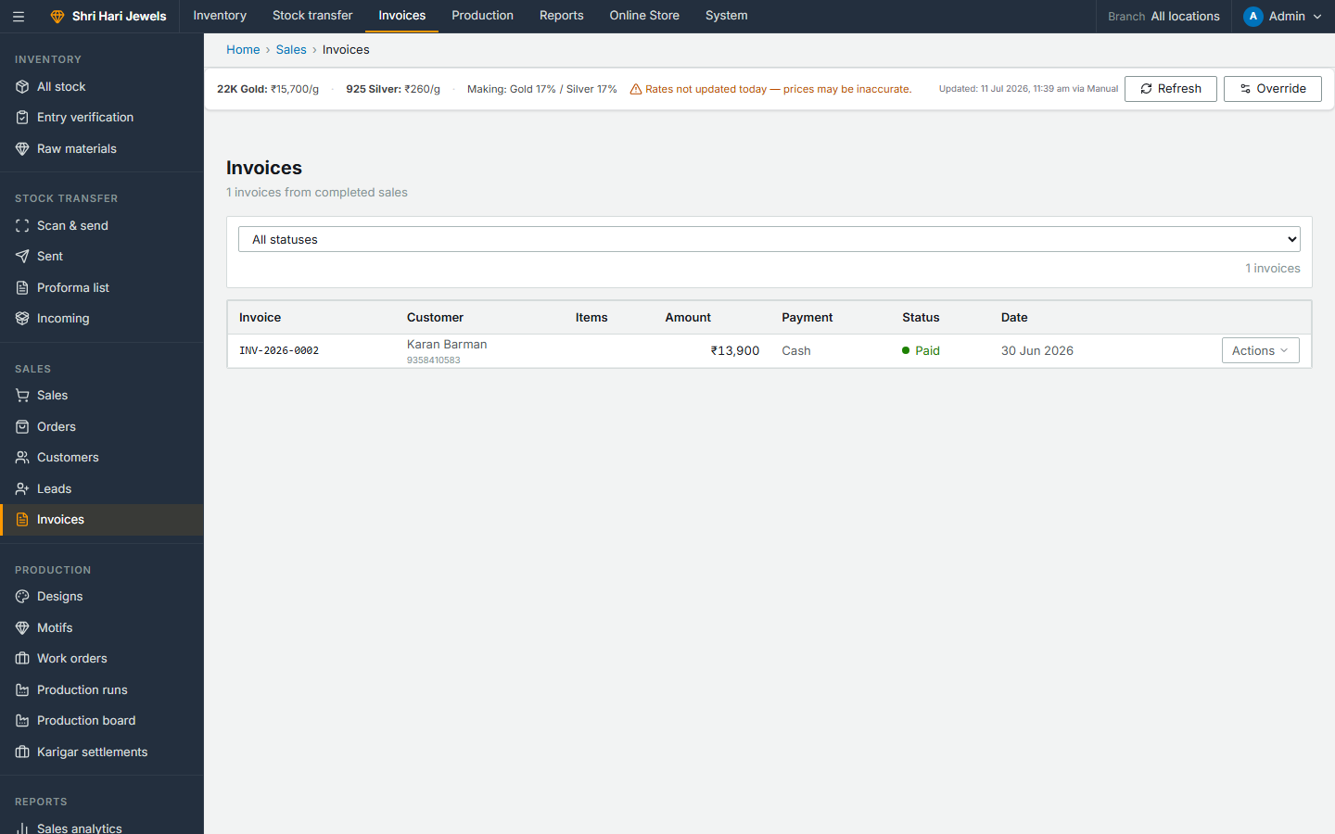
Invoices — GST Billing
Steps:
• All GST invoices from POS sales and wholesale transfers
• Download invoice PDF with CGST/SGST or IGST split
• Generate e-invoice IRN for GST portal compliance
• Filter by date, customer, branch, payment status
ERP → Sales → Invoices

Slide 46
Part 7
Reports & Analytics

Slide 47
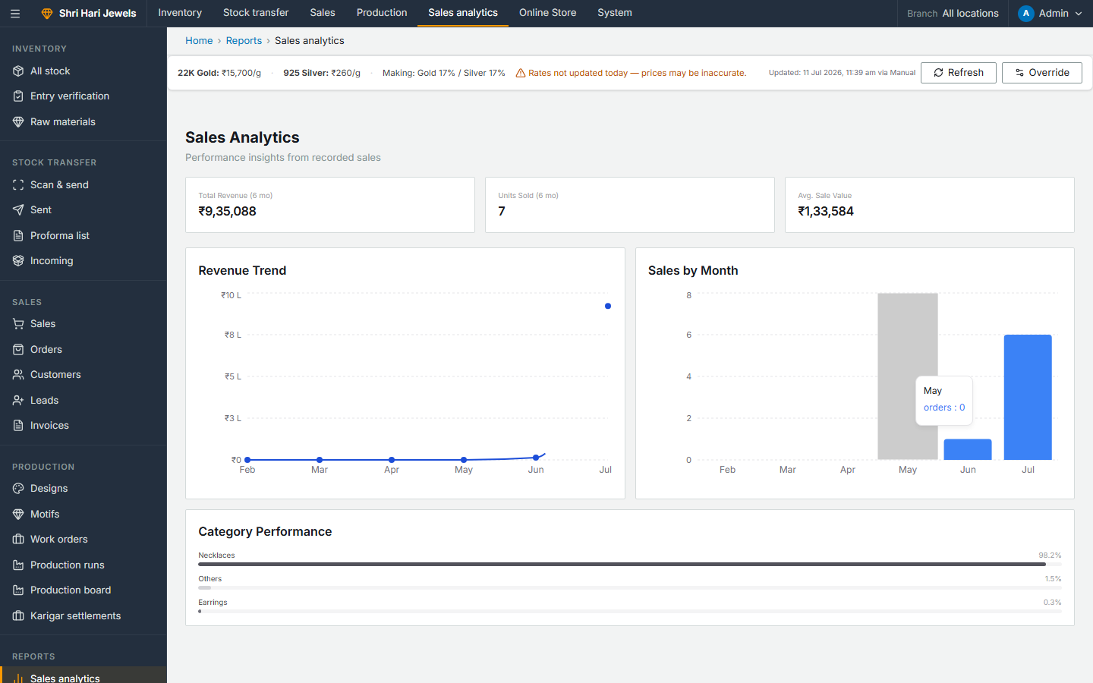
Sales Analytics
Steps:
• Revenue charts by day/week/month
• Top selling products and categories
• Sales by branch and staff member
• Export data for further analysis
ERP → Reports → Sales analytics

Slide 48
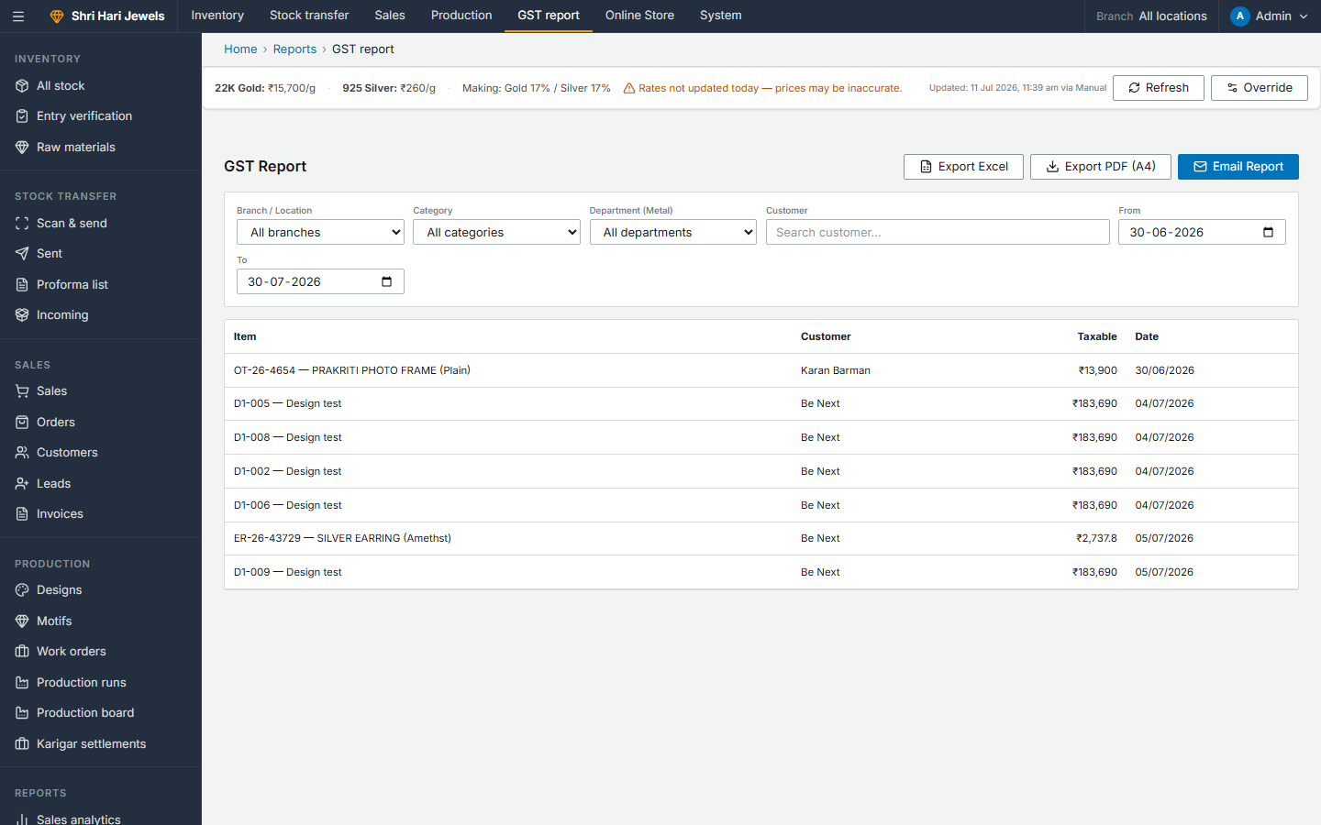
GST Report
Steps:
• Tax liability summary by period
• CGST, SGST, IGST breakdown
• Export for GST filing
• Filter by date range and branch
ERP → Reports → GST report

Slide 49

Stock Valuation Report
Steps:
• Total inventory value at current market rates
• Breakdown by metal type and category
• Useful for balance sheet and insurance
ERP → Reports → Stock valuation

Slide 50
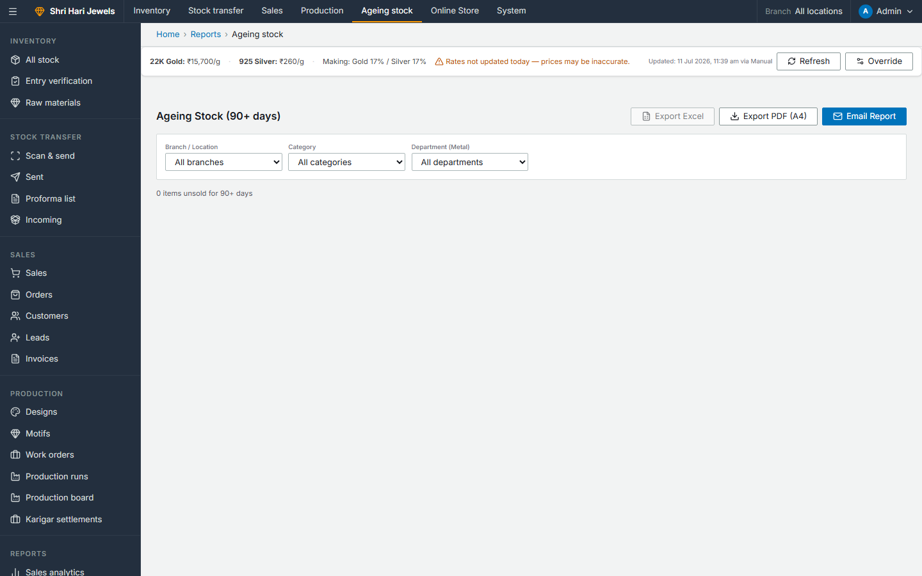
Ageing Stock Report
Steps:
• Items unsold beyond a threshold number of days
• Identify slow-moving inventory
• Plan promotions or transfers for stale stock
ERP → Reports → Ageing stock

Slide 51

Staff Performance Report
Steps:
• Sales productivity by staff member
• Compare performance across branches
• Use for incentives and training decisions
ERP → Reports → Staff performance

Slide 52
Part 8
Online Store
Website setup · Customer journey · Web order fulfillment

Slide 53
Complete Business Flow — Design to Sale
PRODUCTION
INVENTORY
SALES
1. Create motifs
2. Build & approve design
3. Start production run
4. 10 workshop stages
5. Finished goods → stock
1. Entry verification
2. Set list prices
3. Available units
4. Transfer to branches
5. Publish to website
1. In-store POS scan
2. Web order checkout
3. GST invoice
4. E-invoice IRN
5. Reports & analytics

Slide 54
Set Up Your Online Store — 5 Steps
Step 1: ERP → Online Store → Store Settings → Enable online store
Step 2: Set branding: logo, hero banner, colours, contact info, WhatsApp
Step 3: Publish Products → toggle inventory items to Published
Step 4: Create Collections to group products (optional)
Step 5: Share store URL: https://shri-hari-jewels.vercel.app/shop/shree-hari-jewels

Slide 55
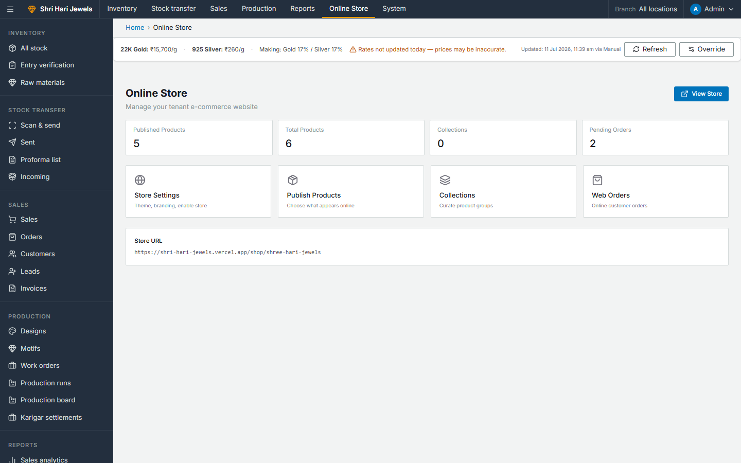
Online Store Dashboard
Steps:
• Stats: published products, collections, pending web orders
• View Store button opens live website
• Quick links to all store management pages
ERP → Online Store → Store dashboard

Slide 56
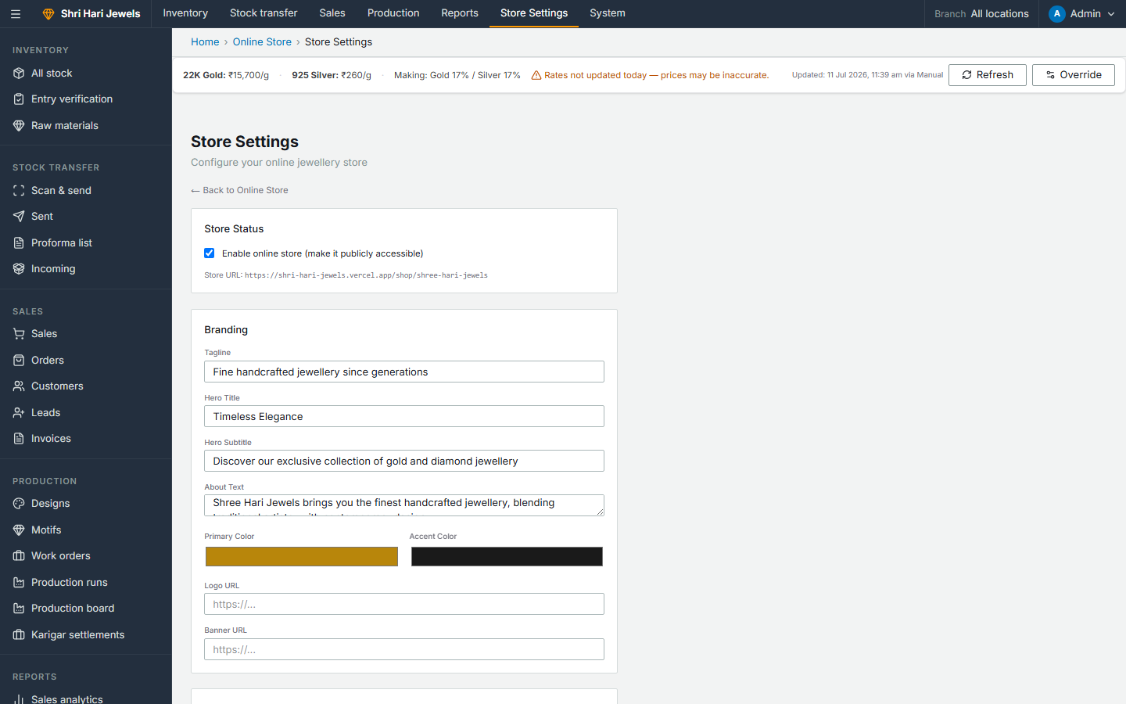
Store Settings
Steps:
• Enable/disable store, set branding and theme colours
• Hero title, subtitle, about text, logo and banner URLs
• Contact phone, WhatsApp, address, return policy
ERP → Online Store → Store settings

Slide 57
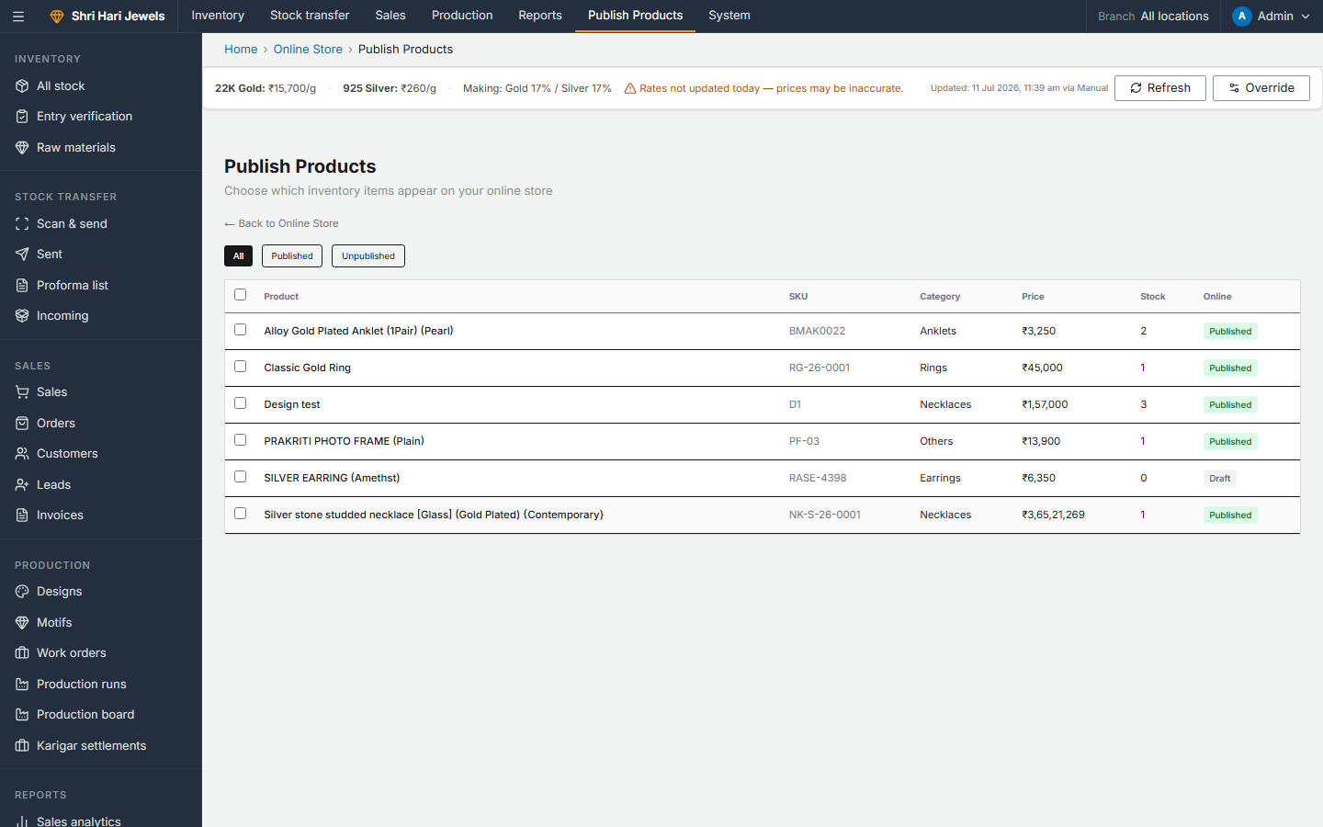
Publish Products to Website
Steps:
• Toggle products from inventory to Published
• Only Published products with stock appear on website
• Prices sync from live market rates automatically
ERP → Online Store → Publish products

Slide 58
Customer Website Journey — 7 Steps
Step 1: Customer opens https://shri-hari-jewels.vercel.app/shop/shree-hari-jewels
Step 2: Browses homepage, product catalog, or collections
Step 3: Opens product → sees specs, live price, stock status
Step 4: Adds to cart (saved in browser — no account needed)
Step 5: Proceeds to checkout → fills guest form (name, mobile, address)
Step 6: Clicks Place Order → order number shown on confirmation page
Step 7: Store contacts customer for payment and delivery arrangement

Slide 59
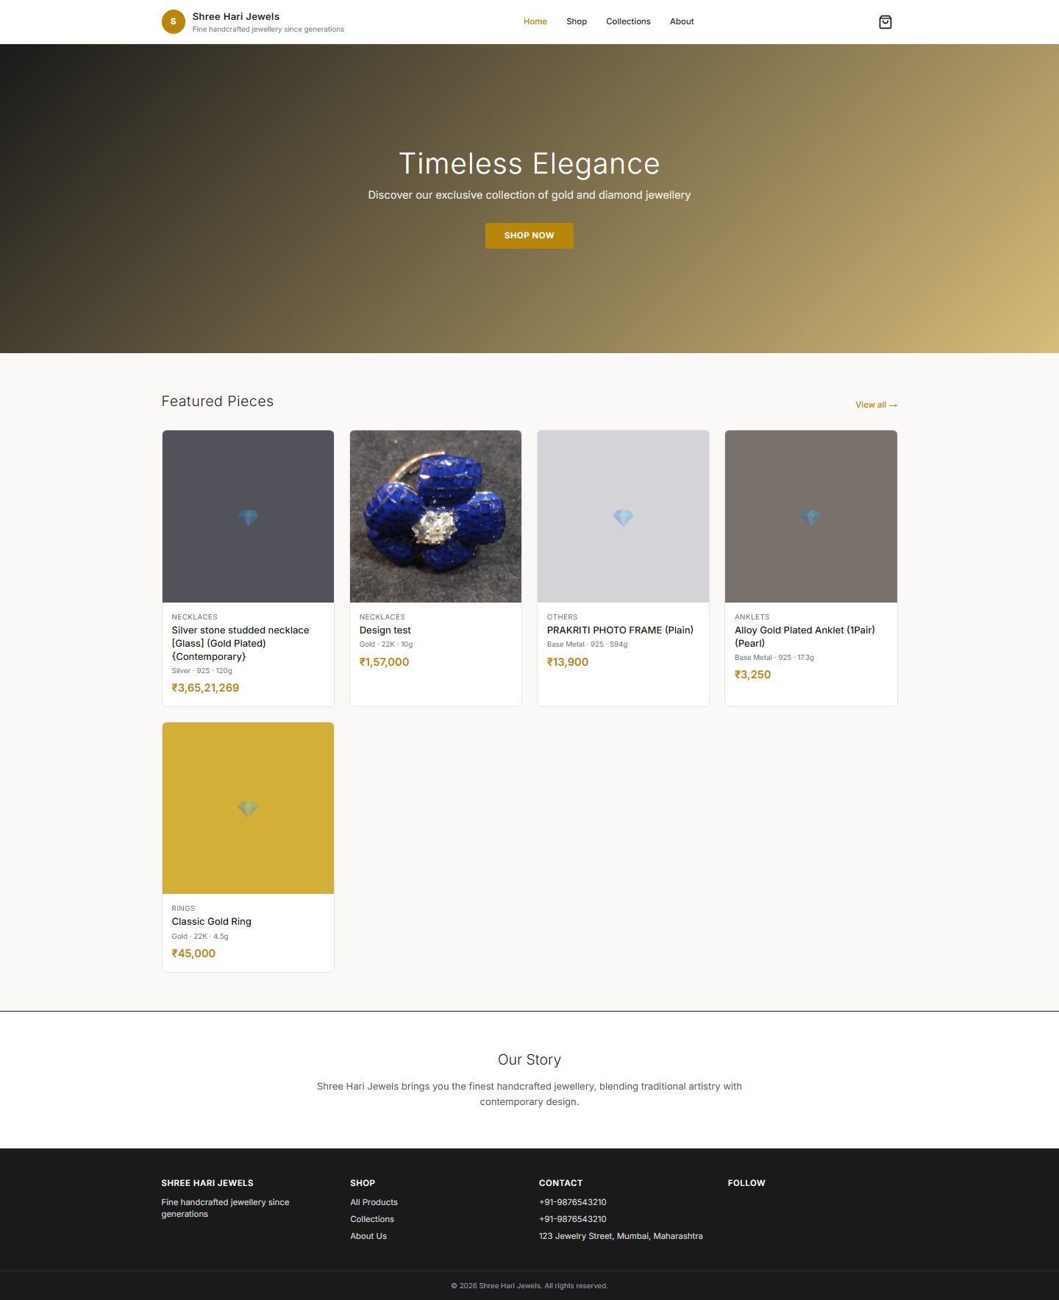
Website — Homepage
Steps:
• Hero banner, featured products, brand story
• Navigation: Home, Shop, Collections, About
• Cart badge shows item count
Customer → https://shri-hari-jewels.vercel.app/shop/shree-hari-jewels

Slide 60
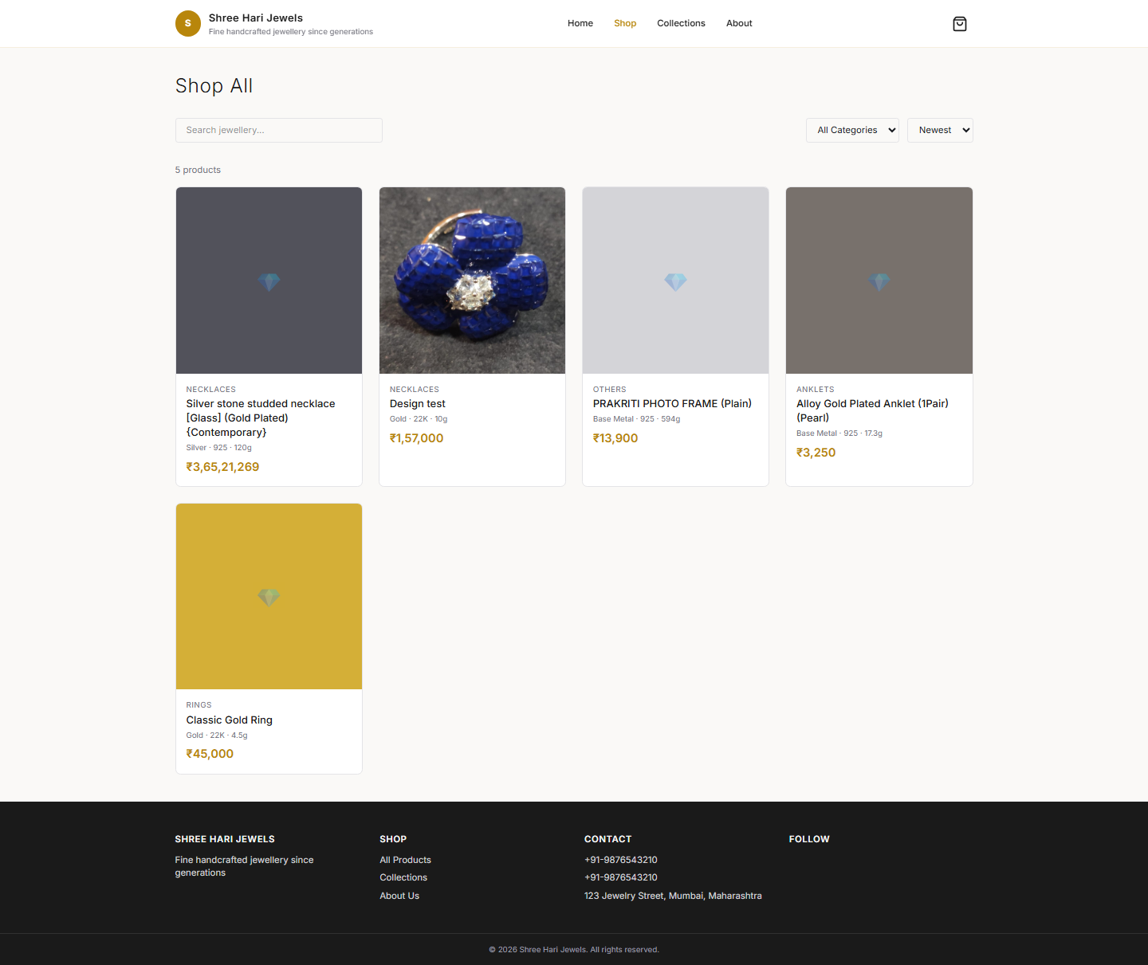
Website — Product Catalog
Steps:
• All published products in a grid
• Search, category filter, sort by price/name
• Live prices from market rates
Customer → Shop → All Products

Slide 61
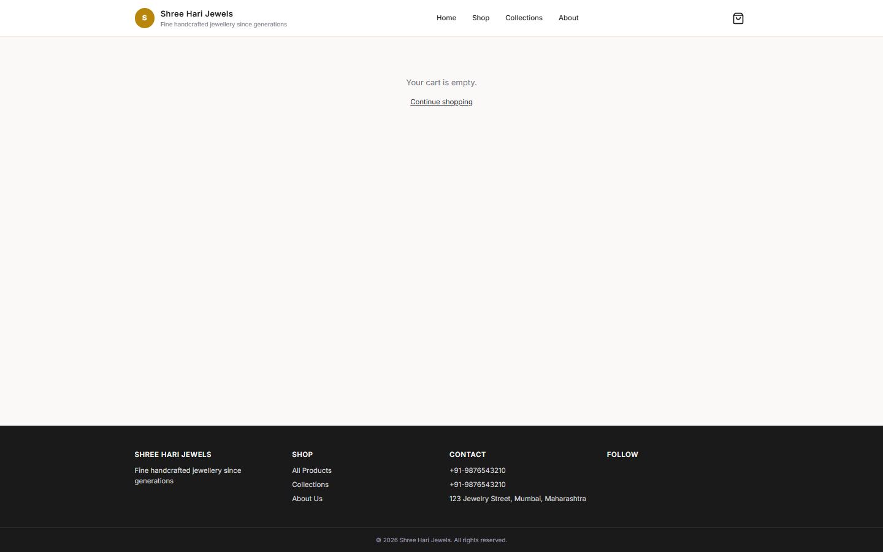
Website — Checkout
Steps:
• Guest form: name, mobile, address, city, state, pincode
• Order summary on right with total
• Payment arranged with store after order — no online payment gateway
Customer → Checkout

Slide 62
Fulfill a Web Order — Step by Step
Step 1: New order appears in ERP → Online Store → Web Orders
Step 2: Call/message customer to confirm order and arrange payment
Step 3: Update Order Status: Pending → Confirmed → Processing → Shipped → Delivered
Step 4: Update Payment Status: Unpaid → Paid (after bank transfer / COD)
Step 5: Inventory units move from Reserved → Sold when order is fulfilled
Step 6: Customer record auto-created in CRM from checkout mobile number

Slide 63

Web Orders — Manage Online Orders
Steps:
• All web orders with customer name, items, total, date
• Update order status and payment status dropdowns
• Linked ERP Order created automatically for fulfillment tracking
ERP → Online Store → Web orders

Slide 64
End of Guide
ERP: https://shri-hari-jewels.vercel.app Store: https://shri-hari-jewels.vercel.app/shop/shree-hari-jewels Every module · Every step · Shree Hari Jewels

