Slide 1
Shree Hari Jewels
Your Online Store & ERP — Complete Step-by-Step Guide Store: https://shri-hari-jewels.vercel.app/shop/shree-hari-jewels

Slide 2
How Your System Works
Step 1: Your ERP holds all inventory — every product, price, and stock count.
Step 2: You choose which products to publish to your website (Online Store section).
Step 3: Customers browse your website — no login needed — and place orders as guests.
Step 4: When a customer checks out, the ERP automatically reserves stock and creates a Web Order.
Step 5: You manage and fulfill web orders from ERP → Online Store → Web Orders.
Step 6: Payment is arranged offline (bank transfer / cash on delivery) — you update payment status in ERP.
This guide covers only your website and how it connects to your ERP.

Slide 3
Part 1
Set Up Your Online Store in the ERP

Slide 4
Go Live — 5 Steps in the ERP
Step 1: Log in to your ERP at https://shri-hari-jewels.vercel.app → Online Store → Store Settings
Step 2: Enable the online store and set your branding (logo, hero banner, colours, contact info)
Step 3: Go to Publish Products — toggle products from your inventory to Published
Step 4: Optionally create Collections to group products (e.g. Wedding, Rings, Necklaces)
Step 5: Share your store URL with customers: https://shri-hari-jewels.vercel.app/shop/shree-hari-jewels

Slide 5
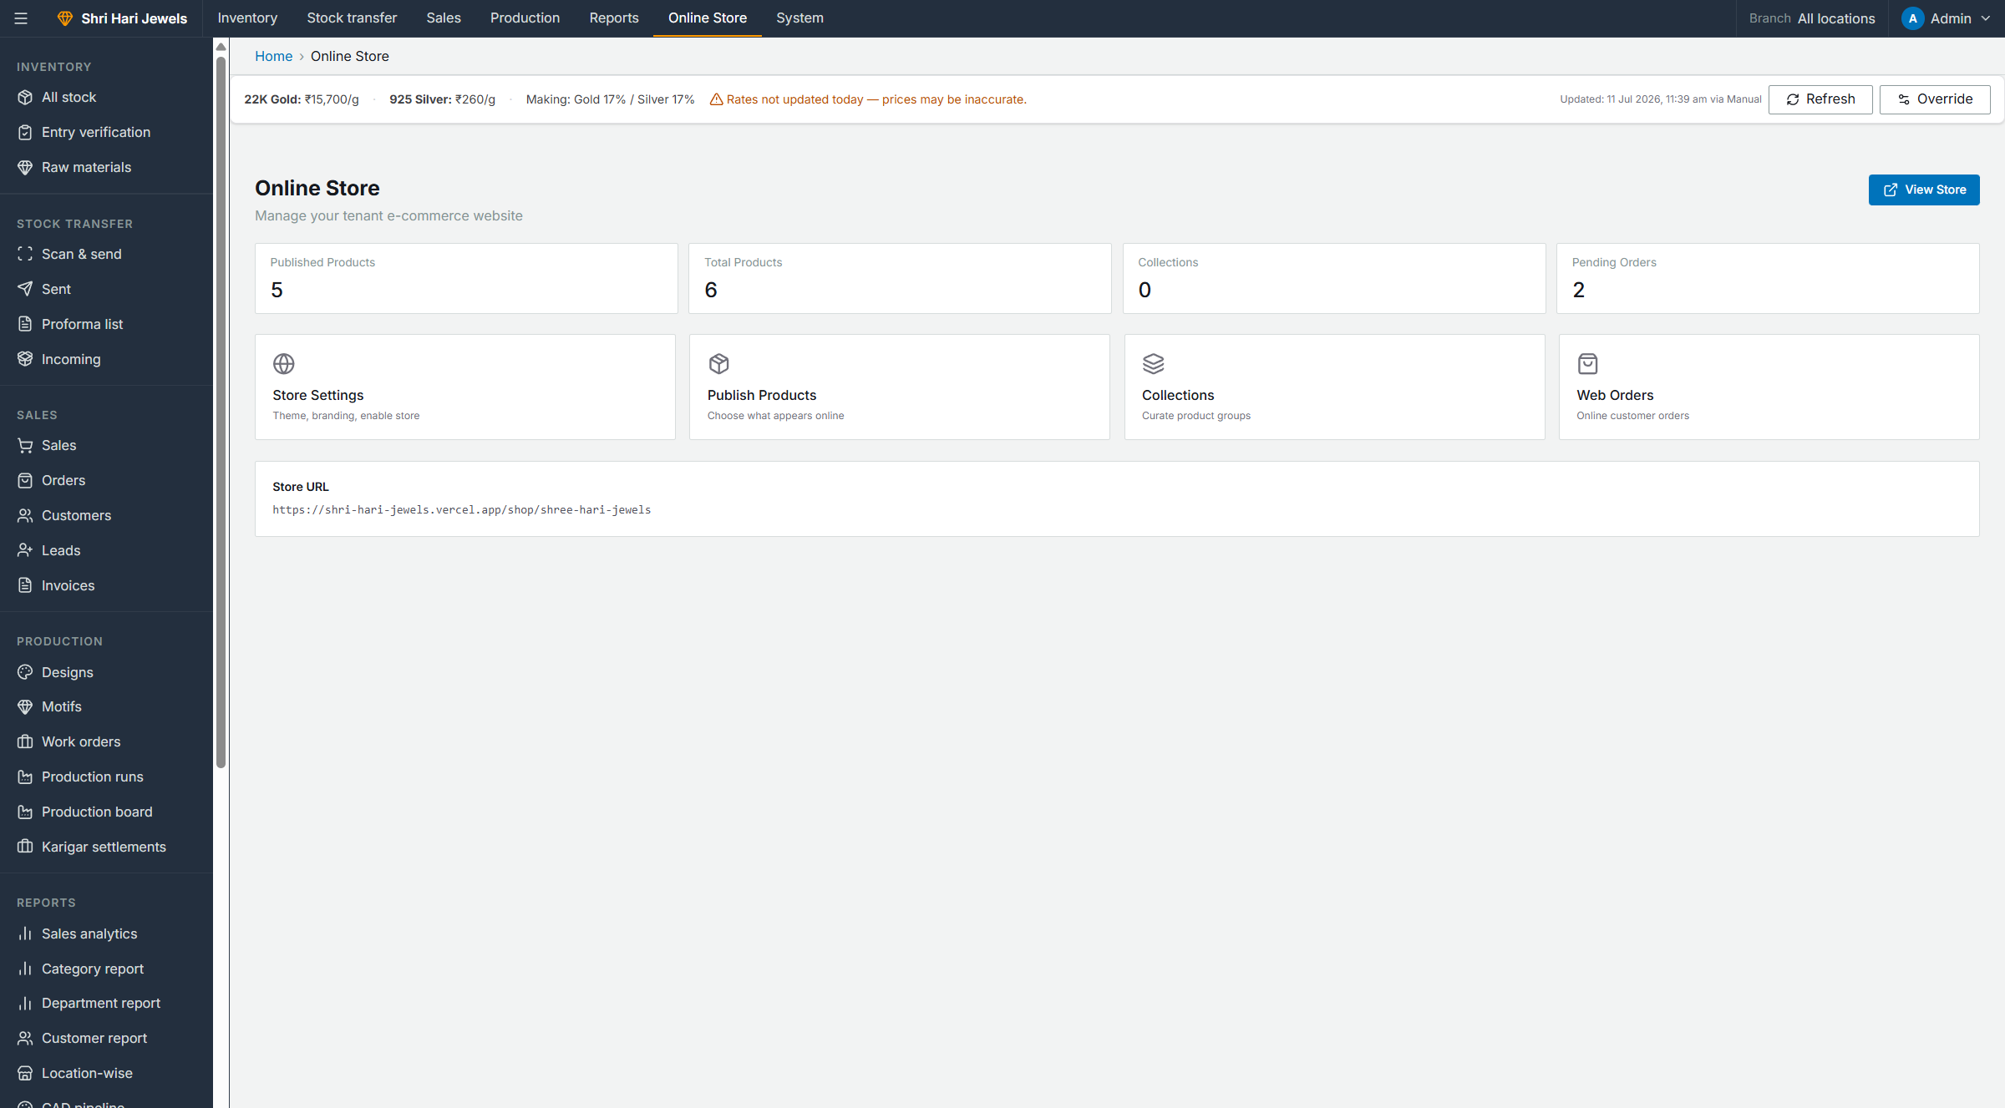
Step 1 — Online Store Dashboard
What happens:
• Login to ERP → sidebar: Online Store → Store dashboard
• See stats: published products, collections, pending orders
• Click View Store to open your live website
• Quick links to Settings, Publish Products, Collections, Web Orders
ERP → Online Store → Store dashboard

Slide 6
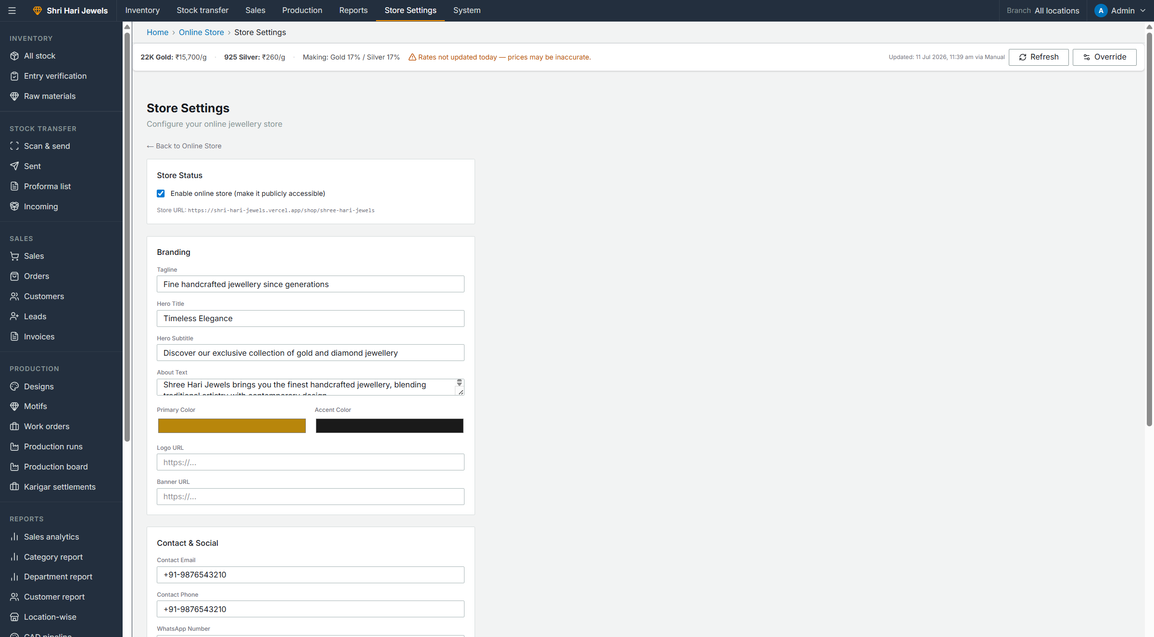
Step 2 — Store Settings (Branding & Enable)
What happens:
• Check Enable online store to make the website public
• Set tagline, hero title, hero subtitle, about text
• Choose primary & accent colours for your website theme
• Add logo URL, banner URL, contact phone, WhatsApp, address
• Click Save — changes appear on your website immediately
ERP → Online Store → Store settings

Slide 7
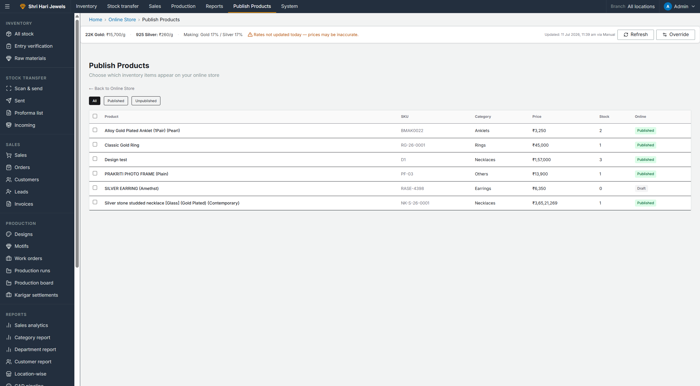
Step 3 — Publish Products to Website
What happens:
• Lists all products from your ERP inventory
• Only Published products appear on the website
• Check stock count — website shows live available stock
• Prices update automatically from current gold/silver market rates
• Toggle a product to Published → it goes live on the website
ERP → Online Store → Publish products

Slide 8
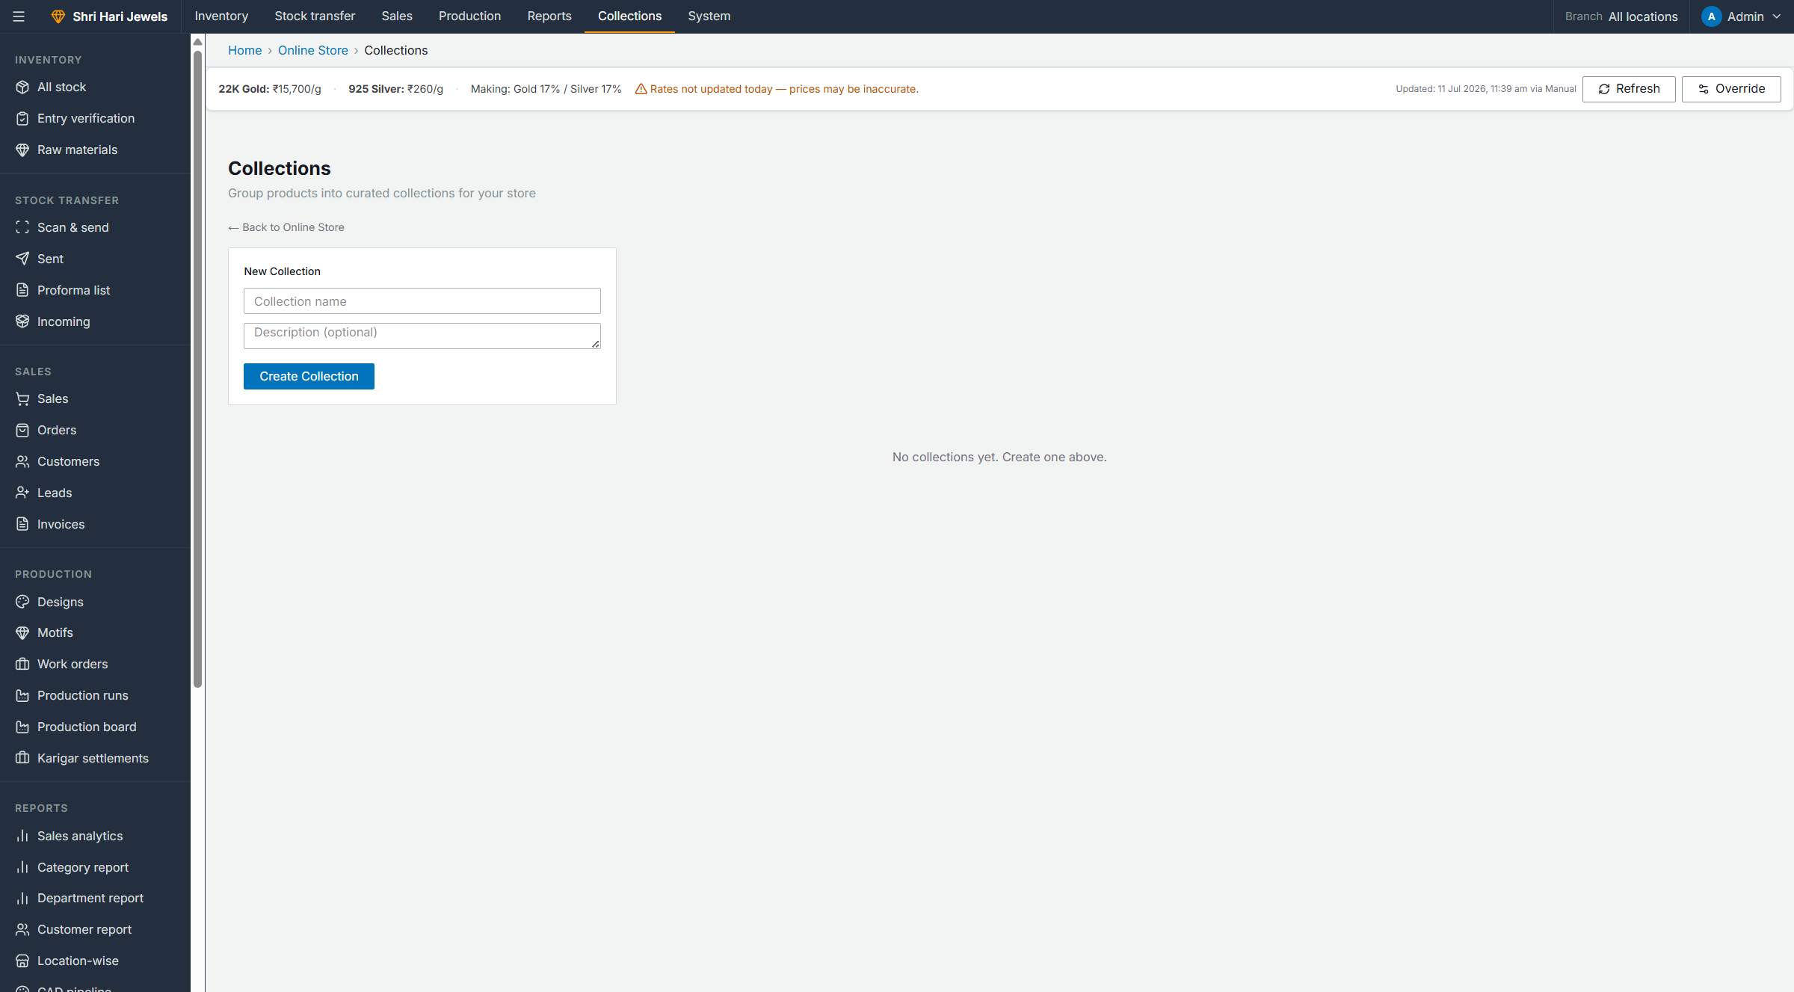
Step 4 — Create Collections (Optional)
What happens:
• Group products into curated collections (e.g. Featured, Wedding)
• Enter collection name and description → Create Collection
• Add published products to each collection
• Collections appear on website homepage and /collections page
ERP → Online Store → Collections

Slide 9
Part 2
What Your Customer Sees on the Website

Slide 10
Customer Journey — 7 Steps
Step 1: Customer opens your store URL (or your custom domain)
Step 2: Browses homepage, product catalog, or collections
Step 3: Opens a product → sees metal, purity, weight, live price, stock status
Step 4: Clicks Add to Cart (cart saved in browser — no account needed)
Step 5: Reviews cart → Proceed to Checkout
Step 6: Fills guest form: name, mobile, delivery address
Step 7: Clicks Place Order → sees confirmation with order number
No customer login or registration — checkout is fully guest-based.

Slide 11
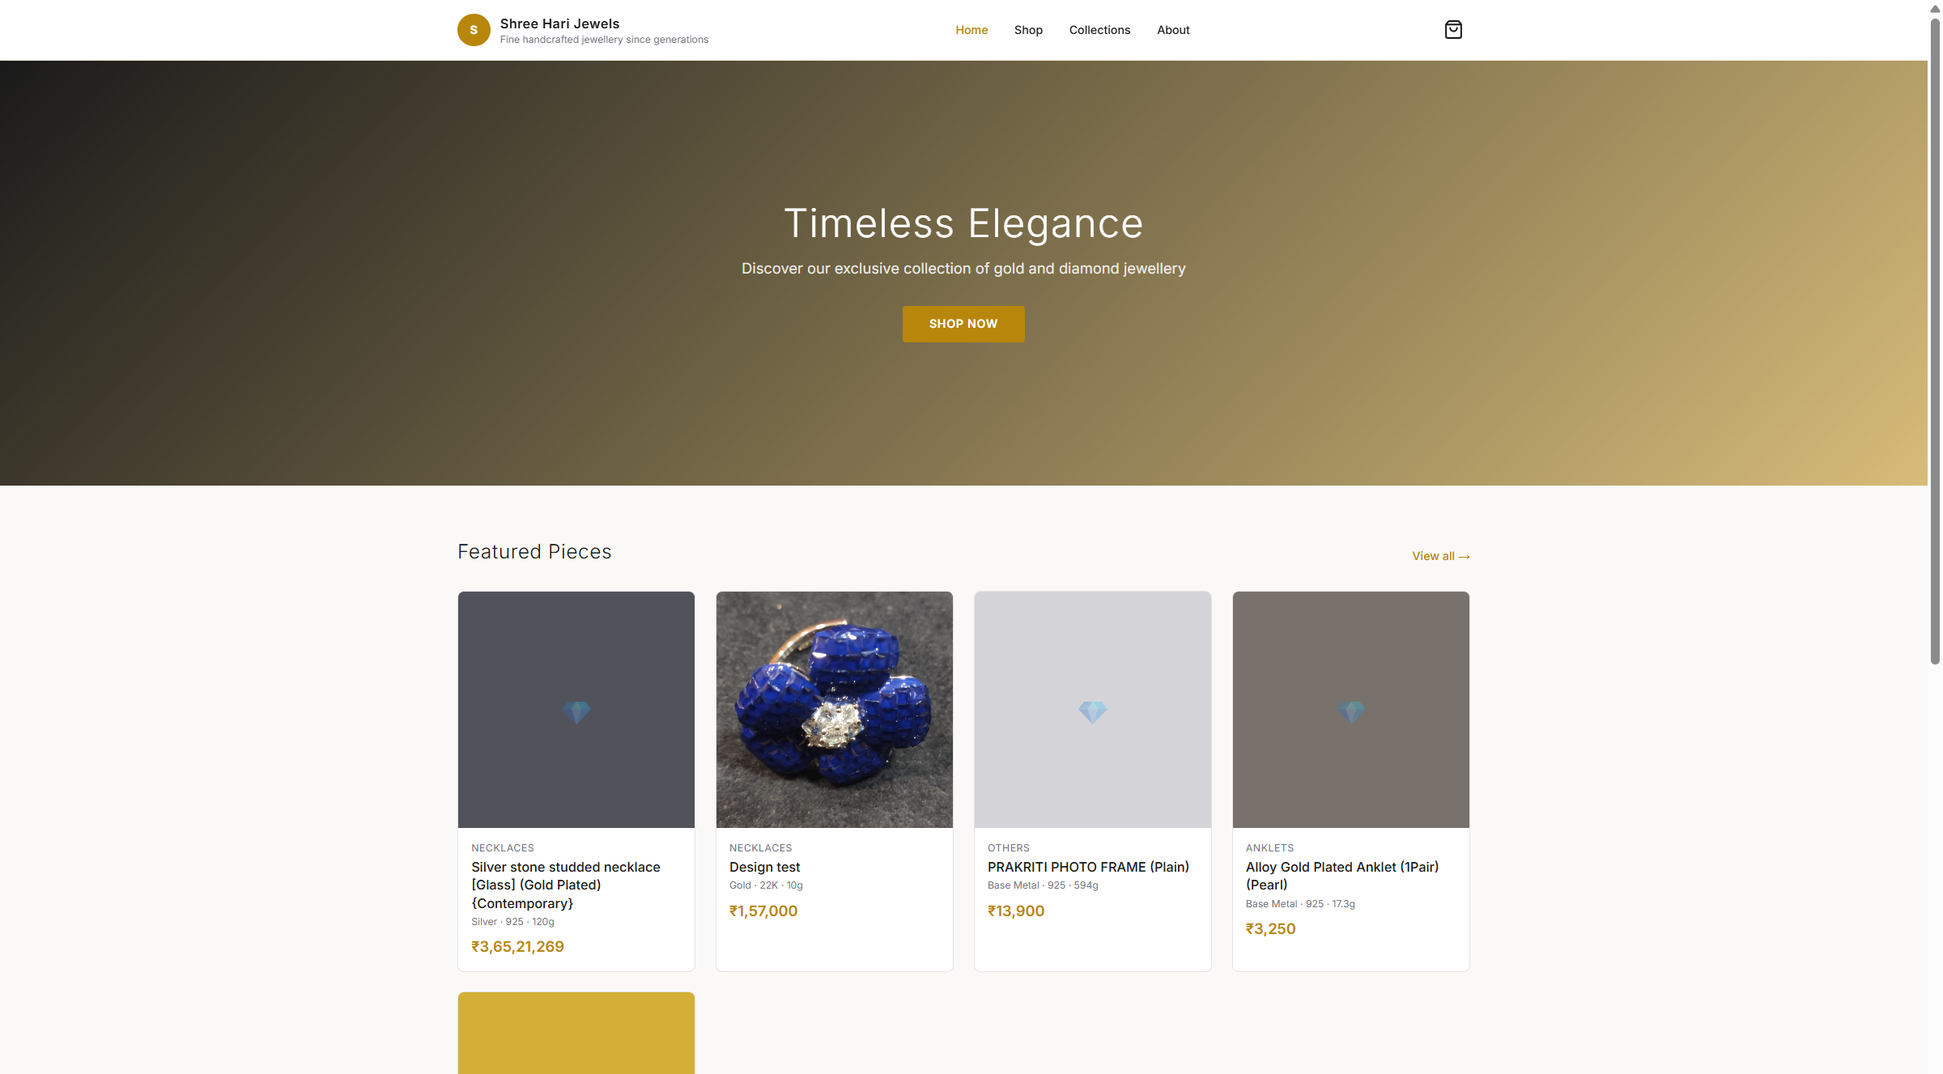
Step 1 — Website Homepage
What happens:
• Hero banner with your tagline and Shop Now button
• Featured products pulled from your published inventory
• Navigation: Home, Shop, Collections, About
• Cart icon shows item count when customer adds products
Customer visits: https://shri-hari-jewels.vercel.app/shop/shree-hari-jewels

Slide 12
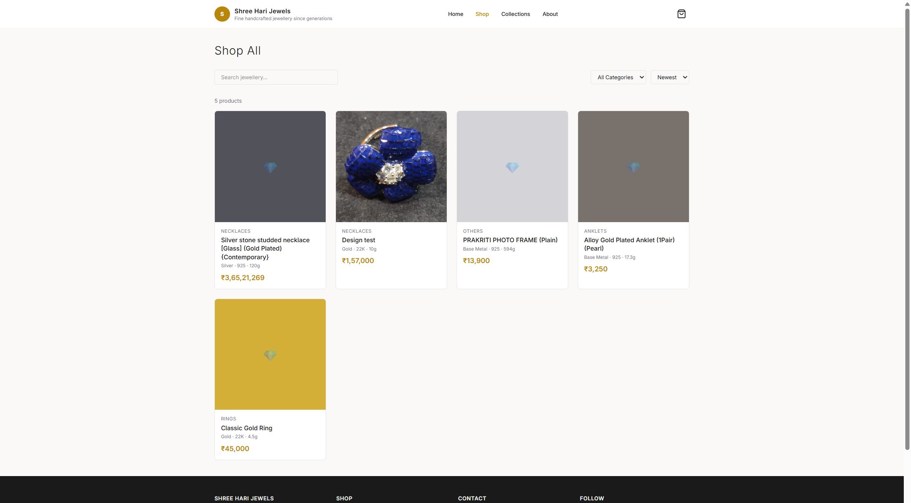
Step 2 — Product Catalog (Shop All)
What happens:
• All published products shown in a grid
• Customer can search by name
• Filter by category, sort by price or name
• Only products you marked Published in ERP appear here
Website → Shop → All Products

Slide 13
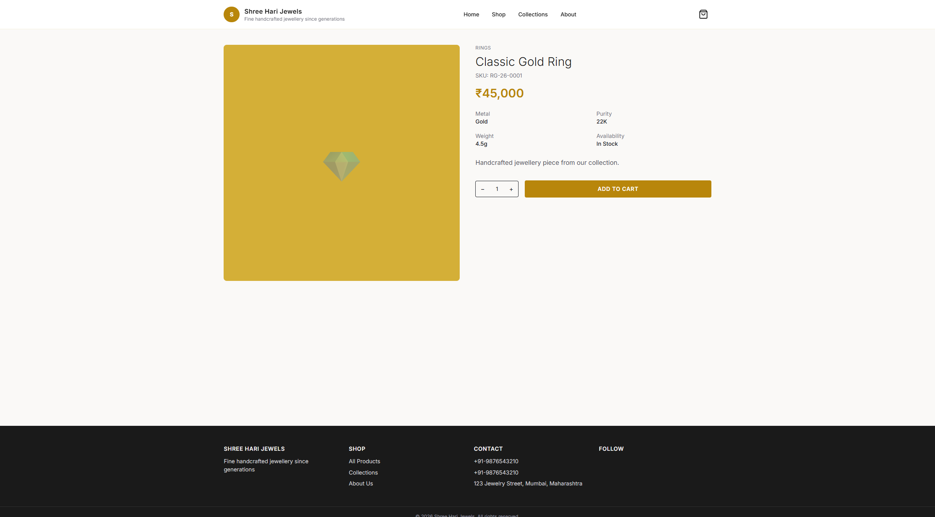
Step 3 — Product Detail Page
What happens:
• Product image, name, SKU, live price
• Specs: Metal, Purity, Weight, Availability
• Customer selects quantity
• Clicks Add to Cart → item saved to browser cart
Website → Product detail → Add to Cart

Slide 14
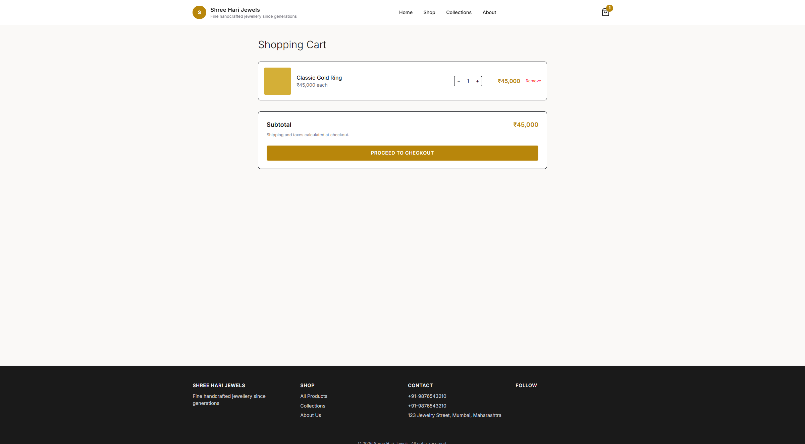
Step 4 — Shopping Cart
What happens:
• Review items, adjust quantities, or remove items
• Subtotal shown — prices from live market rates
• Cart persists even if customer closes the browser
• Click Proceed to Checkout to continue
Website → Cart

Slide 15
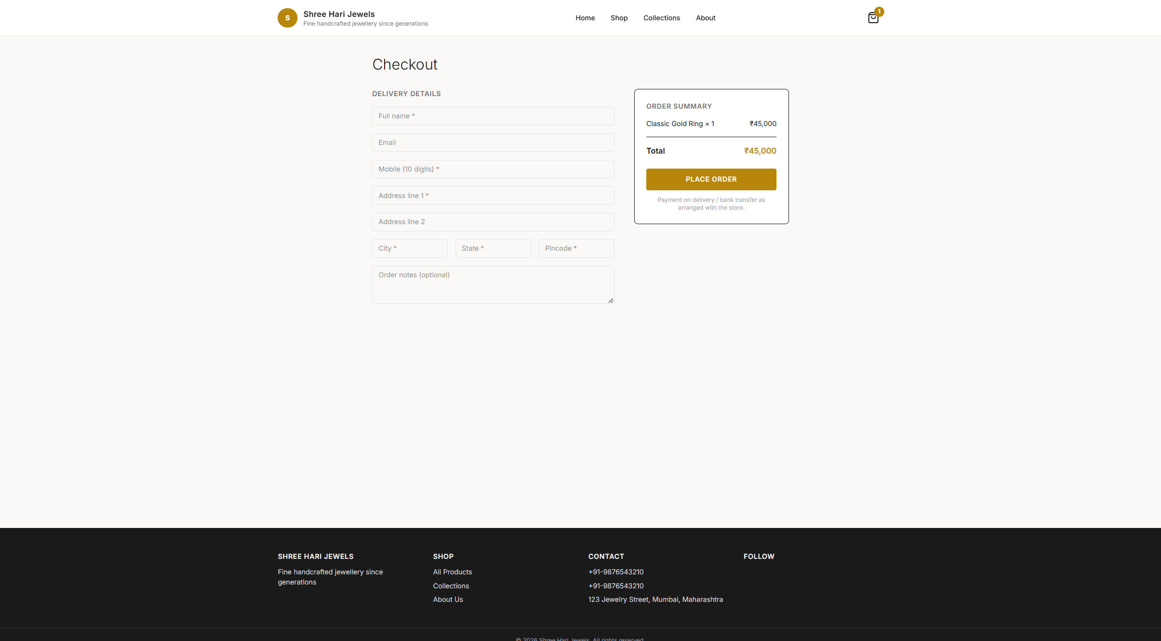
Step 5 — Guest Checkout
What happens:
• Customer fills: Full name, Mobile (10 digits), Address, City, State, Pincode
• Email and order notes are optional
• Order summary shows items and total on the right
• Payment note: arranged with store after order (no online payment)
• Click Place Order to submit
Website → Checkout (guest — no login required)

Slide 16
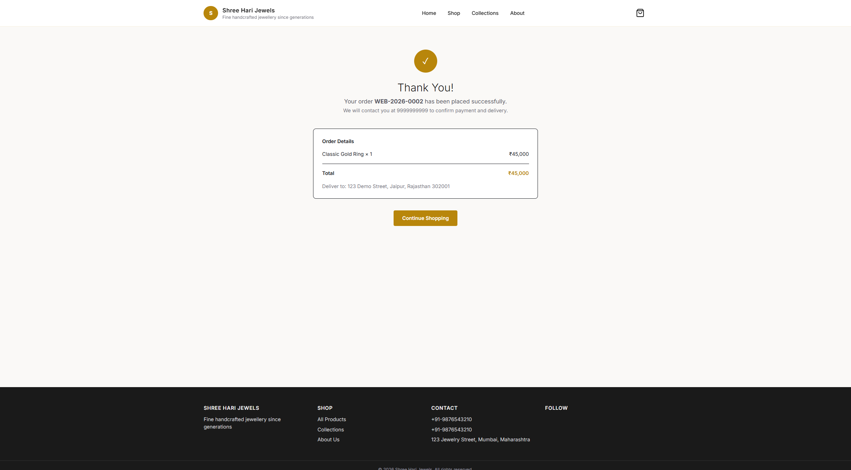
Step 6 — Order Confirmation
What happens:
• Thank you page with order number (e.g. WEB-2026-0002)
• Shows items, total, and delivery address
• Message: store will contact customer for payment & delivery
• Customer can continue shopping
Website → Order confirmation

Slide 17
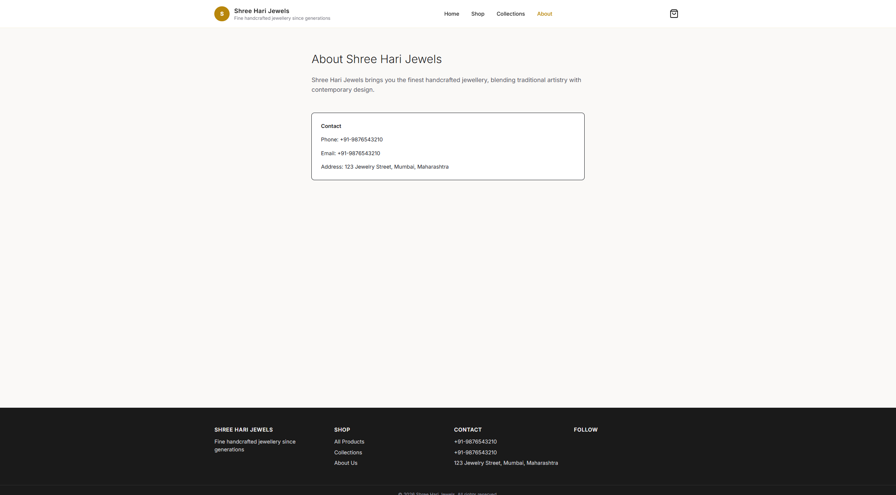
Other Website Pages
What happens:
• About page — your business story and contact details
• Collections page — curated product groups you create in ERP
• All pages use your branding colours and logo from Store Settings
Website → About / Collections

Slide 18
Part 3
What Happens in Your ERP When a Customer Orders

Slide 19
Backend Flow — When Customer Clicks Place Order
Step 1: System validates cart items and checks stock is available
Step 2: Finds or creates a Customer record using the mobile number
Step 3: Reserves inventory units (status: Reserved — not sold yet)
Step 4: Creates a WebOrder with order number (WEB-2026-XXXX)
Step 5: Creates a linked ERP Order for your fulfillment team
Step 6: Product stock counts update automatically
Step 7: You see the new order in ERP → Online Store → Web Orders

Slide 20
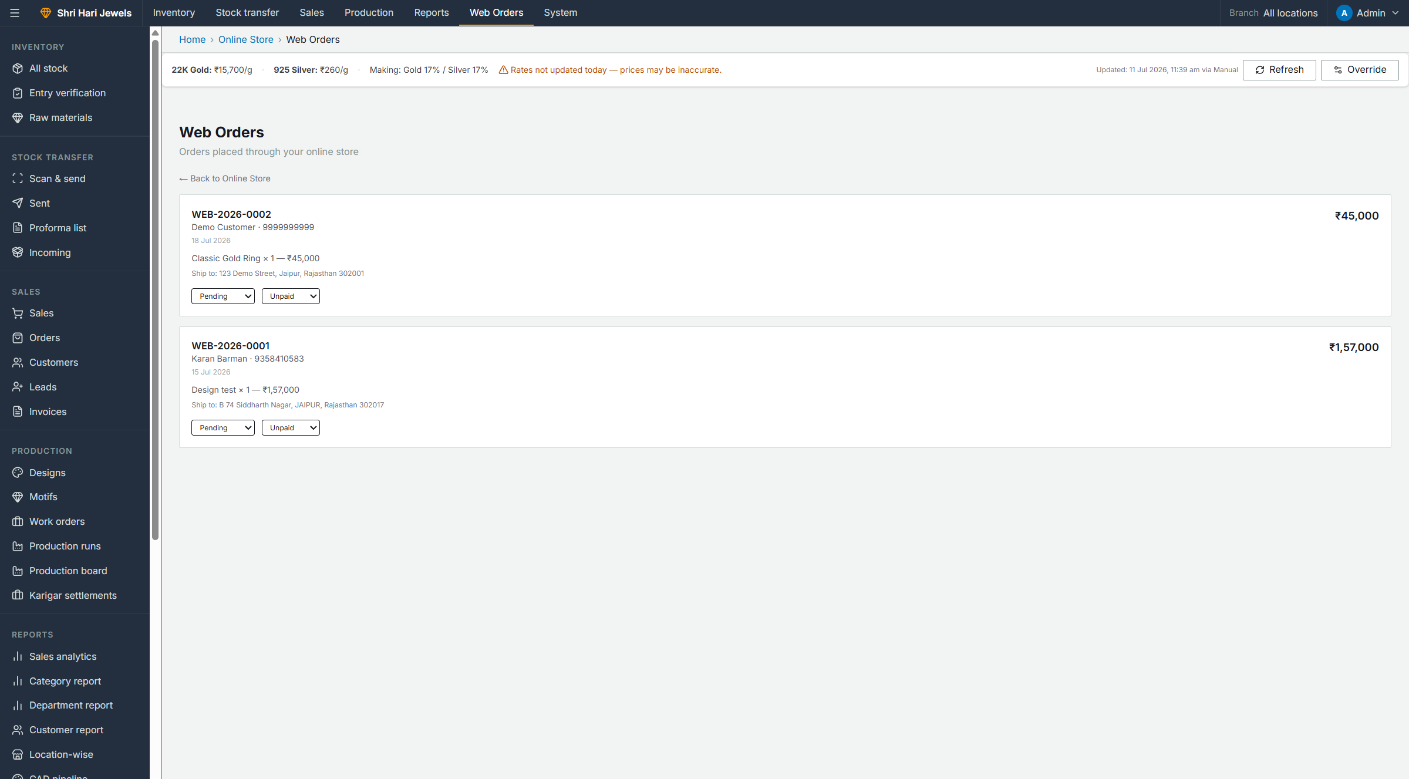
Step 7 — Manage Web Orders in ERP
What happens:
• New web orders appear here automatically
• See customer name, mobile, items, total, date
• Update Order Status: Pending → Confirmed → Processing → Shipped → Delivered
• Update Payment Status: Unpaid → Paid (after bank transfer / COD)
• Contact customer at their mobile to confirm payment & delivery
ERP → Online Store → Web orders

Slide 21
Fulfill a Web Order — Step by Step
Step 1: New order arrives in Web Orders (status: Pending, payment: Unpaid)
Step 2: Call/message customer to confirm order and arrange payment
Step 3: Update status to Confirmed once customer confirms
Step 4: Collect payment (bank transfer / cash on delivery) → set Payment to Paid
Step 5: Pack and dispatch the item → update status to Shipped
Step 6: On delivery → update status to Delivered
Step 7: Inventory units move from Reserved → Sold when order is fulfilled

Slide 22
Complete End-to-End Workflow
YOU (ERP Setup)
CUSTOMER (Website)
YOU (ERP Fulfillment)
1. Add stock to inventory
2. Verify entry & set prices
3. Enable online store
4. Publish products
5. Share store URL
1. Browse catalog
2. Add to cart
3. Guest checkout
4. Place order
5. Get confirmation
1. See Web Order
2. Confirm with customer
3. Collect payment
4. Ship item
5. Mark Delivered

Slide 23
Website vs In-Store Sale — Key Differences
Step 1: Website: guest checkout, no login — In-store POS (/sales): staff scans item codes
Step 2: Website: payment arranged later — In-store: Cash / UPI QR / Card at counter
Step 3: Website: reserves stock (Reserved) — In-store: marks Sold immediately
Step 4: Website: creates WebOrder — In-store: creates Sale + GST Invoice
Step 5: Both use the same inventory and customer records in your ERP
Your website and in-store counter share the same inventory — stock is always in sync.

Slide 24
You're All Set!
Your Store: https://shri-hari-jewels.vercel.app/shop/shree-hari-jewels Your ERP: https://shri-hari-jewels.vercel.app Manage everything from ERP → Online Store

