Slide 1
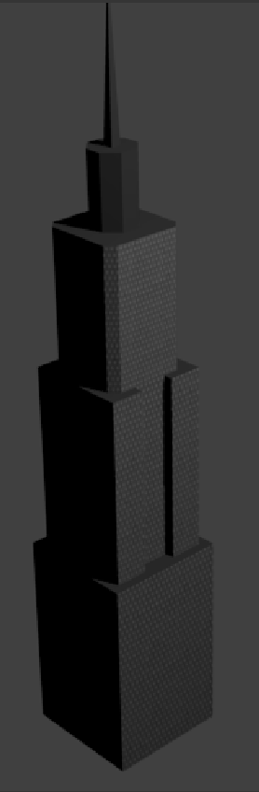
Inanimate City:
Dropkicked Kilometers!
CS 480 Graphics Final Project
By Erin Brown, Molly Headland & Alex Falconi

Slide 2
Overview - ICDK
A city demolition simulator game
Player gains points by knocking buildings over
Player earns high score by knocking over more buildings in a limited time
Simple game concept, with a focus on graphics

Slide 3
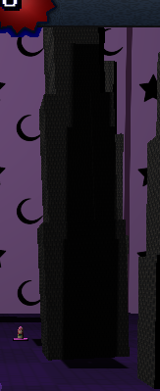
What we learned
Shadow mapping
2D rendering (without openGL gui)

Slide 4
What we would have added:
Sound

