Slide 1
Assignment 2 (total weight of 45%)
Presentation (5 mins)
1. Which controller design method you used?
a. If it is from the scripts we gave – do not present
b. Different control strategy (one slide to briefly explain)
2. Design-space exploration graph (1 slide)
a. State-space exploration method you used (one slide to briefly explain)
3. Compare your part 1 timing analysis results with chronVAL (part 2) timing analysis results (1
slide)
4. Part 2: chronSIM simulation snapshot for one event-chain and chronOPT optimisation results
snapshot (max 2 slides)
5. Part 3: chronSIM simulation snapshots (1 slide)
Basic completion of Assignment 2: 80%
1. Part 1: Your design meets all the requirements and you did a brute-force design space
exploration (25%)
2. Part 2: Your basic Inchron model conforms to the timing results you obtained from Part 1.
You did a basic chronOPT optimisation (35%)
3. Part 3: You answered the questions for flexRay implementation and your Inchron model is
Working (20%)
Bonus: 20%
1. Using different controller strategies (e.g. LQR, ... )
2. Design space exploration using intelligent methods (genetic, pareto, ...)
3. Coherent logic behind design choices (synchronisation of processors, relative start times of
tasks, ...)
4. Timing results from efficient use of chronOPT (changing different parameters like sampling
periods of tasks)

Slide 2
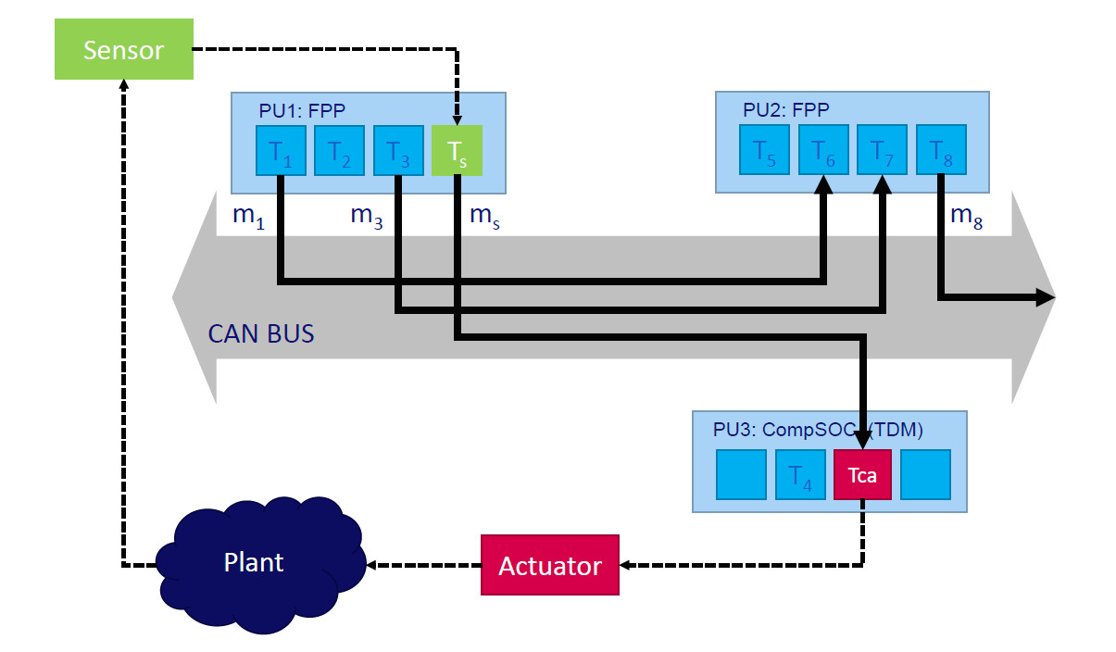
Part II - Control over CAN and Flexray

Slide 3
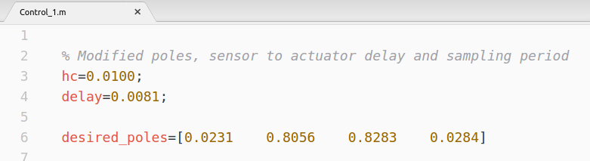
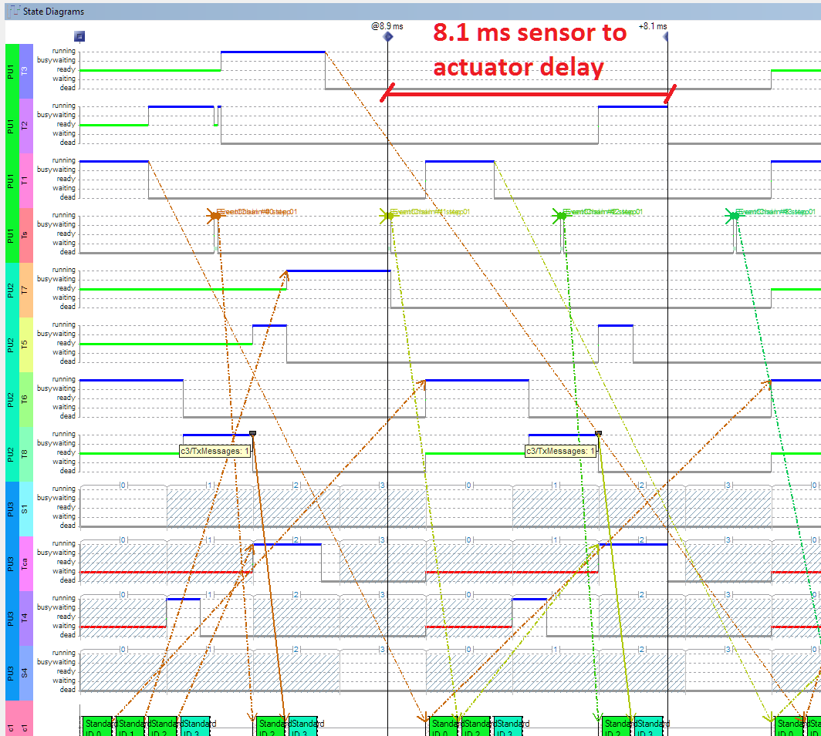
Which controller design method you used?
Sampling period defined from the sensor to actuator delay:
Delay = Ts + 2 x Slot size + m_s + Ta
= 0.1 ms + 2 x 2.5 ms + 1ms + 2ms = 8.1 ms
Then hc can be 10 ms
Poles found with Pareto Algebra

Slide 4
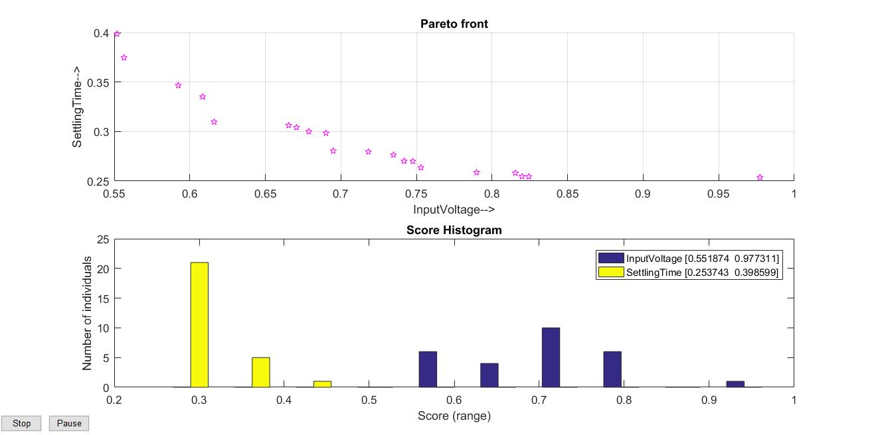
Design-space exploration graph

Slide 5
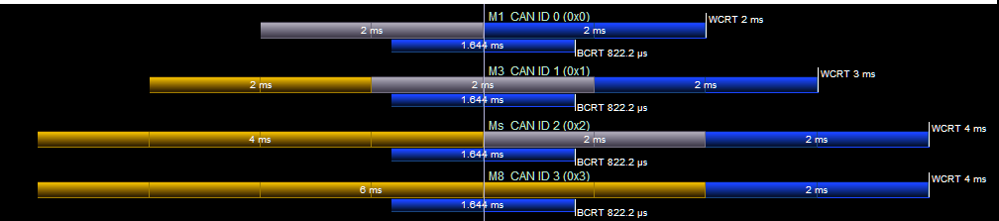
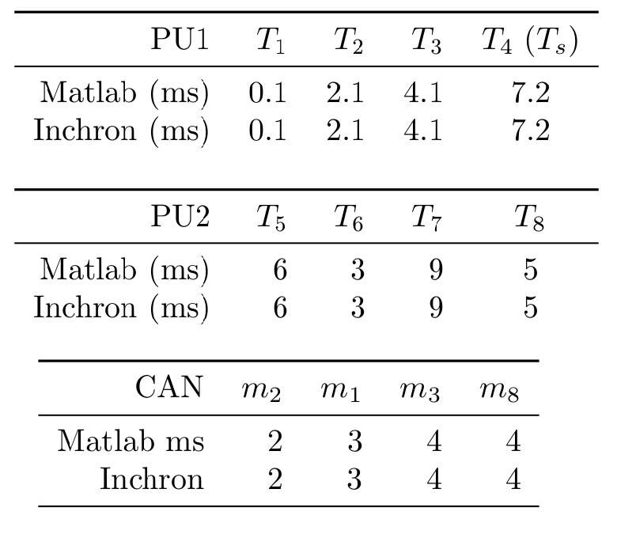
Comparison of part 1 timing analysis with chronVAL

Slide 6
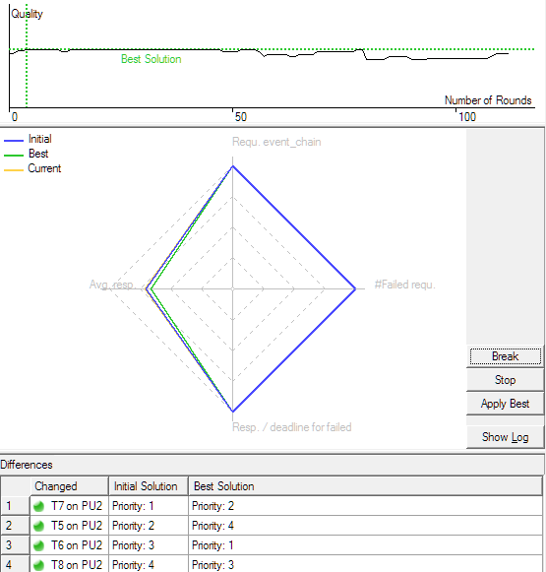
chronSIM simulation snapshot

Slide 7
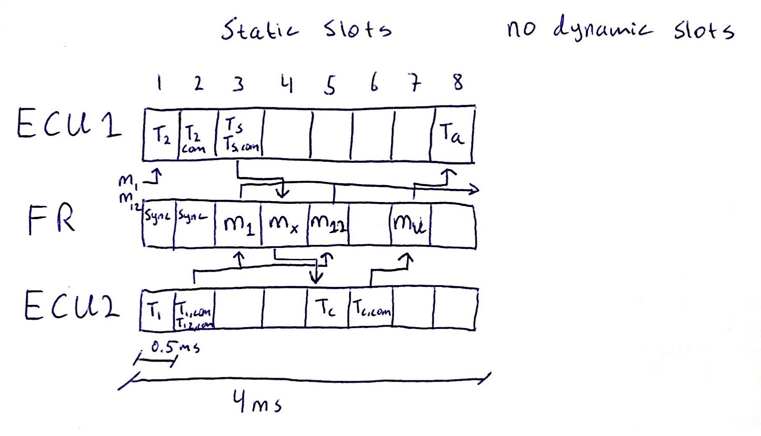

Slide 8
